Slide 1
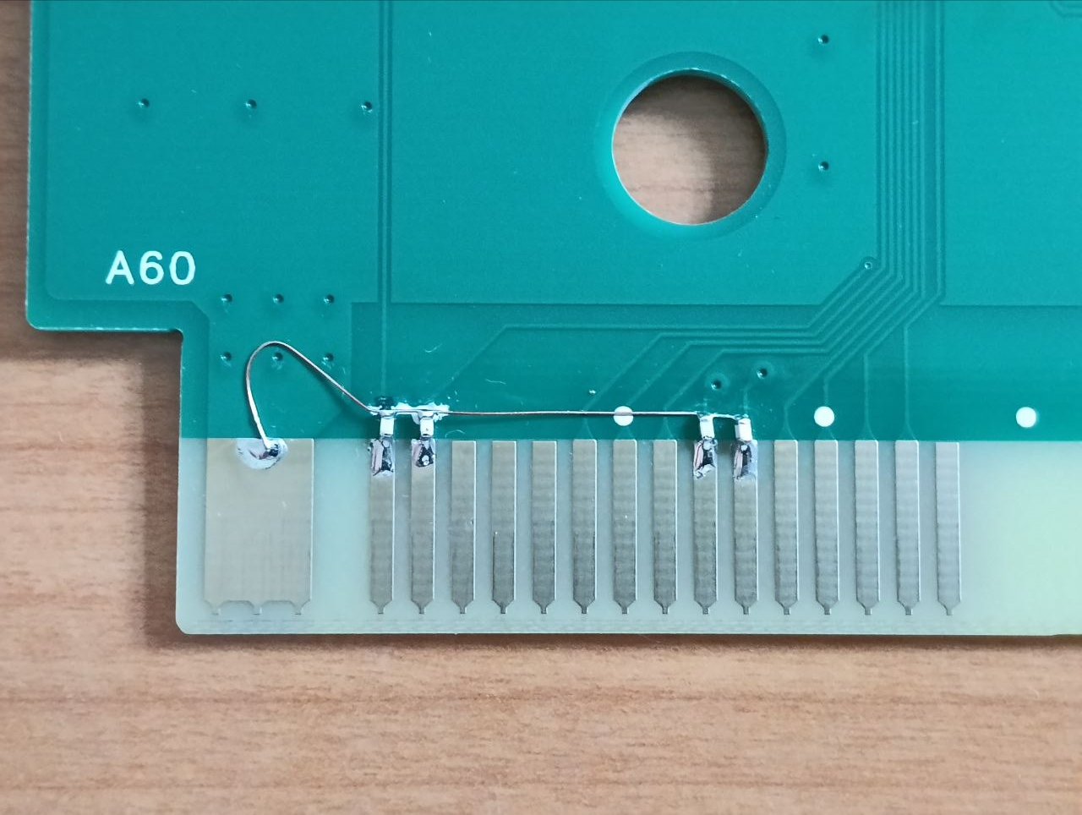
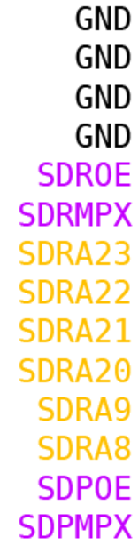
PROG BOARD TOP
47pF
47pF
47pF
47pF

