Slide 1
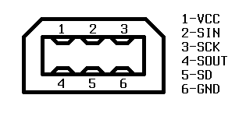
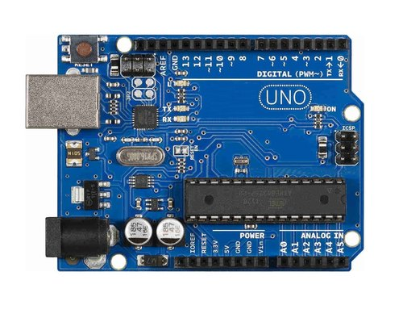
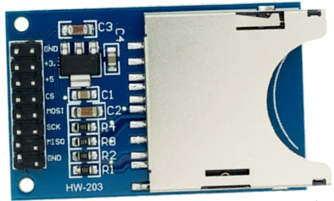
Game Boy serial pinout (cable view)
SIN and SOUT are crossed within the serial cable. When you cut it, you do not know which wire is which pin. Use multimeter in continuity mode to identify wires, do not trust the wire colors.
GND (ground) to GND
SOUT (serial out, TX) to D4
SIN (serial in, RX) to D3
SCK (clock) to D2
CS to D10paint
MOSI to D11
MISO to D12
SCK to D13
GND to GND
+5 to 5V

Slide 2


GND (ground) to GND
SOUT (serial out, TX) to D4
LED to D13
SIN (serial in, RX) to D3
SCK (clock) to D2
Game Boy serial pinout (cable view)
SIN and SOUT are crossed within the serial cable. When you cut it, you do not know which wire is which pin. Use multimeter in continuity mode to identify wires, do not trust the wire colors.

Slide 3
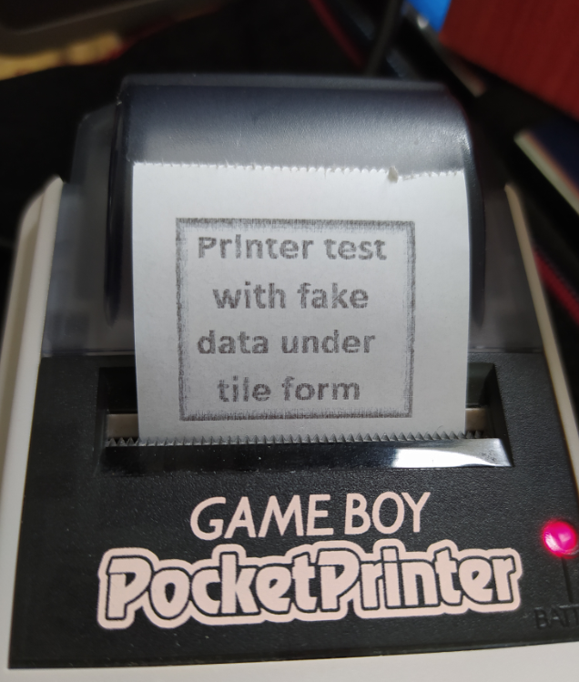

Printing
Image converted

Slide 4
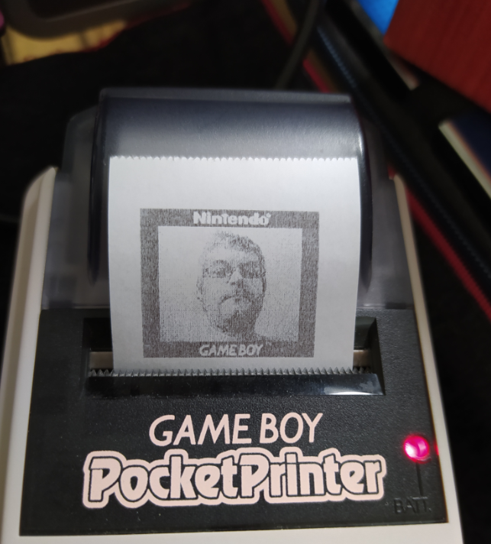

Printing
Image converted

Slide 5

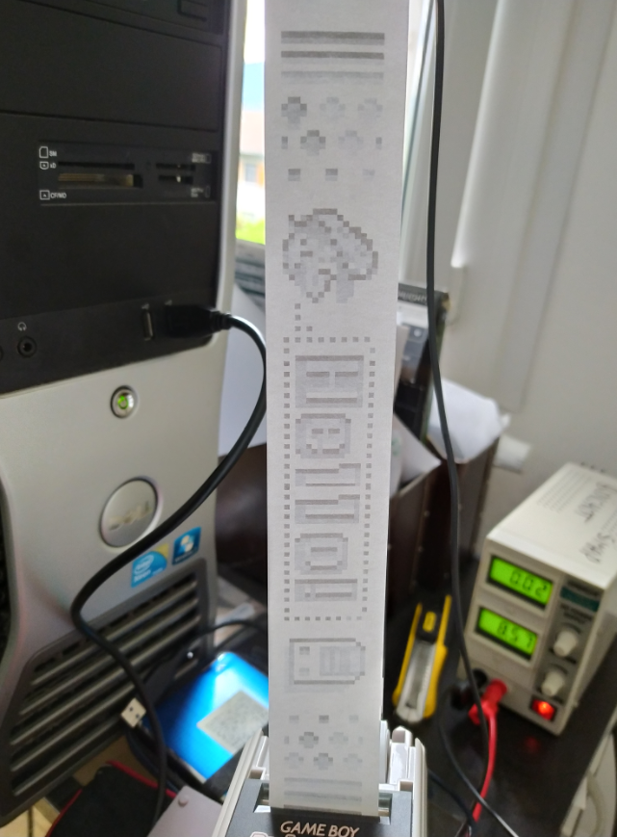
Printing
Image converted

Slide 6
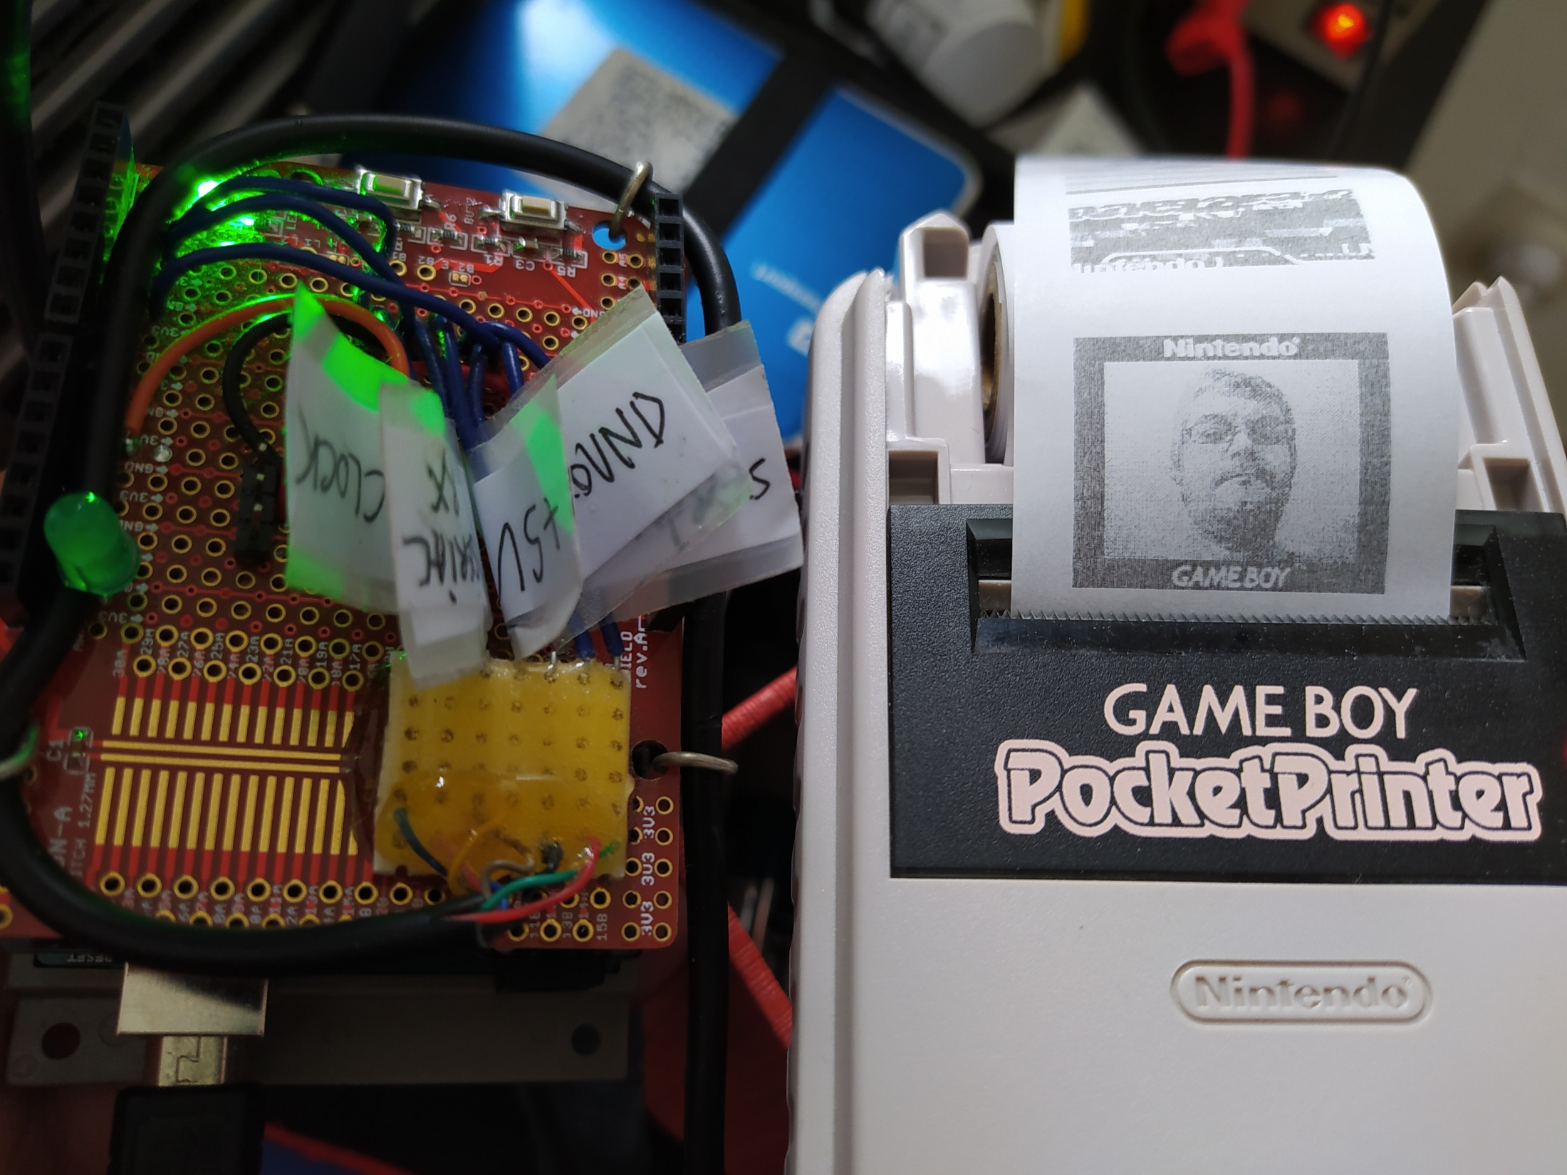
Arduino proto shield on Arduino SD shield, on Arduino Uno
Open Game Boy serial cable
Game Boy Printer

Slide 7
Game Boy Printing protocol used
Command byte
Magic byte
Checksum LSB first
Send INIT command : 88 33 01 00 00 00 01 00 00 00;
Send DATA packet prefix : 88 33 04 00 80 02…
Send 640 bytes of data : …FF FF FF FF FF FF FF FF FF FF FF FF FF FF…
Send DATA packet suffix : …7D 0E 00 00;
Send empty DATA packet : 88 33 04 00 00 00 04 00 00 00;
Send PRINT command : 88 33 02 00 04 00 01 00 E4 7F 6B 01 00 00;
Send INQUIRY command : 88 33 0F 00 00 00 0F 00 00 00;
Bytes into the checksum
Response bytes
Length of data, 640 bytes, LSB first
Repeat 9 times
Bytes red on the SD card (through a memory buffer)
Checksum calculated onboard
No compression
1 print
Standard palette
Length of data
Repeat 9 times, every 1200 ms
0 margins
Printing intensity (max)
Repeat until OEF on SD card
keepalive
errors

Slide 8
Game Boy Printing protocol used
Repeat until no image left
Bytes into
the checksum
Magic byte
Checksum
Response bytes
Repeat until end of image
Send INIT command : 88 33 01 00 00 00 01 00 00 00;
Send DATA packet : 88 33 04 00 80 02…DATA…7D 0E 00 00;
Send empty DATA packet : 88 33 04 00 00 00 04 00 00 00;
Send PRINT command : 88 33 02 00 04 00 01 00 E4 7F 6B 01 00 00;
Send INQUIRY command : 88 33 0F 00 00 00 0F 00 00 00;
Length of DATA 0x0280
No compression
Length of DATA 0x0000
1 print, margin=0x00, default palette, max printing intensity
Repeat 10 times, every 100 ms
Length of DATA 0x0004
Send INIT command : 88 33 01 00 00 00 01 00 00 00;
Send empty DATA packet : 88 33 04 00 00 00 04 00 00 00;
Send PRINT command : 88 33 02 00 04 00 01 03 E4 7F 6E 01 00 00;
Send INQUIRY command : 88 33 0F 00 00 00 0F 00 00 00;
1 print, margin=0x03, default palette, max printing intensity
Repeat marginx10 times, every 100 ms

Slide 9

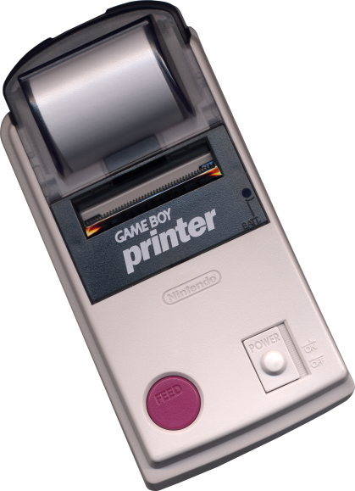
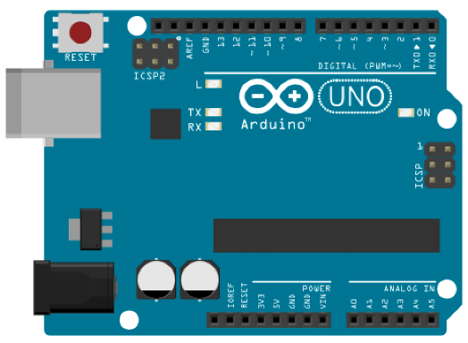
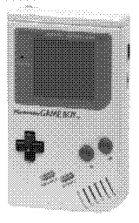
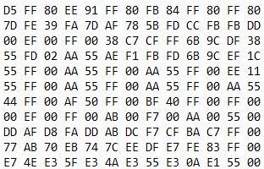
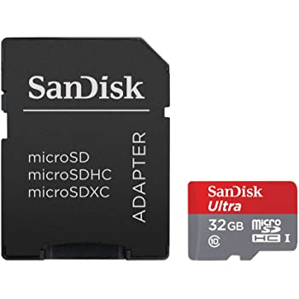
Your images
Octave encoder
Arduino
Game boy printer
160x(16*X) pixels
4 shades of gray
Game Boy data tile format
SD Card

Slide 10

Your images
Octave encoder
Arduino
Game boy printer

