Slide 1
Artificial data for Phylogenetic tree inference
Aubin Fleiss
Juliana Bernardes

Slide 2
Motivation for simulations
A biological validation is a very good way to assess the algorithm performance.
Nothing can be more realistic that biological data itself
However, there are still motivations for using simulations to further benchmark the algorithm
A simulation allows a large-scale testing, that can show the robustness of the algorithm, even if biological data is scarce.
We can then be sure it did not find the correct answer “by chance” but works reliably.
A simulation allows us to test the limits of the algorithm, and to know how much data and which data quality is required for the algorithm to work.

Slide 3
Motivation for simulations
We should avoid the pitfalls related to simulations:
Making the model so close to an experiment
Making the model too simplistic so that it is not representative at all of what biological data would be like.
Making the model so complex that we cannot know reliably the parameters to set.
Setting parameters that are good for the reconstruction program instead of being realistic.

Slide 4
A model to simulate evolution
Raphaël Champeimont et al, 2014 has designed a model that mimics evolution in vertebrates and yeast.
The model needs a mathematical formulation and biological knowledge
what events we should simulate?
Which frequency?
etc.

Slide 5

A model to simulate evolution
Making the tree
The model is based on 13 vertebrates species and 21 yeast species.
It has defined time as going from 0, at the root, to 1, leaves of the tree.
To get the right number of species, it chooses randomly speciation times (branching) uniformly over [0, 1].
t=0.2
t=0.5

Slide 6
A model to simulate evolution
For each speciation time, we have to split a leaf in two.
At each branching, it choose one of the two directions with a 1/2 probability.
When we reach a leaf, it splits it in two at the speciation time previously defined.
species 1
t=0.4
t=0.2
species 2
species 3
It repeats this operation until we have the right number of species.

Slide 7
A model to simulate evolution
It starts with an ancestor with a number of genes and chromosomes
Vertebrate ancestor, 23 chromosomes and 18000 genes,
Yeast ancestor, 8 chromosomes and 5000 genes
These genomes are implemented as lists of signed integers.
Each integer represents a gene.
A special case is the 0 which is used to mark the centromere.
If two integers have an equal absolute value, it means that the genes are homologous: orthologs when between different species, paralogs within the same species.
A different sign means the gene is on a different strand.
In the ancestor, all genes are different (i.e. all integers appear exactly once)..

Slide 8
A model to simulate evolution
>ancestor
1 2 3 4 5 6 7 8 9 10 11 12 13 14 15 16 17 18 19 20 21 $
22 23 24 25 26 27 28 29 30 31 32 33 34 35 36 37 38 39 40 41 42 43 44 45 46 47 48 49 50 51 52 53 $
54 55 56 57 58 59 60 61 62 63 64 65 66 67 68 69 70 71 72 73 74 75 $
76 77 78 79 80 81 82 83 84 85 86 87 88 89 90 91 92 93 94 95 96 97 98 99 100 $
>sp1
2 8 9 11 13 15 17 18 20 21 $
-76 79 80 -82 -81 84 86 50 51 52 $
54 55 56 57 58 59 61 64 65 66 69 70 71 72 74 -42 -41 -40 -39 -36 -35 -34 -33 -29 -28 -22 $
43 45 46 48 90 92 -94 -93 96 98 $
1 3 4 5 6 7 10 12 14 16 19 $
77 78 -83 85 87 88 89 53 $
60 62 63 67 68 73 75 -38 -37 -32 -31 -30 -27 -26 -25 -24 -23 $
44 47 49 91 -95 97 99 100 $

Slide 9
Simulating the number of rearrangements
One of the parameters that must be defined is the average number of events E from the root to any species.
We know approximately what this number is if we take the two most remote species, estimate the number of rearrangements between them, and divide by two.
This has led us to choose E = 500 events for yeasts and E = 1000 events for vertebrates (Drillon and Fischer, 2011).
To choose the number of events on each specific branch
it uses a Poisson distribution and set its parameter to λ = E × L where L is the branch length (in the time unit defined in the previous section).

Slide 10
Simulating each type of event
Once the number of events on each branch has been computed, it needs to decide the type of each event.
To do this, it selects randomly an event type in this list with the following probabilities.

Slide 11
Simulating each type of event
Inversion(60%):
A random sequence of genes is selected uniformly over the genome.
This sequence is reversed.
(1, 2, 3, 4, 5)
(1, −4, −3, −2, 5).
The number of genes involved is chosen according to a Poisson distribution with an average of 5 genes.
If the randomly chosen integer is 0, we try again until we get a non-zero value.

Slide 12
Simulating each type of event
Reciprocal translocation (30%):
Two positions are chosen uniformly over the genome, but on different chromosomes.
These two parts are then exchanged between the chromosomes, such that the end that is the telomere remains the telomere in the other chromosome.

Slide 13
Simulating each type of event
Duplication (5%):
A randomly selected sequence of genes is duplicated.
The number of genes involved is chosen with a Poisson distribution with an average of 5 genes.
If the centromere is duplicated, randomly select one of the two centromeres and delete it.

Slide 14
Simulating each type of event
Deletion (5%):
A randomly selected sequence of genes is deleted.
The number of genes involved is chosen with a Poisson distribution with an average of 1 gene.
Note that the value 0 is forbidden (since it would produce no event). If the sequence includes the centromere, we take care not to delete it.

Slide 15
Simulating each type of event
Fusion (0.1%):
Two positions are randomly selected on the genome, on different chromosomes (like for reciprocal translocations).
The two chromosomes are merged at random ends.
The new centromere is randomly chosen between the two previous centromeres.

Slide 16
Simulating each type of event
Fission (0.1%):
A random position is chosen uniformly over the genome.
The chromosome to which it belongs is split at this position to form two chromosomes. One of the two chromosomes then lacks a centromere.
We add one at a random position in the chromosome.

Slide 17
Simulating each type of event
Whole Genome Duplication (WGD) (0.01%):
All chromosomes are duplicated.
Each gene is then found in two copies.
For each pair, we have an 80% probability to delete one of them (chosen randomly) and a 20% probability to keep both.
The probability of WGD (0.01%) was chosen so that the average number of WGD in the yeast tree is 0.5 (most trees have 0 or 1 WGD, sometimes a few more).

Slide 18
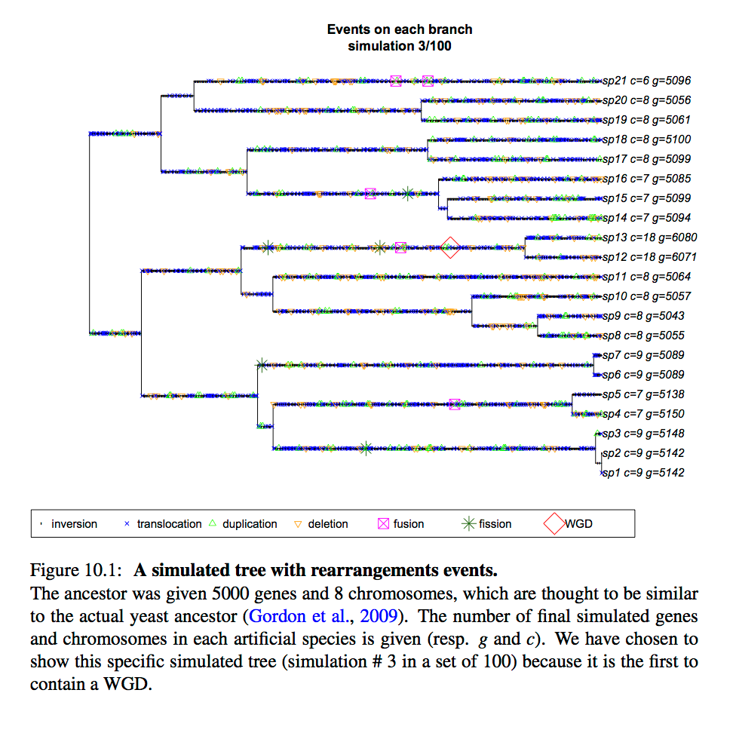

Slide 19
Doing simulation
Installing the program
The programs was done in R and it need “ape" library.
R
install.packages("ape", type = "source")
It needs PhyChro to produce trees.
http://www.lgm.upmc.fr/CHROnicle/PhyChro.html

Slide 20
Doing simulation
Setting parameters
Take a look at sim_example.R

Slide 21
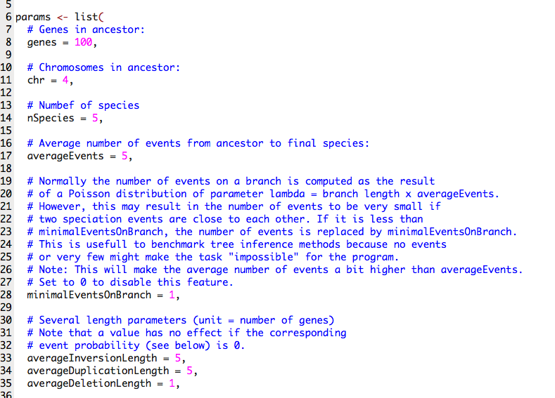

Slide 22
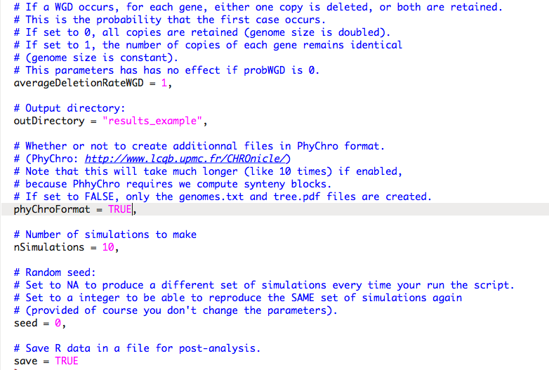

Slide 23
Doing simulation
For vertebrates:
Rscript sim_vert_step1_generate_v2.R
For yeast:
Rscript sim_yeast_step1_generate_v2.R
Executing simulations

Slide 24
Building Trees
Rscript sim_vert_step2_phychro.R

Slide 25
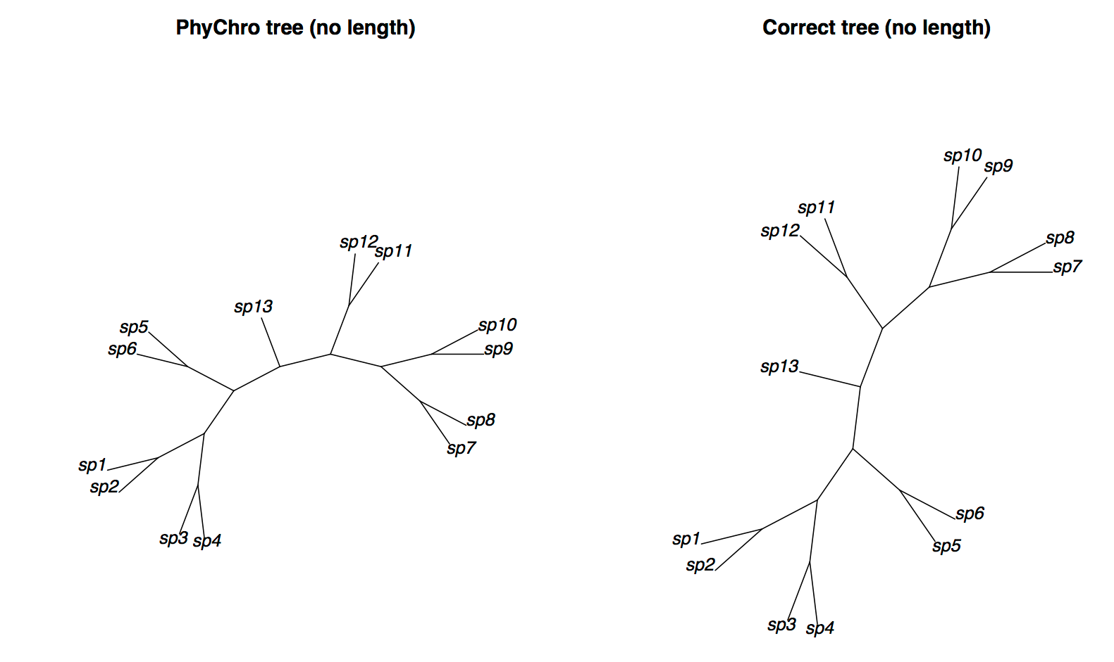
Comparing Trees

