Slide 1
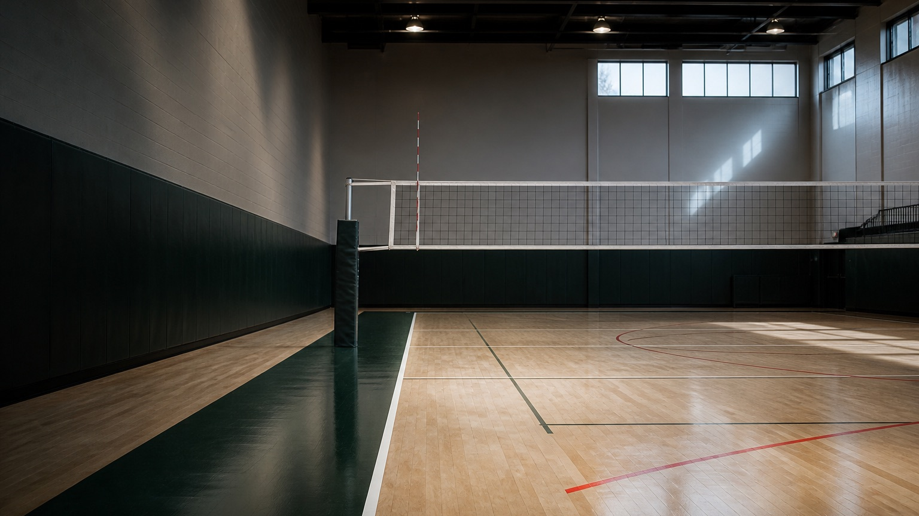
BRAND AND MEDIA KIT
VolleyReach
A recruiting workspace for boys volleyball athletes
Raphael Ferrand September 2026
Notes:
Source: current VolleyReach prototype and project README. Background image created for this project.

Slide 2
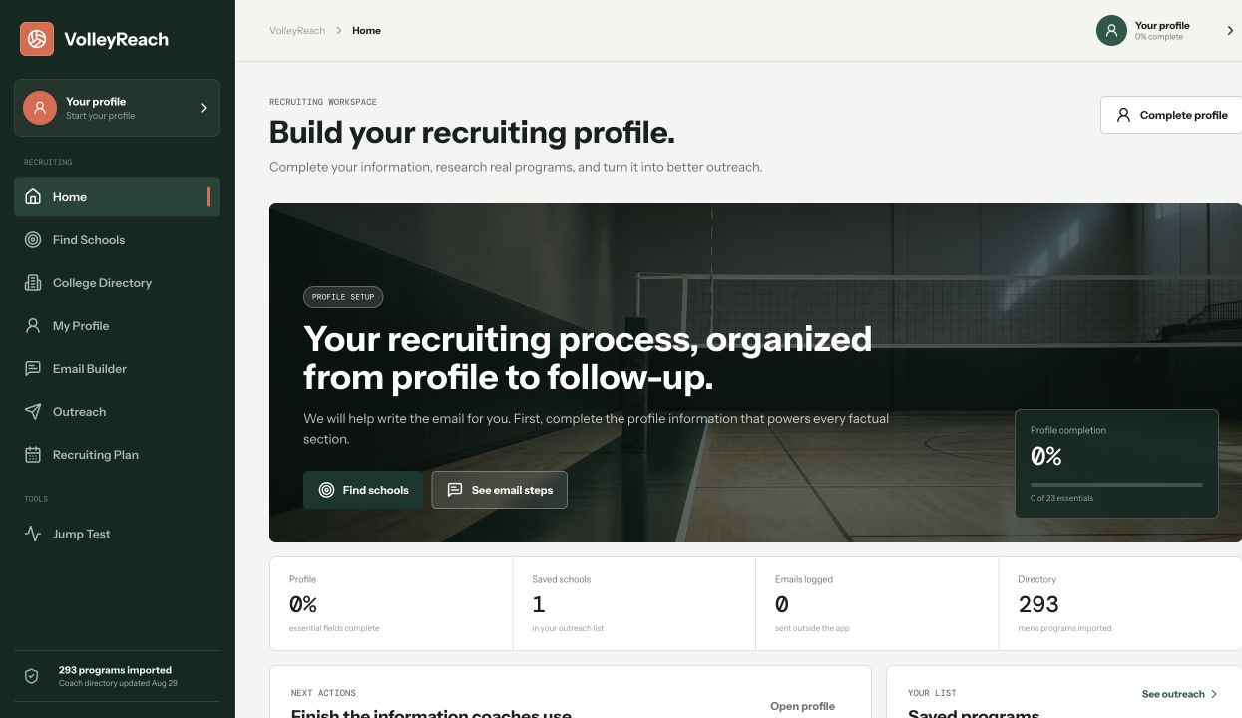
Brand foundation
POSITIONING
VolleyReach helps boys volleyball athletes organize the recruiting work that paid services often handle.
The product serves high school players first. School and club coaches can use the same workflow to help athletes prepare complete, credible outreach.
293
722
men's programs
grouped coach contacts
VOLLEYREACH BRAND AND MEDIA KIT
02
Notes:
Source: current VolleyReach prototype and project README. Directory figures reflect the August 29, 2026 data import.

Slide 3
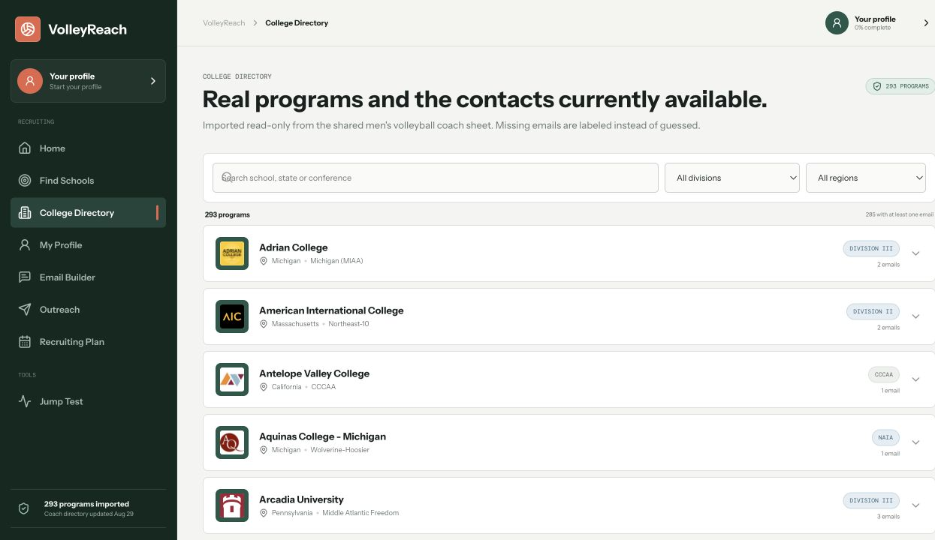
Product experience
01
Complete the profile
Academic, athletic, film, and contact facts
02
Find programs
Division, region, contact availability, and list size
03
Research the school
A real reason for contacting that program
04
Build the email
Profile facts become a personal coach message
05
Track follow up
Sent dates, replies, status, and next action
Recruiting support stays organized without claiming roster openings, admissions odds, or guaranteed outcomes.
VOLLEYREACH BRAND AND MEDIA KIT
03
Notes:
Source: current VolleyReach prototype and project README.

Slide 4

Logo system
PRIMARY USE
Use the full lockup on covers, navigation, school materials, and social profiles.
The name connects volleyball with the two actions the product supports: reaching the right programs and reaching coaches with complete information.
SPACING AND SIZE
Leave at least one icon width around the mark. Keep the icon at 34 px or larger and the full lockup at 140 px or larger for digital use.
GUARDRAILS
Do not stretch the logo, recolor the ball separately, add effects, or place it over a busy image without strong contrast.
VOLLEYREACH BRAND AND MEDIA KIT
04
Notes:
Source: current VolleyReach prototype and project README. Logo shown from the current product interface.

Slide 5
Color system
Forest anchors the product. Coral marks action. Blue supports guidance and measurement. Warm paper keeps dense recruiting work readable.
Forest
Coral
Mist blue
Warm paper
Ink
#12372E
#E66449
#668FA8
#F4F5F1
#17201D
Navigation and primary action
Emphasis and progress
Guidance and measurements
Main application background
Headings and body type
Keep white and warm paper dominant. Avoid gradients, neon yellow and black combinations, and one-color screens.
VOLLEYREACH BRAND AND MEDIA KIT
05
Notes:
Source: current VolleyReach prototype and project README. Hex values come from the current product CSS variables.

Slide 6
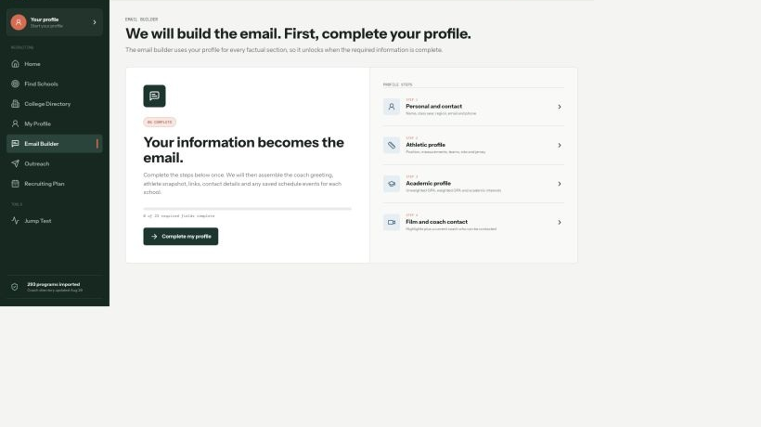
Typography and layout
PRIMARY TYPE
Instrument Sans
Headings use 600 to 700 weight. Body copy uses 400 to 500. Arial is the fallback.
UTILITY TYPE
DM Mono
Small labels, dates, percentages, and status values. System monospace is the fallback.
01
236 px desktop navigation
02
34 px page padding
Letter spacing stays at 0. Tool screens use compact headings and stable dimensions so controls do not shift.
03
5 to 7 px control corners
04
Responsive mobile navigation
VOLLEYREACH BRAND AND MEDIA KIT
06
Notes:
Source: current VolleyReach prototype and project README. Typography names and layout values come from the current product CSS.

Slide 7
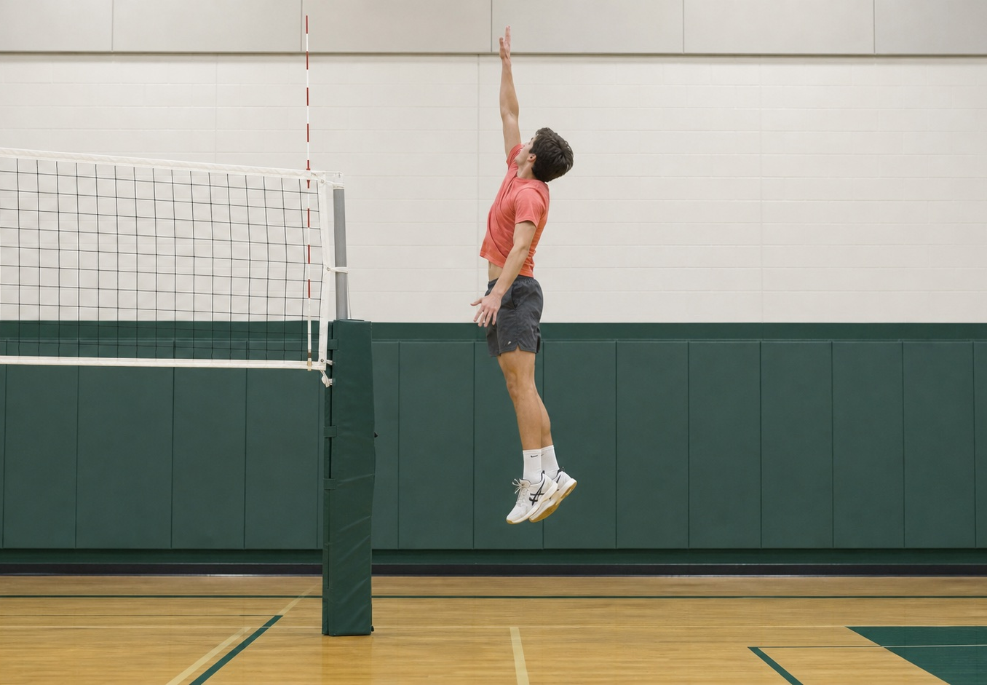
Photography and interface style
PHOTOGRAPHY
Show real volleyball settings with the athlete, court, and net easy to understand. Use natural gym color and practical camera angles.
INTERFACE
Keep the workspace quiet and useful: stable left navigation, familiar icons, short motion, restrained borders, and clear next actions.
AVOID
Generic AI athletes, black and yellow esports styling, heavy gradients, decorative blobs, and images that hide the product.
VOLLEYREACH BRAND AND MEDIA KIT
07
Notes:
Source: current VolleyReach prototype and project README. Photography was created specifically for the VolleyReach prototype.

Slide 8
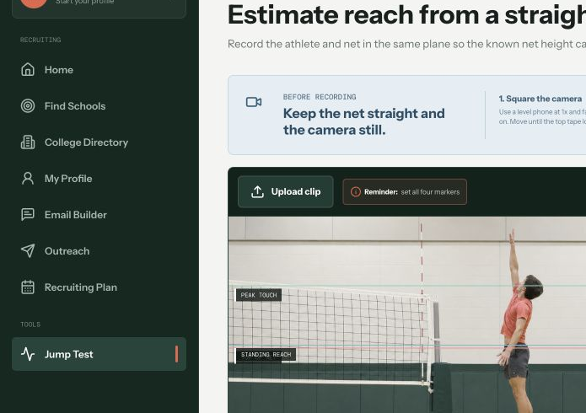
Voice and media system
VOICE
Direct
Say what the athlete should do next.
Specific
Use volleyball and recruiting facts, not generic motivation.
Honest
Label estimates and never promise admission or recruitment.
RECRUITING TOOL
Use a straight-on net clip to estimate reach, then verify the result before sharing it.
CONTENT PILLARS
Recruiting education • Product workflows • Volleyball measurements • Pilot results
@VolleyReach
VOLLEYREACH BRAND AND MEDIA KIT
08
Notes:
Source: current VolleyReach prototype and project README. The sample post demonstrates the approved voice and visual system. Arthur can use these pillars for the marketing plan.

