Slide 1
File I/O
Java 2 Chapter 12

Slide 2
Program
Input
Process
Output
Notes:
Program or Application
I.P.O = Input, Process, Output
Input - data passed into the program from a file, keyboard, touchscreen, etc.
Process - operations performed on the data, such as calculations, decisions, repetitions…
Output - result produced by the processing of data is then stored or displayed

Slide 3







Input
Data the program receives from a keyboard, file, microphone, camera, other source

Slide 4
Input, InputStream, System.in, File, FileInputStream
Input
Data the program receives from a keyboard, file, microphone, camera, other source
InputStream
A class for acquiring input from the source
System.in
A predefined input stream object reference associated with the system’s standard input (the keyboard) that reads data one byte at a time from the system’s buffer and returns an int to the program. When there is no more data -1 is returned.
File
A Java class representation of files, directories and their pathnames as they exist on the host file system
FileInputStream
A FileInputStream obtains input bytes from a file in a file system. What files are available depends on the host environment. It is meant for reading streams of raw bytes such as image data.
Notes:
https://docs.oracle.com/javase/7/docs/api/java/io/File.html
https://docs.oracle.com/javase/8/docs/api/java/io/FileInputStream.html
https://docs.oracle.com/javase/8/docs/api/java/lang/System.html
https://docs.oracle.com/javase/8/docs/api/java/io/InputStream.html

Slide 5
A File in Java has 2 names
and
The identifier of the reference variable for the instance of a File object
The string indicating the path to traverse to reach a file or directory on the host file system.
Notes:
https://docs.oracle.com/javase/8/docs/api/java/io/File.html

Slide 6
What is a File Object?
What is a directory?
What is a pathname for a file or directory?
A java representation of a file or directory and their pathnames as they exist on the host file system.
A type of file that can contain other files or directories within it.
The string indicating the path to traverse to reach a file or directory on the host file system.
Notes:
https://docs.oracle.com/javase/8/docs/api/java/io/File.html

Slide 7
What is a File Object?
A java representation of a file or directory and their pathnames as they exist on the host file system.
Notes:
https://docs.oracle.com/javase/8/docs/api/java/io/File.html

Slide 8

What is a directory?
A type of file that can contain other files or directories within it.
MyStuff
MyStuff
A B C
A
B
C
D1
D2
D1
D2
A1 B1
A2 B2
A1
B1
A2
B2
Notes:
https://docs.oracle.com/javase/8/docs/api/java/io/File.html

Slide 9
What is a pathname?
The string indicating the path to traverse to reach a file or directory on the host file system.
A pathname has two components:
An optional system-dependent disk-drive specifier (used to specify ABSOLUTE path)
Forward Slash "/" for the UNIX root directory
or
Backward Slash "\\\\" or "C:/" or "F:/" for a Microsoft Windows pathname
followed by a sequence of zero or more string names.
Notes:
https://docs.oracle.com/javase/8/docs/api/java/io/File.html

Slide 10
Absolute path
Relative path
The string indicating the path to traverse to reach a file or directory on the host file system.
Beginning from the ROOT directory of the system, independent of the current working directory
“/Users/Documents/myFile.txt” or “C:/Users/Documents/myFile.txt” or “\\\\Users/Documents/myFile.txt”
The string indicating the path to traverse to reach a file or directory on the host file system.
Beginning from the current working directory in the system
“Users/Documents/myFile.txt” or “../Documents/myFile.txt” or “myFile.txt”
The path to the destination directory depends on where it is specified from
Notes:
https://docs.oracle.com/javase/8/docs/api/java/io/File.html

Slide 11
Inspect local file system together
Use the File Explorer and the Command Line Interface to show examples:
Files
Directories
Pathnames

Slide 12
Understanding permissions on files and directories
Basic File & Directory Permissions:
READ
WRITE
EXECUTE
User Based Permission Groups:
OWNER
GROUP
PUBLIC
OWNER
rwx
111
7
GROUP
rwx
111
7
PUBLIC
rwx
111
7
OWNER
rwx
110
6
GROUP
rwx
100
4
PUBLIC
rwx
100
4
Permission of 777
Full Read, Write, Execute permissions for the Owner, Group, and Public (everyone else)
Permission of 644
Full Read, Write, Execute permissions for Owner, READ ONLY for Group, and Public (everyone else)
Notes:
https://docs.oracle.com/javase/8/docs/api/java/io/File.html

Slide 13
Show local file system as an example
Use the Command Line Interface to demonstrate permissions on:
Files
Directories
Use the Command Line Interface and GUI Explorer to show our workspace
Directories - projects, packages, folders
Files - .java .class .txt .csv

Slide 14
Our Java Project inside our IDE’s workspace
MyProject
src
bin
ch12
ch11
ch12
ch11
.java files ( source code )
.class files ( java byte code )
Notes:
https://docs.oracle.com/javase/8/docs/api/java/io/File.html

Slide 15
Create a java File object via the File class
The File class, which is part of Java’s io package, represents files, directories and their pathnames as they exist on the host file system. User interfaces and operating systems use system-dependent pathname strings to name files and directories.
Syntax Examples: Create a java File object representing the system file
File file = new File(“myFile.txt”); //relative path current directory
File file = new File(“Documents/myFile.txt”); //relative path current directory
File file = new File(“./myFile.txt”); //relative path current directory
File file = new File(“../myFile.txt”); //relative path parent directory
File file = new File(“/Users/me/Documents/myFile.txt”); //absolute path
Notes:
https://docs.oracle.com/javase/8/docs/api/java/io/File.html

Slide 16
Working with files via the File class
Some familiar methods from the File class:
exists(); //tests whether the file or directory exists
canRead(); //tests whether the application can read the file
canWrite(); //tests whether the application can modify the file
isFile(); //tests whether the file is a normal file
isDirectory(); //tests whether the file is a directory
list(); //returns an array of strings naming the files and directories in the directory
length(); //returns the length of the file
delete(); //deletes the file or directory
getAbsolutePath(); //returns the absolute pathname string of this pathname
setReadOnly(); //sets the permissions for the file or directory to only allow read operations
https://docs.oracle.com/javase/8/docs/api/java/io/File.html
Notes:
https://docs.oracle.com/javase/8/docs/api/java/io/File.html

Slide 17
Plain Text Files (.txt)

Slide 18
READ Input via the Scanner class
The Scanner class, which is part of Java’s util package, can be used to connect and read input from
the keyboard by passing the standard input stream System.in object to the Scanner constructor
a text file on the host file system by passing the File object to the Scanner constructor
Syntax Examples:
Scanner scanner = new Scanner(System.in); //connect to keyboard
Scanner scanner = new Scanner(new File( “myFile.txt“)); //connect to File object
Notes:
https://docs.oracle.com/javase/7/docs/api/java/util/Scanner.html

Slide 19
Scanner class - some methods
Some familiar methods from the Scanner class:
scanner.hasNext(); //returns true if this scanner has another token in its input
scanner.next(); //finds and returns the next complete token from this scanner
scanner.hasNextLine(); //returns true if there is another line in the input of this scanner
scanner.nextLine(); //advances the scanner past the current line and returns the input
scanner.hasNextInt(); //returns true if the next token in this scanner's input can be interpreted as an int
scanner.nextInt(); //scans the next token of the input as an int
scanner.hasNextDouble(); //returns true if the next token in this scanner's input can be interpreted as a double
scanner.nextDouble(); //scans the next token of the input as a double
Read the API: https://docs.oracle.com/javase/8/docs/api/java/util/Scanner.html
Notes:
https://docs.oracle.com/javase/8/docs/api/java/util/Scanner.html

Slide 20

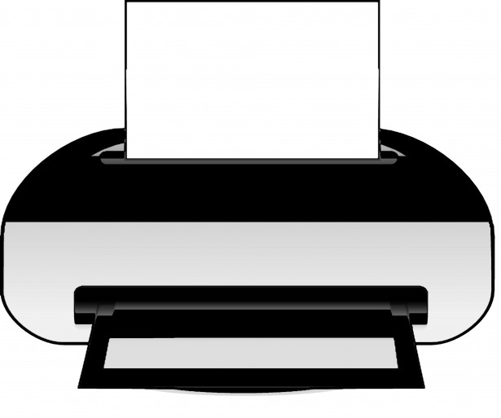
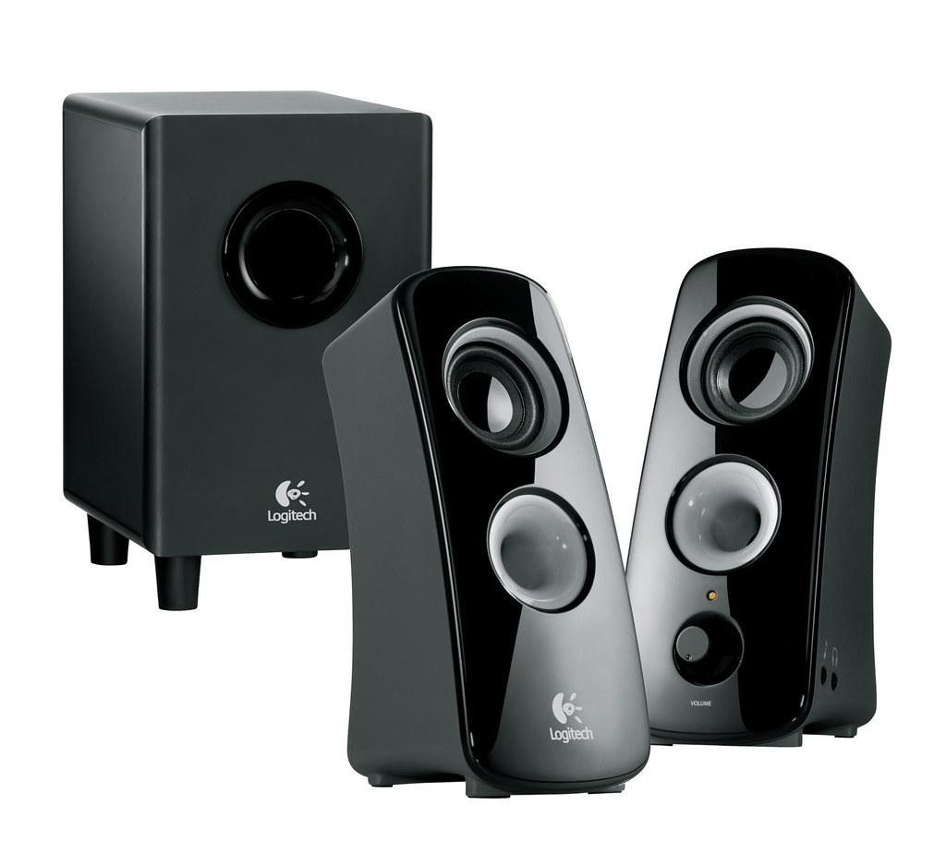
Output
Data the program sends out to a screen, file or printer, speaker, or other device.

Slide 21
Output, OutputStream, File, FileOutputStream
Output
Data the program sends out to a screen, file or printer, speaker, or other device.
OutputStream
A class that supports output by placing bytes of data into a buffer for the system to output
System.out
A predefined output stream object reference associated with the system’s standard output (the console)
PrintStream
A PrintStream adds functionality to another output stream, namely the ability to print representations of various data values conveniently.
File
A Java class representation of files, directories and their pathnames as they exist on the host file system
FileOutputStream
An output stream for writing data to a File. It is meant for writing streams of raw bytes such as image data.
Notes:
https://docs.oracle.com/javase/8/docs/api/java/io/FileOutputStream.html
https://docs.oracle.com/javase/8/docs/api/java/io/OutputStream.html
https://docs.oracle.com/javase/8/docs/api/java/io/File.html
https://docs.oracle.com/javase/8/docs/api/java/lang/System.html

Slide 22
WRITE Output to a File via the PrintWriter class
The PrintWriter class, which is part of Java’s io package, can be used to connect and print formatted representations of objects to a text-output stream.
This class implements all of the print methods found in PrintStream.
It does not contain methods for writing raw bytes, for which a program should use unencoded byte streams.
Syntax Examples:
PrintWriter pw = new PrintWriter(“myFile.txt“); //connect to file at pathname
PrintWriter pw = new PrintWriter(new File( “myFile.txt“)); //connect via File object
PrintWriter pw = new PrintWriter(new FileOutputStream( “myFile.txt“)); //connect via FileOutputStream
NOTE: The output stream connection to the file is created without automatic line flushing.
Notes:
https://docs.oracle.com/javase/8/docs/api/java/io/PrintWriter.html
https://docs.oracle.com/javase/8/docs/api/java/io/PrintStream.html

Slide 23
PrintWriter class - some methods
Some familiar methods from the PrintWriter class:
append(char c); //appends the specified character to this writer
print(String s) //prints a string
print(int i); //prints an integer
println(String x); //prints a String and then terminates the line
println(); //terminates the current line by writing the line separator string
printf(String format, Object... args); //convenience method to write a formatted string to this writer
write(String s); //writes a string
flush(); //flushes the stream
close(); //closes the stream and releases system resources
Read the API: https://docs.oracle.com/javase/8/docs/api/java/io/PrintWriter.html
Notes:
https://docs.oracle.com/javase/8/docs/api/java/util/Scanner.html

Slide 24
Safely working with files
Exception handling is required when working with files
Some common exceptions when working with files:
A FileNotFoundException will be thrown if the string pathname is incorrect
An AccessDeniedException will be thrown if the permissions prohibit the read/write/execute action attempted

Slide 25
Safely Create a new empty file
PrintWriter outStream = null; //notice this is not inside the try block
try {
outStream = new PrintWriter(fileName); //create and connect to a new empty file
} catch (FileNotFoundException e) {
System.err.println("Could not create the file "+fileName);
e.printStackTrace();
}
finally{
if(outStream != null){
outStream.close(); //close the stream and release resources
}
}

Slide 26
Safely Write to a new file
PrintWriter outStream = null;//notice this is not inside the try block
try {
outStream = new PrintWriter(fileName);//create and connect to a new empty file
outStream.println(text);//write text to the file
} catch (FileNotFoundException e) {
System.err.println("Could not create the file "+fileName);
e.printStackTrace();
}
finally{
if(outStream != null){
outStream.close();//close the stream and release resources
}
}

Slide 27
Safely Write/Append to the end of an existing file
PrintWriter outStream = null;//notice this is not inside the try block
try {
outStream = new PrintWriter(new FileOutputStream(fileName, true));//connect to end of file
outStream.println(text);//write text to file
} catch (FileNotFoundException e) {
System.err.println("Could not create the file "+fileName);
e.printStackTrace();
}
finally{
if(outStream != null){
outStream.close();//close the stream and release resources
}
}

Slide 28
Safely Read 1 line from a file
Scanner inStream = null;
String fileContents = "";
try{
inStream = new Scanner (new File (fileName));
fileContents = inStream.nextLine();
System.out.println(fileContents);//display line on console
}
catch(FileNotFoundException fnfe){
System.err.println("Could not read from file "+fileName+"\n"+fnfe.getMessage());
}
finally{
if(inStream !=null){
inStream.close();//close the stream and release resources
}
System.out.println("DONE reading from file "+fileName);
}

Slide 29
Safely Read all lines from a file and display on console
Scanner inStream = null;
String lineFromFile = "";
try{
inStream = new Scanner (new File (fileName));
while(inStream.hasNextLine()){
lineFromFile = inStream.nextLine();
System.out.println(lineFromFile);//display line on console
}
}
catch(FileNotFoundException fnfe){
System.err.println("Could not read from file "+fileName+"\n"+fnfe.getMessage());
System.err.println("Last successful read was "+lineFromFile);
}
finally{
if(inStream !=null){
inStream.close();//close the stream and release resources
}
System.out.println("DONE reading from file "+fileName);
}

Slide 30
Safely Copy a file [READ from File1 and WRITE to File2]
Scanner inStream = null;
PrintWriter outStream = null;
String lineFromFile = "";
try{
inStream = new Scanner (new File (fileName));//connect to input file
outStream = new PrintWriter(new FileOutputStream(fileNameCopy, true));//connect to output file
while(inStream.hasNextLine()){
lineFromFile = inStream.nextLine();
outStream.println(lineFromFile); //write line to output file
}
}
catch(FileNotFoundException fnfe){
System.err.println("Could not read from file "+fileName+"\n"+fnfe.getMessage());
}
finally{
if(inStream !=null){
inStream.close();//close the stream and release resources
}if(outStream != null){
outStream.close();//close the stream and release resources
}
System.out.println("DONE copying from file "+fileName+" to "+fileNameCopy);
}

Slide 31
Delete a file from the file system using the File class
File theFile = new File(fileName);
if(theFile.exists() ){
if(theFile.delete()){
System.out.println("The file "+fileName+ " was deleted successfully");
}
else{
System.out.println("The file "+fileName+ " could NOT be deleted");
}
}
else{
System.out.println("The file "+fileName+ " doesn't seem to exist");
}

Slide 32
GO TO HANDS ON Exercises
In the exercises you will do the following to practice file I/O with proper exception handling:

Slide 33
Comma Separated Value Files (.csv)

Slide 34
Read Comma Separated Value file display on console
Scanner inStream = null;
String token = "";
try {
File theFile = new File(fileName);
if(theFile.exists() && theFile.canRead()){
inStream = new Scanner(theFile);
inStream.useDelimiter(",");//set delimeter to comma
while(inStream.hasNext()){
token = inStream.next();
System.out.print(token+" ");
}
}
} catch (FileNotFoundException e) {
System.err.println("PROBLEM: inside readDelimetedFileDisplayOnConsole " + e.getMessage());
}
finally{
if(inStream!=null){
inStream.close();//close the connection to the file
}
System.out.println("The readDelimetedFileDisplayOnConsole method is done");
}

Slide 35
Exercise #1
Create the following interface TextFileIOable
createNewFile(String fileName) : void
writeToNewFile(String fileName, String text) : void
appendToFile(String fileName, String text) : void
readFile(String fileName) : String
readFileDisplayOnConsole(String fileName) : void
copyFile(String origFileName) : boolean
copyFile(String origFileName, String copiedFileName) : boolean
deleteFile(String fileName) : boolean
writeToFileFromKeyboard(String fileName) : void
findAndReplaceContentInFile(String fileName, String originalText, String replacementText) : boolean
readFileChosenUsingFileChooser() : void

Slide 36
Exercise #2
Create a class TextFileHandler that implements interface TextFileIOable
Implement the methods from the interface
The sample code from the slides can be used as examples to create the method bodies and update the code.
NOTE: Some modifications of the sample code will need to be made to meet the requirements of the methods

Slide 37
Exercise #3
Create a Driver class to test the TextFileHandler
Create an instance of the TextFileHandler and use it to call the methods that will do the following
Create a new file using the createNewFile
Check the file was created on the file system, appears in your IDE and is empty (refresh the project if needed)
Write to the file using the writeToNewFile method
Assure the file contains the appropriate text
Write to the same file again using the writeToNewFile method
Notice the file contains ONLY the new text
Write to the same file again using the appendToFile method
Notice the file contains BOTH the old and new text
Read and display the file content on the console using the readFileDisplayOnConsole method
Did it write all the content to the console correctly?
Copy the file content to another file using the copyFile method
Did it return true? Check the file system for the copied file and compare its content against the original

Slide 38
Exercise #4
Test the methods from the TextFileHandler again
Pass in non-existing file path names when doing the following:
Read and display the file content on the console using the readFileDisplayOnConsole method
Did it write all the content to the console correctly?
Copy the file content to another file using the copyFile method
Did it return true? Check the file system for the copied file and compare its content against the original
What happens?

Slide 39
Exercise #5
Create another Driver class to use the TextFileHandler to serialize Objects to a file
Create an instance of the TextFileHandler
Create an array of Pet objects consisting of Dog, ShowDog, BetterShowDog, each with custom attributes
Iterate through the array of Dog objects
Call the toString() method on each Dog instance and store the content in a String
Use the appendToFile method to write the details that were stored in memory to a file
Read and display the file content on the console using the readFileDisplayOnConsole method
Did it write all the content from the file to the console correctly? Does each Dog’s details display properly?

Slide 40
Exercise #6
Create the following interface TextFileDelimitedIOable
readDelimitedFileDisplayOnConsole(String fileName) : void //use “,” as delimiter
readDelimitedFileDisplayOnConsole(String fileName, String delimiter) : void
readDelimitedFile(String fileName) : String //use “,” as delimiter
readDelimitedFile(String fileName, String delimiter) : String

Slide 41
Exercise #7
Update the class TextFileHandler to implement interface TextFileDelimitedIOable
Implement the methods from the interface
The sample code from the slides can be used as examples to create the method bodies and update the code.
NOTE: Some modifications of the sample code will need to be made to meet the requirements of the methods

Slide 42
Exercise #8
Create another Driver class to test the new methods of the TextFileHandler class
If you have a .csv file available, bring it into your workspace. If not, create one.
Call the implemented methods and review the output the previous delimiter should be replaced

