Slide 1
Java GUI Tutorial

Slide 2
Comparing Java GUI Libraries
AWT (Abstract Window Toolkit) Shipped with Sun’s first release of java Components are heavyweight Intended for quick and easy gui development package name: java.awt | Swing Included in sun’s standard java edition since version 1.2 Components are lightweight and highly customizable Intended for professional gui development package name: javax.swing.*
SWT (Standard Widget Toolkit) Developed by Stephen Northover at IBM and is now maintained by the Eclipse Foundation Components are heavyweight Intended for professional gui development Garbage collection is done manually by calling dispose (unlike other java libraries) package name: org.eclipse.swt | Java FX Included in sun’s standard java edition since version 7 Removed from sun’s standard Java edition in version 11 Components are lightweight and highly customizable Intended for professional gui development as a successor to Swing Also intended for mobile gui development (supported in version 1.0, dropped in 2.0, poor support in later versions) package name: javafx.*
Notes:
Swing has been successfully used for over a decade. It supports MVC standards, but some of today's most popular GUI features are complicated to code using Swing and is therefore losing popularity
JavaFX is designed to provide applications with such sophisticated GUI features as smooth animation, web views, audio and video playback, and styles based on Cascading Style Sheets (CSS). However, it has not picked up as much momentum as expected/desired.
(MVC )Model= Logic,Calculations,Data Manipulation View= What the User sees Controller= Controls the flow of data...Receives User Input from the View, Directs it to the Model, Returns the results to the User

Slide 3
Model-View-Controller (MVC)
Model
Classes and Methods invoked by the controller that perform data manipulations and calculations.
View
GUI, Layout, Components
event
update
Controller
Event Listeners and Adapters
request
result
Notes:
View= GUI (What the User sees). Is updated by the controller
Tightly coupled with the controller, does not interact with the model.
Controller= Controls the flow (AWT,Swing)
Receives User Input from the View, sends modification or request to the Model
Waits for the result and returns it to the User
Model= Logic,Calculations,Data Manipulation. Receives/Returns data requests from and returns responses to the controller(Not visible to user)

Slide 4
AWT and Swing GUI Hierarchy
Object
Component
Container
JComponent
Window
Panel
JPanel
Scrollpane
Dialog
Frame
Applet
JDialog
JFrame
JWindow
JApplet
Notes:
Some Components are Containers
JComponents are listed on the next slide
Remember not to mix AWT components with Swing components
The z-score bug has been fixed, but better to play it safe.

Slide 5
Swing GUI Component Hierarchy
JComponent
AbstractButton
JPanel
JLabel
JTextComponent
JButton
JOptionPane
JToolBar
JTextArea
JToggleButton
JScrollPane
JTree
JSlider
JList
JTextfield
JMenuItem
JSplitPane
JScrollBar
JInternalFrame
JSpinner
JTable
JPasswordfield
JTabbedPane
JMenuBar
JComboBox
JFormattedTextfield
JLayeredPane
JPopupMenu
JColorChooser
JEditorPane
JRootPane
JProgressBar
JFileChooser
JTextPane
Notes:
The majority of Swing Components are shown in this diagram Remember not to mix AWT components with Swing components
Components are created using their constructor Example: JPanel jp = new JPanel();
Components are added to their container by calling the add method and passing them as input parameters add(jp);
http://docs.oracle.com/javase/tutorial/uiswing/components/componentlist.html

Slide 6
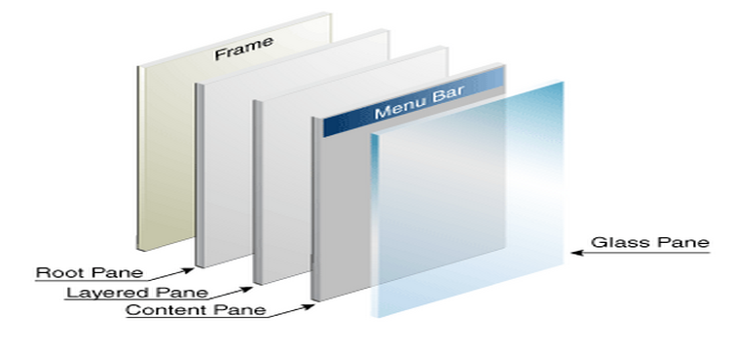
Top-Level Component Containers
Every GUI component must be part of a containment hierarchy that has a top-level container as its root.
Each top-level container has a content pane that, contains the visible components in its GUI.
JApplet, JFrame, and JDialog are top-level containers. JPanel is NOT a top-level container..
Notes:
JPanel is NOT a top-level container and therefore must be placed within a top-level component like JApplet or JFrame to appear.
Components may be placed within other components
http://docs.oracle.com/javase/tutorial/uiswing/components/toplevel.html

Slide 7
Adding Components to a GUI
Create the component using its constructor
JPanel jp = new JPanel(); //create a JPanel to hold other components
JButton jb = new JButton(“My Button”); //construct a JButton with a String on its face
JTextField tf = new JTextField();//construct a TextField
Use available methods to customize the component before adding it.
jp.setBackground(Color.YELLOW); //sets the background color of the Jpanel
jp.setBorder(BorderFactory.createLineBorder(Color.BLUE));//adds blue border to panel
tf.setText(“some default text”); //sets the starting text of the TextField
Add components to their containers
jp.add(tf); //add the JButton component to the JPanel component
jp.add(jb); //add the JButton component to the JPanel component
add(jp); //adds the JPanel to its parent container (to a JFrame for example)
Notes:
For more details on how to swing components see the oracle documentation http://docs.oracle.com/javase/tutorial/uiswing/components/componentlist.html
Also, see the swing project code in Eclipse

Slide 8
Layout Managers
Layout Managers
BoxLayout | Allows multiple components to be laid out either vertically or horizontally without wrapping by using 1 of 4 choices (x-axis, y-axis, line_axis, page_axis)
BorderLayout | Default Layout for Frame, JFrame, Dialog, JApplet. It uses 5 Regions (North, South, East, West, Center)
CardLayout | Acts like a stack of cards where only one card is visible at a time. Cards can be flip through sequentially, or show a specified card using the methods provided in the class.
FlowLayout | Default Layout for Panel, JPanel, Applet. Arranges components in a directional flow, like lines of text wrapping.
GridLayout | Lays out a container's components in a rectangular grid of rows and columns. Can be nested to produce the same effect as GridBagLayout, but without the complexity.
GridBagLayout | Aligns components vertically, horizontally or along their baseline without requiring that the components be of the same size using of customization of GridBagConstraints objects. A bit complicated to use quickly.
GroupLayout | Hierarchically groups components in order to position them in a Container. Each component must belong to a horizontal and vertical group to avoid an IllegalStateException. A bit complicated to use quickly.
SpringLayout | Used by defining directional relationships, or constraints, between the edges of components. Similar to GridBagLayout, but without the complexities. Can mimic the features of most other layout managers.

Slide 9
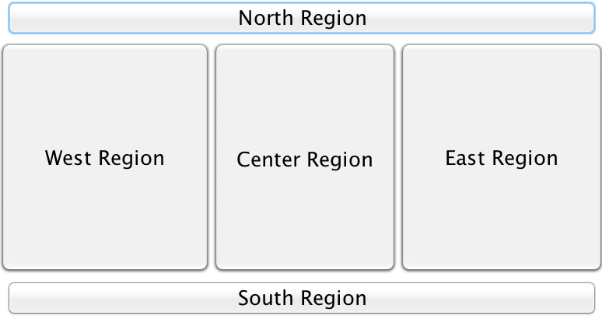
BorderLayout
import java.awt.BorderLayout;
import java.awt.Color;
import javax.swing.JPanel;
import javax.swing.JButton;
public class BorderLayoutPanel extends JPanel{
public BorderLayoutPanel(){
setBackground(Color.WHITE);
add(new JButton("North Region"), BorderLayout.NORTH);
add(new JButton("South Region"), BorderLayout.SOUTH);
add(new JButton("East Region"), BorderLayout.EAST);
add(new JButton("West Region"), BorderLayout.WEST);
add(new JButton("Center Region"), BorderLayout.CENTER);
}
}

Slide 10
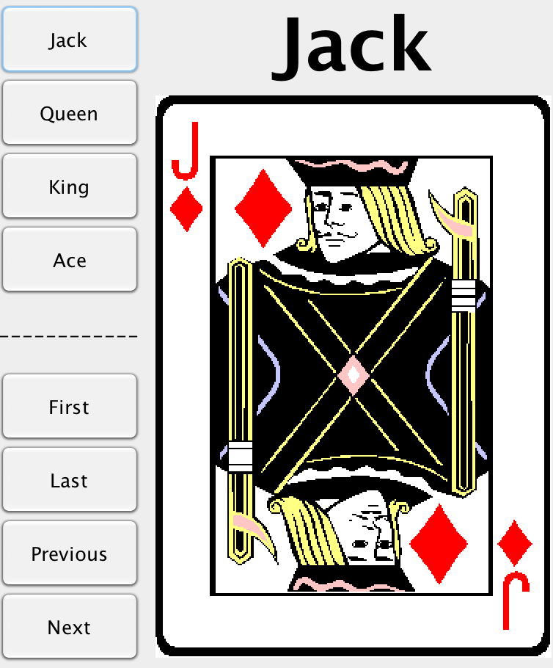
CardLayout (part1 of 2) JPanel using BorderLayout
We will not be using this Layout during the course.
import java.awt.BorderLayout;
import java.net.*;
import javax.swing.*;
public class CardPanel_Swing extends JPanel {
private JLabel name;
private ImageLabel picture;
public CardPanel_Swing(String cardName,
URL directory, String imageFile) {
setLayout(new BorderLayout());
name = new JLabel(cardName, JLabel.CENTER);
add(name, BorderLayout.NORTH);
picture = new ImageLabel(directory, imageFile);
JPanel picturePanel = new JPanel();
picturePanel.add(picture);
add(picturePanel, BorderLayout.CENTER);
setSize(getPreferredSize());
}
public JLabel getLabel() { return(name); }
public ImageLabel getImageLabel() { return(picture); }
}
Notes:
We will not be using this layout

Slide 11
CardLayout (part 2) JFrame displays Card Panels
We will not be using this Layout during the course.
import java.awt.BorderLayout;
import java.awt.CardLayout;
import java.awt.Color;
import java.awt.Font;
import java.awt.GridLayout;
import java.awt.event.*;
import javax.swing.*;
public class CardDemo_Swing extends JFrame
implements ActionListener {
private JButton first, last, previous, next;
private String[] cardLabels = { "Jack","Queen","King","Ace" };
private CardPanel[] cardPanels = new CardPanel[4];
private CardLayout layout;
private JPanel cardDisplayJPanel;
public void CardDemo_Swing() {
setBackground(Color.white);
setLayout(new BorderLayout());
addJButtonJPanel();
addCardDisplayJPanel();
}
private void addJButtonJPanel() {
JPanel JButtonJPanel = new JPanel();
JButtonJPanel.setLayout(new GridLayout(9, 1));
Font JButtonFont = new Font("SansSerif", Font.BOLD, 18);
JButtonJPanel.setFont(JButtonFont);
for(int i=0; i<cardLabels.length; i++) {
JButton JButton = new JButton(cardLabels[i]);
JButton.addActionListener(this);
JButtonJPanel.add(JButton);
}
first = new JButton("First");
last = new JButton("Last");
previous = new JButton("Previous");
next = new JButton("Next");
JButtonJPanel.add(new JLabel("------------", JLabel.CENTER));
JButtonJPanel.add(first);
JButtonJPanel.add(last);
JButtonJPanel.add(previous);
JButtonJPanel.add(next);
add(JButtonJPanel, BorderLayout.WEST);
}
Notes:
We will not be using this layout

Slide 12
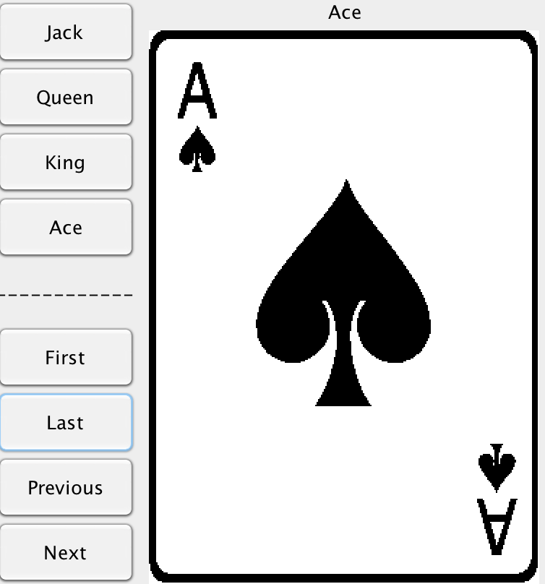
CardLayout (part 2 continued) Show Chosen Card
We will not be using this Layout during the course.
private void addCardDisplayJPanel() {
cardDisplayJPanel = new JPanel();
layout = new CardLayout();
cardDisplayJPanel.setLayout(layout);
String cardName;
for(int i=0; i<cardLabels.length; i++) {
cardName = cardLabels[i];
cardPanels[i] = new CardPanel(cardName,
getCodeBase(), "images/" +
cardName + ".gif");
cardDisplayJPanel.add(cardPanels[i],cardName);
}
add(cardDisplayJPanel, BorderLayout.CENTER);
}
}
Notes:
We will not be using this layout

Slide 13
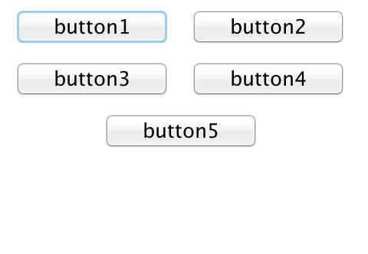
FlowLayout
import java.awt.Color;
import javax.swing.JFrame;
import javax.swing.JButton;
import javax.swing.JPanel;
public class FlowLayoutDemoFrame extends JFrame{
private JButton [ ] jbs = new JButton[ 5 ] ;
public FlowLayoutDemoFrame(){
JPanel jp = new JPanel();
for(int i=0; i<5; i++){
int index=i+1;
jbs[i] = new JButton(" button"+index+" ");
// put code here to attach event handler to button
jp.add(jbs[i]); // add button to jpanel
}
add(jp); // add panel containing buttons to jframe
}
}
Notes:
FlowLayout is the default Layout for JPanels

Slide 14
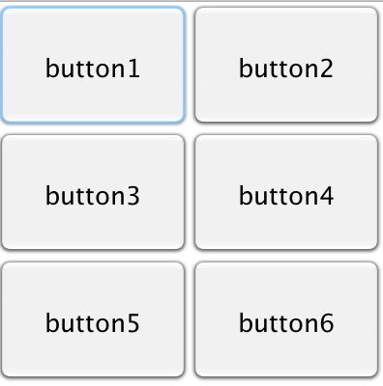
GridLayout
import java.awt.Color;
import java.awt.GridLayout;
import javax.swing.JFrame;
import javax.swing.JButton;
import javax.swing.JPanel;
public class GridLayoutDemo extends JFrame{
private JButton [ ] jbs = new JButton[ 6 ] ;
public GridLayoutDemo(){
JPanel jp = new JPanel();
jp.setLayout(new GridLayout(3, 2));
jp.setBackground(Color.WHITE);
for(int i=0; i<6; i++){
int index=i+1;
jbs[i] = new JButton(" button"+index+" ");
// put code here to attach event handler to button
jp.add(jbs[i]); // add button to jpanel
}
add(jp);
}
}

Slide 15
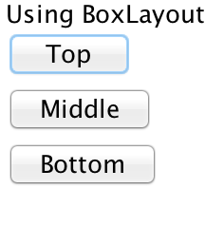
BoxLayout
import java.awt.*;
import java.awt.event.*;
import javax.swing.*;
public class BoxLayoutExample extends JPanel {
private BoxLayout layout;
private JButton topButton, middleButton, bottomButton;
public BoxLayoutExample() {
//layout = new BoxLayout(this, BoxLayout.X_AXIS);
layout = new BoxLayout(this, BoxLayout.Y_AXIS);
setLayout(layout);
JLabel label = new JLabel("Using BoxLayout");
topButton = new JButton("Top");
middleButton = new JButton("Middle");
bottomButton = new JButton("Bottom");
add(label);
add(topButton);
add(middleButton);
add(bottomButton);
setBackground(Color.white);
} We will not be using this Layout during the course.
}
Notes:
We will not be using this layout

Slide 16
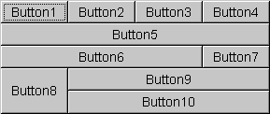
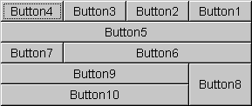
GridBagLayout
We will not be using this Layout during the course.
Each of the ten components has the fill field of its associated GridBagConstraintsobject set to GridBagConstraints.BOTH. In addition, the components have the following non-default constraints:
Button1, Button2, Button3: weightx = 1.0
Button4: weightx = 1.0, gridwidth = GridBagConstraints.REMAINDER
Button5: gridwidth = GridBagConstraints.REMAINDER
Button6: gridwidth = GridBagConstraints.RELATIVE
Button7: gridwidth = GridBagConstraints.REMAINDER
Button8: gridheight = 2, weighty = 1.0
Button9, Button 10: gridwidth = GridBagConstraints.REMAINDER
We will not be using this Layout during the course.
Horizontal, Left-to-Right
Horizontal, Right-to-Left
Notes:
We will not be using this layout
It is intended for use with a GUI Builder Tool

Slide 17
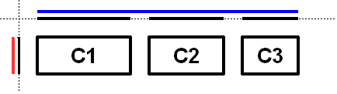
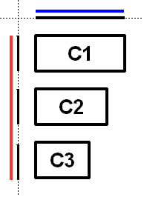
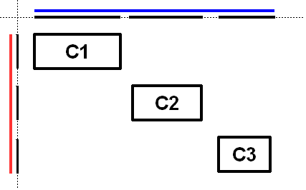
GroupLayout
We will not be using this Layout during the course.
GroupLayout is intended for use by builders, but may be hand-coded as well. Grouping is done by instances of the Group class. GroupLayout supports two types of groups. A sequential group positions its child elements sequentially, one after another. A parallel group aligns its child elements in one of four ways. Each group may contain any number of elements, where an element is a Group,Component, or gap.
We will not be using this Layout during the course.
Sequential group Horizontal
Parallel group Horizontal, Sequential group vertical
Sequential group along Horizontal and Vertical axis
Notes:
We will not be using this layout

Slide 18
SpringLayout
We will not be using this Layout during the course.
SpringLayout vs. Other Layout Managers
Note: Unlike many layout managers, SpringLayout doesn't automatically set the location of the components it manages. If you hand-code a GUI that uses SpringLayout, remember to initialize component locations by constraining the west/east and north/south locations.
Depending on the constraints you use, you may also need to set the size of the container explicitly.
Despite the simplicity of SpringLayout, it can emulate the behavior of most other layout managers. For some features, such as the line breaking provided by FlowLayout, you'll need to create a special-purpose subclass of the Spring class.
SpringLayout also provides a way to solve many of the difficult layout problems that cannot be solved by nesting combinations of Boxes. That said, SpringLayout honors the LayoutManager2 contract correctly and so can be nested with other layout managers -- a technique that can be preferable to creating the constraints implied by the other layout managers.
The asymptotic complexity of the layout operation of a SpringLayout is linear in the number of constraints (and/or components).
We will not be using this Layout during the course.
Notes:
We will not be using this layout

Slide 19
Event Listeners and Adapters
Listener Interfaces |  |  | Adapter Classes
AWT | Swing |  | AWT | Swing
ActionListener AdjustmentListener AWTEventListener ComponentListener ContainerListener FocusListener HierarchyBoundsListener HierarchyListener InputMethodListener ItemListener KeyListener MouseListener MouseMotionListener MouseWheelListener TextListener WindowFocusListener WindowListener WindowStateListener | AncestorListener CaretListener CellEditorListener ChangeListener DocumentEvent DocumentListener HyperlinkListener InternalFrameListener ListDataListener ListSelectionListener MenuDragMouseListener MenuKeyListener MenuListener MouseInputListener | PopupMenuListener RowSorterListener TableColumnModelListener TableModelListener TreeExpansionListener TreeModelListener TreeSelectionListener TreeWillExpandListener UndoableEditListener | ComponentAdapter ContainerAdapter FocusAdapter HierarchyBoundsAdapter KeyAdapter MouseAdapter MouseEvent MouseMotionAdapter WindowAdapter | InternalFrameAdapter MouseInputAdapter
Notes:
Some Events have adapter classes in addition to Listener Interfaces to allow developers to reduce the amount of code written, by overriding only the methods they are interested in.

Slide 20
Event Handling Process Overview
Determine which listener is appropriate based on the event to be monitored and API
Define a class of that type using one of the following methods.
Implement Listener Interface(s) from the GUI
Extend Adapter Class from a class separate from the GUI
Use a Named Inner Class to extend the Adapter Class
Use an Anonymous Inner Class to extend the Adapter Class
Use lambda expression
Register a listener object with the GUI by calling the appropriate add method (addActionListener, addMouseListener, add*******Listener).

Slide 21
Event Handling Approaches
Approach | Advantages | Disadvantages
Implement Listener Interface(s) directly from the GUI | Simple to write and use Can call methods directly from main GUI Can implement more than one Interface | Need to implement used and unused methods Cannot pass arguments to Listener which reduces reusability (not generic)
Extend Adapter Class from a Separate Class | Reusable Ignore unused methods Can pass arguments to class constructor | Cannot directly extend more than 1 class Need a separate class to extend the Adapter class More steps to use the Adapter class’s methods
Named inner class extends Adapter Class | Ignore unused methods Can call methods directly from main GUI Can define constructor to pass arguments | Not Reusable Code is harder to read/understand
Anonymous inner class extends Adapter Class | Ignore unused methods Call methods directly from main GUI | Not Reusable Code is harder to read/understand No constructor to pass arguments
Lambda Expression | Full access from main GUI | Slight learning curve to adapt to the Lambda Expression Syntax of Java 8

Slide 22
Event Listeners and their methods 1
Listener | Type(s) of Event Handled | Associated Method(s)
ActionListener | Button and RadioButton Events | actionPerformed(ActionEvent event)
TextListener | Text Events in TextFields and TextAreas | textValueChanged(TextEvent event)
KeyListener | Keyboard Events | keyPressed(KeyEvent event) keyReleased(KeyEvent event) keyTyped(KeyEvent event)
FocusListener | Component Focus Events | focusGained(FocusEvent event) focusLost(FocusEvent event)
WindowListener | Window Events | windowOpened(WindowEvent event) windowClosing(WindowEvent event) windowClosed(WindowEvent event) windowActivated(WindowEvent event) windowDeactivated(WindowEvent event)

Slide 23
Event Listeners and their methods 2
Listener | Type(s) of Event Handled | Associated Method(s)
MouseListener | Basic Mouse Events (Does not handle mouse movement) | mouseEntered(MouseEvent event) mouseExited(MouseEvent event) mousePressed(MouseEvent event) mouseReleased(MouseEvent event) mouseClicked(MouseEvent event)
MouseMotionListener | Mouse Movement | mouseMoved(MouseEvent event) mouseDragged(MouseEvent event)
MouseInputListener | Button and RadioButton Events | actionPerformed(ActionEvent event)
ItemListener | Selection Events in lists, checkboxes... | itemStateChanged(itemEvent event)
ListSelectionListener | Value of Selection has Changed in a list | valueChanged(itemEvent event)

Slide 24
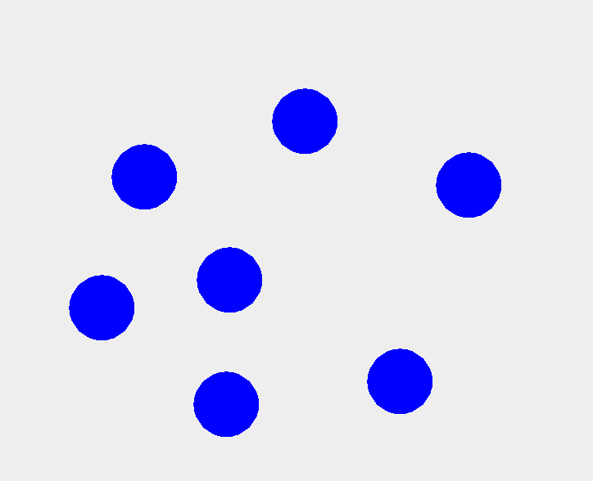
GUI - Components and Coordinates
0,0
width,0
The x,y coordinate of 0,0 is the upper left most corner.
The larger the x value, the further right the component will be drawn.
The larger the y value, the further down the component will be drawn.
Every GUI Component drawn on screen is within an invisible rectangle where the starting point is the upper left corner.
x,y
0,distance from top
width,height

Slide 25
Implement Listener Interface directly
import java.awt.Color;
import java.awt.Graphics;
import java.awt.Graphics2D;
import java.awt.event.MouseEvent;
import java.awt.event.MouseListener;
import javax.swing.JPanel;
//Event Handlng in 1 java file using Interface
public class CircleDrawerExample1
extends JPanel implements MouseListener{
private Color shapeColor = Color.BLUE;
private int drawingSize = 20;
private int lastX=0, lastY=0;
public CircleDrawerExample1{
addMouseListener(this);
}
//same class...code continued
//same class...code continued
@Override
public void mouseClicked(MouseEvent e) { }
public void mouseReleased(MouseEvent e) { }
public void mouseEntered(MouseEvent e) { }
public void mouseExited(MouseEvent e) { }
@Override
public void mousePressed(MouseEvent e) {
lastX = e.getX();
lastY = e.getY();
Graphics g = getGraphics();
Graphics2D g2d = (Graphics2D)g;
g2d.setColor(shapeColor);
//g2d.fillOval(lastX, lastY, drawingSize, drawingSize);
//compare the line of code above with the one below
g2d.fillOval(lastX-drawingSize, lastY-drawingSize, 2*drawingSize, 2*drawingSize);
}
}
Notes:
Everything in 1 class

Slide 26
Separate class extends Adapter
import java.awt.Color;
import javax.swing.JPanel;
//Separate classes in 2 java files
//CircleDrawerAdapter extends MouseAdapter
public class CircleDrawerExample2 extends JPanel{
public CircleDrawerExample2(){
addMouseListener(new CircleDrawerAdapter());
}
}
import java.awt.Color;
import java.awt.Graphics;
import java.awt.Graphics2D;
import java.awt.event.MouseAdapter;
import java.awt.event.MouseEvent;
public class CircleDrawerAdapter extends MouseAdapter {
private Color shapeColor = Color.BLUE;
private int drawingSize = 20;
private int lastX=0, lastY=0;
private int x,y =0;
@Override
public void mousePressed(MouseEvent e) {
lastX = e.getX();
lastY = e.getY();
Graphics g =e.getComponent().getGraphics();
Graphics2D g2d = (Graphics2D)g;
g2d.setColor(shapeColor);
g2d.fillOval(lastX-drawingSize, lastY-drawingSize,
2*drawingSize, 2*drawingSize);
}
}
Notes:
requires 2 separate classes:
1 for the GUI
1 to extend the Adapter

Slide 27
Named Inner extends Adapter Class
import java.awt.Color;
import java.awt.Graphics;
import java.awt.Graphics2D;
import java.awt.event.MouseAdapter;
import java.awt.event.MouseEvent;
import javax.swing.JPanel;
//Nested classes in 1 java file continued below
public class CircleDrawerExample3 extends JFrame{
public CircleDrawerExample3(){
addMouseListener(new CircleDrawerAdapter());
}
//named inner class
private class CircleDrawerAdapter extends MouseAdapter {
private Color shapeColor = Color.BLUE;
private int drawingSize = 20;
private int lastX=0, lastY=0;
private int x,y =0;
public void mousePressed(MouseEvent e) {
lastX = e.getX();
lastY = e.getY();
Graphics g =e.getComponent().getGraphics();
Graphics2D g2d = (Graphics2D)g;
g2d.setColor(shapeColor);
g2d.fillOval(lastX-drawingSize, lastY-drawingSize,
2*drawingSize,2*drawingSize);
}
}
}
Notes:
1 class nested inside the other class

Slide 28
Anonymous Inner uses Adapter
package _EventHandlers;
import java.awt.Color;
import java.awt.Graphics;
import java.awt.Graphics2D;
import java.awt.event.MouseAdapter;
import java.awt.event.MouseEvent;
import javax.swing.JPanel;
//Nested classes in 1 java file
//Anonymous Inner Class use the MouseAdapter
public class CircleDrawerExample4 extends JPanel{
public CircleDrawerExample4(){
addMouseListener(new MouseAdapter() {
private Color shapeColor = Color.BLUE;
private int drawingSize = 20;
private int lastX=0, lastY=0;
private int x,y =0;
@Override
public void mousePressed(MouseEvent e) {
lastX = e.getX();
lastY = e.getY();
Graphics g =e.getComponent().getGraphics();
Graphics2D g2d = (Graphics2D)g;
g2d.setColor(shapeColor);
g2d.fillOval(lastX-drawingSize, lastY-drawingSize,
2*drawingSize, 2*drawingSize);
}
});
}
}
Notes:
The anonymous inner class is created within the JPanel’s constructor.
It uses the MouseAdapter() constructor to create the anonymous class.
Notice the syntax is different from an ordinary constructor call {.....});

Slide 29
GUI - Result of MouseListener
Same GUI result for all 4 approaches
When the mouse is pressed a circle is drawn surrounding the location of the cursor.
The math used in the examples shifted the start point of the drawing so the circle would appear around the mouse click.

Slide 30
Summary
At this point the expected knowledge acquired is:
Theoretical knowledge
General understanding of Java libraries and their history
Knowledge of MVC Architecture
Clear understanding of the Swing Library and its components
Practical knowledge (write code):
Construct GUI Containers and components
Add components and arrange them using layout managers
Add event handlers to components
Receive and respond to user-triggered events
To get these slides go to: http://bit.ly/javaguislides

