Slide 1
Decision Branches
Java 1 Chapter 4

Slide 2


Decision Branch
A path taken in the program if a condition is true
isSunny
true
Go to the beach

Slide 3
Decision Branch if
How does it work?
The condition within the parentheses is evaluated to make a decision
TRUE enter if block and execute the code in it
FALSE skip if block
if ( CONDITION ) {
}
Block of code to execute if the condition is TRUE
Block of code to execute if the condition is TRUE
Block of code to execute if the condition is TRUE

Slide 4
Decision Branch if
How do we use an if statement in Java?
TRUE
Syntax
boolean isSunny = true;
boolean
isSunny
true
if( isSunny ){
System.out.println(“Go to the beach!”);
}

Slide 5
Decision Branch if
How do we use an if statement in Java?
FALSE
Syntax
boolean isSunny = false;
We DO NOT print “Go to the beach!”
We skip the block of code associated with the if statement
boolean
isSunny
false
if( isSunny ){
System.out.println(“Go to the beach!”);
}

Slide 6
Decision Branch
if - else

Slide 7

Decision Branch if - else
A path taken in the program if a condition is true
An alternate path if the condition is false
isSunny
true
false
Go to the beach
Go to the movies

Slide 8
Decision Branch if - else
How does it work?
The condition within the parentheses is evaluated to make a decision
TRUE enter if block to execute the code in it
FALSE skip if block, enter else block to execute the code in it
if ( CONDITION ) {
}
else{
}
Block of code to execute if the condition is TRUE
Block of code to execute if the condition is FALSE

Slide 9
Decision Branch if - else
How do we use an if-else statement in Java?
TRUE
Syntax
boolean isSunny = true;
boolean
isSunny
if( isSunny ){
System.out.println(“Go to the beach!”);
}
else{
System.out.println(“Go to the movies.”);
}
true

Slide 10
Decision Branch if - else
How do we use an if-else statement in Java?
FALSE
Syntax
boolean isSunny = false;
boolean
isSunny
if( isSunny ){
System.out.println(“Go to the beach!”);
}
false
else{
System.out.println(“Go to the movies.”);
}

Slide 11
Decision Branch
Can we use decision branches with other primitive data types?
YES

Slide 12
Decision Branch
Will it work the same?
YES
The condition within the parentheses is evaluated to make a decision
TRUE enter if block and execute the code in it
FALSE skip if block

Slide 13
Decision Branch
Is there anything different when using non-boolean data types?
YES
The condition within the if statement will be an expression that gets evaluated
as true or false to decide whether to enter the block or not

Slide 14
Relational Operators for All Primitive Data Types
==
EQUAL
x == y
!=
NOT EQUAL
x != y
>
GREATER THAN
x > y
>=
GREATER THAN OR EQUAL
x >= y
<
LESS THAN
x < y
<=
LESS THAN OR EQUAL
x <= y
Notes:
Remember our primitive data types: int, long, short, byte, char, float, double, boolean

Slide 15

Decision Branch
How does an if statement with a conditional expression work?
degrees > 80
true
Go to the beach

Slide 16
Decision Branch if
How does an if statement with a conditional expression work?
TRUE
Syntax
int degrees = 85;
int
degrees
85
if( degrees > 80 ){
System.out.println(“Go to the beach!”);
}

Slide 17
Decision Branch if
How does an if statement with a conditional expression work?
FALSE
Syntax
int degrees = 54;
int
We DO NOT print “Go to the beach!”
We skip the block of code associated with the if statement
degrees
54
if( degrees > 80 ){
System.out.println(“Go to the beach!”);
}

Slide 18
Decision Branch if - else
A path taken in the program if expression is true
An alternate path if expression is false
degrees > 80
true
false
Go to the beach
Go to the movies

Slide 19
Decision Branch if - else
Syntax
int
int degrees = 54;
degrees
54
if( degrees > 80 ){
System.out.println(“Go to the beach!”);
}
else{
System.out.println(“Go to the movies.”);
}

Slide 20
Decision Branch
multiple branches
if - else if - else
if - else if - else if - else

Slide 21
Decision Branch if - else if - else
Use when decisions will be made based on:
Ranges of values
Examples: temperature ranges, grade ranges, height ranges, weight ranges, etc.
3 or more dependent decision branches with ranges, or fixed sets
Ranges of values:
temperature ranges, grade ranges, height ranges, weight ranges, etc.
Fixed limit of choices:
number choices, letter choices, color choices, size choices, name choices, etc.

Slide 22
Decision Branch if - else if - else
How does it work?
Each condition is evaluated in order
Only 1 block of code will be executed
When NO condition evaluates to true, the block of code within the else is executed
TRUE enter block and execute the code in it, then jump past all other branches
FALSE skip block, and evaluate next condition in the chain

Slide 23
Decision Branch if - else if - else
if ( CONDITION 1 ) {
}
else if( DEPENDENT CONDITION 2 ){
}
else if( DEPENDENT CONDITION 3 ){
}
else if( DEPENDENT CONDITION N ){
}
else{
}
Block of code to execute if the condition is TRUE
Block of code to execute if the condition is TRUE, and all previous conditions were FALSE
Block of code to execute if the condition is TRUE, and all previous conditions were FALSE
Block of code to execute if the condition is TRUE, and all previous conditions were FALSE
Block of code to execute if NO condition was TRUE

Slide 24
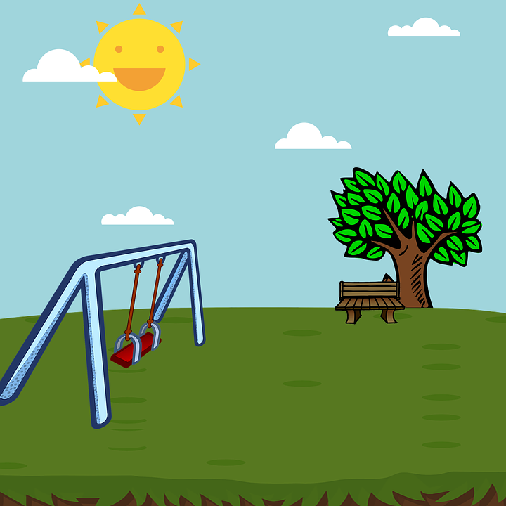
Decision Branch if - else if - else
degrees > 80
true
false
degrees > 70
Go to the beach
true
false
Go to the park
Go to the movies

Slide 25
Decision Branch if - else if - else
Syntax
int
int degrees = 72;
degrees
72
if( degrees > 80 ){
System.out.println(“Go to the beach!”);
}
else if( degrees > 70 ){
System.out.println(“Go to the park.”);
}
else{
System.out.println(“Go to the movies.”);
}
Notes:
These are dependent branches also known as chaining

Slide 26
Decision Branch if - else if - else
Syntax
int
int degrees = 54;
degrees
54
if( degrees > 80 ){
System.out.println(“Go to the beach!”);
}
else if( degrees > 70 ){
System.out.println(“Go to the park.”);
}
else{
System.out.println(“Go to the movies.”);
}
Notes:
These are dependent branches also known as chaining

Slide 27
Decision Branch
Can we use decision branches for non-primitive data types (class types)?
YES

Slide 28
Decision Branch
Will it work the same?
YES
The condition within the parentheses is evaluated to make a decision
TRUE enter if block and execute the code in it
FALSE skip if block

Slide 29
Decision Branch
Is there anything different with a non-primitive data type such as String?
YES
The expression within the if statement will use methods
instead of the primitive relational operators introduced earlier

Slide 30
Decision Branch using Strings
char | H | e | l | l | o
index | 0 | 1 | 2 | 3 | 4
char | H | e | l | l | o
index | 0 | 1 | 2 | 3 | 4
String
String
s
s1
s.equals( s1 )
Strings are EQUAL
same character sequence and typecase
true
!( s.equals( s1 ) )
Expression is NOT EQUAL
The ! negates the result of the equals method
false
s.equalsIgnoreCase( s1 )
Strings are EQUAL
same character sequence
ignoring upper or lower typecase
true

Slide 31
Decision Branch using Strings
char | H | e | l | l | o
index | 0 | 1 | 2 | 3 | 4
char | H | e | l | l | o
index | 0 | 1 | 2 | 3 | 4
char | H | e | l | l | o
index | 0 | 1 | 2 | 3 | 4
String
String
s
s1
s.equals( s1 )
Strings are EQUAL
same character sequence and typecase
true
s.equals( s2 )
NOT EQUAL
different typecase so character sequence is not equal
false
s.equalsIgnoreCase( s2 )
Strings are EQUAL ignoring typecase upper/lower
true
char | H | e | l | L | o
index | 0 | 1 | 2 | 3 | 4
char | H | e | l | L | o
index | 0 | 1 | 2 | 3 | 4
char | H | e | l | L | o
index | 0 | 1 | 2 | 3 | 4
String
s2

Slide 32
Decision Branch if
How do we use an if statement with a String?
Syntax
String s = “Hello”; String s1=”Hello”; String s2=”HelLo”;
if( s.equals(s1) ){
System.out.println(“s and s1 are the same typecase and character sequence”);
}
if( s.equals(s2) ){
System.out.println(“s and s2 are NOT the same typecase and character sequence”);
}
if( s.equalsIgnoreCase(s2) ){
System.out.println(“s and s2 are considered equal if we ignore the typecase”);
}
Notes:
Notice these are independent if statements

Slide 33
Decision Branch if - else
How do we use an if-else statement with a String?
Syntax
String s = “Hello”; String s1=”Hello”; String s2=”HelLo”;
if( s.equals(s1) ){
System.out.println(“s matches s1”);
}
else{
System.out.println(“s does not match s1”);
}
if( s.equals(s2) ){
System.out.println(“s matches s2”);
}
else{
System.out.println(“s does not match s2”);
}
OUTPUT: s matches s1
OUTPUT: s does not match s2
Notes:
Notice these are independent if statements

Slide 34
Decision Branch if - else if - else
s.equals(“yellow”)
true
false
s.equals(“red”)
show yellow
true
false
s.equals(“green”)
show red
true
false
show green
show black

Slide 35
Decision Branch if - else if - else
OUTPUT
yay for yellow
Syntax
String s = “yellow”;
if( s.equals(“yellow”) ){
System.out.println(“yay for yellow”);
}
else if( s.equals(“red”) ){
System.out.println(“royal in red”);
}
else if( s.equals(“green”) ){
System.out.println(“great in green”);
}
else{
System.out.println(“best in black”);
}
Notes:
These are dependent branches also known as chaining

Slide 36
Decision Branch if - else if - else
OUTPUT
royal in red
Syntax
String s = “red”;
if( s.equals(“yellow”) ){
System.out.println(“yay for yellow”);
}
else if( s.equals(“red”) ){
System.out.println(“royal in red”);
}
else if( s.equals(“green”) ){
System.out.println(“great in green”);
}
else{
System.out.println(“best in black”);
}
Notes:
These are dependent branches also known as chaining

Slide 37
Decision Branch if - else if - else
OUTPUT
great in green
Syntax
String s = “green”;
if( s.equals(“yellow”) ){
System.out.println(“yay for yellow”);
}
else if( s.equals(“red”) ){
System.out.println(“royal in red”);
}
else if( s.equals(“green”) ){
System.out.println(“great in green”);
}
else{
System.out.println(“best in black”);
}
Notes:
These are dependent branches also known as chaining

Slide 38
Decision Branch if - else if - else
OUTPUT
best in black
Syntax
String s = “orange”;
if( s.equals(“yellow”) ){
System.out.println(“yay for yellow”);
}
else if( s.equals(“red”) ){
System.out.println(“royal in red”);
}
else if( s.equals(“green”) ){
System.out.println(“great in green”);
}
else{
System.out.println(“best in black”);
}
Notes:
These are dependent branches also known as chaining

Slide 39
Decision Branch
switch

Slide 40
Decision Branch switch
Use when decisions will be made based on:
Ranges of values
Examples: temperature ranges, grade ranges, height ranges, weight ranges, etc.
Multiple decision branches with ranges, or fixed sets
Ranges of values:
temperature ranges, grade ranges, height ranges, weight ranges, etc.
Fixed limit of choices:
number choices, letter choices, color choices, size choices, name choices, etc.
The switch case supports Primitive Data Types, and as of Java 7, Strings as well

Slide 41
Decision Branch switch
How does it work?
Each case is evaluated in order
The 1st case that evaluates to true, triggers statements to be executed until a break; is encountered, even if those statements are under subsequent cases.
When the break; is encountered, skip past any other cases to the end of the switch.
When NO condition evaluates to true, the default case’s statements will be executed.
TRUE enter block and execute the code until break; then skip to the end of the switch
FALSE skip block, and evaluate next case in the chain

Slide 42
Decision Branch switch
case 1:
int
numBabies
1
OUTPUT:
Congrats
true
false
case 2:
Congrats
true
false
case 3:
Twins!
When there is no break;
continue executing instructions
true
false
case 4:
Wow!
true
false
Quads
default
Speechless

Slide 43
Decision Branch switch
case 1:
int
numBabies
2
OUTPUT:
Twins! Wow!
true
false
case 2:
Congrats
true
false
case 3:
Twins!
When there is no break;
continue executing instructions
true
false
case 4:
Wow!
true
false
Quads
default
Speechless

Slide 44
Decision Branch switch
case 1:
int
numBabies
3
OUTPUT:
Wow!
true
false
case 2:
Congrats
true
false
case 3:
Twins!
true
false
case 4:
Wow!
true
false
Quads
default
Speechless

Slide 45
Decision Branch switch
case 1:
int
numBabies
4
OUTPUT:
Quads
true
false
case 2:
Congrats
true
false
case 3:
Twins!
When there is no break;
continue executing instructions
true
false
case 4:
Wow!
true
false
Quads
default
Speechless

Slide 46
Decision Branch switch
case 1:
int
numBabies
99
OUTPUT:
Speechless
true
false
case 2:
Congrats
true
false
case 3:
Twins!
When there is no break;
continue executing instructions
true
false
case 4:
Wow!
true
false
Quads
default
Speechless

Slide 47
Decision Branch switch
case 1:
int
numBabies
-1
OUTPUT:
Speechless
true
false
case 2:
Congrats
true
false
case 3:
Twins!
When there is no break;
continue executing instructions
true
false
case 4:
Wow!
true
false
Quads
default
Speechless

Slide 48
Decision Branch switch
Syntax
int numBabies = 1;
switch(numBabies){
case 1:
System.out.print("Congrats");
break;
case 2:
System.out.print("Twins! "); //eliminate break to also print the next case’s instructions
case 3:
System.out.print("Wow!");
break;
case 4:
System.out.print("Quads");
break;
default:
System.out.println("Speechless");
break;
}
OUTPUT:
Congrats

Slide 49
Decision Branch switch
Syntax
int numBabies = 2;
switch(numBabies){
case 1:
System.out.print("Congrats");
break;
case 2:
System.out.print("Twins! "); //eliminate break to print next case’s instructions too
case 3:
System.out.print("Wow!");
break;
case 4:
System.out.print("Quads");
break;
default:
System.out.println("Speechless");
break;
}
OUTPUT:
Twins! Wow!

Slide 50
Decision Branch switch
Syntax
int numBabies = 3;
switch(numBabies){
case 1:
System.out.print("Congrats");
break;
case 2:
System.out.print("Twins! "); //eliminate break to print next case’s instructions too
case 3:
System.out.print("Wow!");
break;
case 4:
System.out.print("Quads");
break;
default:
System.out.println("Speechless");
break;
}
OUTPUT:
Wow!

Slide 51
Decision Branch switch
Syntax
int numBabies = 4;
switch(numBabies){
case 1:
System.out.print("Congrats");
break;
case 2:
System.out.print("Twins! "); //eliminate break to also print the next case’s instructions
case 3:
System.out.print("Wow!");
break;
case 4:
System.out.print("Quads");
break;
default:
System.out.println("Speechless");
break;
}
OUTPUT:
Quads

Slide 52
Decision Branch switch
Syntax
int numBabies = 8;
switch(numBabies){
case 1:
System.out.print("Congrats");
break;
case 2:
System.out.print("Twins! "); //eliminate break to also print the next case’s instructions
case 3:
System.out.print("Wow!");
break;
case 4:
System.out.print("Quads");
break;
default:
System.out.println("Speechless");
break;
}
OUTPUT:
Speechless

Slide 53
Decision Branch
switch
ANOTHER EXAMPLE

Slide 54
Decision Branch switch
Syntax
char shirtSize = 's';
switch(shirtSize){
case 'M'://eliminate break to also print the next case’s instructions
case 'm':
System.out.print("Size Medium");
break;
case 'L'://eliminate break to also print the next case’s instructions
case 'l':
System.out.print("Size Large");
break;
case 'X'://eliminate break to also print the next case’s instructions
case 'x':
System.out.print("Size XLarge");
break;
default:
System.out.println("One Size Fits All");
break;
}
OUTPUT:
One Size Fits All

Slide 55
Decision Branch switch
Syntax
char shirtSize = 'm';
switch(shirtSize){
case 'M'://eliminate break to also print the next case’s instructions
case 'm':
System.out.print("Size Medium");
break;
case 'L'://eliminate break to also print the next case’s instructions
case 'l':
System.out.print("Size Large");
break;
case 'X'://eliminate break to also print the next case’s instructions
case 'x':
System.out.print("Size XLarge");
break;
default:
System.out.println("One Size Fits All");
break;
}
OUTPUT:
Size Medium

Slide 56
Decision Branch switch
Syntax
char shirtSize = 'L';
switch(shirtSize){
case 'M'://eliminate break to also print the next case’s instructions
case 'm':
System.out.print("Size Medium");
break;
case 'L'://eliminate break to also print the next case’s instructions
case 'l':
System.out.print("Size Large");
break;
case 'X'://eliminate break to also print the next case’s instructions
case 'x':
System.out.print("Size XLarge");
break;
default:
System.out.println("One Size Fits All");
break;
}
OUTPUT:
Size Large

Slide 57
Decision Branch switch
Syntax
char shirtSize = 'X';
switch(shirtSize){
case 'M'://eliminate break to also print the next case’s instructions
case 'm':
System.out.print("Size Medium");
break;
case 'L'://eliminate break to also print the next case’s instructions
case 'l':
System.out.print("Size Large");
break;
case 'X'://eliminate break to also print the next case’s instructions
case 'x':
System.out.print("Size XLarge");
break;
default:
System.out.println("One Size Fits All");
break;
}
OUTPUT:
Size XLarge

Slide 58
Decision Branch
nested if statements

Slide 59
Decision Branch nested if
Use when decisions will be made based on:
dependent decision branches with multiple conditions
consisting of ranges, or fixed sets
Ranges of values:
temperature ranges, grade ranges, height ranges, weight ranges, etc.
Fixed limit of choices:
number choices, letter choices, color choices, size choices, name choices, etc.

Slide 60
Decision Branch nested if
How does it work?
Each condition is evaluated in order
Only 1 block of code will be executed
When a condition is true the block is entered and code is executed.
Conditions within the recently entered block are evaluated following the same rules
TRUE enter block and execute/evaluate the code in it, then jump past other branches
FALSE skip block, and evaluate next condition in the chain

Slide 61
Decision Branch nested if EXAMPLE 1
if ( OUTERMOST CONDITION 1 ) {
if( NESTED CONDITION 1 ){
}
}
Code to execute if the outer condition is TRUE
Block of code to execute if outer and inner condition are TRUE

Slide 62
Decision Branch nested if statements
Syntax
int
double
moneyInBank
>
100
dayOfMonth
moneyInBank
5
200.75
true
dayOfMonth
<
15
true
Go shopping

Slide 63
Decision Branch nested if statements
Syntax
int
double
int dayOfMonth = 5;
double moneyInBank = 200.75;
if(moneyInBank > 100){
if(dayOfMonth < 15){
System.out.println("Go shopping");
}
}
dayOfMonth
moneyInBank
5
200.75
OUTPUT:
Go shopping

Slide 64
Decision Branch nested if-else EXAMPLE 2
if ( OUTERMOST CONDITION 1 ) {
if( NESTED CONDITION 1 ){
}
else{
}
}
Code to execute if the outer condition is TRUE
Block of code to execute if outer and inner condition are TRUE
Block of code to execute if the outer condition is TRUE, but inner condition is FALSE

Slide 65
Decision Branch nested if statements
Syntax
int
double
moneyInBank
>
100
dayOfMonth
moneyInBank
25
200.75
true
dayOfMonth
<
15
true
false
Go shopping
Go to work

Slide 66
Decision Branch nested if statements
Syntax
int
double
int dayOfMonth = 25;
double moneyInBank = 200.75;
if(moneyInBank > 100){
if(dayOfMonth < 15){
System.out.println("Go shopping");
}
else{
System.out.println("Go to work");
}
}
dayOfMonth
moneyInBank
25
200.75
OUTPUT:
Go to work

Slide 67
Decision Branch nested if-else EXAMPLE 3
if ( OUTERMOST CONDITION 1 ) {
if( NESTED CONDITION 1 ){
}
else{
}
}
else{
}
Code to execute if the outer condition is TRUE
Block of code to execute if outer and inner condition are TRUE
Block of code to execute if the outer condition is TRUE, but inner condition is FALSE
Block of code to execute if Outer condition was FALSE

Slide 68
Decision Branch nested if statements
Syntax
int
double
moneyInBank
>
100
dayOfMonth
moneyInBank
5
57.95
true
false
dayOfMonth
<
15
Work overtime
true
false
Go shopping
Go to work

Slide 69
Decision Branch nested if statements
Syntax
int
double
int dayOfMonth = 5;
double moneyInBank = 57.95;
if(moneyInBank > 100){
if(dayOfMonth < 15){
System.out.println("Go shopping");
}
else{
System.out.println("Go to work");
}
}
else{
System.out.println("Work overtime");
}
dayOfMonth
moneyInBank
5
57.95
OUTPUT:
Work overtime

Slide 70
Decision Branch nested if-else EXAMPLE 4
if ( OUTERMOST CONDITION 1 ) {
if( NESTED CONDITION 1A ){
}
else{
}
}
else{
if( NESTED CONDITION 2A){
}
}
Code to execute if the outer condition is TRUE
Block of code to execute when both outer and inner condition are TRUE
Block of code to execute when outer condition is TRUE, but inner condition is FALSE
Block of code to execute if Outer condition was FALSE
Block of code to execute when outer condition FALSE, but inner condition is TRUE

Slide 71
Decision Branch nested if statements
Syntax
int
double
int dayOfMonth = 5;
double moneyInBank = 57.95;
if(moneyInBank > 100){
if(dayOfMonth < 15){
System.out.println("Go shopping");
}
else{
System.out.println("Go to work");
}
}
else{
System.out.println("Work overtime");
if(dayOfMonth < 15){
System.out.println("Save paycheck");
}
}
dayOfMonth
moneyInBank
5
57.95
OUTPUT:
Work overtime
Save paycheck

Slide 72
Decision Branch nested if statements
Syntax
int dayOfMonth = 25;
double moneyInBank = 200.75;
if(moneyInBank > 100){
if(dayOfMonth < 15){
System.out.println("Go shopping");
}
else{
System.out.println("Go to work");
}
}
else{
System.out.println("Work overtime");
if(dayOfMonth < 15){
System.out.println("Save paycheck");
}
else{
System.out.println("Hustle!");
}
}
int
double
dayOfMonth
moneyInBank
25
57.95
OUTPUT:
Work overtime
Hustle!

Slide 73
Decision Branch nested if-else EXAMPLE 4
if ( OUTERMOST CONDITION 1 ) {
if( NESTED CONDITION 1A ){
}
else{
}
}
else{
if( NESTED CONDITION 2A){
}
else{
}
}
Code to execute if the outer condition is TRUE
Block of code to execute when both outer and inner condition are TRUE
Block of code to execute when outer condition is TRUE, but inner condition is FALSE
Block of code to execute if Outer condition was FALSE
Block of code to execute when outer condition FALSE, but inner condition is TRUE
Block of code to execute when outer if condition, and else’s inner condition are FALSE

Slide 74
Decision Branch
if statements
multiple conditions

Slide 75
Decision Branch if with multiple conditions
Use when decisions will be made based on:
decision branches with multiple conditions
Ranges of values:
temperature ranges, grade ranges, height ranges, weight ranges, etc.
Fixed limit of choices:
number choices, letter choices, color choices, size choices, name choices, etc.

Slide 76
Logical Operators
&&
AND
TRUE when both conditions are true
||
OR
TRUE when both at least one conditions is true, FALSE when none are true
!
NOT
TRUE when condition is false, FALSE when condition is true

Slide 77
Truth Tables
AND
OR
T
&&
T
=
T
T
||
T
=
T
T
&&
F
=
F
T
||
F
=
T
F
&&
T
=
F
F
||
T
=
T
&&
=
||
=
F
F
F
F
F
F
NOT
!
T
=
F
!
=
F
T

Slide 78

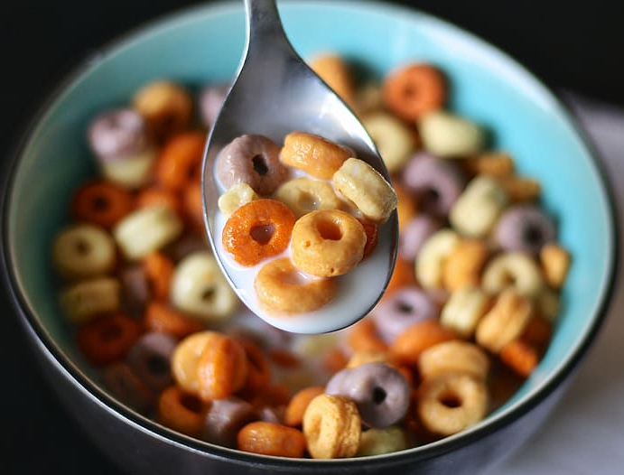
Decision Branch &&
Syntax
int
int hourOfDay = 6;
if((hourOfDay > 4 ) && (hourOfDay < 9)){
System.out.println("breakfast time");
}
else{
System.out.println("eat something else");
}
hourOfDay
6
OUTPUT:
breakfast time

Slide 79


Decision Branch &&
Syntax
int
int hourOfDay = 11;
if((hourOfDay > 4 ) && (hourOfDay < 9)){
System.out.println("breakfast time");
}
else if((hourOfDay >= 10 ) && (hourOfDay < 12)){
System.out.println("eat snack");
}
else if((hourOfDay >= 12 ) && (hourOfDay <= 15)){
System.out.println("eat lunch");
}
else if((hourOfDay > 15) && (hourOfDay < 22)){
System.out.println("eat dinner");
}
else{
System.out.println("eat something else");
}
hourOfDay
11
OUTPUT:
eat snack

Slide 80


Decision Branch &&
Syntax
int
int hourOfDay = 13;
if((hourOfDay > 4 ) && (hourOfDay < 9)){
System.out.println("breakfast time");
}
else if((hourOfDay >= 10 ) && (hourOfDay < 12)){
System.out.println("eat snack");
}
else if((hourOfDay >= 12 ) && (hourOfDay <= 15)){
System.out.println("eat lunch");
}
else if((hourOfDay > 15) && (hourOfDay < 22)){
System.out.println("eat dinner");
}
else{
System.out.println("eat something else");
}
hourOfDay
13
OUTPUT:
eat lunch

Slide 81
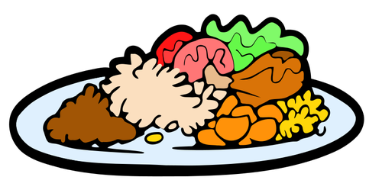
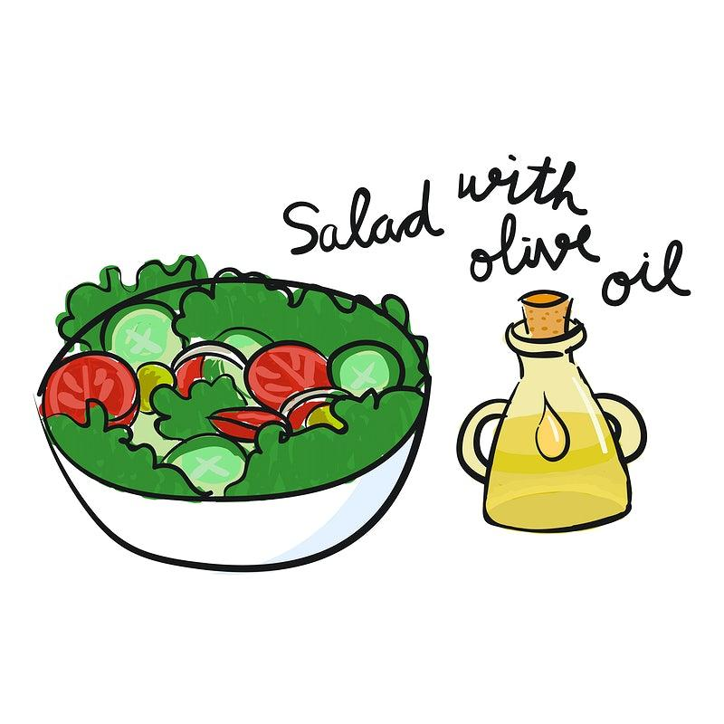
Decision Branch &&
Syntax
int
int hourOfDay = 18;
if((hourOfDay > 4 ) && (hourOfDay < 9)){
System.out.println("breakfast time");
}
else if((hourOfDay >= 10 ) && (hourOfDay < 12)){
System.out.println("eat snack");
}
else if((hourOfDay >= 12 ) && (hourOfDay <= 15)){
System.out.println("eat lunch");
}
else if((hourOfDay > 15) && (hourOfDay < 22)){
System.out.println("eat dinner");
}
else{
System.out.println("eat something else");
}
hourOfDay
18
OUTPUT:
eat dinner

Slide 82
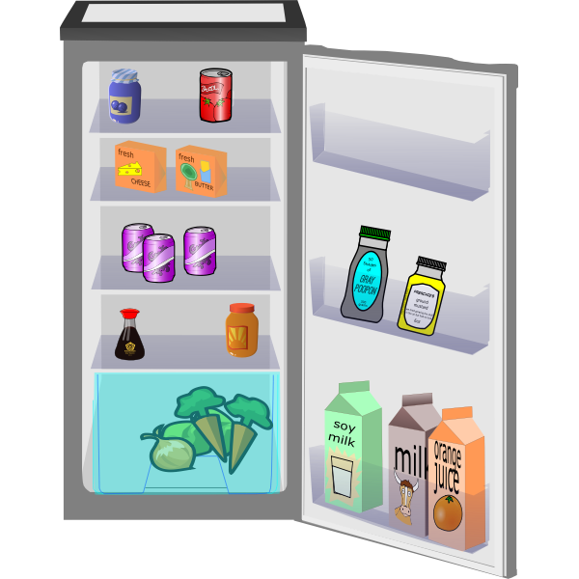
Decision Branch &&
Syntax
int
int hourOfDay = 23;
if((hourOfDay > 4 ) && (hourOfDay < 9)){
System.out.println("breakfast time");
}
else if((hourOfDay >= 10 ) && (hourOfDay < 12)){
System.out.println("eat snack");
}
else if((hourOfDay >= 12 ) && (hourOfDay <= 15)){
System.out.println("eat lunch");
}
else if((hourOfDay > 15) && (hourOfDay < 22)){
System.out.println("eat dinner");
}
else{
System.out.println("eat something else");
}
hourOfDay
23
OUTPUT:
eat something else

Slide 83
Decision Branch ||
Syntax
int
int hourOfDay = 6;
if((hourOfDay < 0 ) || (hourOfDay > 23)){
System.out.println("not a valid time");
}
else{
System.out.println("valid time");
}
hourOfDay
6
OUTPUT:
valid time

Slide 84
Decision Branch ||
Syntax
int
int hourOfDay = 25;
if((hourOfDay < 0 ) || (hourOfDay > 23)){
System.out.println("not a valid time");
}
else{
System.out.println("valid time");
}
hourOfDay
25
OUTPUT:
not a valid time

Slide 85
Decision Branch !
Syntax
boolean isSunny = true;
if( !isSunny){
System.out.println("Stay inside");
}
else{
System.out.println("Go outdoors");
}
OUTPUT:
Go outdoors

Slide 86

Decision Branch !
Syntax
boolean isSunny = false;
if( !isSunny ){
System.out.println("Stay inside");
}
else{
System.out.println("Go outdoors");
}
OUTPUT:
Stay inside

Slide 87
Exercise 1
In your IDE create and run an application as per the instructions below.
Take the following code and rewrite it using one if statement to produce the same result.
if (x > 0) {
if (x < 10) {
System.out.println("positive single digit number.");
}
}

Slide 88
Exercise 2
In your IDE create and run an application as per the instructions below.
Take the following code and rewrite it using the logical OR operator in the if statement.
Convert to if-else from if -else if - else to produce the same result.
if (x < 0) {
System.out.println("invalid value");
}
else if(x > 9){
System.out.println("invalid value");
}
else{
System.out.println("valid value, positive single digit number.");
}

Slide 89
Exercise 3
In your IDE create and run an application as per the instructions below.
Ask the user for the temperature as an int, and print the associated statement using the below temperatures to make decisions.
Above 80 degrees - Go to the beach
Above 70 degrees - Go to the park
Above 60 degrees - Go for a walk
Above 50 degrees - Go to the movies
Above or equal to 40 degrees - Go to the billiards
Below 40 degrees - Stay home
Note: You can start with the example from the slides and modify it if you like

Slide 90
Exercise 4
In your IDE create and run an application as per the instructions below.
Ask the user for the letter grade and print the feedback based on the rules below
Both upper and lower case characters should produce the same output
A or a - AMAZING!
B or b - Bazinga
C or c - Cool
D or d - It didn’t go so well
F or f - Next time will be better - It didn’t go so well
Any other char - INVALID ENTRY
Note: You can write your application using either a switch case, or if - else if - else

Slide 91
Exercise 5
In your IDE create and run an application as per the instructions below.
Ask the user for the degrees and the weather status of “yes”/“no” representing whether it is sunny or not.
Print the feedback based on the rules below
Whenever it is sunny print “SUNNY - Air is ” , followed by the description from the list below
Whenever it is not sunny print “NOT SUNNY - Air is ”, followed by the description from the list below
Above 95 - VERY HOT
Above 85 - HOT
Above 72 - WARM
Above or equal to 50 - COOL
Anything lower than 50 - COLD

Slide 92
Exercise 6
In your IDE create and run an application as per the instructions below.
Recall the “Guess My Number” game from the previous chapter.
Expand upon the application by using conditional statements to customize the output.
Ask the user to guess the number as before.
Print the following feedback based on the rules below:
When the user’s guess is equal to the random number
"Congrats! Your guess of "+userGuess+" was correct!"
When the user’s guess is greater than the random number
"Your guess of "+userGuess+", is "+diff+" greater than the number I was thinking of, "+randNum
When the user’s guess is less than the random number
Print the difference in the two numbers as a positive value, followed by
"Your guess of "+userGuess+", is "+diff+" less than the number I was thinking of, "+randNum
NOTE: The difference in the two numbers is always presented as a positive value. Hint: Math.abs

