Slide 1
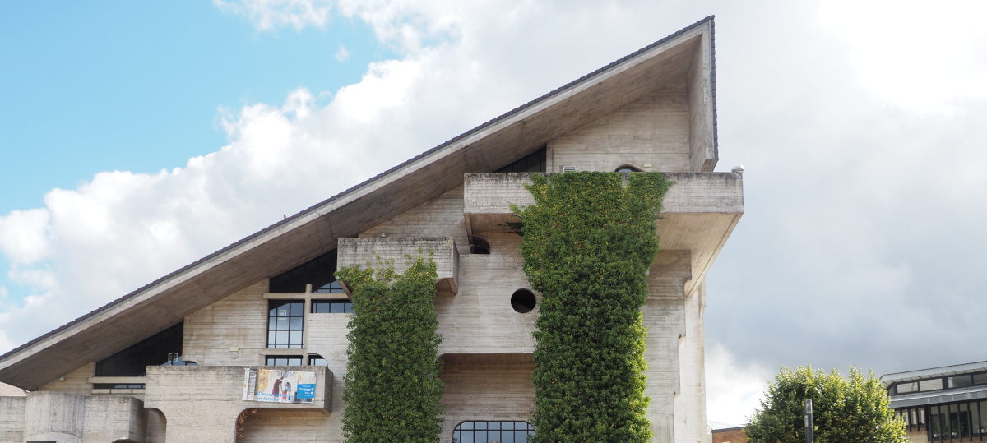









Diverse Paraphrasing with Insertion Models
for Few-Shot Intent Detection
Raphaël Chevasson, Charlotte Laclau, and Christophe Gravier
https://github.com/RaphaelChevasson/DPIM
raphael.chevasson@univ-st-etienne.fr

Slide 2
Overview
<numéro>
I – Motivation
AR and control, alternatives
II – Method
a) paraphrasing pipeline
b) metrics
c) datasets
III – Results & perspectives
a) 3-way tradeoff
b) qualitative and sample analysis

Slide 3
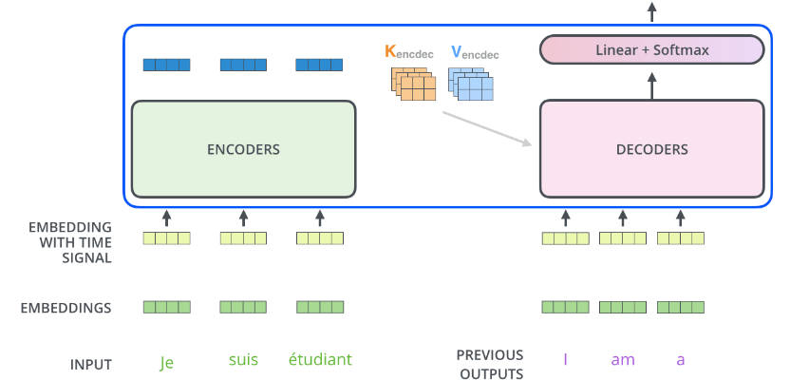
Scientific context
<numéro>
Current Text Generation is dominated by
Autoregressive, decoder-only transformers:
Task
Artificial Intelligence
→ NLP (tokens)
→ Text Generation
Method
Deep Learning
→ Transformers
→ Autoregressive
[Alammar 2018] Jay Alammar: The Illustrated Transformer,
June 27, 2018, https://jalammar.github.io/illustrated-transformer/

Slide 4
Motivation
<numéro>
Current NLG dominated by AR, decoder-only transformers
(+) can train every token in one pass with masked attention
(+) scale well across data and compute
Controlled generation can be hard
(-) cannot force a token to be included
(-) cannot force both left and right context

Slide 5
Motivation
<numéro>
Alternatives :
Encoder-decoder
→ can solve the bidirectionality (e.g. XLNet [Yang 2019])
Non autoregressive
→ one-pass, lower quality generation (e.g. the Non-Autoregressive Transformer [Gu 2018])
Semi-autoregressive
→ lots of very diverse works (cf the NAR tutorial [Gu 2022] from ACL 2022 for a very good overview)
[Gu 2018] Jiatao Gu, et. al.: Non-Autoregressive Neural Machine Translation, ICLR 2018
[NAR tutorial] Jiatao Gu, Xu Tan: Non-Autoregressive Sequence Generation
Tutorial at ACL 2022, May 22, 2022, https://github.com/NAR-tutorial/acl2022

Slide 6
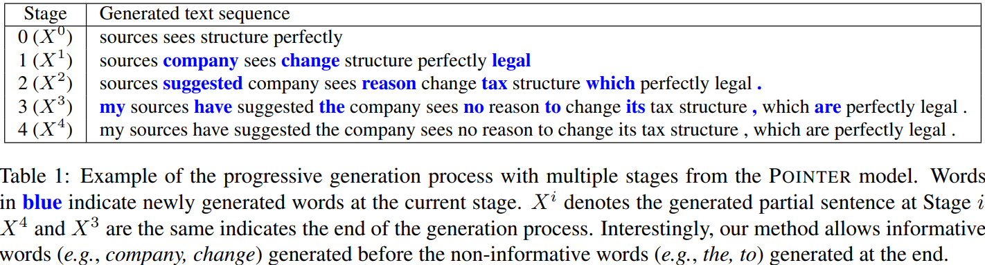
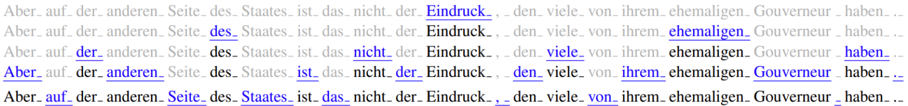
Method
<numéro>
Today’s focus: insertion models
Principle [Stern 2018]
Properties
→ can build sentence around key words
→ can guarantee tokens presence + order
→ can restrict where to fill with left an right context (unused here)
[Stern 2018] Mitchell Stern, William Chan, Jamie Kiros, and Jakob Uszkoreit:
Insertion Transformer: Flexible Sequence Generation via Insertion Operations
In: Proceedings of International Conference on Machine Learning. ICML (2018)

Slide 7
Method
<numéro>
Implementation
Survey → our own → POINTER [Zhang 2020]
(not to be confused with Pointer Networks [Vinyals 2015])
(+) use BERT skeleton, can leverage BERT checkpoints
(+) open source, give datasets and pretrained models
(-) no cross-attention
[Zhang 2020] Yizhe Zhang, Guoyin Wang, Chunyuan Li, Zhe Gan, Chris Brockett, Bill Dolan:
POINTER: Constrained progressive text generation via insertion-based generative pre-training.
In: Proceedings of EMNLP. pp. 8649–8670. ACL (2020)
[Vinyals 2015] Oriol Vinyals, Meire Fortunato, N. Jaitly:
Pointer Networks
In: In Advances in Neural Information Processing Systems, Vol. 28. NeurIPS (2015)

Slide 8
Method
<numéro>
Application: paraphrasing for data augmentation
→ Why: high diversity, low fidelity
good match w/ no cross-attention
→ How: ...

Slide 9
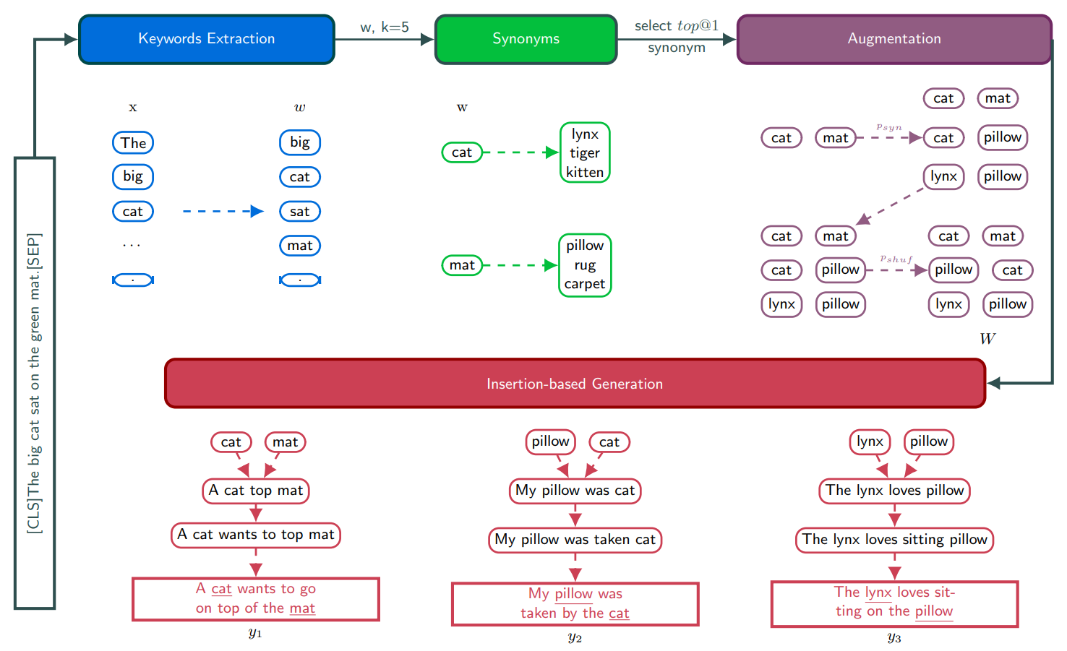
Method - overview
<numéro>
→ How:
Notes:
Keyword extraction:
Identify the k (=5) most important keywords
a keyword = a list of token e.g. « every#day », « living room »
← trained keyword extractor – stopwords + end punctuation
Keyword augmentation:
- shuffle each keyword with proba pshuf (=0,75)
- synonimize each keyword with proba psyn (=0,25)
→ gives m (=5) different augmentations
Constrained generation:
Finetuned POINTER model

Slide 10
Method - detail
<numéro>
Keyword extraction:
Identify the k (=5) most important keywords
a keyword = a list of token e.g. « every#day », « living room »
← trained keyword extractor – stopwords + end punctuation
Keyword augmentation:
- shuffle each keyword with proba pshuf (=0,75)
- synonimize each keyword with proba psyn (=0,25)
→ gives m (=5) different augmentations
Constrained generation:
Finetuned POINTER model
...

Slide 11
Metrics - separable
<numéro>
Evaluation
A batch of paraphrases should be:
1) fluent
2) diverse (from source + each others)
3) semantically similar
We can resp. use:
1) ppl (˅)
2) dist-2 (˄)
3) use-similarity (˄)
as a quantitative approximation + qualitative look

Slide 12
Metrics - separable
<numéro>
Example with “A big cat”→ “A huge cat”:
1) ppl(“A huge cat”)
[p(“A”) * p(“huge”) * p(“cat”)] ^ -1/3 = 11.3
2) dist-2(“A huge cat”, “A big cat”)
4 distinct bi-grams / 4 distinct tokens = 1
3) use-similarity(“A huge cat”, “A big cat”)
cos(embedding(“A huge cat”), embedding(“A big cat”)) = 0.943

Slide 13
Metrics - global
<numéro>
Extra metrics
1) BLEURT
2) BERTScore
3) End task
classification accuracy w/ data augmentation

Slide 14
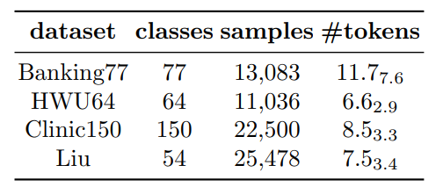

Experiments
<numéro>
Datasets
4 fine-grained classification datasets
Baselines
- EDA (4 augmentations)
- AEDA (‘;’ insertion)
- RTT ( translation)
- Bart-uni (finetuned BART
with diverse beam search)

Slide 15
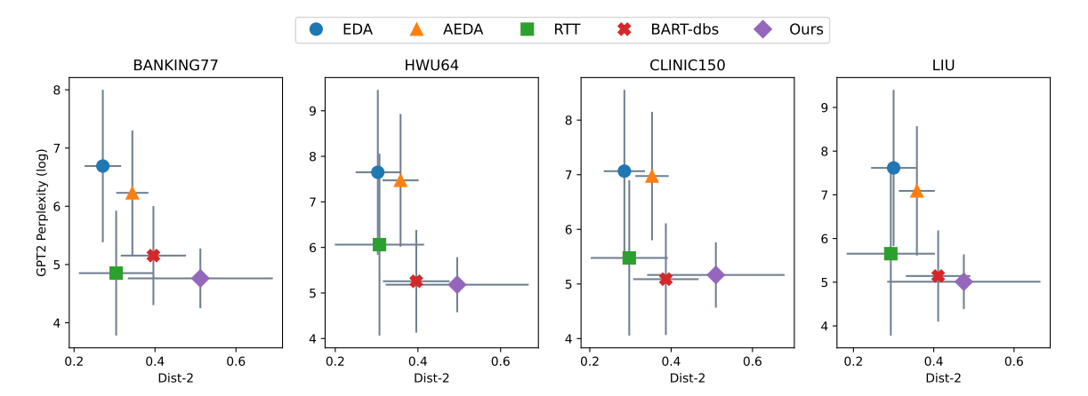
Results - tradeoffs (separable metrics)
<numéro>
- dist-2 & use-similarity highly correlated → 2D tradeoff analysis
- we plot fluency (y) vs. diversity (x) for different baselines (color)
- best is fluent and diverse (lower-right corner) → ours (purple)

Slide 16
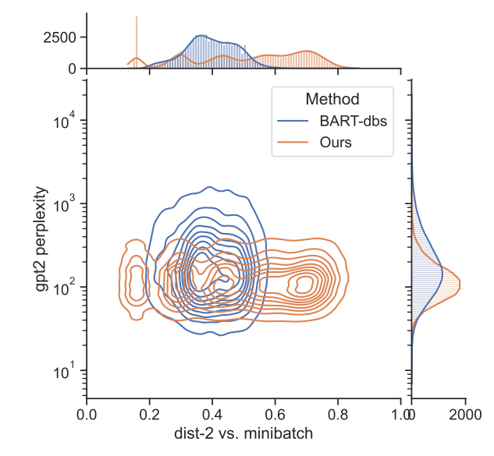
Results - distribution (separable metrics)
<numéro>
- how are paraphrases distributed ?
orange: ours
blue: best baseline
- less fluency spread
more diversity spread
- blobs ← number of augmented keywords
- fluency and diversity not correlated

Slide 17

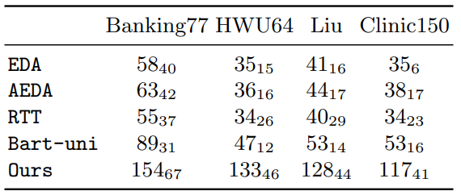
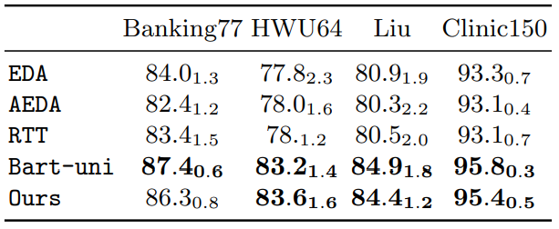
Results - quantitative
<numéro>
→ Classification accuracy:
How do we perform as a data augmentation technique ?
we match our best AR baseline
→ Length mismatch:
- translation: x0.96
- finetuned AR model: x1.4
- ours: x3.1

Slide 18
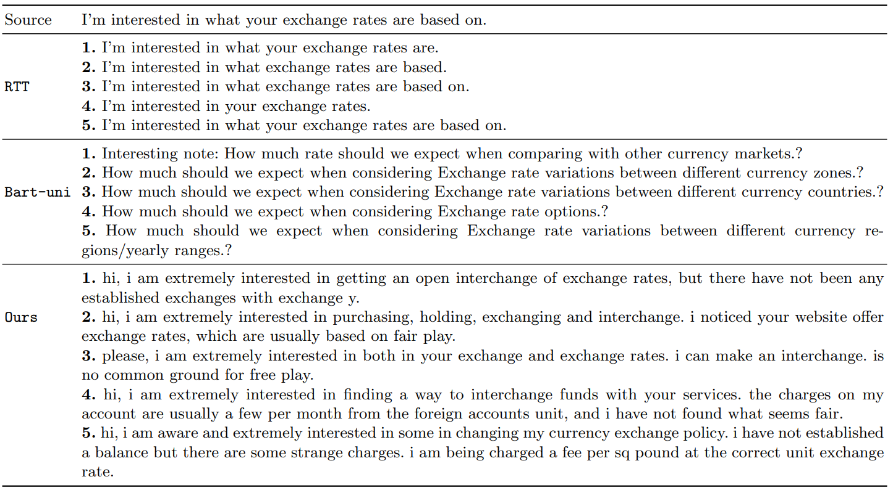
Results - qualitative
<numéro>
Notes:
- aug/ T: conservative - minor edits
- seq2seq: more creative - start to add some info, still see where the beam search (// gen process) diverge
- from keywords: very creative, for better and for worse

Slide 19
Results - qualitative
<numéro>
- aug/ T: conservative - minor edits
- seq2seq: more creative - start to add some info, still see where the beam search (// gen process) diverge
- from keywords: very creative, for better and for worse

Slide 20
Perspectives
<numéro>
Limitations
→ involved pipeline
→ length mismatch
Strengths
→ very extensible (+ more interpretable) generation
Conclusion
→ insertion models offers more flexibility and control, but harder to train
→ NAR is viable for data augmentation on low-resource fine classif
→ exciting future for semi-AR and NAR methods
open new tasks + can benefit e.g. interactive writing
(change style/length of a span w/ context and better Pareto)
}
→ can opt for an end-to-end cross-attention model
→ or can control with a latent/input variable

Slide 21
References
<numéro>
[Yang 2019] Zhilin Yang, Zihang Dai, Yiming Yang, Jaime Carbonell, Ruslan Salakhutdinov, Quoc V. Le:
XLNet: Generalized Autoregressive Pretraining for Language Understanding
In: Proceedings of Advances in Neural Information Processing Systems 32. NeurIPS (2019)
[Gu 2017] Jiatao Gu, James Bradbury, Caiming Xiong, Victor O.K. Li, Richard Socher:
Non-Autoregressive Neural Machine Translation
In: Proceedings of International Conference on Learning Representations. ICLR (2018)
[Gu 2022] Jiatao Gu, Xu Tan:
Non-Autoregressive Sequence Generation
Tutorial at ACL 2022, May 22, 2022, https://github.com/NAR-tutorial/acl2022
[Stern 2018] Mitchell Stern, William Chan, Jamie Kiros, and Jakob Uszkoreit:
Insertion Transformer: Flexible Sequence Generation via Insertion Operations
In: Proceedings of International Conference on Machine Learning. ICML (2018)
[Zhang 2020] Yizhe Zhang, Guoyin Wang, Chunyuan Li, Zhe Gan, Chris Brockett, Bill Dolan:
POINTER: Constrained progressive text generation via insertion-based generative pre-training.
In: Proceedings of EMNLP. pp. 8649–8670. ACL (2020)
[Vinyals 2015] Oriol Vinyals, Meire Fortunato, N. Jaitly:
Pointer Networks
In: In Advances in Neural Information Processing Systems, Vol. 28. NeurIPS (2015)

Slide 22
Thank you for your attention!
Any question?
https://github.com/RaphaelChevasson/DPIM
raphael.chevasson@univ-st-etienne.fr

Slide 23
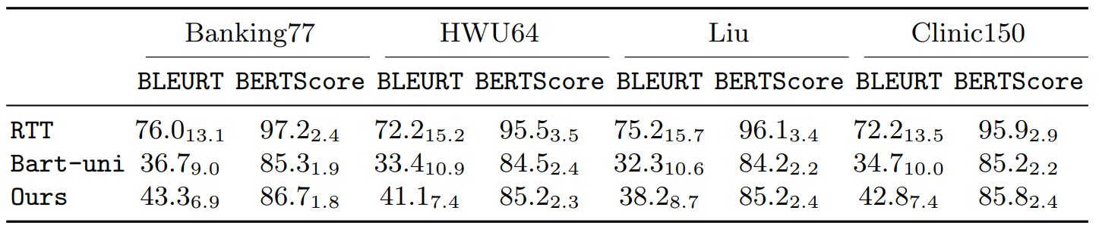
Results - quantitative
<numéro>
→ Additional results – overall quality:

