Slide 1
Dimensionality Reduction

Slide 2
Why Dimensionality Reduction?
Data compression
Noise Removal
Feature Extraction

Slide 3
Principal component analysis
Linear mapping of data to a lower-dimensional space such that the variance of the data in the lower-dimensional space is maximized.
In practice, for a given data matrix X, the covariance data matrix is constructed: X^{T}X
Eigen vectors of X^{T}X correspond to the largest eigen-values are the principal components
In MatLab: [V,D] = eig(X^{T}X)
Using the principal components, we can approximate the data.
Notes:
the principal components) can now be used to reconstruct a large fraction of the variance of the original data.

Slide 4
Finding the Principle Components: Singular Value Decomposition
Factor matrix X into X = USV^{T}, where columns of U and V are orthonormal and S is diagonal.
Given eigen-decomposition of the covariance of X: [W,D] = eig(X^{T}X)
One can verify that,
W = V

Slide 5
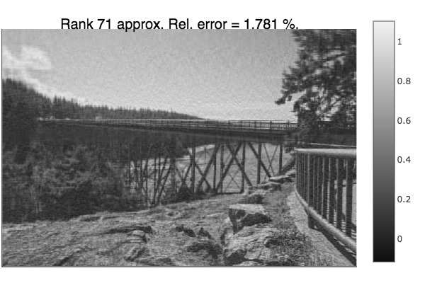

Example – Image Compression

Slide 6
Exercise – PCA Pets
PCApets.m

