Slide 1
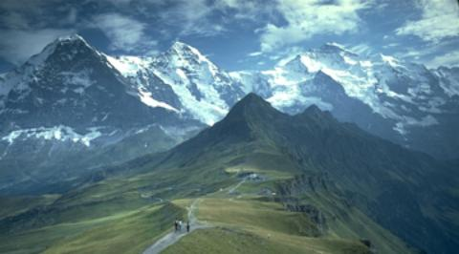


HATI
+
Hiking
and
Transportation
in Innsbruck

Slide 2
Overview
Team Introduction
Project Description
Identified Services
Technologies
Expected Results

Slide 3
Team Introduction
Bernhard Fritz
Thibault Gerrier
Raphael Gruber
Philipp Häusle
Mario Zelger

Slide 4
Project Description
Touristic service packaging
Hiking tours and public transport in Innsbruck
„All In One“ - Application
Possible hiking routes with public transport connection
Recommendations based on weather forecasts and time limits

Slide 5
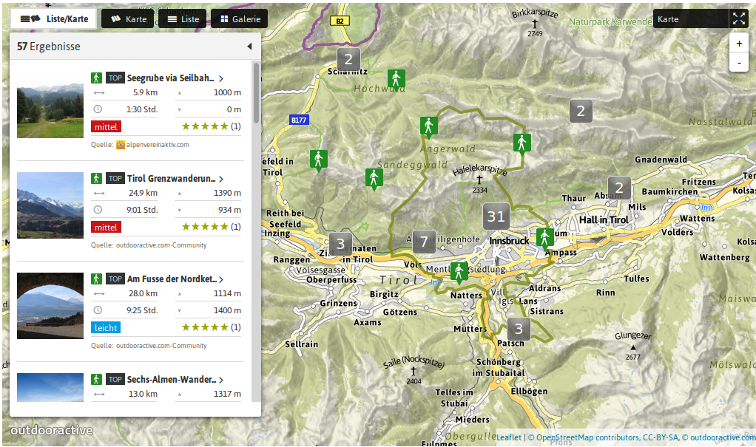
Identified Services (1)
http://www.outdooractive.com
Access through API calls

Slide 6
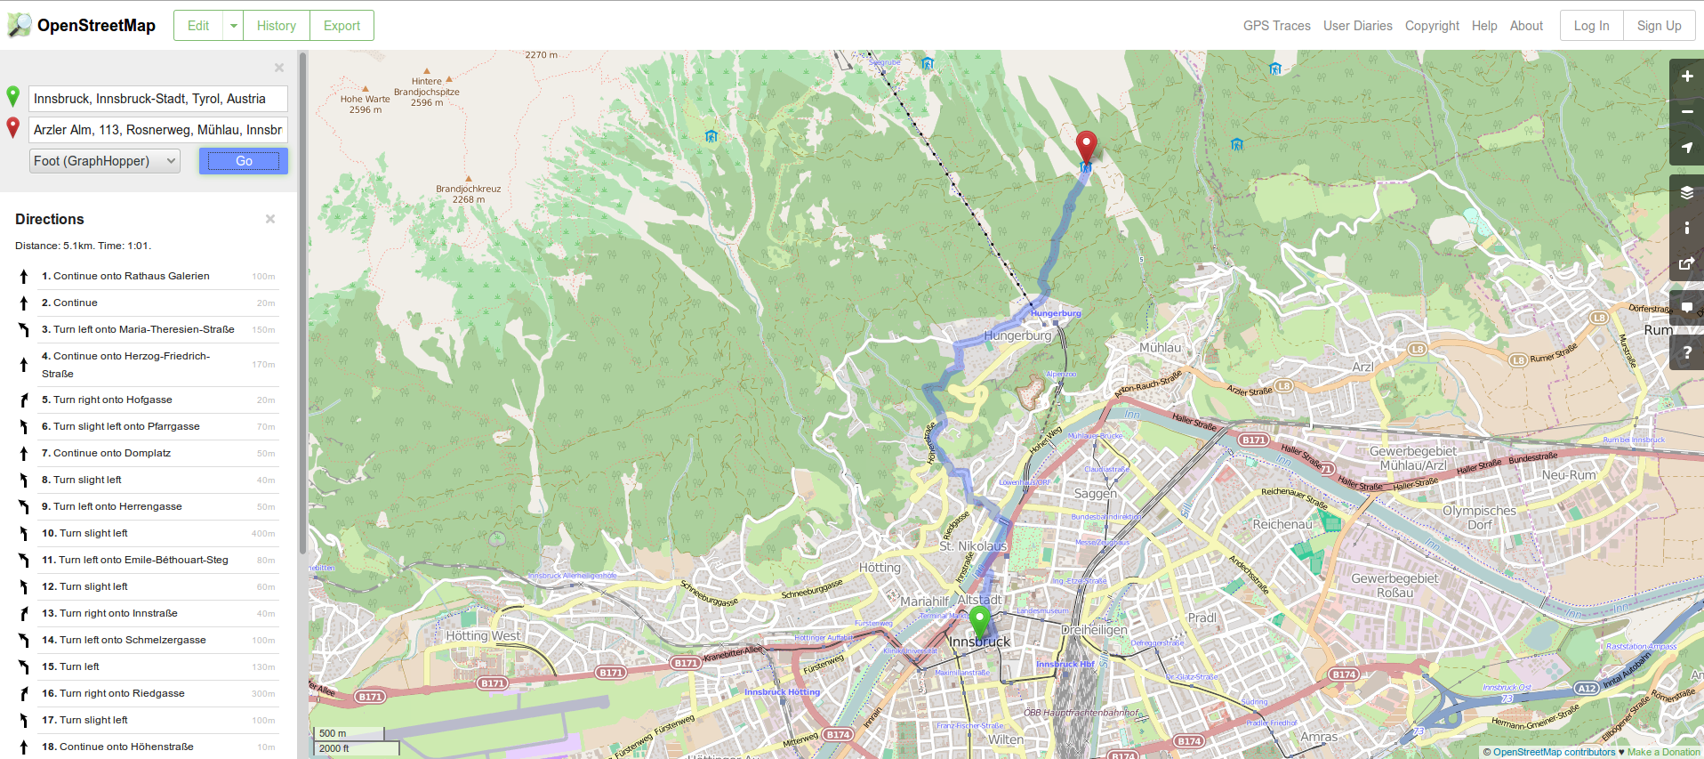
Identified Services (2)
http://www.openstreetmap.org
Access through API calls

Slide 7
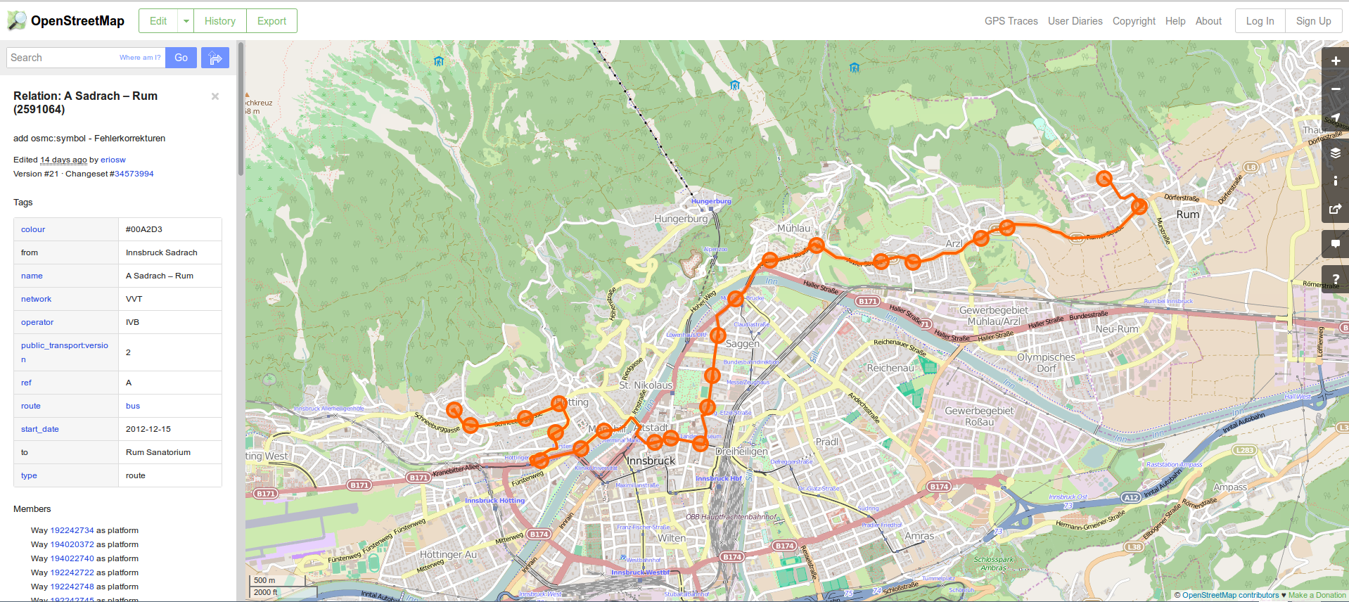
Identified Services (3)
http://www.openstreetmap.org/relation/2591064
Access through API calls

Slide 8
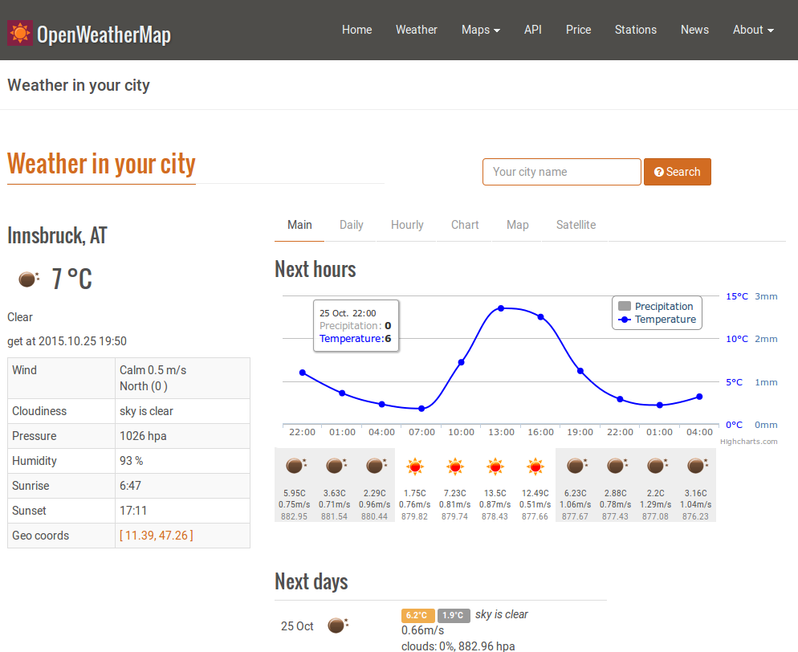
Identified Services (4)
http://www.openweathermap.org/city/2775220
Access through API calls

Slide 9










Technologies
Bootstrap
JavaScript
  Node.js
  ExpressJS
  Jade
MongoDB
Atom
Eclipse
GitHub
Slack

Slide 10
Expected Results
Hiking routes and public transport services composition
Easy way to plan hiking tours starting in Innsbruck
Tour recommendations for tourists based on weather forecasts and individual time limits
Get to know the beauty of nature around Innsbruck

Slide 11
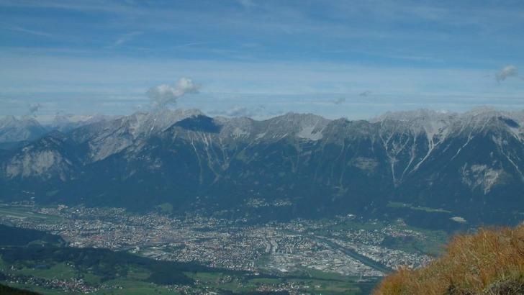
Thank You
Source: http://www.outdooractive.com

