Slide 1
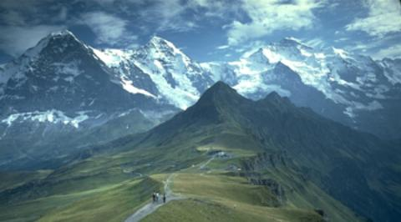


HATI
+
Hiking
and
Transportation
in Innsbruck

Slide 2

Progress
Now using leaflet instead of OpenLayers
Bus stop graph is now only generated once per server start instead of generating a new graph at every request
Calculate routes between bus stops with yournavigation API
Draw bus stops and bus route

Slide 3
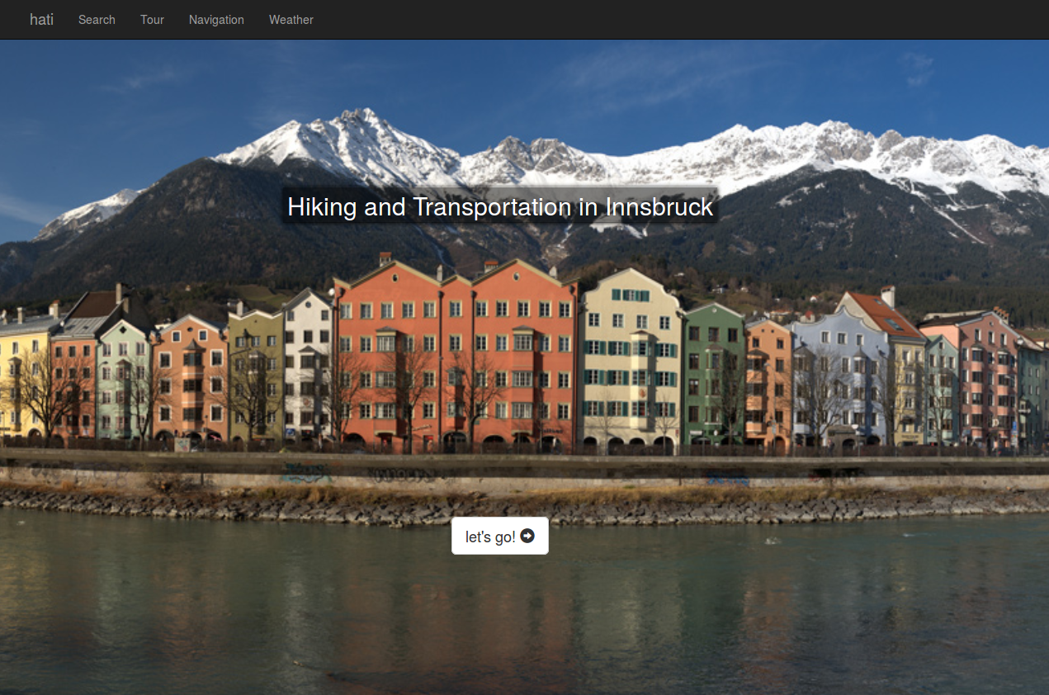
Demo

Slide 4
Next steps
Draw bus line info
Prettify weather mixin
Deployment on OpenShift

Slide 5
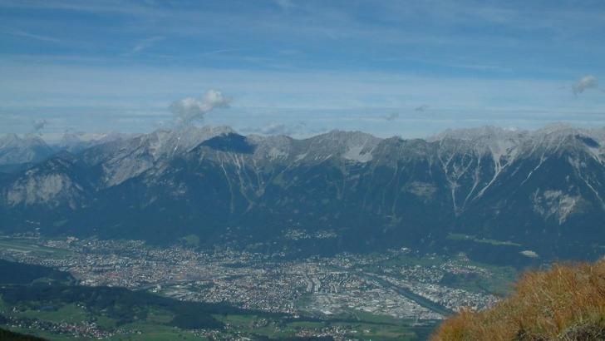
Thank You
Source: http://www.outdooractive.com

