Slide 1
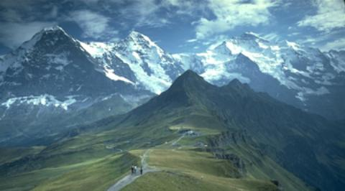


HATI
+
Hiking
and
Transportation
in Innsbruck

Slide 2
Project Description
Touristic service packaging
Hiking tours and public transport in Innsbruck
„All In One“ - Application
Possible hiking routes with public transport connection
Recommendations based on weather forecasts and time limits

Slide 3
Progress
Set up GitHub, Slack, Trello
Test outdooractive and OpenStreetMap APIs
Implement example requests for outdooractive and OpenStreetMap
Set up example Node.js server

Slide 4
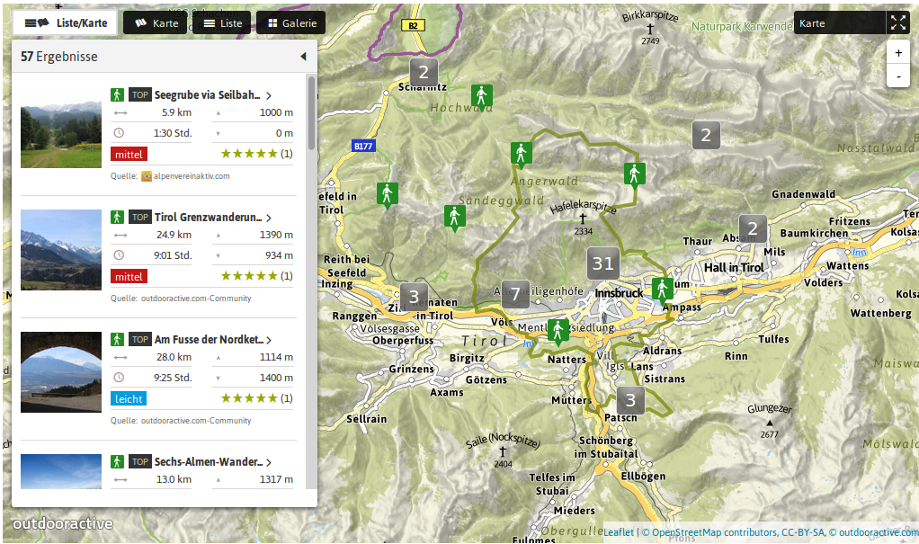
Services (1)
http://www.outdooractive.com
Access through API calls

Slide 5
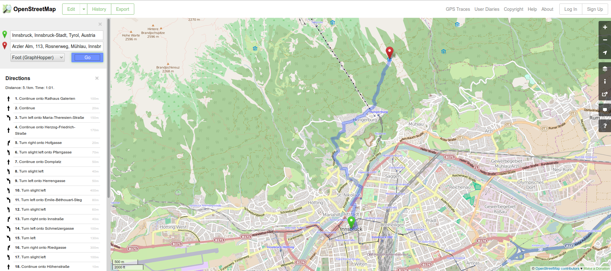
Services (2)
http://www.openstreetmap.org
Access through API calls

Slide 6
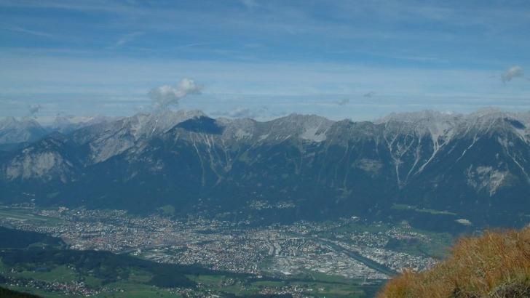
Thank You
Source: http://www.outdooractive.com

