Slide 1
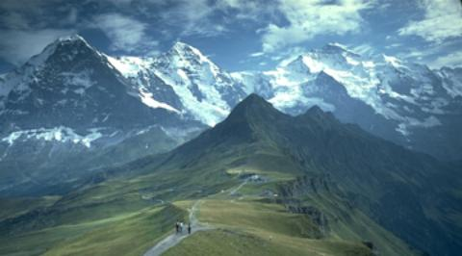


HATI
+
Hiking
and
Transportation
in Innsbruck

Slide 2
Overview
Team Introduction
Project Description
Included Services
Technologies
Expected Results
Final Results
Demo

Slide 3
Team Introduction
Bernhard Fritz
Thibault Gerrier
Raphael Gruber
Philipp Häusle
Mario Zelger

Slide 4
Project Description
Touristic service packaging
Hiking tours and public transport in Innsbruck
„All In One“ - Application
Possible hiking routes with public transport connection
Weather forecasts for the next 5 days in the area of the selected hiking route

Slide 5
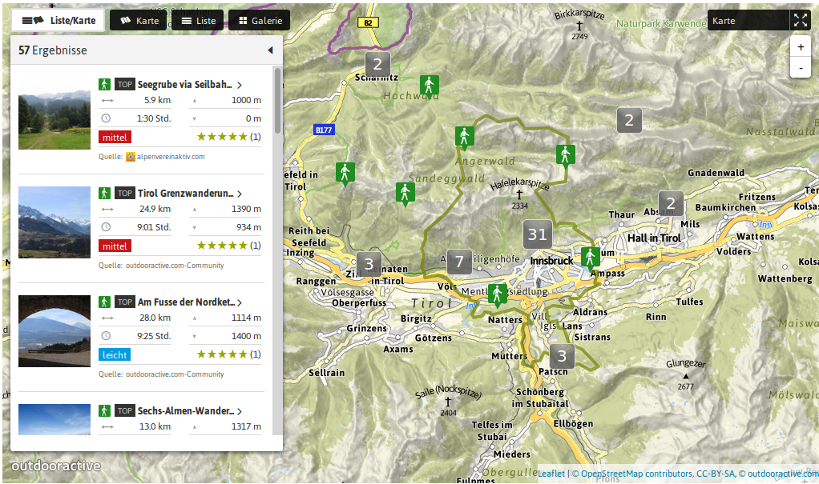
Included Services (1)
http://www.outdooractive.com
Access through API calls

Slide 6
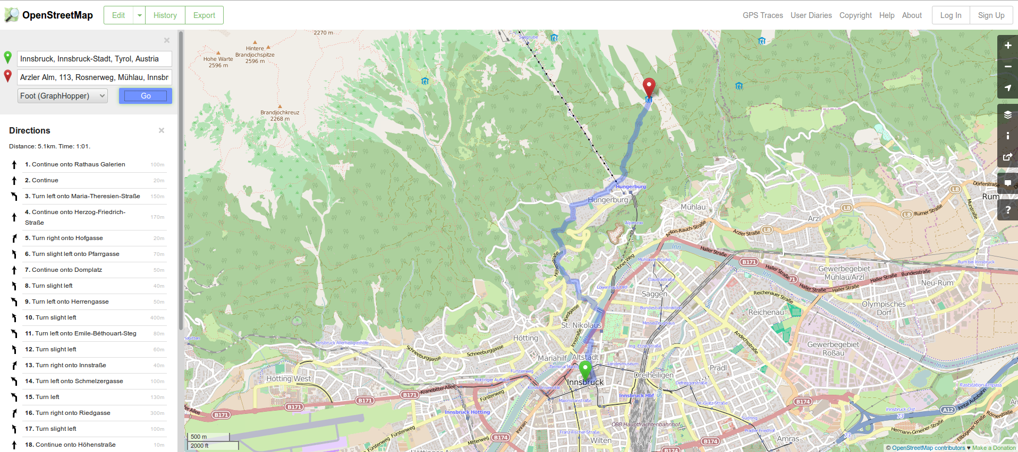
Included Services (2)
http://www.openstreetmap.org
Access through API calls

Slide 7
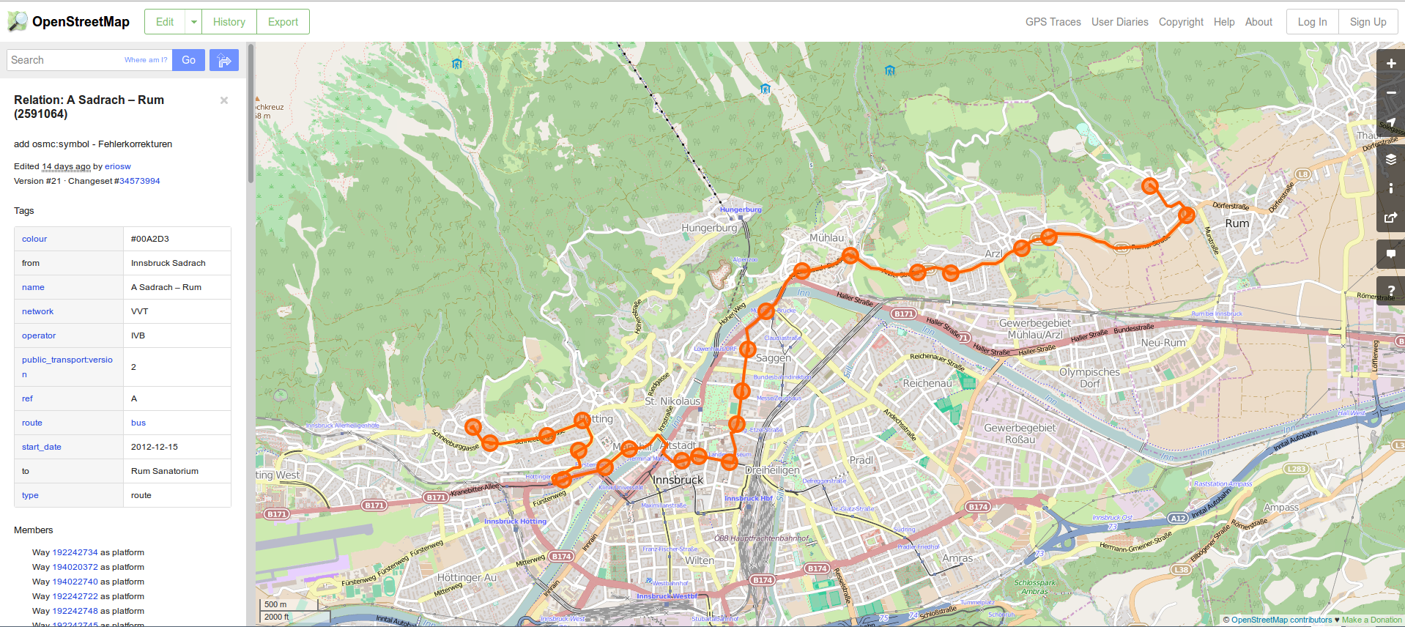
Included Services (3)
http://www.openstreetmap.org/relation/2591064
Access through API calls

Slide 8
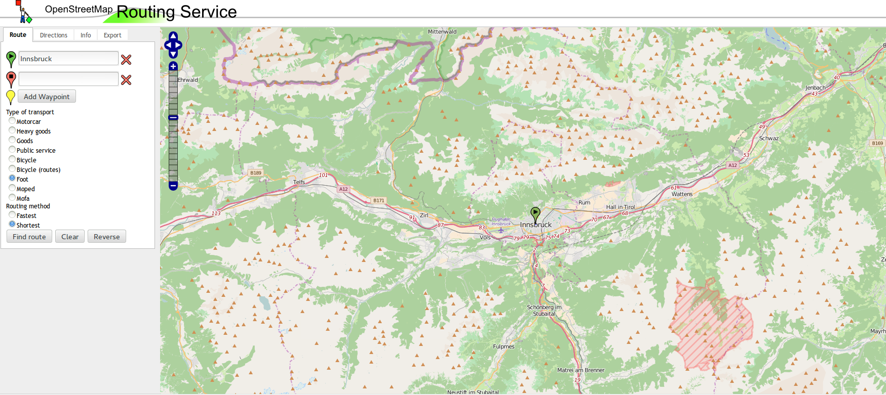
Included Services (4)
http://www.yournavigation.org
Access through API calls

Slide 9
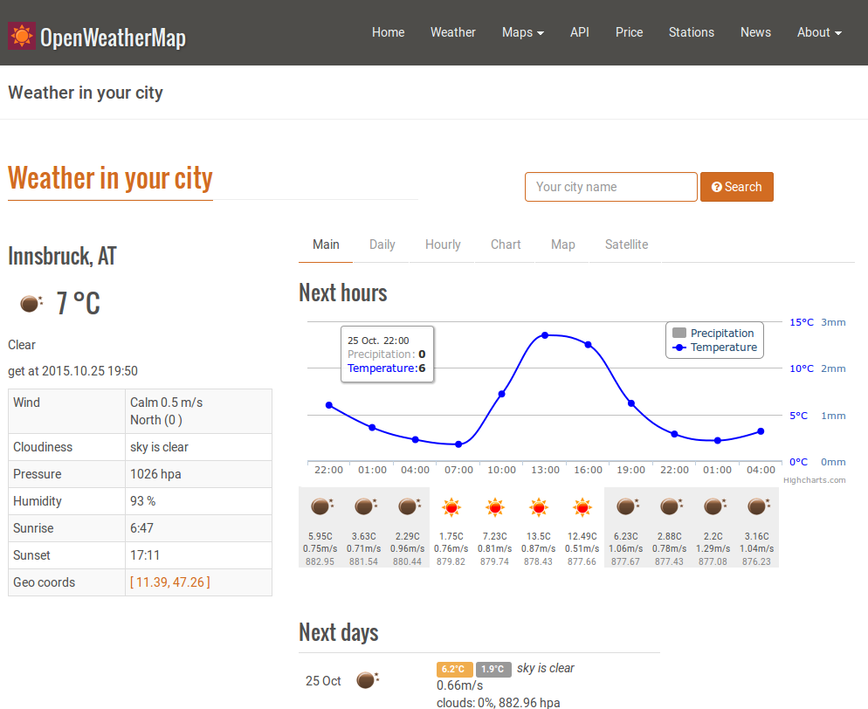
Included Services (5)
http://www.openweathermap.org/city/2775220
Access through API calls

Slide 10










Technologies
JavaScript
  Node.js
  ExpressJS
  Jade
Bootstrap
Atom
GitHub
Slack
Trello
Heroku

Slide 11
Expected Results
Hiking routes and public transport services composition
Easy way to plan hiking tours starting in Innsbruck
Weather forecasts in the area of the route to plan the trip accordingly
Get to know the beauty of nature around Innsbruck

Slide 12

Final Results
Hiking routes and public transport services composition
Easy way to plan hiking tours starting in Innsbruck
Weather forecasts in the area of the route to plan the trip accordingly
Get to know the beauty of nature around Innsbruck

Slide 13
Final Results
Hiking routes and public transport services composition
Easy way to plan hiking tours starting in Innsbruck
Weather forecasts in the area of the route to plan the trip accordingly
Get to know the beauty of nature around Innsbruck

Slide 14
Final Results
Hiking routes and public transport services composition
Easy way to plan hiking tours starting in Innsbruck
Weather forecasts in the area of the route to plan the trip accordingly
Get to know the beauty of nature around Innsbruck

Slide 15

Final Results
Hiking routes and public transport services composition
Easy way to plan hiking tours starting in Innsbruck
Weather forecasts in the area of the route to plan the trip accordingly
Get to know the beauty of nature around Innsbruck

Slide 16
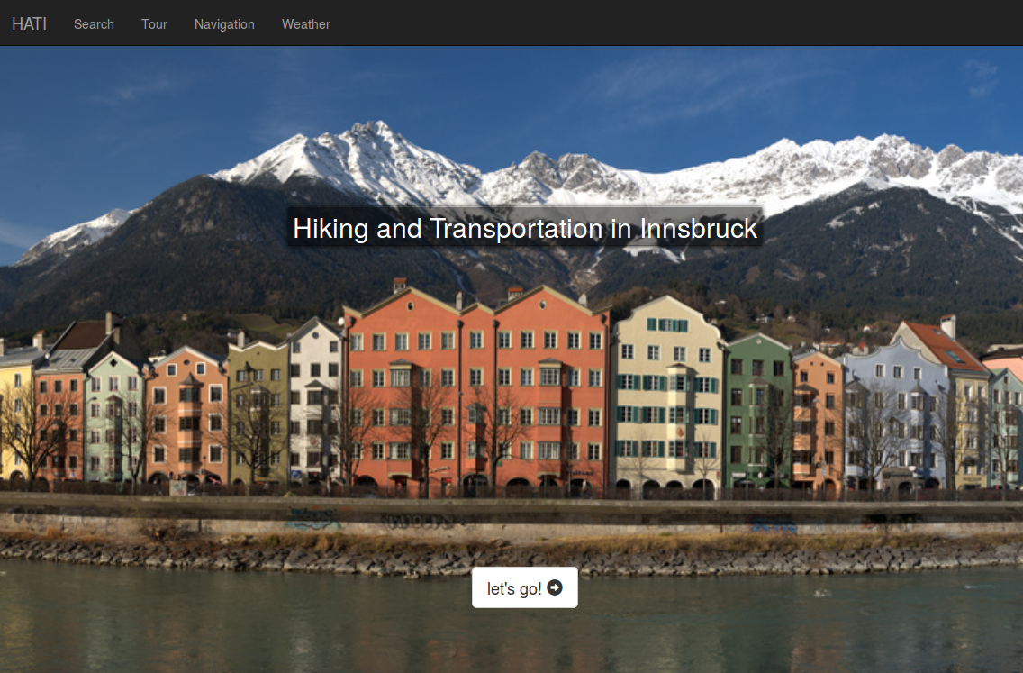
Demo

Slide 17
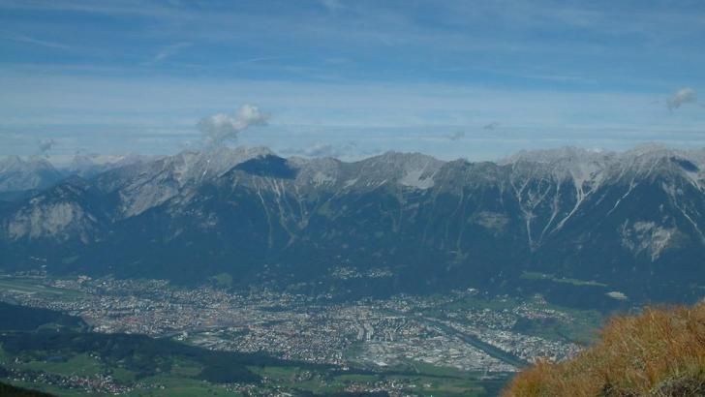
Thank You
http://hatiapp.herokuapp.com
Source: http://www.outdooractive.com

