Slide 1
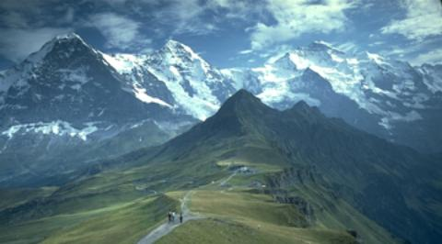


HATI
+
Hiking
and
Transportation
in Innsbruck

Slide 2
Progress
Set up Node.js server
Add example OpenStreetMap
Implement tour search with outdooractive
Implement single tour design example
Implement line drawing on map

Slide 3
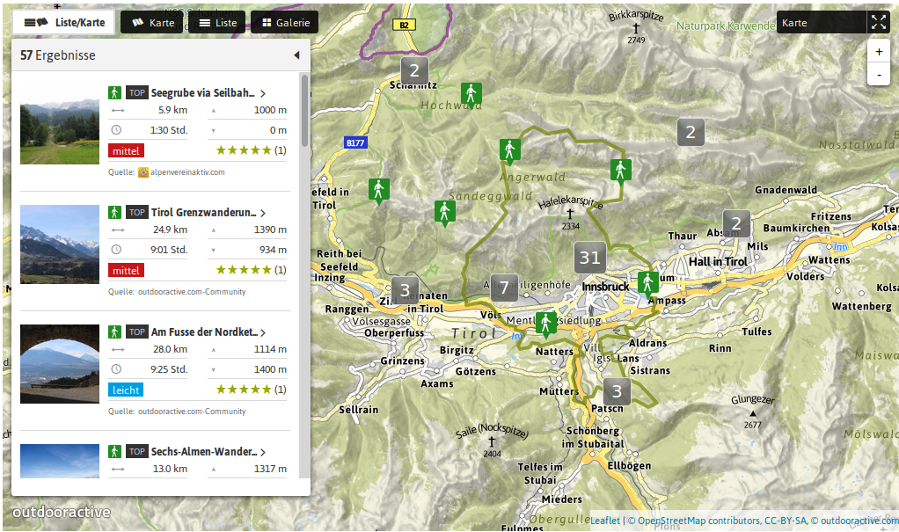
Services (1)
http://www.outdooractive.com
Access through API calls

Slide 4
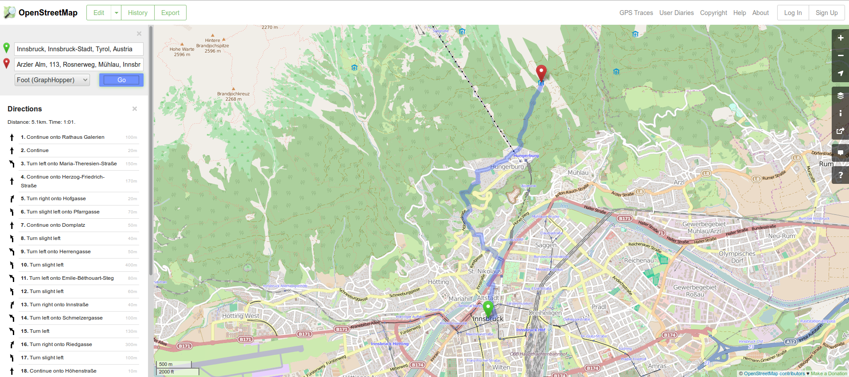
Services (2)
http://www.openstreetmap.org
Access through API calls

Slide 5
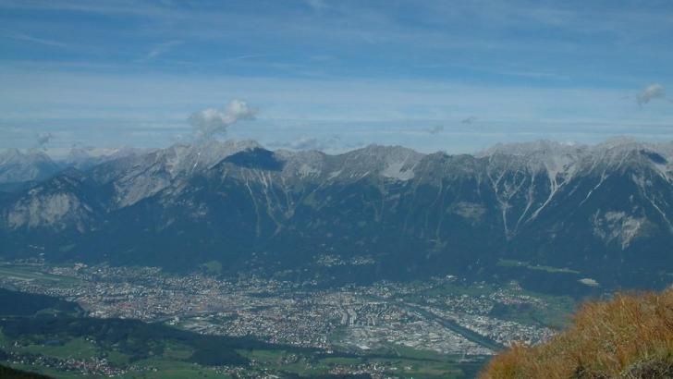
Thank You
Source: http://www.outdooractive.com

