Slide 1
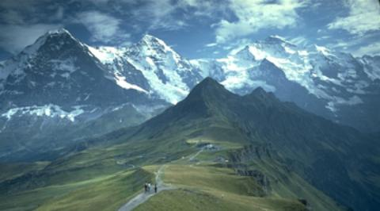


HATI
+
Hiking
and
Transportation
in Innsbruck

Slide 2

Progress
Start with public transport graphs
Combine user location with route starting point
Implement weather functions

Slide 3
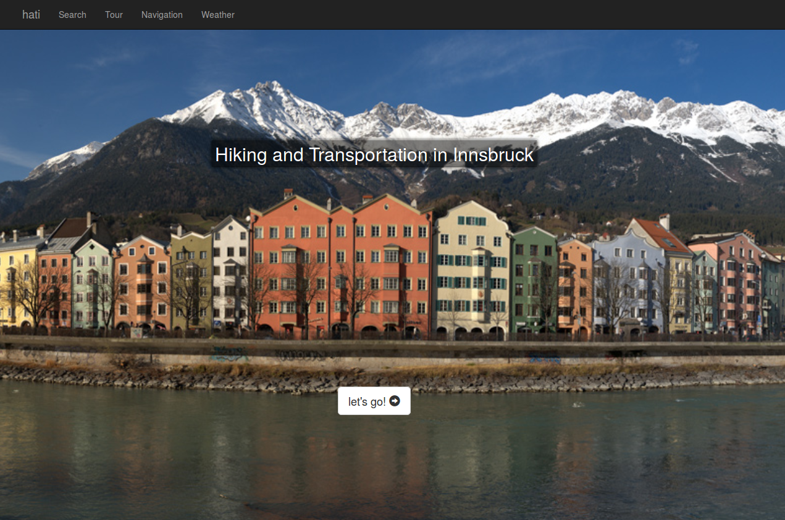
Demo

Slide 4
Next steps
Combine public transport graph with route planning

Slide 5
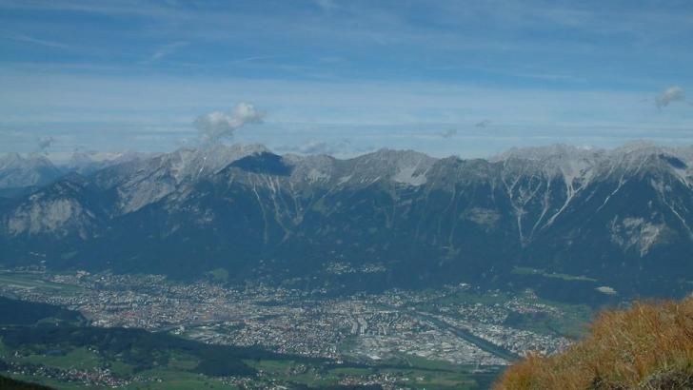
Thank You
Source: http://www.outdooractive.com

