Slide 1

Analysis of Government Debt and Revenue Dynamics: Trends, Correlations, and Sustainability Challenges with Microsoft Excel
DATA ANALYST RAPHAEL ITOTIA

Slide 2
Table of Content
Problem Statement ………………………………………….. 1
Dataset description …………………………………………… 2
Exploratory Data Analysis
Descriptive Analysis ……………………………… 3
Trend Analysis ……………………………………… 4
Grants Dependency Analysis ……………….. 5
Correlation Analysis …………………………….. 6
Debt Sustainability Analysis
Debt-to-revenue Ratio ……………. 7
Year-on-Year Growth Rate ………. 8
Critical periods ……………………….. 9 - 10
Conclusion ………………………………………………………….. 11
Recommendations ……………………………………………… 12 - 14

Slide 3

Problem Statement
Challenge: There is need to understand the relationship between Government Debt and Revenue over time.
Data: We have a dataset that has details about Kenya’s Revenue, External Grants, and Domestic and External Debt.
Objective: To analyze our data to uncover trends and relationships between Kenya’s revenue and debts with an aim of providing insights into the fiscal health of Kenya.
1

Slide 4
Dataset Description
I gathered some data from the Central Bank of Kenya Annual reports and financial statements.
Our data has 15 records/rows with 5 attributes/columns;
Fiscal Year: From 2008/2009 to 2022/2023( CBK has not yet released 2023/2024 Annual report)
Revenue: Total government revenue (in billions of KSh).
External Grants: Total grants received (in billions of KSh).
Internal Debt: Total internal debt (in billions of KSh).
External Debt: Total external debt (in billions of KSh).
2

Slide 5

Data Analysis with Microsoft Excel

Slide 6
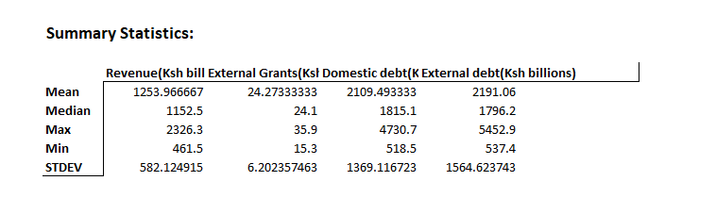
Descriptive Analysis
Kenya portrays a significant growth in both domestic and external debt, with averages around Ksh 2110 billion and Ksh 2191 billion, respectively.
Revenue has also increased, averaging Ksh 1253.97 billion, but the high standard deviations in both debt and revenue indicate considerable fluctuations over time.
The growing debt relative to revenue suggests potential challenges in maintaining debt sustainability, especially if revenue growth is not consistent or if borrowing continues to rise sharply.
3

Slide 7
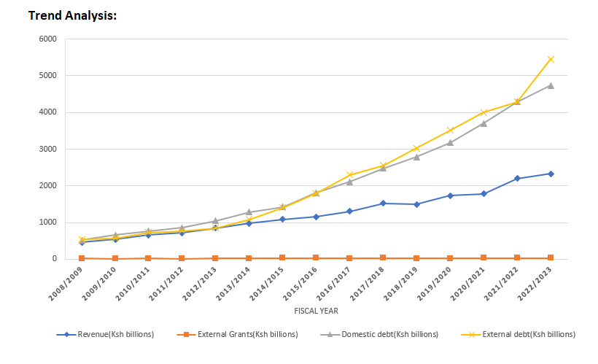
Trend Analysis
Kenya's domestic and external debts have sharply increased over time, particularly since 2014/2015, with external debt rising the most. In contrast, revenue growth has been more gradual and modest. External grants remain minimal throughout the period.
The widening gap between debt and revenue suggests growing concerns about debt sustainability.
4

Slide 8
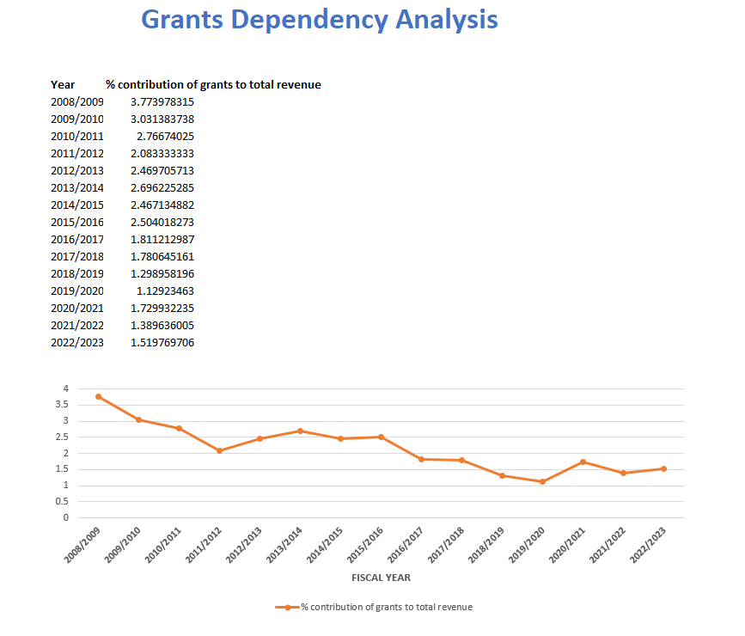
Grants Dependency Analysis
There is a declining trend in the percentage contribution of grants to Kenya's total revenue over time, dropping from around 3.77% in 2008/2009 to about 1.52% in 2022/2023.
This indicates a reduced reliance on external grants as a revenue source.
5

Slide 9
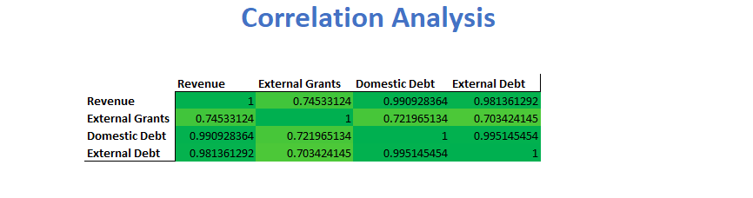
Correlation Analysis
There are strong positive correlations between revenue, domestic debt, and external debt, with coefficients above 0.98, indicating that as revenue increases, both types of debt tend to increase as well.
External grants have a moderate positive correlation with revenue (0.75) and a slightly lower correlation with both domestic and external debt. This suggests that while grants contribute to revenue, they are less closely linked to the increases in debt compared to revenue itself.
Overall, the high correlations highlight that Kenya's revenue and debt levels have been rising together, potentially reflecting reliance on borrowing as revenues grow.
6

Slide 10
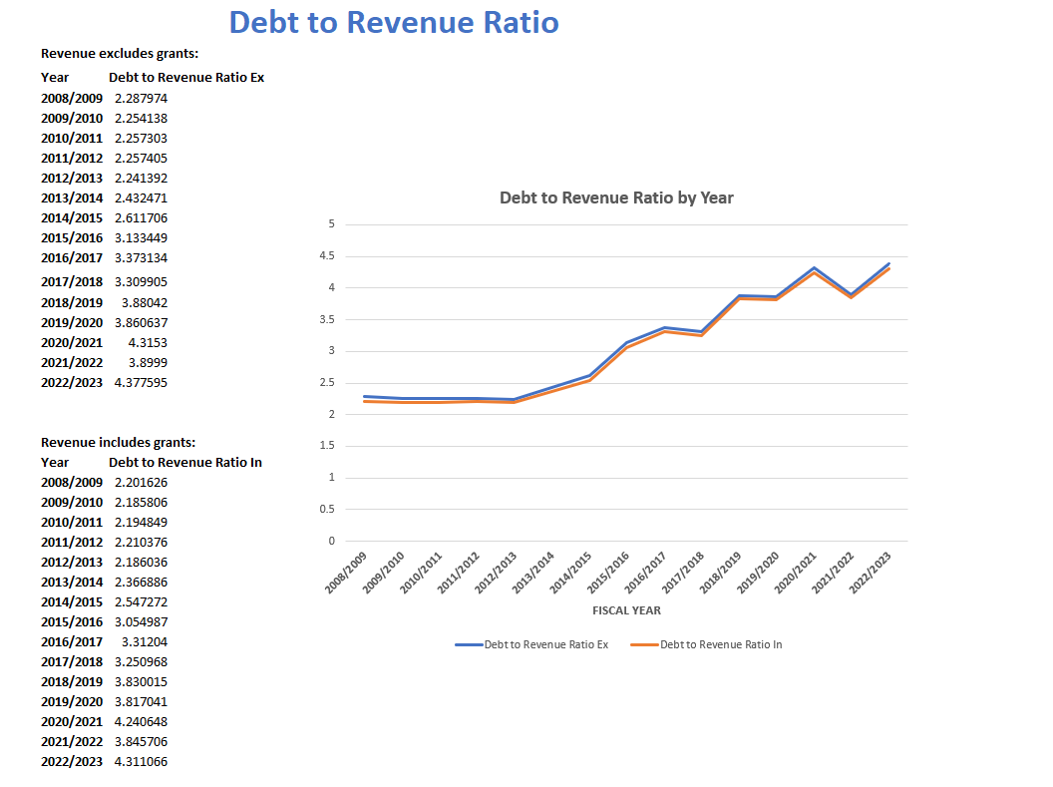
Debt Sustainability Analysis
a. Debt-to-Revenue Ratio
The two lines are almost identical, indicating that grants have a minimal effect on the overall debt burden relative to revenue.
Whether grants are included or excluded, the trend shows a significant increase in the debt-to-revenue ratio over time, reflecting growing fiscal pressure.
This suggests that Kenya's debt sustainability concerns are largely independent of grants, and the primary focus should be on managing debt relative to internally generated revenue.
7

Slide 11
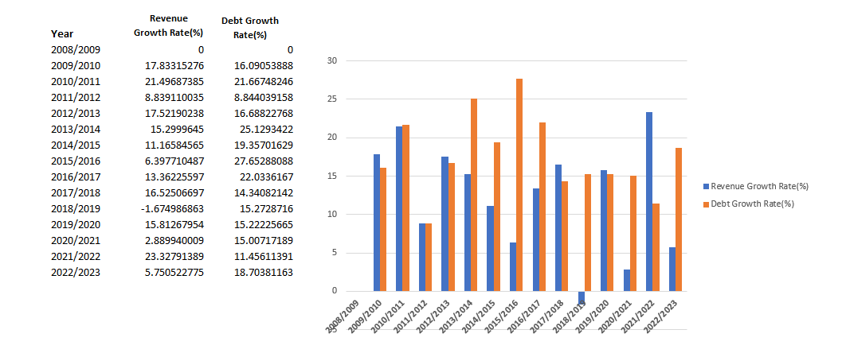
Debt Sustainability Analysis
b. Year-on-Year Growth Rate
It’s clear that debt has generally been growing at a faster pace compared to revenue over the years, with several years where debt growth significantly outpaced revenue growth (e.g., 2015/2016 and 2019/2020).
Notably, in 2018/2019, revenue growth was negative, while debt growth continued, indicating increasing reliance on borrowing even when revenue declined.
This suggests a widening gap between revenue and debt, potentially signaling increasing fiscal pressures. The few years where revenue growth exceeded debt growth are exceptions rather than the norm.
8

Slide 12
Debt Sustainability Analysis
c. Critical Periods
From the Debt-to-Revenue Ratio chart, the following periods show notable spikes in the ratio:
2015/2016: There is a significant increase in the Debt-to-Revenue Ratio, moving from approximately 2.6 to 3.13 (excluding grants).
2018/2019: The ratio continues to rise, reaching around 3.88 (excluding grants).
2020/2021: Another spike is observed where the ratio exceeds 4, reaching 4.31 (excluding grants).
These periods indicate times when the growth in debt substantially outpaced revenue, leading to an increased debt burden relative to the revenue generated.
9

Slide 13
Debt Sustainability Analysis
From the Growth rate chart,
2015/2016: Debt Growth Rate was at 27.65% while Revenue Growth Rate at 6.40%. This shows a substantial divergence, with debt growth far exceeding revenue growth by over 20%. This could indicate heavy borrowing during a period of relatively slow revenue increase.
2018/2019: Debt Growth Rate was at 15.27% while Revenue Growth Rate at -1.67%. Revenue actually declined this year, while debt growth was still substantial. This creates a critical financial imbalance, suggesting that borrowing continued despite a drop in revenue.
10

Slide 14

Conclusion
The analysis of the relationship between government debt and revenue over the years has provided several critical insights:
Increasing Debt-to-Revenue Ratio: The Debt-to-Revenue Ratio has shown an upward trend over the years, indicating that debt is growing at a faster pace than revenue.
Periods of Significant Debt Growth: Certain periods, notably 2015/2016 and 2019/2020, saw significant spikes in debt growth, especially compared to revenue growth. These spikes indicate times of fiscal stress where the government likely had to borrow heavily to deal with economic challenges.
Correlation Between Debt and Revenue: The correlation analysis revealed strong positive relationships between revenue and the two forms of debt (domestic and external). It indicates that revenue alone may not be sufficient to curb borrowing trends.
Impact of Grants: The analysis shows that including grants in revenue calculations does somewhat reduce the Debt-to-Revenue Ratio, but not significantly. It means that while grants provide some relief, they are not enough to counterbalance the overall rising debt levels.
11

Slide 15

Recommendations
a. Implement Fiscal Discipline:
The government should implement stronger fiscal policies to control debt growth, especially during periods of slow revenue growth. Prioritizing expenditure and reducing reliance on debt to finance budgets will help maintain a sustainable debt-to-revenue ratio.
b. Diversify Revenue Sources:
To mitigate the risk of declining revenue growth, the government should focus on diversifying its revenue sources. This could involve tax reforms, improving tax collection efficiency, or finding new streams of income like public-private partnerships.
Revenue
12

Slide 16
Recommendations
c. Debt Management Strategy:
A comprehensive debt management strategy should be put in place, focusing on reducing the reliance on external debt, which may be more volatile. Domestic debt can be safer but must be managed to avoid crowding out private investment.
d. Monitor and Adjust Debt Levels:
Regular monitoring of the debt-to-revenue ratio and adjusting borrowing levels accordingly is essential. During periods of economic downturn or revenue shortfall, borrowing should be minimized, and alternative funding strategies should be explored.
Revenue
13

Slide 17


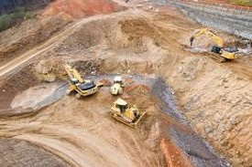





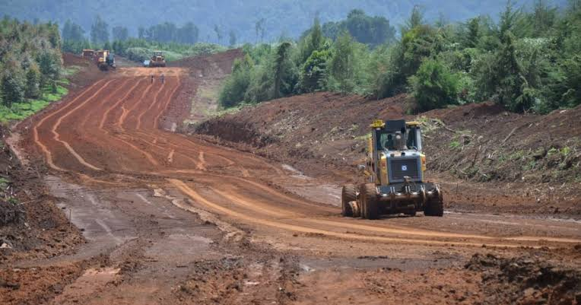
Recommendations
e. Increase Efficiency in Public Spending:
Ensuring that borrowed funds are used effectively and contribute to projects that stimulate economic growth will be crucial. This includes investing in infrastructure, healthcare, education, and other sectors that can yield long-term economic benefits.
By implementing these recommendations, the government can work towards a more sustainable fiscal position, reducing the risks associated with high debt levels relative to revenue.
14

Slide 18
THANK YOU
raphaelitotia@gmail.com
+254 726 371 657
Nairobi, Kenya

