Slide 1

Prologin
French programming contest

Slide 2
Contents
What ? Who ? Where ?
Selections
Semifinals
Final
2011 Final

Slide 3


What ?
Algorithmic/AI
French-speaking students
20 years (or less)
EPITA & l’ Ecole Polytechique
Free
Since 1995

Slide 4
Selections
October to December
Online problems
Input: ATT isoleucine TCC serine GCC alanine ATTGCCTCC
Output: isoleucine alanine serine

Slide 5
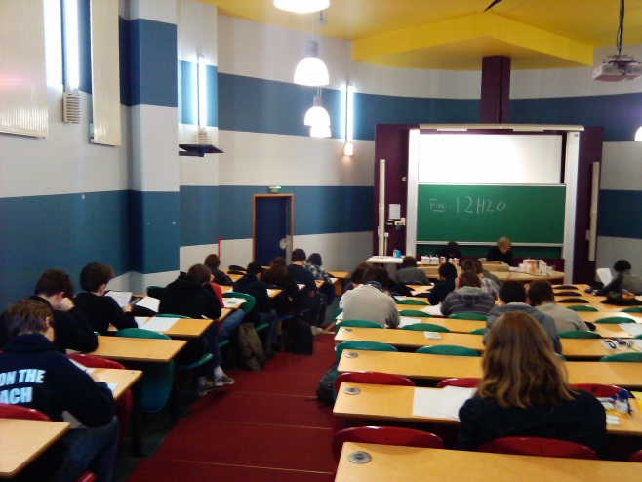
Semifinals
300 contenders
January to March
Paris, Bordeaux, Grenoble, Lille …
Paper
Interview
Computer

Slide 6
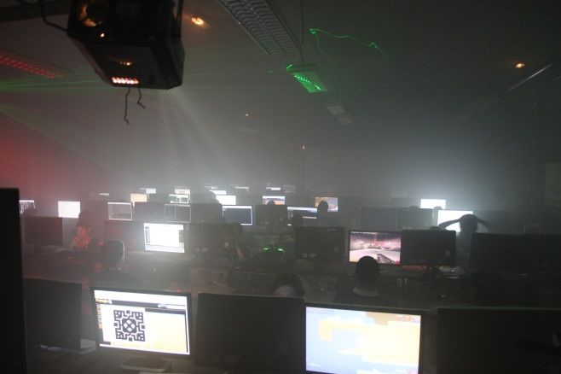
Final
100 competitors
EPITA, Paris
WE of May 1
IA for a strategy game
36h
Matches between players “bots”

Slide 7
2011 final
Game, rule and strategies

Slide 8
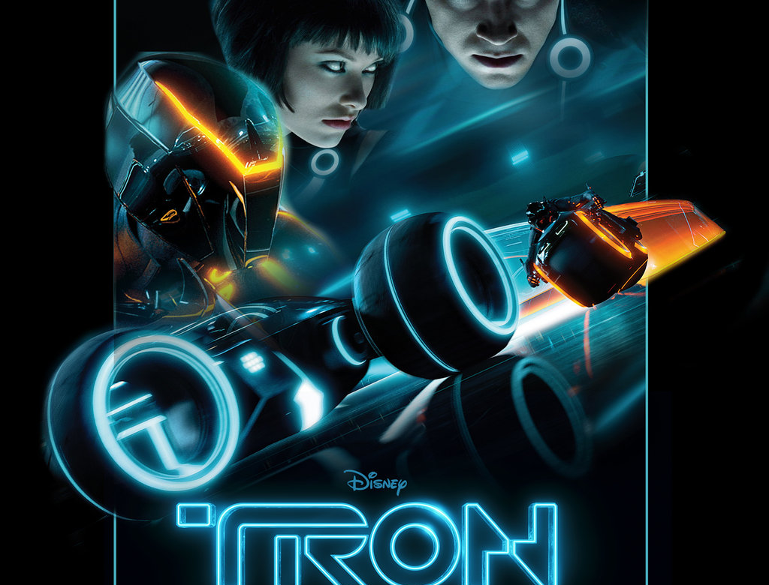
The game
Tron Legacy

Slide 9
Basics
2 players
Turn-based strategy game

Slide 10
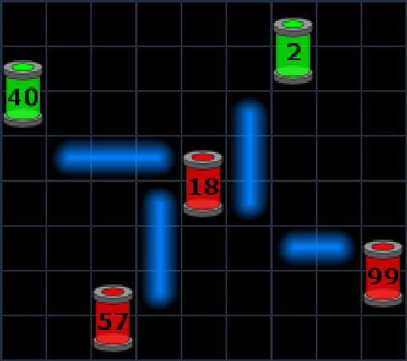
Rules
Minimum (Sum generators, Sum consumers)
Here Minimum (42, 174) = 42

Slide 11
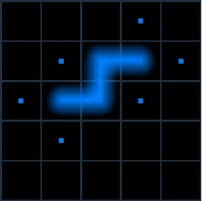
Moves
Head and tail only
Max. 3 moves per round (Move Points)

Slide 12
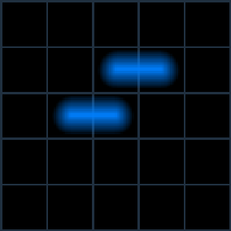
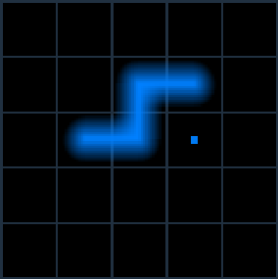
Division
=>
Division costs 1 Move Point

Slide 13




Bonus
Cross point
Regeneration
Beam elongation
Add 4 Move Points

Slide 14
A simple strategy
Move to the closest generator/consumer
Divide if faster
Take bonus on the road
Enclose generators/consumers to trap the enemy

Slide 15




Languages
C++
Pascal
C#
Abstract
C
Close to the machine
In abstract languages, a lot of things are implicit

Slide 16
Programming Interface
Examples:
scores(#player)
move(pos1, pos2)
divide(pos1, pos2)
…

Slide 17
Conclusion

Slide 18
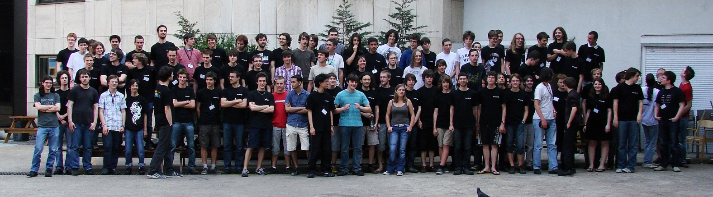
Conclusion
A lot of new friends
A lot of fun
Last year :’-(

Slide 19
The end

