Slide 1
Computability
Raphael Javaux – 16th November 2010

Slide 2
Introduction
Wait … Computability ?
Computability is the branch of mathematics which talks about algorithms
What an algorithm is ;
How to prove an algorithm ;
Does an algorithm can be computed by a physical machine ?
Initiated by Alan Turing (UK), Alan Church (USA) and Kurt Gödel (AT) during the late 1930s ;
First computers (after WWII) were created to validate these models.

Slide 3
Outline
Definition of an algorithm ;
How to prove an algorithm
Result of a simple equation ;
Proof of a simple algorithm.
Does an algorithm can be computed by a physical machine ?
I think it’s true …
… Just an evidence ;
So, no slides about that .

Slide 4
Definition of an algorithm
An algorithm is a list of well defined instructions for resolving a given logical problem.

Slide 5
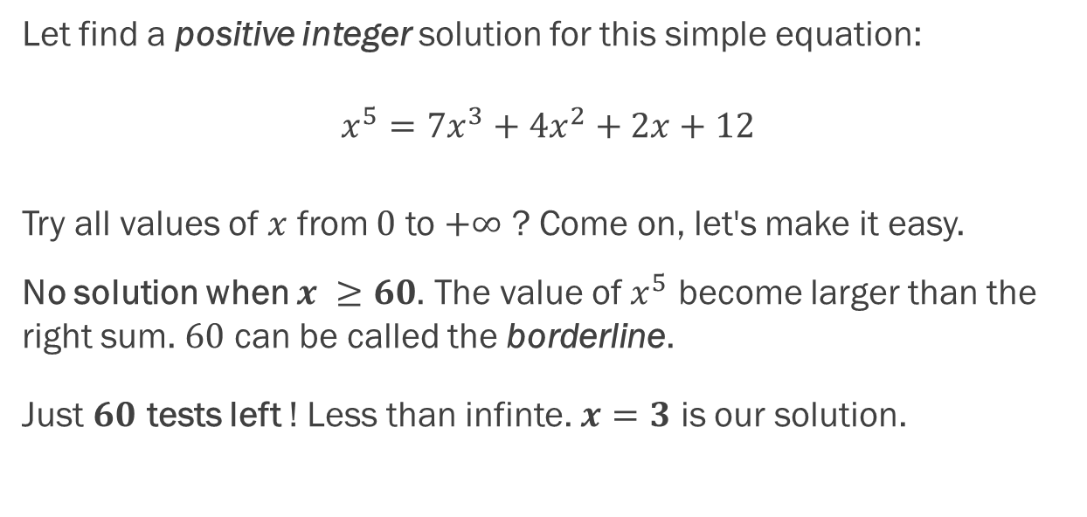
Resolve a simple equation
Let find a positive integer solution for this simple equation:
$$x^{5}=7x^{3}+{4x}^{2}+2x+12$$
Try all values of $x$ from $0$ to $+∞$ ? Come on, let's make it easy.
No solution when $x ≥60$. The value of $x^{5}$ become larger than the right sum. $60$ can be called the borderline.
Just $60$ tests left ! Less than infinte. $x=3$ is our solution.

Slide 6
Resolve a simple equation
The method is quite straightforward:
Limit the infinite range of tests by setting a borderline ;
Tests all values for the new range of tests.
No solution in the restricted range, no solution at all.

Slide 7
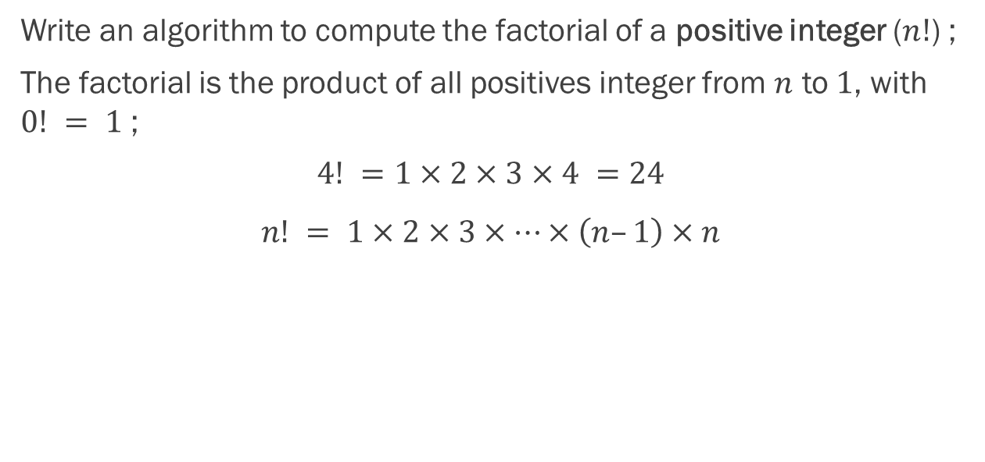
Proof of a simple algorithm
Write an algorithm to compute the factorial of a positive integer ($n!$) ;
The factorial is the product of all positives integer from $n$ to $1$, with $0! = 1$ ;
$$4! =1×2×3×4 =24$$
$$n! = 1×2×3×…×\left(n–1\right)×n$$

Slide 8
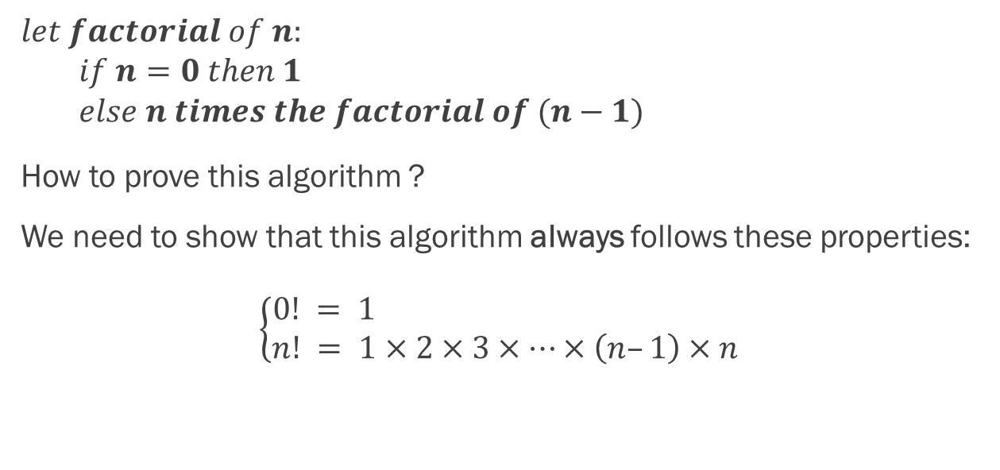
Proof of a simple algorithm
$$let factorial of n: \\ if n=0 then 1 \\ else n times the factorial of (n−1)$$
How to prove this algorithm ?
We need to show that this algorithm always follows these properties:
$$\left\{\begin{aligned}0! = 1 \\ n! = 1×2×3×…×\left(n–1\right)×n\end{aligned}\right.$$

Slide 9

Proof of a simple algorithm
So, test all values of $n$ from $0$ to $+∞$.
Wait, remember the equation ? Put something like a borderline to remove infinity !
The borderline is just $1$, because after $0$, the result is always the same computation ($n times the factorial of n−1$).

Slide 10
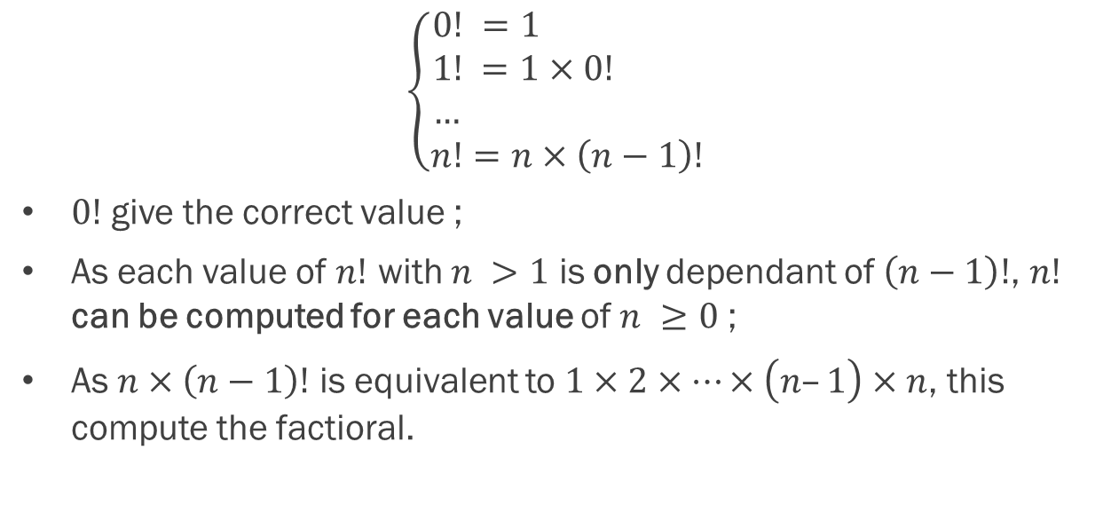
Proof of a simple algorithm
$$\left\{\begin{aligned}0! =1 \\ 1! =1×0! \\ … \\ n!=n×\left(n−1\right)!\end{aligned}\right.$$
$0!$ give the correct value ;
As each value of $n!$ with $n >1$ is only dependant of $\left(n−1\right)!$, $n!$ can be computed for each value of $n ≥0$ ;
As $n×\left(n−1\right)!$ is equivalent to $1×2×…×\left(n–1\right)×n$, this compute the factioral.

Slide 11
Conclusion
In the end …
You can put a borderline to limit an infinite range of tests ;
For the algorithm, this method is called « proof by induction ».
Thank you for listening.

