Slide 1
Disassembler
By: Nibble’s a crowd
Samuel Debesai, Lu Lu, Bryan Song

Slide 2
Program Overview
List of Instructions:
NOP
MOVE, MOVEQ, MOVEM, MOVEA
ADD, ADDA, ADDQ
SUB
LEA
AND, OR, NOT
LSL, LSR, ASL, ASR
ROL, ROR
Bcc(BGT,BLE,BEQ)
JSR,RTS
BRA
Effective Addressing Modes:
Data Register Direct
Address Register Direct
Address Register Indirect
Immediate Addressing
Address Register Indirect with Post-Incrementing
Address Register Indirect with Pre-decrementing
Absolute Long Address
Absolute Word Address
Program Description:
Our program acts as a disassembler in the easy68k program. It takes in a starting and ending address from user input through the console and will disassemble the instructions within the range given by the user and revert the code to its readable format.

Slide 3
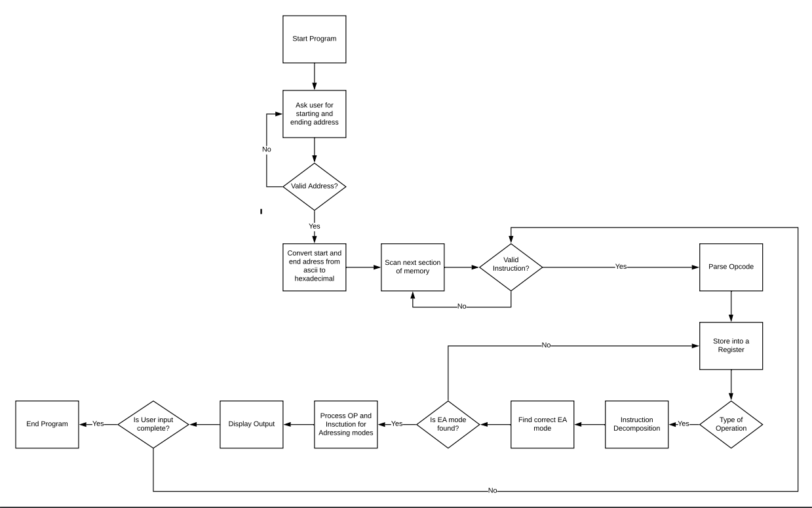

Slide 4
Challenges
When looping over the same address, our program began to skip over address spaces.
Cases when the move address would get the effective addressing mode wrong.
Notes:
For the instruction read, we recognized that for the beginning of the sections of the read in we were able to get the instructions disassembled but for some reason when we looped over the addresses again, our program began to skip over address spaces. In addition, there were some cases where the move address would get the effective addressing mode wrong. We were able to resolve the problem through regression testing and finding registers that were operating on a separate op instruction, so we reset the value to run a separate subroutine.

