Slide 1
Interactive Ray Tracing using KD-Tree in DFS manner
Jiayin Cao

Slide 2
Agenda
The highlight of my work.
What’s ray tracing.
How do I map ray tracing algorithm on CUDA hardware.
The performance of the algorithm.

Slide 3
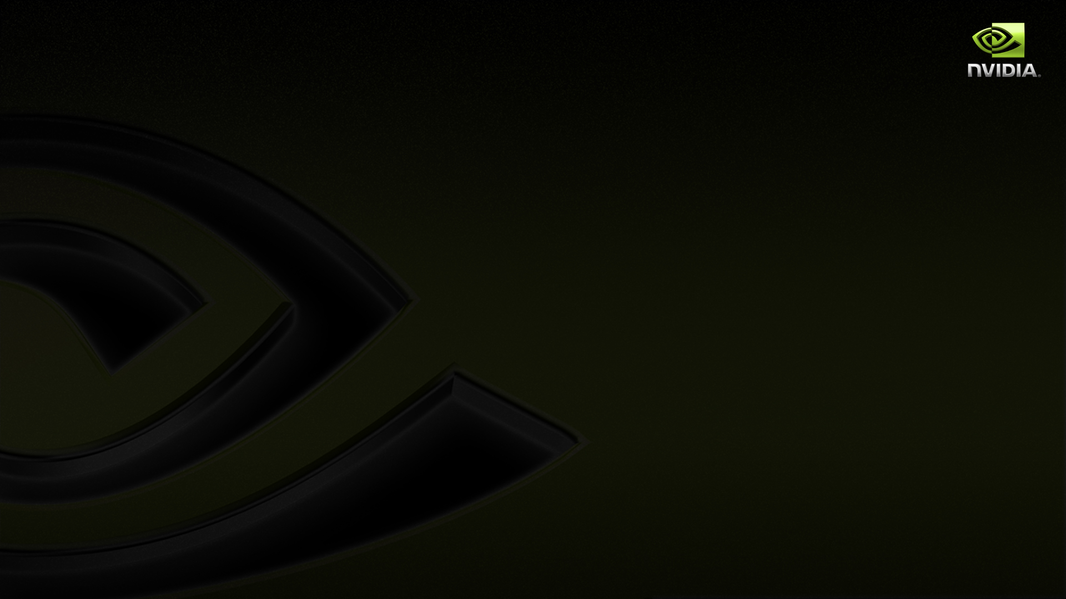
The highlight of my work
Mapping ray tracing algorithm on CUDA hardware well , support texture , shadow , reflection , refraction and multiple lights.
A depth first search algorithm in GPU kernel without hardware stack.
Achieving interactive performance for complex scenes.

Slide 4
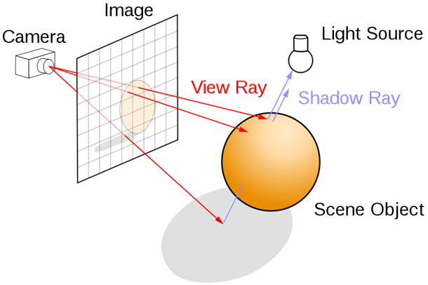
The way ray tracing works
In computer graphics, ray tracing is a technique for generating an image by tracing the path of light through pixels in an image plane.

Slide 5
Why ray tracing
Ray tracing can generate photo realistic images.( reflection, refraction )
Ray tracing is software rendering , which means that every pass is programmable.
Ray tracing could be mixed with other algorithm, such as photon mapping , radiosity.

Slide 6
A naïve ray tracing algorithm
The following operations are performed for each pixel:
Generate primary ray for current pixel
Get Intersection between the ray and the scene
Accumulate the shading color
Generate secondary rays if necessary

Slide 7
A naïve ray tracing algorithm
Accumulate shading result ( get intersection , brdf )
Generate next level ray
Generate primary ray

Slide 8
The problems need to be solved
How to map the algorithm on CUDA hardware.
How to traverse KD-Tree to get the intersection result.

Slide 9
A simple way of doing GPU ray tracing
Each pixel is processed by one single thread.
Problem
Divergence in warp will cause bad performance.
thread

Slide 10
The way my algorithm works
ray
pass

Slide 11
Depth first search in KD-Tree
Problem:
There is no hardware stack in GPU kernel.
The way it is solved:
Using 32-bits unsigned integer as stack. ( fast , low cost )

Slide 12
Depth first search in KD-Tree
t
KD-Tree Traverse
t → l
l → a
a → l
l → b
b → l
l → t ( important )
t → r
r → d
a
b
l
r
c
d
a
b
c
d

Slide 13
Virtual stack using bits
t
Virtual stack
0
0
0
0
…
Traverse state
a
b
l
r
c
d
a
b
c
d

Slide 14
Virtual stack using bits
t
Virtual stack
0
0
0
0
…
Traverse state
a
b
l
r
c
d
a
b
c
d

Slide 15
Virtual stack using bits
t
Virtual stack
0
0
0
0
…
Traverse state
→
Back track state
a
b
l
r
c
d
a
b
c
d

Slide 16
Virtual stack using bits
t
Virtual stack
0
0
1
0
…
Traverse state
→
Back track state
a
b
l
r
c
d
a
b
c
d

Slide 17
Virtual stack using bits
t
Virtual stack
0
0
0
0
…
Back track state
a
b
l
r
c
d
a
b
c
d

Slide 18
Virtual stack using bits
t
Virtual stack
0
0
0
0
…
Back track state
a
b
l
r
c
d
a
b
c
d

Slide 19
Virtual stack using bits
t
Virtual stack
0
0
0
0
…
Traverse state
a
b
l
r
c
d
a
b
c
d

Slide 20
Virtual stack using bits
t
Virtual stack
0
0
0
0
…
Traverse state
a
b
l
r
c
d
a
b
c
d

Slide 21
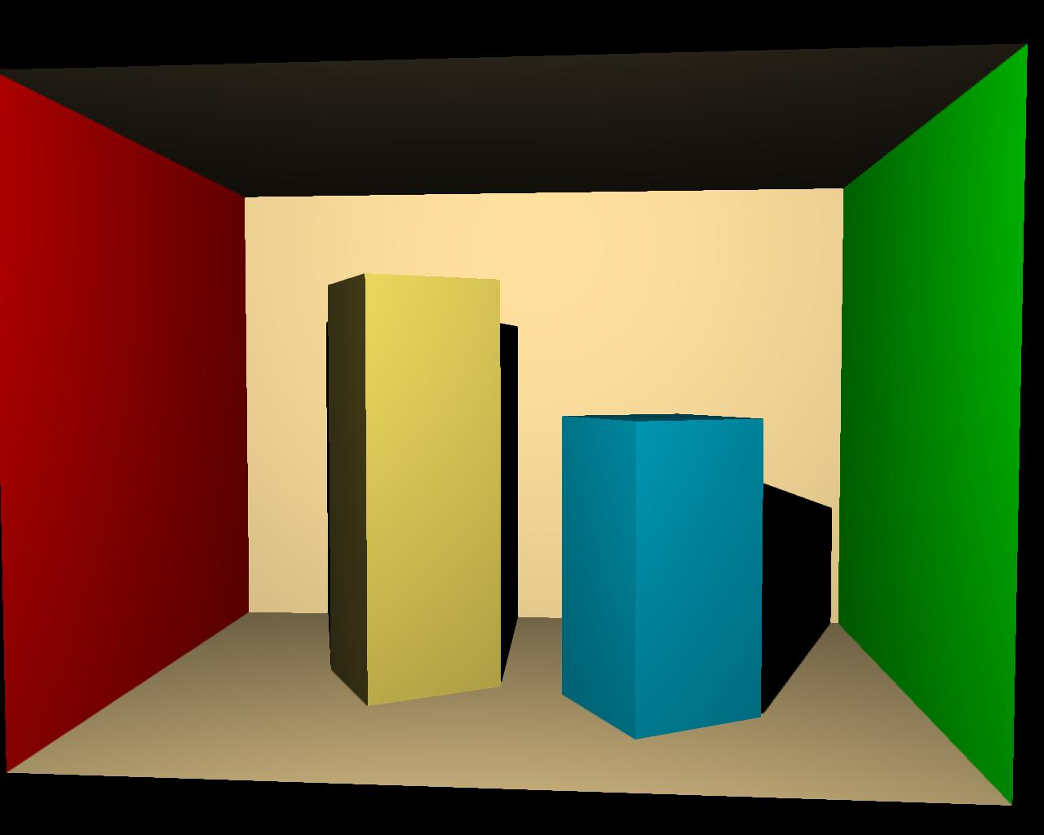
The performance of the algorithm
GPU | FPS
GTX 285 | 30
GTX 460 | 50
70 times faster than a naïve CPU ray tracing algorithm.
Cornell Box ( 34 triangles )

Slide 22
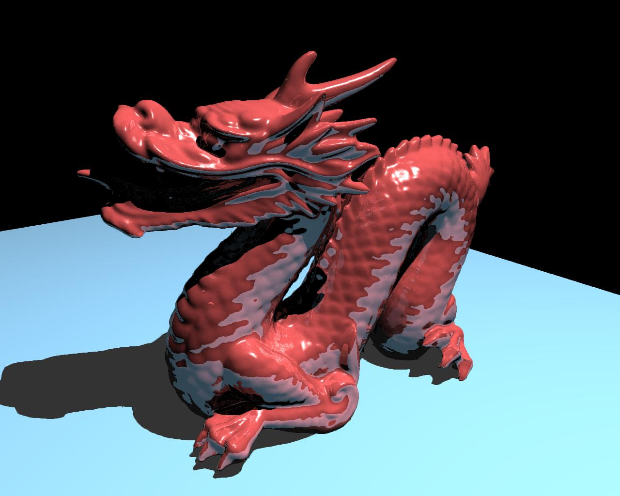
The performance of the algorithm
GPU | FPS
GTX 285 | 3
GTX 460 | 7
18 times faster than a naïve CPU ray tracing algorithm.
Dragon on table ( 872870 triangles )

Slide 23
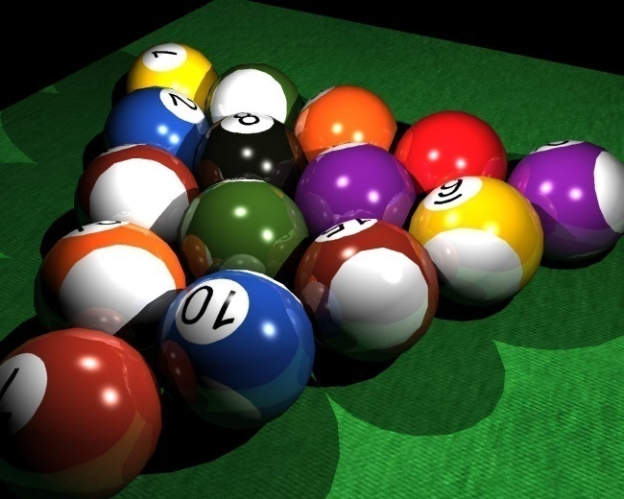
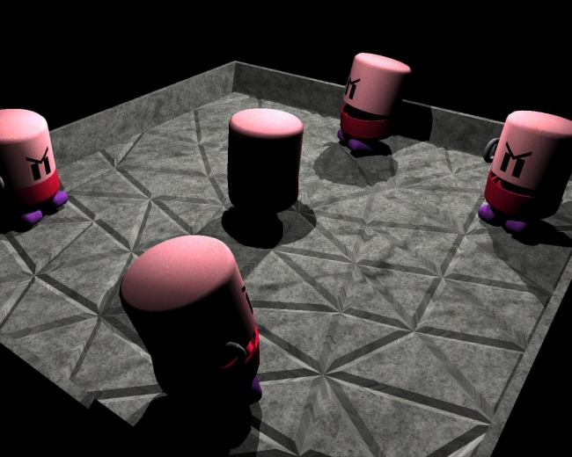
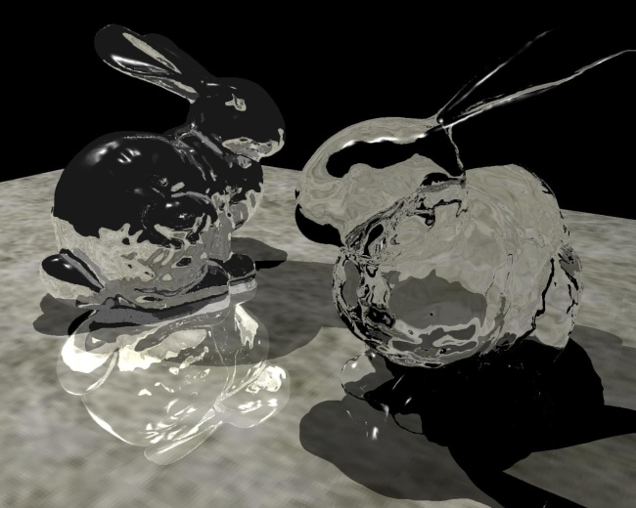
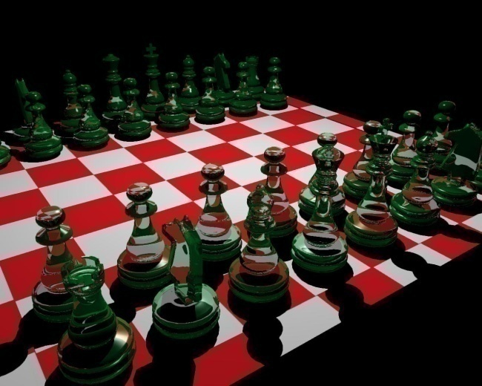
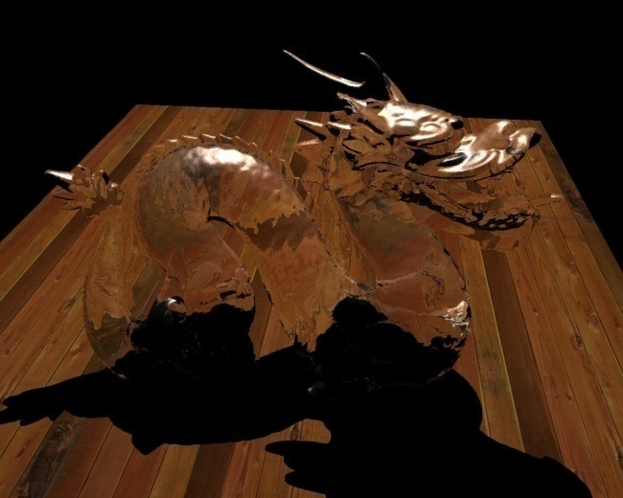
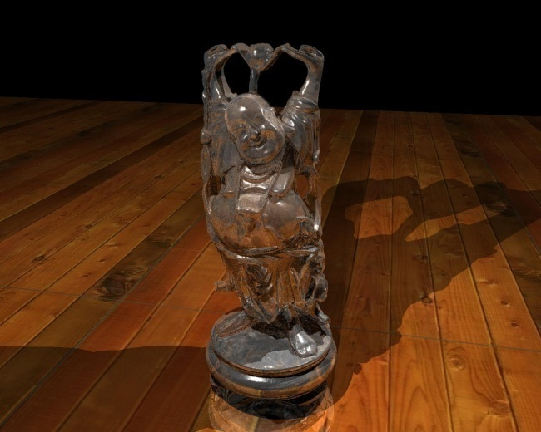
The gallery

