Slide 1
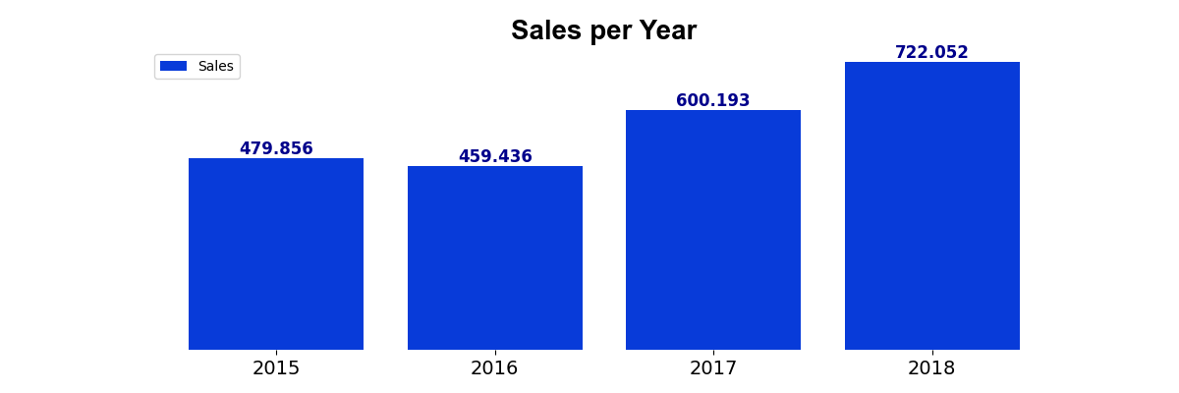
RESULTS SUMMARY
Sales started to grow after 2016
Betwen 2017 and 2018 our sales grown 20 %

Slide 2
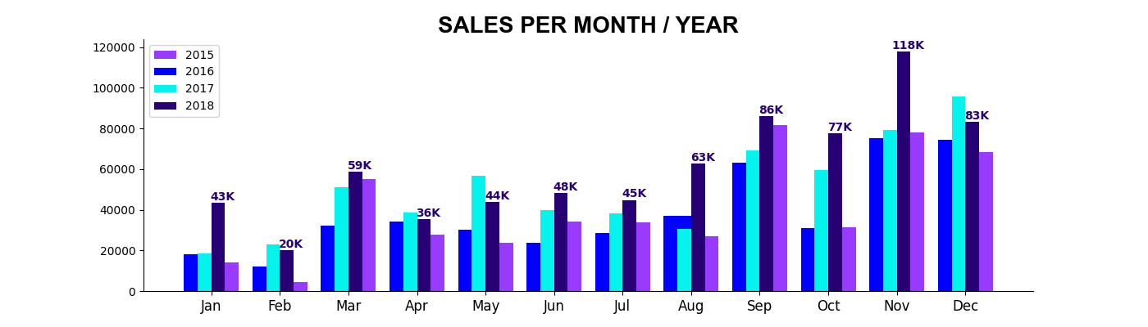
RESULTS SUMMARY
Only May and December had sales in 2018 lower than 2017

Slide 3
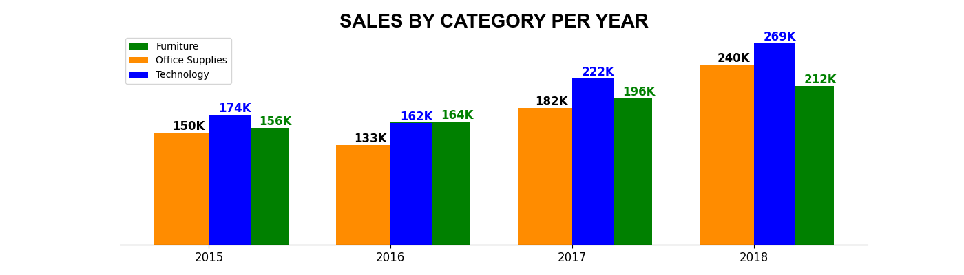
RESULTS SUMMARY
As we can see, the sales force category is the “Technology”

Slide 4
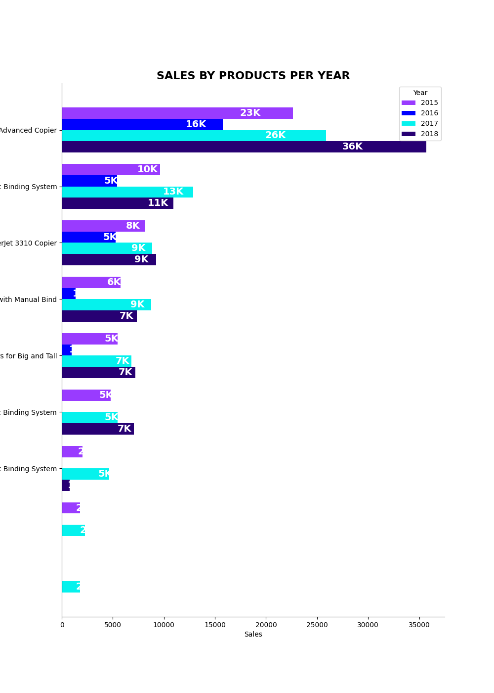
RESULTS SUMMARY
These are the top10 best-selling items each year

