Slide 1

Customer Clustering Software For Customer Analysis
Presentated By
Rafiat Ajibode
Teesside University

Slide 2
Table of Contents
5
4
3
2
1
Conclusion
Modeling and Evaluation
Result Analysis
Data Overview
Introduction

Slide 3

01
Introduction

Slide 4
Customer Segmentation
A strategic approach that involves dividing a customer base into distinct groups based on shared characteristics.
It significantly contributing to the success of businesses because of its benefits.

Slide 5
Advantages of Segmentation
Satisfaction
Customer clustering helps increase revenue by enabling targeted marketing strategies, personalized promotions, and tailored product offerings, leading to more effective customer engagement and higher sales.
Marketing
Revenue

Slide 6
—Grudva.com, 2023
“It’s not just a strategy;
it’s a game-changer”

Slide 7
Objectives
Utilizing R for Customer Segmentation
Implementing Unsupervised Learning
Grouping Customers Based on Various Factors

Slide 8
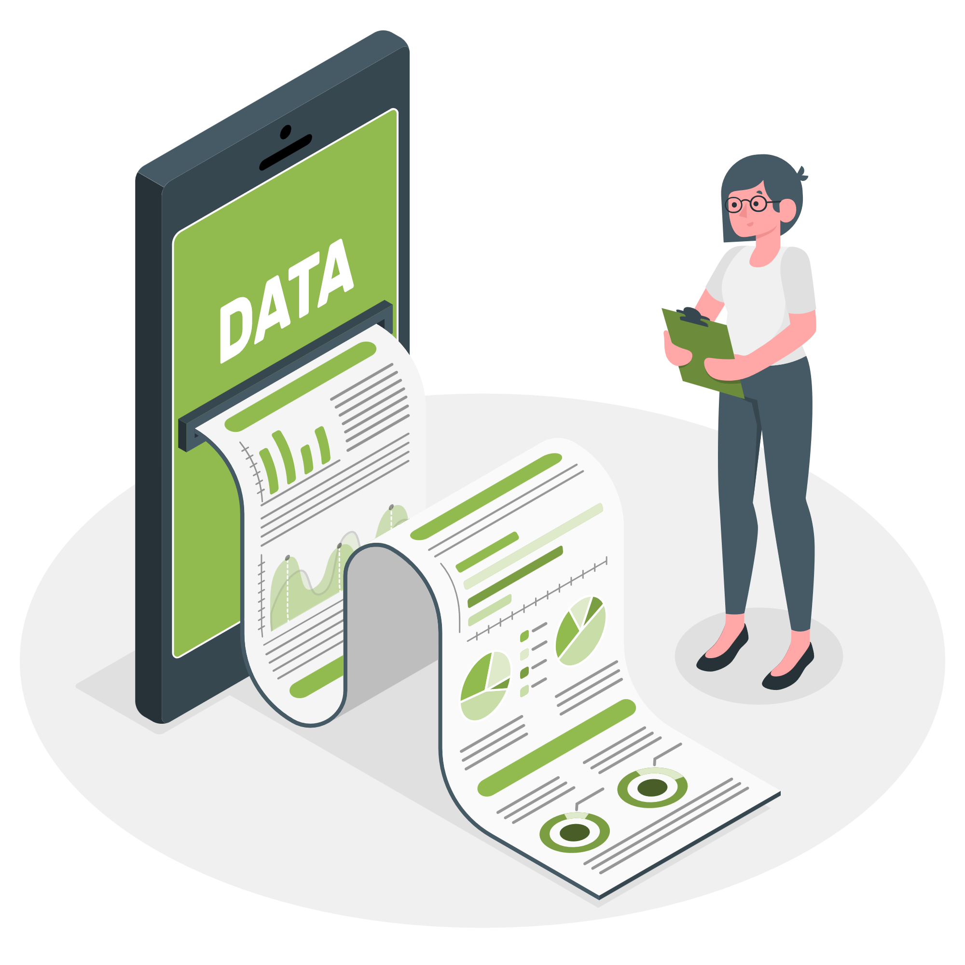
02
Data Overview

Slide 9
Mall Customer Dataset
1 | 2 | 3 | 4 | 5
Customer Id | Gender | Age | Annual Income | Spending Score
Unique ID assigned to the customer | Male or Female | Age of the customer | Annual Income of the customer in thousand dollars (k$) | Score based on customer behavior and spending nature (1-100)
Numerical | Categorical | Numerical | Numerical | Numerical

Slide 10
Data Science Processing steps
Share
Model & Evaluation
Step 6
Result Interpretation and communication
Building the model using K-Means Clustering
Step 5
Step 4
Analyse
Analysis was performed on the dataset to show bar plots, scatter plots and box plots between attributes.
Process
Step 3
Clean the imported raw data in R studio by checking for missing values & ensuring that the attributes are in the right format.
Step 2
Prepare
The mall customer data was used for this project.
Ask
Step 1
Can we segregate customers based on the data in form of clusters?

Slide 11
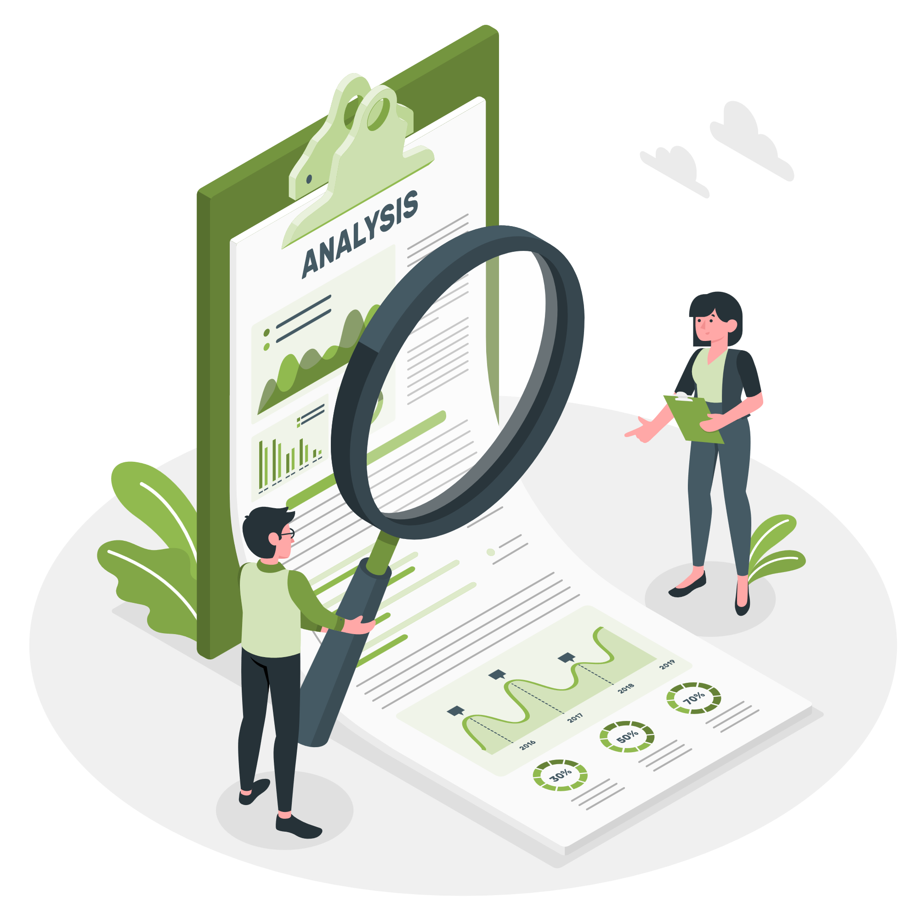
03
Result Analysis

Slide 12
$60,560
200 Observations
Mean Annual Income of the project
Total Entry
44%
56%
Male
Female

Slide 13
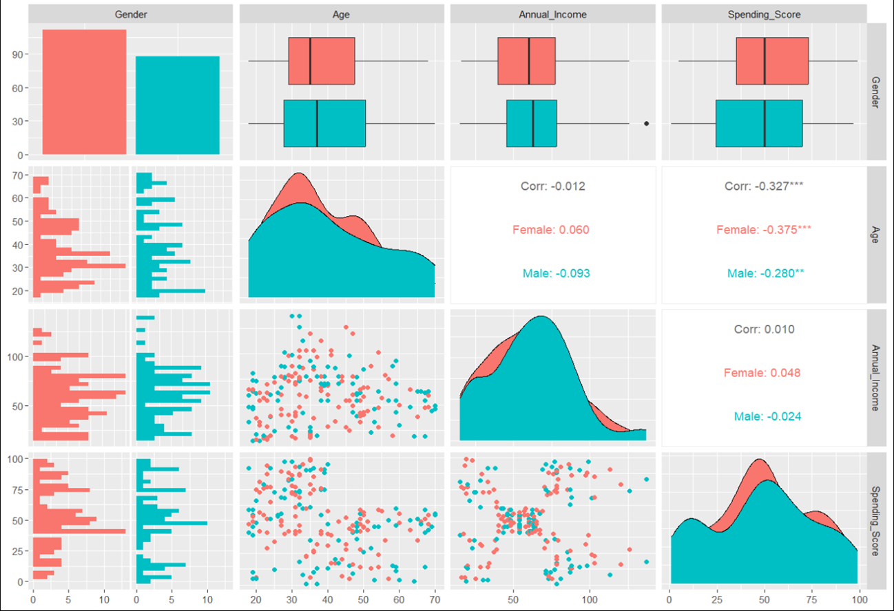
Visualization of the Attributes of the Dataset
Men are generally older and have higher incomes, while women tend to spend more.
There are no strong relationships between variables and only weak correlations.
Spending tends to decrease as customers age.

Slide 14
04
Modeling and Evaluation

Slide 15
Unsupervised Learning and K-means Clustering
Unsupervised Learning:
Identifying patterns in unlabeled data without predefined outcomes.
K-means Algorithm Overview:
Iteratively assigns data points to clusters, minimizing within-cluster sum of squares (WCSS).
Why K-means:
Efficiently partitions customers into groups based on age, education, and interests.

Slide 16
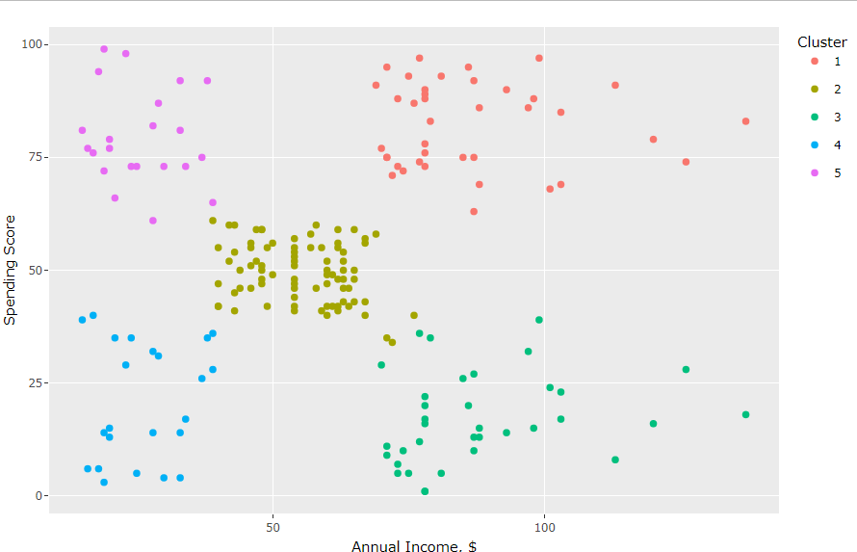
K-Means Cluster Profiles of Income Vs Spending Score

Slide 17
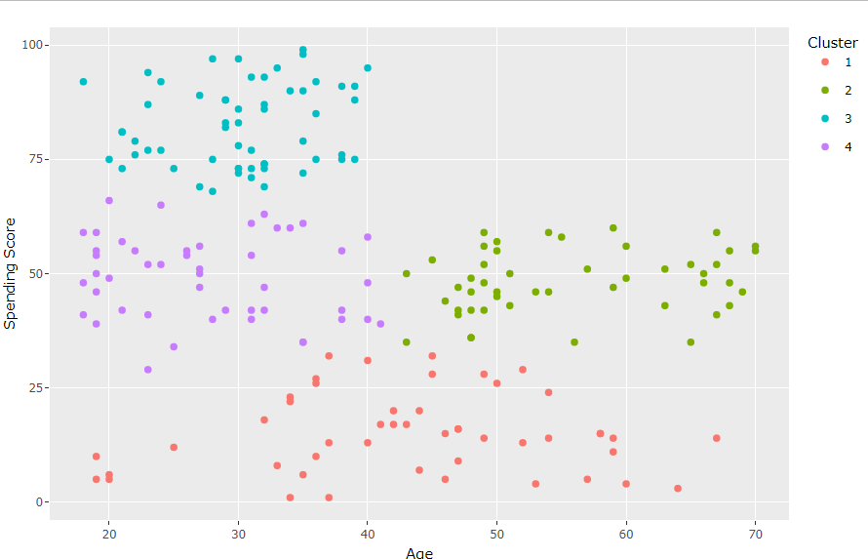
K-Means Cluster Profiles of Age Vs Spending Score

Slide 18
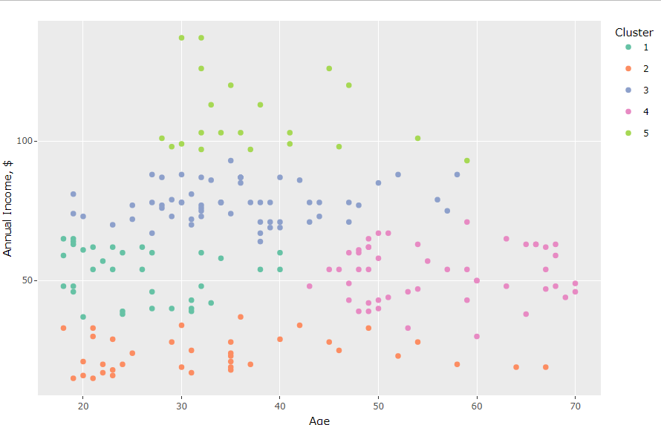
K-Means Cluster Profiles of Age Vs Income

Slide 19
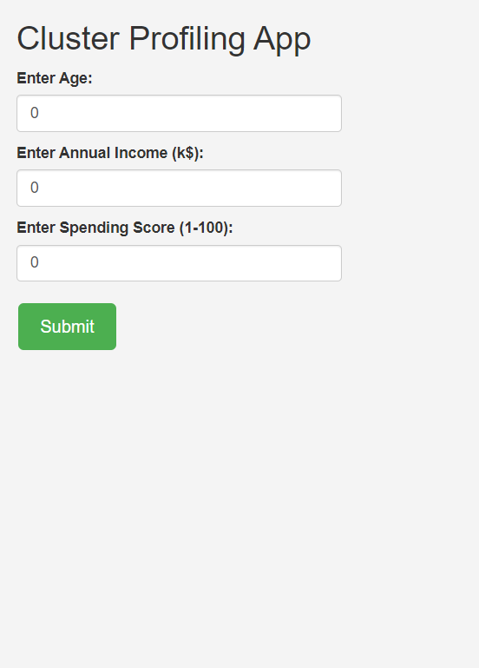
Customer Profiling Software
Group customers based on Age, Annual Income and Spending Score.
Explore a live demo of our customer profiling software: Link

Slide 20
05
Conclusion

Slide 21
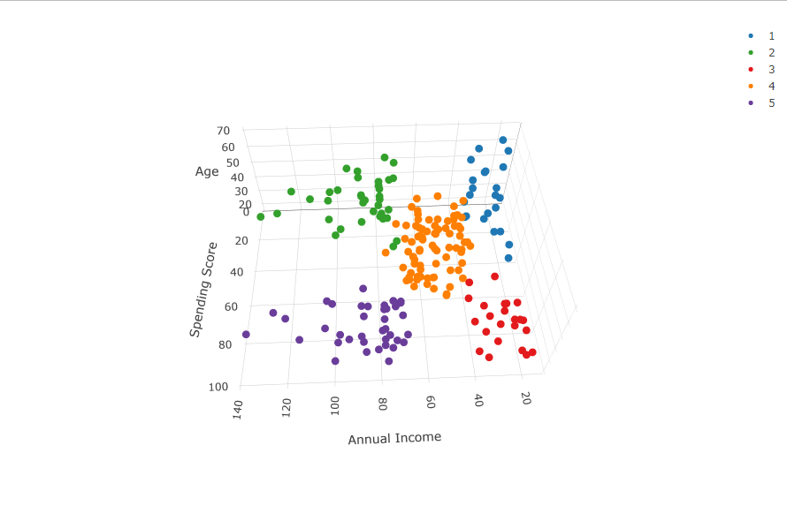
K-Means Cluster Profiles of Income Vs Spending Score

Slide 22
Conclusion
 | Steady Savers | Comfortable Conservative | Young Trendsetters | Balanced Middle Class | Affluent Trendsetters
Cluster | 1 | 2 | 3 | 4 | 5
Average Age | 45.2 | 40.7 | 25.5 | 43.1 | 32.7
Average Annual Income | 26.3 | 87.8 | 26.3 | 55.3 | 86.5
Average Spending Score | 20.9 | 17.6 | 78.6 | 49.6 | 82.1

Slide 23
References
https://github.com/sharmaroshan/Clustering-of-Mall-Customers
https://www.linkedin.com/posts/grudva-llc_customersegmentation-businessinsights-tailoredexperiences-activity-7123324102265737216-Vpz-/

Slide 24
Do you have any questions?
Rafiat Ajibode | ajiboderafiat@yahoo.com | Teesside University

