Slide 1
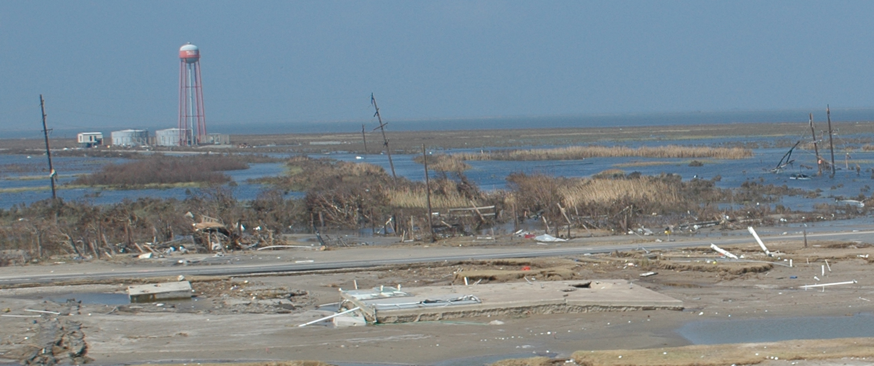
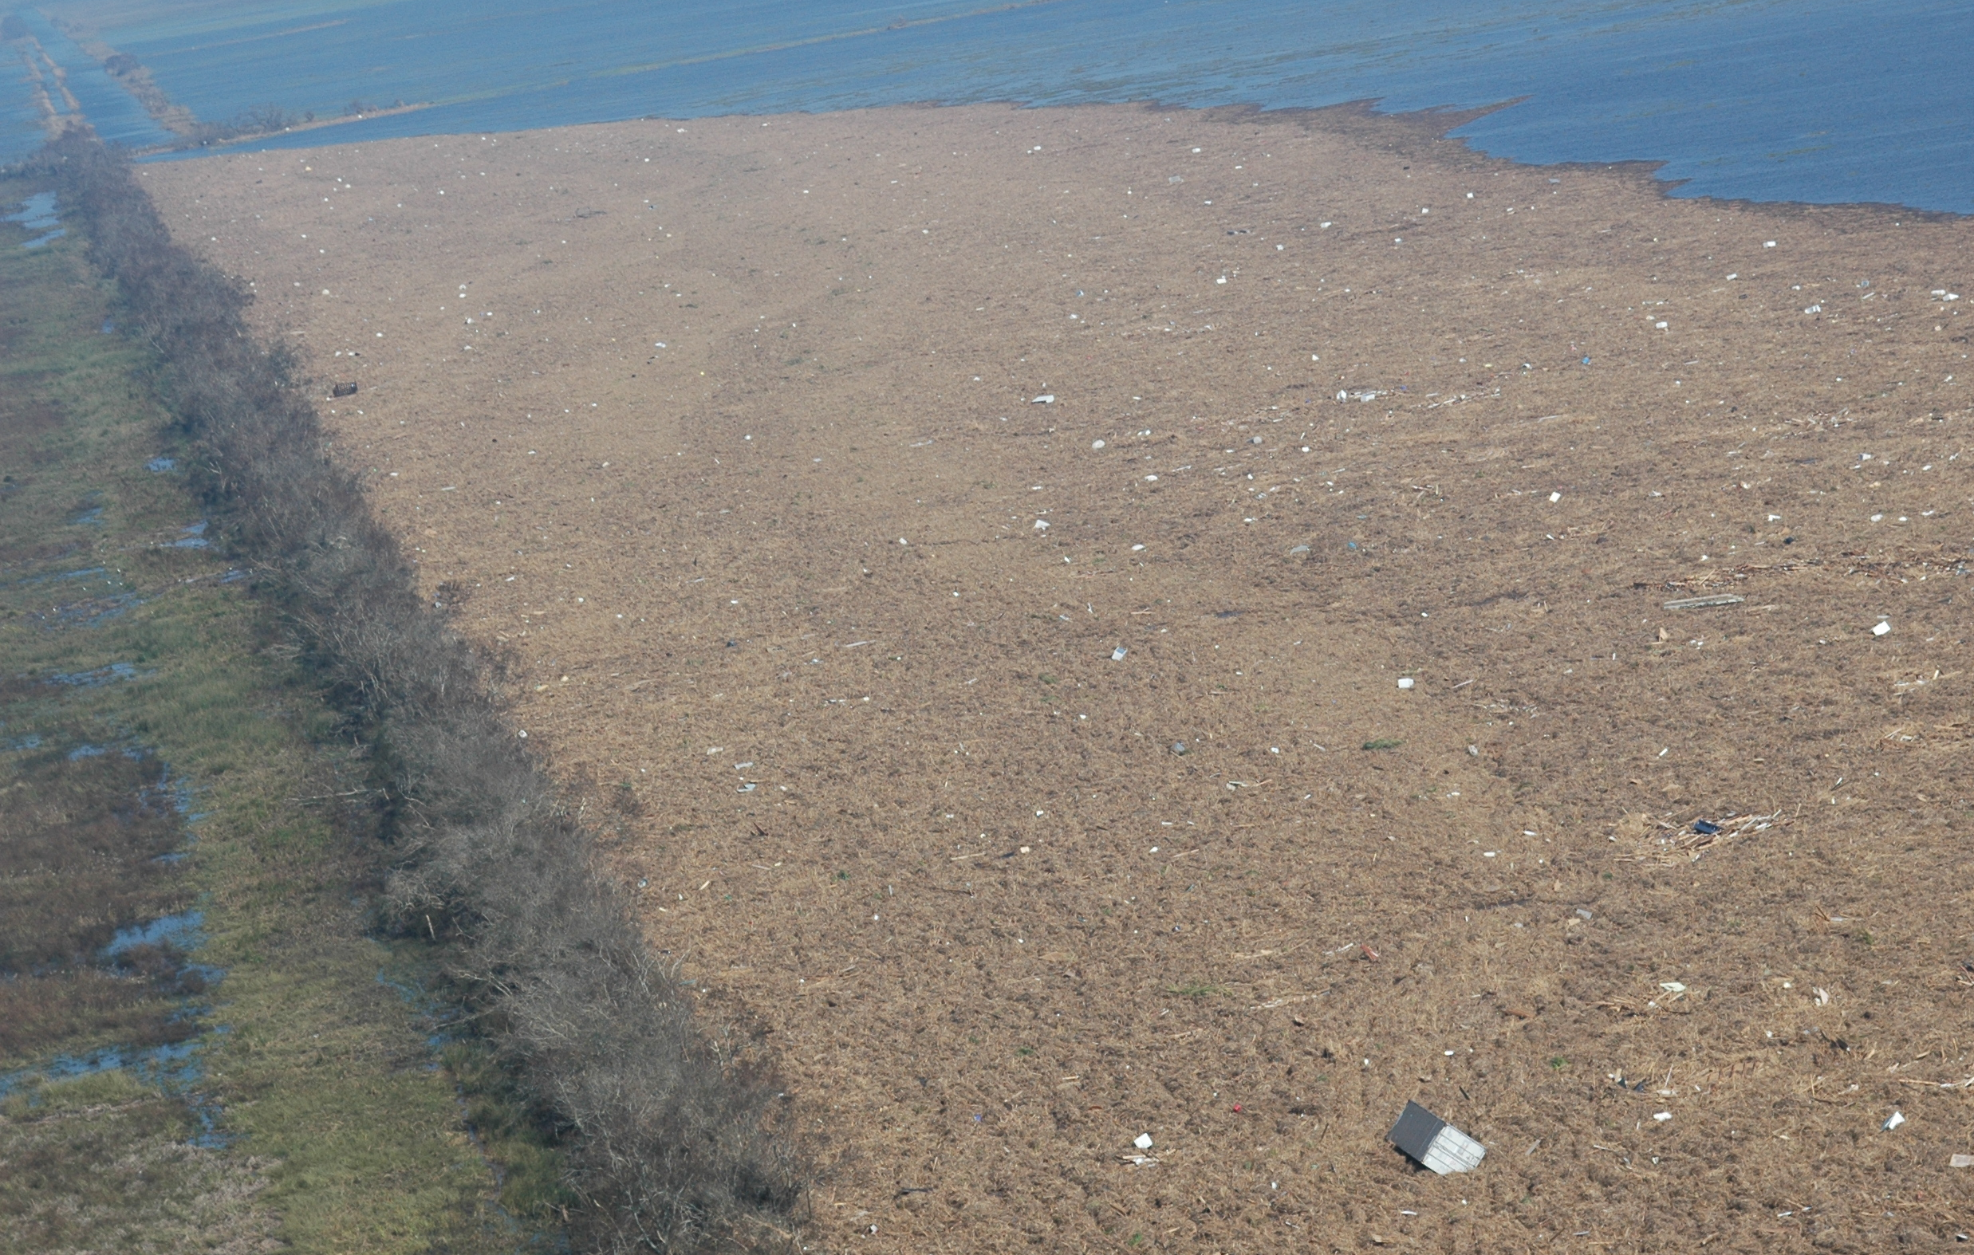
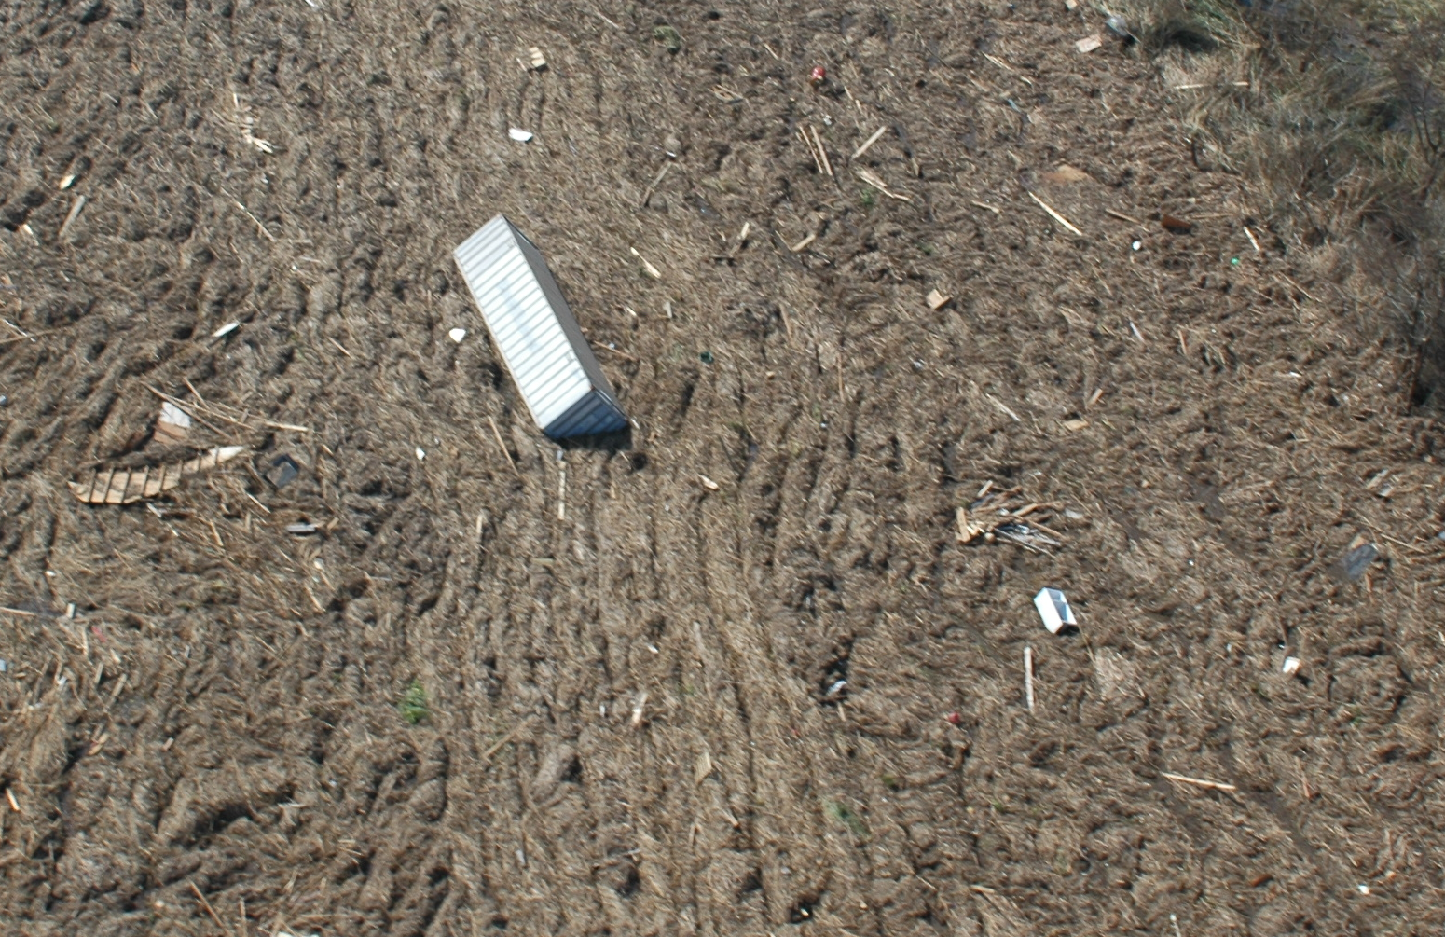
Anthropogenic debris was gathered by the storm surge, mixed with vegetation and randomized then deposited in huge wrack lines as the storm waters subsided.
Holly Beach community, Cameron Parish, Louisiana
One of the wrack deposited in Sabine National Wildlife Refuge north of Holly Beach, Louisiana
Sabine National Wildlife Refuge
For scale, here’s a shipping container.
This is a refrigerator.

