Slide 1
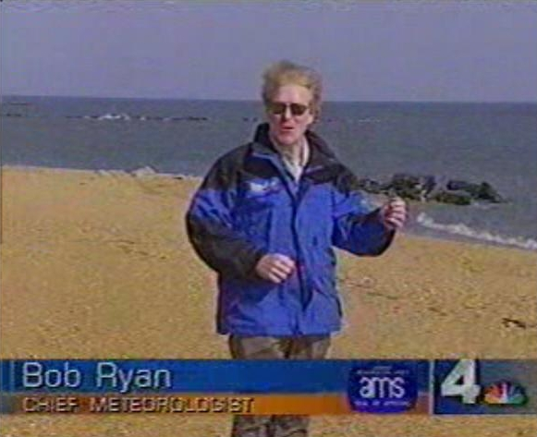
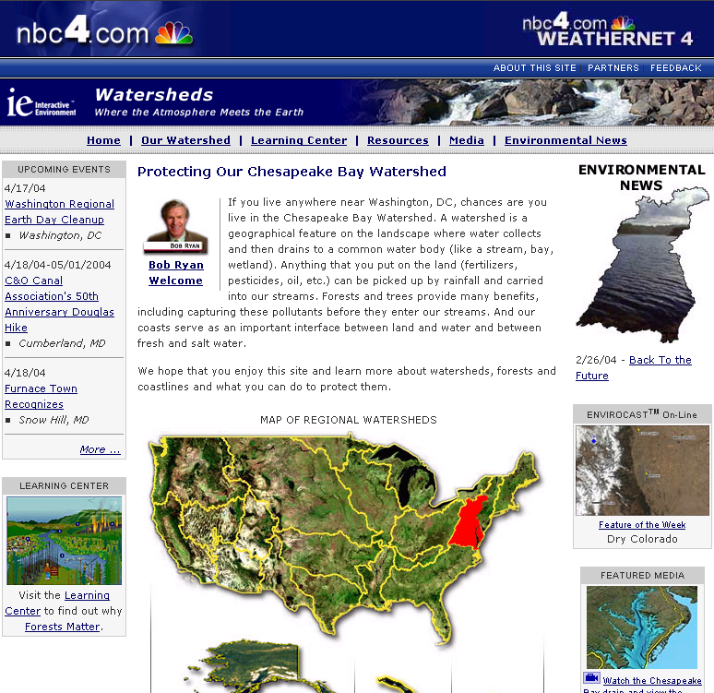
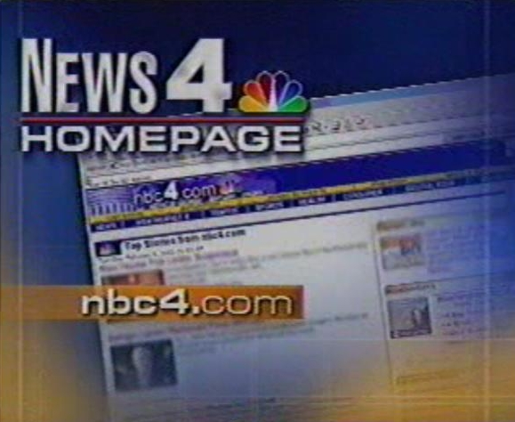
Raising the Environmental I.Q. of America
Through Innovative Agency & Media Partnerships
Dave Jones, Founder, President & CEO, StormCenter Communications, Inc.
President, Foundation for Earth Science (501 c (3) corporation)
Past-President, Federation of Earth Science Information Partners (ESIP Federation)

Slide 2
StormCenter Goals
To apply environmental science in such a way as to engage Americans to increase their understanding of the environment
To utilize science information as a tool for improved public and agency decision making
To directly relate science to societal benefits
To increase public environmental awareness so better decision making can be made in times of crisis
Notes:
02.06 - USDA

Slide 3
Media Market Research Results
Notes:
02.06 - USDA

Slide 4
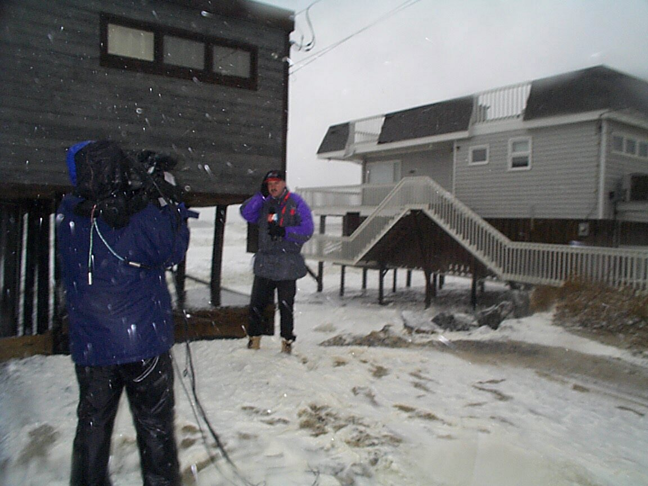
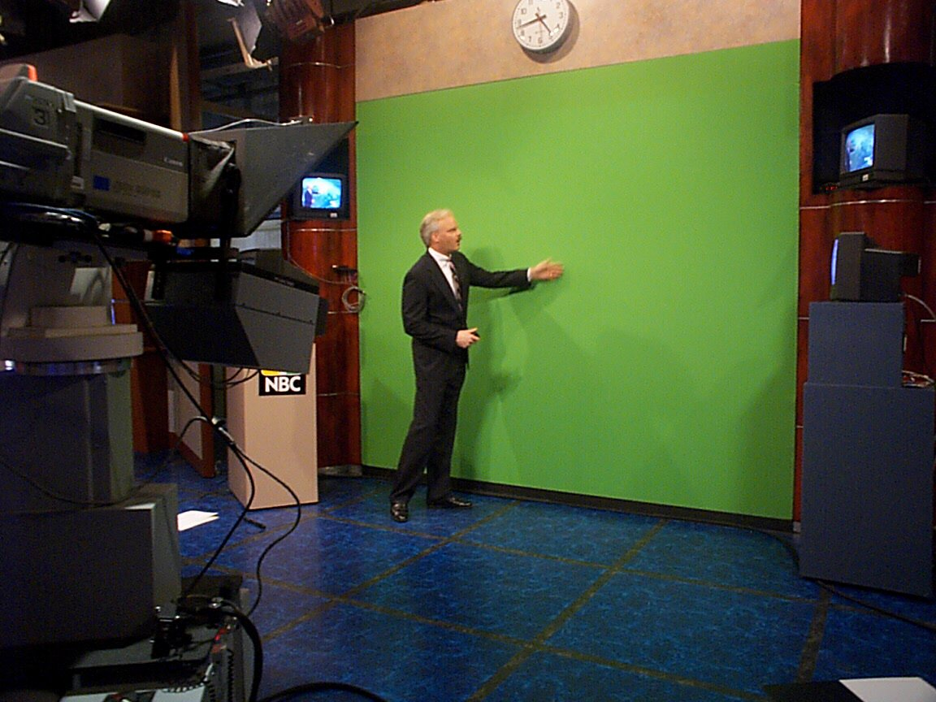
Why People Watch
Weather is the # 1 Reason People
Watch local news
Most #1 stations have
the top rated weather coverage
TV station management LOVES when weather affects their market
Most people are fascinated by the
weather
The weather is FUN to watch

Slide 5
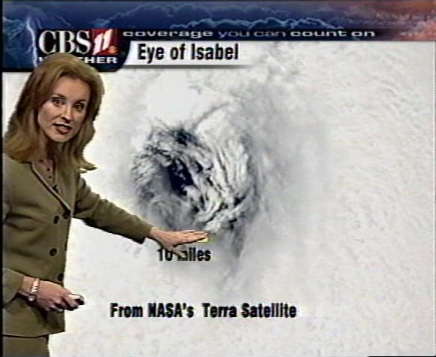
Why Partner with Weathercasters
Weathercast uses visual images to
communicate complex ideas
Delivers maximum exposure of
science to the public on a daily
basis
When TV stations WIN with Weather –
They usually WIN the newscast !
People are in a LEARNING mode when they watch the weather

Slide 6
Why Partner with Federal, State & Local Agencies ??
Most agencies have as part of their strategic plan to communicate effectively with those whom they serve
Many of those agencies have had numerous programs to communicate more effectively with their communities for years with few results.
Many agencies have valuable data sources but have not had a direct conduit to the public on a regular basis.
Excellent resources exist that should be tested for applications in media

Slide 7













It Takes Partners

Slide 8
Envirocast TV
Notes:
02.06 - USDA

Slide 9
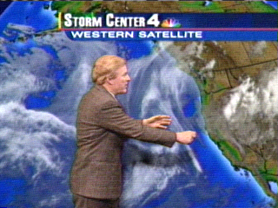
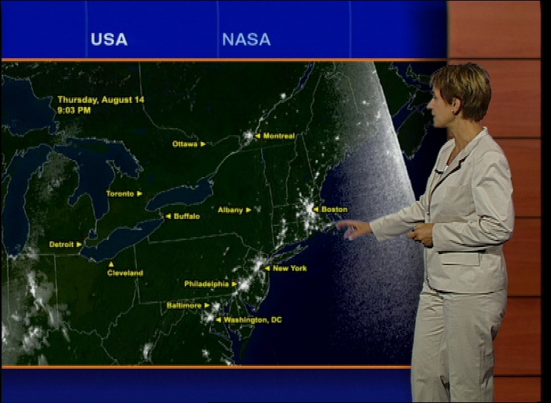
Future Weathercasts
The Weathercaster is TV station scientist…like it or Not
In the past…weather was it
Now & In the Future…
Viewers will turn to TV Weathercasters for more detailed environmental information updates on:
  Air & Water Quality (health risks), Environmental Hazards/Pollution, Toxic Releases, Forest Fires, El Nino, Climate Change and more…
  Forest Fire Forecasts, Air & Water Quality Forecasts, Airborne Health Risk Forecasts, etc.
  Urban Meteorology Issues

Slide 10
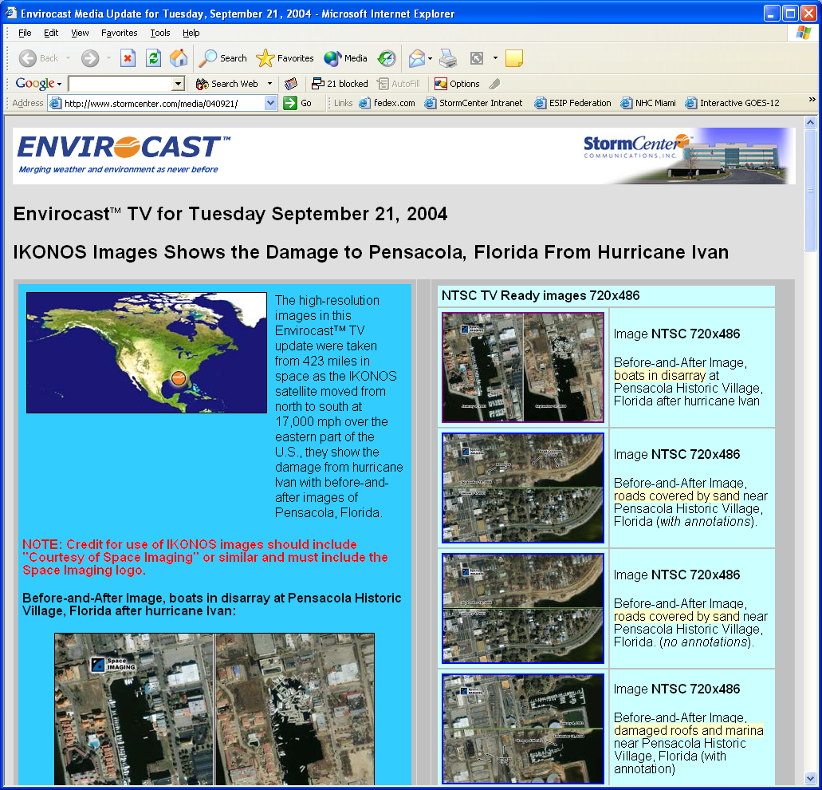
Envirocast TV

Slide 11
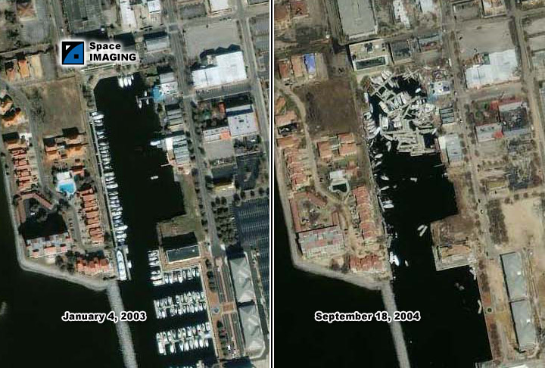
Pensacola Historic Village
Before Ivan
After Ivan
5 Days Ago

Slide 12
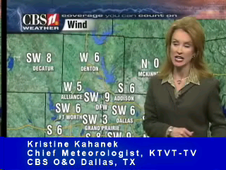
Non-Traditional Data Use

Slide 13
Envirocast Web
Notes:
02.06 - USDA

Slide 14
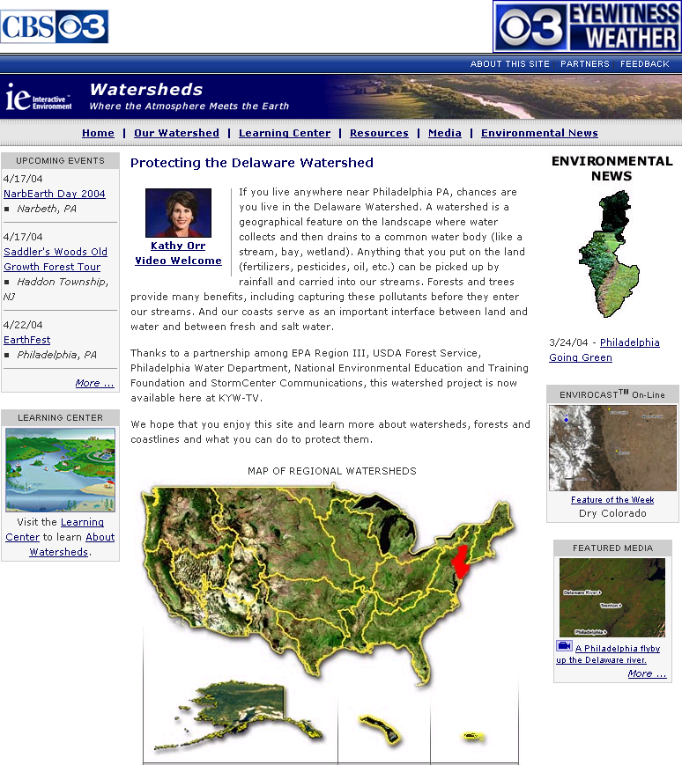



Learning Center
About Watersheds
Forests Matter
Along the Coast

Slide 15
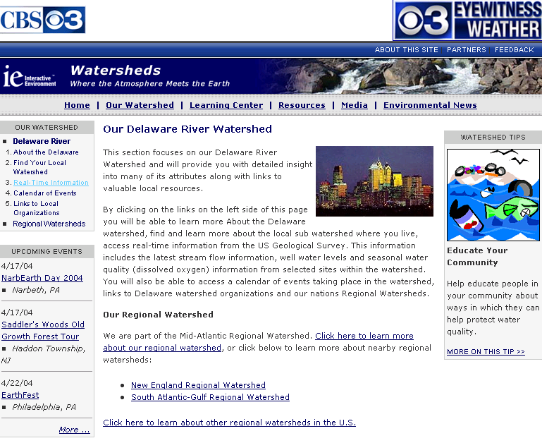
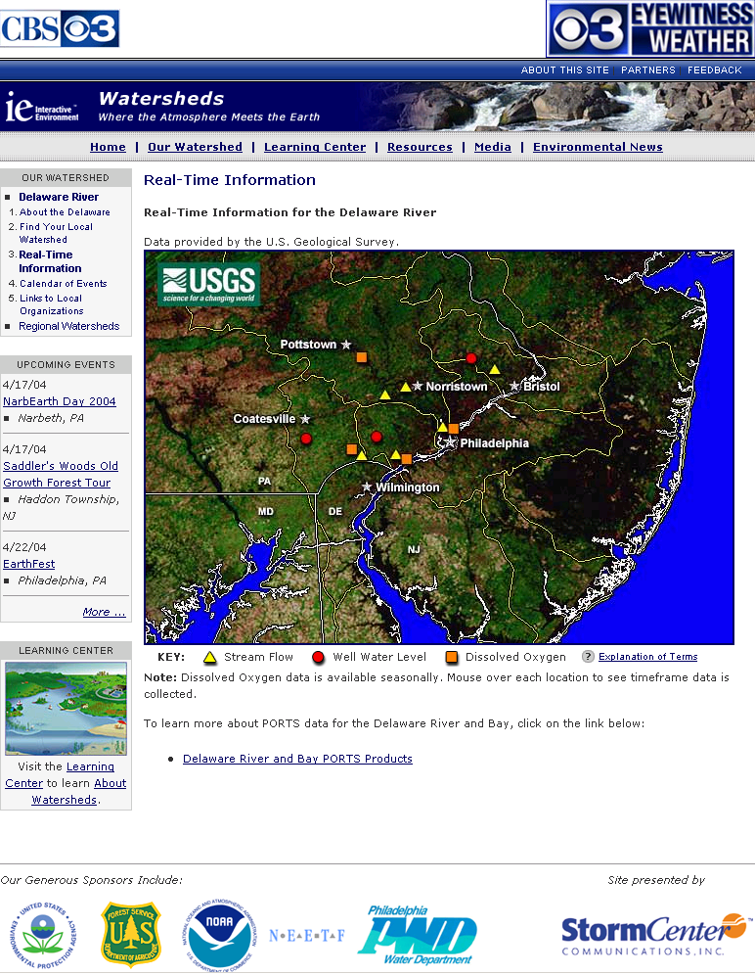
Access to Real-Time Information
Fun Interface for the Public

Slide 16
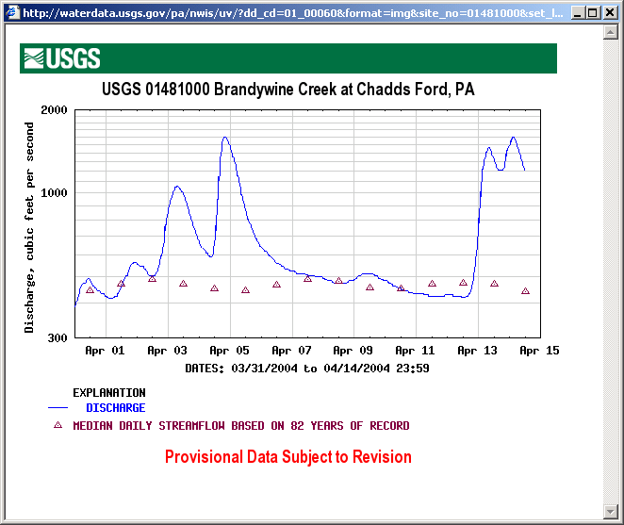
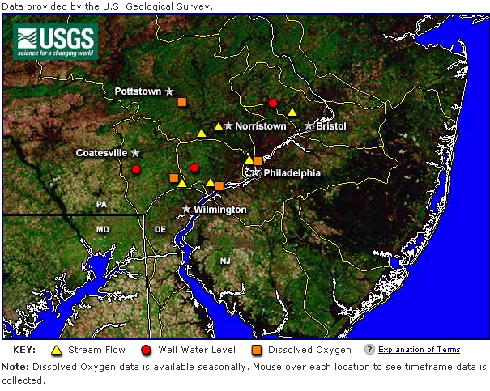
Imagery as an Interface

Slide 17
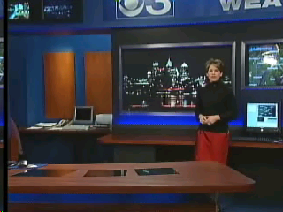
Watersheds as an Introduction
KYW-TV Launch Philadelphia

Slide 18
Audience To Date
Market TV Households
Washington, DC 2,128,000
Philadelphia, PA 2,802,000
Minneapolis, MN 1,574,000
6,504,000 or 6.19% of Nation
Forecast:
By Dec 2005 Envirocast will be reaching 100 Million people on a regular basis with enhanced environmental information

Slide 19

EnviroTrack
Hurricane Wind Field Modeling
Notes:
02.06 - USDA

Slide 20
EnviroTrack
Based on the GFDL Model
  Coupled ocean-atmosphere model
High Resolution Digital Elevation Model (30 m)
Land Use (urbanization) incorporated into model
Visualization of “Official NHC Forecast”
  Storm Path & Intensity
First time official NHC forecast visualized as a high resolution wind field and delivered to media

Slide 21
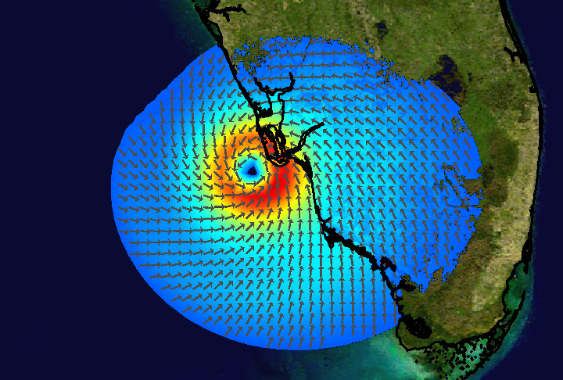
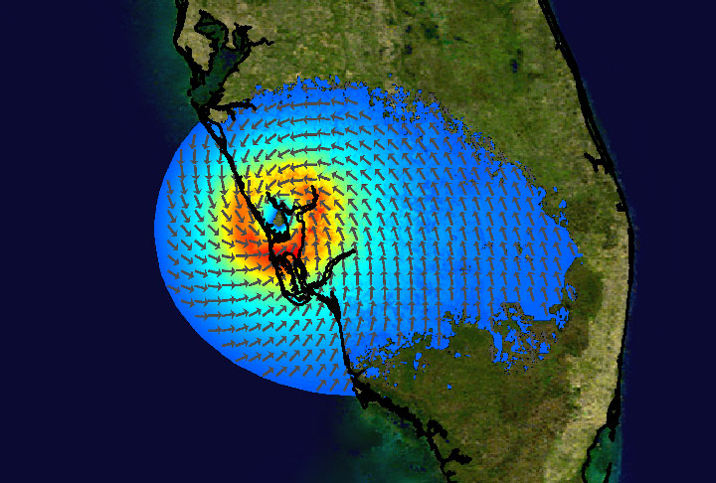
WindForce4
4pm EDT September 13, 2004
5pm EDT September 13, 2004
Land-Use “Friction Factor” activated to show affects of land use on wind field
Notes:
02.06 - USDA

Slide 22
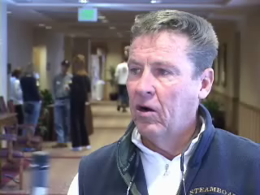
WindForce4
Notes:
02.06 - USDA

Slide 23
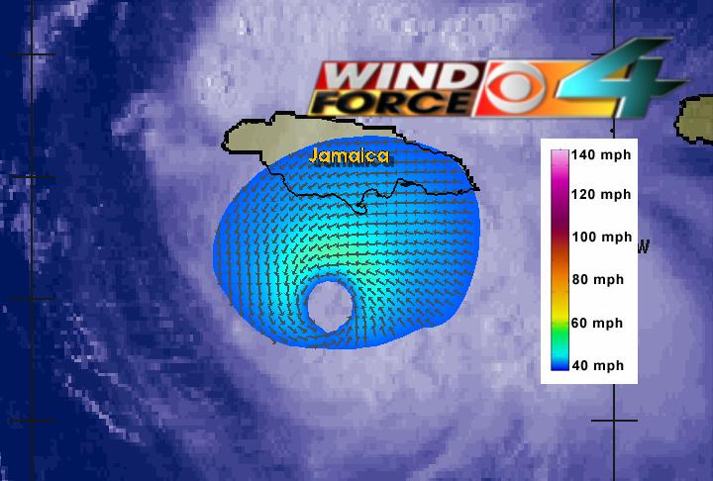
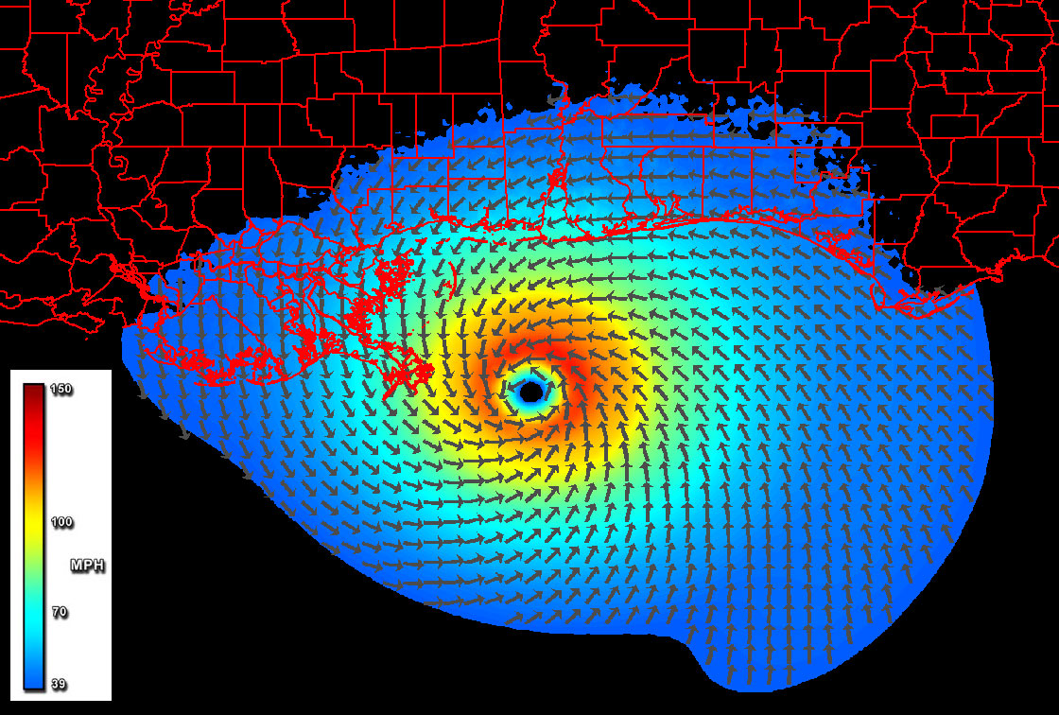
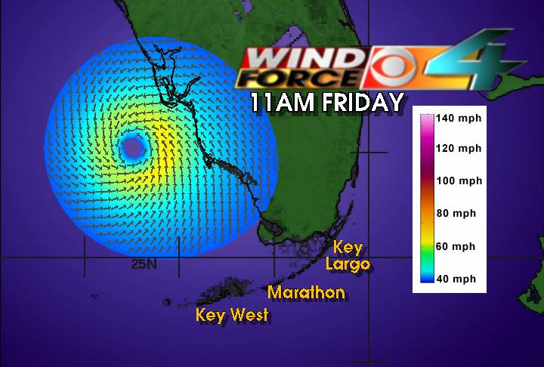
WindForce4
9pm EDT September 15, 2004
Hurricane Charley
Hurricane Charley
Hurricane Ivan
Notes:
02.06 - USDA

Slide 24
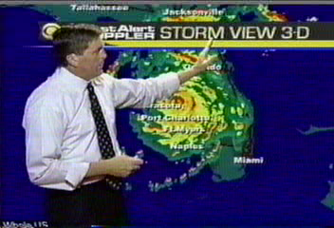
WindForce4
WBZ Boston
Notes:
02.06 - USDA

Slide 25
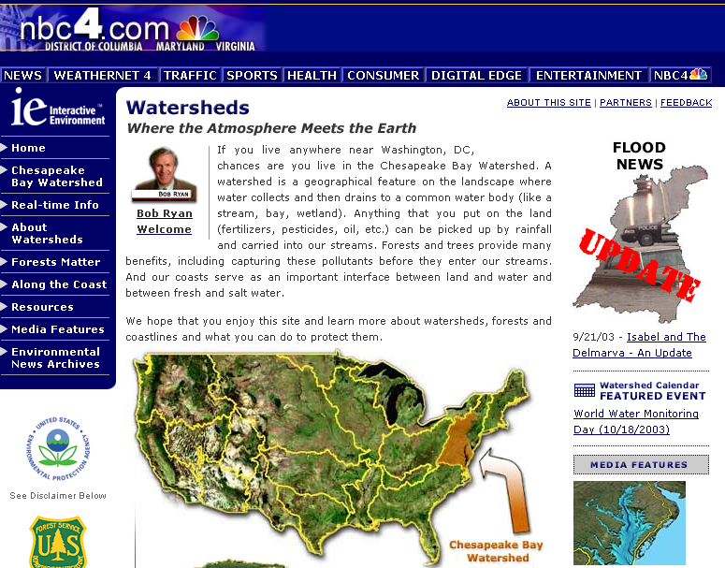
By working together we can make a difference !
Thank You

