Slide 1
Remote Sensing in Hydrology
Robert J. Kuligowski, Ph. D.
NOAA/NESDIS Office of Research and Applications
Bob.Kuligowski@noaa.gov
Presentation to NWS/WMO Hydrologic Forecasting Course
Kansas City, MO
29 October 2003

Slide 2
Outline
Precipitation
  Theory/basis—visible/IR and microwave
  Specific Algorithms and Examples
  Forecasting Tools
  Validation Efforts
Surface Conditions
  Vegetation
  Snow
  Surface Wetness
  Flood Inundation

Slide 3
Part I: Precipitation
Theory/basis—visible/IR and microwave
Specific Algorithms and Examples
Forecasting Tools
Validation Efforts

Slide 4
Precipitation—Theory/Basis
Visible (VIS)/Infrared (IR) Algorithms
  Basic assumption is that cloud-top temperature brightness is related to cloud height, which in turn is related to cloud thickness, and to rainfall rate
    Colder, brighter clouds are associated with heavier rain
    Warmer, less bright clouds are associated with light or no rain
  Reasonable assumption for convective clouds
  Poor assumption for
    stratiform clouds (warm, but wet)
    cirrus clouds (cold, but rain-free)

Slide 5
Cirrus
T_{b}=210 K
Cumulonimbus
T_{b}=200 K
Nimbostratus
T_{b}=240 K
200
250
290
T (K)
Illustration of the IR signal from different cloud types

Slide 6
Precipitation—Theory/Basis
Microwave (MW) Algorithms
  Scattering: ice in clouds scatters (warm) terrestrial radiation downward, producing cold areas in imagery.
    Rainfall rates are related to the magnitude of the resulting brightness temperature depression.
    Strength: can be applied to high-frequency channels where surface effects are not detected: works over both land and ocean
    Weakness: poor at detecting precipitation clouds with little or no ice (e.g. warm orographic clouds in the tropics)

Slide 7
Precipitation—Theory/Basis
Microwave (MW) Algorithms
  Emission: water in clouds emits radiation, can be seen against a radiatively cold background (i.e. oceans).
    Rainfall rates are related to the magnitude of the resulting brightness temperature difference
    Strength: Sensitive to clouds with little or no ice
    Weakness: must know terrestrial radiances without cloud beforehand; generally applicable over oceans but not land

Slide 8
Lower T_{b} above cloud
Higher T_{b} above clear air
Higher T_{b} above cloud
Lower T_{b} above clear air
High ε
Low ε
Land (Scattering)
Ocean (Emission)

Slide 9
Precipitation—IR/VIS vs. MW
Physical Robustness:
  Microwave radiances are sensitive to moisture throughout the cloud
  IR/VIS data reflect cloud-top conditions only and thus are more weakly related to actual rainfall rates over a wider range of conditions than MW radiances.
Space/Time Resolution
  IR/VIS data are available at 4 km/1km resolution (GOES) on geostationary platforms, allowing looks in many locations every 15 minutes—suitable for extreme precipitation events at short time scales
  MW instruments are presently restricted to polar-orbiting platforms, limiting views to 2 per day per satellite—more suitable for larger scales in time and space

Slide 10
Part I: Precipitation
Theory/basis—visible/IR and microwave
Specific Algorithms and Examples
  IR Algorithms
  Microwave Algorithms
  Blended Algorithms
Forecasting Tools
Validation Efforts

Slide 11
IR Algorithms: Hydro-Estimator (H-E)
The operational satellite rainfall algorithm at NESDIS since August 2002
Uses 10.7-μm (T_{10.7}) brightness temperature to determine raining areas and rain rates
  Assigns rain only to regions where T_{10.7} is below local average; i.e. active precipitating cores
  Rain rates are a function of both T_{10.7} and its value relative to the local average—further enhancement of rain rates in precipitating cores

Slide 12
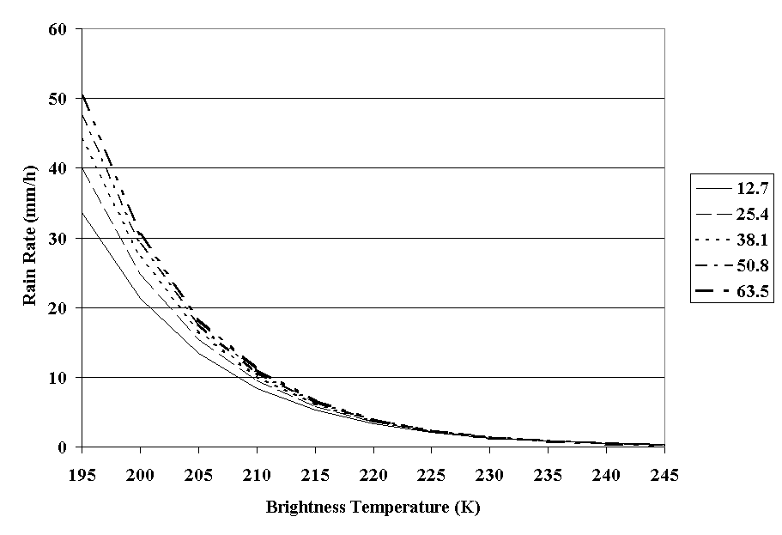
H-E Continued
Sample Hydro-Estimator Rain Rate Curves as a Function of Precipitable Water

Slide 13
H-E Continued
Adjustments using Numerical Weather Prediction Model Data, including:
  Relative humidity to reduce precipitation in arid regions with significant sub-cloud evaporation of raindrops
  Wind fields interfaced with digital topography to determine orographic enhancements or reductions of precipitation
Also adjustments for parallax in regions away from satellite sub-point

Slide 14
H-E Availability
Produced every 15 minutes over the continental United States using GOES-10 and -12 data
Produced in other regions throughout the globe whenever IR imagery are available
Instantaneous rates are summed into 1-, 3-, 6- and 24-hourly totals
Available in real-time for entire Western Hemisphere over the Internet from the NESDIS Flash Flood Home page
Contact: Rod Scofield at Roderick.Scofield@noaa.gov

Slide 15
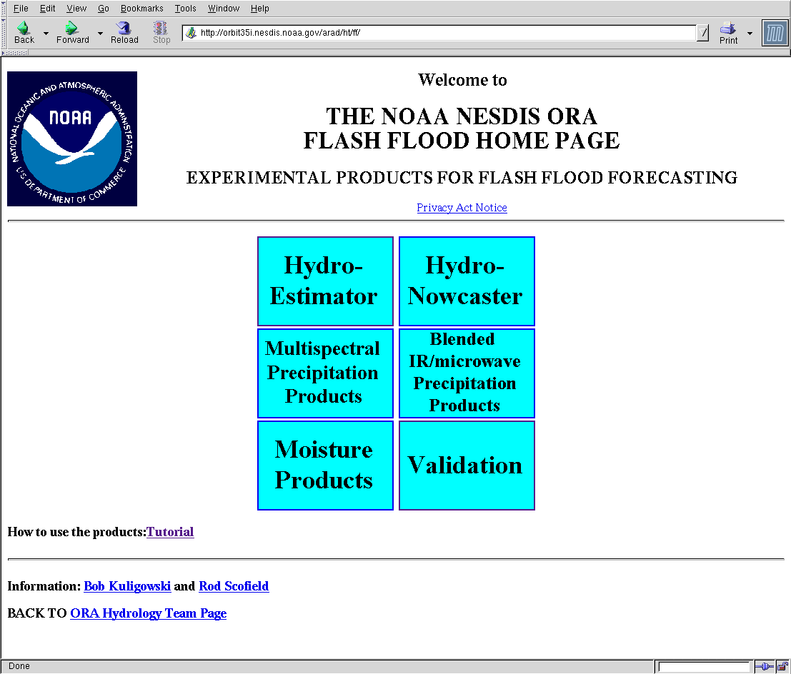
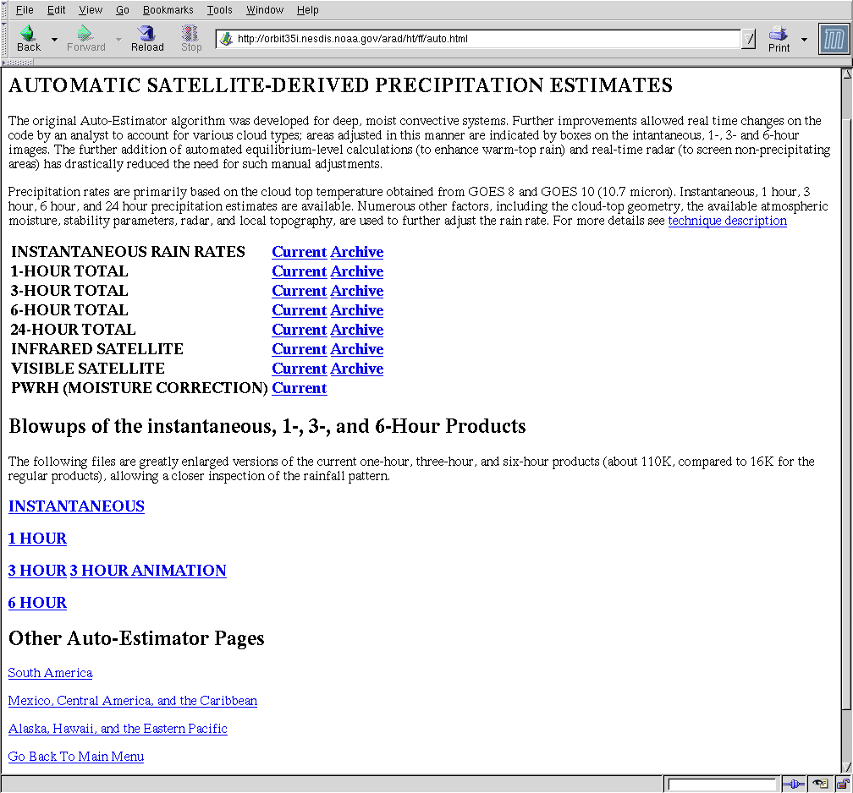
H-E—Where to Get Data
http://orbit-net.nesdis.noaa.gov/arad/ht/ff
Continental U.S.
Central & South America.

Slide 16
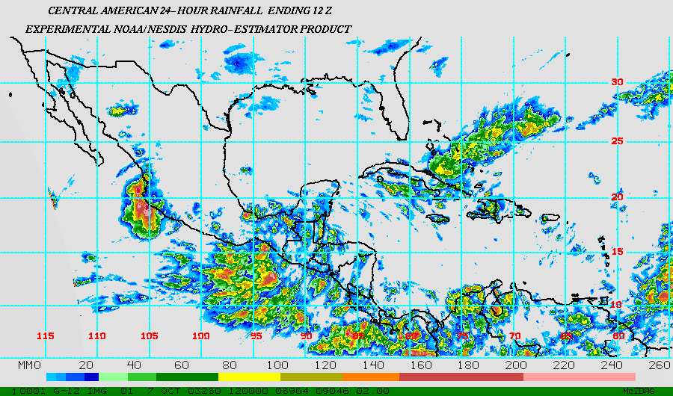
H-E—Example
T.D. Nora
T.D. Olaf
24-h Total Ending 1200 UTC 7 October 2003

Slide 17
IR Algorithms: GMSRA
GMSRA=GOES Multi-Spectral Rainfall Algorithm
Uses Data from 4 Different Channels:
  Visible (0.69 μm)—discriminate between thin (nonraining) cirrus and thicker (raining) clouds
  “Short” IR Window (3.9-μm)—use reflectivity to identify clouds that are warm but have large particles near cloud-top and are thus producing rain
  Water Vapor (6.7-μm)—warm signature above overshooting cloud tops differentiates from cirrus
  IR Window (10.7-μm)—texture screening of cirrus clouds (low texture=cirrus; high texture=rain) and calculation of rainfall rate (but dependent only on value at pixel of interest)

Slide 18
GMSRA Continued
Adjustment for rainfall evaporation using precipitable water and relative humidity data from numerical weather models
Produced every 15 minutes for the continental United States using GOES-10 and -12 data
Instantaneous rates are summed into 1-, 3-, 6- and 24-hourly totals
Available in real-time over the Internet from the NESDIS Flash Flood Home page
Contact: Mamoudou Ba at mba@atmos.umd.edu

Slide 19
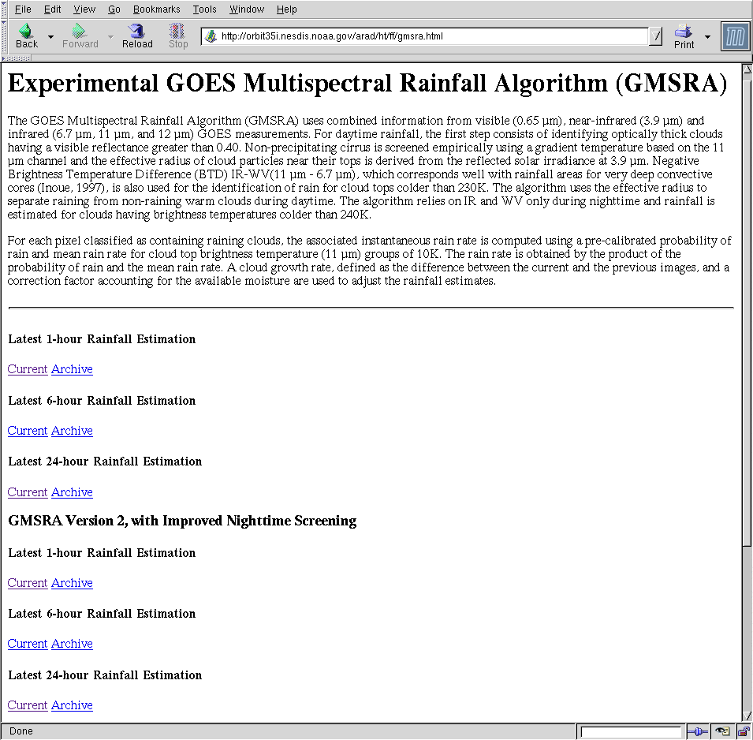
GMSRA—Where to Get Data
http://orbit-net.nesdis.noaa.gov/arad/ht/ff

Slide 20
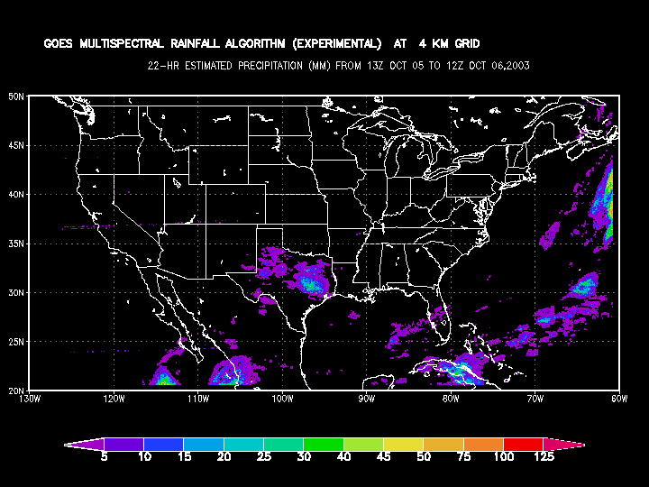
GMSRA—Example
24-h Total Ending 1200 UTC 6 October 2003

Slide 21
MW Algorithms: SSM/I
SSM/I=Special Sensor Microwave/Imager
  Seven channels: 19, 22, 37, and 85 GHz with both horizontal (H) and vertical (V) polarization (except no H on 22 GHz)
Two separate algorithms:
  Emission: T_{B} at 19V, 22V used to create “clear-sky” 37V values—degree of warming of observed 37V related to rainfall rate over water in regions of weak scattering
  Scattering: T_{B} at 19V, 22V used to estimate “clear-sky” 85V values—degree of cooling of observed 85V related to rainfall rate (separate calibrations for land and ocean)

Slide 22
SSM/I Continued
Approximate horizontal resolution of 25 km
Maximum rainfall rate of 35 mm/h
Available 6 times per day (~0600, 0915, 1100, 1800, 2115, 2300 Local Standard Time); estimates produced globally as data become available
Contact: Ralph Ferraro at Ralph.R.Ferraro@noaa.gov

Slide 23
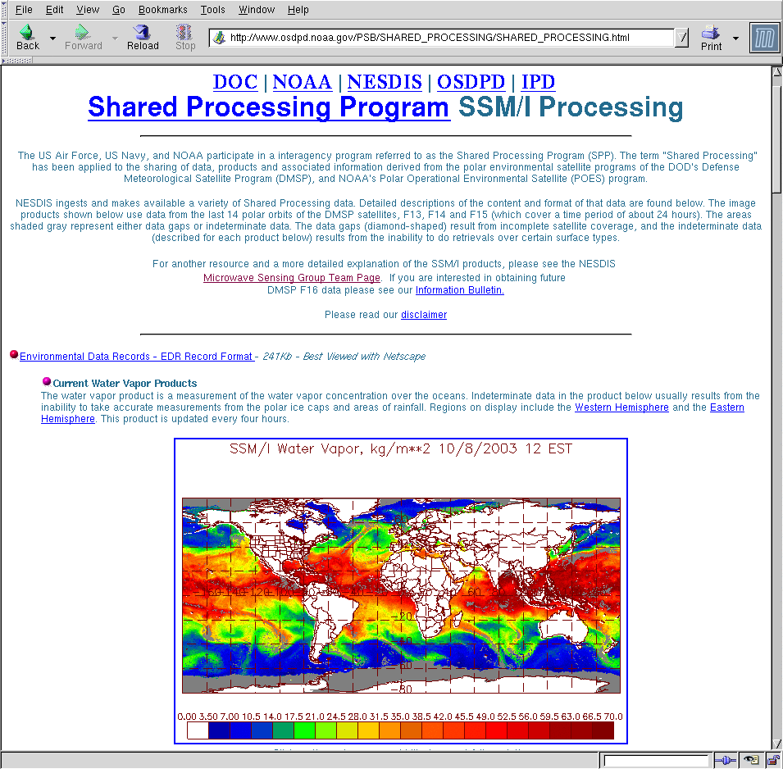
SSM/I—Where to Get Data
http://www.osdpd.noaa.gov/PSB/SHARED_PROCESSING/SHARED_PROCESSING.html

Slide 24
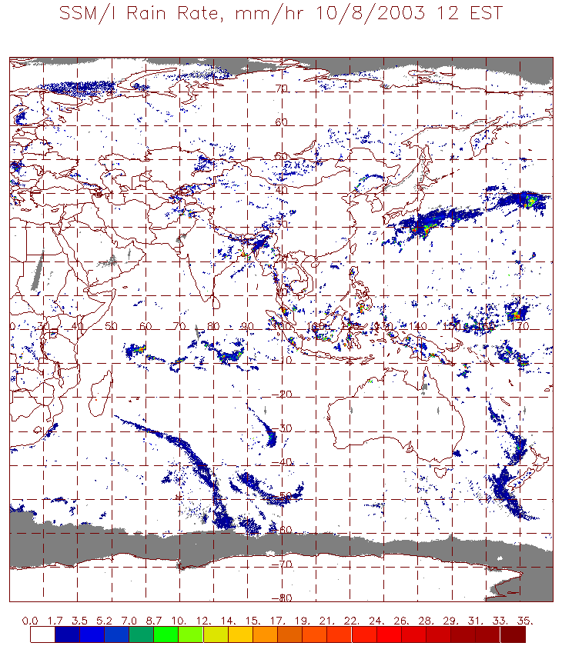
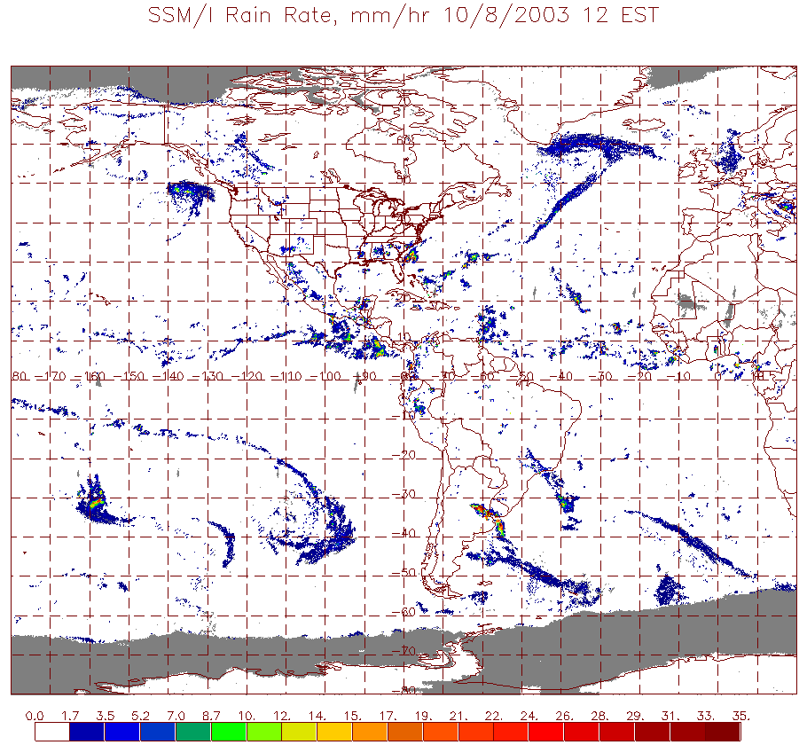
SSM/I—Example
Rain Rate During the 4 h Ending 1600 UTC 8 October 2003

Slide 25
MW Algorithms—AMSU-B
AMSU=Advanced Microwave Sounding Unit
Single scattering algorithm over both land and ocean: difference between brightness temperatures at 89 and 150 GHz is related to rainfall rate
Maximum rain rate of 35 mm/h
Approximately 16-km horizontal resolution
Available 6 times per day (~0130, 0730, 1030, 1330, 1930, and 2230 Local Standard Time); estimates produced globally as data become available
Contact: Ralph Ferraro at Ralph.R.Ferraro@noaa.gov

Slide 26
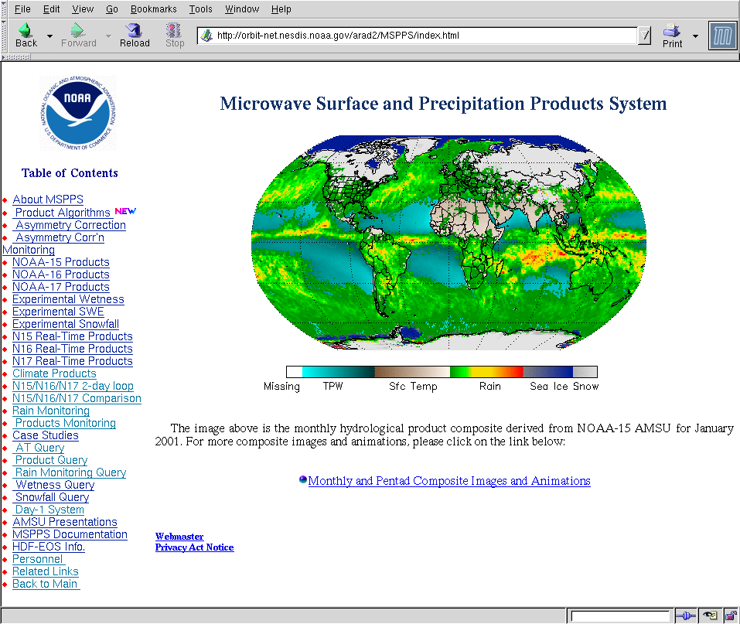
AMSU-B—Where to Get Data
http://orbit-net.nesdis.noaa.gov/arad2/MSPPS/index.html

Slide 27
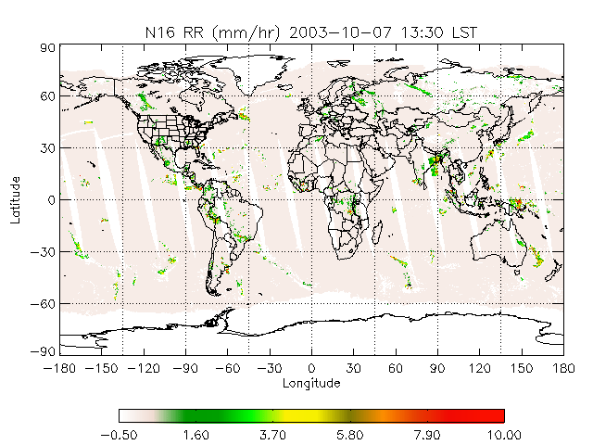
AMSU-B—Example
NOAA-16 Rain Rate at 1330 LST 7 October 2003

Slide 28
IR-Microwave Algorithms
Numerous algorithms for combining the relative accuracy of MW rainfall rates with the space/ time resolution of IR data
Most algorithms calibrate a relationship between MW rainfall rates and 10.7μm IR brightness temperatures
Three types (Turk algorithm, PERSIANN, and CMORPH) running in real-time at NOAA

Slide 29
IR-MW Algorithms: Turk
Developed by F. J. Turk of Naval Research Laboratory (NRL)
Determines relationship between MW rain rate and IR brightness temperature by matching cumulative distribution functions (CDF’s); e.g. 90th percentile rain rate is assigned to temperature corresponding to 90th percentile
Calibration updated every few hours for a 5x5-degree region
Also includes H-E adjustments based on model data (moisture, etc.)
Contact: Joe Turk at turk@nrlmry.navy.mil

Slide 30
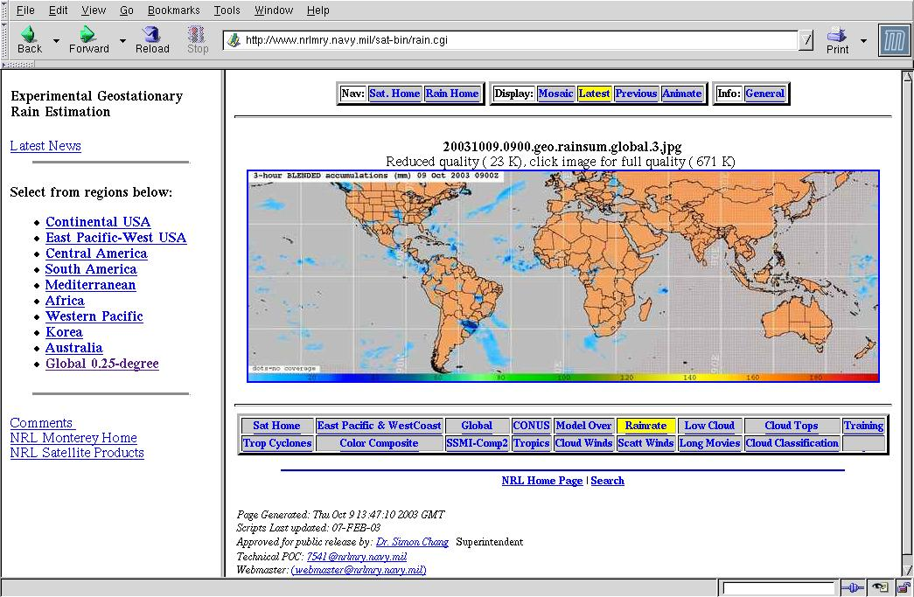
Turk Blend—Where to Get Data
http://www.nrlmry.navy.mil/sat-bin/rain.cgi
or (CONUS only): http://orbit-net.nesdis.noaa.gov/arad/ht/ff/blended.html

Slide 31
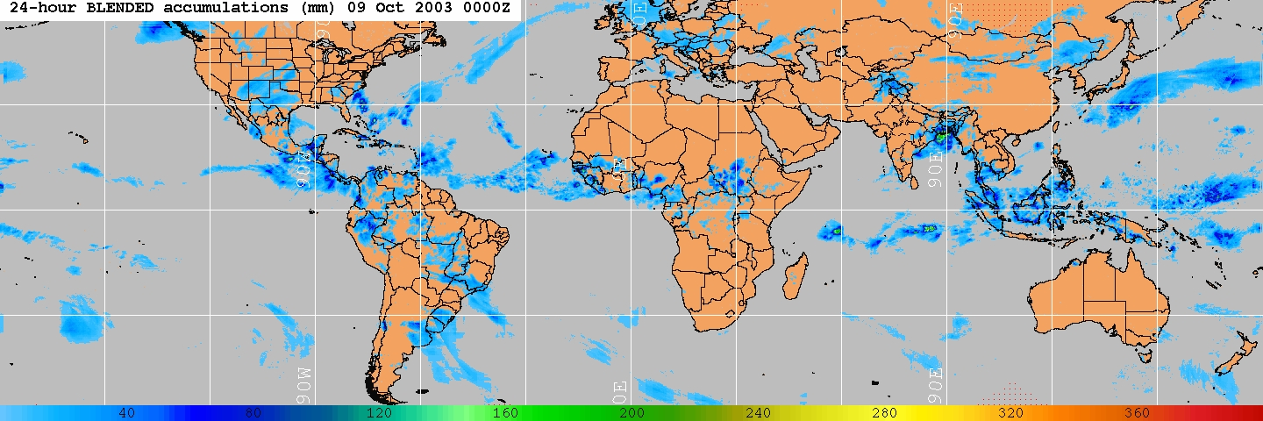
Turk Blend—Example
24-hour Total Ending 0000 UTC 9 October 2003

Slide 32
IR-MW Algorithms: PERSIANN
Precipitation Estimation from Remotely Sensed Information using Artificial Neural Networks
Developed by Soroosh Sorooshian’s research group at the U. of Arizona (now at UC-Irvine)
Uses artificial neural networks to relate 10.7-μm brightness temperature (both pixel values and local patterns) to MW rainfall rates
About to begin routine global estimates at 0.25-degree resolution
Will have link from NESDIS Flash Flood Web page
Contact: Bob Kuligowski at Bob.Kuligowski@noaa.gov

Slide 33
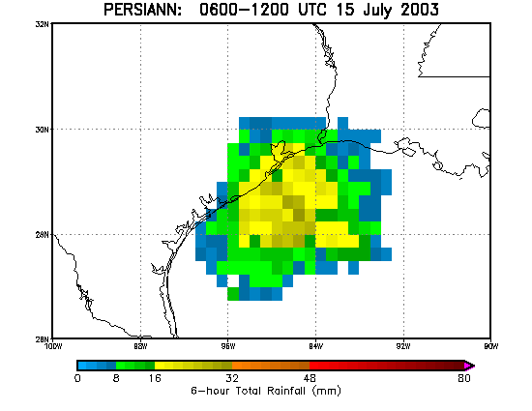
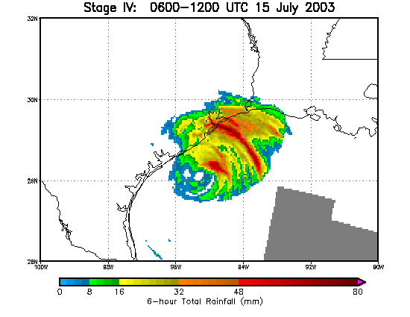
PERSIANN—Example
PERSIANN
Radar-Raingauge Blend
6-hour Total Ending 1200 UTC 15 July 2003
(Tropical Storm Bill)

Slide 34
IR-MW Algorithms: CMORPH
CMORPH=CPC MORPHing technique
Developed by R. Joyce and colleagues at the Climate Prediction Center (CPC)
Uses IR imagery to interpolate the movement of rainfall areas in MW imagery in between images
Also interpolates growth/decay of MW rainfall between MW images
Produced globally at 0.727-degree resolution in near-real time
Contact: Bob Joyce at Robert.Joyce@noaa.gov

Slide 35
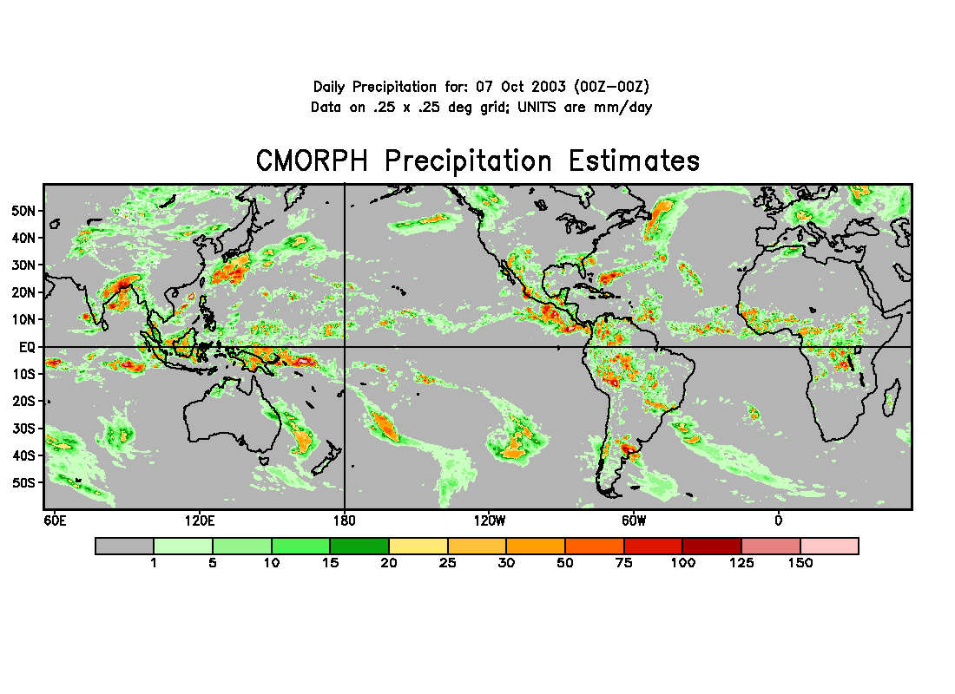
CMORPH—Example
24-h Totals ending 0000 UTC 8 October 2003

Slide 36
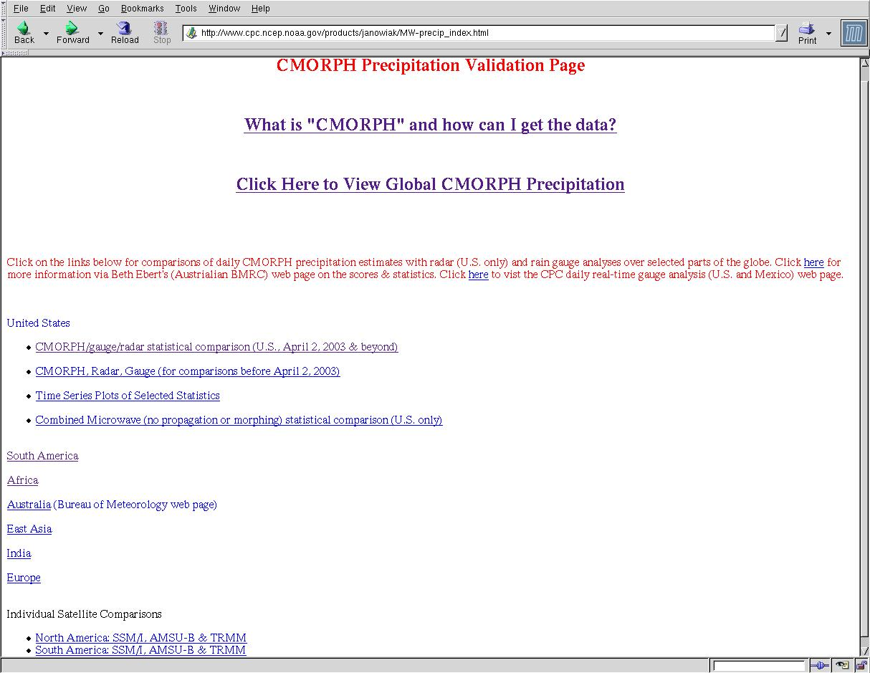
CMORPH—Where to Get the Data
http://www.cpc.noaa.gov/products/janowiak/MW-precip_index.html

Slide 37
Part I: Precipitation
Theory/basis—visible/IR and microwave
Specific Algorithms and Examples
Forecasting Tools
  TRaP
  Hydro-Nowcaster
Validation Efforts

Slide 38
Forecasting Tools: TRaP
TRaP=Tropical Rainfall Potential—24-hour precipitation forecast
Produced by extrapolating microwave-based instantaneous precipitation estimates along the predicted storm track
Forecasts produced automatically whenever a new microwave image or track forecast becomes available—posted in Web in graphic format

Slide 39
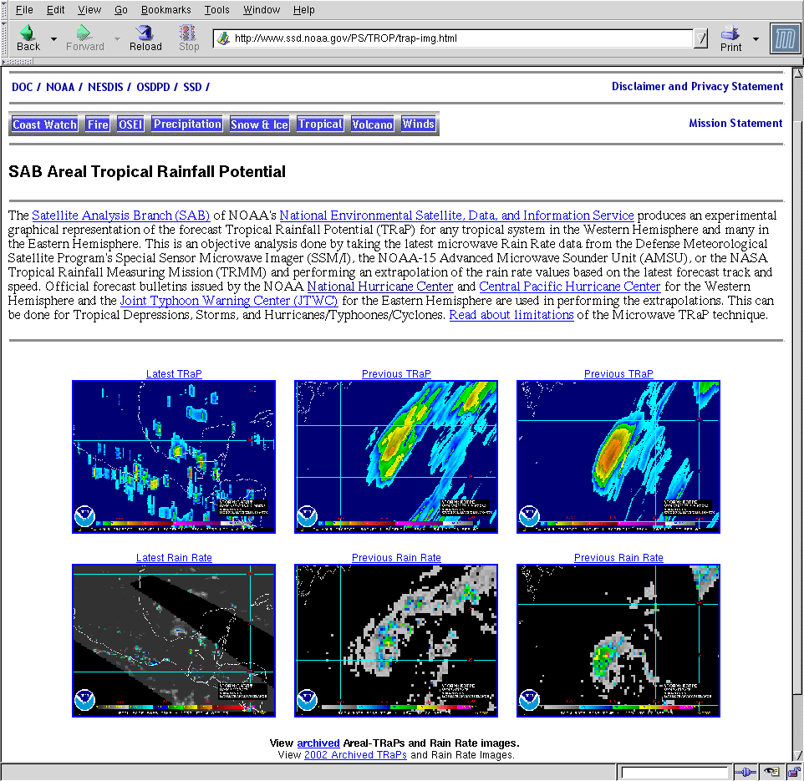
TRaP—Where to Get the Data
http://www.ssd.noaa.gov/PS/TROP/trap-img.html

Slide 40
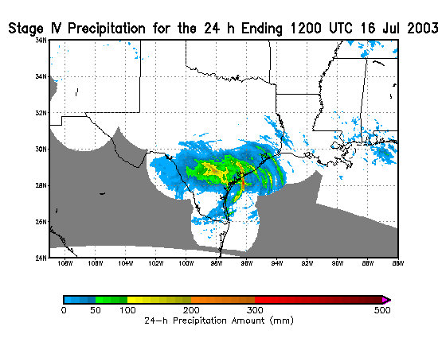
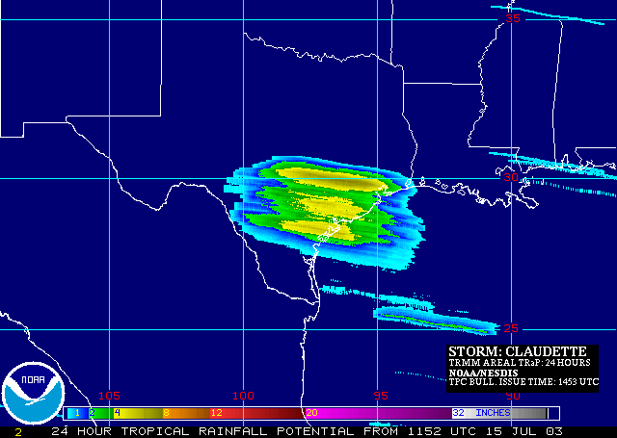
TRaP—Example
(Hurricane Claudette)
TRaP Forecast
Radar-Raingauge Blend
Pre-landfall TRaP for the 24 h ending 1200 UTC 16 July 2003

Slide 41
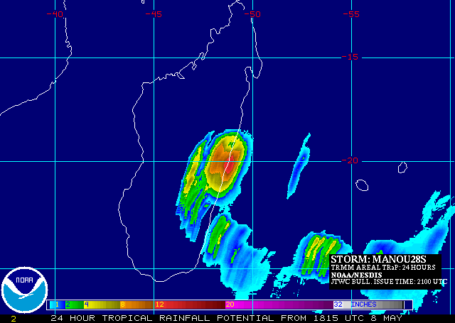
TRaP—Example
TRaP for Tropical Cyclone Manou—1815 UTC 8 May 2003

Slide 42
Forecast Tools: Hydro-Nowcaster
0-3 hour nowcasts of precipitation amount
Based on extrapolation of H-E instantaneous rainfall rates along the direction of movement of precipitation cells
Rain rates are enhanced or reduced with time based on previous trends
Produced routinely for the continental U.S.

Slide 43
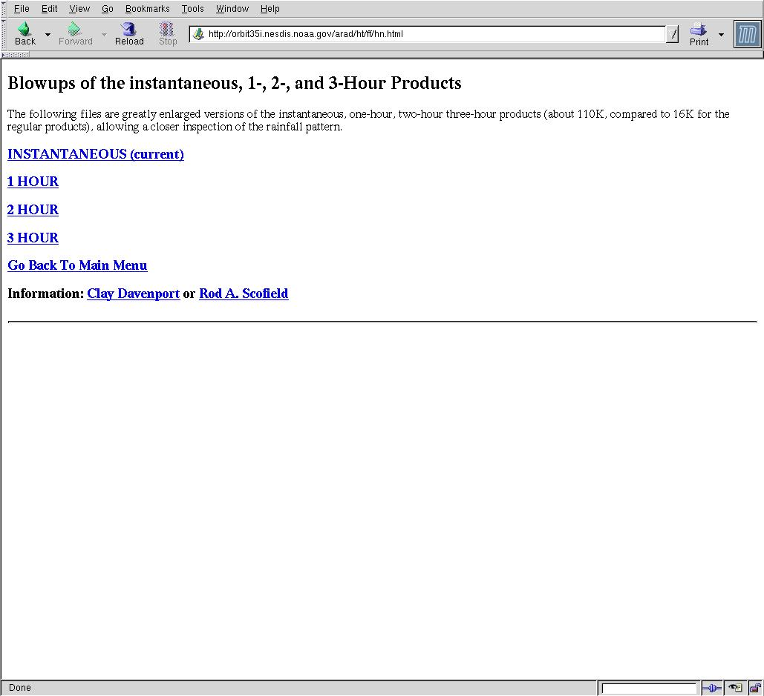
Hydro-Nowcaster—Where to Get Data
http://orbit-net.nesdis.noaa.gov/arad/ht/ff

Slide 44
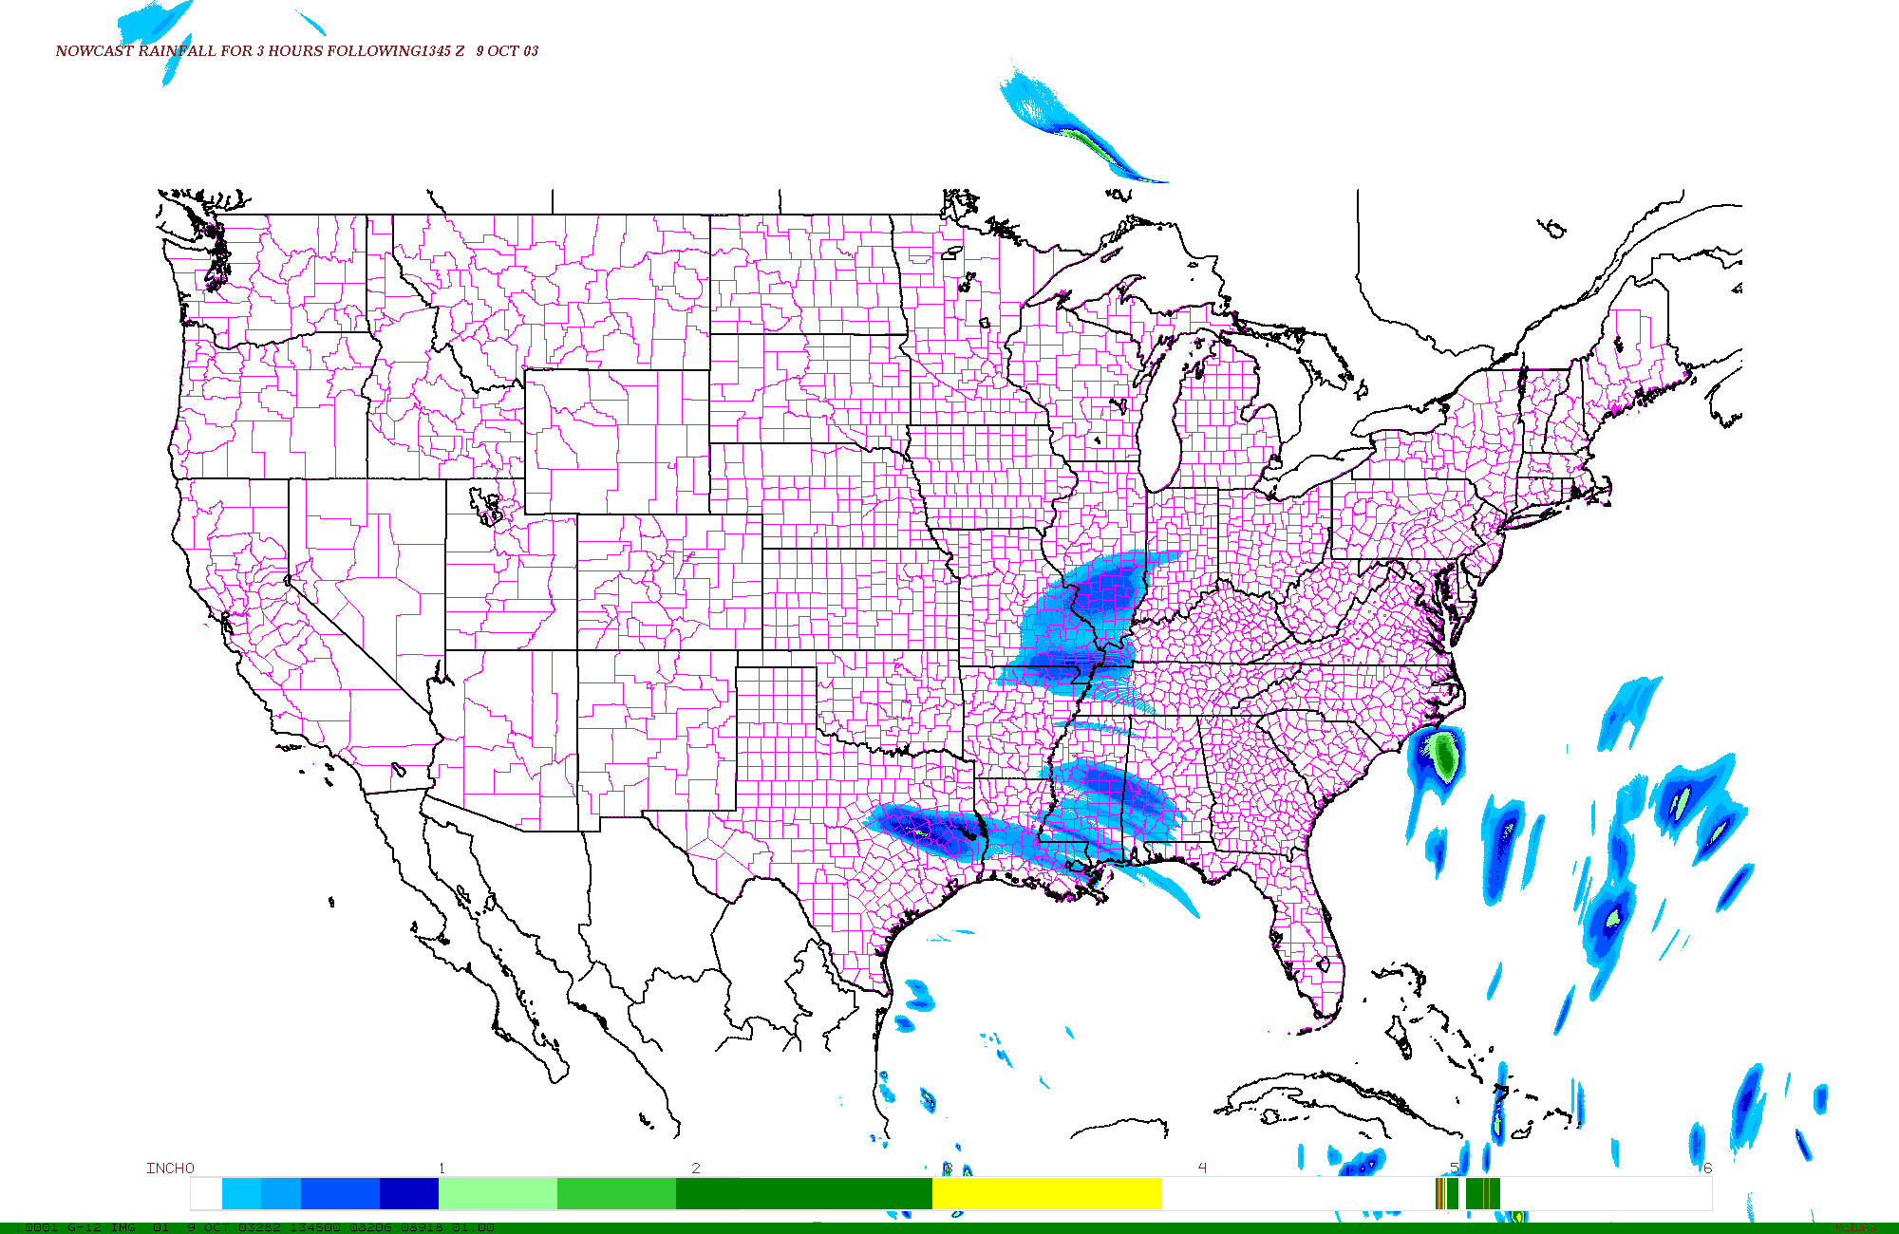
Hydro-Nowcaster—Example
3-h Forecast for 1345-1645 UTC 9 October 2003

Slide 45
Part I: Precipitation
  Theory/basis—visible/IR and microwave
  Specific Algorithms and Examples
  Forecasting Tools
  Validation Efforts

Slide 46
Satellite QPE Validation: NESDIS
Validation over continental U.S. against raingauges (24-h amounts) and 4-km Stage IV radar/raingauge blend (6-h amounts)
Statistics produced and displayed once per day
Daily spatial plots of all algorithms for 6 regions for comparison
Archive of digital data also available for analysis

Slide 47
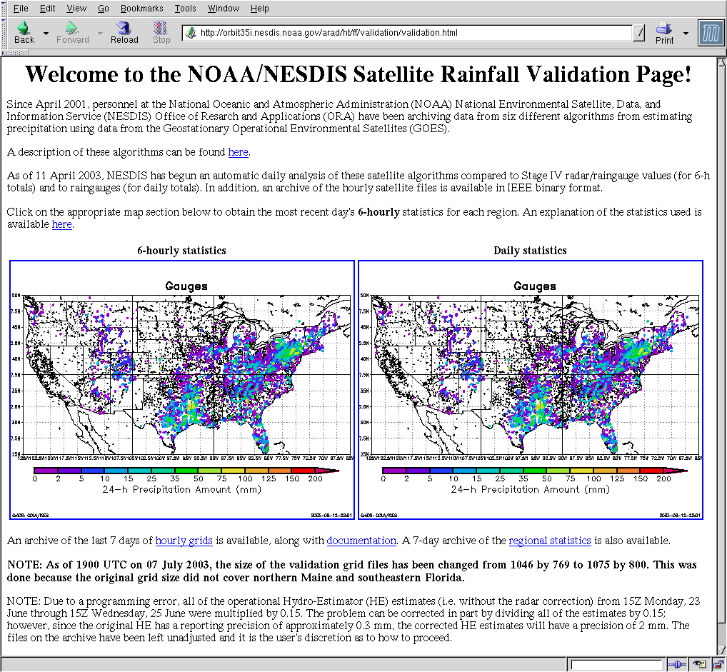
NESDIS Satellite QPE Validation Web Page
http://orbit-net.nesdis.noaa.gov/arad/ht/ff/validation/validation.html
Algorithm
descriptions
Click on map
regions for
statistics
Digital
Archive

Slide 48
Satellite QPE Validation: CPC
Validation against CPC daily 0.25-degree raingauge analysis over the continental U.S.
Evaluation of 14 different IR, MW, and PR+MW algorithms from different agencies
Numerous statistics for comparison, plus spatial plots of all algorithms

Slide 49
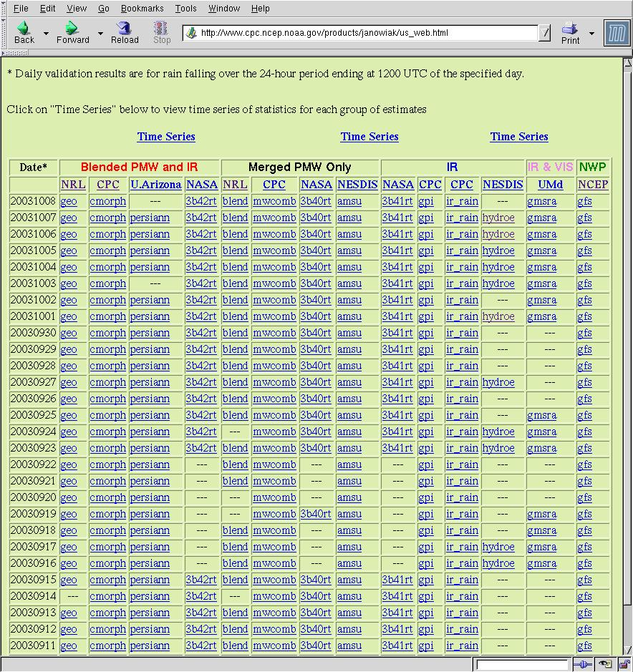
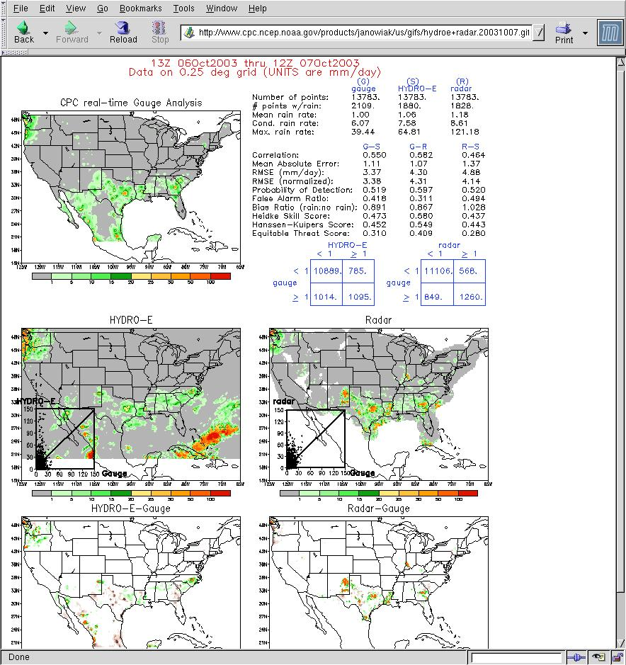
CPC Validation Web Page
http://cpc.ncep.noaa.gov/products/janowiak/us_web.html

Slide 50
Satellite QPE Validation: Australia
Validation over Australia against 0.25-degree daily raingauge analysis
Evaluation of 13 different IR, MW, and PR+MW algorithms plus precipitation forecasts from 4 numerical weather models
Numerous statistics for comparison, plus spatial plots of all algorithms

Slide 51
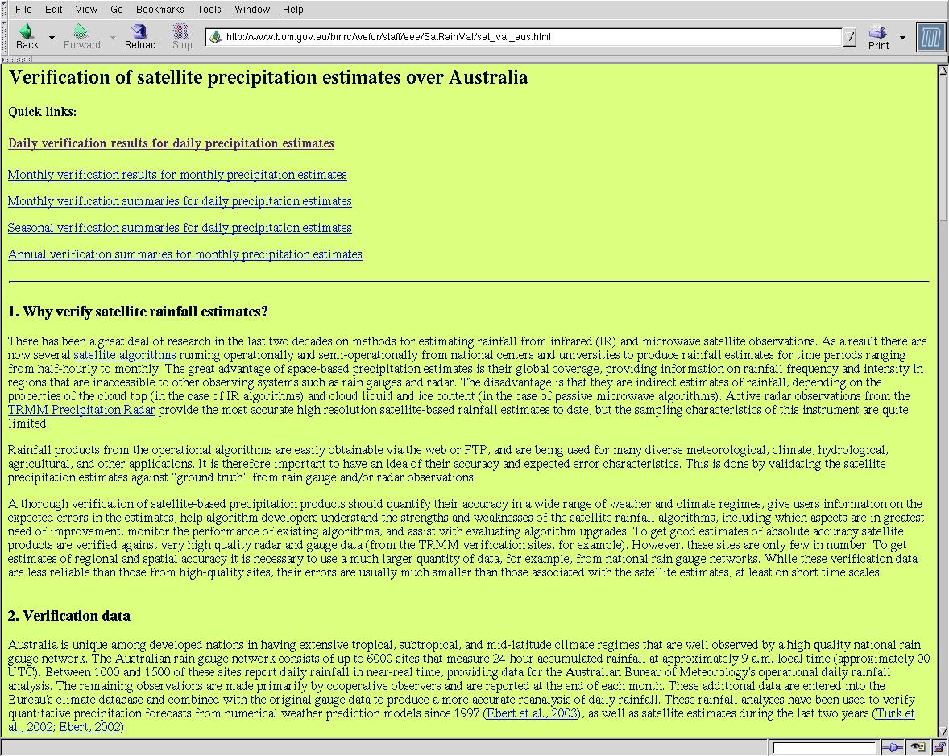
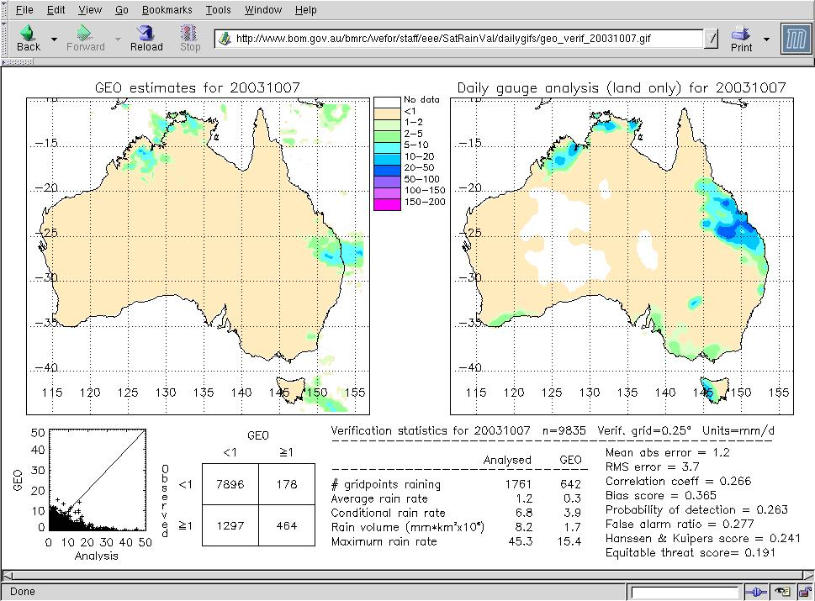
Australian Bureau of Meteorology Validation Page
http://www.bom.gov.au/bmrc/wefor/staff/eee/SatRainVal/dailyval_dev.html

Slide 52
Part II: Surface Conditions
Vegetation
Snow
Surface Wetness
Flood Inundation

Slide 53
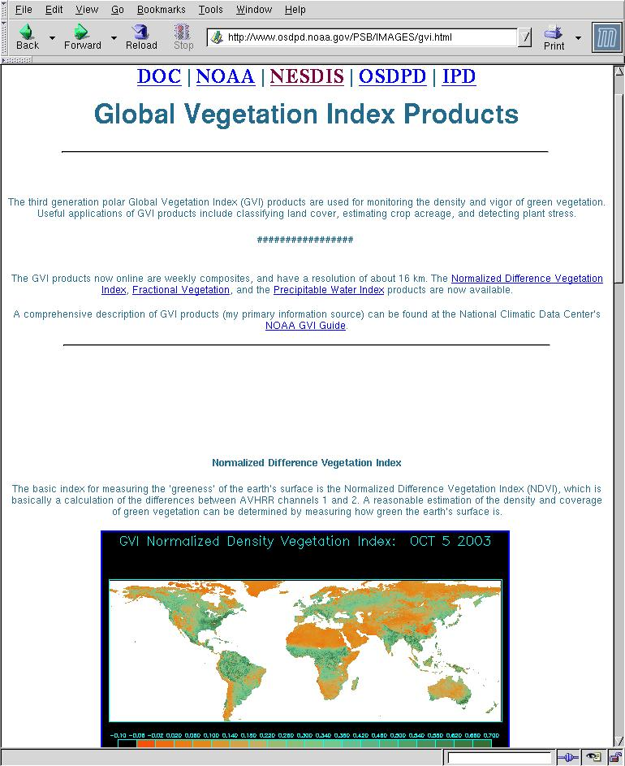
Vegetation Products
http://www.osdpd.noaa.gov/PSB/IMAGES/gvi.html

Slide 54
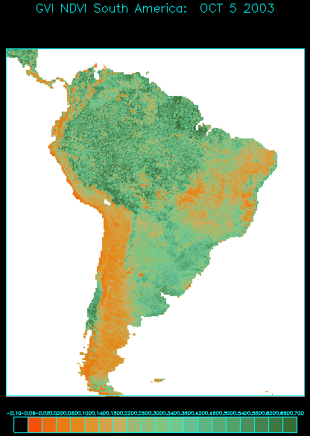
Vegetation Products: NDVI
Normalized Difference Vegetation Index
Values from -0.1 to +0.703
NDVI<0—bodies of water, clouds, rain, or snow
0<NDVI<0.1—rocks, bare soil, desert
NDVI>0.1—vegetation, with biomass proportional to NDVI value
0.0
0.1

Slide 55
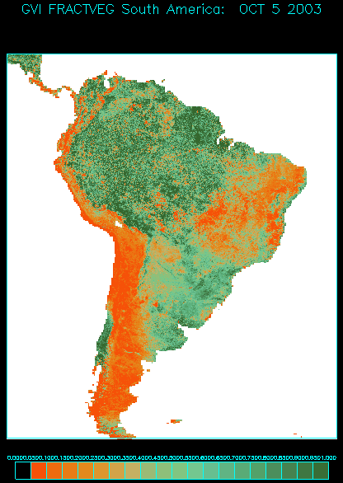
Vegetation Products: Fractional Vegetation
NDVI converted to fractional vegetation using a linear relationship:
NDVI≤0.07→0.0 fraction
NDVI≥0.57→1.0 fraction

Slide 56
Vegetation Products: Vegetative Health
Uses a combination of visible, 0.85-µm, and 10.8-µm bands of the polar-orbiting Advanced Very High Resolution Radiometer (AVHRR)
Sensitive to clorophyll and moisture content in the vegetation and to surface temperature
Ranges from 0 (extremely poor) to 50 (fair) to 100 (excellent)
Values below 35 indicate vegetative stress and drought
16-km spatial resolution; updated once per week
Contact: Felix Kogan at Felix.Kogan@noaa.gov

Slide 57
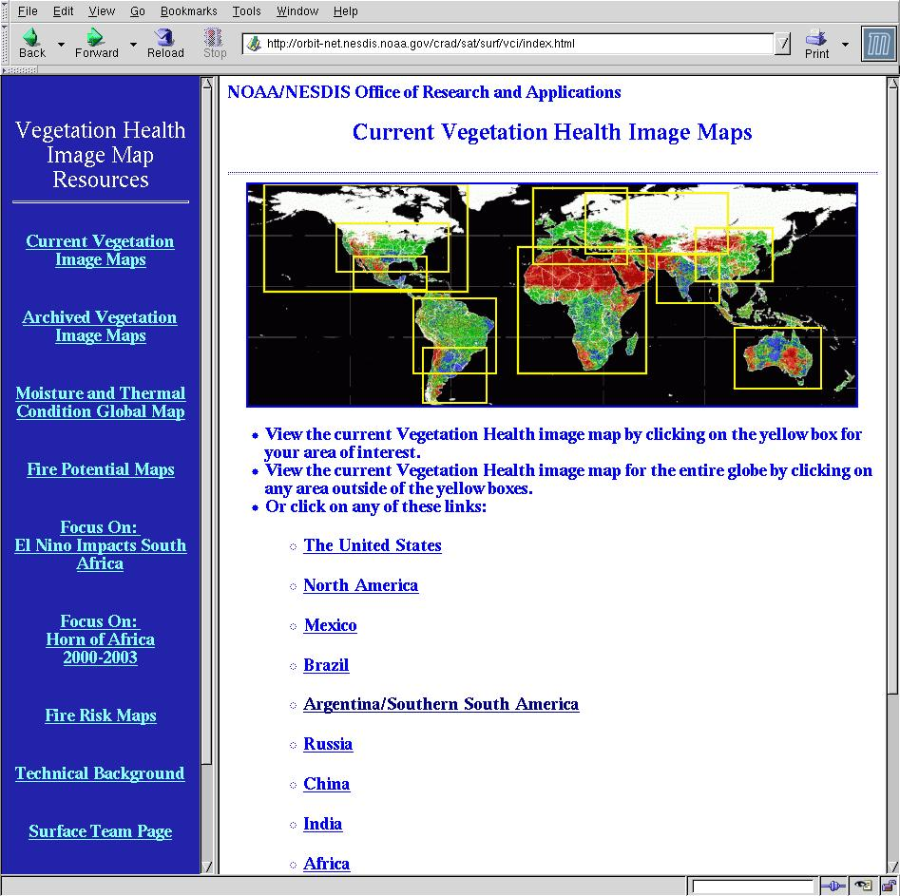
Vegetative Health: Where to Get the Data
http://orbit-net.nesdis.noaa.gov/crad/sat/surf/vci/index.html

Slide 58
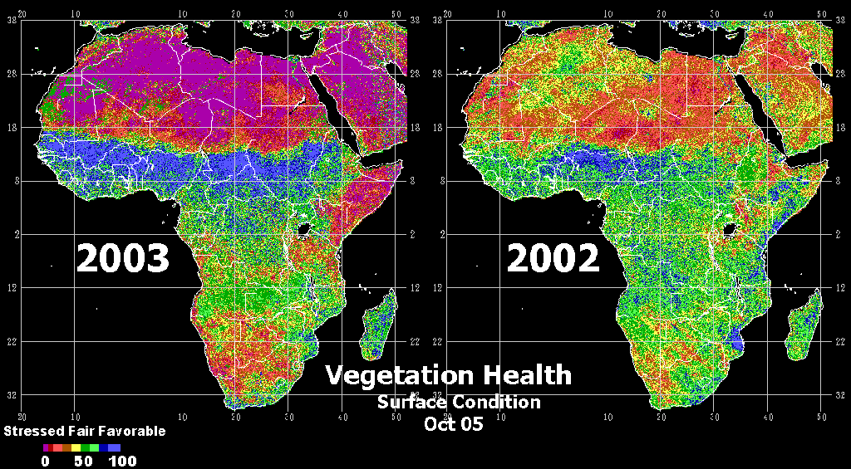
Vegetative Health: Example
Comparison for Africa for 05 October 2002 and 2003

Slide 59
Part II: Surface Conditions
Vegetation
Snow
  Automated
  Manual
Surface Wetness
Flood Inundation

Slide 60
Automated Snow Products—Where to Get Data
http://orbit-net.nesdis.noaa.gov/arad2/MSPPS/index.html
Link to previous day’s products
Experimental Snow Water Equivalent (SWE)
Link to current products

Slide 61
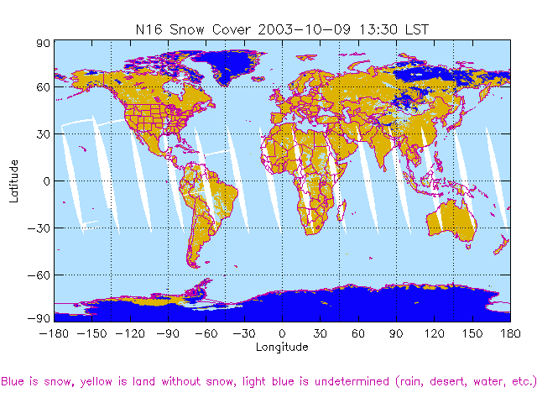
Automated Snow Cover—Example
NOAA-16 AMSU Snow Cover at 1330 LST 9 October 2003

Slide 62
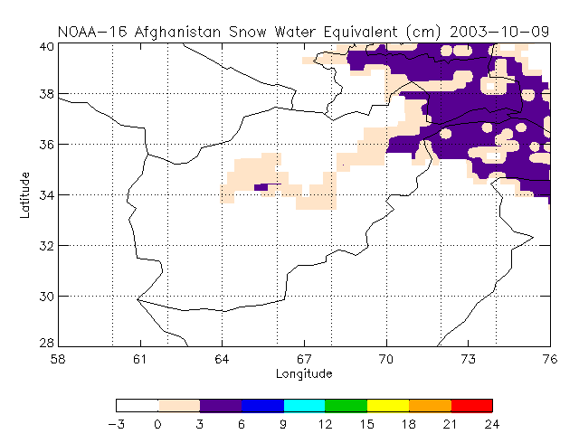
Snow Water Equivalent (SWE)—Example
NOAA-16 AMSU SWE for 9 October 2003

Slide 63
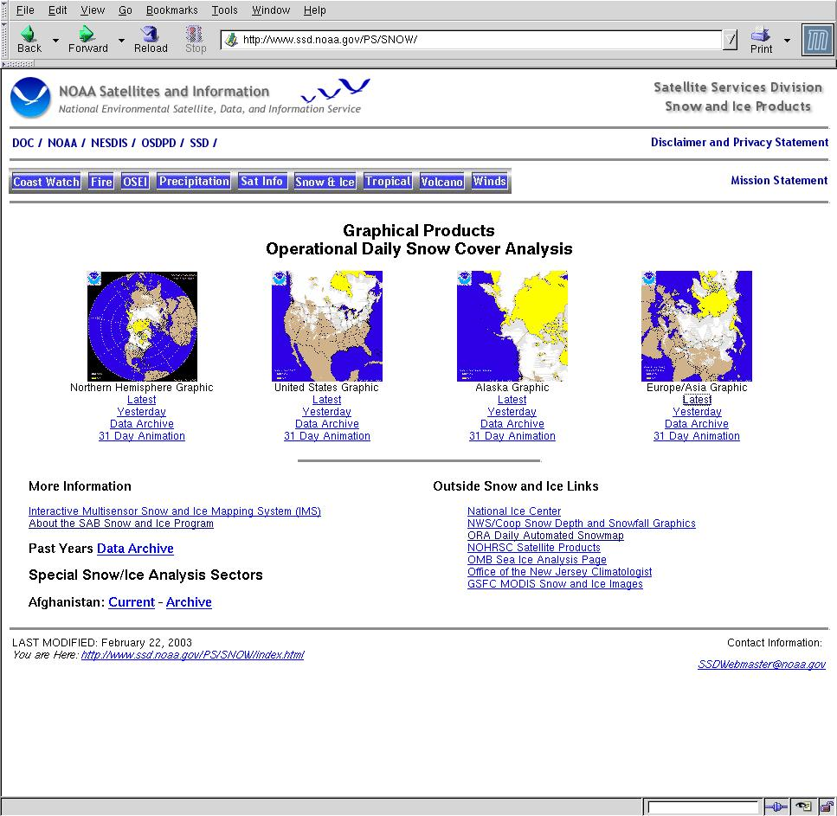
Manual Snow Products—Where to Get Data
http://www.ssd.noaa.gov/PS/SNOW/
Current and recent daily snow products by region
Data archive from past years

Slide 64
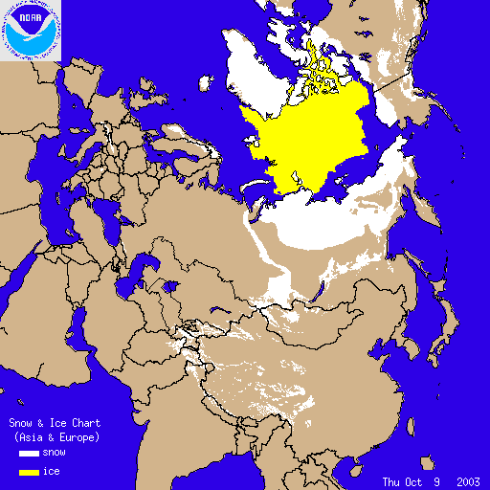
Manual Snow Cover—Example
Estimates are produced daily by Satellite Analysis Branch (SAB) forecasters using satellite imagery and surface observations.
Snow Cover for 9 October 2003

Slide 65
Part II: Surface Conditions
Vegetation
Snow
Surface Wetness
Flood Inundation

Slide 66
Surface Wetness—Where to Get Data
http://orbit-net.nesdis.noaa.gov/arad2/MSPPS/index.html
Link to experimental surface wetness for US and China

Slide 67
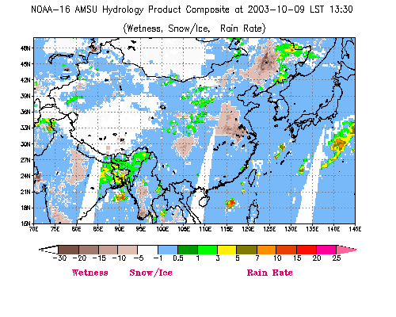
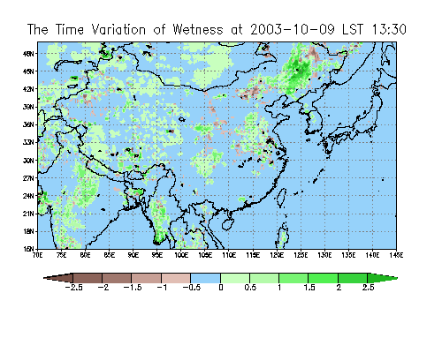
Surface Wetness—Example
Surface Wetness and Precipitation
24-h Change in Surface Wetness
NOAA-16 AMSU Wetness Products for 9 October 2003

Slide 68
Part II: Surface Conditions
Vegetation
Snow
Surface Wetness
Flood Inundation

Slide 69
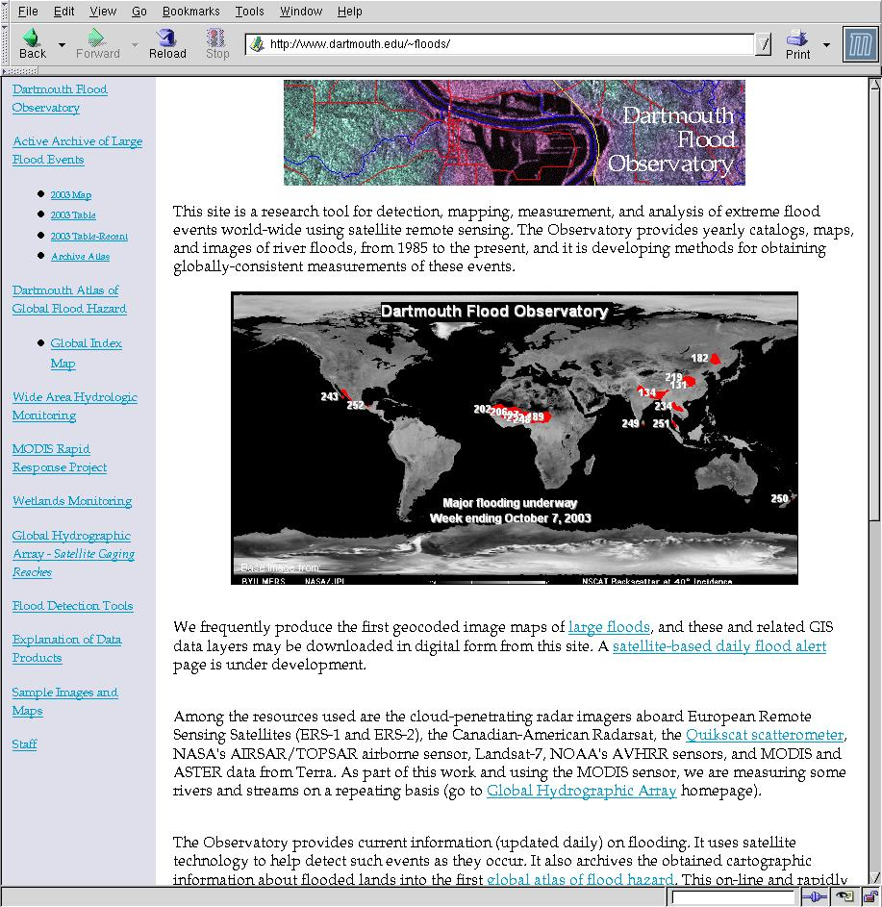
Flood Inundation
http://www.dartmouth.edu/~floods
Monitors flooding worldwide
Uses data from a combination of satellites to produce inundation images for larger floods
Archives available

Slide 70
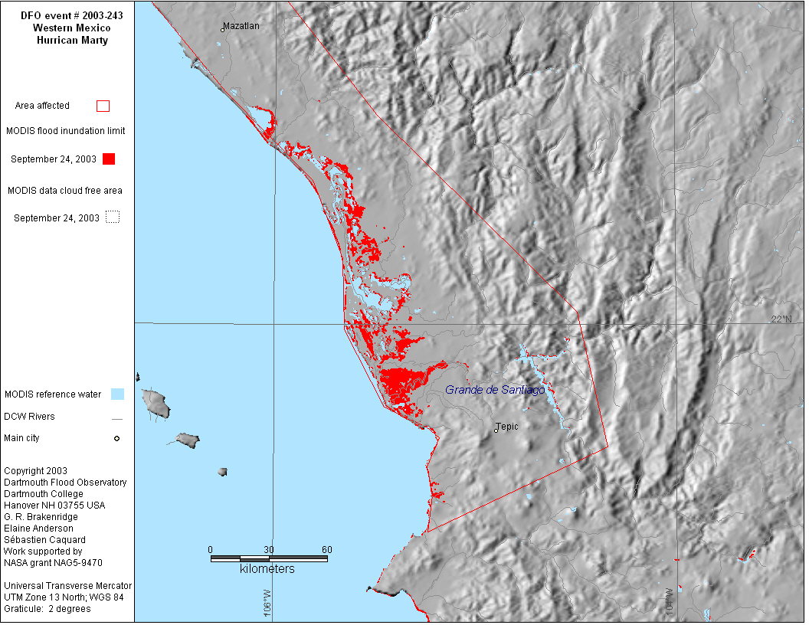
Flood Inundation—Example
Flooding in southwestern Mexico from Hurricane Marty—24 September 2003

Slide 71
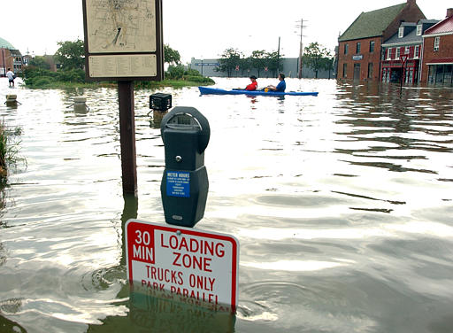
Questions?

