Slide 1
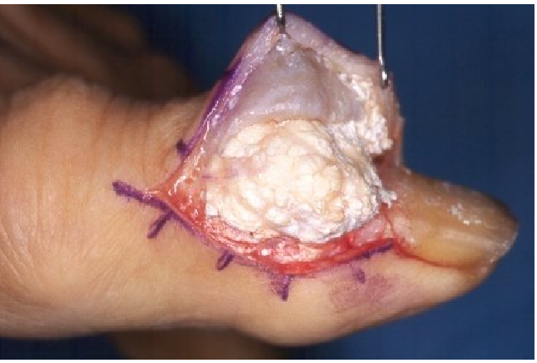
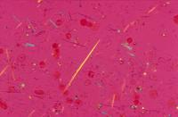
GOUT: THE PROTOTYPICAL CRYSTAL
DEPOSITION ARTHROPATHY
Monosodium
Urate
Crystal

Slide 2
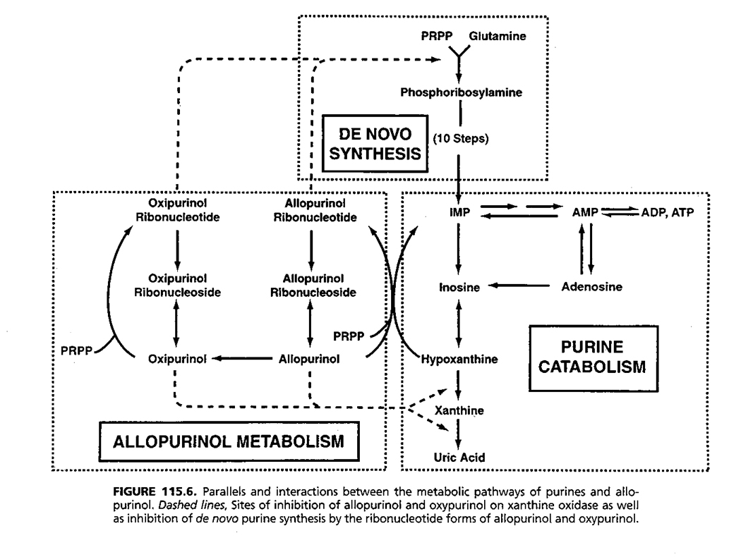
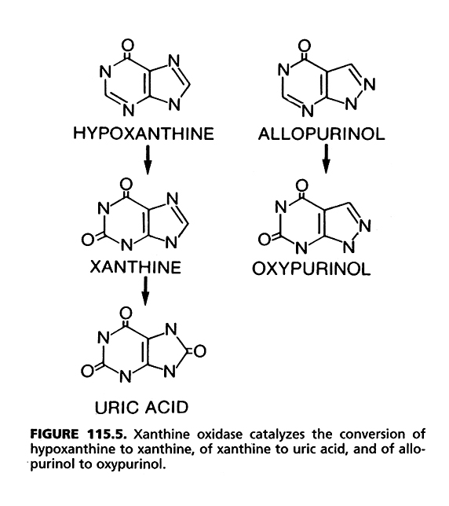
Xanthine Oxidase
Xanthine Oxidase
Uric Acid: A Normal Product of Purine Metabolism
Notes:
Edwards, NH. Arthritis and Allied Conditons, Koopman, WJ, Lippincott Williams Wilkins, p. 2320. 2001

Slide 3
Miscible
urate
pool
DELICACY OF URIC ACID BALANCE
IN HUMANS

Slide 4
Uric Acid Imbalance
Hyperuricemia
Increased Total Body Miscible Urate Pool
Monosodium Urate Crystal Deposition
Clinical Expression:
Tophi
Gouty Arthritis
Uric Acid (and Oxalate) Urolithiasis
Interstitial Nephropathy

Slide 5
Gout:
Etiology Well Understood
Diagnosis & Rx of Arthritis and Hyperuricemia Well-Developed but Often Poorly Applied
Prevalence > 1% in adults (~ 3-5 million in USA)
High Prevalence in Certain Minorities
Disease Growing in Numbers
Disease Evolving Clinically via Iatrogenic and Socioeconomic Factors
= MAJOR PUBLIC HEALTH PROBLEM

Slide 6
GOUT EPIDEMIOLOGY IN RAW NUMBERS

Slide 7
BASES FOR INCREASED GOUT PREVALENCE AND
CLINICAL COMPLEXITY IN THE USA
FROM 1980’s-PRESENT
INCREASED LONGEVITY
INCREASED HYPERTENSION
INCREASED DIURETIC AND ASPRIRIN THERAPY
DIETARY TRENDS
INCREASED OBESITY &METABOLIC SYNDROME
DEMOGRAPHIC TRENDS
IMPROVED CAD, CHF, DM SURVIVAL
INCREASED ESRD SURVIVAL AND TRANSPLANTS
LIMITATIONS IN CURRENT ANTIHYPERURICEMICS

Slide 8
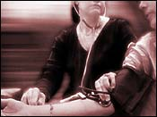
High Blood Pressure Rising In U.S.
July 8, 2003
(Photo: AP / CBS)
Government data collected to chart the nation's health shows that in 1991, 25 percent of adults surveyed had high blood pressure and in 2000, the number climbed to 28.7 percent.

Slide 9
HYPERTENSION TREATMENT PATTERNS ARE CHANGING
ALLHAT STUDY RESULTS ARE INTERPRETED TO SUPPORT USE OF INEXPENSIVE THIAZIDES
The Thiazide Chlorthalidone compared to ACE inhibitor, Calcium Channel Blocker, Alpha-Adrenergic blocker in 42,418 USA subjects with mild-moderate hypertension:
Thiazide had improved stroke, CHF outcomes
Ferdinand KC. Am J Hyp 2003

Slide 10
SUMMARY OF VA VISN 22 PRESCRIPTION REVIEW 1999-2003
(Population: ~92%male, n ~ 250,000)
ASA UP ~10%
FUROSEMIDE UP 4.7%
HYDROCHLORTHIAZIDE UP 74.2%
ALLOPURINOL UP 12.3%

Slide 11
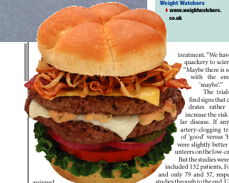
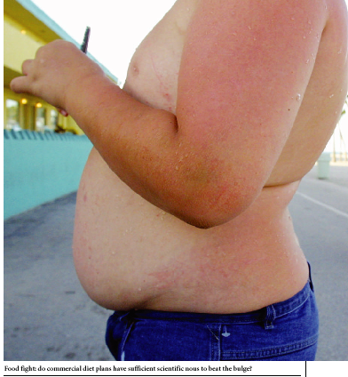
The “American Diet” and its consequences

Slide 12
Obesity, Metabolic Syndrome and Gout
~ 1/3 of Americans meet
criteria for obesity, ~2/3 overweight
Obesity and Increased Body Mass alone associated with Hyperuricemia
Insulin Resistance Compounds the Problem

Slide 13
PRINCIPAL FEATURES OF
METABOLIC SYNDROME
ELEVATED CIRCULATING INSULIN LEVELS
INSULIN RESISTANCE
GLUCOSE INTOLERANCE OR TYPE II DM
ABDOMINAL (VISCERAL) OBESITY: defined as waist
circumference > 40 inches in men (>35 inches in females)
DYSLIPIDEMIA (Hypertriglyceridemia&low HDL chol)
HYPERTENSION
HYPERURICEMIA
INCREASED RISK OF ATHEROSCLEROSIS AND
COAGULATIVE ARTERIAL OCCLUSIVE EVENTS

Slide 14
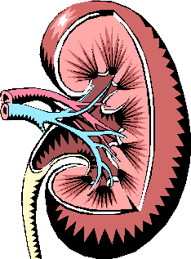
Renal Effects of Metabolic Syndrome Pertinent to Gout
Hyperinsulinemia Stimulates Increased Renal Sodium and Urate Reabsorption
A Mild Defect in Renal Ammonium Excretion Associated with IR Promotes Acid Milieu for Uric Acid Urolithiasis
Urate
pH
relative risk of urolithiasis
in men with diagnosis of gout:
= 2.12
Kramer et al . Kidney Int 2003

Slide 15
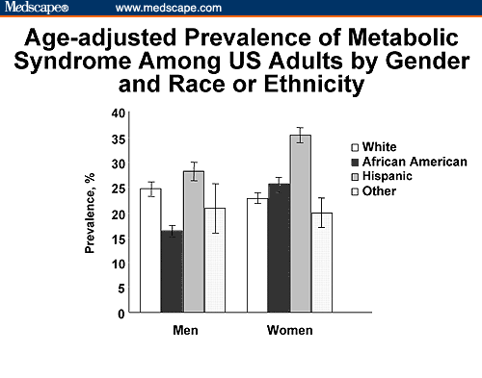
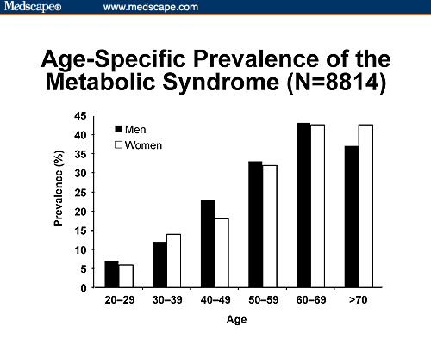

Slide 16
Diet and Alcohol-Related Trends Influencing Incident Gout
in the “Health Professionals Follow-Up Study”
Relative risk of incident gout :
Meat 1.41
Seafood 1.51
Dairy 0.56
Any Alcohol 2.53
Five 12 oz Beers/Wk To One Beer Daily 1.75
Two or More Beers Daily 2.51
Per Shot of Spirits daily 1.15
Per Glass of Wine Daily 1.04
Highest intake quintiles
n = 47,150 men without gout aged 40-75,
12 year follow-up with 730 cases of new gout
Choi H et al, NE_x0008_JM and Lancet 2004

Slide 17
SEVERAL POPULAR DIETS HIGH IN FAT AND LOW IN CARBOHYDRATES HAVE THE POTENTIAL TO PROMOTE HYPERURICEMIA VIA KETOSIS AND HIGH MEAT AND SEAFOOD INTAKE

Slide 18
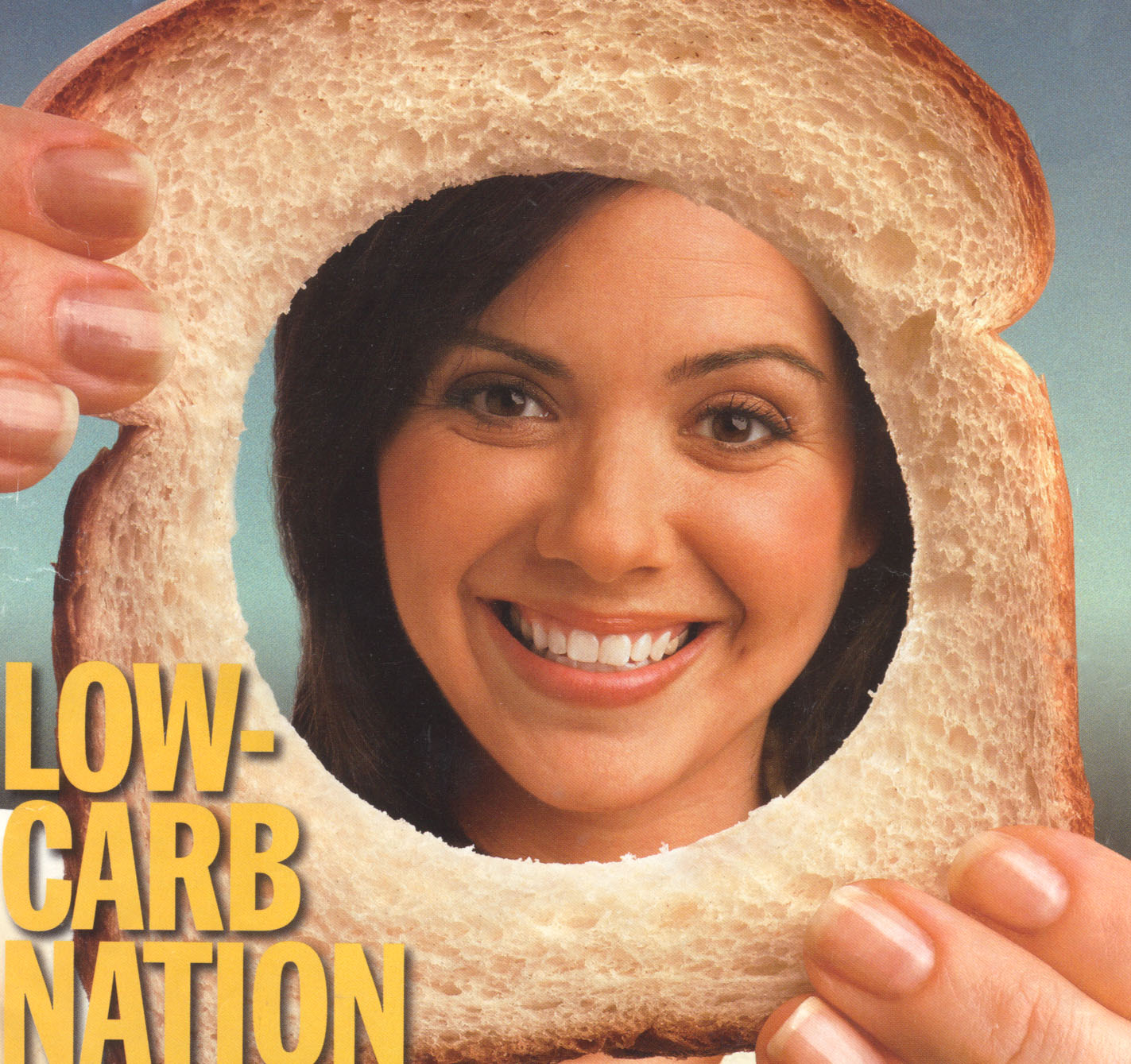
“LOW CARB” MANIA IN THE USA:
TIME, May 2004
26
MILLION
The number of
Americans on a
hard-core low carb
diet right now
$30
BILLION
Expected sales of
low-carb products
in 2004. That’s
more than Coca-Cola
generates in revenue
from soft-drink sales
worldwide

Slide 19
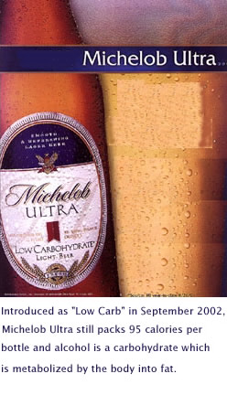
USA TRENDS IN ALCOHOL CONSUMPTION IN
THE LAST 20 YEARS MAY FAVOR INCIDENT GOUT
Overall alcohol consumption flat or slightly declining
Beer consumption has risen steadily
Beer is rich in the readily absorbed purine Guanosine
Light beer and “Low Carb” Beers markedly increased in
market share and promoted as “health-conscious” option

Slide 20
GOUT EPIDEMIOLOGY:
CLASSIC PROFILE OF GOUT PATIENT.
MALE, MIDDLE-AGED, AFFLUENT, EDUCATED, ALCOHOL, HOT PODAGRA

Slide 21
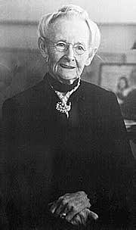
EMERGING EPIDEMIOLOGY IN GOUT:
MORE FEMALES, ++ RISE IN 70-80 AGE GROUP

Slide 22
GOUT IN OLDER WOMEN
INCREASING PREVALENCE ALONG WITH INCREASED LONGEVITY
LINKED TO COMMON USE OF DIURETICS (>25% after age 65)
LINKED TO CRI AND CHF
WILL DECREASED USE OF ESTROGENS RAISE URIC ACID&GOUT PREVALENCE ?
MAY BE CLINICALLY SUBTLE AND MASQUERADE AS INFLAMMATORY HAND OSTEOARTHRITIS

Slide 23
A COMMON PRESENTATION OF GOUT
IN OLDER WOMEN:
TOPHACEOUS GOUT IN
JOINTS WITH PRIMARY OA

Slide 24
RENAL INSUFFICIENCY PROMOTES
HYPERURICEMIA AND GOUT AND
MAKES MANAGEMENT OF HYPERURICEMIA
AND GOUTY ARTHRITIS
SUBSTANTIALLY MORE DIFFICULT

Slide 25
Rise in End Stage Renal Disease (ESRD) & Transplants in USA
1987: ESRD 156 new cases/million
1997: ESRD 303 new cases/million
(ESRD prevalence 4-5 x higher in African- Americans and Elderly)
1988 Renal Transplants 8,874
2002 Renal Transplants 14,777
(Improved transplant donor networks and protocols also >> more heart, liver, pancreas transplants)

Slide 26
EVOLVING EPIDEMIOLOGY OF GOUT:
TRANSPLANT/CYCLOSPORINE GOUT
HYPERURICEMIA IN >80%
MEAN SERUM URATE >12 mg%
GOUT PREVALENCE >10% BY 3 YEARS

Slide 27
TRANSPLANT CYCLOSPORINE (CSA)
GOUT:
RAPIDLY EXPANDING TOPHI REFRACTORY TO Rx
?EXTRARENAL CSA EFFECTS
ARTHRITIS REFRACTORY TO STEROIDS AND OTHER Rx’s
CSA NEPHROPATHY
CRI AND CSA
CONTRIBUTE TO SERIOUS, ADVERSE DRUG INTERACTIONS
INCLUDING COLCHICINE TOXICITIES

Slide 28
GOOD NEWS PREDICTION: CYCLOSPORINE GOUT WILL BE A BRIEF FOOTNOTE IN THE LONG HISTORY OF GOUT
CYCLOSPORINE ALTERNATIVES WITH LESS HYPERURICEMIC AND NEPHROPATHIC TOXICITY ARE CURRENTLY BEING OPTIMIZED FOR TRANSPLANT MEDICINE:
TACROLIMUS (FK506): another calcineurin inhibitor but marginally better for hyperuricemia
SIROLIMUS (RAPAMYCIN)
MYCOPHENOLATE
COMBINATION REGIMENS WITH LOW-DOSE CSA
EVENTUALLY: ADVANCES IN THERAPEUTIC IMMUNE TOLERANCE WILL RENDER CSA FULLY OBSOLETE

Slide 29

INCREASED GOUT PREVALENCE AND GOUT CLINICAL COMPLEXITY IN THE USA
OVER THE LAST 20 YEARS:
THE PERFECT STORM

Slide 30
Gout Epidemiology: Nationwide ~25% Rise in Allopurinol-Treated Patients 1996-2002
Allopurinol Patients - IMS factored TRx for Gout by 4.7 TRxs per Patient
Notes:
Source: Data from "Allopurinol67-02-IMSnrx_trx"
and "AlloAnnualRoundup-trx-nrx"
2002 Est. through Nov. data
Scripts factored for gout and Allo patients
factored by 6.06 (avg. number of rx purchased per patient)

Slide 31
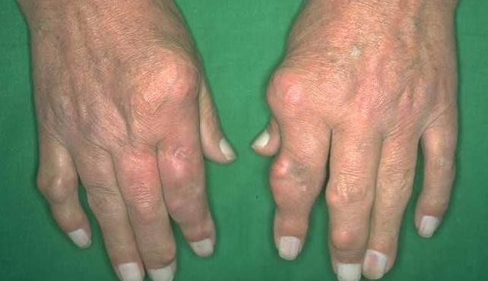
EVOLVING EPIDEMIOLOGY OF GOUT:
REFRACTORY TOPHACEOUS DISEASE
HAS NOT DISAPPEARED AND APPEARS
TO BE MAKING A COMEBACK

Slide 32
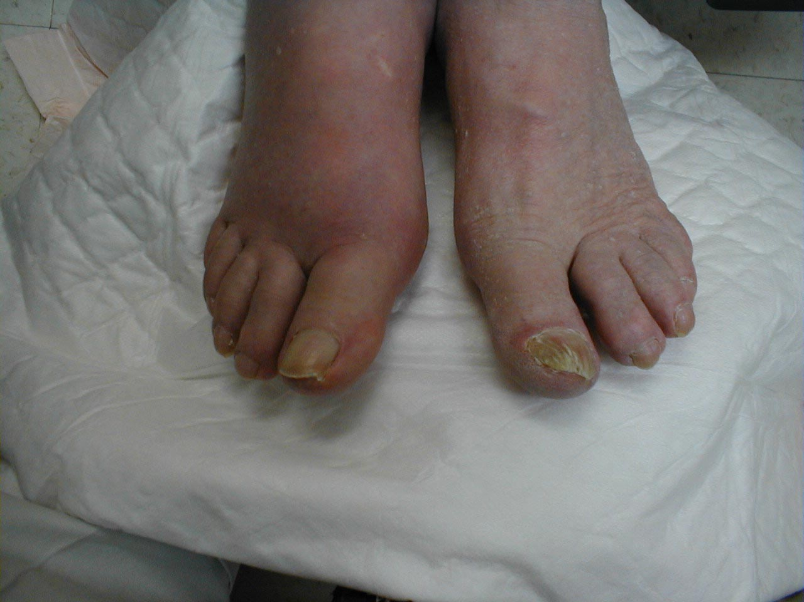
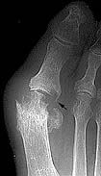
REFRACTORY GOUT IS PAINFUL, DESTRUCTIVE, AND INCAPACITATING
JOINT EROSION CAN PROGRESS EVEN WITH EFFECTIVE URATE LOWERING THERAPY

Slide 33
Prevention and Management of Urate Crystal Deposition:
Larger Issues and Needs
1. Sustained hyperuricemia associated with incident gout in only ~20% by 5 years:
Need to determine what factors other than serum uric acid account for clinical crystal deposition as gout; can urate crystallization regulators be harnessed in therapy ?
2. Extent of Effectiveness of Diet and Alcohol/Lifestyle and BP Therapy Modifications Alone ?
3. Existing Generation of Antihyperuricemics is Antiquated and Needs Improvement

Slide 34
DIETS TO REDUCE URIC ACID LEVELS
*Traditional low purine diets unpalatable and only reduce serum urate by up to 1 mg/dL or 15%
* ? Role of Customized 40/30/30 Diet with Caloric Reduction for Gout

Slide 35
SMALL OPEN STUDY OF “LOW CARB” DIET
FOR URATE LOWERING
13 nondiabetic overweight men with gout
Wt reduction diet tailored for Insulin Resistance
Caloric restriction to 1600 kcal/day
40/30/30 carbs/protein/fat
Replaced refined carbs with complex carbs
Replaced saturated fat with monounsaturates in olive oil, nuts, and seafood
Mean wt loss 7.7 kg at 16 week endpoint
Serum urate levels decreased by 18%
Dessein et al: Ann Rheum Dis 2000

Slide 36
SIGNIFICANCE:
NOT ALL LOW CARB DIETS MAY BE ADVERSE FOR
HYPERURICEMIA
EFFECTS OF DIET AND ALCOHOL MODIFICATION
ON HYPERURICEMIA AND GOUT NEED CAREFUL, CONTROLLED
LONG-TERM STUDY

Slide 37
URIC ACID LOWERING DRUGS CURRENTLY IN USE
1. XANTHINE OXIDASE INHIBITORS:
ALLOPURINOL (> 95% of US Market)
OXYPURINOL (compassionate use basis)
XO
XO

Slide 38
LIMITATIONS OF ALLOPURINOL
RASH IN ~2%
INTOLERANCE IN UP TO 10%
MAJOR ALLOPURINOL HYPERSENSITIVITY SYNDROME RARE BUT HAS ~20% MORTALITY
OXYPURINOL CROSS-REACTIVITY LIMITS ALTERNATIVE USE
TOPHUS REDUCTION OFTEN SLOW
OPTIMUM DOSING CONTROVERSIAL, PARTICULARLY WITH CRI

Slide 39
CURRENT OPTIONS FOR ALLOPURINOL-HYPERSENSITIVE&REFRACTORY GOUT
NO CRI, URATE UNDEREXCRETION
*URICOSURIC
CRI, URATE OVERPRODUCTION
*ALLOPURINOL-ALLERGIC
* ALLOPURINOL
DESENSITIZATION (50:50)
*OXYPURINOL
*IF ALLOPURINOL-TOLERANT
& REFRACTORY GOUT
*PUSH ALLOPURINOL
* ? COMBINE
ALLOPURINOL WITH
PROBENECID, LOSARTAN

Slide 40
URIC ACID LOWERING DRUGS CURRENTLY IN USE
2. DRUGS USED TO PROMOTE URICOSURIA:
PROBENECID
SULFINPYRAZONE (problematic)
BENZBROMARONE (not FDA-approved, hepatotoxicity can be serious)
LOSARTAN, FENOFIBRATE (relatively weak effects,
questionable extent of synergy with current drugs)

Slide 41
CAN WE DEVELOP PHARMACOGENOMIC APPROACHES TO OPTIMIZE URATE-LOWERING THERAPY BASED ON RECENT DEVELOPMENTS IN RENAL URATE HANDLING ?

Slide 42
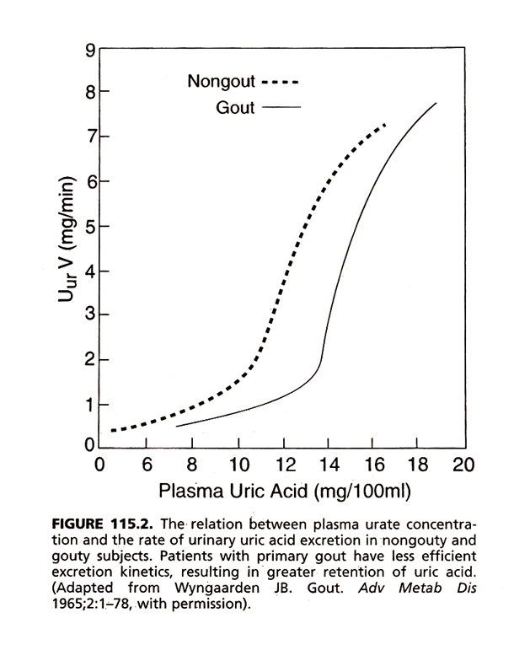
CLASSIC DISORDER IN RENAL URATE EXCRETION
IN PRIMARY GOUT
Notes:
Edwards, NH. Arthritis and Allied Conditions, Koopman, WJ, Lippincott Williams Wilkins, p. 2316. 2001

Slide 43
“OLD 4-COMPONENT MODEL OF RENAL URATE HANDLING”
SOURCE: DR PAUL DIEPPE

Slide 44
URAT1
Urate
TUBULE LUMEN
INTRACELLULAR
NH₂
COOH
Anion Exchanger
Activated
by Organic Anions
(Less so by Inorganic
Anions)

Slide 45
Phylogenetic tree of
human transporters
of SLC22
family (e.g. URAT1)
*
Distance along the branches is inversely related the degree of sequence identity. For example, sequence identities are 70% between hOCT1 and hOCT2, 32% between hOCT1 and hOCTN1, and 32% between hOCT1and hOAT1.
Koepsell, H. and Endou, H. Pflugers Arch July 2003

Slide 46
SNPS AND MUTATIONS
IN
MULTIPLE-PASS
TRANSMEMBRANE
SLC22
TRANSPORTERS
MAY CAUSE DISEASE
Koepsell, H. and Endou, H. Pflugers Arch July 2003

Slide 47
INTRARENAL SLC22 FAMILY
MEMBER EXPRESSION
REGULATED BY:
GENDER
AGING AND DEVELOPMENT
HYPERTENSION
HYPERURICEMIA
RENAL FAILURE
CERTAIN DRUGS

Slide 48
Urate
URAT1
TUBULE LUMEN
INTRACELLULAR
NH₂
COOH
Anion
+
Urate
UAT
+
+
EXTRACELLULAR
INTRACELLULAR
-
-
Urate
COOH
NH₂
-
β GALACTOSIDE BINDING SITE
ADENOSINE BINDING SITE
URATE/OXONATE
BINDING SITE

Slide 49
Proximal Tubule Cell Urate Reabsorption
Organic
Anion
Organic Anion
Organic Anion
OAT3?
(e.g., Lactate, PZA)
Urate
Urate
URAT1
Urate
Urate
+
_
Urate
UAT
Urate
Benzbromarone
Probenecid
Losartan
Sulfinpyrazone
+
_
basolateral
membrane
(interface with
the circulation)
apical
membrane
(tubule
lumen)

Slide 50
Proximal Tubule Cell Urate Secretion
Urate
Urate
Urate
Urate
Na⁺
OAT1
OAT3?
NPT1?
Anion
Anion
_
+
Urate
Urate
UAT
basolateral
membrane
_
+
apical
membrane

Slide 51
2004: URATE HANDLING IN THE NEPHRON
Glomerular Filtration: Normally ~99%
Bidirectional
Urate Movement
in Proximal Tubule
*
Reabsorption
Secretion
Reabsorption Fine Tuning
? Na⁺/H⁺
antiporter,
OATS
Excretion:
Normally ~10%
of Filtered Load
Pharmacogenomics and URAT1:
Probenecid, Pyrazinamide, Benzbromarone Fail to Alter
Renal Urate Clearance in subjects with Defective URAT1
*

Slide 52
PROBLEM: EFFECTIVENESS OF ALL CURRENT URICOSURICS IS LIMITED
CRI
URATE OVERPRODUCTION IN 10- 25% OF PRIMARY GOUT UROLITHIASIS RISK
OTHER SIDE EFFECTS AND DRUG INTERACTIONS

Slide 53
POTENTIAL THERAPEUTIC
ROLE OF URICASE
URIC ACID + 2.H₂0+ O₂
ALLANTOIN + H₂O₂ + CO₂
URICASE (Uric acid oxidase)
A critical means to convert relatively insoluble
uric acid to highly soluble allantoin

Slide 54
URICASE GENE SILENCING
RENDERS HUMAN URATE BALANCE
PRECARIOUS
Urate Insoluble in vitro at ~7 mg/100 ml

Slide 55
RECOMBINANT URICASE FOR URIC ACID LOWERING
FDA-APPROVED FOR SHORT TERM SINGLE COURSE IN PEDIATRIC HEMATOLOGIC MALIGNANCIES
PROFOUND ACUTE URATE-LOWERING
(e.g. 10-15 --> 1-2 mg/dL)
EFFECTIVE URATE-LOWERING IN SHORT TERM STUDIES IN GOUT
POTENTIAL FOR ACCELERATED TOPHUS DISSOLUTION (MONTHS)

Slide 56
RECOMBINANT URICASE:
CURRENT STATUS
IMMUNOGENICITY LIMITS SAFETY AND EFFICACY
H₂O₂ GENERATION LIMITS SAFETY:
CELL TRANFORMATION IN VITRO,
ANAPHYLAXIS, HEMOLYSIS with G6PD loss,
METHEMOGLOBINEMIA IN VIVO
POTENTIALLY LETHAL
NOT ORALLY BIO-AVAILABLE
CLINICAL TRIALS OF LESS IMMUNOGENIC PEGYLATED FORMS IN PROGRESS FOR GOUT

Slide 57
PROPOSED THERAPEUTIC NICHE FOR RECOMBINANT URICASE IN GOUT:
Limited-term (months) treatment with long-lasting recombinant uricase preparations of low antigenicity for the reduction of macroscopic, destructive tophus burden in carefully selected patients

Slide 58
ASYMPTOMATIC HYPERURICEMIA AND VASCULAR DISEASE
Serum urate correlates with untreated BP in children of 6-18
Hyperuricemia a powerful predictor pf atherosclerosis and arterial occlusive events and adverse outcome in 1⁰ vascular diseases (e.g., 12-fold more cardiac death in stroke survivors at 5 yrs, adjusted for renal function)
Serum urate may be an independent risk factor for atherosclerosis and certain atherosclerotic vaso-occlusive complications
Feig et al, Hypertension 2003, and Wong et al Eur Ht J 2002
Reviewed in Bieber and Terkeltaub, Arthritis and Rheumatism, 2004

Slide 59
ASYMPTOMATIC HYPERURICEMIA AND RENAL AND VASCULAR DISEASE
Controversial Recent Data Suggest Direct Linkage of Hyperuricemia to:
VSMC Dysfunction
Increased sodium reabsorption
Hypertension
Glomerulopathy
Cyclosporine Nephropathy
CRI

Slide 60
IS MARKEDLY ELEVATED “NORMAL” SERUM URATE IN HUMANS A BENEFICIAL OR HARMFUL RESULT OF EVOLUTIONARY HUMAN URICASE GENE SILENCING?

Slide 61
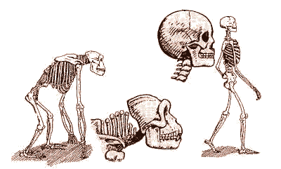
EVOLUTION OF
APES TO HOMINIDS
WITH MORE UPRIGHT
POSTURE

Slide 62
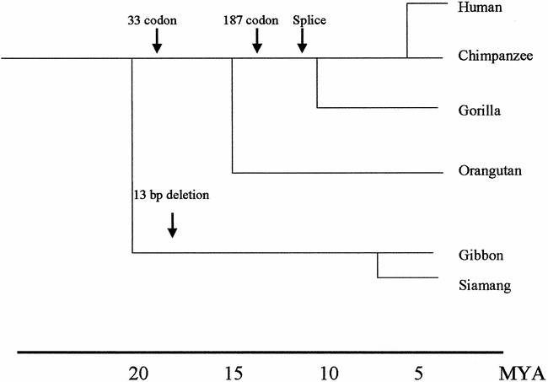
URICASE GENE INACTIVATION BY MUTATION IN THE
LATE MYOCENE PERIOD COINCIDING WITH A
MORE UPRIGHT POSTURE OF HIGHER PRIMATES
From: Watanabe et al, Hypertension, 40:355, 2002

Slide 63
The Oxonic Acid-Treated Rat Model of “Mild” Hyperuricemia
(developed by Richard Johnson and colleagues)
URIC ACID + 2 H₂0 + 0₂
URICASE
OXONIC
ACID
ALLANTOIN + C0₂ + H₂0₂
rat serum urate rises
from ~1 mg/dL to
~2 to 3 mg/dL

Slide 64
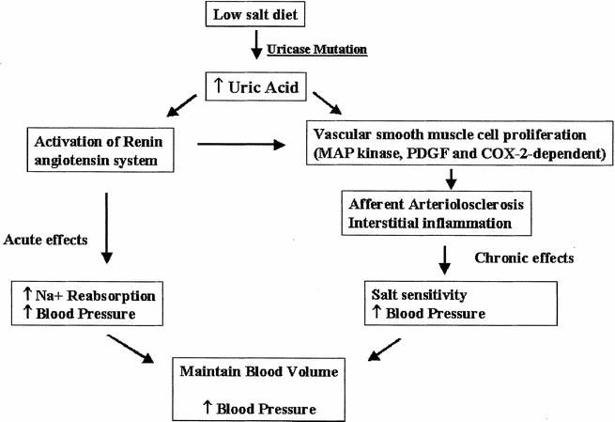
From: Watanabe et al, Hypertension, 40:355, 2002

Slide 65
Flaws in the Oxonic Acid-Treated Rat Model of
“Mild” Hyperuricemia
Urate
UAT
EXTRACELLULAR
Oxonate
INTRACELLULAR
Urate
COOH
NH₂
URATE/OXONATE
BINDING SITE
OXONATE HAS THE POTENTIAL
TO PROMOTE INTRACELLULAR
RETENTION OF URATE AND OTHER
SOLUTES

Slide 66
OTHER LIMITS ON INTERPRETING
EXISTING DATA OF ADVERSE RENAL
AND VASCULAR EFFECTS OF HYPERURICEMIA
1. DIRECT URIC ACID INFUSION IN HEALTHY HUMAN
ADULTS DID NOT ALTER HEMODYNAMIC
OR ENDOTHELIAL FUNCTIONS *
2. URATE HANDLING AS WELL AS SERUM URATE LEVELS
MAY DIFFER MARKELY IN RAT AND HUMAN
3. CELLULAR EFFECTS OF SOLUBLE URIC ACID
IN VITRO SUBJECT TO ARTEFACTS
*Waring et al, Heart, 2004

Slide 67


URIC ACID IN HUMANS: THE GOOD, THE BAD, AND...
Uric acid is an antioxidant , 8 times more abundant in human serum than ascorbate
Human ascorbate production lost in evolution in parallel with uricase
Uric acid appears to protect against oxidant and hypoxic brain and heart injury
Uric acid may be a pro-oxidant under certain conditions
Soluble uric acid induced Cox-2 and MCP-1 in cultured VSMCs
Reviewed by Bieber and Terkeltaub, Arthritis and Rheum, 2004

Slide 68
FOOD FOR THOUGHT
GOUT IS EVOLVING CLINICALLY
GOUT AND “REFRACTORY GOUT” ARE RISING
BETTER PREVENTATIVE EFFORTS INCLUDING PATIENT EDUCATION ARE NEEDED
DEVELOPMENT OF NEW TREATMENTS FOR HYPERURICEMIA HAS NOT KEPT PACE WITH MEDICAL NEEDS
“TYPICAL” ASYMPTOMATIC HYPERURICEMIA HAS NOT BEEN PROVEN TO DIRECTLY CAUSE RENAL AND VASCULAR DISEASE
GOUT AND HYPERURICEMIA ARE WELL UNDERSTOOD AND MANAGED BUT NOT WELL ENOUGH

