Slide 1
Utah Astronomical Sites
Dave Kieda
University of Utah
S. LeBohec, W. Springer, P. Gondolo, B. Bromley, K. Martens

Slide 2
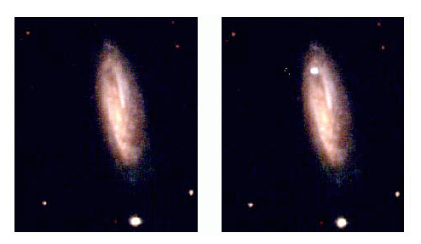
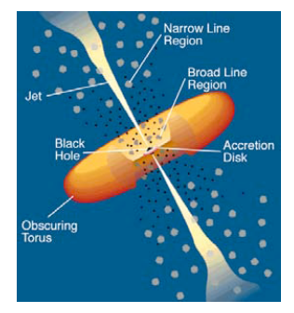
Meter-class Robotic-Telescope Science
Supernovae in distant galaxies
Gamma-Bursts: world network
Variable Stars: world network
New planetary systems
Near-Earth Asteroid Surveys
Multi-wavelength monitoring of AGN

Slide 3
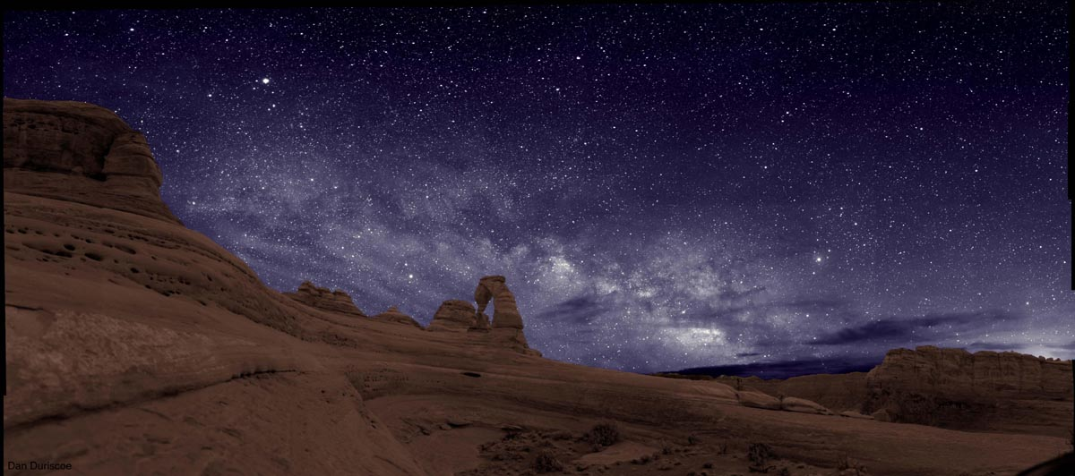
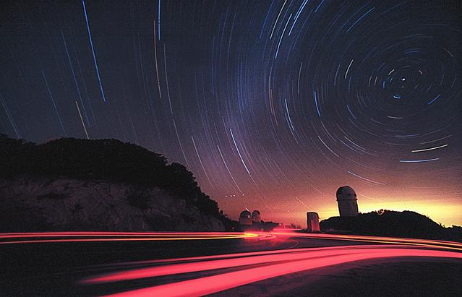
Utah Optical Observatory
Southern Utah Sky
Kitt Peak Sky & Phoenix glow
Low Population density
No Light Pollution
Higher altitudes (10,000 ft+): Infrared/sub-mm/mm Astronomy
Large Site Areas (10-100 sq. miles)
UT State trust lands
Last large area, high altitude in US suitable for research astronomy

Slide 4
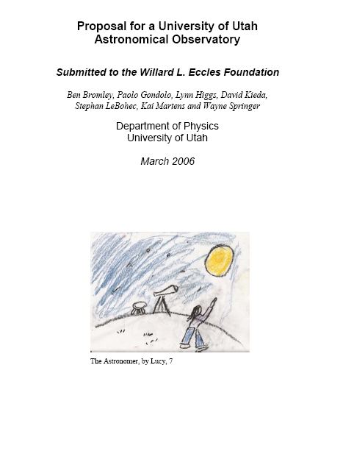
Proposed April 2006
Funded May 1, 2006

Slide 5
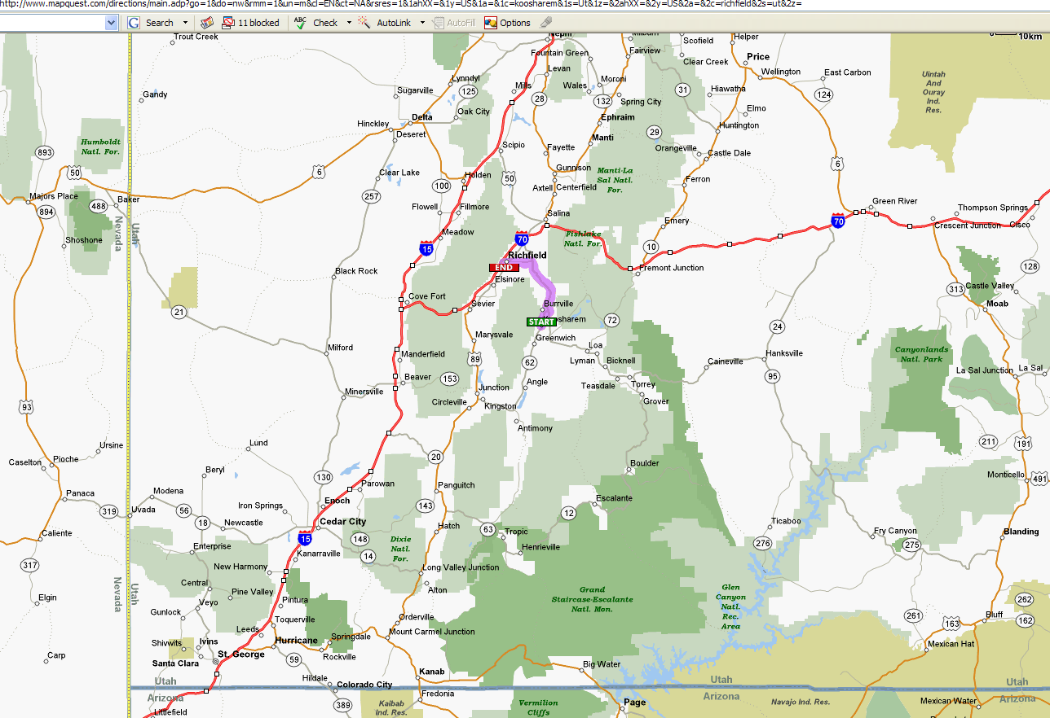
Utah Site Locations: 3000+ m
Thousand Lakes
Parker Mountain
Boulder Mountain
Griffin Top

Slide 6
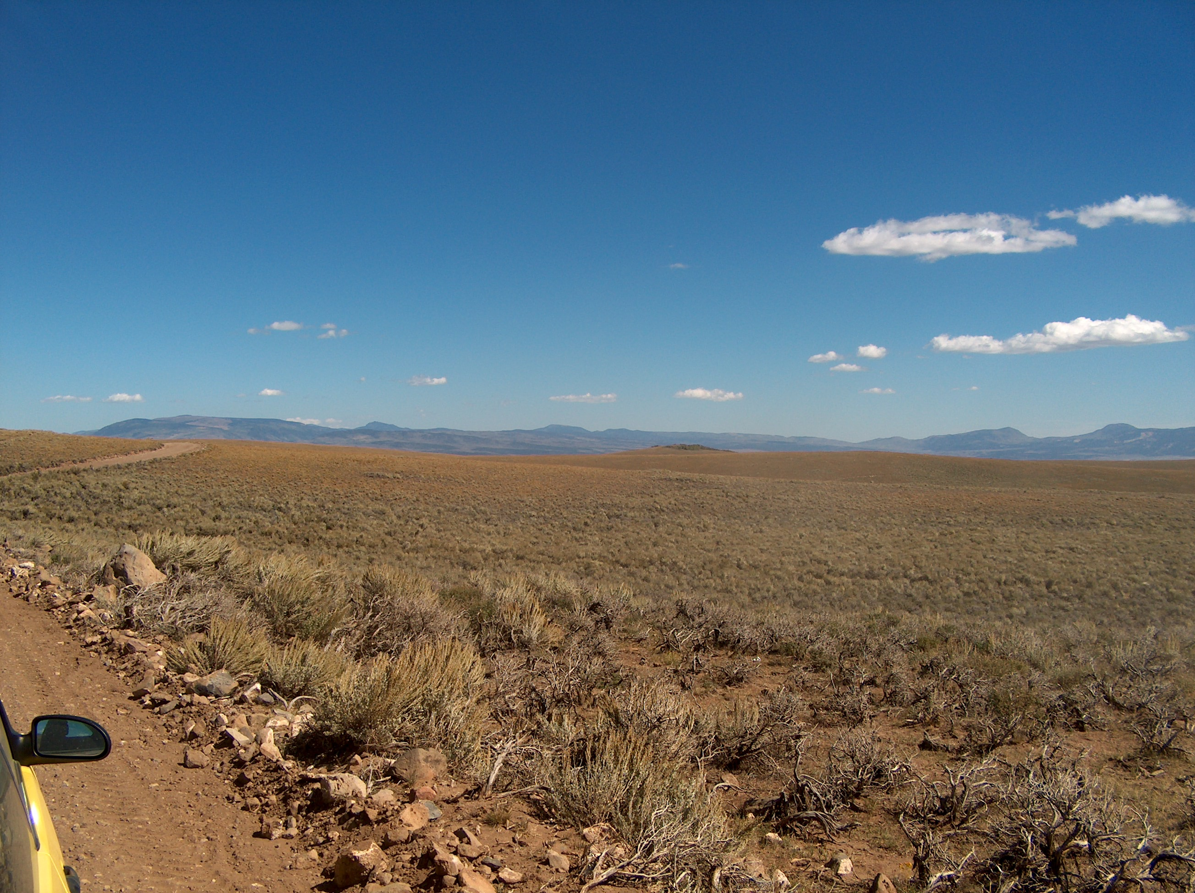
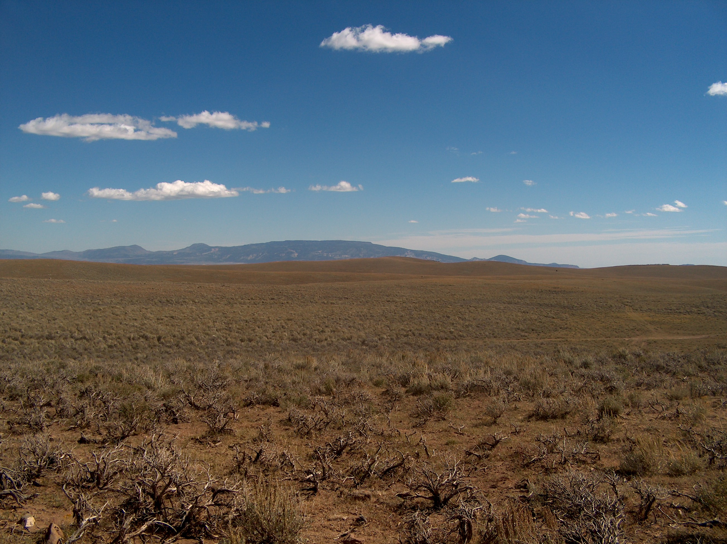
Parker Mountain: Flat Mountain plateau, 10,000 ft, Utah State Trust land
Thousand lakes: Flat Mountain Plateau, 11,400 ft Fishlake National Forest
Extremely dark, very large area (10-600 sq miles) available, existing roads, excellent weather
Suitable for international optical, Infrared, millimeter and sub-millimeter observatories

Slide 7
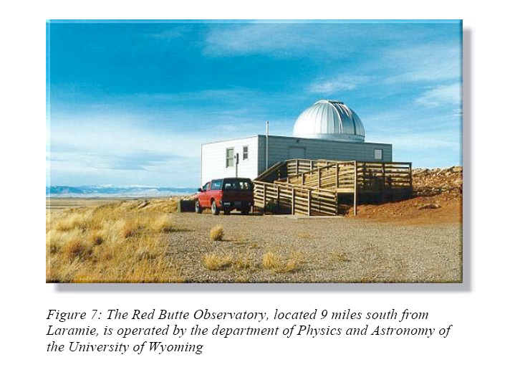
Observatory Telescope

Slide 8
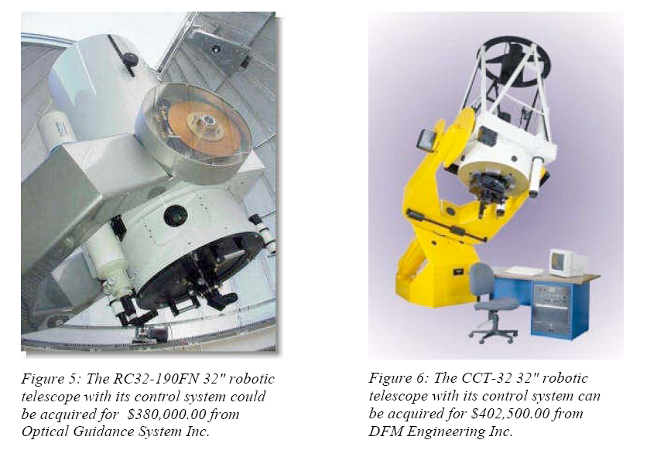
Robotic Telescope Possibilities

Slide 9
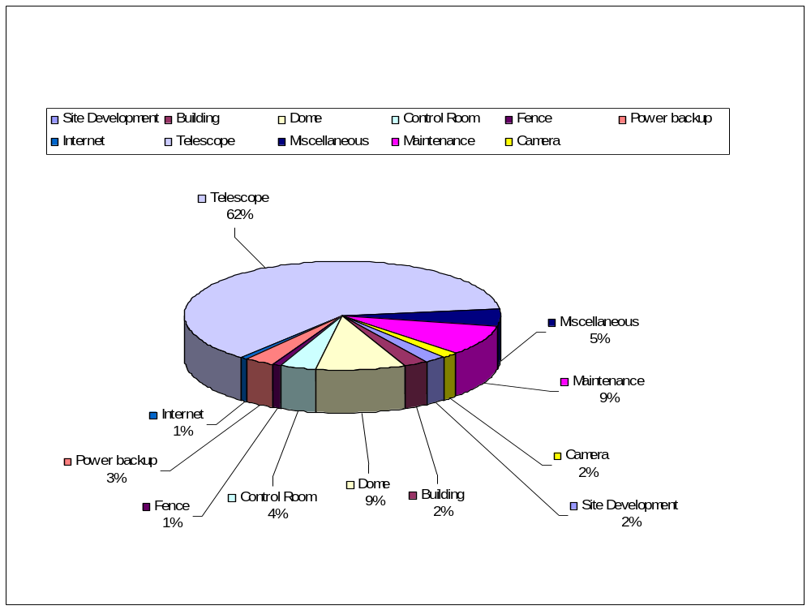
Telescope Cost Breakdown

Slide 10
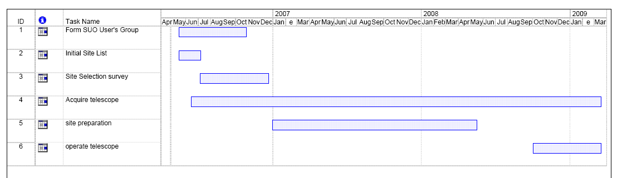
Observatory Schedule
Site Survey/Sky Monitoring: Begin June 2006
Site Acquisition: Spring 2007
Telescope Order: Fall 2006
Site Preparation : Spring 2007
Observations begin: Fall 2008

Slide 11








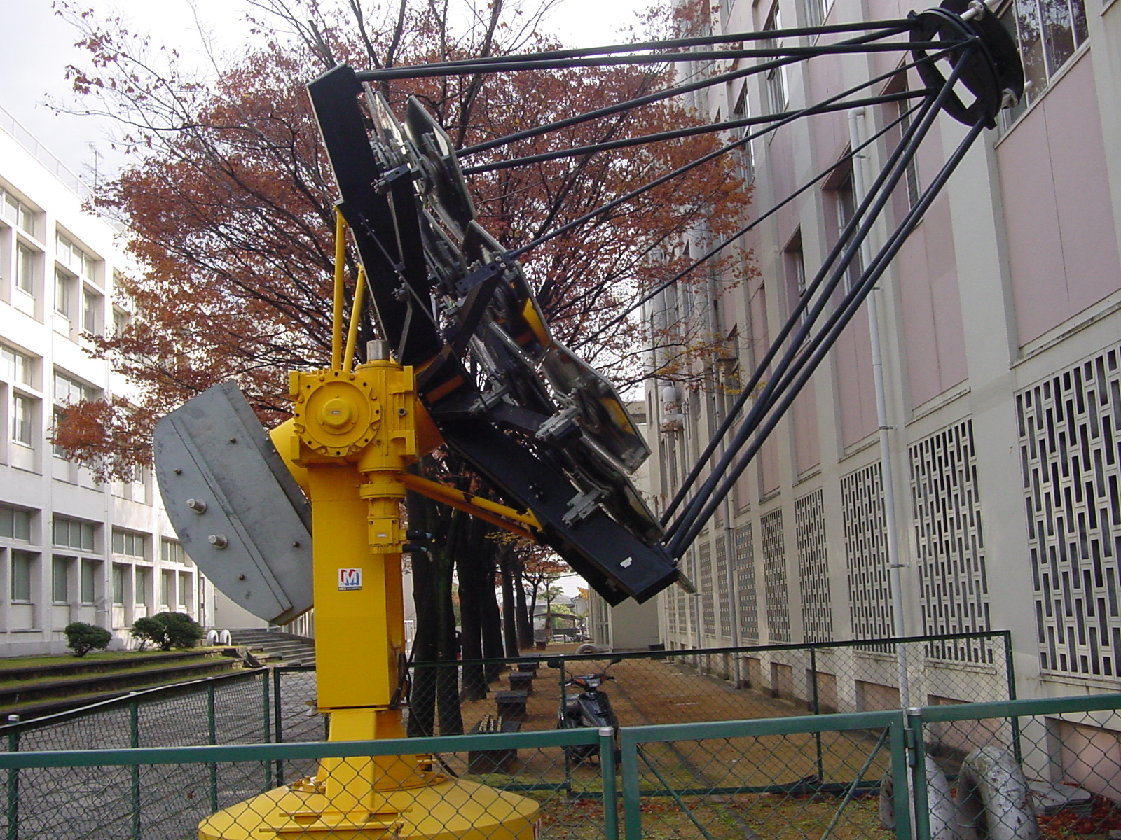
Utah Observatory Collaboration
In process of Forming
Oversee Science Program
Site/telescope selection, development
Interest in moving additional instruments to site
Site for prototyping/testing new ideas
Initial Collaboration meeting at U of Utah June 26
Contact Dave Kieda if interested in collaborating

