Slide 1
Progress in Heavy Ion Driven Target Fabrication and Injection
”Mass-production of targets for inertial fusion - the challenge of 500,000 targets/day”
D.T. Goodin, A. Nobile, N. B. Alexander, R. Gallix, J.L. Maxwell, R.W. Petzoldt, W. S. Rickman, and E.I. Valmianski
Presented by Dan Goodin
15th International Symposium on Heavy Ion Inertial Fusion
Princeton Plasma Physics Laboratory
June 7-11, 2004

Slide 2
Main points and summary of this talk
    Target fabrication is one of the key feasibility issues for inertial fusion energy
    At HIF2002 we described a “pathway” for fabrication of a high gain, distributed radiator target for energy production
    Here we provide an update on that pathway with:
      Streamlining of the steps addressing issues of handling and assembly of the foam materials
      Preliminary estimates of the per-target cost (in a fusion economy)
      Evaluation of hohlraum materials and their cost impact
Conclusions:
The “pathway” for the HIF target supply is being improved
There are several good options for hohlraum materials (tradeoffs!)
Estimates of future target mass-fabrication costs are reasonable for energy production

Slide 3
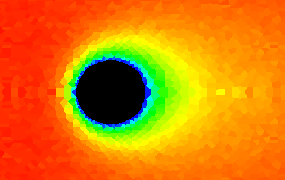

The target supply is a feasibility issue for IFE
    Target supply requirements are challenging
      ~500,000/day (6 Hz) precision, cryogenic targets with unique materials
      Low cost is required for commercial energy production
      Positioned at center of high-temperature chamber
    Comparison of laser fusion and heavy ion fusion issues:
      Direct drive = most difficult issue is injection
      Indirect drive = most difficult issue is fabrication
Cost goals of about $0.25-0.35 per target have been presented
Direct drive target heating during injection
Heavy Ion Driven HYLIFE-II Plant

Slide 4

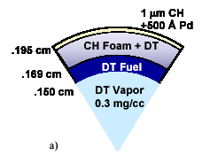
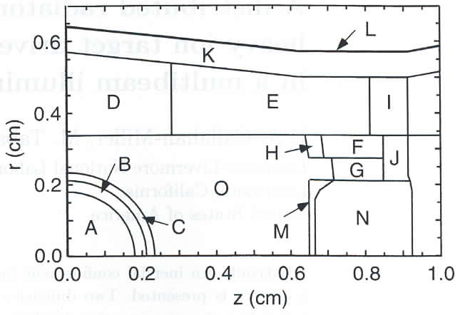
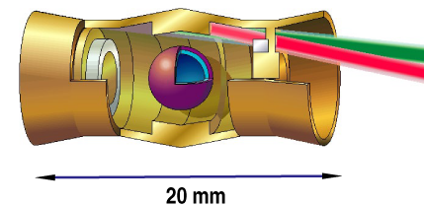
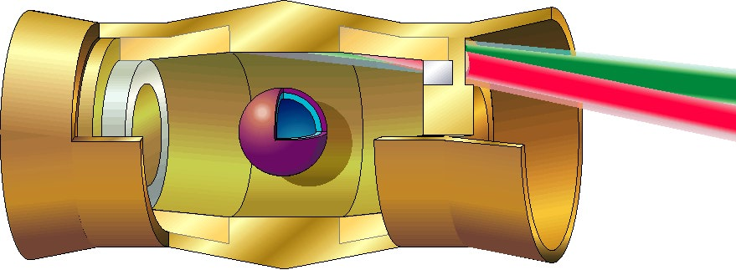

“Reference” target designs
- laser & heavy ion fusion
being simplified…
Direct Drive High Gain Target Design
LLNL Distributed Radiator Target
Laser driven
Foam shell - divinyl benzene
Callahan and Tabak
Two sided illumination by heavy ions
Unique materials in hohlraum = issue
Some Expected Direct Drive Specifications
Capsule Material CH (DVB) foam
Capsule Diameter ~4 mm
Capsule Wall Thickness 290 μm
Foam shell density 20-120 mg/cc
Out of Round <1% of radius
Non-Concentricity <1% of wall thickness
Shell Surface Finish ~20 nm RMS
Ice Surface Finish <1 μm RMS
Temperature at shot ~15 - 18.5K
Positioning in chamber ± 5 mm
Alignment with beams <20 μm
Some Expected Indirect Drive Specifications
Capsule Material CH or Be
Capsule Diameter ~4.6 mm
Capsule Wall Thickness 250 μm
Out of Round <1% of radius
Non-Concentricity <1% of wall thickness
Shell Surface Finish 20-200 nm RMS
Ice Surface Finish 1-10 μm RMS
Temperature at shot ~15 - 18.5K
Positioning in chamber ± 1-5 mm
Alignment with beams <200 μm
Comparison = addition of hohlraum (1) insulates DT during injection, (2) reduces requirements on capsule and (3) on DT “ice” surface finish

Slide 5
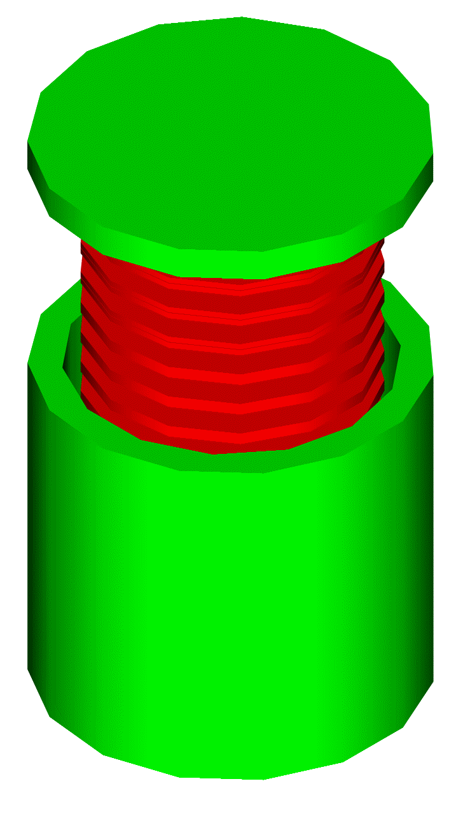
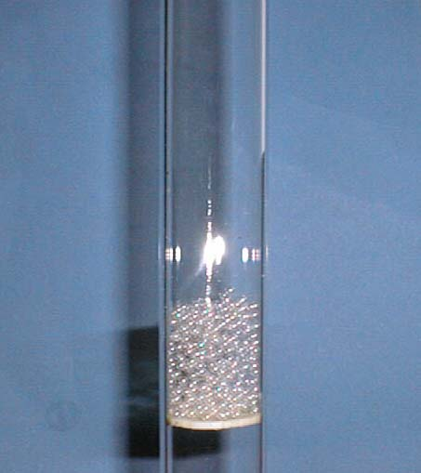
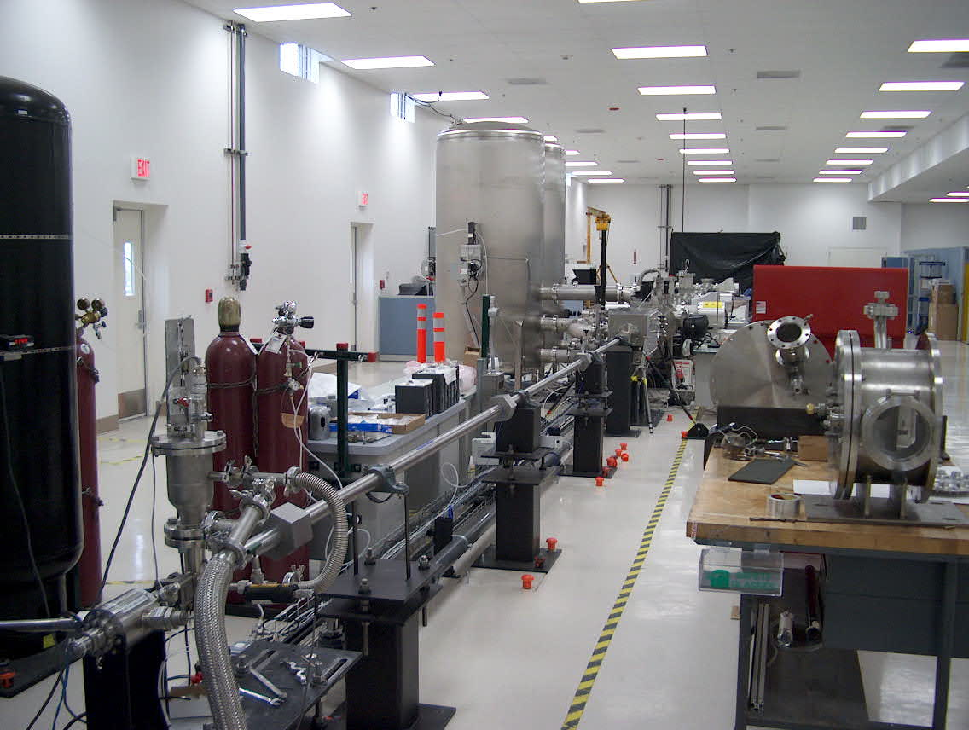
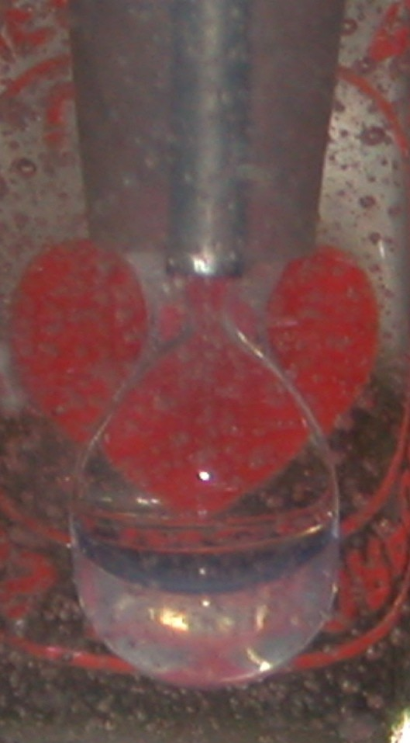
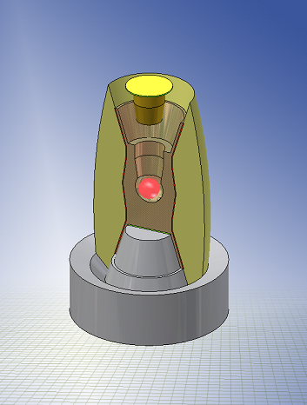
Overall pathway for HIF target supply has been established
Fabricate Capsules
DT Fuel Fill
DT Fuel Layer
Load capsule in hohlraum
Inject/
track
Micro-
encapsulation
Fabricate hohlraum
Pressure cell
Fluidized bed
Injector demo experiment
Multiple advanced manufacturing steps
    1) Fabricating the spherical capsule
    2) Filling the capsule with fuel
    3) Cooling the capsule to cryo
    4) Layering the DT into shell
    5) Fabricating the hohlraum case
    6) Fabricating the radiators
    6) Assembling the cryo components
    8) Accelerating for injection
    9) Tracking the target’s position
    10) Providing steering/timing info
Major advantages: started with DP/ICF experience base, synergism with laser fusion and ZFE programs

Slide 6
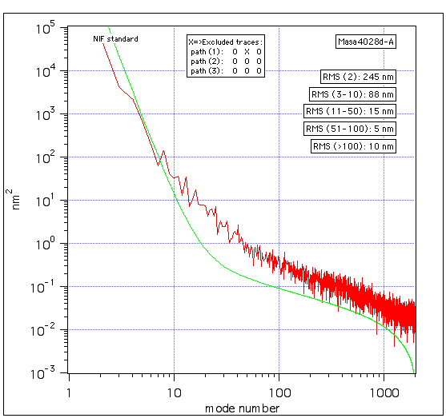
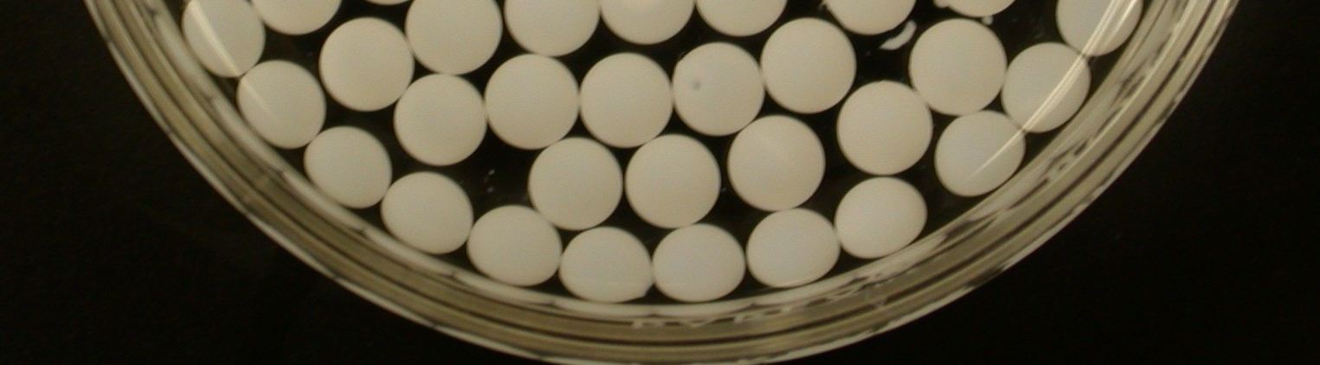
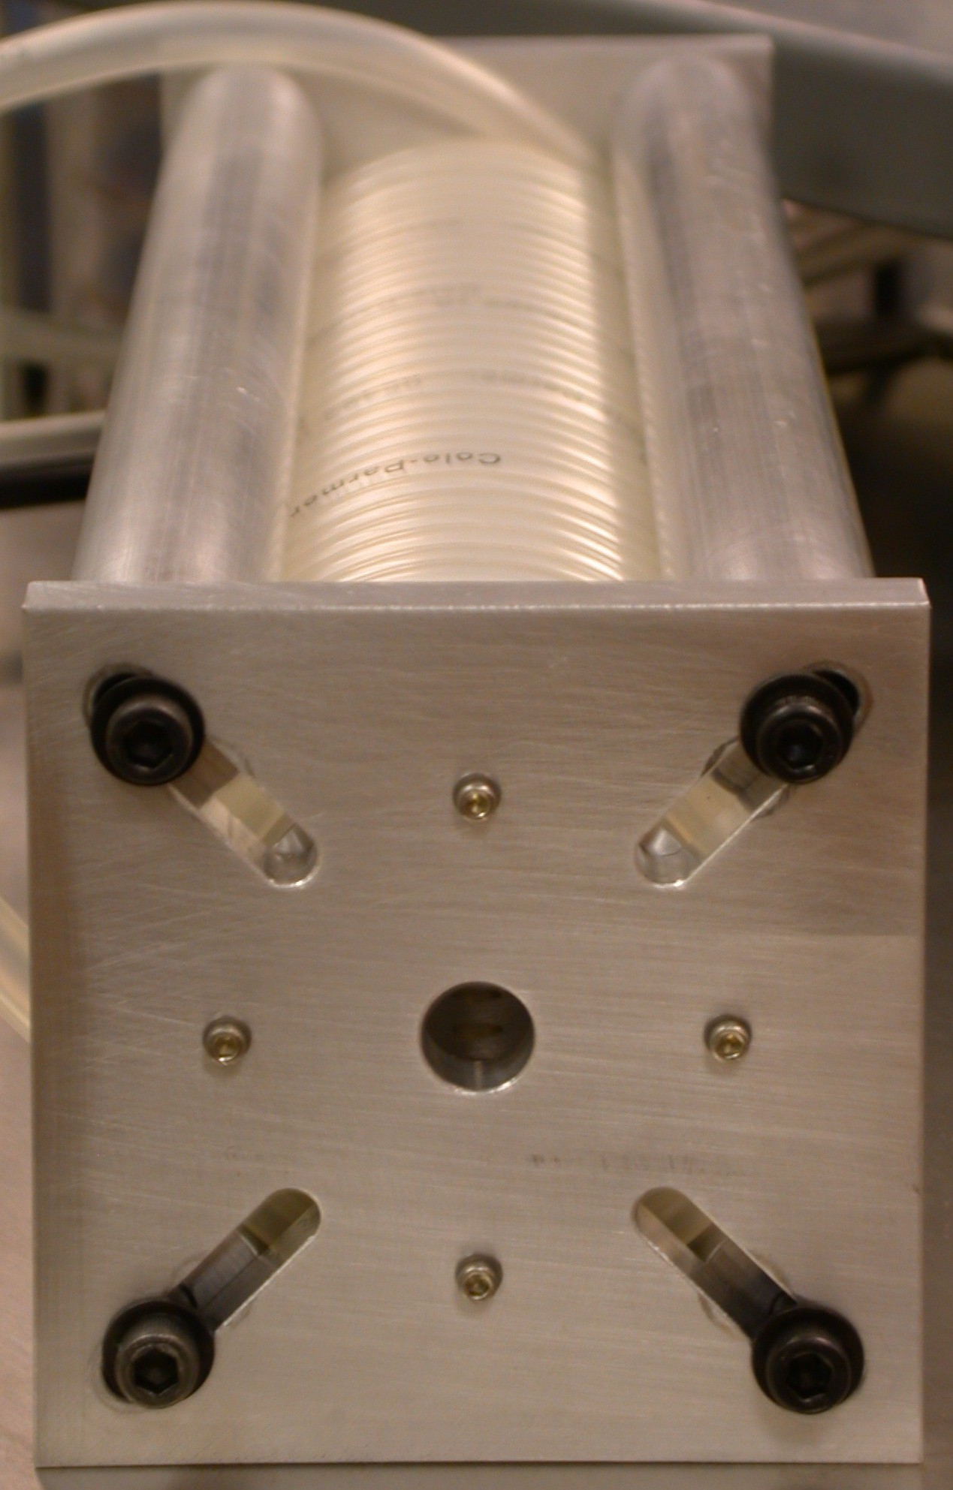
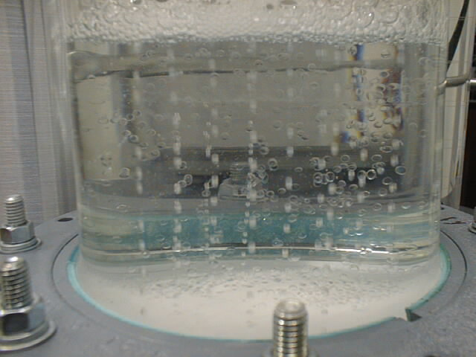
Thick walled capsules (HIF, ZFE) & foam capsules (DD) are being made
CH capsule (HIF, ZFE)
CH overcoated
foam capsule (DD)
Power spectrum of 4.6mm CH capsule, 45 μm wall, OOR <1% of radius, NC <3% of wall, rate 36/minute (GA)
4 mm dia., 200 μm foam layer, CH overcoat, production rate - 3 Hz
Process Scaleup Studies - HAPL
Approaching IFE Requirements
NIF Spec (green)
The microencapsulation process has demonstrated the feasibility of fabricating thick-walled and CH overcoated foam capsules - but IFE specifications not yet met

Slide 7

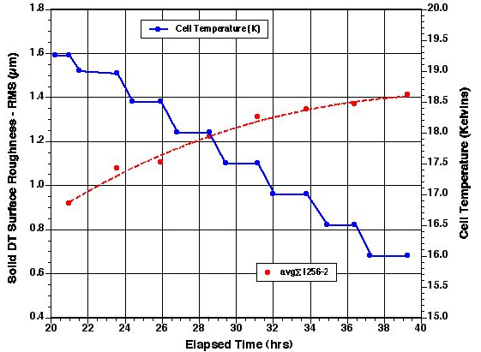
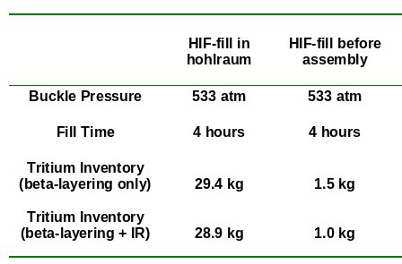
DT filling/layering technologies synergistic with ICF and HAPL
DT Filling - Demonstrated in ICF program
Cryogenic fluidized bed layering
Proof of principle shown
Lab-scale unit being built
Rapid filling of many capsules (500,000/day)
For HIF, issue is acceptable tritium inventory
  Goal = less than ~1 kg
HIF Targets
Theoretical minimum DT inventories
Art Nobile et al, IAEA TM on IFE Targets, San Diego, June 2002
LANL cooldown data show lower temperatures are possible

Slide 8
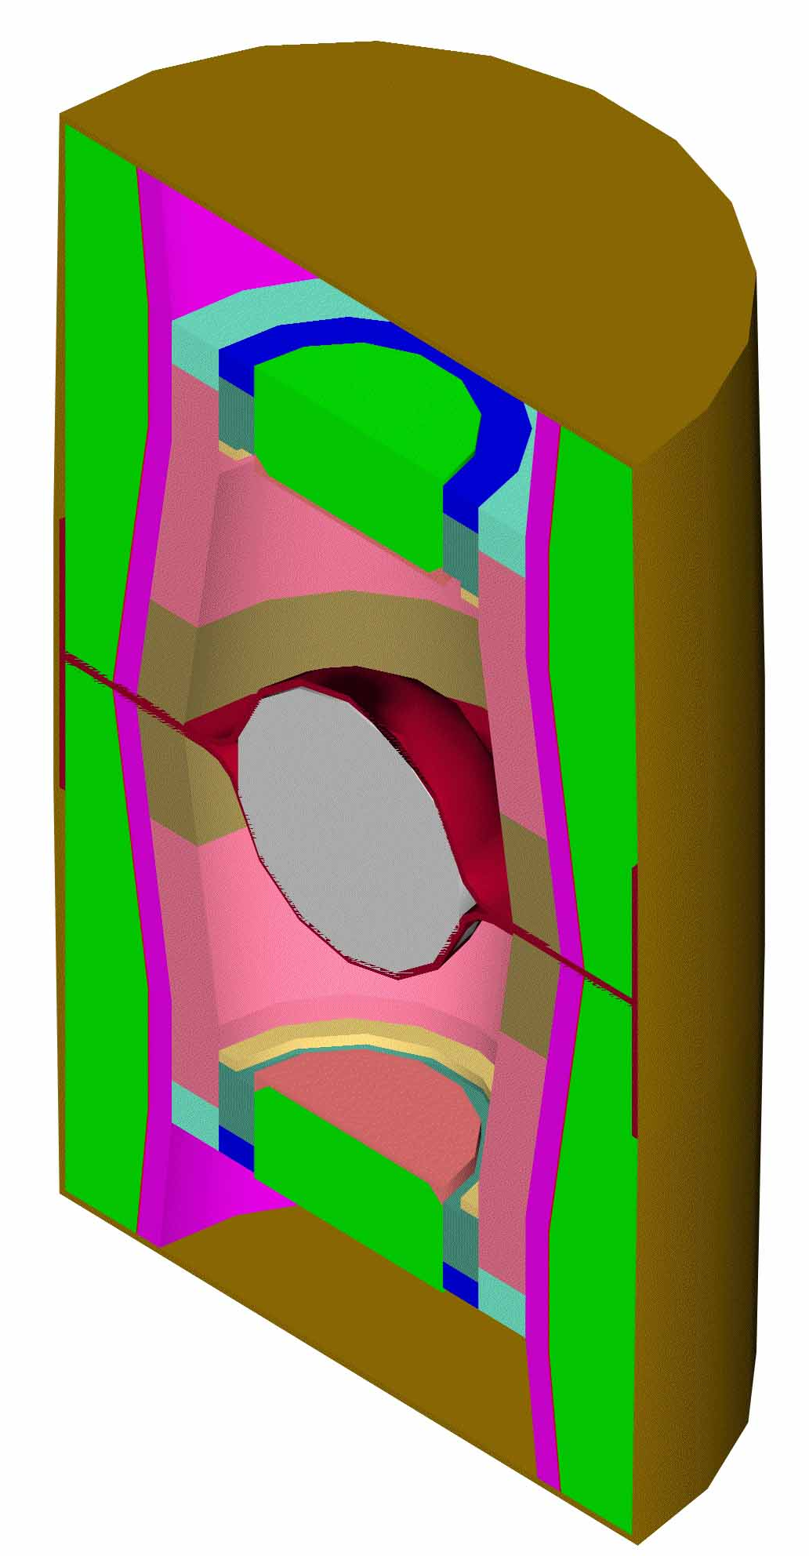
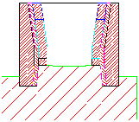
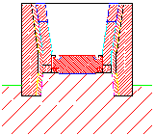
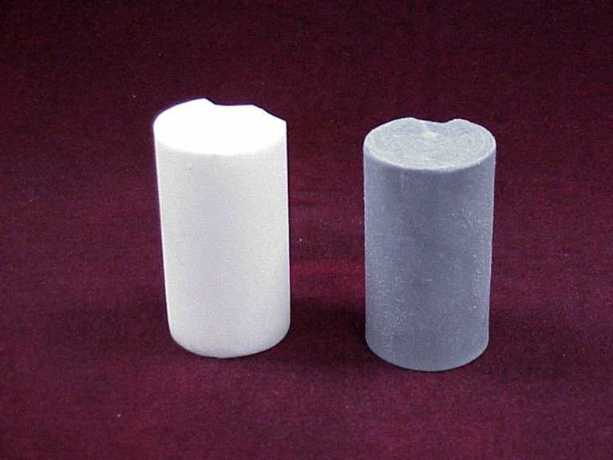
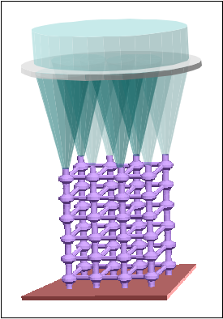
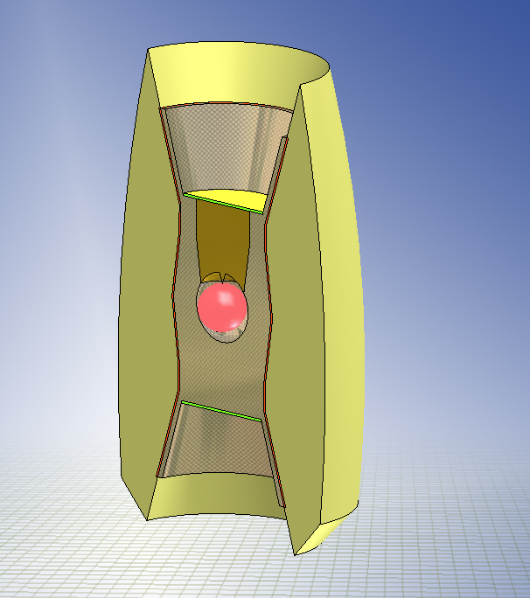
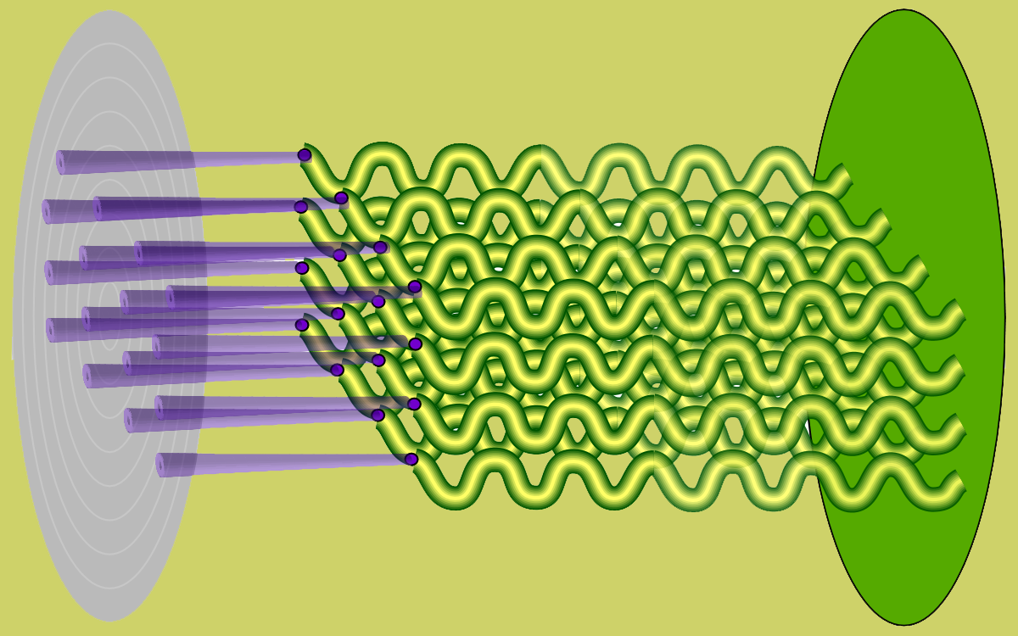
Improvements in hohlraum concepts
Old (HIF2002) hohlraum assembly process
Issues = include precise handling and “stacking” of very low-density foams in discrete zones and doing it quickly
Die set & assemble precast foams (E,D,C)
Continue “stacking” (G,F,H,J,I)
Materials range
11 - 13,500 mg/cc
2% W-doped 30 mg/cc CH foam or LCVD
Laser-assisted Chemical Vapor Deposition (J. Maxwell, LANL)
Hohlraum
Wall-Coating
Laser gives controlled chemical vapor deposition
Lattice
Plug
Functionally
Graded
Lattice
Variable Spacing & Fiber Diameter→Variable Density
Capsule
New proposed process uses LCVD to manufacture most of the hohlraum……..
Thin Film
Membranes
Epoxy Case

Slide 9
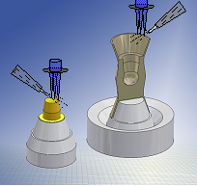
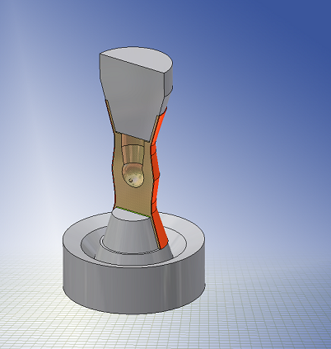
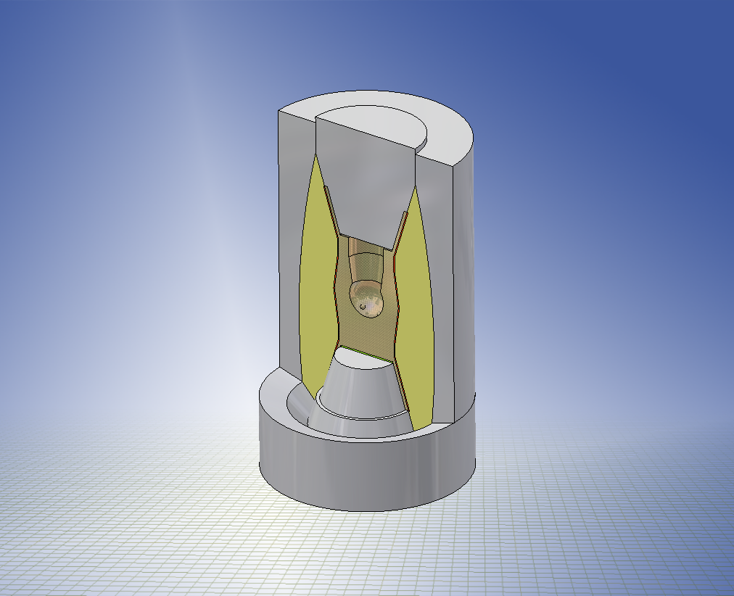
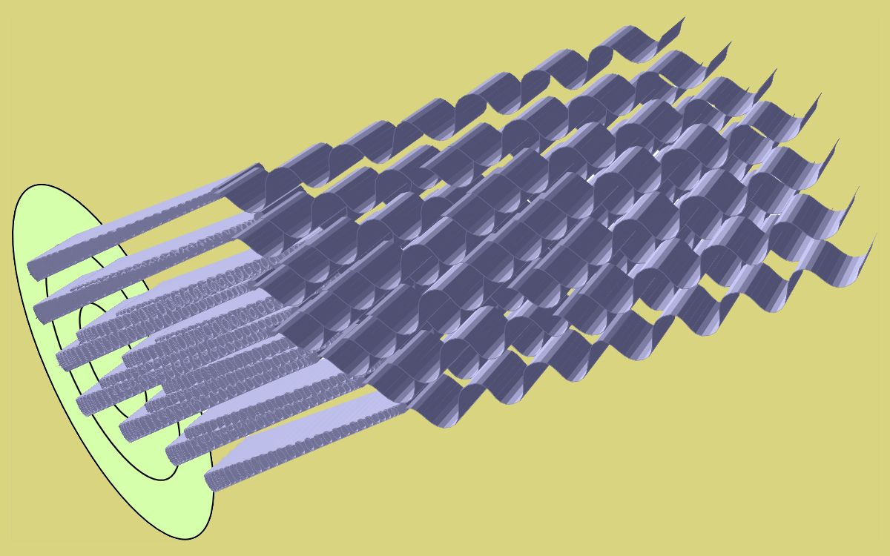
New hohlraum fabrication concept
LCVD radiator and assembly process
3D-LCVD of Low-p, High-Z Metal Lattices
Reactive Injection of Polymeric Case
Capsule/Plug Insertion and Immediate Target Injection
Deposit Hohlraum Exterior Wall
New concept - design for manufacture:
  Builds from “inside out”
  Avoids precision machining steps
  Avoids assembly steps
  Avoids “split” hohlraum assemblies
  Auto-aligned final assembly step
  Maximum use of LCVD process
“Micro-engineered” materials by LCVD
- capable of “high-Z only” materials
Experimental demonstration is underway……..

Slide 10
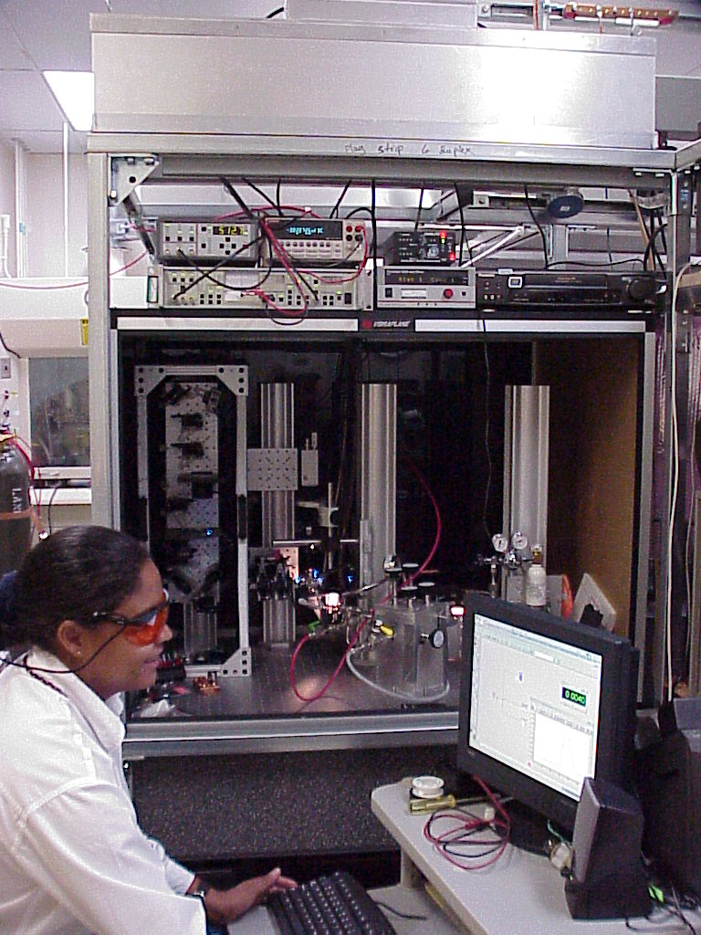

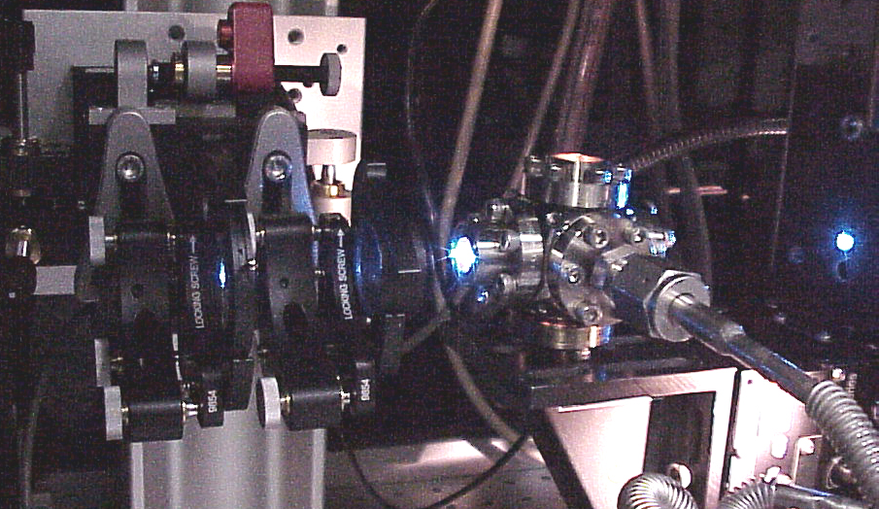
LCVD development is underway
LCVD experimental setup at LANL (PI - James Maxwell)
Examples:
WF6 + 3H2 → W(s) + 6HF
Rapid Growth Expected Above 100C
Example fibers
~10-15 μm OD
Over 68 Thermodynamic scenarios investigated, to optimize deposition rates
Close-up of chamber and focusing optics

Slide 11
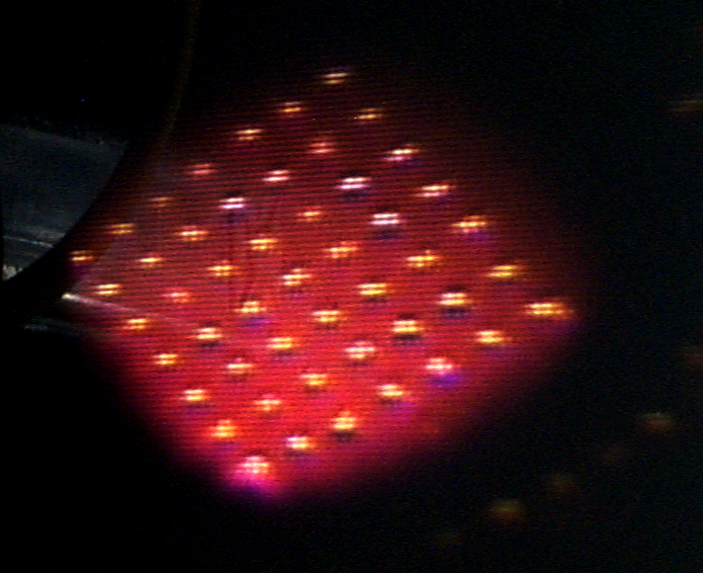
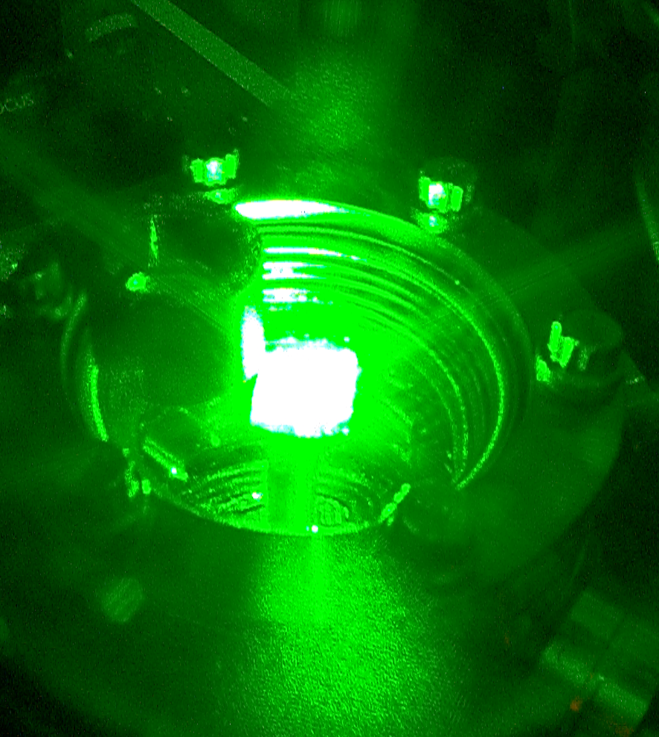
This LCVD process has been incorporated into a plant scaleup/costing study
Assume 100x100 spot arrays with 12 micron spacing
Axial growth rates ~ 2mm/s (typical now)
Each hohlraum takes 12.5 minutes; Unit Processor grows 48 samples simultaneously; 112 Unit Processors operating in parallel, so 5376 hohlraums made simultaneously.
Arrays of fibers are essential for mass-production
~1500 ft² modular production facility

Slide 12
Estimates for indirect drive target production costs
1) Production rate ~500,000 targets/day - 1000 MW(e) plant
2) Pb/Hf (70:30) is high Z material (single use)
Installed capital cost ~ $304M ($38 M annualized cost)
Annual materials and utilities ~$11M
Annual maintenance costs (labor and materials) ~$18M
Annual operating labor costs ~$10 M
Cost per injected target is estimated at ~40.8¢ each
(~32¢ each for 3000 MW(e), ~22¢ each for centralized production)
LCVD systems are major capital cost
Assumptions:
1) R&D programs done
2) Major “paradigm shift” from current targets - no first-of-a-kind costs, statistical characterization, increased yield, larger batch sizes
3) “nth-of-a-kind” plant, standard engineering cost factors
TFF layout for capsule, filling, layering, injection

Slide 13
_x0008_Single use versus recycling for hohlraum materials
Original basis = recycle hohlraum materials to reduce waste streams
  Required for Au/Gd design - costs $0.43/target to throw away!
But resulting radioactivity results in remote processing/maintenance for target fab
  Our estimates indicate fully remote makes targets cost more than their E value
Single-use: hohlraum materials make up <1% of total life-cycle plant waste stream
  Laila El-Guebaly paper Wednesday morning in Fusion Chamber session
Other hohlraum materials are much cheaper - but entail an energy penalty
Example - replacing Au/Gd with Pb/Hf loses 2% of E but allows single use
  Pb cost per hohlraum = 0.02 cents (~$100 per day)
  Hf cost per hohlraum = 1.6 cents (~$8000 per day)
…. single use options results in lower cost of electricity

Slide 14
Indirect Drive Target Hohlraum Fabrication
Choosing the right hohlraum material is a key for HIF targets
Issue Mat’l | Target Gain Loss | Target Manufacturing | Separable from Flibe | Waste Hazard | Comment
Au/Gd | 0 % | High cost |  | Radiation | Must recycle
Hg and Hg/X | 0-13 % | Toxicity | Excellent (Hg) | Mixed Waste | Toxicity prohibitive
Pb/Hf Pb/W | 2 % 4 % | OK ($0.41) OK | Electrochemical (Hf) | Mixed (Pb) | Pb may attack steel
W | 12 % | Excellent | Potential Plating Problem | Low level waste | Once-thru
Hg/Hf/Xe/Kr | 0 % | Complex | Electrochemical (Hf), others easy | Mixed Waste | Toxicity prohibitive
“Ref.”
Several material options have been identified for heavy ion driven hohlraums
Cost study
LCVD Demo
Au/Gd is “reference” with 0% energy loss - recyling drives up cost
Hg has advantage of easy removal from molten salt coolant - but toxicity prohibitive
Tradeoff - Pb alone loses 14% while Pb/Hf loses only 2% ($150K vs $8K Hf cost)
No single element (e.g., W) has less than 12% energy loss = huge cost
W is non-toxic - but 12% loss is $150K/day (issue of “attractiveness” for fusion?)
Hg/Hf/Xe/Kr has no loss but rather more difficult to produce a target!

Slide 15
Summary and conclusions
    Supplying 500,000 targets/day to a 1000 MW(e) power plant will be a challenge
    A significant target development program is required
    A target supply pathway has been defined - and recent studies have improved upon its features
    There are several good options for hohlraum materials - they all have tradeoffs on costs and attractiveness
    Estimates of future target mass-fabrication costs are reasonable for energy production

