Slide 1

Bechtel Nevada Duty Manager
Qualification Program
Sedan Crater
Radioactive Waste
Management Site
Apple II House
Henry P. Pazos, III
Emergency Services and Operations Support
Nevada Test Site, Operations Coordination Center
May 4, 2005
DOE/NV/11718-1049. This work was supported by the U.S. Department of Energy,
National Nuclear Security Administration Nevada Operations Office
Under Contract No. AC08-96NV11718

Slide 2
Discussion Topics
BN Duty Manager, NTS Operations General Information
Lessons Learned
Qualification Requirements and Training
  Incident Reporting
  HAZMAT and HAZTRAK
  Protective Actions
  Categorization and Classification
  Drills and Exercises
Conclusion/Questions

Slide 3
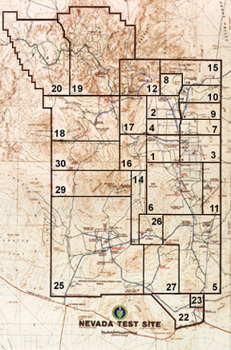
Nevada Test Site
Located 65 Miles NW of Las Vegas
Spans 1,375 Square Miles
BN Duty Manager Located in Mercury

Slide 4
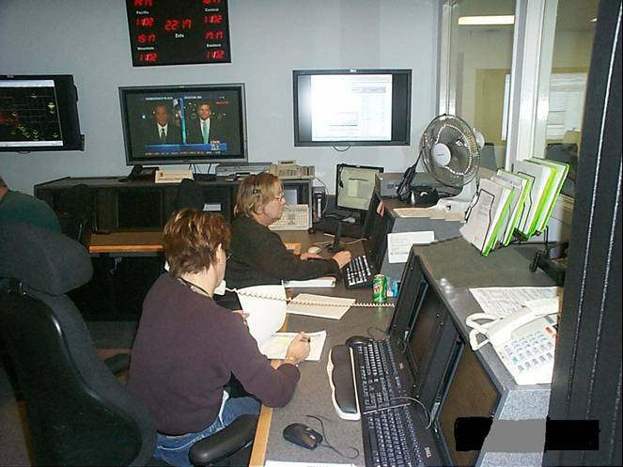
Bechtel Nevada Duty Manager
Established February 2002
NTS Operations Coordination Center
Manage all Aspects of NTS Operations Support
Eight Senior Operations Specialists
Operations 24-hours-a-day
  Three 8 - hour Shifts
  Two 12 - hour Shifts
NTS Operations Coordination Center

Slide 5
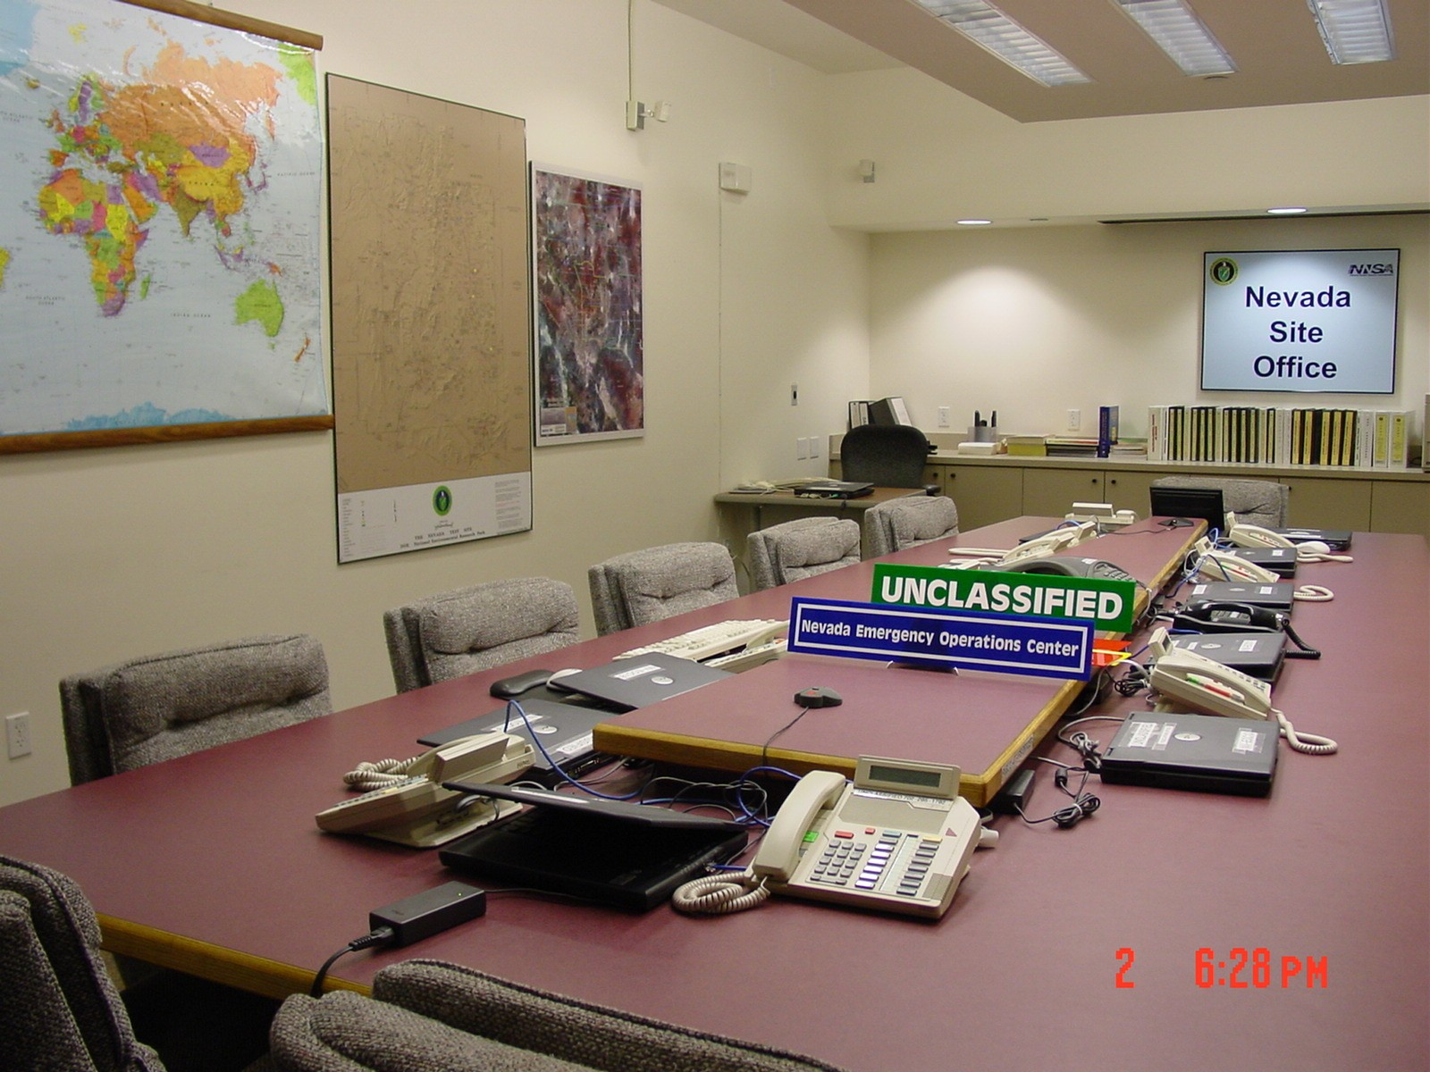
Lessons Learned
Drills, Exercises, Real-world
After-action Reports
Improve Communications and Coordination
Improve Delivery of notification to
DOE Headquarters
Duty Manager Categorizes and Classifies
  Base Program Operational Emergencies
  HAZMAT Operational Emergencies
NLV Emergency Operations Center
Notes:
ERO, IC Communication & Coordination

Slide 6
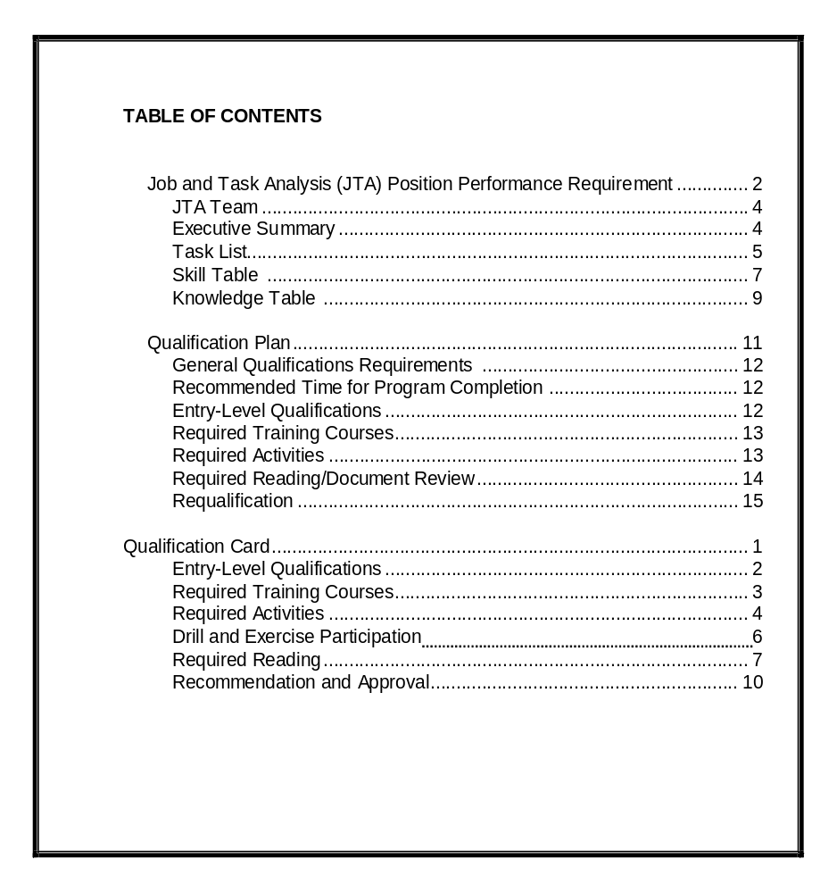
Qualification Program
Table of Contents
Three- to Six-month Intensive Training Program
Formal Qualification Packet
Required Reading
Required Training
Interactive Program
Notes:
Required Reading – 2500 pages
Required Training, Technical in nature
Allows users to sign up for training, conduct Required Reading, self paced

Slide 7
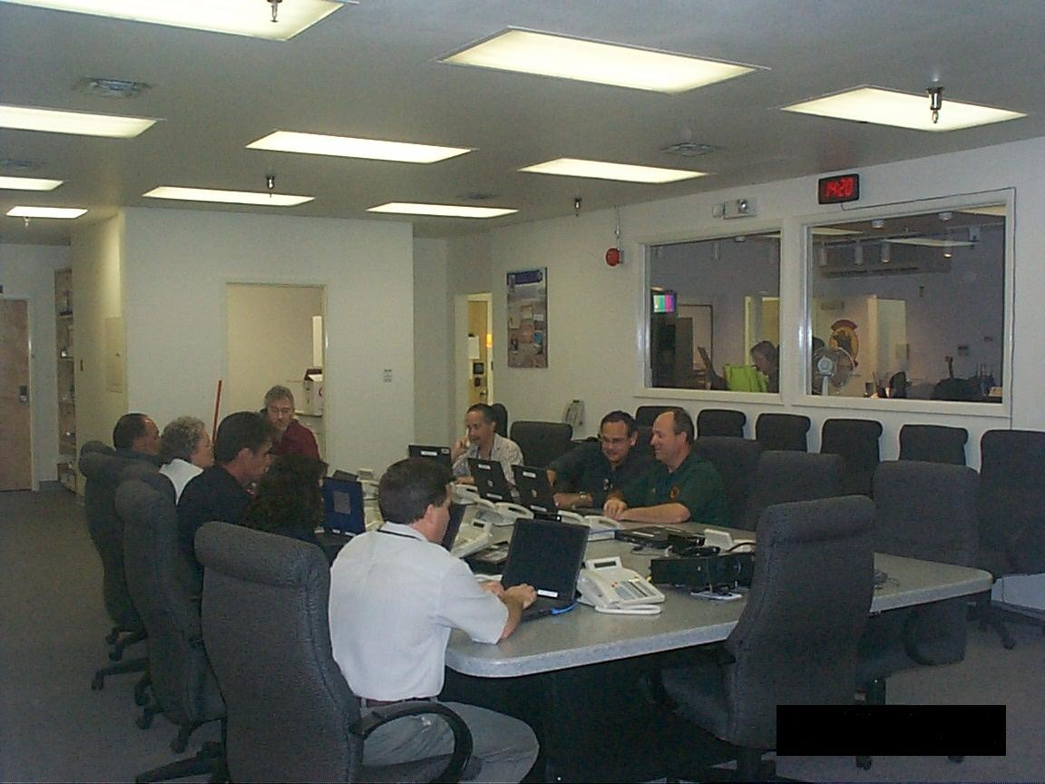
Required Activities
Incident Reporting and Notifications
Primary HAZTRAK Point of Contact
Activates Emergency Management Center
Initiates Protective Actions
Categorize and Classify Emergencies
NTS Emergency Management Center
Notes:
Qualification Packet revised to include Categorization and Classification of Operational Emergencies, in the absence of an LED, also for Trans Emergencies

Slide 8
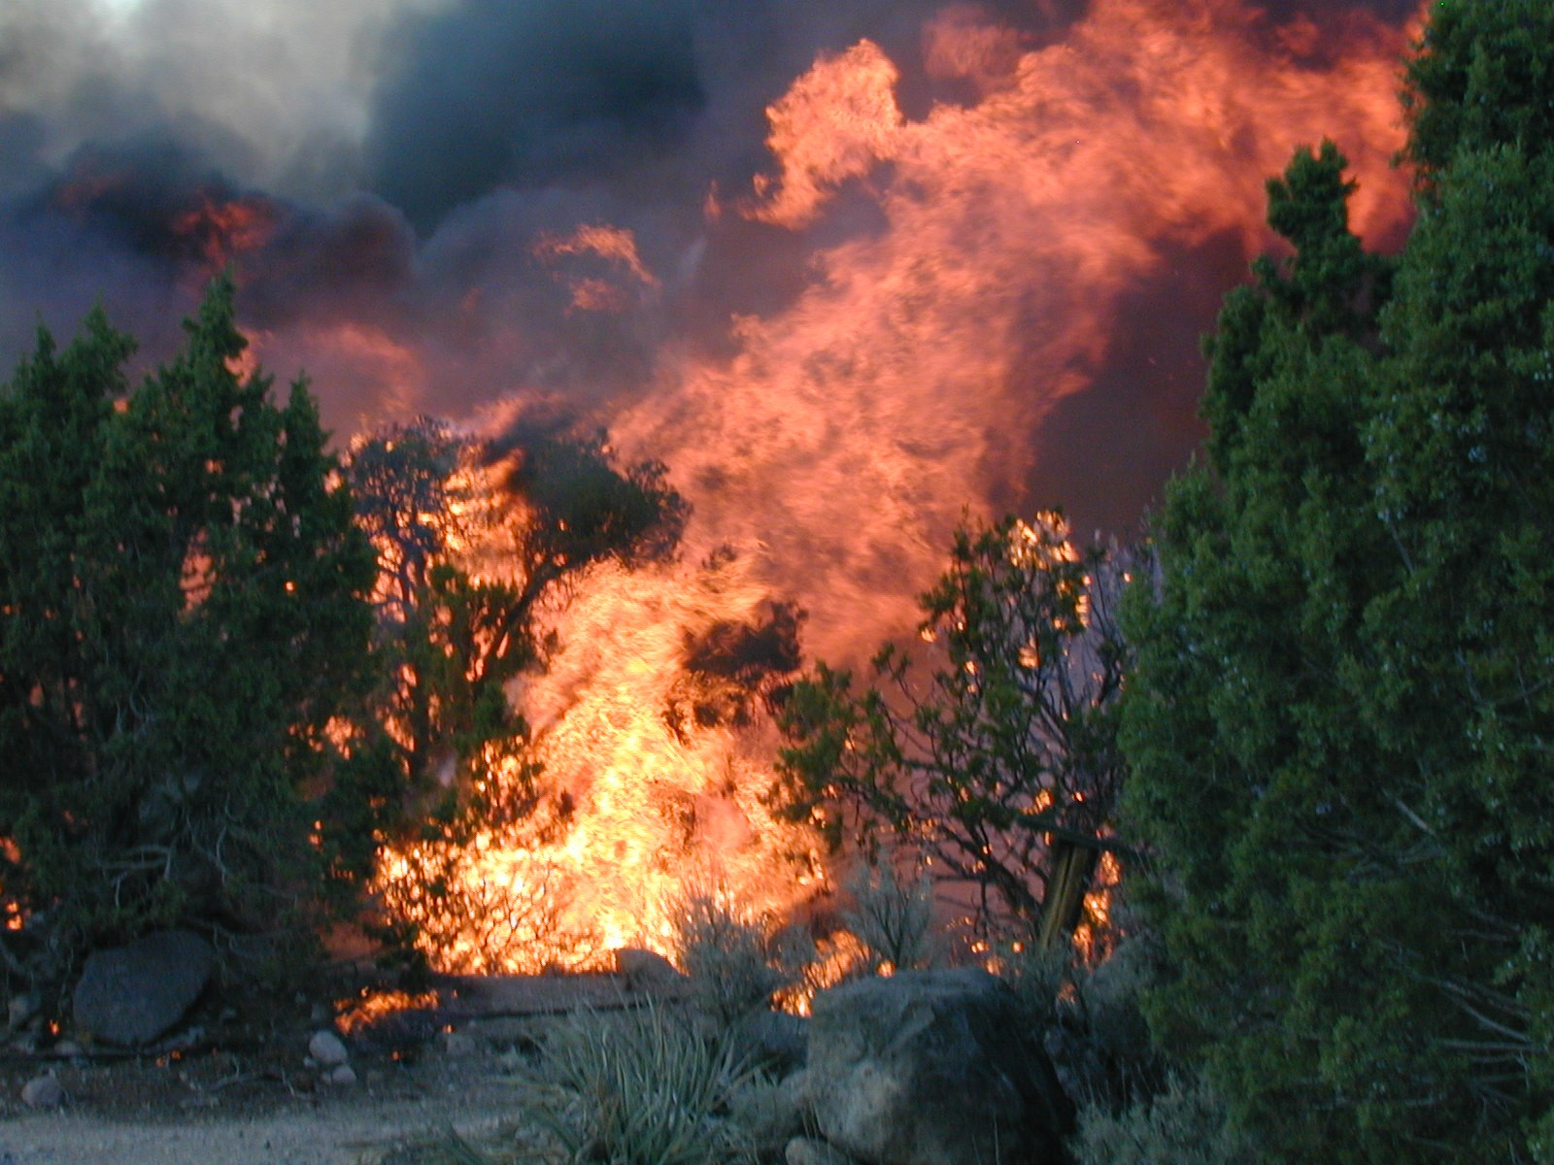
Incident Notification and Reporting
  Operational Emergencies
    NSO-149 Is Sent to
    DOE/HQ Within 15 Minutes
    Verbal Notifications
    Notification Report
    Executive Text Page
NTS Egg Point Fire

Slide 9
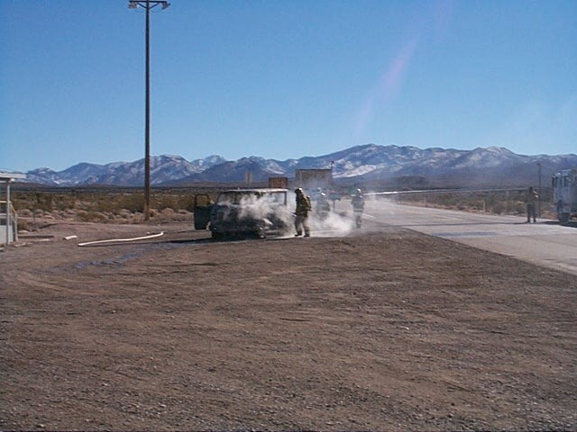
Incident Notification and Reporting (continued)
  Emergency
    Verbal Notifications
    Notification Report
    Executive Text Page
  Non-emergency
    Notification Report
    Executive Text Page
NTS Vehicle Fire

Slide 10
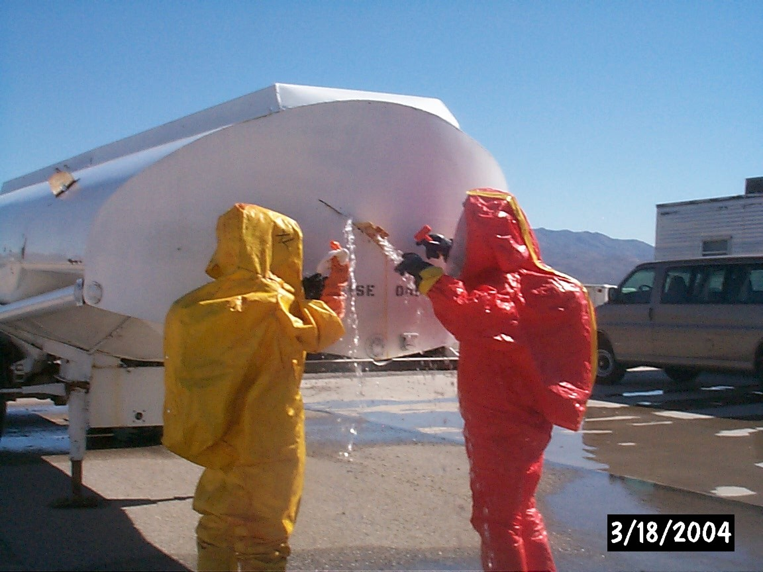
Hazardous Materials Training
  HAZTRAK
  Basic Incident Command
  Emergency Response Guide
  Fire and Rescue First Responder
  HAZMAT
  Transportation Drills
NTS Fire and Rescue, HAZMAT Training
Notes:
In accordance with 49 CFR 172.604, must have a 24 hour emergency response telephone number for Hazmat Shipments

Slide 11
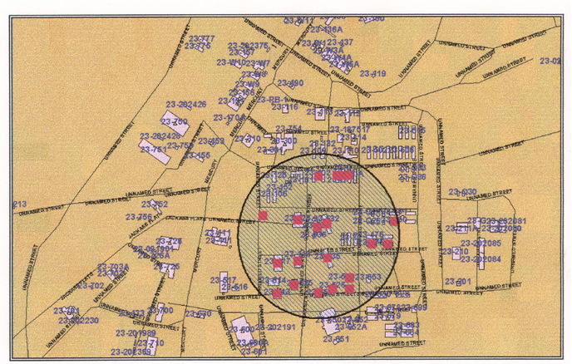
Protective Actions Training
  Required Reading - CDs,
  DOE G 151.1
  Communicator Training - Activate the Emergency Management Center
  GeoNotify Training -
  Initiate Protective Actions
  FEMA Independent Study
NTS Protective Actions using GeoNotify
Notes:
Based on Emergency Response Training and Required Reading

Slide 12

Categorization and Classification Training
  Rigorous Required Reading
  Eight Weekly Examinations
  Final Comprehensive Exam
    Three Separate Scenarios
    Timed Exam
    Candidate Must Properly Categorize and Classify Emergency

Slide 13
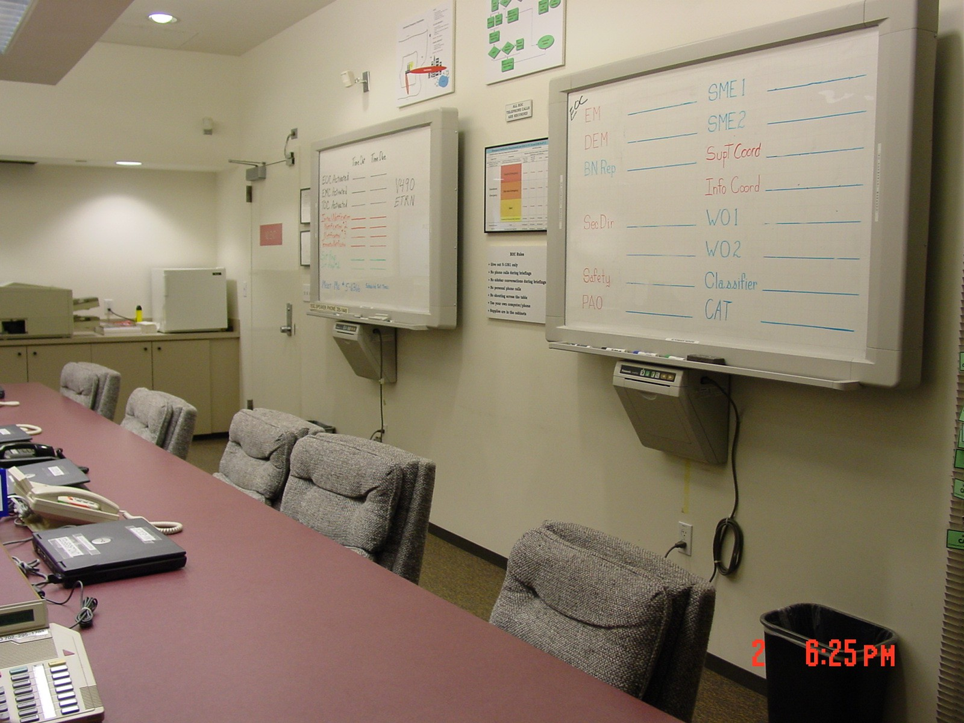
Drills and Exercises
  C3 Drills
  Tabletop Drills
  Exercises
  No-notice Exercises
NLV Emergency Operations Center

Slide 14


Conclusion
Increased Knowledge Base
Improved On-the-job Performance
Improved Notification to DOE/HQ
Improved Emergency Response Organization Communications

Slide 15

Questions?
Point of Contact:
BN Duty Manager
NTS Operations Coordination Center
(702) 295-0311

