Slide 1
SPACECRAFT ACCIDENTS: EXAMINING THE PAST, IMPROVING THE FUTURE
Skylab Space Station
Bryan Palaszewski
working with the
Digital Learning Network
NASA Glenn Research Center

Slide 2
Skylab (1/2)
Launched: May 14, 1973
Mission: to be the first USA Space Station, allowing crews of 3 to work for up to 84 days in space
During launch, the meteoroid shield that protects the station ripped away from the Skylab, severely reducing its power level and creating a life threatening atmosphere in the station (very hot).

Slide 3
Skylab (2/2)
Repairs were made by astronaut crews, and the station was made safe for habitation. Three-person crews visited it for 28, 59, and 84 days, doing major scientific investigations.
Skylab re-entered Earth’s atmosphere on July 11, 1979.

Slide 4
Skylab Results (1/2)
A sunshade was designed and was launched with the first Skylab crew.
The sunshade was erected, and the temperatures in the Skylab station dropped to acceptable levels.
The atmosphere was cleaned of harmful vapors, and the crew worked in the station for 28 days.

Slide 5
Skylab Results (2/2)
One solar array wing was ripped away during launch.
Fortunately, the second solar array wing was still attached to the station.
The sunshade was deployed during space walks by the first crew.
An additional sunshade was erected by the second crew.

Slide 6
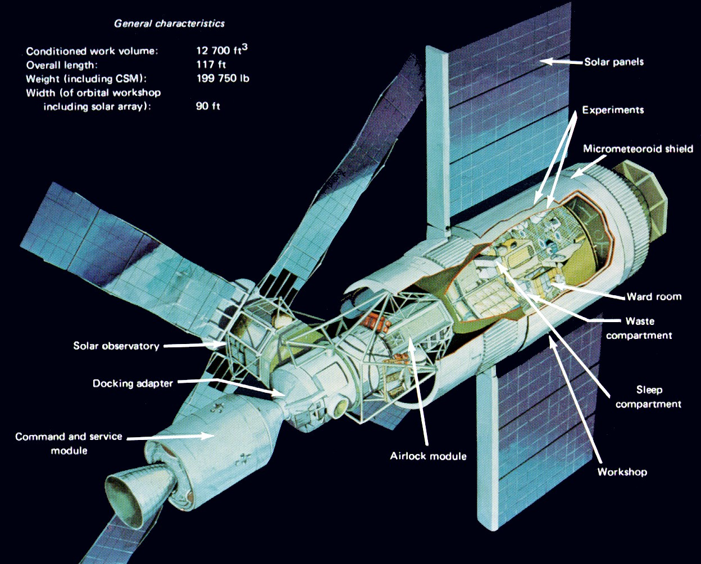
Notes:
http://www.hq.nasa.gov/office/pao/History/diagrams/skylab.html
Skylab General Characteristics
from "Skylab, Our First Space Station"
(NASA SP-400, published 1977)

Slide 7
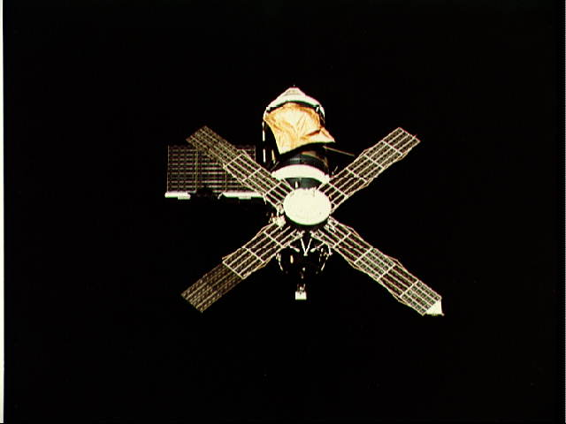
Notes:
http://images.jsc.nasa.gov/images/pao/SL2/10076167.jpg
NASA Photo ID: SL2-07-615 File Name: 10076167.jpg
Film Type: 70mm Date Taken: 06/22/73
Title: Skylab 2 Farewell View from the Departing Skylab Command/Service Module
Description:
This overhead view of the Skylab Space Station was taken from the Departing
Skylab Command/Service Module during the Skylab 2's final fly-around
inspection. The single solar panel is quite evident as well as the parasol
solar shield, rigged to replace the missing micrometeoroid shield. Both
the second solar panel and the micrometeoroid shield were torn away
during a mishap in the original Skylab 1 liftoff and orbital insertion.
Subject terms:
EARTH ORBITAL RENDEZVOUS
MANNED ORBITAL LABORATORIES
ORBITAL WORKSHOPS
SKYLAB 2
SOLAR ARRAYS
SPACE STATIONS

Slide 8
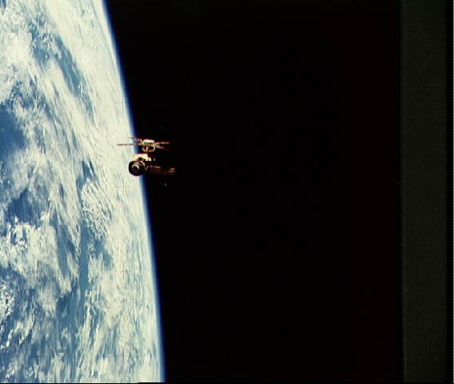
Notes:
http://images.jsc.nasa.gov/images/pao/SL2/10076169.jpg
NASA Photo ID: SL2-07-667 File Name: 10076169.jpg
Film Type: 70mm Date Taken: 06/22/73
Title: Skylab 2 Farewell View from the Departing Skylab Command/Service Module
Description:
This overhead view of the Skylab Space Station was taken from the Departing
Skylab Command/Service Module during the Skylab 2's final fly-around
inspection. The single solar panel is quite evident as well as the parasol
solar shield, rigged to replace the missing micrometeoroid shield. Both
the second solar panel and the micrometeoroid shield were torn away
during a mishap in the original Skylab 1 liftoff and orbital insertion.
Subject terms:
EARTH LIMB
EARTH ORBITAL RENDEZVOUS
MANNED ORBITAL LABORATORIES
ORBITAL WORKSHOPS
SKYLAB 2
SOLAR ARRAYS
SPACE STATIONS

Slide 9
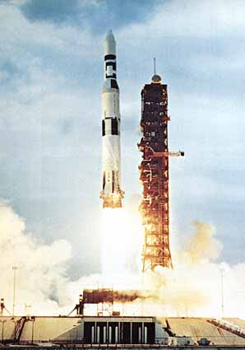
Notes:
http://history.nasa.gov/SP-400/ch3.htm

Slide 10
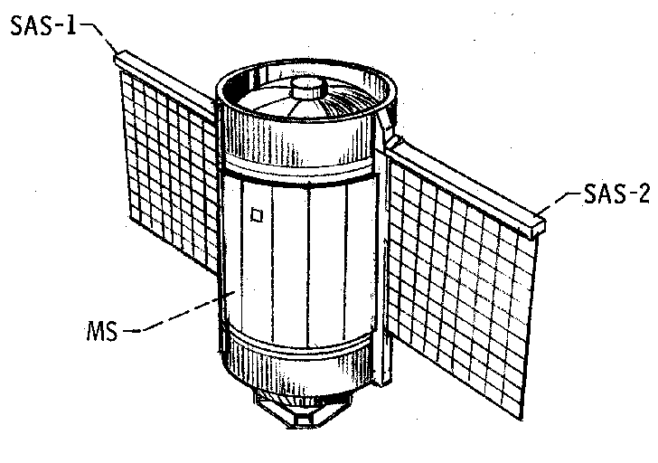
Notes:
http://history.nasa.gov/skylabrep/SRch2.htm#Ch2
Figure 2-4. - Meteoroid shield and solar array system. (b) DEPLOYED.

Slide 11
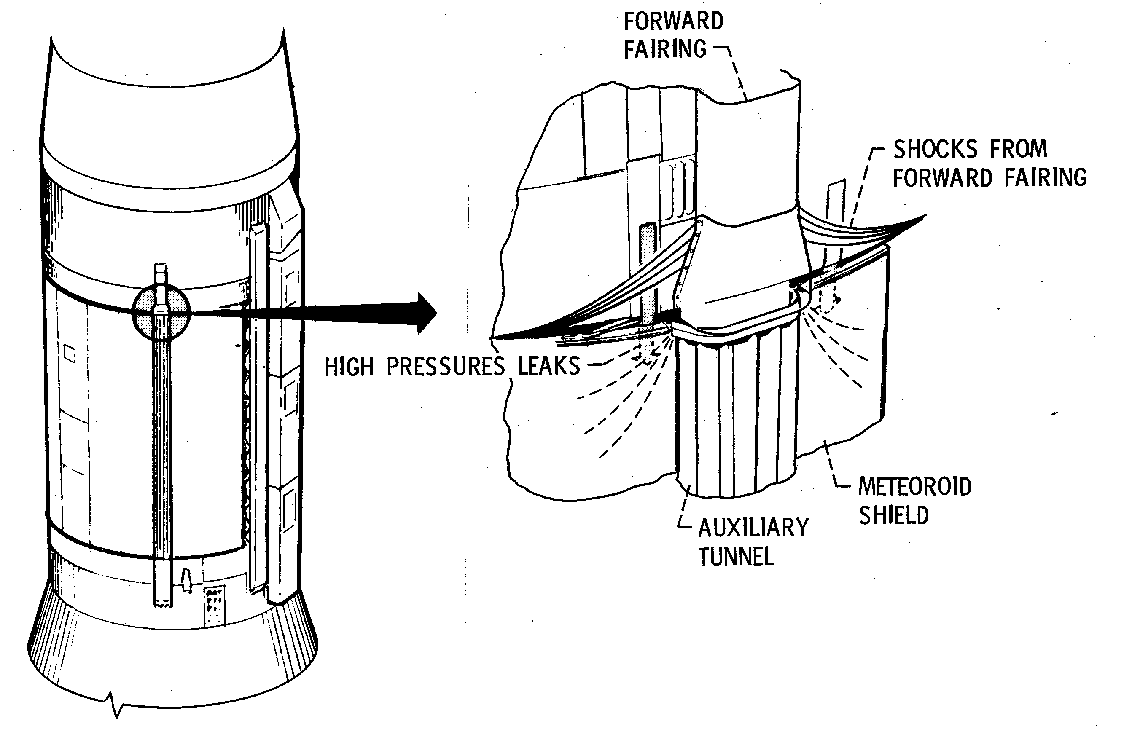
Notes:
http://history.nasa.gov/skylabrep/SRch6.htm#Ch6
Figure 6-14. - Compressibility waves from the forward auxiliary tunnel fairing.

Slide 12
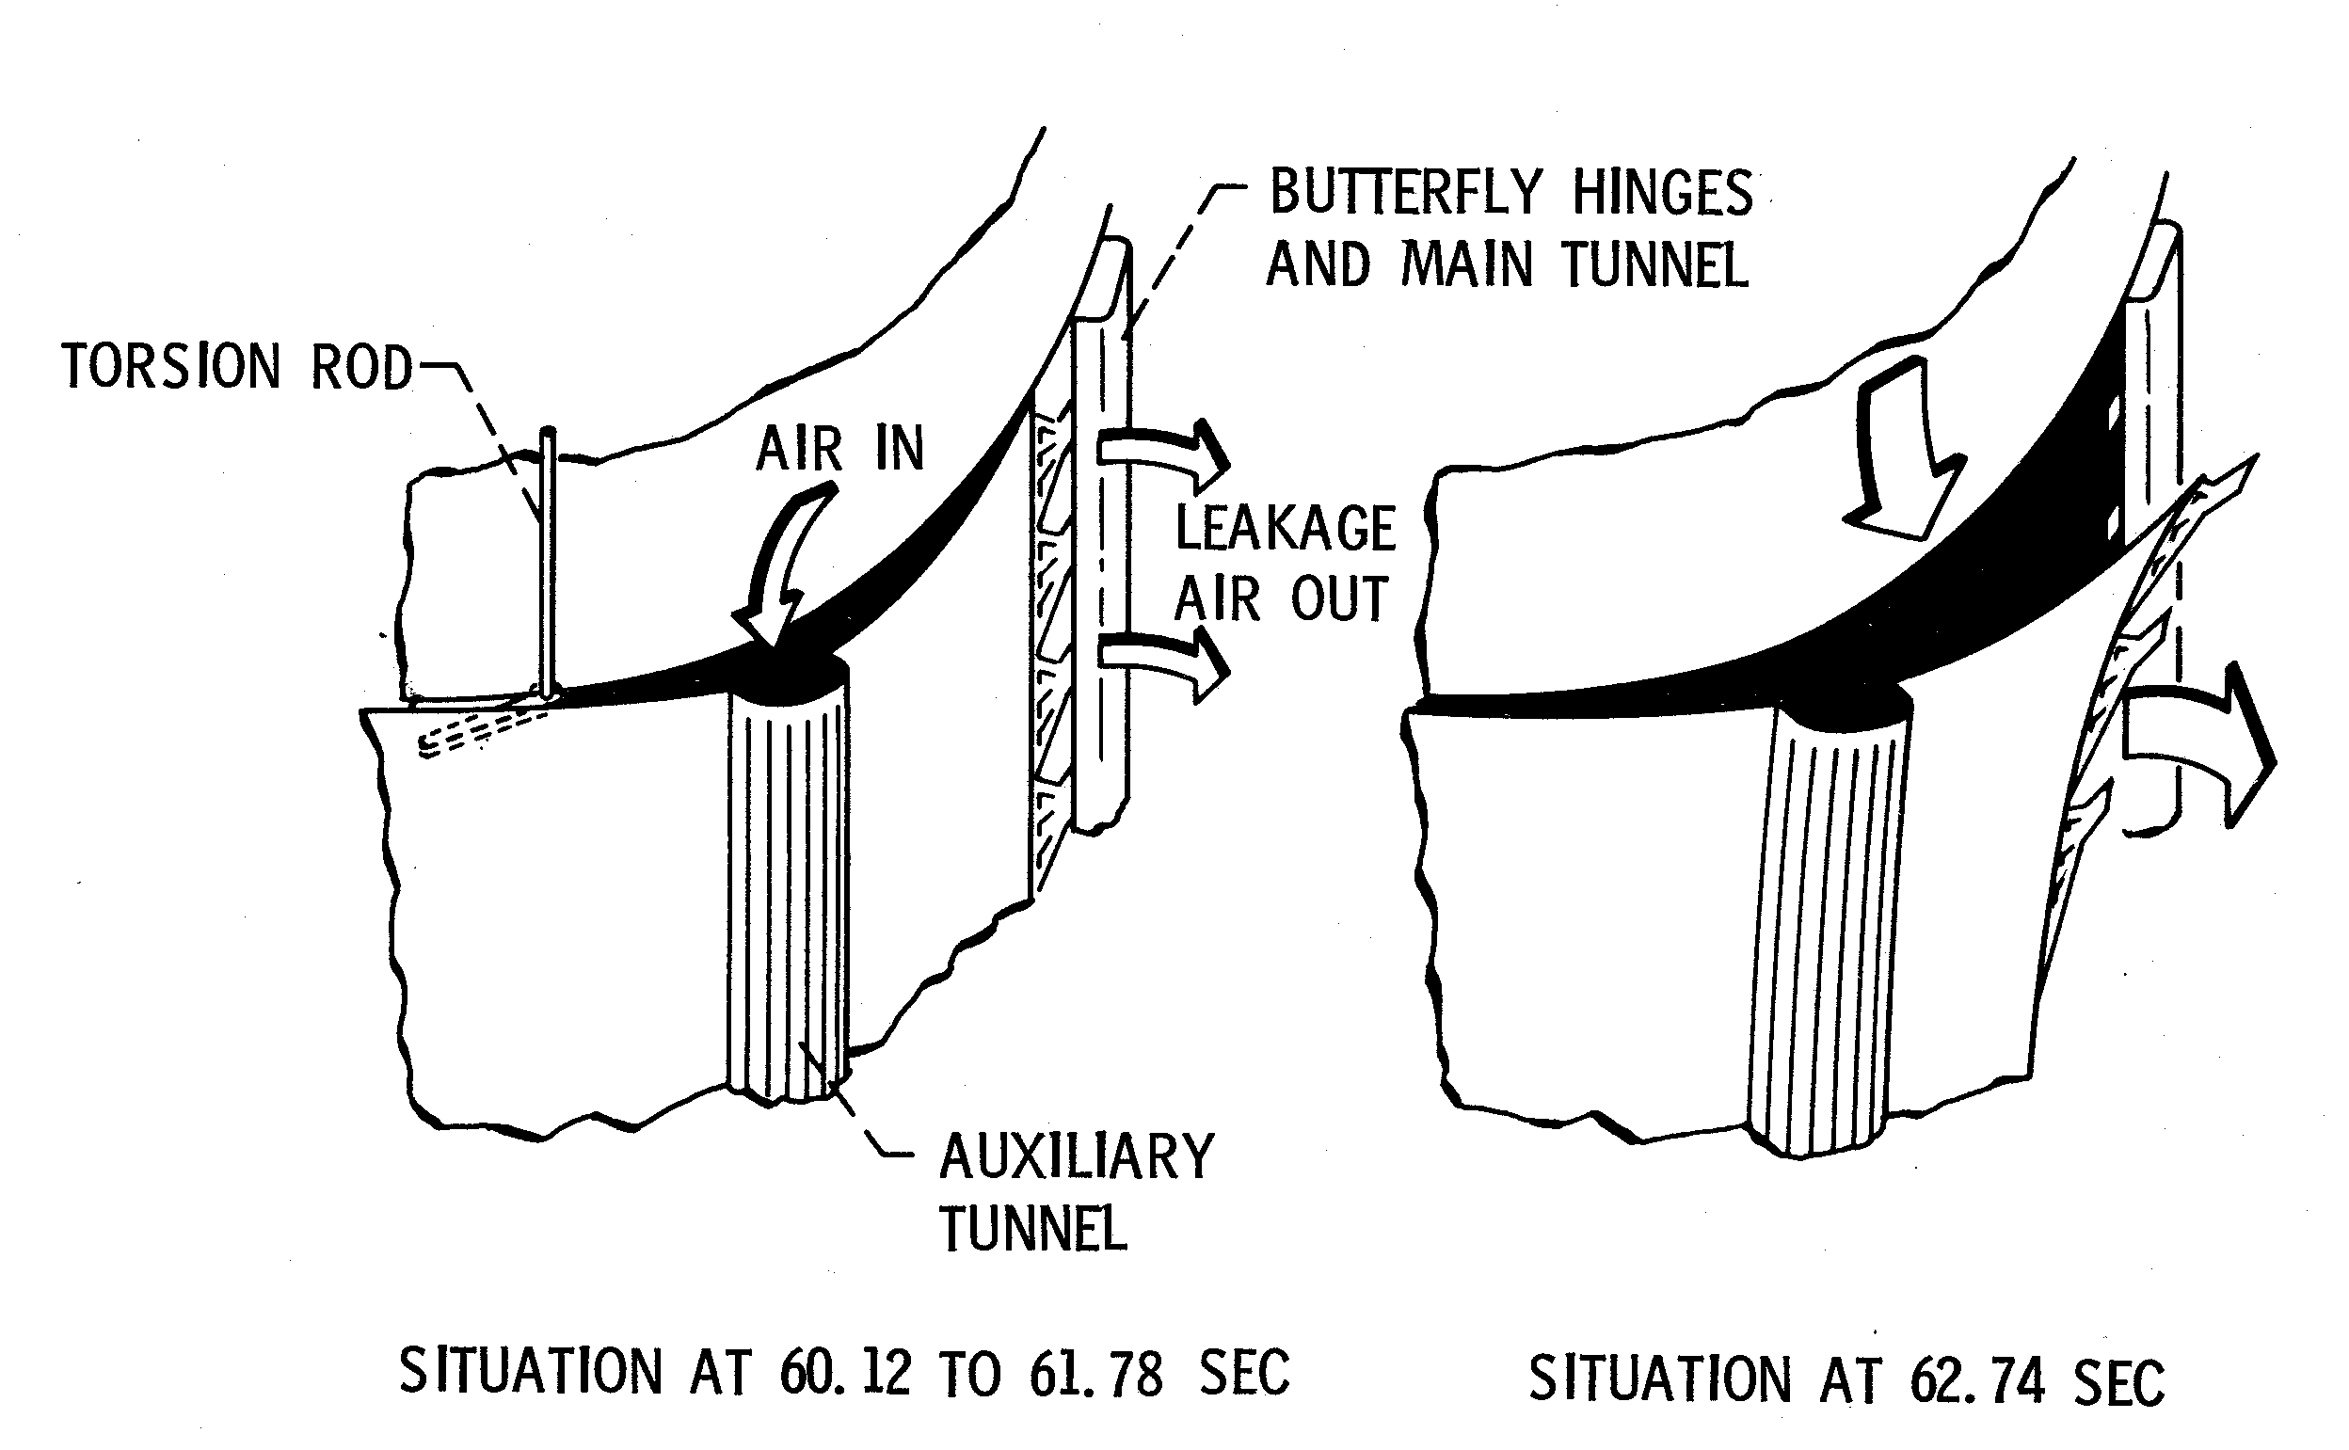
Notes:
http://history.nasa.gov/skylabrep/SRch7.htm#Ch7
Figure 7-2. - Sketches of possible shield dynamics during the 63 second anomaly.

Slide 13
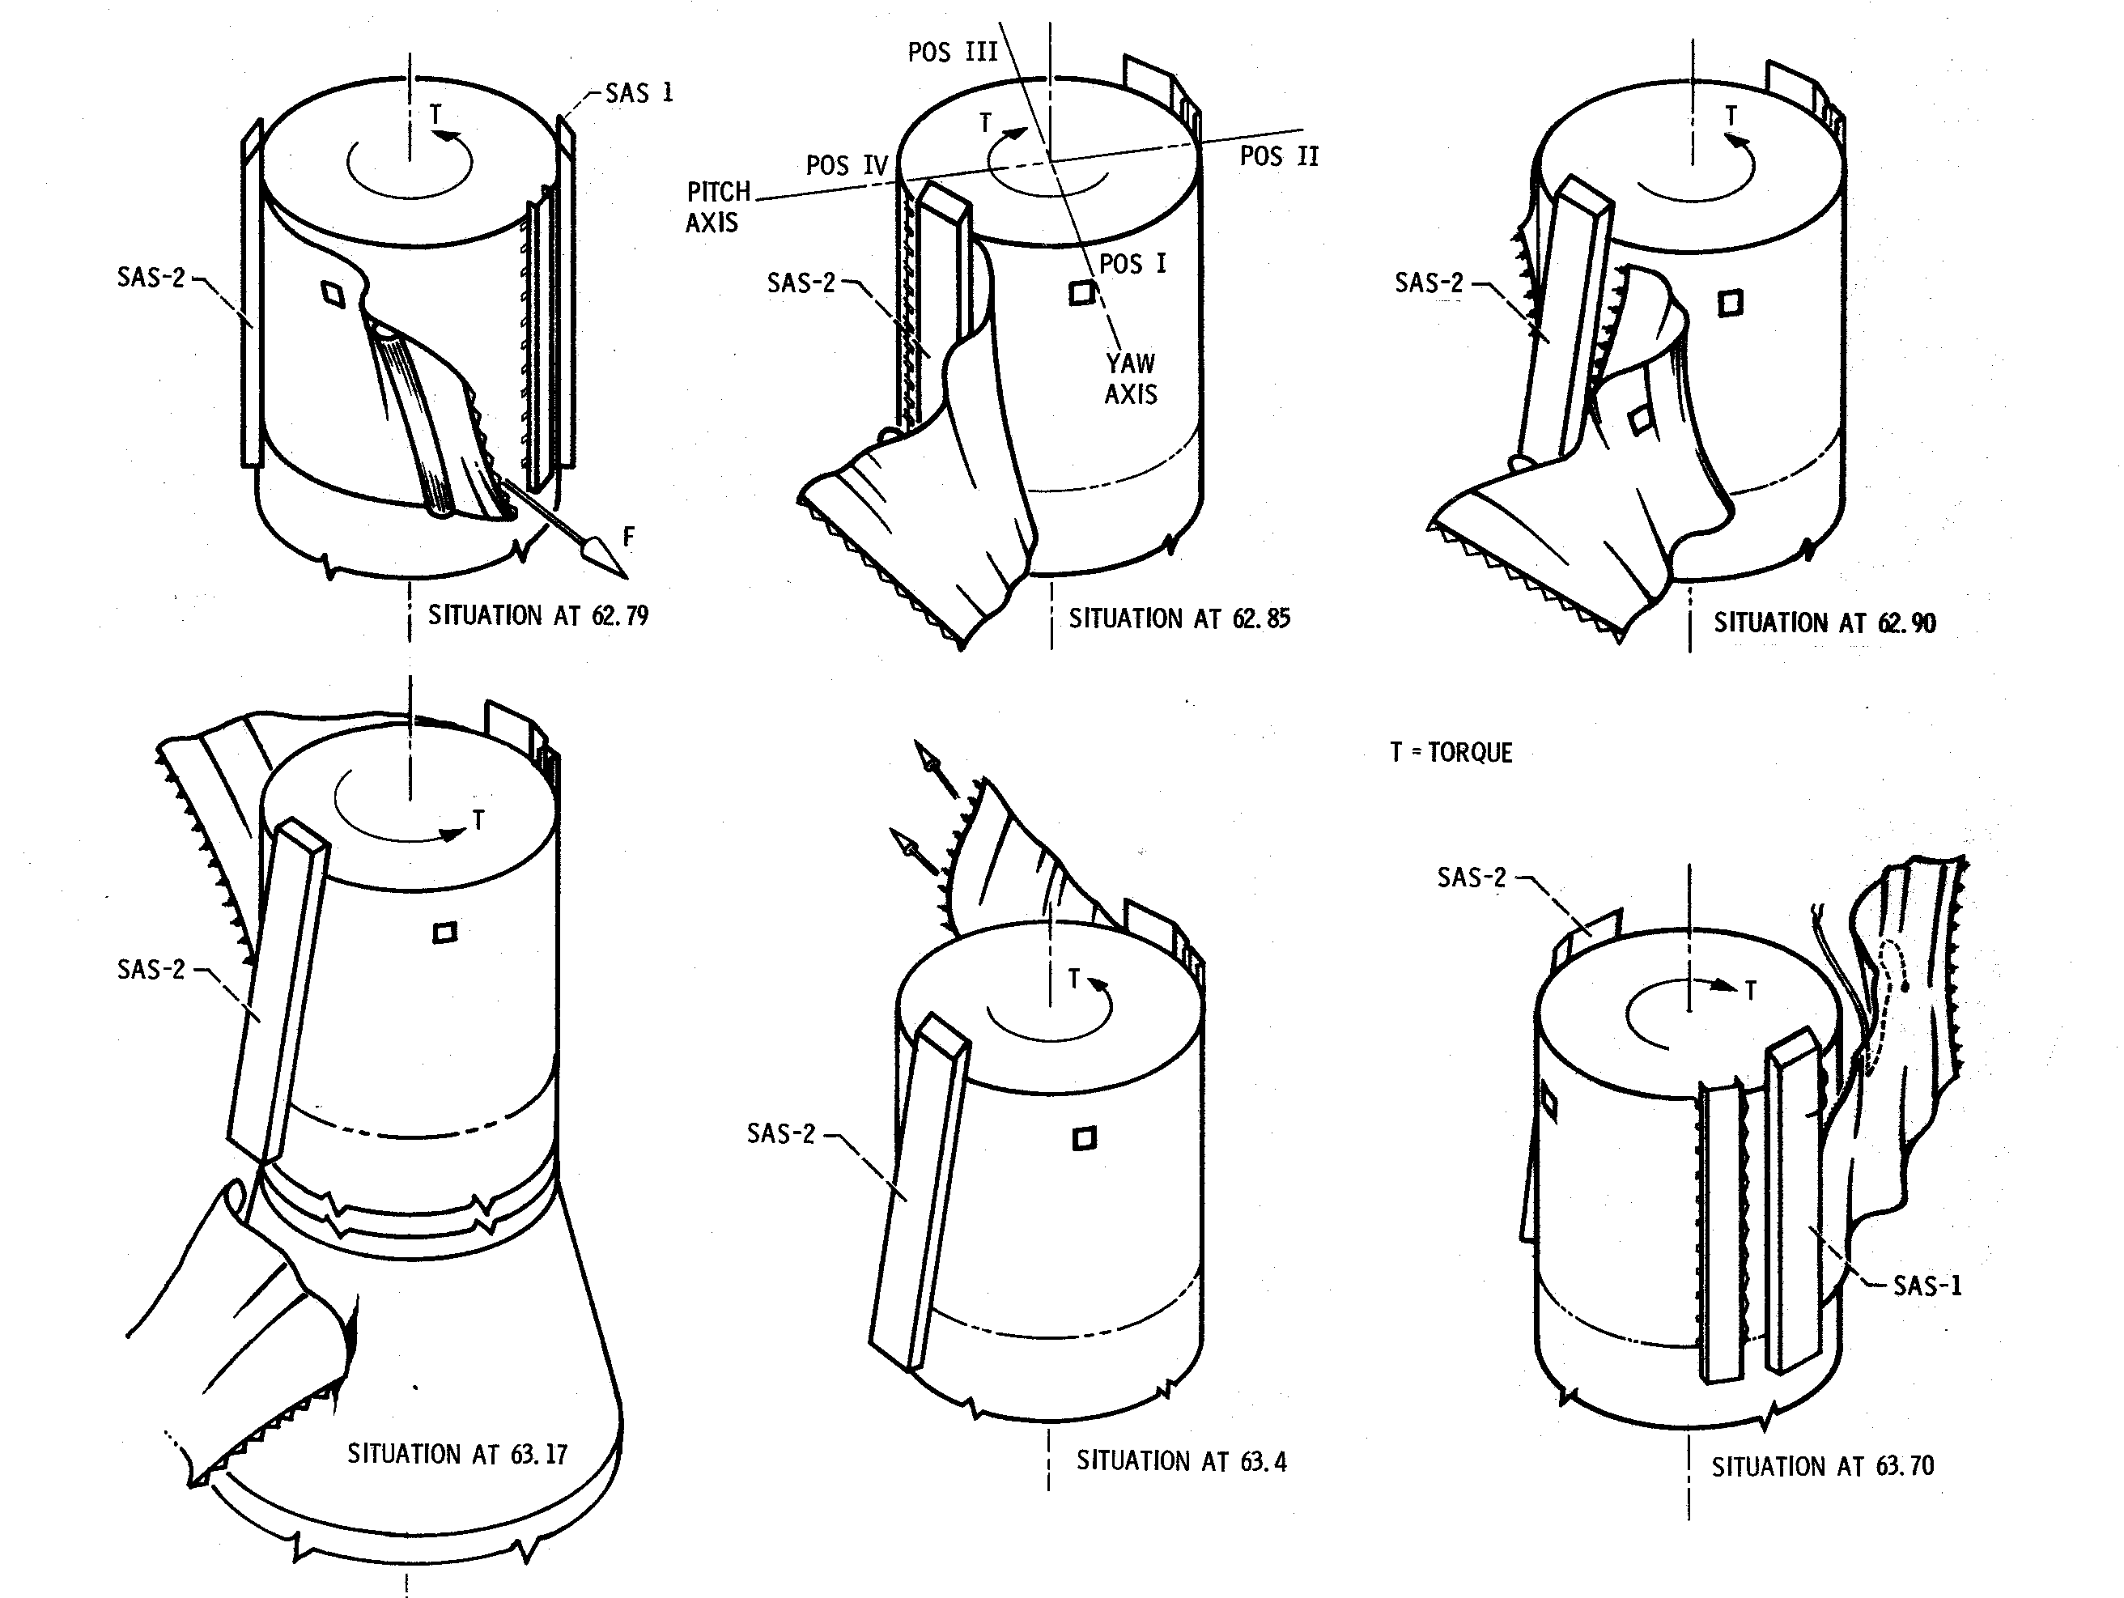
Notes:
http://history.nasa.gov/skylabrep/SRch7.htm#Ch7
Figure 7-3. - Sketches of possible shield dynamics during the 63 second anomaly.

Slide 14
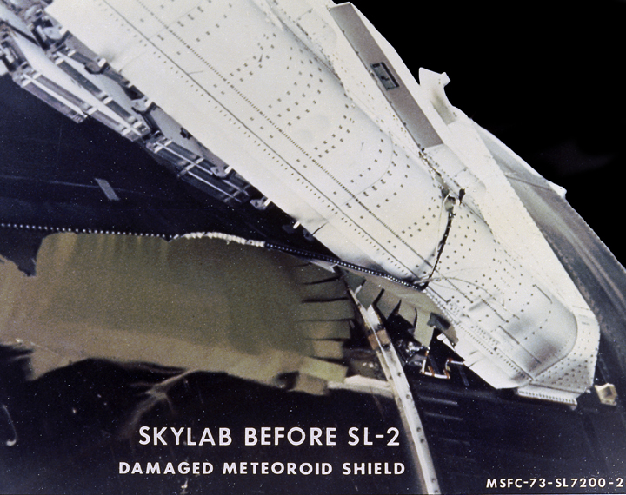
Notes:
http://mix.msfc.nasa.gov/ABSTRACTS/MSFC-0100552.html
Name of Image:
Damaged Skylab Micrometeoroid Shield
MIX #:
0100552
NIX #:
MSFC-0100552
Date of Image:
May-73
Category:
Skylab
Full Description:
"The Saturn V vehicle, carrying the unmanned
orbital workshop for the Skylab-1 mission, lifted off
successfully and all systems performed normally.
Sixty-three seconds into flight, engineers in the
operation support and control center saw an
unexpected telemetry indication that signalled that
damages occurred on one solar array and the
micrometeoroid shield during the launch. The
micrometeoroid shield, a thin protective cylinder
surrounding the workshop protecting it from tiny
space particles and the sun’s scorching heat,
ripped loose from its position around the
workshop. This caused the loss of one solar wing
and jammed the other. Still unoccupied, the Skylab
was stricken with the loss of the heat shield and
sunlight beat mercilessly on the lab’s sensitive
skin. Internal temperatures soared, rendering the
station uninhabitable, threatening foods,
medicines, films, and experiments. This image,
taken during a fly-around inspection by the
Skylab-2 crew, shows the damaged meteoroid
shield being held by a thin aluminum strap
entangled with green-hued remnants of the lost
heat shield. The Marshall Space Flight Center
(MSFC) developed, tested, rehearsed, and
approved three repair options. These options
included a parasol sunshade and a twin-pole
sunshade to restore the temperature inside the
workshop, and a set of metal cutting tools to free
the jammed solar panel."
(MRPO) MRD/SPD Discipline(s):
n/a
(MRPO) Subject Type:
n/a
Keywords:
"Skylab, Micrometeoroid Shield"
MSFC Negative Number:
0100552
Reference Number:
MSFC-73-SL-7200-268
(MRPO) Source Ref#:
n/a

Slide 15
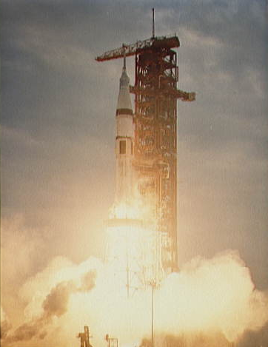
Notes:
http://images.jsc.nasa.gov/images/pao/SL3/10076200.jpg
NASA Photo ID: S73-32570 File Name: 10076200.jpg
Film Type: 4x5 Date Taken: 07/28/73
Title: Launch of Skylab 3/Saturn 1B space vehicle
Description:
The Skylab 3/Saturn 1B space vehicle is launched from Pad B, Launch Complex
39, Kennedy Space Cneter, Florida, at 7:11 a.m., Saturday, July 28, 1973.
Subject terms:
FLORIDA
KENNEDY SPACE CENTER
LAUNCHING PADS
LAUNCHING SITES
LIFTOFF (LAUNCHING)
SKYLAB 3
SKYLAB PROGRAM

Slide 16
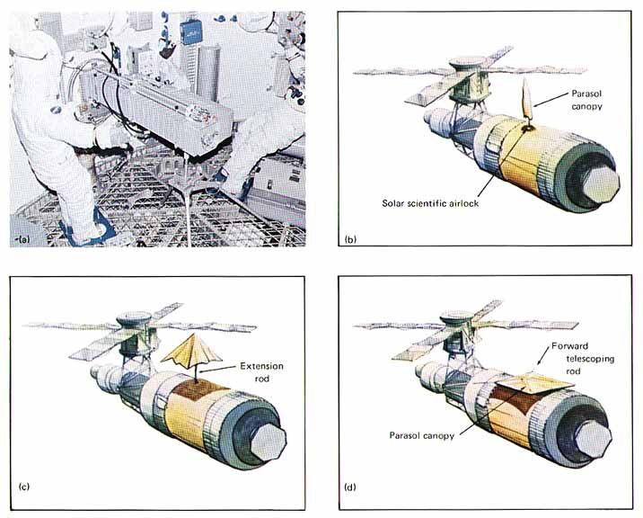
Notes:
http://history.nasa.gov/SP-400/p72.htm
http://history.nasa.gov/SP-400/ch4.htm
Sequence of parasol deployment. (a) Parasol operation from interior of airlock. (b) Parasol at partial extension. (c) Full extension and partial deployment. (d) Fully deployed and retracted for service.

Slide 17
Notes:
http://history.nasa.gov/SP-400/p72.htm
http://history.nasa.gov/SP-400/ch4.htm
Sequence of parasol deployment. (a) Parasol operation from interior of airlock. (b) Parasol at partial extension. (c) Full extension and partial deployment. (d) Fully deployed and retracted for service.

Slide 18
Notes:
http://history.nasa.gov/SP-400/p72.htm
http://history.nasa.gov/SP-400/ch4.htm
Sequence of parasol deployment. (a) Parasol operation from interior of airlock. (b) Parasol at partial extension. (c) Full extension and partial deployment. (d) Fully deployed and retracted for service.

Slide 19
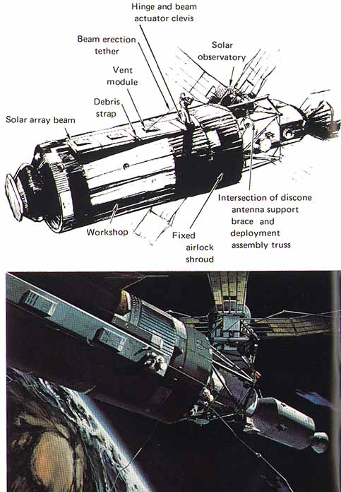
Notes:
http://history.nasa.gov/SP-400/p74.htm
http://history.nasa.gov/SP-400/ch4.htm

Slide 20
Notes:
http://history.nasa.gov/SP-400/p74.htm
http://history.nasa.gov/SP-400/ch4.htm

Slide 21
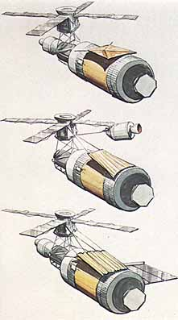
Notes:
http://history.nasa.gov/SP-400/ch3.htm

Slide 22
Notes:
http://history.nasa.gov/SP-400/ch3.htm

Slide 23
Notes:
http://history.nasa.gov/SP-400/ch3.htm

Slide 24
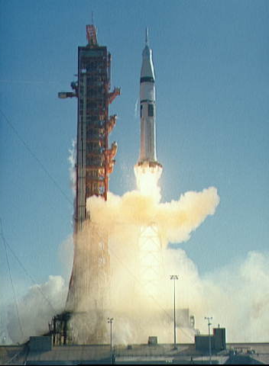
Notes:
http://images.jsc.nasa.gov/images/pao/SL4/10076336.htm
NASA Photo ID: S73-37287 File Name: 10076336.jpg
Film Type: 120mm Date Taken: 11/16/73
Title: Launch of the Skylab 4/Saturn 1B space vehicle
Description:
The Skylab 4/Saturn 1B space vehicle is launched from Pad B, Launch Complex
39, Kennedy Space Center, Florida, at 9:01:23 a.m., Friday, November 16,
1973. Skylab 4 is the third and last of three scheduled manned Skylab
missions.
Subject terms:
COMMAND MODULES
FLORIDA
KENNEDY SPACE CENTER
LAUNCHING PADS
LAUNCHING SITES
LIFTOFF (LAUNCHING)
SATURN LAUNCH VEHICLES
SKYLAB 4

Slide 25
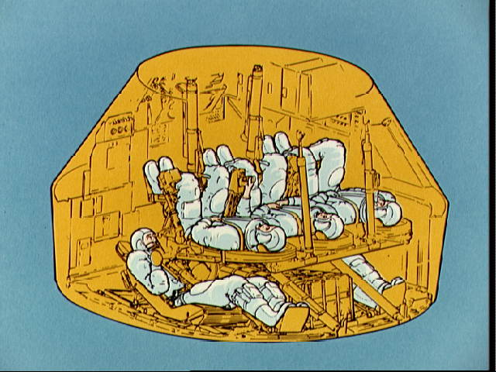
Notes:
http://images.jsc.nasa.gov/images/pao/SKY_OV/10076046.jpg
JSC Digital Image Collection
Press Release Images
NASA Photo ID: S73-31922 File Name: 10076046.jpg
Film Type: 4x5 Date Taken: 08/06/73
Title: Artist's concept illustrating cutaway view of Skylab Rescue Command Module
Description:
An artist's concept illustrating a cutaway view of the general arrangement
of the Skylab Rescue Command Module (CM). The standard Skylab CM
accommodates a crew of three with storage lockers on the aft bulkhead for
resupply of experiment film and other equipment as well as the return of
exposed film, data tapes and experiment samples. To convert the standard
CM to a rescue vehicle, the storage lockers are removed and replaced with
two crew couches in order to seat five crewmen. The rescue CM would then
be launched with a crew of two.
Subject terms:
ASTRONAUTS
COMMAND MODULES
GRAPHIC ARTS
RESCUE OPERATIONS
SKYLAB PROGRAM
VISUAL AIDS

Slide 26
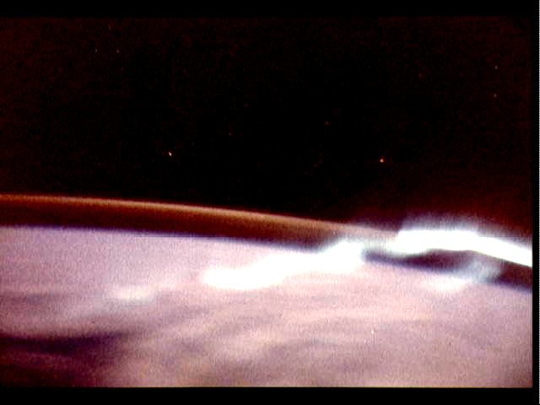
Notes:
http://images.jsc.nasa.gov/images/pao/SL3/10076265.jpg
NASA Photo ID: SL3-130-3130 File Name: 10076265.jpg
Film Type: 35mm Date Taken: 08/01/73
Title: View of the southern aurora, luminous bands or streamers of light
Description:
An excellent view of the southern aurora, luminous bands or streamers of
light, in the Southern Hemisphere, as photographed from the Skylab space
station in Earth orbit. The space station was moving into the sunlight when
this picture was taken. This view is near the edge of the aurora cap. The
surface of the Earth is in the foreground. The permanent aurora over the
South Pole is in the background. Scientist-Astronaut Owen K. Garriott,
Skylab 3 science pilot, took this photograph with a hand-held 35mm Nikon
camera, with a four-second exposure at f/1.2, using high speed Ektachrome
film. Because auroras are caused by solar activity, they occur at the same
time in the Northern and Southern hemispheres.
Subject terms:
AURORAS
EARTH OBSERVATIONS (FROM SPACE)
ONBOARD ACTIVITIES
PHOTOGRAPHY
SKYLAB 3
SKYLAB PROGRAM

Slide 27
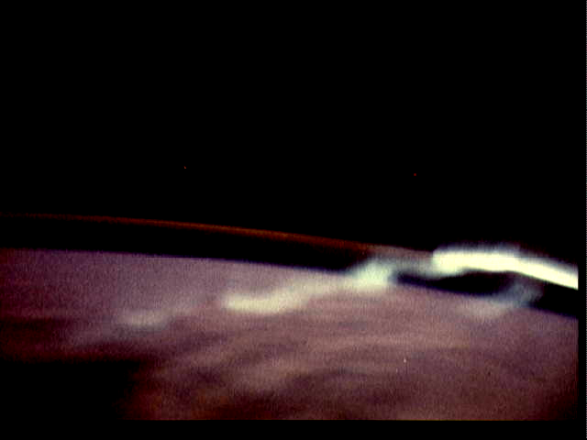
Notes:
http://images.jsc.nasa.gov/images/pao/SL3/10076265.jpg
NASA Photo ID: SL3-130-3130 File Name: 10076265.jpg
Film Type: 35mm Date Taken: 08/01/73
Title: View of the southern aurora, luminous bands or streamers of light
Description:
An excellent view of the southern aurora, luminous bands or streamers of
light, in the Southern Hemisphere, as photographed from the Skylab space
station in Earth orbit. The space station was moving into the sunlight when
this picture was taken. This view is near the edge of the aurora cap. The
surface of the Earth is in the foreground. The permanent aurora over the
South Pole is in the background. Scientist-Astronaut Owen K. Garriott,
Skylab 3 science pilot, took this photograph with a hand-held 35mm Nikon
camera, with a four-second exposure at f/1.2, using high speed Ektachrome
film. Because auroras are caused by solar activity, they occur at the same
time in the Northern and Southern hemispheres.
Subject terms:
AURORAS
EARTH OBSERVATIONS (FROM SPACE)
ONBOARD ACTIVITIES
PHOTOGRAPHY
SKYLAB 3
SKYLAB PROGRAM

Slide 28
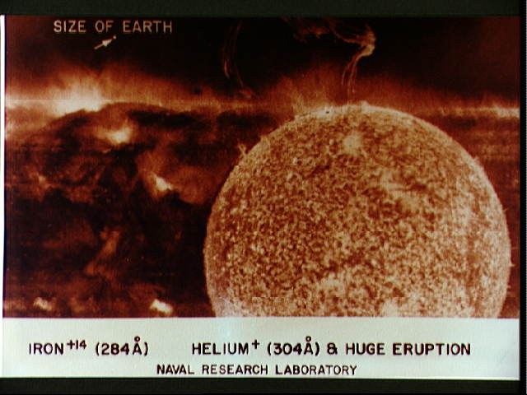
Notes:
http://images.jsc.nasa.gov/images/pao/SL3/10076294.htm
NASA Photo ID: S74-15583 File Name: 10076294.jpg
Film Type: 8x10 Date Taken: 01/01/74
Title: ATM photo of the sun taken form S082 experiment
Description:
One Apollo Telescope Mount (ATM) photo of the sun (Helium + (304A) + Huge
Eruption) taken from the S082A Extreme Ultraviolet Spectroheliograph
experiment.
Subject terms:
ONBOARD ACTIVITIES
PHOTOGRAPHY
SKYLAB 3
SKYLAB PROGRAM
SOLAR ATMOSPHERE
SOLAR FLARES
SPACEBORNE EXPERIMENTS
SPACEBORNE TELESCOPES
SUN
ULTRAVIOLET PHOTOGRAPHY

Slide 29
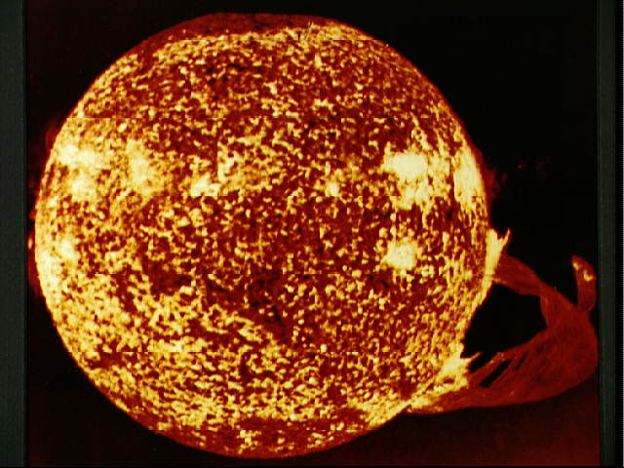
Notes:
http://images.jsc.nasa.gov/images/pao/SL4/10076406.htm
NASA Photo ID: S74-23458 File Name: 10076406.jpg
Film Type: 4x5 Date Taken: 06/20/74
Title: Photograph of the Sun, taken during final Skylab mission
Description:
This photograph of the Sun, taken on December 19, 1973 during the third and
final manned Skylab mission, shows one of the most spectacular solar flares
ever recorded, spanning more than 588,000 kilometers (365,000 miles) across
the solar surface. The flare gives the distinct impression of a twisted
sheet of gas in the process of unwinding itself. In this photograph the
solar poles are distinguished by a relative absence of supergranulation
network, and a much darker tone than the central portions of the disk.
Several active regions are seen on the eastern side of the disk. The
photograph was taken in the light of ionized helium by the extreme
ultraviolet spectroheliograph instrument of the U.S. Naval Research
Laboratory.
Subject terms:
PHOTOGRAPHY
SKYLAB 4
SKYLAB PROGRAM
SOLAR ATMOSPHERE
SOLAR FLARES
SUN

Slide 30
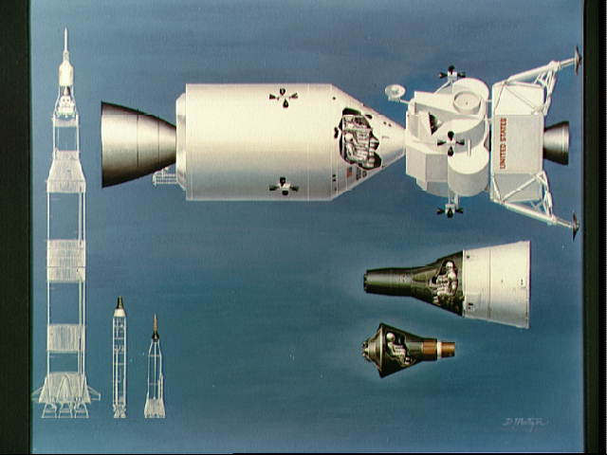
Notes:
http://images.jsc.nasa.gov/images/pao/MERC_OV/10073402.htm
JSC Digital Image Collection
Press Release Images
NASA Photo ID: S64-22331 File Name: 10073402.jpg
Film Type: 4x5 Date Taken: 01/09/87
Title: Illustration of relative sizes of Mercury, Gemini and Apollo spacecraft
Description:
Artist concept illustrating the relative sizes of the one-man Mercury
spacecraft, the two-man Gemini spacecraft, and the three-man Apollo
spacecraft. Also shows line drawing of launch vehichles to show their
relative size in relation to each other.
Subject terms:
APOLLO SPACECRAFT
DIMENSIONAL MEASUREMENT
GEMINI SPACECRAFT
MERCURY SPACECRAFT
REENTRY VEHICLES

Slide 31
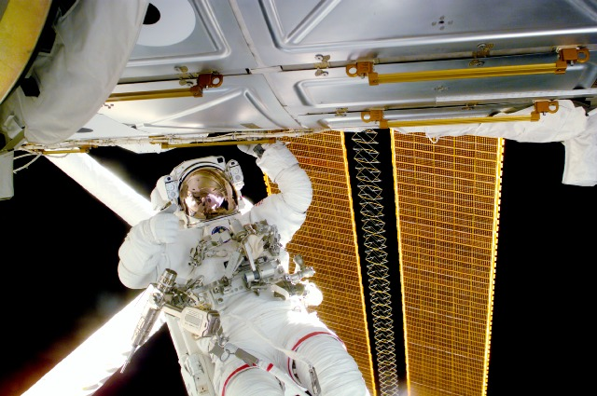
Notes:
http://Spaceflight.nasa.gov/gallery/images/shuttle/sts-97/html/s97e5034.html
S97-E-5034 (5 December 2000) ---
Astronaut Joseph R. Tanner, mission
specialist, signals "thumbs-up" during his
extravehicular activity (EVA) to perform
work on the International Space Station
(ISS). Part of the RMS robotic arm and a
section of the newly- deployed solar array
panel are in the background.

Slide 32
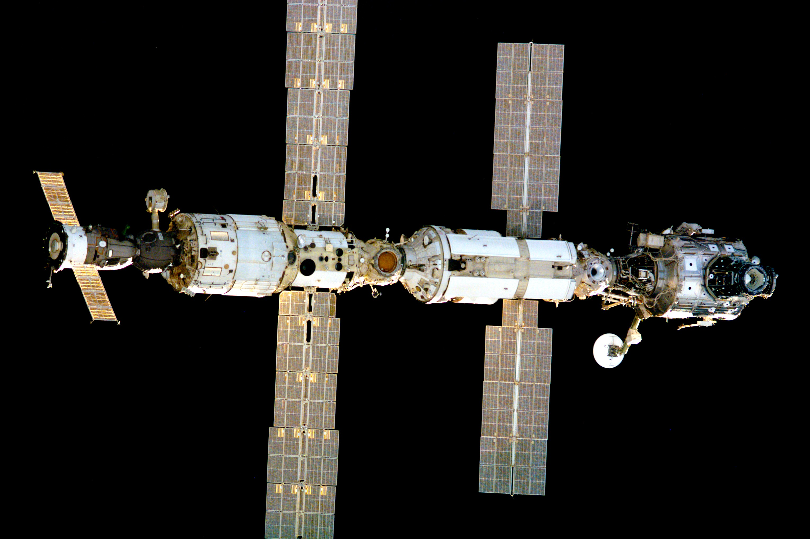
Notes:
http://Spaceflight.nasa.gov/gallery/images/shuttle/sts-97/html/s97e5010.html
high res (0.7 M) low res (48 K)
S97-E-5010 (2 December 2000) ---
International Space Station (ISS), against
darkness of space, photographed by
STS-97 crew members onboard the
approaching Space Shuttle Endeavour.

Slide 33
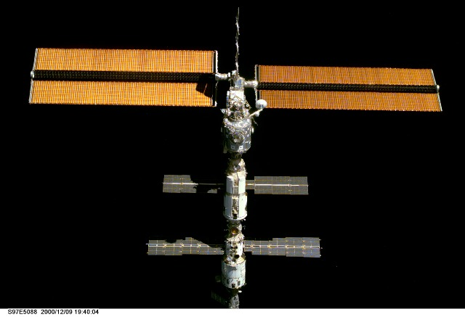
Notes:
http://Spaceflight.nasa.gov/gallery/images/shuttle/sts-97/html/s97e5088.html
S97-E-5088 (9 December 2000) --- This
is one of a series of digital still camera views
showing the International Space Station
(ISS) during a fly-around by the Space
Shuttle Endeavour. The 240-foot-long,
38-foot-wide solar array (top) is the newest
part and one of the most prominent
components of the station. Onboard ISS
for about 40 days at the time of this photo
were astronaut William M. Shepherd and
cosmonauts Yuri P. Gidzenko and Sergei
K. Krikalev. Onboard the shuttle were
STS-97 astronauts -- commander Brent
W. Jett, Jr., pilot Mike Bloomfield and
mission specialists Marc Garneau of the
Canadian Space Agency (CSA), Carlos I.
Noriega and Joseph R. Tanner.

Slide 34
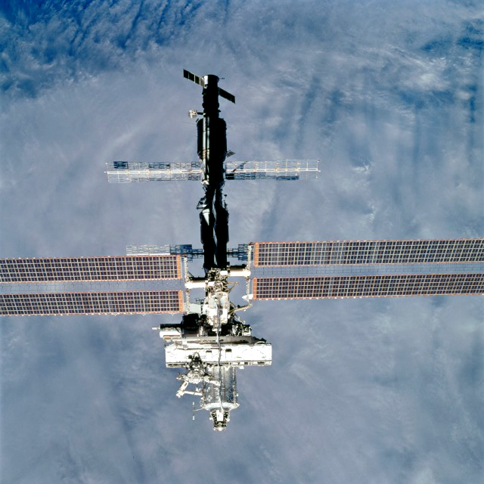
Notes:
http://spaceflight.nasa.gov/gallery/images/shuttle/sts-111/lores/sts111-711-005.jpg
http://spaceflight.nasa.gov/gallery/images/shuttle/sts-111/html/sts111-711-005.html
STS-111 Shuttle Mission Imagery
high res (7.0 M) low res (265 K)
STS111-711-005 (15 June 2002) ---
Backdropped by a blue and white Earth,
this view of the International Space Station
(ISS) was photographed by a crewmember
on board the Space Shuttle Endeavour
following the undocking of the two
spacecraft over western Kazakhstan.
Endeavour pulled away from the complex
at 9:32 a.m. (CDT) on June 15, 2002. The
S0 (S-zero) Truss with the newly added
Mobile Base System (MBS) is visible just
below center frame.

Slide 35
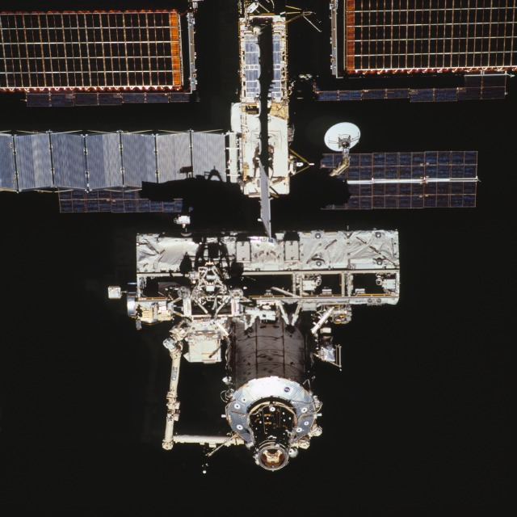
Notes:
http://spaceflight.nasa.gov/gallery/images/shuttle/sts-111/lores/sts111-708-057.jpg
http://spaceflight.nasa.gov/gallery/images/shuttle/sts-111/html/sts111-708-057.html
STS-111 Shuttle Mission Imagery
high res (6.1 M) low res (99 K)
STS111-708-057 (15 June 2002) ---
Backdropped by the blackness of space,
this close-up view of the International
Space Station (ISS) was photographed by
a crewmember on board the Space Shuttle
Endeavour following the undocking of the
two spacecraft over western Kazakhstan.
Endeavour pulled away from the complex
at 9:32 a.m. (CDT) on June 15, 2002. The
S0 (S-zero) Truss with the newly added
Mobile Base System (MBS) is visible
center frame.

Slide 36
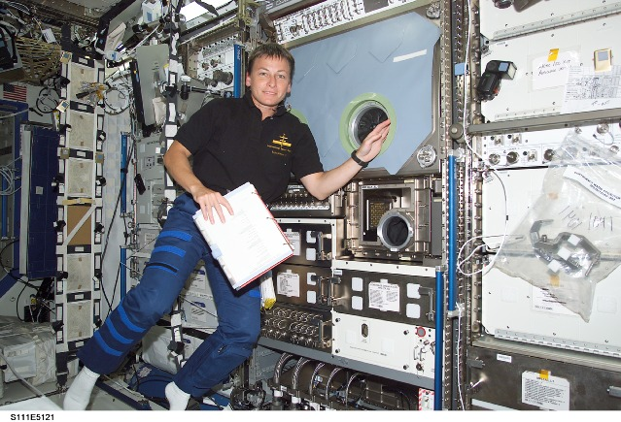
Notes:
http://spaceflight.nasa.gov/gallery/images/shuttle/sts-111/lores/s111e5121.jpg
http://spaceflight.nasa.gov/gallery/images/shuttle/sts-111/html/s111e5121.html
STS-111 Shuttle Mission Imagery
high res (2.0 M) low res (124 K)
STS111-E-5121 (9 June 2002) ---
Astronaut Peggy A. Whitson, Expedition
Five flight engineer, floats near the
Microgravity Science Glovebox (MSG) in
the Destiny laboratory on the International
Space Station (ISS).

Slide 37
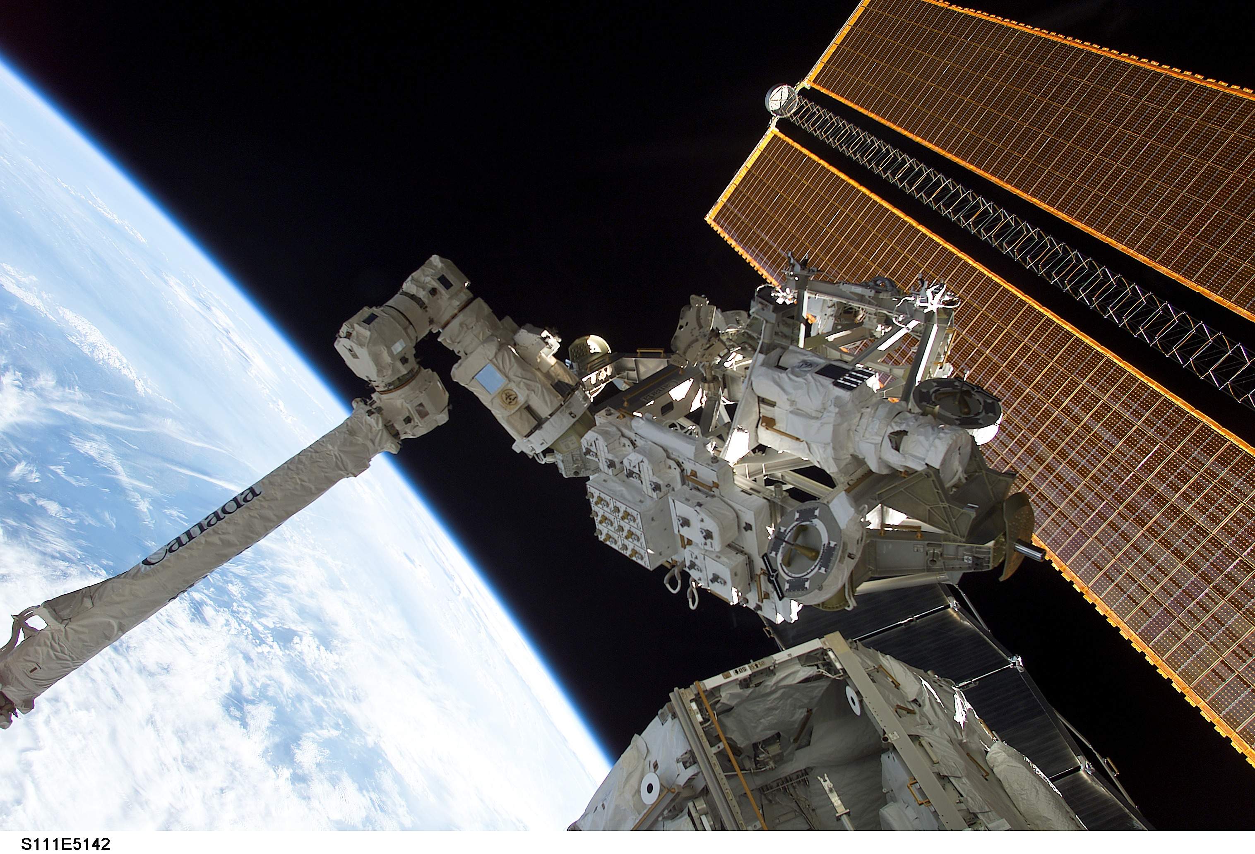
Notes:
http://spaceflight.nasa.gov/gallery/images/shuttle/sts-111/hires/s111e5142.jpg
http://spaceflight.nasa.gov/gallery/images/shuttle/sts-111/html/s111e5142.html
STS-111 Shuttle Mission Imagery
high res (1.8 M) low res (99 K)
STS111-E-5142 (10 June 2002) ---
Backdropped by the blackness of space
and Earth’s horizon, the Mobile Remote
Servicer Base System (MBS) is moved by
the Canadarm2 for installation on the
International Space Station (ISS).
Astronauts Peggy A. Whitson, Expedition
Five flight engineer, and Carl E. Walz,
Expedition Four flight engineer, attached the
MBS to the Mobile Transporter on the S0
(S-zero) Truss at 8:03 a.m. (CDT) on June
10, 2002. The MBS is an important part of
the station’s Mobile Servicing System,
which will allow the station’s robotic arm to
travel the length of the station to perform
construction tasks.

Slide 38
Notes:
THIN Earth atmosphere. ☺
http://spaceflight.nasa.gov/gallery/images/shuttle/sts-111/hires/s111e5142.jpg
http://spaceflight.nasa.gov/gallery/images/shuttle/sts-111/html/s111e5142.html
STS-111 Shuttle Mission Imagery
high res (1.8 M) low res (99 K)
STS111-E-5142 (10 June 2002) ---
Backdropped by the blackness of space
and Earth’s horizon, the Mobile Remote
Servicer Base System (MBS) is moved by
the Canadarm2 for installation on the
International Space Station (ISS).
Astronauts Peggy A. Whitson, Expedition
Five flight engineer, and Carl E. Walz,
Expedition Four flight engineer, attached the
MBS to the Mobile Transporter on the S0
(S-zero) Truss at 8:03 a.m. (CDT) on June
10, 2002. The MBS is an important part of
the station’s Mobile Servicing System,
which will allow the station’s robotic arm to
travel the length of the station to perform
construction tasks.

