Slide 1


An Overview of Anasazi
November 2nd, 2:15-3:15pm
Chris Baker
Ulrich Hetmaniuk
Rich Lehoucq
Heidi Thornquist (Lead)
Sandia is a multiprogram laboratory operated by Sandia Corporation, a Lockheed Martin Company,
for the United States Department of Energy under contract DE-AC04-94AL85000.
Notes:
Questions from audience
Can you use another matrix-vector multiply?
Are multivectors supported?
Are Petsc and Hypre available via TSF?
How does Trilinos differ from Petsc?

Slide 2
Outline
Background
  ARPACK
  SLEPc
Eigensolver design goals
  Generic programming
Anasazi
  What’s in Trilinos 6.0
  Current Interfaces
  Current Customers
  Future Development
Concluding remarks

Slide 3
Background
Several iterative eigensolver libraries exist:
  SLEPc
  LOBPCG (hypre)
  ARPACK
  …
None are (completely) written in C++.
Stopping criteria are predetermined for most libraries.
The underlying linear algebra is static.

Slide 4
ARnoldi PACKage (ARPACK)
Written in Fortran 77.
Algorithms: Implicitly Restarted Arnoldi/Lanczos
Static convergence tests.
Output formatting, verbosity level is determined by user.
Uses LAPACK/BLAS to perform underlying vector space operations.
Offers abstract interface to matrix-vector products through reverse communication.

Slide 5
Scalable Library for Eigenvalue Problem Computations ( SLEPc )
Written in C (Hernández, Román, and Vidal, 2003).
Provides some basic eigensolvers as well as wrappers around:
  ARPACK (Lehoucq, Maschhoff, Sorensen, and Yang, 1998)
  BLZPACK (Marques, 1995)
  PLANSO (Wu and Simon 1997)
  TRLAN (Wu and Simon, 2001)
Native Algorithms: Power/Subspace Iteration, RQI, Arnoldi
Wrapped Algorithms: IRAM/IRLM (ARPACK), Block Lanczos (BLZPACK), and Lanczos (PLANSO/TRLAN)
Static convergence tests.
Uses PETSc to perform underlying vector space operations, matrix-vector products, and linear solves.
Allows the creation / registration of new matrix-vector products.

Slide 6
Eigensolver Software Design
Why not create a solver library that:
  Provides an abstract interface to an operator-vector products, scaling, and preconditioning.
  Allows the user to enlist any linear algebra package for the elementary vector space operations essential to the algorithm (Epetra, PETSc, etc.).
  Allows the user to define convergence of any algorithm (a.k.a. status testing).
  Allows the user to determine the verbosity level, formatting, and processor for the output.
  Allows these decisions to be made at runtime.

Slide 7
Generic Eigensolver
Eigenproblem
Status Test
AlgorithmA( … )
while ( myStatusTest.CheckStatus(…)
== Unconverged )
…
…
% Compute operator-vector product
myProblem.ApplyOp(NOTRANS,v,w);
α = w.dot(v);
…
end
myOM.print(something);
return (solution);
end
Generic Operator
Interface
Generic Linear
Algebra Interface
Output Manager

Slide 8
Benefits of Generic Programming
Generic programming techniques ease the implementation of complex algorithms.
Developing algorithms with generic programming techniques is easier on the developer, while still allowing them to build a flexible and powerful software package.
Generic programming techniques also allow the user to leverage their existing software investment.
Caveat: It’s not as easy as taking a piece of code and adding:
template <typename OT, typename ST>
More work has to be done to handle “numeric traits”

Slide 9
Introducing Anasazi
Next generation eigensolvers library, written in templated C++.
Provide a generic interface to a collection of algorithms for solving large-scale eigenproblems.
Algorithm implementation is accomplished through the use of traits clases and abstract base classes:
  e.g.: MultiVecTraits, OperatorTraits
  e.g.: Eigensolver, Eigenproblem, StatusTest
Includes block eigensolvers:
  Higher operator performance.
  More reliable.
Solves AX = XΛ or AX = BXΛ.

Slide 10
Anasazi Status
(Trilinos Release 6.0.5)
Anasazi
  Currently has three solvers:
    Block Krylov-Schur Method
    Block Davidson
    LOBPCG
  Can solve standard and generalized eigenproblems.
  Can solve Hermitian and non-Hermitian eigenproblems.
  Can target largest or smallest eigenvalues.
  Linear algebra adapters for Epetra, NOX/LOCA and Thyra.
  Epetra interface accepts Epetra_Operators, so it can be used with Belos, AztecOO, etc…
  Block size is independent of number of requested eigenvalues.

Slide 11
Anasazi Design
Eigenproblem Class
  Describes the problem and stores the answer.
Eigensolver Class
  Provide iteration interface.
MultiVecTraits and OperatorTraits
  Traits classes for interfacing linear algebra.
SortManager, OrthoManager
  Specify these operations.
StatusTest Class
  Control testing of convergence, etc.
OutputManager Class
  Control verbosity and printing in a MP scenario.

Slide 12
Anasazi Eigenproblem Interface
Provides an interface between the basic iterations and the eigenproblem to be solved.
Abstract base class Anasazi::Eigenproblem
  Allows spectral transformations to be removed from the algorithm.
  Defines the inner product to be used for the problem.
  Differentiates between standard and generalized eigenproblems.
  Initial vector, stiffness/mass matrix, operator, eigenvalues, eigenvectors.
Concrete class Anasazi::BasicEigenproblem
  Describes standard or general, Hermitian or non-Hermitian eigenproblems and the Euclidean inner product.

Slide 13
Anasazi Eigensolver Interface
Provides an abstract interface to Anasazi basic iterations.
Abstract base class Anasazi::Eigensolver
  number of iterations / restarts
  native residuals
  eigenproblem
  initialize/finalize
  iterate()
Specialization for solvers that can provide more information
  Block Krylov-Schur -> Ritz values / residuals

Slide 14
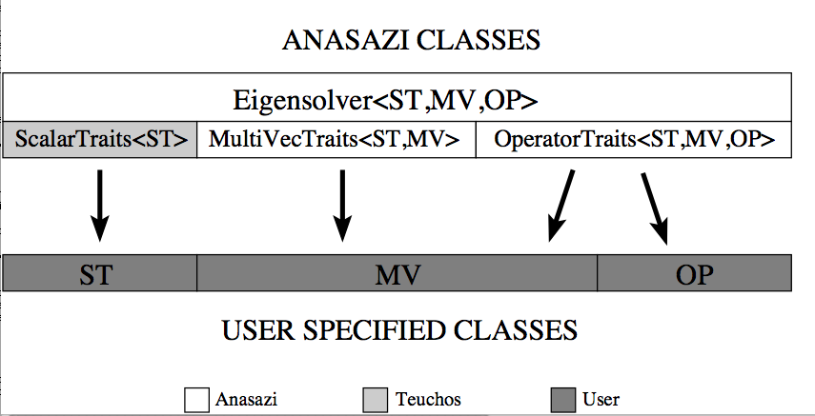
Anasazi Linear Algebra Interface
Anasazi::MultiVecTraits
  Abstract interface to define the linear algebra required by most iterative eigensolvers:
    creational methods
    dot products, norms
    update methods
    initialize / randomize
Anasazi::OperatorTraits
  Abstract interface to enable the application of an operator to a multivector.

Slide 15
Interfacing Your LA With Anasazi
Three approaches for using your own linear algebra:
  Specialize the traits classes for the multivector and operator:
    Fill out Anasazi::MultiVecTraits<ST,MyMV>
    Fill out Anasazi::OperatorTraits<ST,MyMV,MyOP>
  Subclass abstract base classes, for which traits specializations are already defined:
    class MyMV : public Anasazi::MultiVec<ST>
    class MyOP : public Anasazi::Operator<ST>
  Implement your linear algebra in the Thyra framework:
    Then use the Anasazi adapter to Thyra.
Or you can simply use Epetra!

Slide 16
Testing Your Interface
We need a way to test functionality of a new linear algebra library.
Anasazi includes two routines for testing LA libraries/interfaces:
  Anasazi::TestMultiVecTraits<ST,MV>(…)
  Anasazi::TestOperatorTraits<ST,MV,OP>(…)
Tests MultiVecTraits/OperatorTraits specialization and underlying classes.
Interfaces don’t have explicit access to object data, so tests are limited.

Slide 17
Anasazi StatusTest Interface
Allows user to decide when solver is finished.
Similar to NOX / AztecOO.
Multiple criterion can be logically connected.
Abstract base class methods:
  StatusType CheckStatus( Eigensolver<…>* solver );
  StatusType GetStatus() const;
  void Reset();
  ostream& Print( ostream& os ) const;
Concrete classes:
  Maximum iterations/restarts,
  Residual norm,
  Combinations {AND,OR}, …

Slide 18
Anasazi Output Manager Interface
Allows user to control which processor will handle output from the solver and the verbosity.
Default is lowest verbosity, outputting on proc 0.
Methods:
  Get/Set Methods:
    void SetOStream( ostream& os );
    void SetVerbosity( int vbLevel );
    ostream& GetOStream();
  Query Methods:
    bool isVerbosity( MsgType type );
    bool isVerbosityAndPrint( MsgType type );
    bool doPrint( MsgType type );

Slide 19
Anasazi Sort Manager Interface
Abstract interface for managing the sorting of the eigenvalues computed by the eigensolver.
Important tool to complement spectral transformations.
Only two methods:
  ReturnType sort(Eigensolver<ST,MV,OP>* solver,
  int n, ST *evals,
  std::vector<int> *perm=0);
  ReturnType sort(Eigensolver<ST,MV,OP>* solver,
  int n, ST *r_evals, ST *i_evals,
  std::vector<int> *perm=0);
Concrete class Anasazi::BasicSort
  Provides basic sorting methods:
    largest/smallest magnitude
    largest/smallest real part
    largest/smallest imaginary part

Slide 20
Current Anasazi Customers
LOCA
  Bifurcation analysis
  Continuation methods
RBGen
  Generating bases for model reduction

Slide 21
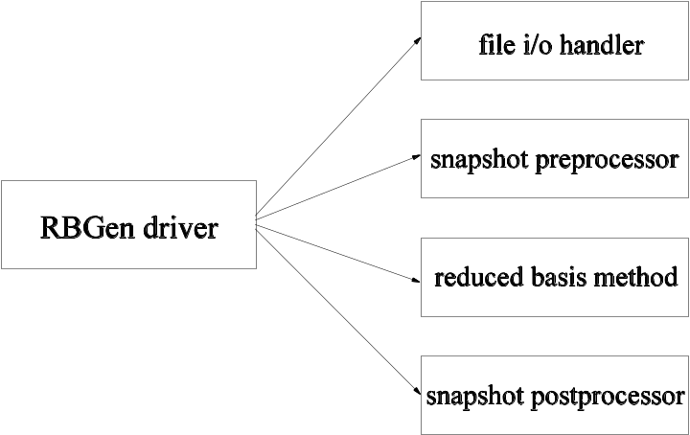
Infomercial: RBGen
RBGen - Reduced Basis Generator
Lead developer: Heidi Thornquist
Implemented tool to compute reduced basis (RBGen)
  Modular software design facilitates research of RBMs and snapshot generation, Exodus I/O utilities (Paul Lin).
  General purpose tool for any physics application.
  Quick development using tools already written (Anasazi/Teuchos)
    First reduced-basis method: POD
    Centroidal Voronoi Tessellations (CVT)

Slide 22
Reduced Order Modeling
Problem: Computing high-fidelity state solutions are extremely computationally intensive when performing real-time analysis.
Solution: Reduce the cost of the nonlinear state solution by using a reduced-order model for the state.
Need for reduced order modeling capabilities:
  Forward problem (flow modeling)
  Optimization problem (source inversion)
Proper Orthogonal Decomposition (POD)
  Attempt to capture the dominant behavior of the method.
  Constructs basis from a set of solution snapshots.
  Compute first n left singular vectors of snapshot matrix.
Work with John Shadid, Paul Lin, Rich Lehoucq, and Max Gunzburger (Florida State University)

Slide 23
RBGen::POD
Given matrix A of n snapshots of length m, we need the first k left singular vectors of A
  These are the rightmost k eigenvectors of A^{H}·A
Flexibility of Anasazi allows trivial usage in RBGen:
  Anasazi operator consists of two multiplications by snapshot matrix.
RBGen has access to any Anasazi eigensolver!

Slide 24
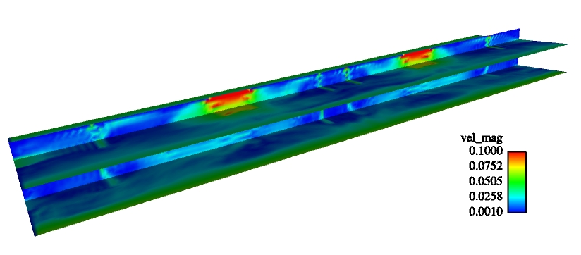
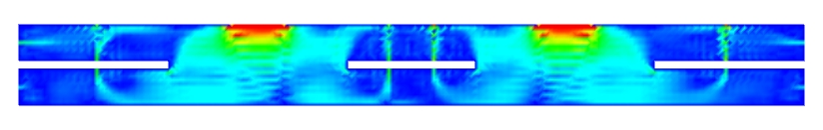
ROM Preliminary Qualitative Results
Transient LES-k 3D Airport Simulation
3D airport (230K nodes; 1.15M unknowns)
  Large output files (5 unknowns: Vx, Vy, Vz, P, TKE)
    output every time step for 6000 sec (each time step roughly 1 sec) gives 5.5 GB exodusII file
  7200 seconds of simulation time required about 100 hrs on 16 3.1-GHz Intel Xeon processors
Consider simulation time interval 1200-7200 seconds
  RBGen software (POD with Anasazi eigensolver)
    Compute 151 basis vectors for 151 snapshots (687K length snapshot): 600 sec on 32 3.1-GHz Intel Xeons
  Compare snapshots intervals of 20 and 40 seconds
    Much cheaper if snapshots over larger intervals provide sufficient information.
Velocity field magnitude averaged from 2200-7200 sec
Velocity field magnitude averaged from 2200-7200 sec

Slide 25
Future Anasazi Development
New solvers: Generalized Davidson, ???
Implement StatusTest mechanism:
  Convergence
  Krylov subspace restarting
  Switching to a different solver
  and much, much more!
Abstract interface to orthogonalization.
Support for complex scalar types.
Abstract interface for Rayleigh-Ritz process.
Solver managers:
  Contains logic not essential to an eigensolver iteration.
  Orchestrates multiple solvers (e.g., hybrid solver).
  Guarantees solution properties.
Python interface.

Slide 26
Concluding Remarks
(audience participation)
Are there any additional capabilities that you may need from a eigensolver?
Do you have any questions, comments, or suggestions about the user interface?
Are there any other solvers that you would like to see in Anasazi?

