Slide 1
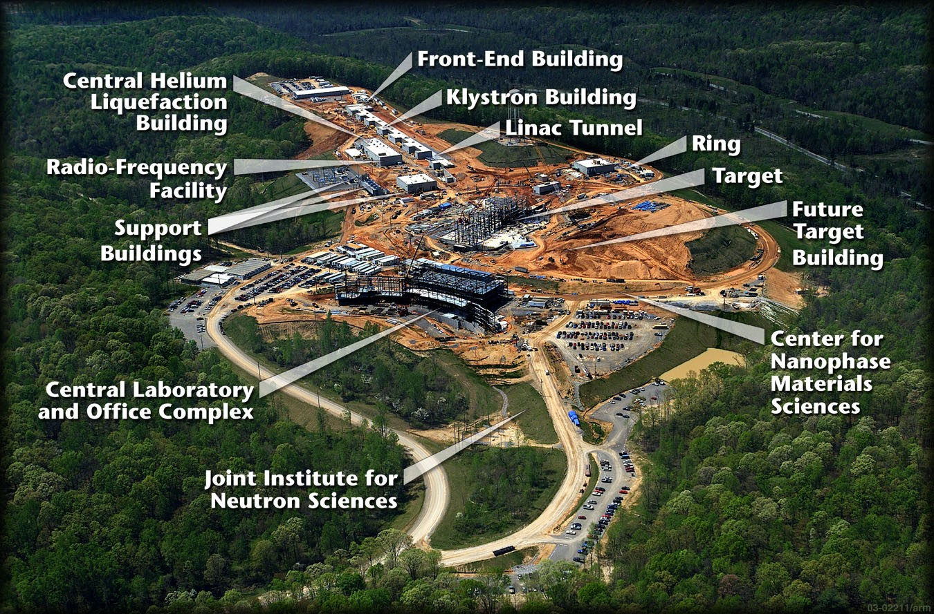
Upcoming Dates Accumulator Ring:
DOE Review October 2003
Extraction magnets being assembled
Injection DC Magnets and Kickers Complete
HEBT and RTBT Collimators Delivered
Ring 1 and 2 Collimator Chambers Coated
Design complete July 2003
More ½ cells delivered.
First doublet cell assembled
RF Cavities delivered
First quarter cell assembled

Slide 2
Hot Topics
South Crane capacity increased to 20 tons. – Lost lifting height and larger hook - S. Mason/G. Mahler Lifting fixture for ring ½ cell assembly layout to ORNL.
Magnet heat load verification/water flow verification. M. Hemmer
First Article Measurement 30Q44 – water flow measurement/dp/dT.
Price for ring primary collimator (May go out for bids.)
RTBT top plate.

Slide 3
ORNL Visit
Wednesday, July 23, 2003— Building 911B, Small Conference Room
8:00 a.m. Drawing Review …………………............ Alduino, McGahern, Tuozzolo
8:30 a.m. SDMS Teleconference Becker, Ludewig, McGahern, Tuozzolo
9:00 a.m. TESLA Teleconference Becker, Mahler, McGahern, Tuozzolo
9:15 a.m. Lambertson Review ……………. Alduino, McGahern, Miglionico, Raparia,
Rank, Tuozzolo
Wednesday, July 23, 2003— Building 911B, Large Conference Room
10:00 a.m. Collimator Meeting Alduino, Korostyshevsky, Longo, Ludewig, McGahern, McNeill, Mullany, Tuozzolo
11:00 a.m Mechanical Group Meeting Distribution
12:00 p.m. Lunch
Wednesday, July 23, 2003— Building 911B, EAG Conference Room
1:00 to 3:00 p.m. Open Issues. Hemmer, Mahler, Tuozzolo
• Crane Issues and HC Lifting…………………….Mahler, Tuozzolo
• Cooling Water Requirements……..Hemmer, McGahern, Tuozzolo
Wednesday, July 23, 2003— Building 817, Conference Room
1:15 p.m. NETC Meeting …………………………… Badea, Becker, McGahern
1:30 p.m. Alpha Magnetics Meeting Badea, Becker, McGahern

Slide 4
Hot Topics ORNL Wednesday Morning Phone Conference
Installation drawings – G. Murdoch and J. Error visit next Wednesday.
Magnet resistance measurements – record the coil temperature.
Magnet water flow measurements.
36Q85 must define installation configuration (they are doing drawings).
36Q85 – who owns the vacuum chamber and remote clamp?
Lambertson design has been reviewed – final video conference, power point – mechanical design only, bidders list, always installed - easy engage lifting fixture water fittings.
ORNL to provide Crane dimensions for south crane. BNL to provide dimensions of present fixture.
ORNL visit to Oak Ridge Tool and Machine for HEBT shielding.

Slide 5
HEBT Magnets
HEBT Dipole, 12Q45 Quadrupole, & 16CD20 Corrector
HEBT/RTBT 27CD30 Corrector (BNL participation complete other than payment).
NETC – 5 at ORNL
HEBT/RTBT 21Q40 Quadrupole – Phase II
8 Magnets received BNL.
Second shipment dispatched end of June - Revised to July 11 – Revised to August 8, frames end of september.
Third shipment dispatched end of July? Final shipment dispatched end of August? ??????????
All Stands received at ORNL.

Slide 6
Ring Magnets
902 ½ Cell Assembly Area
Production on hold for magnet acceptance/inspection
Lifting fixture for ORNL ring crane.
17D120 - complete
21Q40 Quadrupole – 29/29 in house
Shimming/magnetic measurement complete
Phase II HEBT 21Q40 magnets (production measurement priority 5)
26Q Quadrupole Requisition (production measurement priority 1)
1st Production measurement – multipole component ok
Production measurement status – 6 complete

Slide 7
Ring Magnets
30Q Quadrupole Requisition (1st article measurement 30Q44 underway)
Shipment #1 in house 5/30/03 – Processing Payment 3L-2S
Shipment #2 on the truck (5/15/03) – At BNL July 11. 2L-3S
Shipment #3 (shipped 6/10/03) – In Saint Petersburg June 20. 4L-1S
Shipment #4 to be shipped July 7??, 1L-3S
21S26 High Field Sextupole (production measurements priority 2)
Production, 5 in house and accepted.
One shorted magnet returned to Alpha for repair.
26S26 High Field Sextupole
1st article approved 5/15/03 – In production.
27CDM30 Corrector All Magnets in house

Slide 8
Ring Magnets
21CO26 Corrector – 8 at ORNL – one spare at BNL
21CS26 Corrector – ALL 9 in house
Production Measurement complete.
41CDM30 Corrector (production measurements priority 4)
4 Magnets in house??, 2 Magnets returned??
2 to be shipped July 10.
36CDM30 Corrector (production measurements priority 3)
5 in house

Slide 9
Special Injection Magnets
Injection Vacuum Chambers
In the shops – delivery date?
Injection Septum Magnet - magnet measurements in 902. (1st article measurement priority 4)
SDMS vacuum chamber by July 30, 2003 – inspection report ok’d
Injection Dump Septum Magnet and Chicane Magnets #2, #3 (1st article measurement priority 3)
Injection Magnet #1 Alpha Magnetics delivery date ??
Thin Foil Mechanism – D. Gassner motor control design.
Spare Unit Parts shops RFQ underway
Thick (Injection Dump) foil fabrication underway
Injection Magnet #4 – Z Bumps IV in the works OK?
Return to NETC
Magnet Stands – In fabrication
Injection Kicker Magnets
Production Assembly #2 long pair complete, #1 short magnet pair complete.
Shipping container magnet.
Ceramic Chamber Coating Underway/Order Status

Slide 10
Magnet Measurement Schedule
First Articles
26S26 – Done
30Q44 – Done – Good??
30Q58 check final configuration
Chicane #2 and #3 separate
Chicane #4
Chicane #2 and #3 together
Injection septum
Production Measurements
41CDM30 – 2 Done
26Q40 (6 magnets complete two to go) – shimming will be required.
21S26
36CDM30
41CDM30
21Q40 – RTBT magnets for ORNL
30Q58 (soon 7 in house)
30Q44

Slide 11
Special Extraction And RTBT Magnets
Extraction Kicker Magnets
Ferrite Order Complete
Shops RFQ for downstream kicker assembly?
All drawings approved
Lambertson Magnet
Design Status
ORNL Design Review.
36Q85
Fifth production coil winding complete
The rest of the coil material being received.
36CDR30 – First Coil Wound

Slide 12
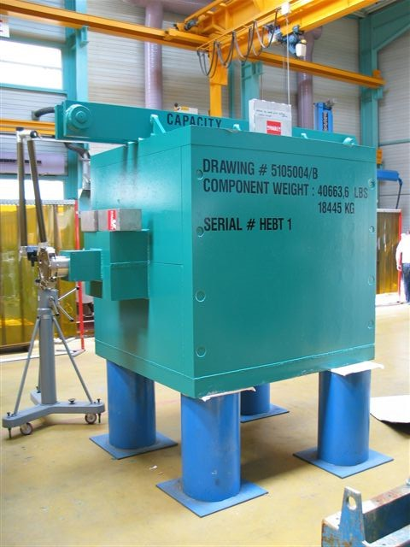
Collimators - HEBT
Friday 11:00 Weekly Meeting in the EAG Conference Room
HEBT Collimator Beam Line Stand - Redesign complete, fabrication
HEBT Shield Fabrication Done - Shipped
HEBT collimator to ship June 20, 2003? June 27, 2003 – On the high seas July 6 – estimated delivery date July 25 FOB ORNL.
HEBT Strippers 919B ready for assembly.
HEBT Momentum Collimator contract with Oak Ridge Machine Shop
Inner collimator checking complete – shops RFQ.
Remaining Work:
Assemble and drive HEBT Strippers,

Slide 13
Collimators - Ring
Friday 11:00 Weekly Meeting in the EAG Conference Room
Procurement STATUS SDMS – ring 1 (primary) collimator cost
Change orders for ring 2 and 3
Ring Primary Collimator detailed drawings in checking.
Ring Moveable Scraper Fabrication Shop order 1072
Moveable and Primary Shielding Layout Complete
Remaining Work:
Ring Primary Collimator Order, Primary/Moveable Collimator Stand and Shielding, Assemble and drive moveable scrapers, Ring 1 and 2 shielding order

Slide 14
Collimators - RTBT
Friday 11:00 Weekly Meeting in the EAG Conference Room
Procurement STATUS SDMS – RTBT change orders
RTBT #1 to ship August 29, 2003.
New RTBT #2 top lifting plate cost.
Remaining Work:
RTBT 1 and 2 stand and jacks.

