Slide 1
Amanda/IceCube Integration
Christian Spiering
DESY

Slide 2
Amanda Integration plan
- Version from June 12, 2004 submitted to PO
- Changes have been suggested in July
- Then it became clear that this plan was much too
optimistic. Priorities at NH and Pole to other tasks.
- New plan has to be written asap
- The last weeks resulted in a much clearer picture about
what has been done and what is still to do.

Slide 3
Basic Idea
First year: study coincident events between Amanda
and string 21 (muons, IceCube flasher) as preparation
for 2006 concident analysis
2006/07: First 10-25 IceCube strings + Amanda form a
combined detector significantly more powerful than either
alone.
( Season 2007/08: Raise MAPO )
Finally: Amanda as high density nested sub-array
with considerably lower energy threshold than the
full IceCube detector and capabilities much beyond
Amanda‘s alone.

Slide 4
„House raising plan“
05/06: raise ASTRO
06/07: disconnect from MAPO and raise VIPER
and DASI towers
07/08: raise MAPO (max. one year later, i.e. 08/09)
by ~ 3 m
How many strings are long enough ?
Can too short strings be extended by patch cables ?
Move Amanda electronics to first flooor of MAPO ?
Get a final understanding of options in 2005
and in season 2005/06

Slide 5
Trigger and Event Building
(Version proposed last year)
Amanda
Satellite
Amanda
Array
Processor
Event
Builder
Reco
String
Processor
Tape
Event builder
Cluster
Network
Global Trigger
Network
Satellite
P&F
Tape

Slide 6
Trigger and Event Building
(no feedback IceCube → Amanda)
Amanda
Satellite
Amanda
Array
Processor
Event
Builder
Reco
String
Processor
Tape
Event builder
Cluster
Network
Global Trigger
Network
Satellite
P&F
Tape

Slide 7
Trigger and Event Building
(envisage for 06/07 merging in event builder)
Amanda
Satellite
Amanda
Array
Processor
Event
Builder
Reco
String
Processor
Tape
Event builder
Cluster
Network
Global Trigger
Network
Satellite
P&F
Tape

Slide 8
Trigger and Event Building
(envisage for 06/07 merging in event builder)
Amanda
Satellite
Amanda
Array
Processor
Event
Builder
Reco
String
Processor
Tape
Event builder
Cluster
This part
will be
closed
eventually
Network
Global Trigger
Network
Satellite
P&F
Tape

Slide 9
Time Synchronization between Amanda and IceCube
Send the IceCube GPS signal from ICH to MAPO
→ need 3 fibers
(H.Leich: GPS4TWR module in MAPO
- Send strobe signal from Amanda DAQ to a DOM
main board in ICH (1 Hz).
→ 1 fiber
Send Amanda trigger to a second DOM main board
in ICH (100 Hz)
→ 1 fiber
5 fibres + 2 backups, prefer MM.
NO USE OF ELECTRICAL CABLES.
Season 05/06

Slide 10
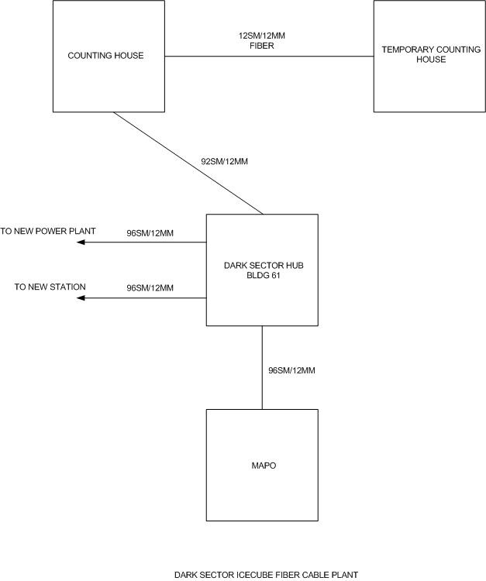
present
cable
connections

Slide 11
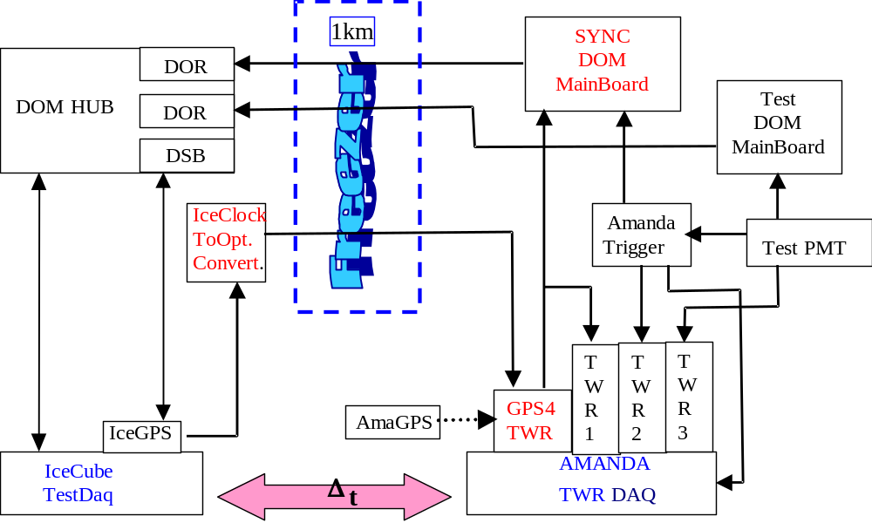
Wuppertal Development and Test Setup

Slide 12
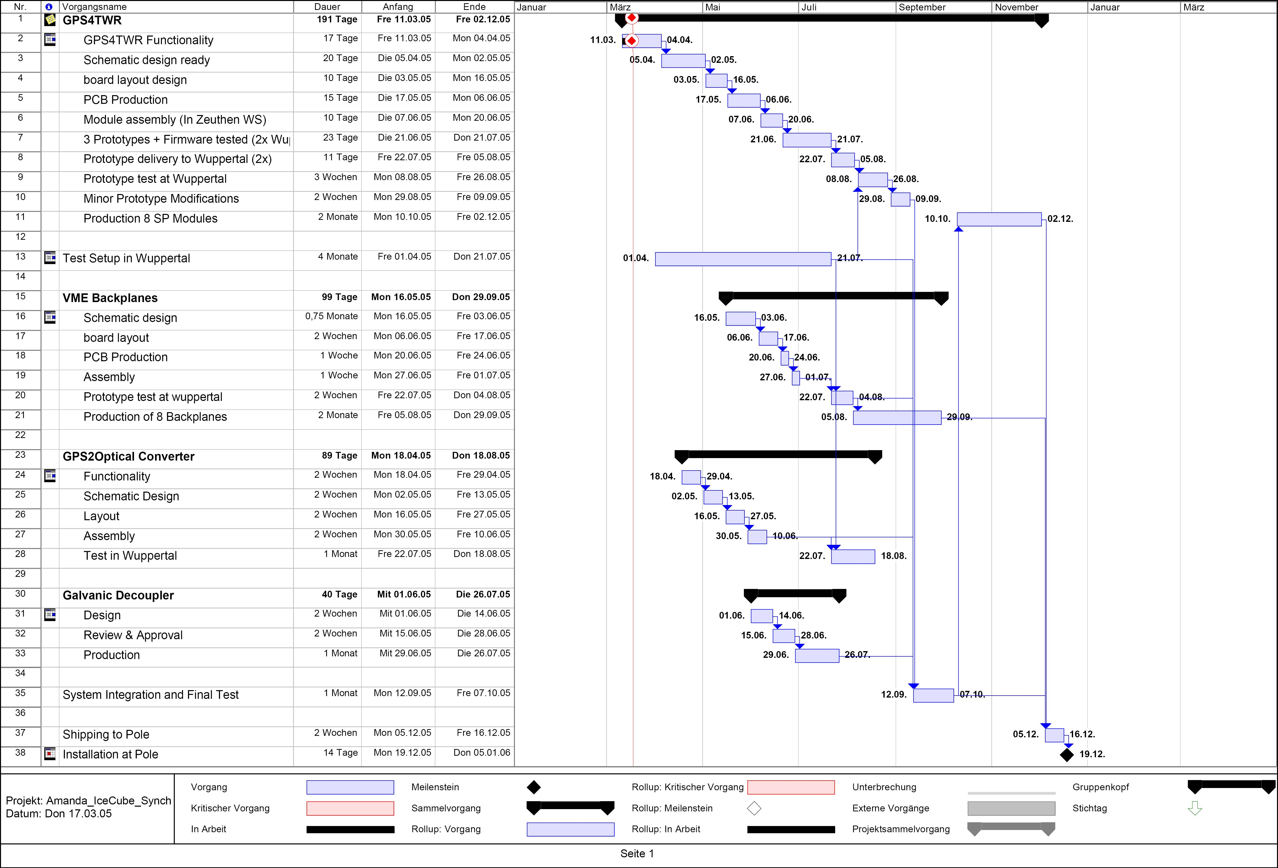
Timeline

Slide 13
Amanda Trigger → GT
Only Amanda triggers to IceCube, no IceCube information
to be used by the Amanda trigger.
- DMADD M18 trigger
- DMADD M12 trigger + TWR based volume trigger
- DMADD string trigger
If a fast raw filter against downward muons can be
implemented in the TWR system, the present M12
can possibly lowered down to M7 or M6 without such
a filter to M10 or M9.
Season 05/06

Slide 14
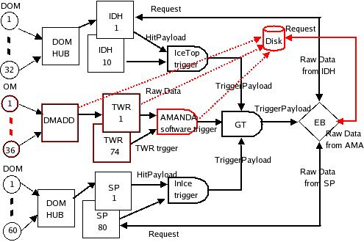
IceCube Global trigger
from Seon-Hee

Slide 15
Reconstruction of merged events
IceCube and Amanda are both handled together
in natural way by IceTray/dataclasses.
System will be on track for handling a 30-32 string
Detector in summer 2005.
2006: mergeand reconstruct events at NH and gain
experience.
Install online merging and reconstruction in season
06/07.

Slide 16
P&F System Overview
Raw
Data
Expt. Control / Logging
DAQ
Land
4-15MB/s
1500-2000Hz
DAQ
Dispatch
P&F
Server
ALL: RAW+FILT+REC
FILT:RAW+FILT+REC
Data Handling
Transient
Buffer
ALL:FILT+REC
Online Analysis
Rec/Filt
Data
Online Analysis
Tape
Online Analysis
Recon Worker
X 50-60?
Recon Monitor
From Erik
Offline Software/IceTray
Filt/Rec
Data

Slide 17
presently involved persons
1.5.4.1 Planning: CS
1.5.4.5 Amanda computing systems:
D.Schneider, D.Hardtke, L.Köpke
1.5.4.7 TWR system
W.Wagner, T.Messarius, A.Gross, TBD (Dortm.)
J.Nam, A.Silvestri
1.5.4.8 Supernova
M.Hellwig, J.Ahrens
1.5.4.10 Time Synchronization
C.Wiebusch, H.Leich, K.H.Becker, D.Nygren,
J.Przybilski

Slide 18
presently involved persons
1.5.4.11 Coincident triggering
W.Wagner, T.Messarius, S-H Seo, M.Walter,
O.Tarasova, .. TBD (UW) (C.Song + ..)
1.5.4.12 Event building and reconstruction
Maryland Crew, M.Hellwig, C.Wiebusch,
D.Hardtke, S.Schlenstedt, D.Pieloth
1.5.4.13 Amanda offline
Photonics: Lundberg, Hundertmark Lang, Wiebusch, Woschnagg
TWR algorithms: Dortmund crew, C&T Burgess, Nam
TWR-Sieglinde: Boersma, Gross, Ackermann
Full use of TWR: Castermans, Hubert, Burgess, Dortmund people
+ ....
Sieglinde maintenance: Steffen, Gross, Niessen, Boersma, T.Burgess
Pieloth

