Slide 1


EPA’s Wood Smoke Reduction Partnership Programs
Amanda Aldridge
U.S. EPA Office of Air Quality Planning and Standards
http://www.epa.gov/woodstoves

Slide 2
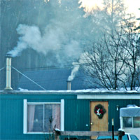
Why do we care about wood smoke?
Benzene
Toluene
Aldehyde gases
Polycyclic aromatic
hydrocarbons
Dioxin
Particle Matter
  or fine particles (PM2.5)
Notes:
This is one of our biggest challenges, people do not associated wood smoke as particularly harmful.

Slide 3

Wood Smoke Affects Health and Visibility
A small community in Washington state
That’s not fog, it’s wood smoke
Notes:
From the picture you’ll notice there’s no fog over the river.

Slide 4
Sources of Residential
Wood Smoke:
Wood Stoves
Fireplaces
Outdoor Hydronic Heaters
(also known as Wood Boilers)
Notes:
ASTM – American Society for Testing and Materials

Slide 5
Over 45 Million Wood Burning Appliances in the U.S.
  35 million fireplaces
  10 million wood stoves
    75% are old and inefficient stoves built before EPA’s 1990 regulation
  100,000 outdoor hydronic heaters in use
Notes:
Estimates vary, but we believe there are more than 100,000 currently in use. Most are in the Northeast and upper Midwest. NESCAUM estimates that more than 155,000 units have been sold since 1990. And New York State estimates about 77,500 have been sold since 1999 nationwide
ASTM – American Society for Testing and Materials

Slide 6
National PM2.5 Emissions from Residential Wood Smoke
SOURCE | Tons per year PM2.5(direct)
Woodstoves | 336,000
Fireplaces | 84,000
Outdoor Hydronic Heaters | 250,000 (NESCAUM)
Source: NEI and NESCAUM
Notes:
ASTM – American Society for Testing and Materials
Non-road Diesel 174,000
Highway Diesel 124,000

Slide 7
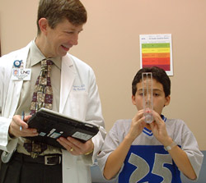
Who’s affected by wood smoke?
Everyone, especially children and older adults
People with existing diseases such as:
  Coronary artery disease
  Heart failure
  Asthma
  Chronic bronchitis and
  emphysema

Slide 8
Wood Stove Changeout Results of the Libby, Montana In-Home PM_{2.5} Studies
Tony J. Ward, Ph.D.
The University of Montana
Presented: August 2007
Publish: Summer 2008

Slide 9
Libby Wood Stove Changeout and Sampling Program: 2006-2007
Goal: Evaluate the impact of wood stove changeouts on residential indoor PM_{2.5}
This is significant because we spend the majority of our time indoors.
Numerous studies link PM_{2.5} exposure to a variety of problems, including aggravated asthma, irregular heartbeat, and premature death in people with heart or lung disease.

Slide 10
Residential PM_{2.5} Sampling Program
24-hour sampling period before and after changeout in 16 homes
Leland Sampler / Personal Environmental Monitor (PEM) with a 37-mm quartz filter:
  Organic Carbon / Elemental Carbon
  Chemical markers of wood smoke
DustTrak measured continuous PM_{2.5}
Notes:
Levoglucosan is a tracer for biomass burning sources in atmospheric aerosol particles

Slide 11
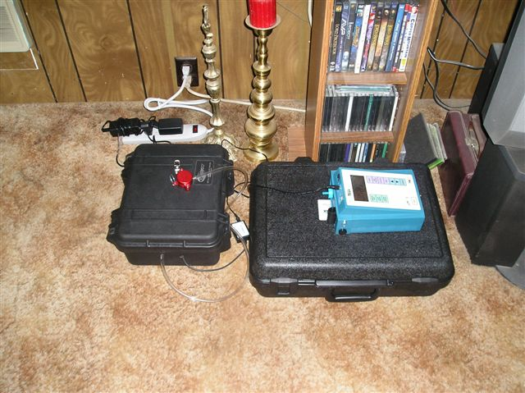
Residential Sampling Equipment

Slide 12
Libby Wood Stove Changeout
PM_{2.5} Mass Results
Pre-changeout average PM_{2.5} concentrations within 21 homes: 53.4 μg/m³
Post-changeout average PM_{2.5} concentrations within 16 homes: 15.0 μg/m³

Slide 13
Results
The average reduction in indoor PM2.5 as a result of wood stove changeouts within 16 homes:
72%
Notes:
Levoglucosan is used to estimate wood smoke mass concentrations. It does not include cigarette smoke or cooking.

Slide 14
EPA’s Voluntary Programs to Reduce Wood Smoke
Outdoor Hydronic Heaters
  Helped States develop Model Rule
  Partnership with industry to bring cleaner units to market
Fireplaces
  Consensus ASTM Test Method complete
  Working on consensus emission qualifying level and SIP Guidance
Great American Wood Stove Changeout
  Partnership program to replace inefficient wood stoves with cleaner burning technologies
Notes:
ASTM – American Society for Testing and Materials

Slide 15
What is The Great American Wood Stove Changeout?
A voluntary effort to encourage people to upgrade their inefficient wood stoves to cleaner-burning technologies.

Slide 16
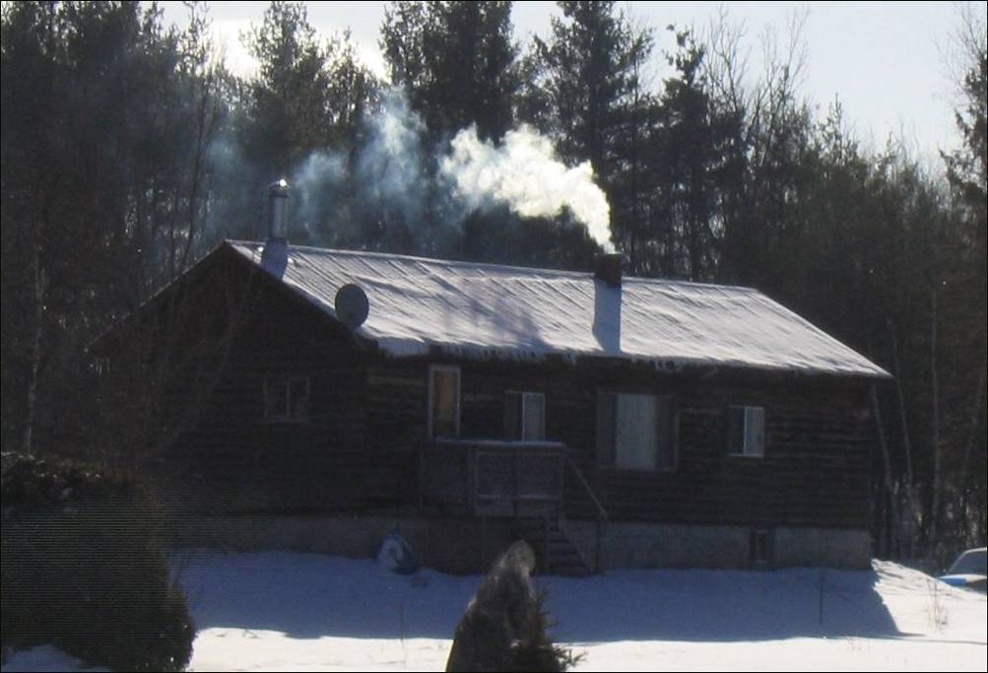
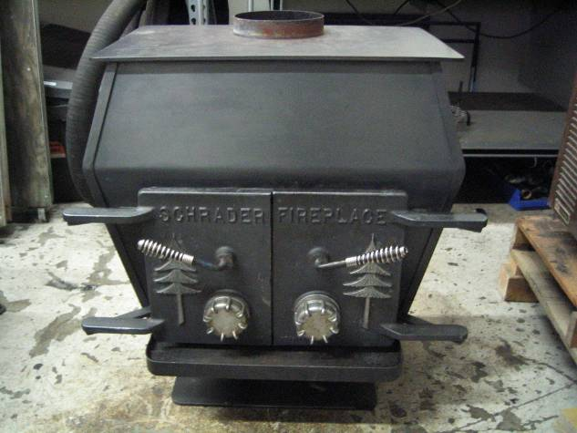
Old and Inefficient Wood Stoves built before 1990
Notes:
Ah, the sweet smell of wood smoke” - but what makes it so sweet?
CO, benzene, toluene, dioxin and PM
Woodstoves and fireplaces emit more pollution than all of the:
US petroleum refineries
Cement manufactures
Pulp and paper plants combined.
~80% from woodstoves
XXXXXXXXXXXXXXXXXXXXXXXXXXXXXX
Fine particle pollution (PM_{2.5}) - ~6 % (420,000 tons) of total PM_{2.5}
Wood smoke is emitted in our neighbourhoods, low to the ground, during the winter when air inversions can prevent dispersion of pollution.

Slide 17
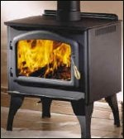
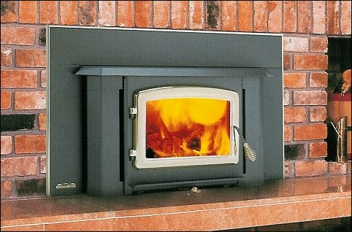
EPA-Certified Woodstoves (after 1990)
Slide from Wood Heat Organization Inc
Notes:
EPA Certified stoves, sold after 1990
70 % less smoke
For every 20 stoves changed out you get a ton of PM 2.5
~ 50% more energy efficient, use 1/3 less wood
Provide secondary combustion, air inside fire box allow for cleaner burn
Cost is $2500

Slide 18
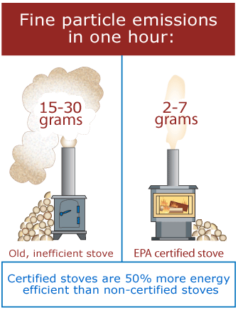
How does a Wood Stove Changeout benefit the consumer?
Cleaner Burning Technologies:
  Are 50% more energy efficient
  Use less fuel
  Pollute less – 70% less PM2.5
  indoors and outdoors
  Cut creosote buildup in
  chimneys, reducing fire risk
  Save money and require
  less work

Slide 19
How do I get started?
Identify potential partners
  local elected officials, non-profits, industry
Identify sources of funding
  in-store discounts, supplemental environmental projects (SEPs), low-interest loans, local utility companies, grants, rebates
Develop a project plan
  determine staff, timing, resources and set goals

Slide 20
How can EPA help?
Wood Stove Changeout “How To” Guide
  Example brochures, posters, fact sheets, video footage, case studies
Existing Partnerships: hearth industry, American Lung Association, state and local organizations
Wood Stove Changeout state implementation plan (SIP) credit guidance
Suggestions for securing funds: grants, industry rebates, SEPs
Technical assistance

Slide 21
Past and Current Wood Stove Changeout Programs
CA - Sacramento
CA - Yolo-Solano
CA - Butte County
CO - Delta County
ID - Pinehurst
ID – Cache Valley
ID – Nez Perce Tribe
MT - Libby
NM - Questa
NV - Washoe Co.
OH - Dayton area
OH - Marietta
OR - Oakridge
PA – Southwest counties
VA – Christiansburg
WA – Darrington
WA – Ferry County
WA - Yakima
WA - Bellingham
WA – Spokane
WA – Stevens County
WA – Swinomish Tribe
WI – Oneida Tribe
WV - Parkersburg

Slide 22
Progress To Date, 2005-08
25 communities have implemented wood stove changeouts
$6 million invested nationally
  $800K: EPA grants
  $700K: SEPs
  $4M Public and private partners
Over 3000 stoves and/or fireplaces changed out
More than 125 tons of PM reduced/year from changeouts
Notes:
The cancer risk from wood stove emissions may be 12 times greater than exposure to an equal amount of cigarette smoke

Slide 23
Wood Stove Changeouts
What is next?
  Wood Stove Changeout Innovative Financing
  Partnership with Big Box Stores to Promote Changeouts
  Public-Private Marketing and Outreach Effort with Hearth Industry Leaders and others
  Wood stove & outdoor hydronic heater changeout pilot using innovative financing
  Data to confirm link between wood burning and green house gases emissions
Notes:
The cancer risk from wood stove emissions may be 12 times greater than exposure to an equal amount of cigarette smoke

Slide 24
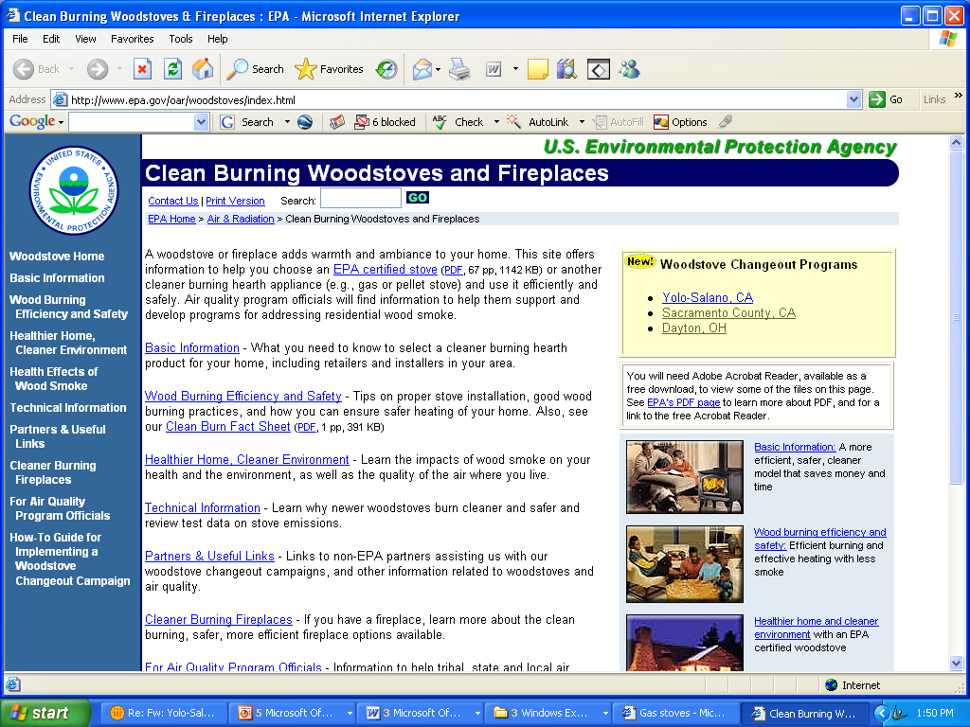
Notes:
All available on our Website under our Changeout “How To” Guide.
As is our SIP credit document for woodstove changeouts.

Slide 25
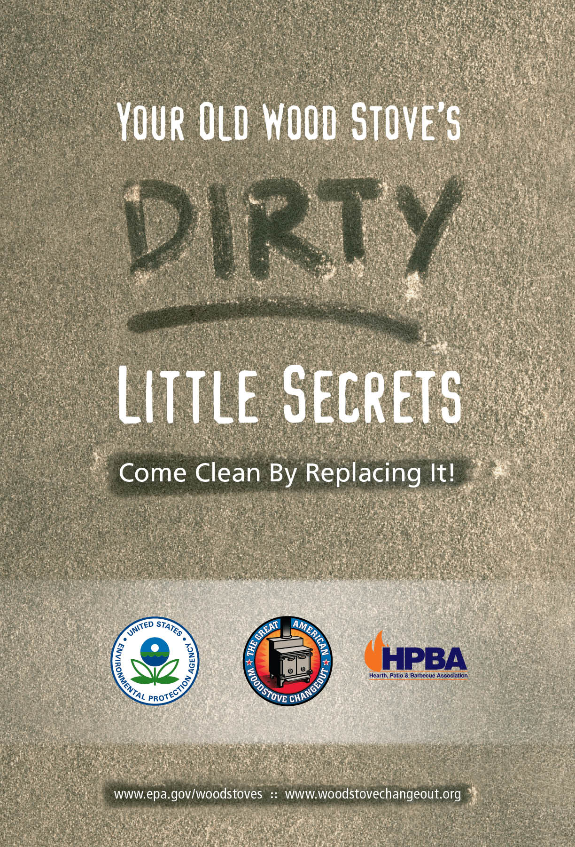

Slide 26
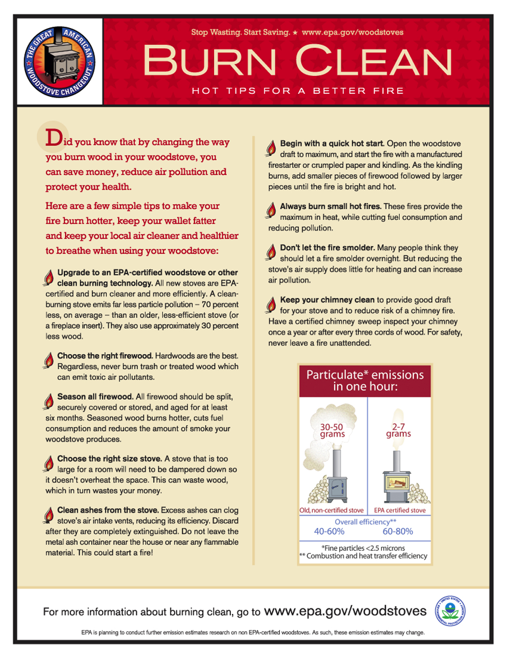
Notes:
Burn Clean Fact Sheet
Wood smoke emissions can be minimized by using good fuel and burning practices. We have facts ready for your use.

Slide 27

Notes:
Advertisement for newspapers

Slide 28

Notes:
Banner for media event and retail stores

Slide 29
A Wood Stove Change-out Program in Spokane, WA
Lisa Woodard, PIO
Spokane Regional
Clean Air Agency

Slide 30
Change-out Program
-Planning began in Summer ’07
-Program’s public launch: Jan ’08
1st Step: Secure funding partners and
get retailers on board
$50,000 EPA grant for the rebate component
$10,000 Avista Corp (utility) grant
$10,250 from Retailers (media co-op)

Slide 31

Change-out Program
With $60,000, approx. 125 “rebates” will be provided:
  $400 to change-out to wood/pellet
  $550 to change-out to natural gas
  Plus additional retailer discounts of $75-$200

Slide 32
Change-out Program
Partnered with all nine local wood/gas retailers:
  Retailer Participation Packet
  -agreement form
  -additional discounts form
  -co-op media form

Slide 33
Change-out Program
Program Promotion:
- 3 week advertising “blitz” tv & radio
- Utility billing inserts
- News coverage
- Articles in utility billing
- Flyers/applications at retailers
- Web page

Slide 34
Change-out Program
Applicants pre-qualified based on:
  homeowner in Smoke Control Zone
  regularly heats w/ non-certified device
  uses at least 2 cords per season
  If Qualified:
  Sent a dated/numbered voucher with a list of participating retailers

Slide 35
Change-out Program
Program Results to Date:
  160 rebate vouchers issued during initial 9-week “application period”
  60-day expiration/follow-up calls
  30% or more(?) of the vouchers issued won’t be redeemed

Slide 36

Change-out Program
Program Lessons to Date:
  Timing is important –
  -retailer “off season”
  -application “window”
  Address “Expected Out-of-Pocket Costs” upfront
  Clearly state program terms & conditions (don’t make exceptions)
  Stay in close communication with your retailers/sales managers

Slide 37
Change-out Program
Benefits to date:
  Reduced emissions
  Formed working relationships with wood stove retailers
  Heightened awareness of wood burning impacts
  Increased agency visibility/positive news coverage

Slide 38
Change-out Program
Next steps:
  Survey card to rebate recipients
  Survey card to “voided” voucher recipients
  Survey letter to participating retailers
  Tweak/make plans for next year!

