Slide 1
Avionics Compt. Smoke Detection System
- minimize risk of fires in hidden areas
Klaus Schmötzer Schmoetzer Airbus Cargo compartment compt. Smoke detection det Bremen Germany bay class c faa working group Arbeitsgruppe luftfahrt systems systeme Brandschutz fire ATA26
Presented by
Klaus Schmoetzer
Airbus, Dept. ECYM
Head of
Fire Protection & Conveyance Systems
28183 Bremen / Germany
E-mail: klaus.schmoetzer@airbus.com
International Aircraft Systems Fire Protection Working Group
Meeting in Grenoble on June 21-22th, 2004

Slide 2
Minimize risk of fires in hidden areas
Remember:
  Hidden areas maybe
    on main deck / on lower deck / between decks
    Above ceilings, behind side panels, below cargo hold floor, dedicated compartments, equipment bays …………..
  Efficient Fire Protection is an overall approach and requires dedicated to type solutions
    Passive protection (materials & construction)
    Active protection system (detection & extinguishing)
  Installation of not required automatic detection systems may additionally support the crew

Slide 3
Subsystem breakdown
Examples given are based on current A380 design
Avionics Smoke Detection System
  ATA 26-14 Additional Electronics (AFT Avionics)
  ATA 26-15 Main, Upper Avionics + IFEC
    Separation of Main and Upper in LH and RH

Slide 4
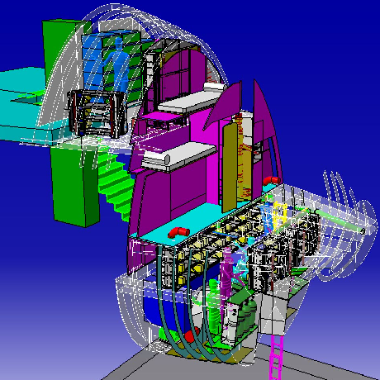
Location: Main and Upper Avionics including IFEC
IFE Center
Upper Avionics Bay
FWD
Main Avionics Bay

Slide 5
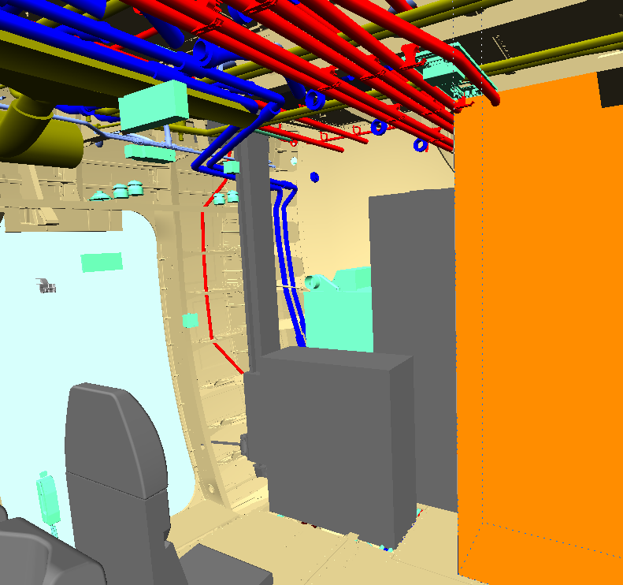
Location: AFT Avionics
AFT Avionics Compartment
Trolley Lift trunk
Trolley Lift

Slide 6
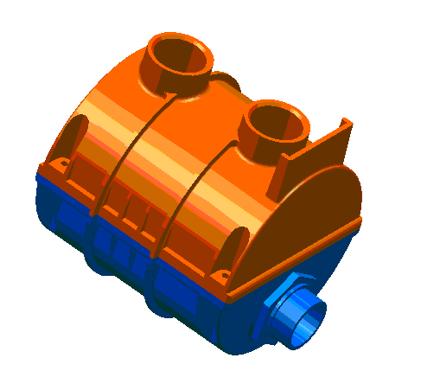
Components
Smoke Detector
  Duct-type smoke detector
    enhanced optical detection principal
  Interfaces with avionics air extraction ducting
    classical piccolo tube or equivalent air interface
Smoke Detection Function (SDF)
  Hardware and software platform to interface fire/smoke detectors and fire extinguishing system components
  Communication with cockpit & cabin and other systems

Slide 7
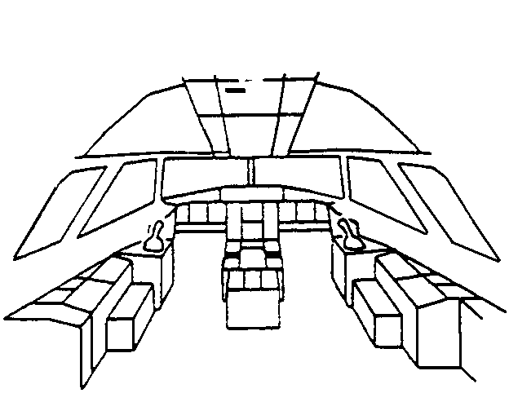
System Architecture
AFDX
Cockpit (FWS)
OMS
other systems
Discrete
Cockpit indications (ICP09)
PTT
Reset
Upper Avionics + IFEC
D
Main Avionics
C
ATA44
ATA26
CAN Bus
B
A
Director 1 & 2 & 3
Smoke Detection Function
is a segregated HW/SW platform which manages essential safety items
AFT Avionics

Slide 8
SMOKE Warnings (dedicated ducting)
Smoke Alarm Indications
  Indication on ECAM (E / WD) (Level 3 warning)
Corresponding Fault Indications
  Indication on ECAM (E / WD) (Level 1 warning)
SMOKE L MAIN AVNCS SMOKE
SMOKE R UPPR AVNCS SMOKE
SMOKE AFT AVNCS SMOKE
SMOKE L MAIN AVNCS DET FAULT
SMOKE R UPPR AVNCS DET FAULT
SMOKE AFT AVNCS DET FAULT

Slide 9
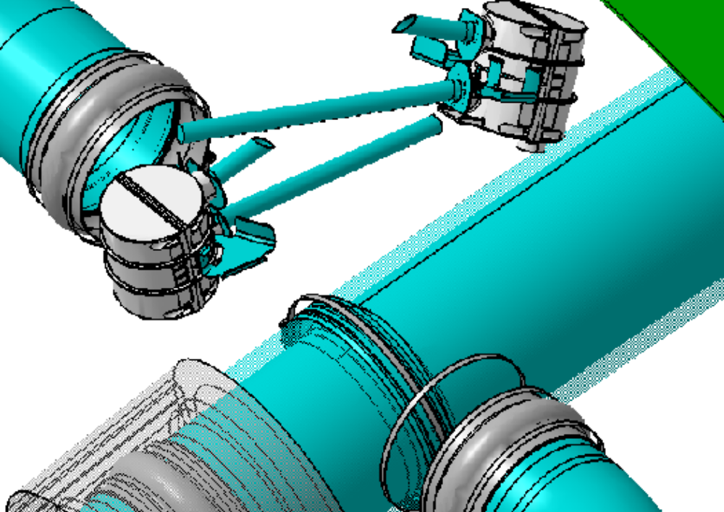
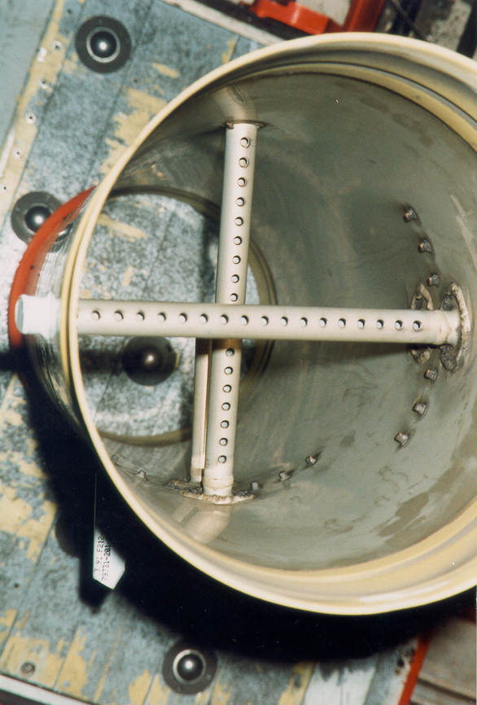
Smoke Detector with Piccolo Tube
Generic installation with Piccolo Tubes
Main Avionics duct (A330 / A340)

Slide 10
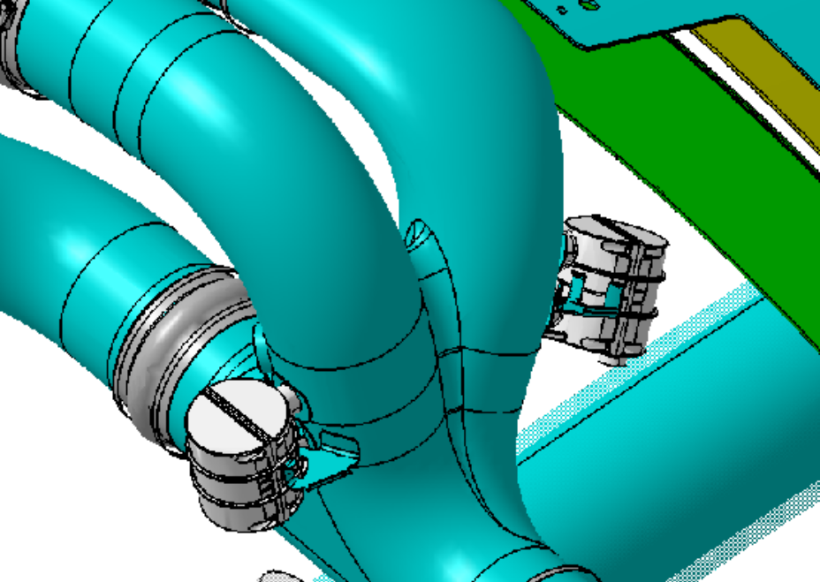
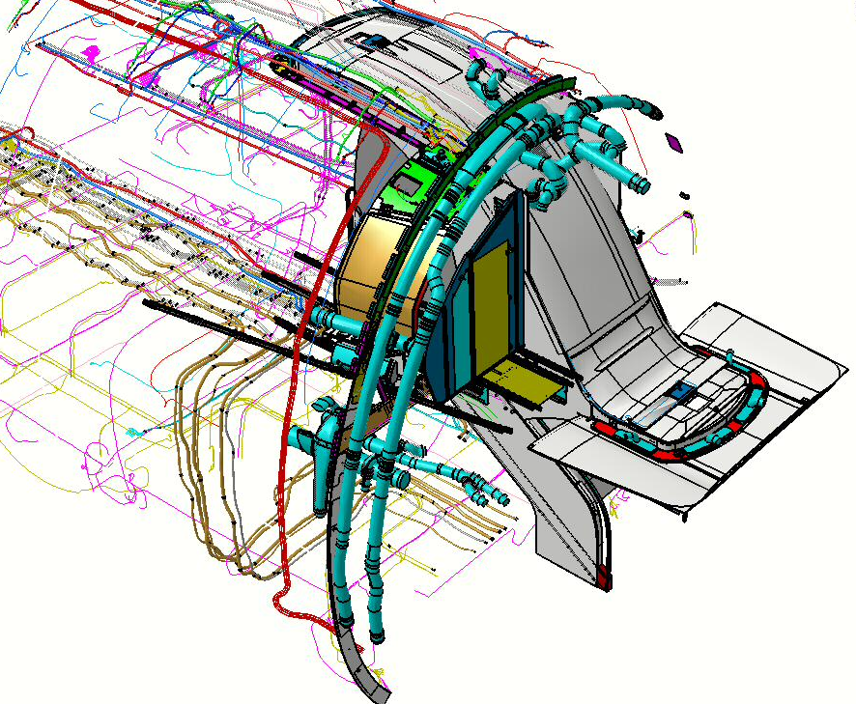
Installation IFEC

Slide 11
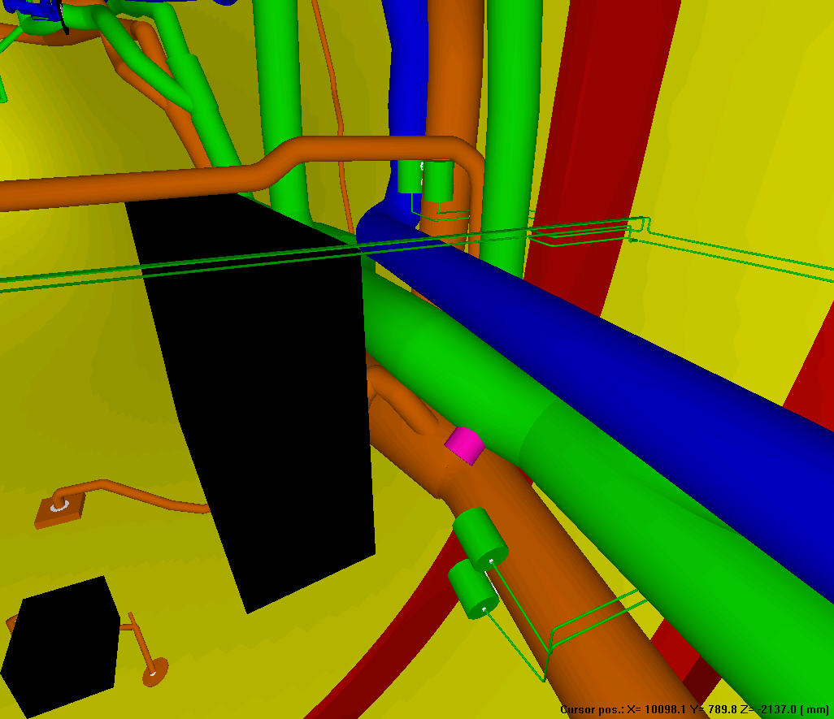
Installation Main and Upper Avionics
Frame 17
FWD
Detector pair
Upper RH Avionics
Detector pair
Main RH Avionics

Slide 12

Dieses Dokument und alle darin enthaltenen Informationen sind das alleinige Eigentum von AIRBUS DEUTSCHLAND GmbH. Die Zustellung dieses Dokumentes oder die Offenlegung seines Inhalts begründen keine Rechte am geistigen Eigentum. Dieses Dokument darf ohne die ausdrückliche schriftliche Genehmigung von AIRBUS DEUTSCHLAND GmbH nicht vervielfältigt oder einem Dritten gegenüber enthüllt werden. Dieses Dokument und sein Inhalt dürfen nur zu bestimmungsgemäßen Zwecken verwendet werden.
Die in diesem Dokument gemachten Aussagen stellen kein Angebot dar. Sie wurden auf der Grundlage der aufgeführten Annahmen und in gutem Glauben gemacht. Wenn die zugehörigen Begründungen für diese Aussagen nicht angegeben sind, ist AIRBUS DEUTSCHLAND GmbH gern bereit, deren Grundlage zu erläutern.

