Slide 1
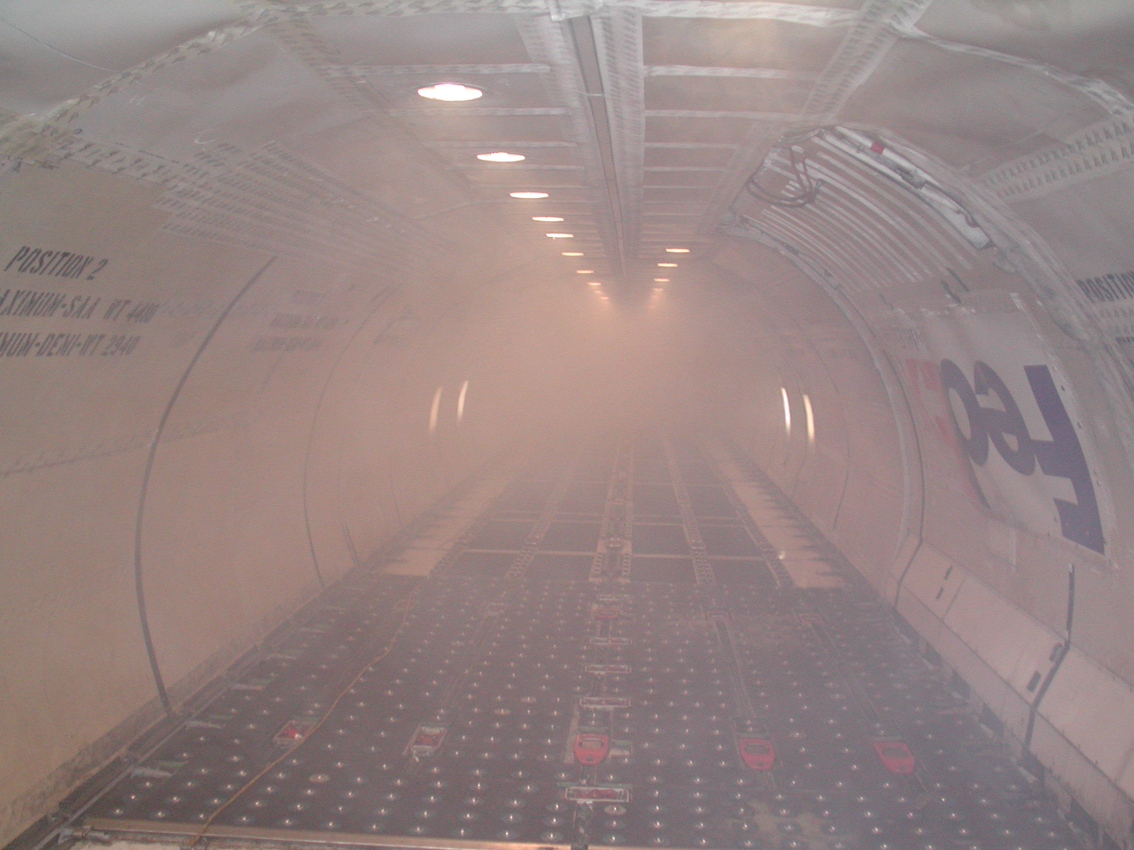

Design for Security
Cockpit Smoke Penetration
David Blake
FAA Technical Center
Fire Safety Section
609-485-4525
dave.blake@tc.faa.gov

Slide 2
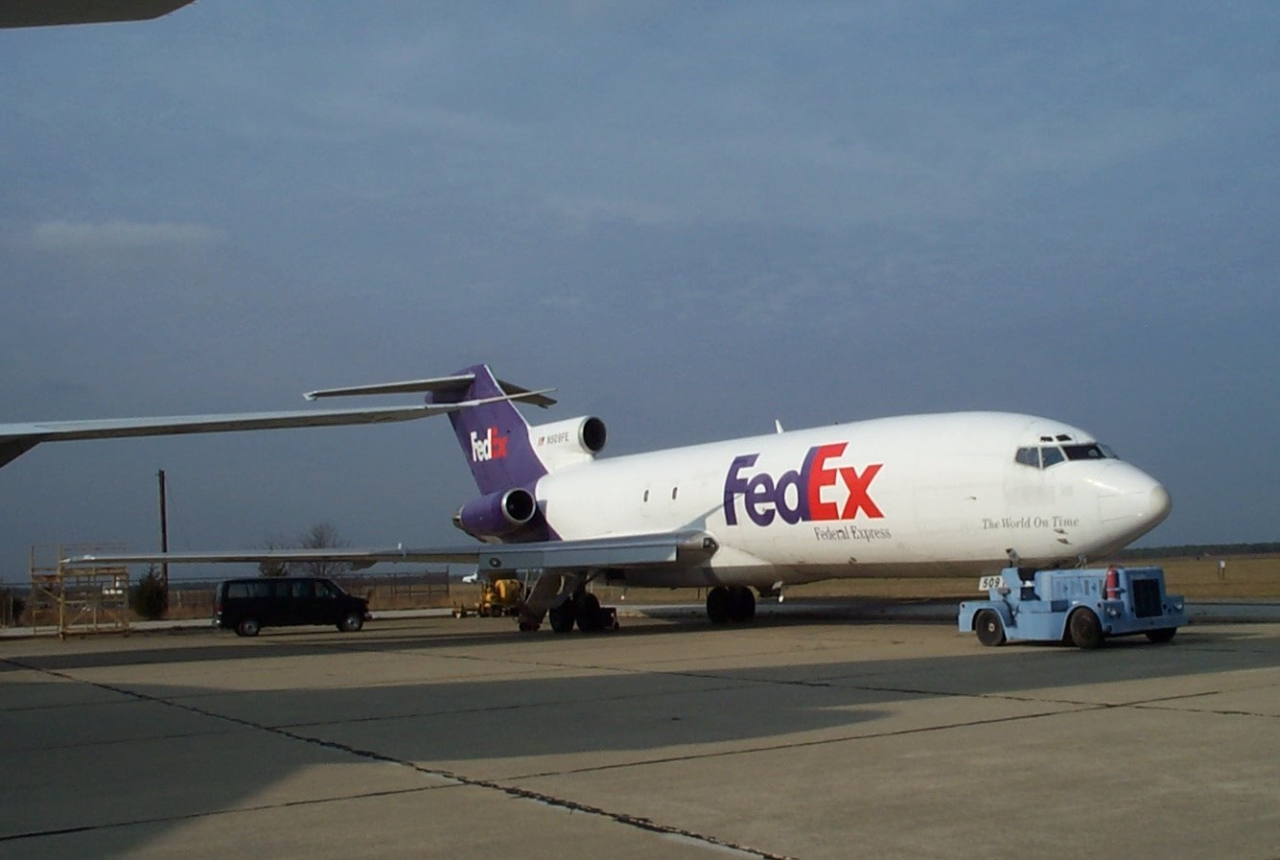

Slide 3
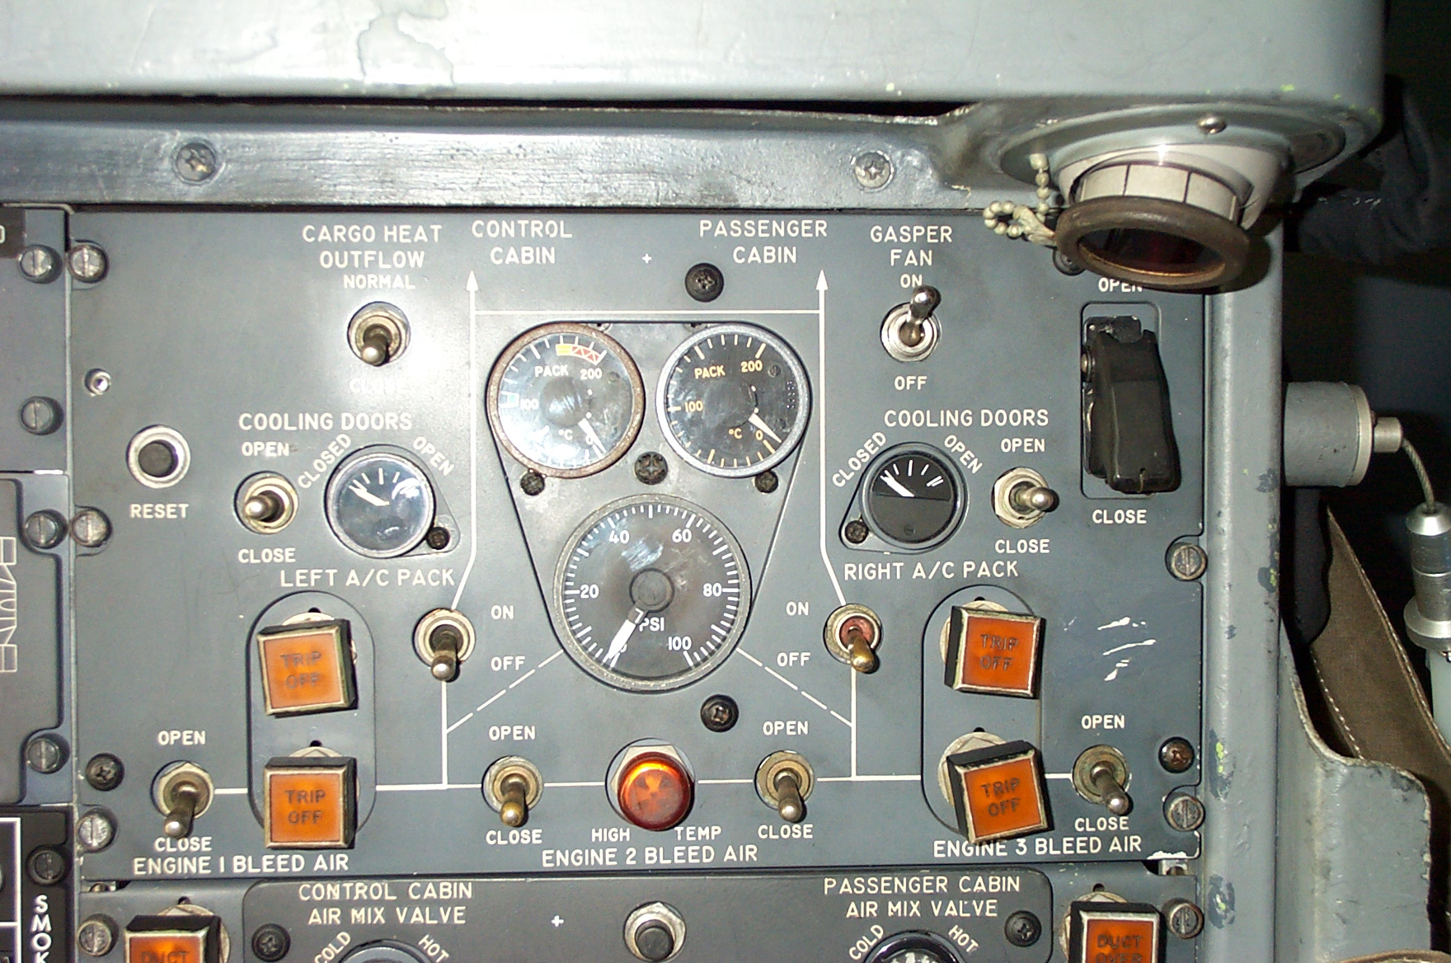

Slide 4
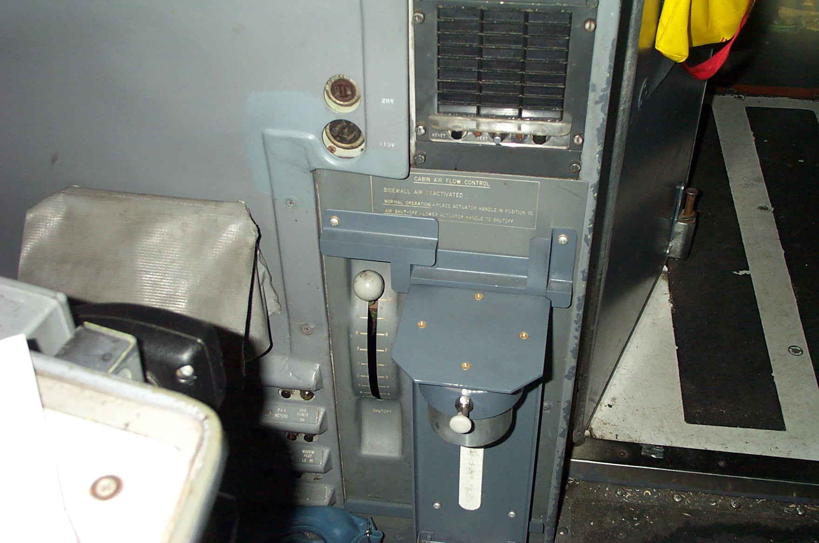

Slide 5
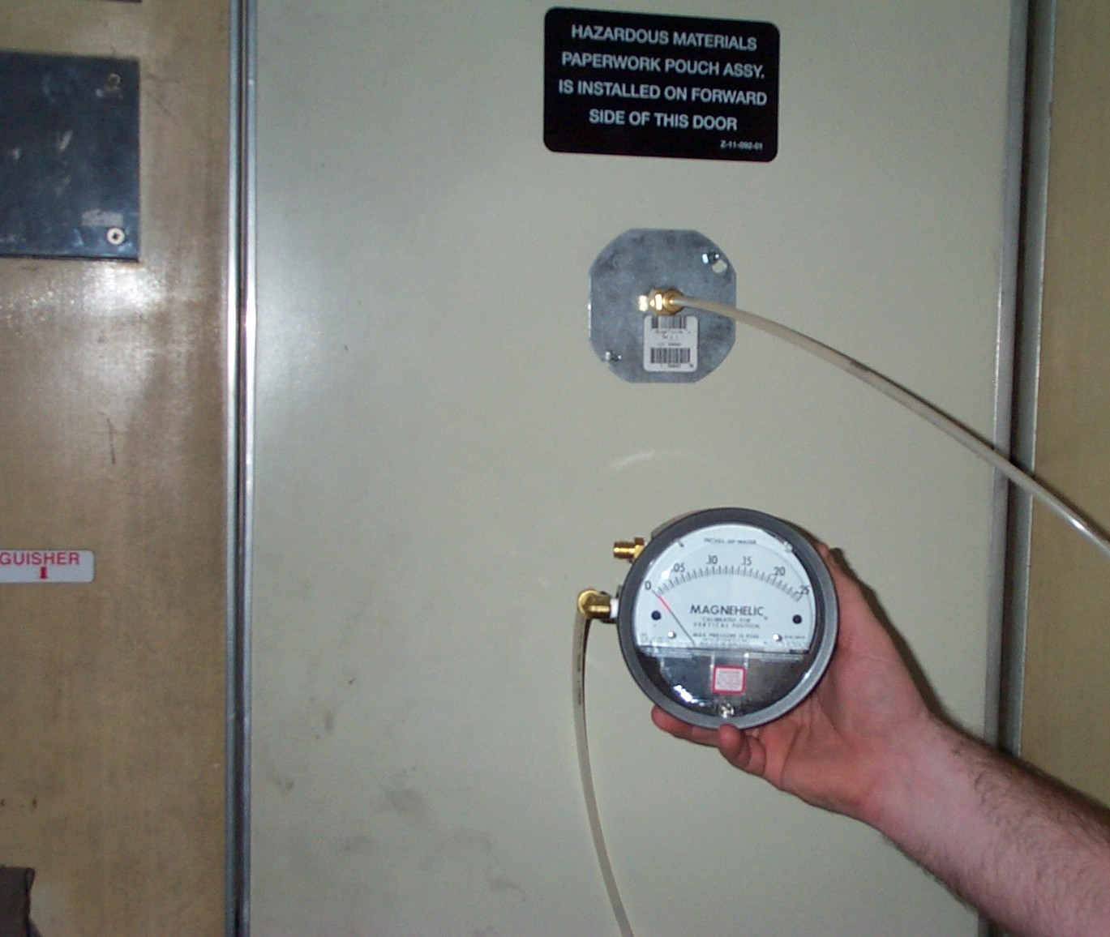

Slide 6
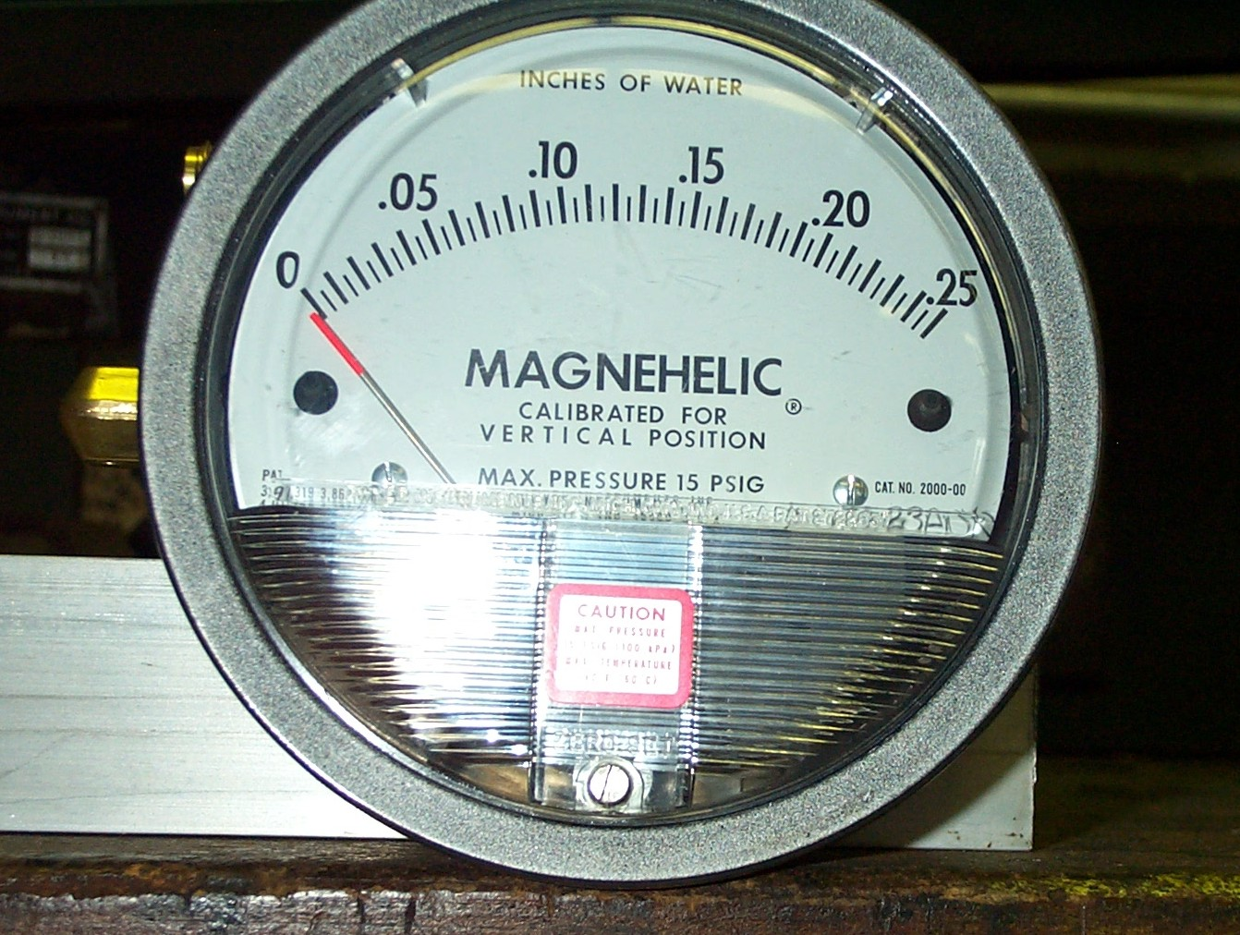
.005” H₂O= 1.8 X10⁻⁴ psi

Slide 7
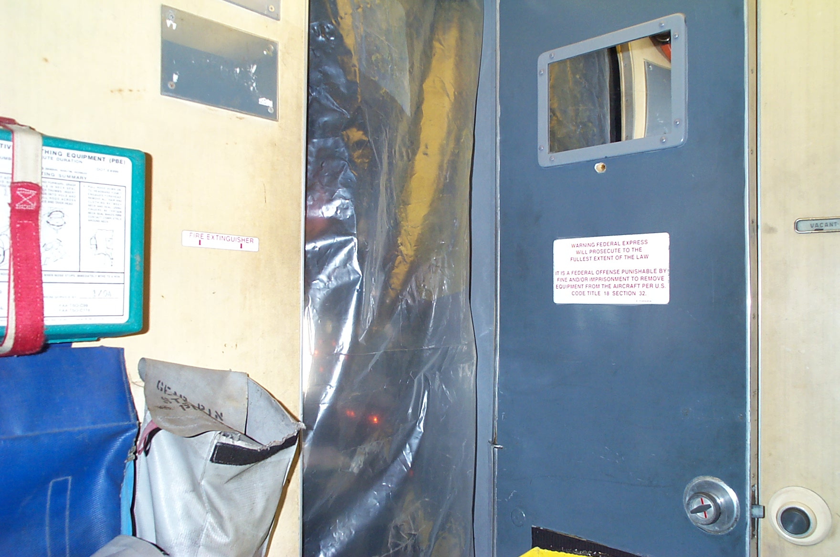

Slide 8
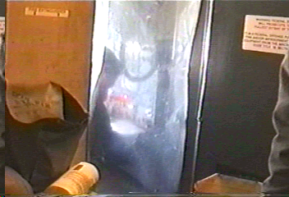
727
Plastic sheet covering cockpit door opening. Video shows the effect of closing and opening valve for cabin air supply.

Slide 9
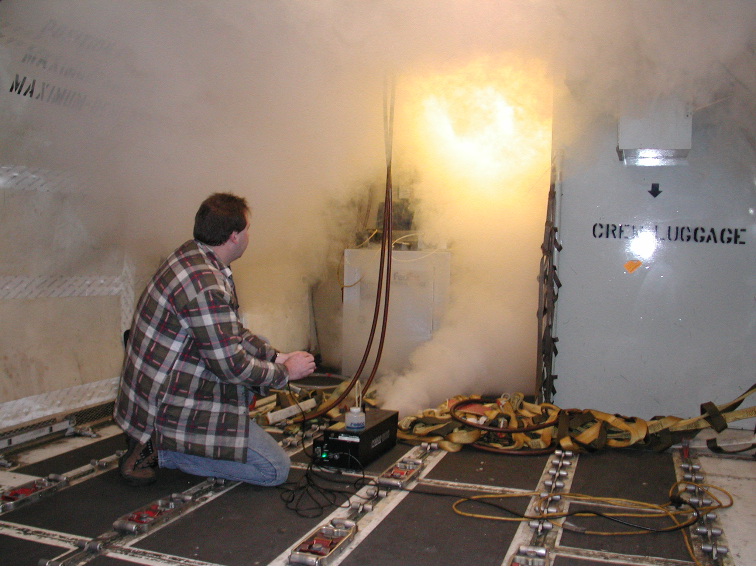

Slide 10
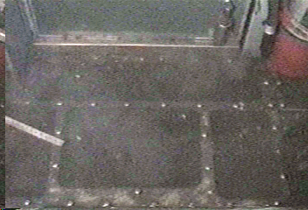
727
Smoke penetration into cockpit. Cabin air supply valve open. Cockpit gasper fan on and all cockpit gaspers full open.

Slide 11
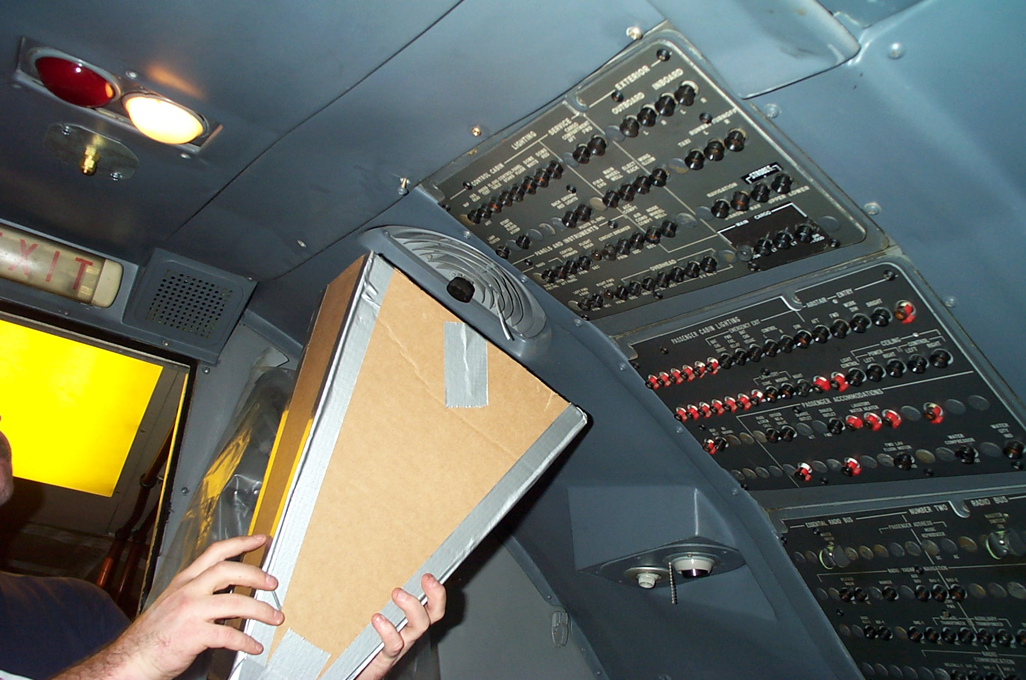

Slide 12
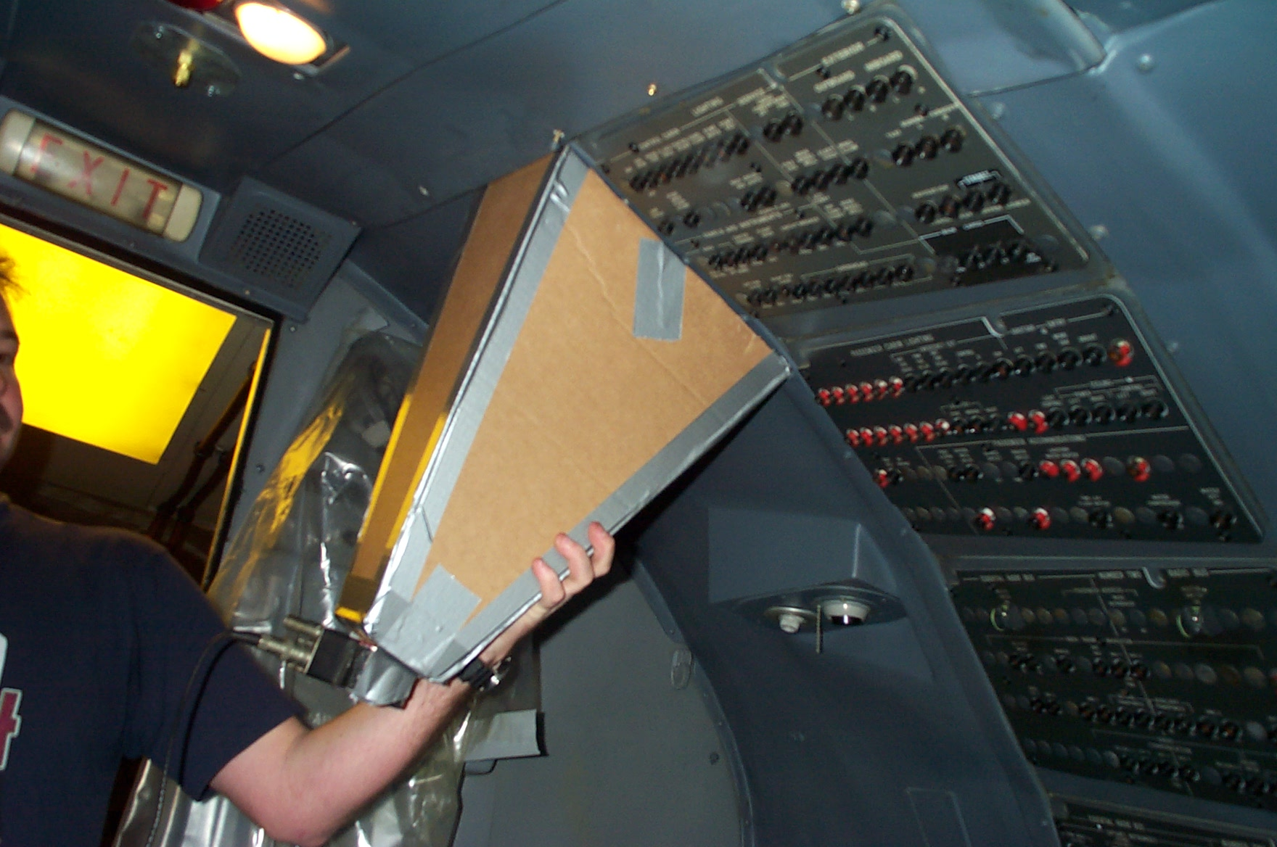

Slide 13
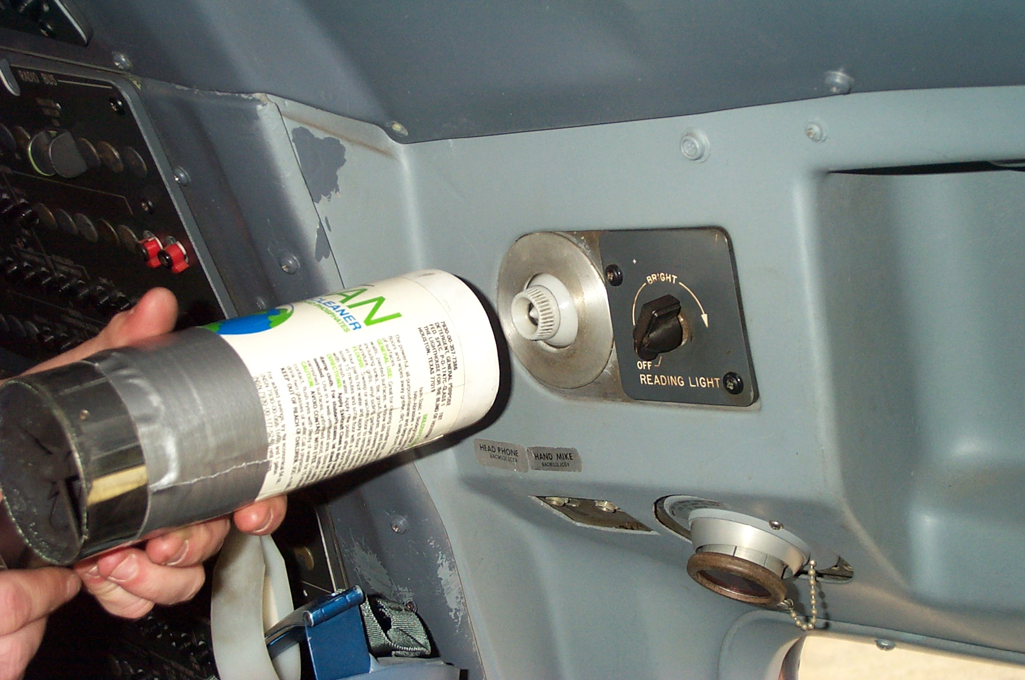

Slide 14
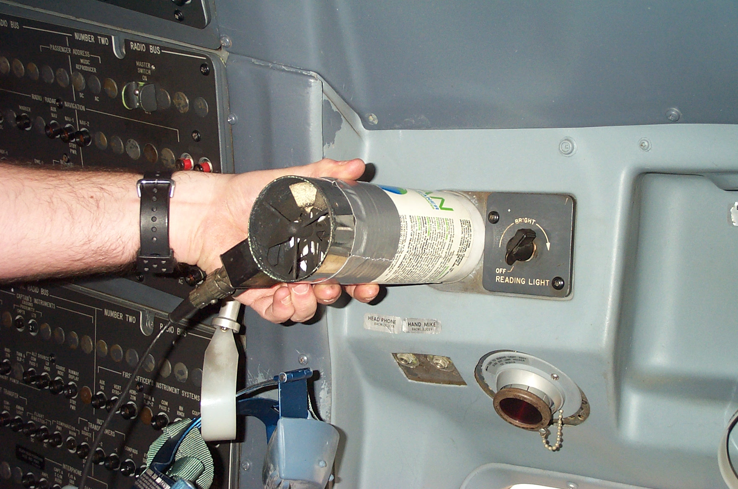

Slide 15
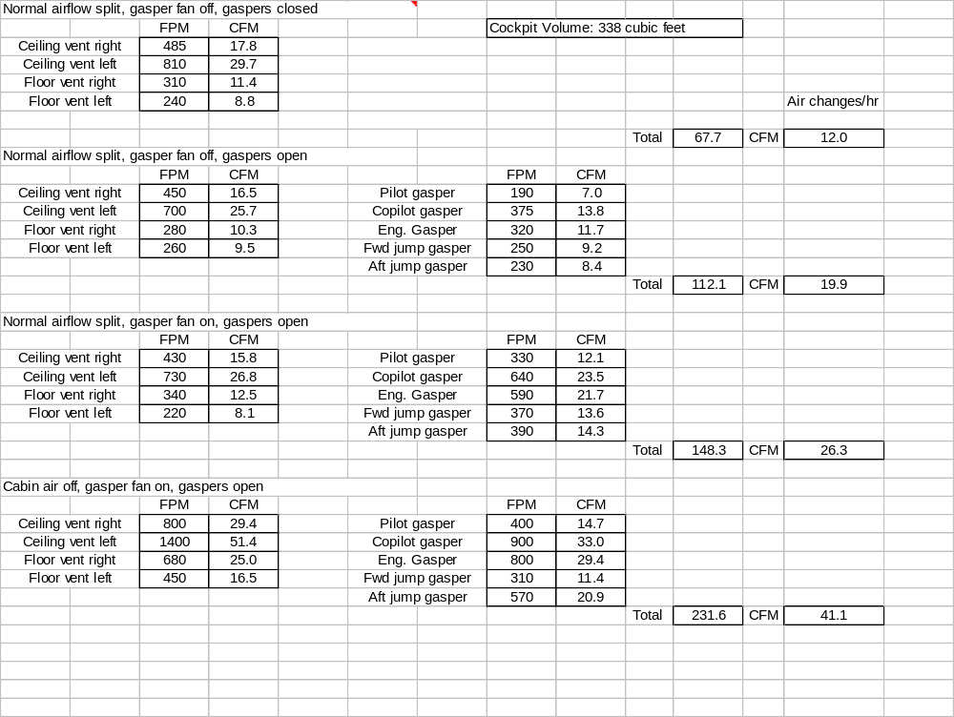
727

Slide 16
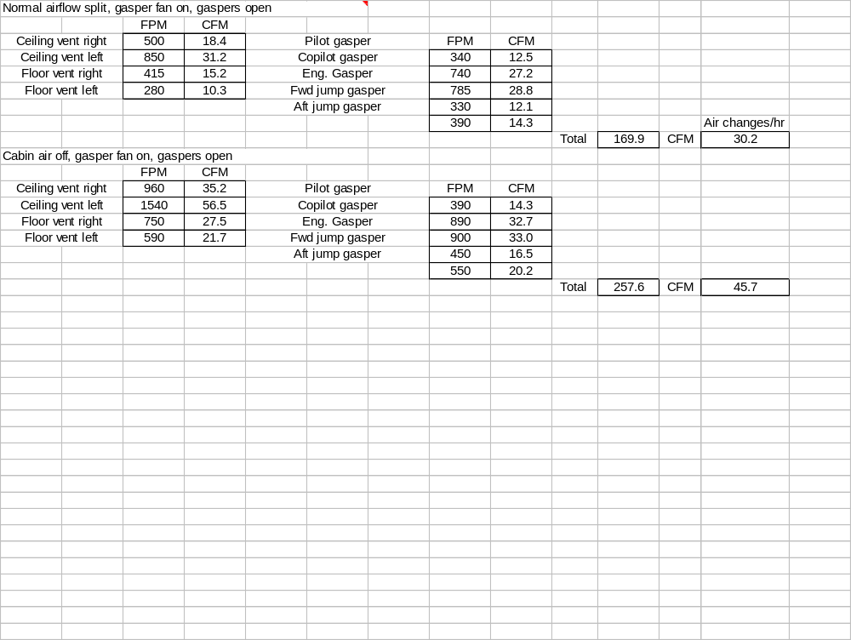
727

Slide 17
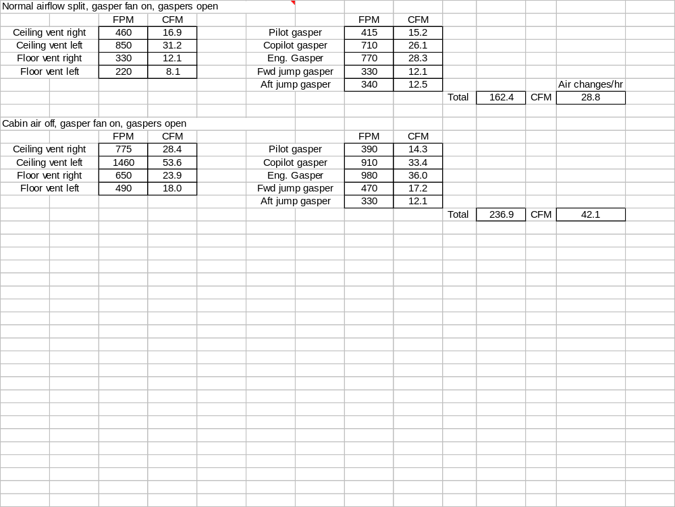
727

Slide 18
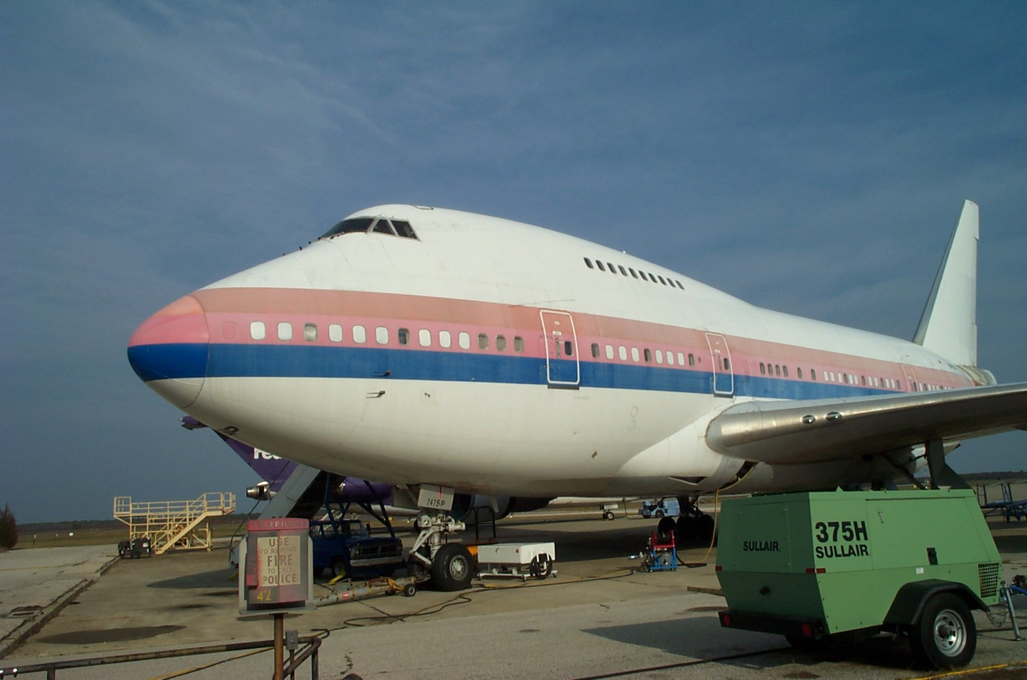

Slide 19
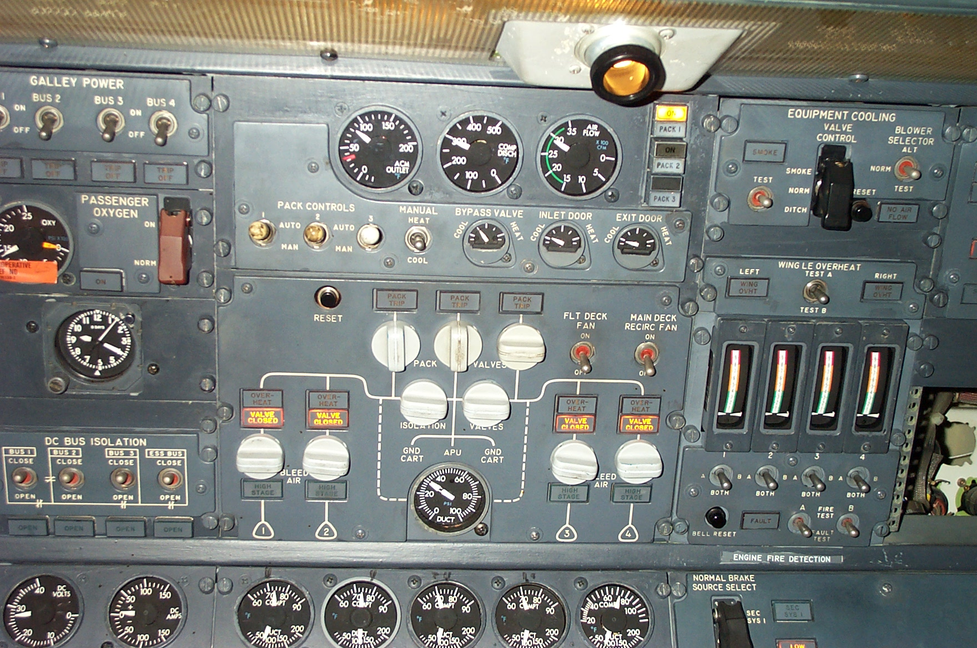

Slide 20
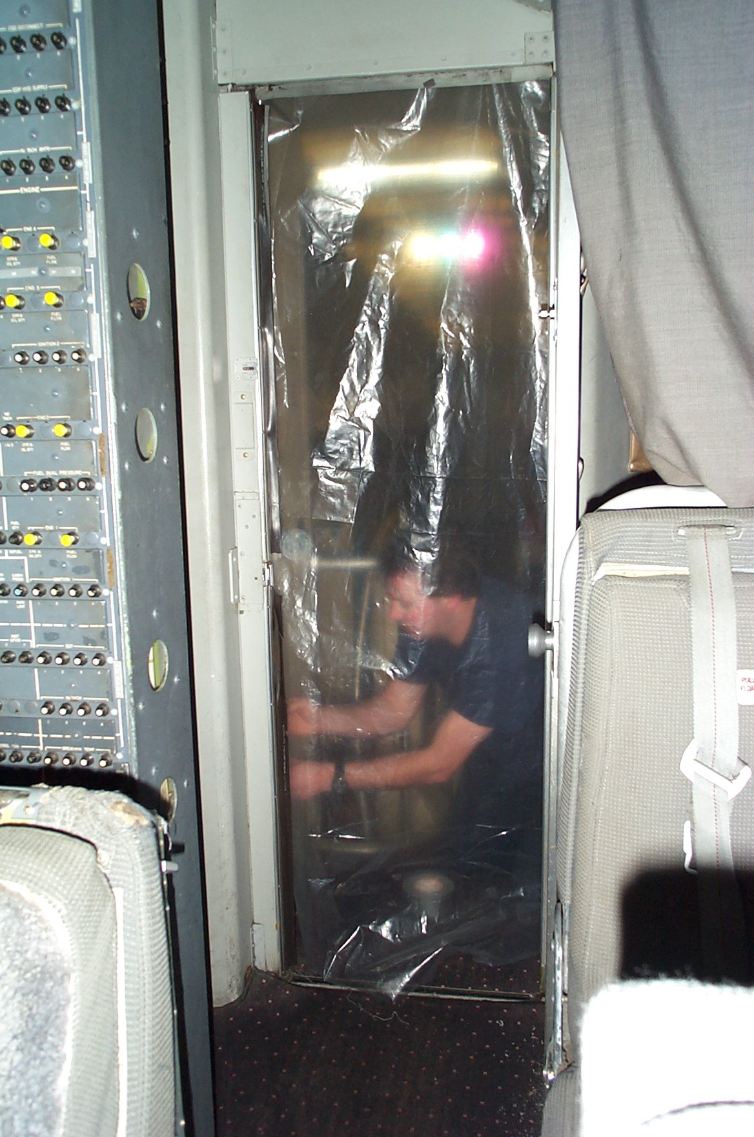

Slide 21
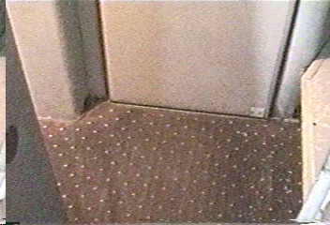
747
Smoke penetration into cockpit. Flight deck fan on. All cockpit gaspers and vents full open.

Slide 22
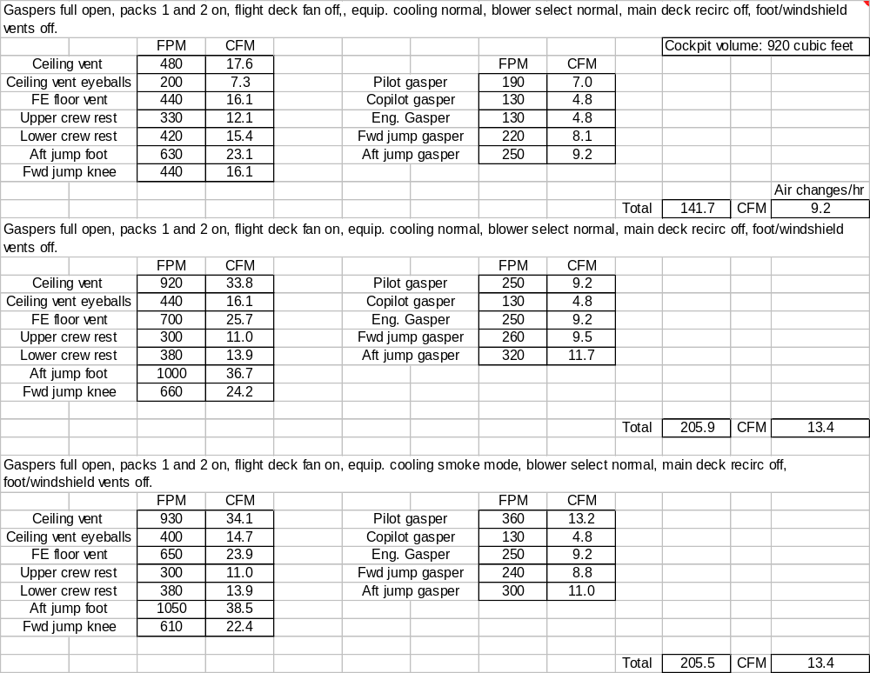
747

