Slide 1


Internationally Coordinated Modeling Activities:
HTAP and
AC&C
Mian Chin
This list is soooo long !!
&
Thomas Diehl
Huisheng Bian
Tom Kucsera
Goddard Aerosol Update
Year of the Pig 2007

Slide 2

Memory Test – Memorize these acronyms in 30 seconds
ACCENT-MIP | Atmospheric Composition Change: The European Network for Excellence – Model Intercomparison Project
AEROCOM | Aerosol Comparisons between Observations and Models
AC&C | Atmospheric Chemistry and Climate Initiative
CCM-Val | Chemistry-Climate Model Validation
CCSP | Climate Change Science Program
HTAP | Hemispheric Transport of Air Pollution
IGAC | International Global Atmospheric Chemistry
IGBP | International Geosphere-Biosphere Programme
IPCC | Intergovernmental Panel on Climate Change
LRTAP | Long-Range Transboundary Air Pollution
SPARC | Stratospheric Processes And their Role in Climate
WCRP | World Climate Research Programme
WMO | World Meteorological Organization
Oh no, my brain hurts…

Slide 3

HTAP: Hemispheric Transport of Air Pollution
HTAP:
  A United Nations Task Force created in December 2004, under the Convention on Long-Range Transboundary Air Pollution (LRTAP)
  Led by the European Community and the United States (Co-Chairs: Andre Zuber, EC; Terry Keating, USEPA)
  Purpose: To develop a fuller understanding of intercontinental transport of ozone, aerosols, and other pollutants and their impact
  Task Force includes experts from emission, observation, and modeling communities
Who is polluting us ?

Slide 4
HTAP Modeling Activities
The TF HTAP is conducting a series of model evaluation and intercomparison experiments to
  Estimate intercontinental source-receptor relationships
  Improve our understanding of the variability and uncertainty in current model estimates
  Guide future model developments
Currently >20 global and regional models are involved in HTAP experiments including GOCART, GMI, MOZART, GEOS-CHEM, CAM-CHEM from the U.S. and many others from Europe
Interim report due 2007, assessment report due 2009
Who is polluting us ?
http://aqm.jrc.it/HTAP/ for model experiments
http://www.htap.org/ for general information

Slide 5
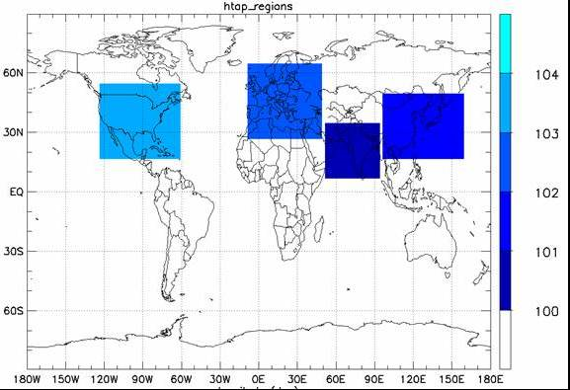
HTAP model experiment regions
Assessing the impact of pollutants emitted from major source regions on other areas. Major anthropgoenic source regions: North America (NA), Europe (EU), East Asia (EA), South Asia (SA).
Can we blame China for our bad air ?
AEROCOM will conduct additional multiple model experiments to assess dust and smoke transport.

Slide 6

AC&C: Atmospheric Chemistry and Climate Initiative
AC&C:
  Endorsed in March 2006 as a joint effort of WCRP and IGBP
  Coordinated by Phil Rasch (Co-chair of IGAC/IGBP) and A.R. Ravishankara (Co-chair of SPARC/WCRP)
  Purpose: Coordination of defining a common set of scientific themes and facilitating their execution
  Building upon existing international modeling activities including
    CCM-Val (stratospheric chemistry)
    AEROCOM (aerosols)
    ACCENT-MIP (tropospheric chemistry)
Even me can feel climate is changing

Slide 7
AC&C Phase I Activities
Long-term simulation:
  20-25 year hindcast of tropospheric ozone and aerosols.
Understanding processes:
  distribution of aerosols/gases between 5km and tropopause.
Aerosol, Cloud, Chemistry:
  improving their interactions in models.
Future Scenarios:
  experiments for IPCC AR5.
Even me can feel climate is changing

Slide 8
WCRP-SPARC/IGBP-IGAC
Atmospheric Chemistry and Climate Initiative
Research Implementation Bodies
CCM-Val
(stratospheric gas-phase chemistry)
AEROCOM
(tropospheric aerosols)
“Tropos Chem”
(tropospheric gas-phase chem)
AC&C Research Activities
Overarching Activities
1) 20 year hindcast for tropospheric gases/aerosols
2) What controls the distribution of troposhperic aerosols/gases? (Step 1: Focus on 5km to tropopause distribution)
3) Cloud/aerosol/chemical interactions
4) Future scenarios; sensitivities & uncertainties
1) Emissions Harmonization Committee
2) Data Center Committee
3) AC&C Web page & “E-newsletter”
Can some human tell me what’s going on?
Unifying thematic areas
Composition impacts on climate
Climate impacts on chemistry
Climate impacts on surface-level ozone & aerosols (“air quality”)

Slide 9

Who are funding these activities?
No funding from any “international” organizations
The success of these activities is contingent on buy-in from the scientific community, including us
By participating, we take advantage of the community as well
  Share progresses on model improvement and development
  Better evaluate the model performance
  Better access to emission, observations, etc.
  More relevant to international community
NASA ??
$$$

Slide 10


How can these model exercises help aerosol missions and science?
The ensemble of model results are proven to be more robust than a single “best” model (if there is any). Therefore, these exercises can be used for
  Analyzing data from past and current missions to better understand global and regional aerosol trends, emissions, processes, and impacts
  Identifying common needs or problems among the models that can be used to recommend or emphasize future observation priorities
  Forming an international assessment body (e.g., IPCC, WMO, CCSP) providing guidance for research and policies
Wow ! This is so cool !

