Slide 1

Census 2000:
Census 2000:
Working with
Redistricting Summary Data
(Public Law 94-171)
on CD-ROM
Notes:
The Redistricting Summary Data will be released first on American Fact Finder (a data access tool on our web site). It will be followed by a release on CD-ROM. Once all states are released, the same state-by-state data will be made available on DVD.
Today we will discuss how to install the CD-ROM and how to maneuver through the data on the disc.
This presentation has been designed to introduce the product and the screens to the data user. It will lead you through installation and show how to drill down through the screens to get the information. The purpose of this exercise is to have you become familiar with the disc format.
2000DemoDisc3_7.ppt

Slide 2
HOW TO: INSTALL YOUR DISC
HOW TO: INSTALL YOUR DISC
Census 2000
Demonstration Disc
1998
Public Law 94-171 Redistricting Data
This CD-ROM contains
summary data files,
documentation, and
software to display
information for the
city of Sacramento,
California
To install:
click “My Computer”,
click the CD-ROM icon,
then click the “Install”
button and follow the
instructions.
For additional information
go to: http://tier2.census.gov/DemoDisc.htm
Issued
December 2000
United States
Census
2000
USCENSUSBUREAU
Helping You Make Informed Decisions
Notes:
TRAINER INFORMATION AND INSTRUCTIONS:
The slides show what is on the disc, and what will be seen as the user runs through the installation process. Also, shown is how to maneuver through the information on the disc. This presentation concludes with how and where to order the CD-ROM or a DVD.
The presentation is automatically timed for movement. The presenter only needs to click through the screens and use the notes. It would be advisable if time allows to do a quick rehearsal of the presentation.

Slide 3
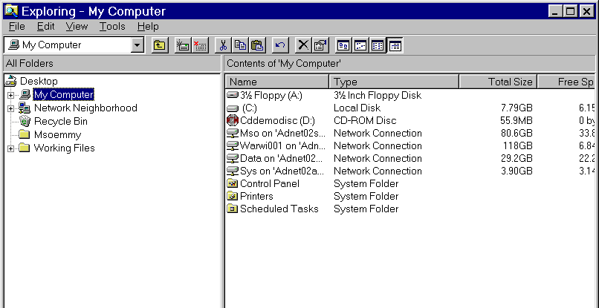
Insert CD-ROM
Click CD Drive
Notes:
The first step is to insert the disc. Look for the following:
Icon of My Computer on the desktop.
Select the CD-ROM disc.

Slide 4
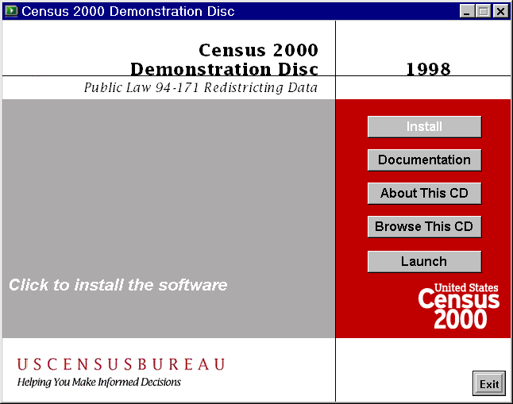
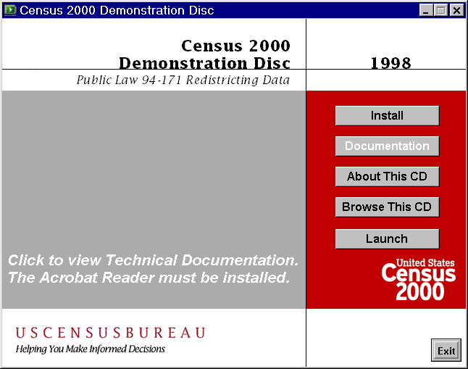
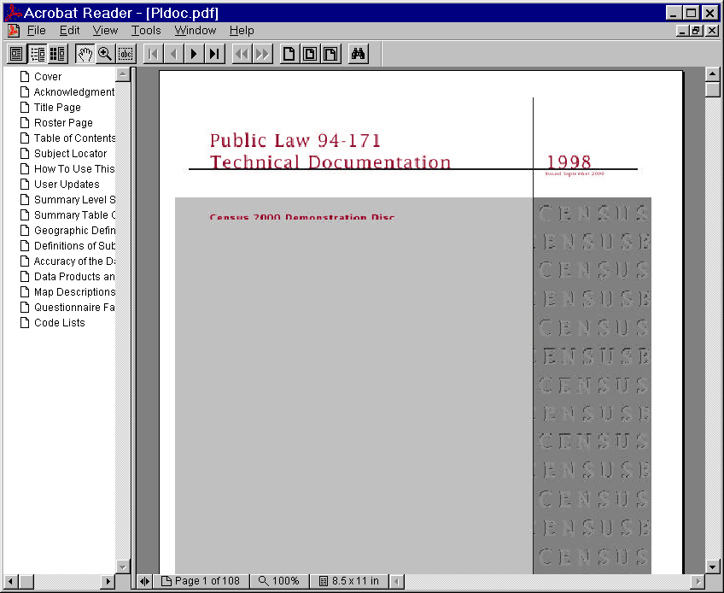
Selecting Documentation will provide you with Public Law 94-171 Technical Documentation that can be printed
Notes:
What you will see when you insert the disc is five buttons that you can select. You can select Install, Documentation, About this CD, Browse this CD and Launch. We will start with Documentation and come back to Install. Selecting Documentation will provide you with Public Law 94-171 Technical Documentation that is in PDF format and can be printed and used as reference.

Slide 5
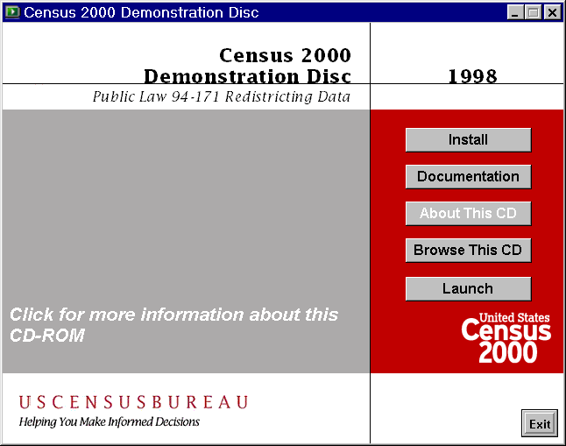
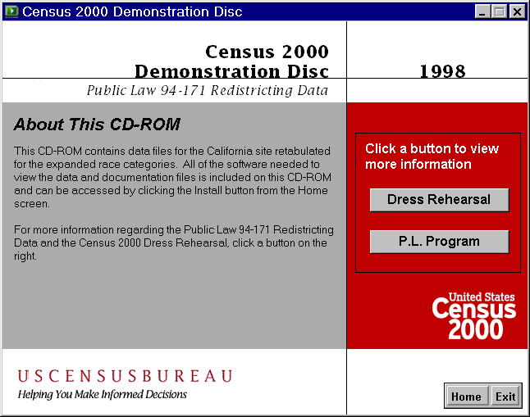
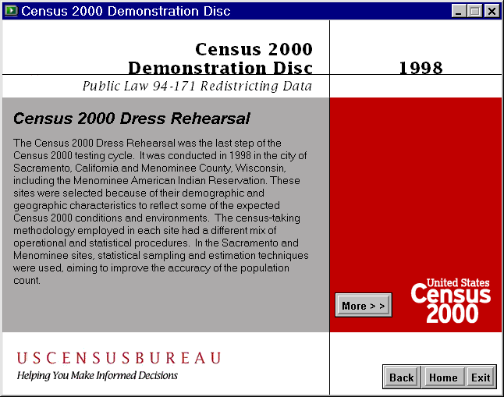
Selecting About this CD will tell you about the CD-ROM and lead you to Dress Rehearsal and P.L. Program
Notes:
Selecting About This CD will lead you to information about the CD-ROM.
You can see that there are additional buttons for Dress Rehearsal and P.L. Program. Clicking on Dress Rehearsal will give you some information about this activity, in which the Census Bureau tested various operations prior to taking Census 2000.

Slide 6
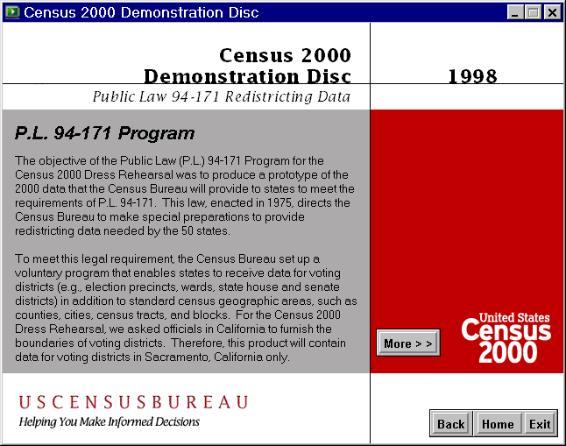
Selecting P.L. Program
will lead you to information about
P.L. 94-171 Program
Notes:
The other selection is P.L. Program. Selecting P.L. Program will lead you to information about the P.L. 94-171 Redistricting Program.

Slide 7
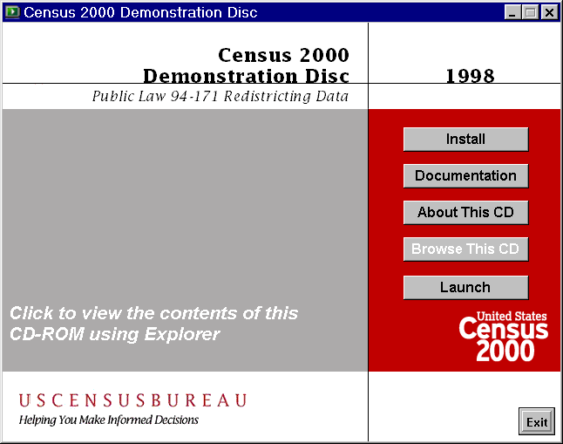
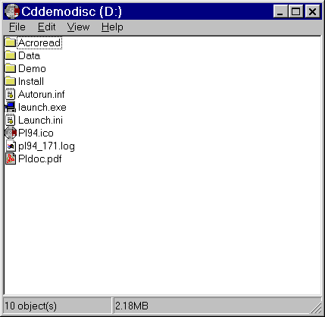
Selecting Browse this CD will show you the actual files that make up this program
Notes:
The fourth choice or button on the CD is Browse this CD. Selecting this button will show you the actual files that are included on this disc.

Slide 8

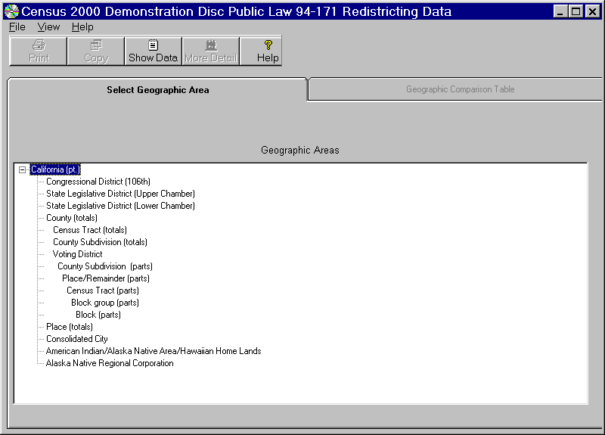
Selecting Launch will bring up the Public Law Redistricting Data
Notes:
Your fifth choice is to Launch. When you select Launch it will bring up the Public Law Redistricting data.
But first, we have to install the CD-ROM.

Slide 9
Select Install
Click to Install
Notes:
Let’s go back to Install, your first selection. Select Install. Notice that when you select Install the button will be highlighted. Along with that highlight you will get highlighted instruction that will prompt “Click to install the software”.

Slide 10
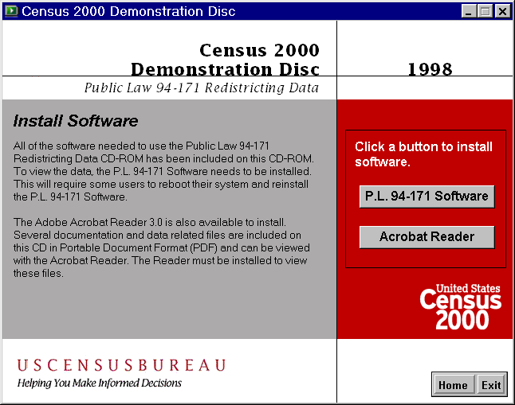
Click P.L. 94-171 Software
Notes:
You can now select to install the P.L. 94-171 Software or the Acrobat Reader which you will need to read the technical documentation. Most users already have Adobe Acrobat on their machines.
Let’s choose Select P.L. 94-171 Software.

Slide 11
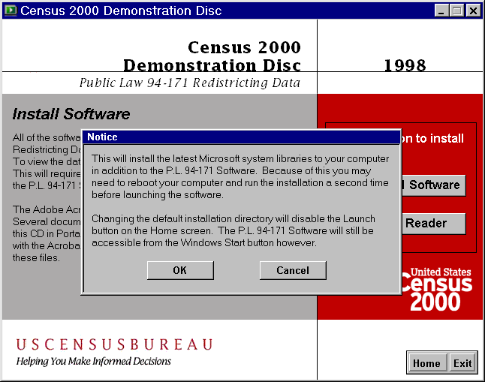
Select OK
Notes:
At this point a notice will pop up giving instruction. Select OK and continue.

Slide 12
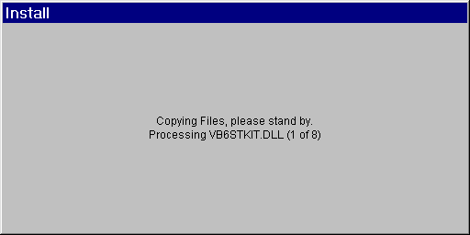
Copying Files
Notes:
The following are some of the screens that you will see while going through the install process.

Slide 13
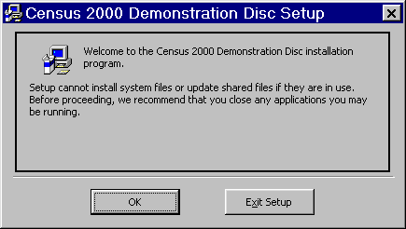
Select OK
Notes:
You will always be prompted. As in this example either select OK or Exit Setup.

Slide 14
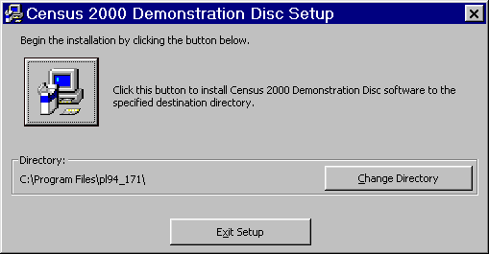
Click button to install
Notes:
You are at the actual installation. Click button to install.

Slide 15
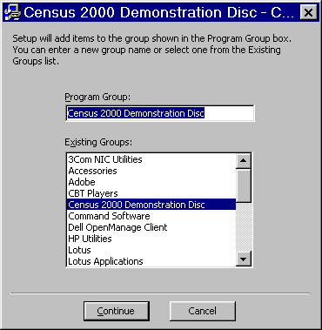
Click Continue
Notes:
Follow the prompts. Either Continue or Cancel.

Slide 16

Notes:
The next couple of slides show the screens that the user will be seeing as the process is finishing.

Slide 17
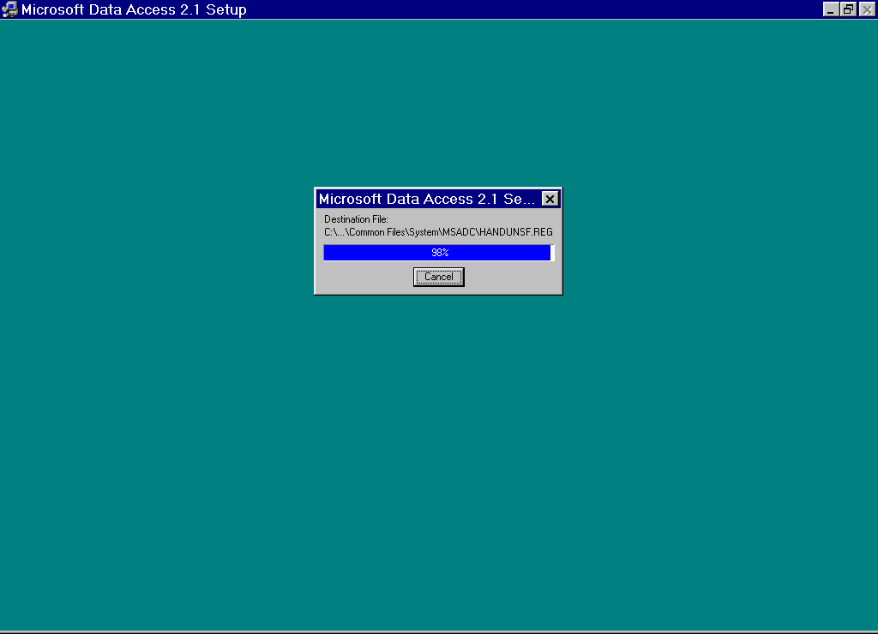

Slide 18
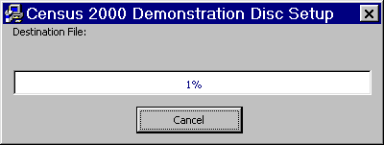

Slide 19
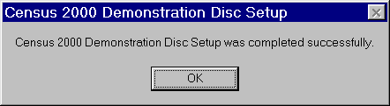
Click OK
Notes:
At this point you will receive a message that says the Disc Setup was completed successfully. Click OK. Once the setup has been completed you will be returned to the Install screen.

Slide 20
Click Home
Notes:
When you have been returned to the Install screen you can select Exit to exit the disc, or select Home to return to the main menu.
Let’s return to the Main Menu then by clicking Home.

Slide 21
HOW TO: MANEUVER THROUGH THE DISC
HOW TO: MANEUVER THROUGH THE DISC
Click Launch to begin using the data
Notes:
You are now sitting at the main menu. You may launch the information directly from the disc. Click Launch to begin using the data.

Slide 22
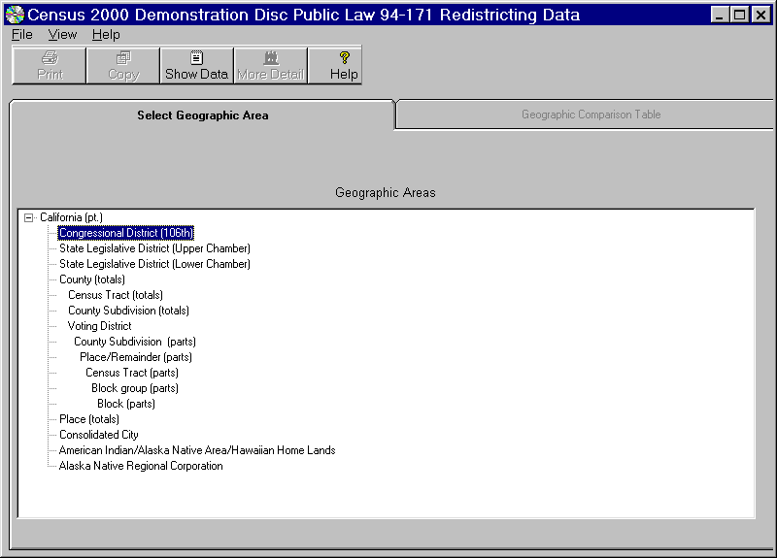
Screen is set up like file folders
with identifying tabs
Notes:
We will be using the default file, California. This screen shows the various levels of geography on the file including Congressional Districts, various State Legislative Districts, and then Census Statistical Areas, such as, Census Tract and Block.
The files are setup like files in a filing cabinet.
Let’s pick the first geographic summary level - Congressional District - and Click on Show Data.

Slide 23
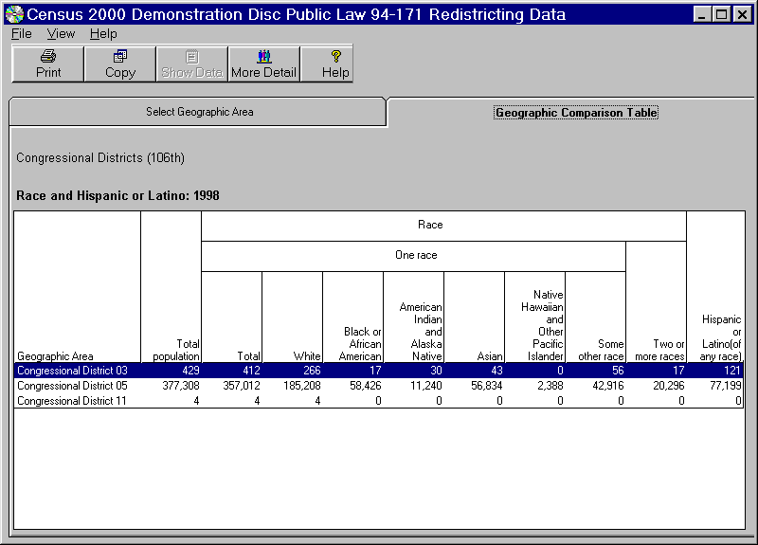
Notes:
The first screen that comes up is a geographic comparison table. The geographic comparison tables present comparable information for similar geographic areas, for example, all counties within a state, all census tracts within a county, etc. (The Dress Rehearsal only covered a part of California; we only have data for Congressional District 05 and parts of Congressional Districts 03 and 11.)
This table shows the total population, the population in the 6 OMB race groups, the population that checked two or more races, and the Hispanic or Latino population.

Slide 24
266
17
30
43
0
+ 56
412
+ 17
429
C
B
A
Total of One Race Only
Plus Two or More Race
Equals the Total Population
Notes:
The total population count in column (C) is a summary of the one race alone categories (A) plus the two or more races (B), (column10). It does not include the Hispanic/Latino Population category (column 11), because Hispanic/Latino may be of any race.
Click on More Detail to see additional data items for the highlighted geographic area.

Slide 25
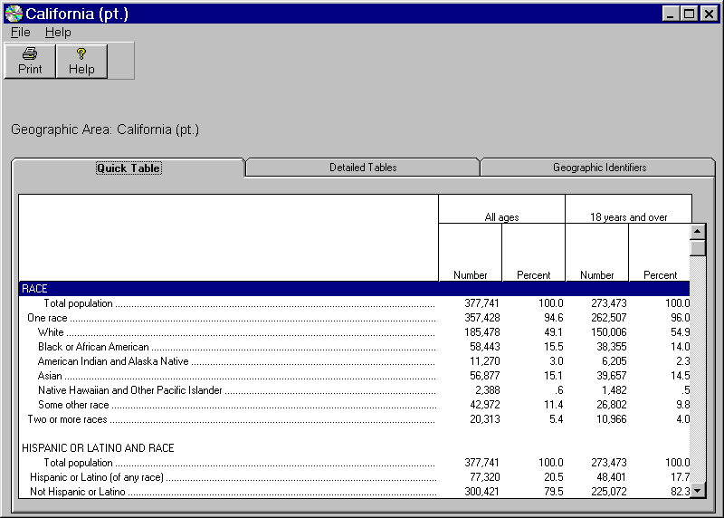
Select Detailed Tables
Notes:
On this screen you have three choices or three folders. A Quick Table which is displayed on the screen , Detailed Tables and Geographic Identifiers.
Select Detailed Tables...

Slide 26
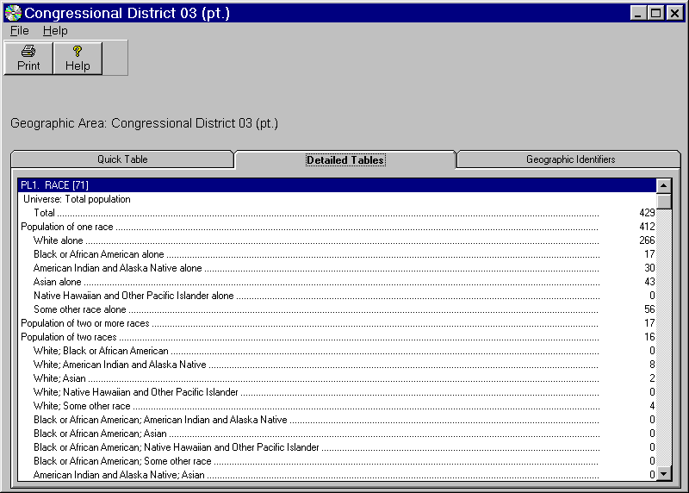
Covers PL1, PL2, PL3 and PL4
Notes:
The Detailed Tables include the 4 data tables on the disc.
PL1. Race (71 data cells)
PL3. Race for the population 18 years and over (71)
PL2. Hispanic or Latino, and NOT Hispanic or Latino by race (73)
PL4. Hispanic or Latino, and NOT Hispanic or Latino by race for the population 18 years and over (73).
NOTE: You can scroll down to see all four tables for this geographic area. The Redistricting Data does not show information on race alone or in combination. These totals would need to be calculated.

Slide 27
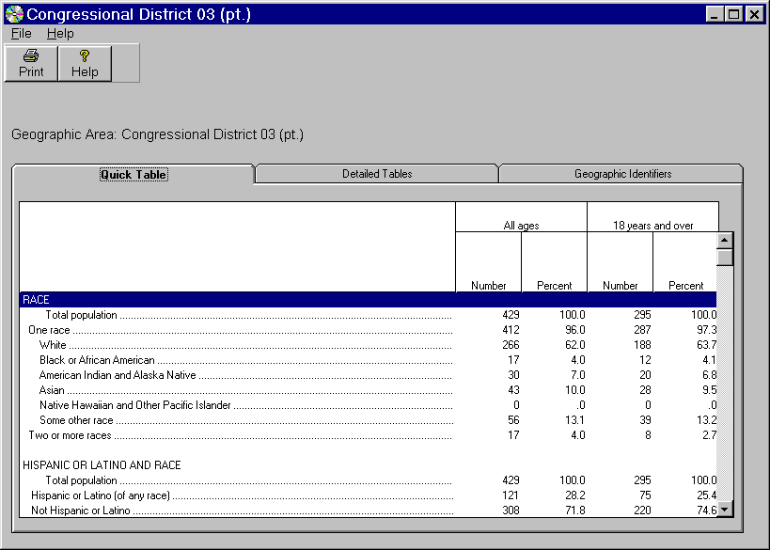
Congressional District 03 (pt.)
Exit or discontinue
Notes:
You can exit or discontinue using the data by clicking on the (X) in the right hand corner.

Slide 28
HOW TO ORDER THE CD-ROM
Notes:
You can order the CD-ROM or DVD from our Census Bureau Customer Service Center via the telephone at 301-457-4100.
Orders may be placed in several ways:
•via the Internet, by selecting the "BUY" button following the product description (all CD-ROMs and other selected products only)
•via FAX to our toll-free number, 888-249-7295(Orders Only) inquiry faxes should be sent to 301-457-4714
•via telephone to our customer services staff at 301-457-4100. Customer Services is open from 8:30 - 4:30 Eastern Standard Time and closed 11:00 - 11:45 Wednesday. Customer Services is also closed intermittently on Thursdays from 11:00 - 11:45.
Direct any questions about these products to: Webmaster@Census.GOV.
Source: U. S. Census Bureau, Customer Services Center

