Slide 1

ERA Navigation

Slide 2

Learning Objectives
At the conclusion of this session, you will understand:
Lesson 1: ERA Overview
Lesson 2: Log Onto and Navigate ERA
Lesson 3: Manage Workbenches
Lesson 4: Search ERA
Lesson 5: ERA Accounts & Help Desk

Slide 3
Lesson 1: ERA Overview

Slide 4
ERA Overview
ERA will be a fully functioning on-line archives.
ERA is designed to provide easy access to anyone with an interest and legal right of access, now and for the life of the republic.
ERA will also provide the capability to implement selected archival management tasks for non-electronic records, such as the scheduling and appraisal functions.

Slide 5
What is ERA?
ERA is an online, web-based portal application that provides the functions and tools needed by users from the National Archives and Records Administration (NARA) and Federal agencies to perform their jobs.
ERA organizes information for easy access freeing up users to perform archival and records management work rather than spending time finding, organizing, and tracking information for processing.
ERA users log into the portal and are presented with a customized workbench based upon their credentials.

Slide 6
ERA Processes
ERA supports four NARA business processes:
  Records Scheduling
  Transfer
  Ingest
  Access

Slide 7
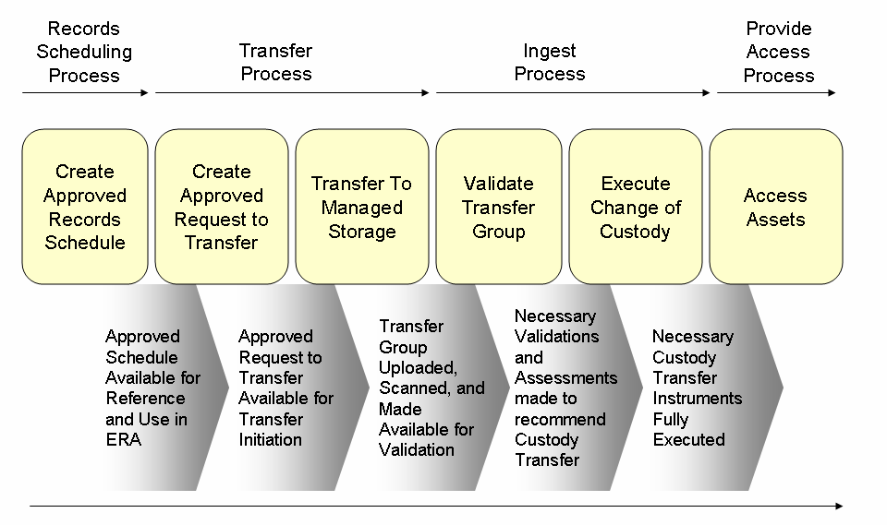
ERA Processes: Functional Flow

Slide 8
Road Map: Records Schedule
Records Scheduling Process
Provide Access Process
Transfer Process
Ingest Process
Create Approved Records Schedule
Create Approved Transfer Request
Transfer To Managed Storage
Validate Transfer Group
Execute Change of Custody
Access Assets
Approved Schedule Available for Reference and Use in ERA
Approved Transfer Request Available for Transfer Initiation
Transfer Group Uploaded, Scanned, and Made Available for Validation
Necessary Validations and Assessments made to recommend Custody Transfer
Necessary Custody Transfer Instruments Fully Executed
Lifecycle Management Process
Notes:
The Records Schedule is the beginning of the lifecycle management process. First we’ll discuss the process for creating and approving a records retention schedule.

Slide 9






Create and Approve a Records Schedule
Records Scheduler
Certifying Official (CO)
NARA Appraiser
Records
Scheduler
Creates RS/RSI
Submit RS/RSI to
Certifying Official
Certifying Official reviews
if approval is granted
submits to NARA
Appraisal Mgr. 1
NARA Appraisal reviews/
modifies RS for approval, if
granted submits to
Appraisal Mgr. 1
Appraisal Mgr. 2
Appraisal Mgr. 2 reviews
for approval, if granted
submits to Appraisal Mgr. 3
Appraisal Mgr. 3
Appraisal Mgr. 3 reviews
for FINAL approval, if
granted RS is released into
managed system
Approved RS
in managed storage
awaiting action
Notes:
The steps in the process are as follows:
A Records Scheduler from an Agency uses ERA to create a Records Schedule and submits it to a “certifying official” within the agency
The Certifying Official reviews and/or modifies the schedule, grants approval and submits the Records Schedule to NARA
A NARA appraiser reviews and/or modifies the Records Schedule. If the appraiser recommends approval, the schedule is submitted to managers for concurrence, and the final approver (usually the Archivist) for approval.

Slide 10
Road Map: Transfer Process
Records Scheduling Process
Provide Access Process
Transfer Process
Ingest Process
Create Approved Records Schedule
Create Approved Transfer Request
Transfer to Managed Storage
Validate Transfer Group
Execute Change of Custody
Access Assets
Approved Schedule Available for Reference and Use in ERA
Approved Transfer Request Available for Transfer Initiation
Transfer Group Uploaded, Scanned, and Made Available for Validation
Necessary Validations and Assessments made to recommend Custody Transfer
Necessary Custody Transfer Instruments Fully Executed
Lifecycle Management Process
Notes:
Transfer is the business process by which Agencies transfer their electronic or non-electronic Documentary Materials to NARA. The Transfer Process provides the capability for two kinds of transfers:
Transfer of physical custody, and
Transfer of legal custody.
These two kinds of transfer can occur simultaneously, or at different times.
The transfer of physical custody has 2 components:
Create and approve a Transfer Request (TR)
Transfer the records to NARA

Slide 11

Transfer Process for Electronic Records
Transfer Official or Transfer Staff
Transferring Official
or Transfer Staff Create
Transfer Request
Transfer Staff
Transfer Staff views. If approval
is granted, system begins
processing which notifies
Transferring Official
to Send Records
Submit Request
for Acceptance
System performs
automatic processing
for each shipment
Records Processor
performs manual
processing
for each shipment
System
Records Processor
System releases records
to managed storage for
post ingest verification
Notes:
The steps in the Transfer Process are as follows:
The agency Transferring Official or NARA Transfer Staff create a Transfer Request based upon an approved records schedule
The request is submitted for acceptance
The Transfer Staff reviews the Transfer Request. If the request is approved, the Transferring Official is notified to send records to NARA
Records are sent to NARA using either manual or automated means

Slide 12
Road Map: Ingest Process
Records Scheduling Process
Provide Access Process
Transfer Process
Ingest Process
Create Approved Records Schedule
Create Approved Transfer Request
Transfer To Managed Storage
Validate Transfer Group
Execute Change of Custody
Access Assets
Approved Schedule Available for Reference and Use in ERA
Approved Transfer Request Available for Transfer Initiation
Transfer Group Uploaded, Scanned, and Made Available for Validation
Necessary Validations and Assessments made to recommend Custody Transfer
Necessary Custody Transfer Instruments Fully Executed
Lifecycle Management Process
Notes:
Ingest is the process by which NARA reviews and accepts transferred Records into its holdings. It involves a number of activities:
Create, update Ingest Tracking Report
Validate transfer
Extract lifecycle data from Records
Provide initial automatic verification of data files in Transfer Groups and report results
Provide initial manual verification of data files in Transfer Groups and report results

Slide 13
Ingest Process
Transfer Official
Records Processor
Records Processor
Transferring
Official
Sends approved
records to NARA
Records
processor
conducts
preliminary
check
Records processor
performs manual
and automatic
verification
for each shipment
Physical custody
accepted by
NARA
Transferring Official
or Transfer Staff creates
Legal Transfer
Instrument and submits
for approval
Transferring Official or Transfer Staff
Notes:
The Ingest Process has the following steps:
The Agency Transferring Official sends records to NARA as specified in an approved Transfer Request
The Records Processor conducts a preliminary check and then performs manual and automatic verification for each shipment
Once any problems are resolved, NARA accepts physical custody of the records
At the same time or later, the Transferring Official or the Transfer Staff create a Legal Transfer Instrument and submit it for approval.

Slide 14
Road Map: Provide Records Access
Records Scheduling Process
Provide Access Process
Transfer Process
Ingest Process
Create Approved Records Schedule
Create Approved Transfer Request
Transfer To Managed Storage
Validate Transfer Group
Execute Change of Custody
Access Assets
Approved Schedule Available for Reference and Use in ERA
Approved Transfer Request Available for Transfer Initiation
Transfer Group Uploaded, Scanned, and Made Available for Validation
Necessary Validations and Assessments made to recommend Custody Transfer
Necessary Custody Transfer Instruments Fully Executed
Lifecycle Management Process
Notes:
The final step in the lifecycle management process is to provide access to assets.
“Assets” includes both “records” and “business objects”
“Records” are defined according to traditional archives and records management principles
“Business Objects” are the “forms” ERA creates in order for NARA to conduct its business. Some examples are: the Records Schedule, the Transfer Request, and the Legal Transfer Instrument.

Slide 15

Provide Records Access
User
System
User
identifies records
to access from
Browsing the
Access Catalog
ERA validates
users access
rights to view
associated asset
If granted,
records
are retrieved
for user to view
or download
If denied, access
restriction
message is
displayed by
screen pop-up
Notes:
The steps in the Provide Access process are:
A user identifies records he or she wishes to access
ERA makes certain that the user has sufficient access permissions to see the records
If access is granted, the records are presented to the user
If access is denied, the user receives a notice to that effect

Slide 16
Lesson 2:
Log Onto and Navigate ERA

Slide 17
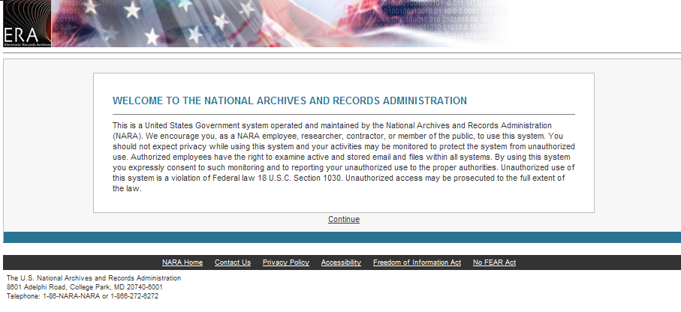
ERA Home Page
Notes:
The first screen a user will see is the ERA Home Page. In the center of the screen is a Welcome message that also advises users that:
ERA is a government system operated by NARA
Users should not expect privacy and may be monitored while on the ERA system
Unauthorized use may be reported to proper authorities
To enter the ERA system, the user must click on “Continue.” By clicking on “Continue,” the user is consenting to both monitoring and reporting of activities

Slide 18
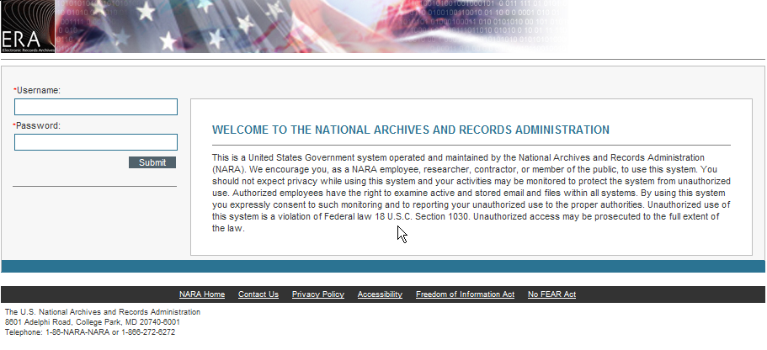
Log On Screen
Notes:
After clicking on “Continue,” the user is presented with a Log On Screen.
The right side of the screen repeats the welcome message and notification of monitoring.
The left side of the screen has fields to enter “Username” and “Password.” The red asterisk in front of these two field names means that they are “required fields.” After entering a username and password, the user clicks on the “Submit” button.

Slide 19
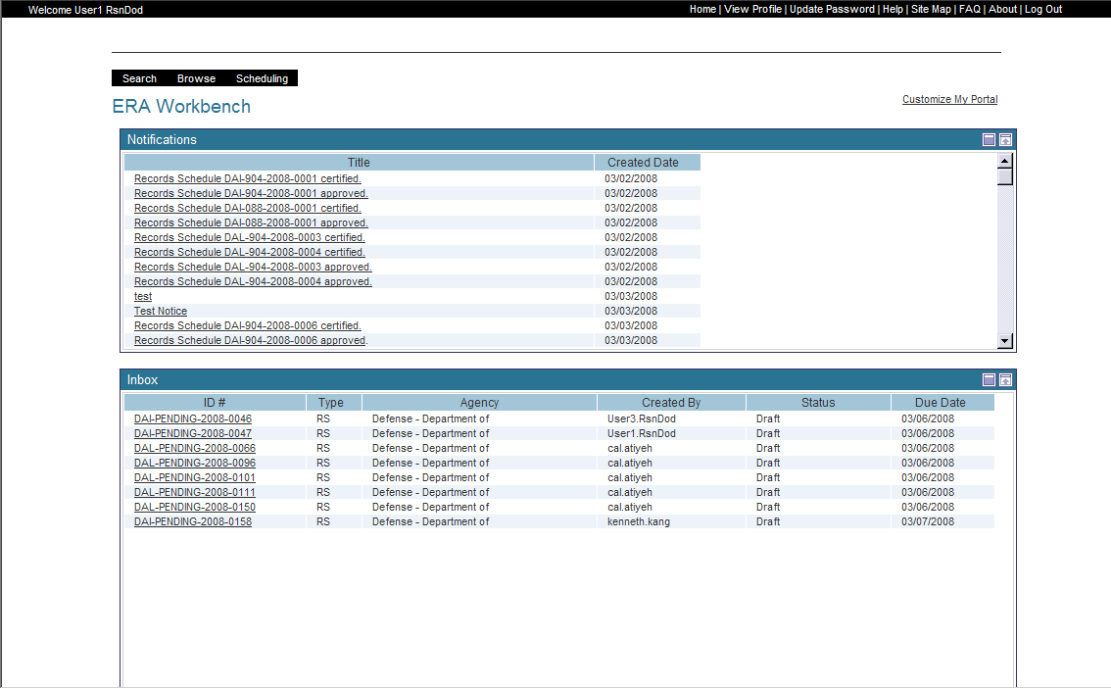
ERA Workbench
Notes:
When a user logs into ERA, the System validates the ID/password (authentication) then determine the user’s role(s). Based on user role(s), the system generates a Workbench to display for the user. Workbench functionality is dependent upon the role or combination of roles the user has. For example, if a user has one role, the Workbench will only display options for that role. However, if the user has two roles, the Workbench will display options for both roles.
The Workbench has the following main sections that we’ll discuss in the next module:
A black bar that goes across the entire top of the page
A smaller black menu bar on the upper left that displays actions that are available based upon the user’s roles
Portals for “Notifications,” Inbox,” and “Help”. The Help portal is not displayed here but we’ll discuss it in the next module.

Slide 20
Common Screen Elements
Element Name | Element Type
Calendar
Spell Check
Lookup
Cancel
Save
Submit
Notes:
ERA screens use a number of common elements. We will discuss each element on a separate slide

Slide 21
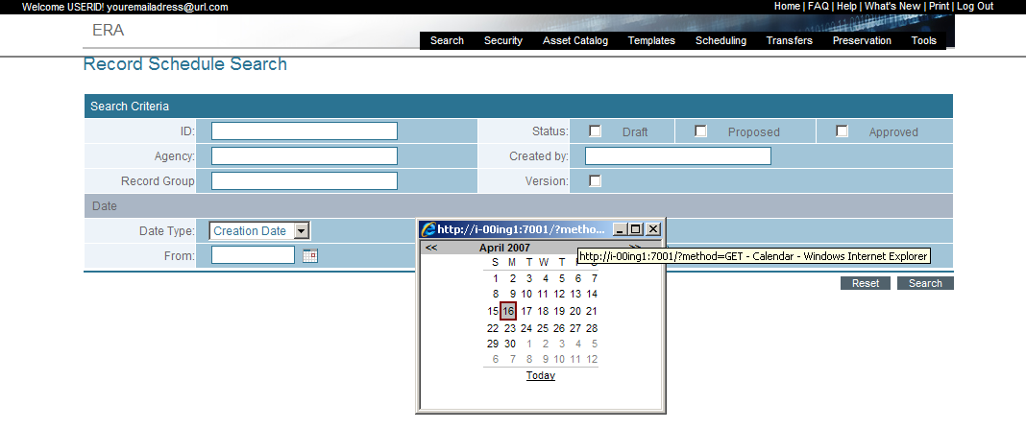
Calendar Icon
Notes:
The Calendar appears when fields have date values to be entered such as:
Creation Date
Due Date
To/From Date
The Calendar icon provides a method to look up and select a date to populate the box to the left of this icon. When selected, a popup calendar appears which allows the user the option to change month and/or year when selecting a date. When the date is selected, the popup closes. Users can also enter the date manually without selecting the calendar icon

Slide 22
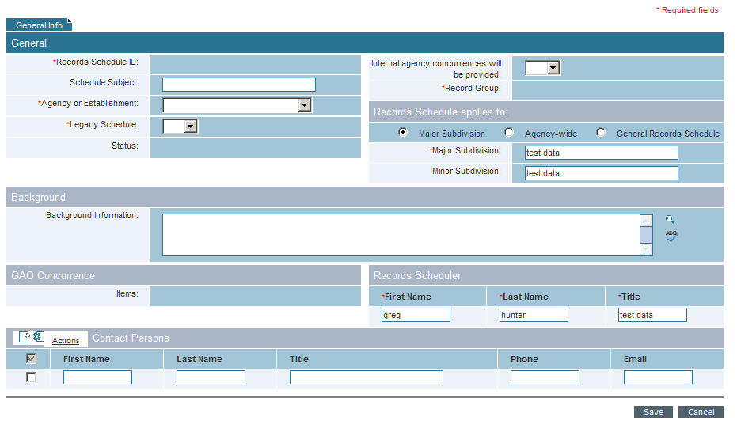
Spell Check Icon
Notes:
The Spell Check icon is displayed as an “ABC checkmark” symbol. It checks the spelling of the text in the box to the left of the icon.
The spell check icons appears when performing tasks such as entering:
Comments
Descriptions
Instructions

Slide 23
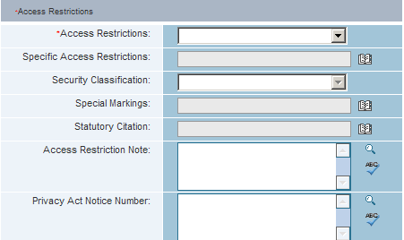
Lookup Icon
Notes:
The Lookup icon (also referred to as the pick list) is displayed as a book icon. Selecting the lookup icon allows the user to update a field from a system-generated list

Slide 24
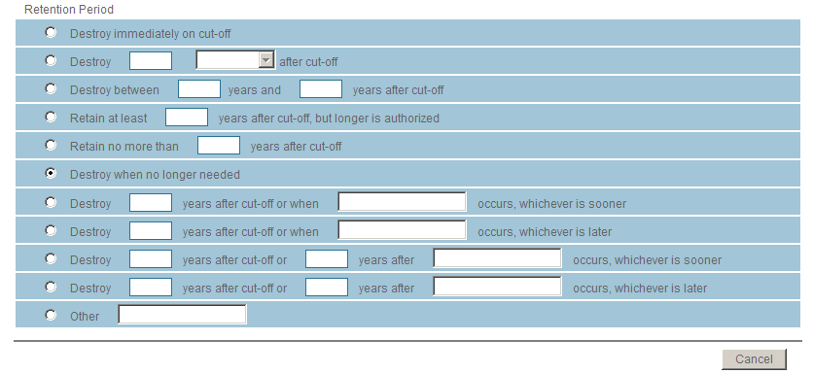
Cancel Button
Notes:
The Cancel button is designed to disregard work. When the cancel button is selected, information is not saved in the system and the user is returned to the prior page

Slide 25
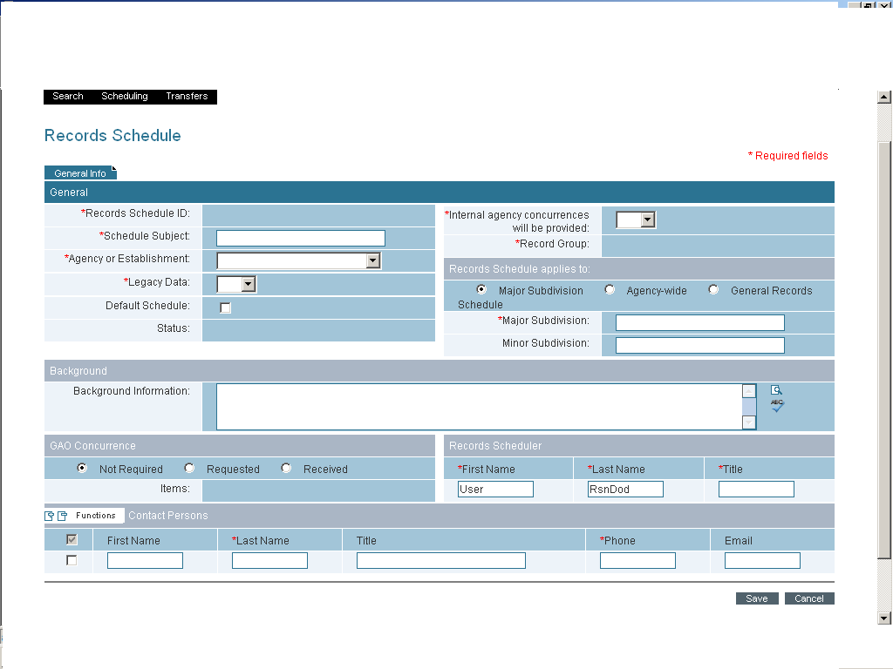
Save Button
Notes:
The Save button is designed to allow the user to enter as much or as little information as he or she wishes. It allows the user to start work then return to it later to complete without having to start over.
When the save button is selected, information is saved to the system and work is temporarily suspended. The user cannot move forward to the next step in the process until the page is submitted. The user can leave the page and continue other work

Slide 26
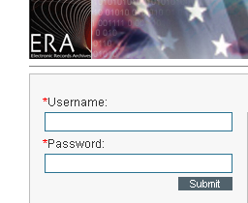
Submit Button
Notes:
The Submit button is designed to complete work and move to the next step in the process. When the Submit button is selected, validation occurs. Upon successful validation, the information is saved to the system. The work is complete and the system moves to the next step in the process

Slide 27
Lesson 3: Manage Workbenches

Slide 28
What is a Workbench?
A workbench is an abstract concept for the arrangement of the tools on a user’s portal.
The workbench is the entire screen that displays when the user logs in.
It provides a custom view tailored to the user based on their role and permissions.
Notes:
Users interact with ERA through a series of workbenches, which include tools that support their business needs. The workbench is the entire screen that displays when the user logs in.
When a user logs into the ERA System, the ERA System will validate the ID/password (authentication) then determine the user’s role(s). Based on user role(s), the system generates a Workbench to display for the user.
An authorized user has the ability to customize the default workbench by minimizing, maximizing, and restoring portlets

Slide 29
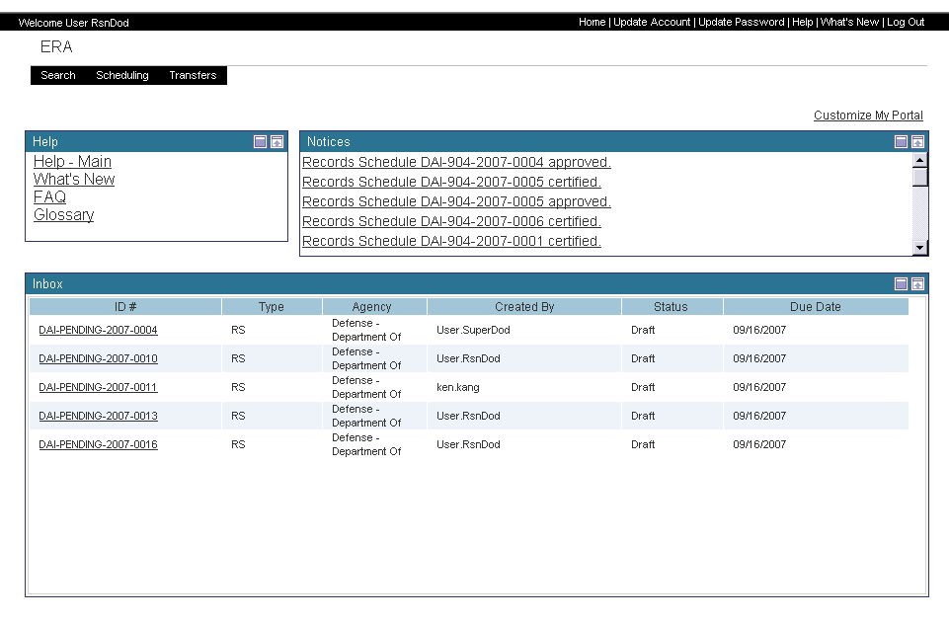
Workbench
Notes:
A Workbench is a specific view of the ERA Portal, allowing for variations based on characteristics of the authenticated user. For example, a Records Scheduler and an Access Reviewer might both visit the ERA Portal, but each will be shown the appropriate Workbench tailored to his or her individual roles and functions. Each Workbench can have a distinct look and feel, organization of pages and contents, and set of available portlets or tools.
The workbench contains the following:
The Username of the person logged in (usually listed at the top left of the page).
A Fixed Toolbar that provides quick access to services, and support. The fixed toolbar is the same no matter which user is logged into the ERA System. The toolbar will display on all pages except the home page. “Help” will not be displayed on the Homepage Toolbar.
An Interactive Toolbar with a drop down menu to provides quick access to various system applications. The menu will have a different look depending on the end user role and permissions.
The portlets displayed on the rest of the page and the individual boxes’ titles: Help, Notices, PTV [Post-Transfer Verification] Tasklist, Inbox, and Tasklist. What an end user will see depends on their roles and permissions when he or she logs into the ERA System.

Slide 30
ERA Toolbars
Notes:
The standard navigational tool of the ERA System consists of a fixed Toolbar with vertical and horizontal drop down menus. The menus are activated when the user’s mouse is over the text and inactive when the user’s mouse if off the text.
The ERA Toolbar will differ according to the individual’s roles and permissions. The Toolbar that is shown on the homepage after logging in will be the same on all other screen / pages within the ERA System.
Options that are displayed on the end user toolbar will only change when the user roles and or permissions are changed.
In most cases, options that a user has in the toolbar will signify access to the various applications within the ERA System. However, a user can have access to some submenus and not have access to others.

Slide 31
Workbench Top Bar
Notes:
The Top Bar has information on both the left and right sides.
The left side says “Welcome” and displays the Username that was used to logon to the system
The right side has a number of other options common across ERA screens. I will show each of these on separate slides:
“Home” returns the user to the Logon screen to enter Username and Password
“View Profile” displays information about the user
“Update Password” permits the user change password
“Help” opens up on-line user assistance
“Site Map” enables the user to see ERA functionality organized in another way
“FAQ” provides frequently asked questions and their answers
“About” provides general information concerning the ERA system
“Log Out” ends the user session and returns the user to the Log On Screen

Slide 32
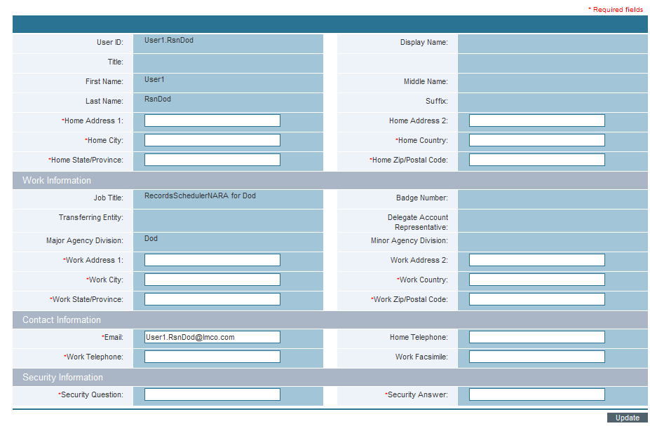
View Profile
Notes:
The user can complete additional profile information in a number of categories:
Home information
Work information
Contact information
Security information
Note that some of the fields are required. To complete the process, the user clicks on the “Update” button on the lower right.

Slide 33
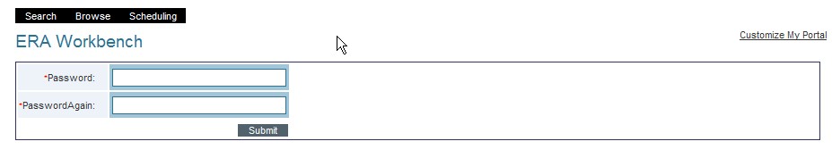
Update Password
Notes:
The user can select a new password. it has to be entered the same way a second time. Clicking the “Submit” button executes the change.

Slide 34
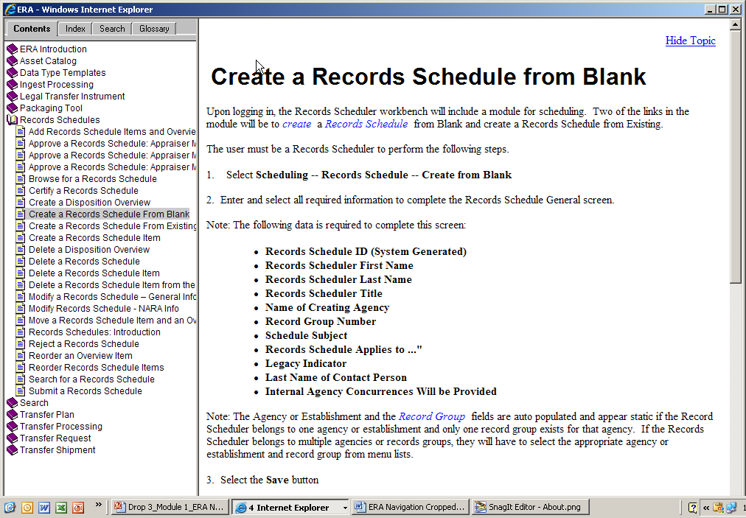
Help
Notes:
On-Line Help has 2 main sections:
The left-hand side displays topics that are available for viewing. Main headings are indicated by the “Book” icon. When a book is “opened,” individual topics are displayed. I will discuss the tabs across the top of this section on subsequent slides.
The right-hand side displays the actual Help file, which is presented as step-by-step instructions.
If we click on “Hide Topic” in the upper right hand corner, the left-hand pane of books and topics will be closed
The words in blue italics are terms found in the Glossary. Clicking on these words will display the definitions from the Glossary. I’ll illustrate this functionality as well as “Hide Topic” on the next 2 slides.

Slide 35
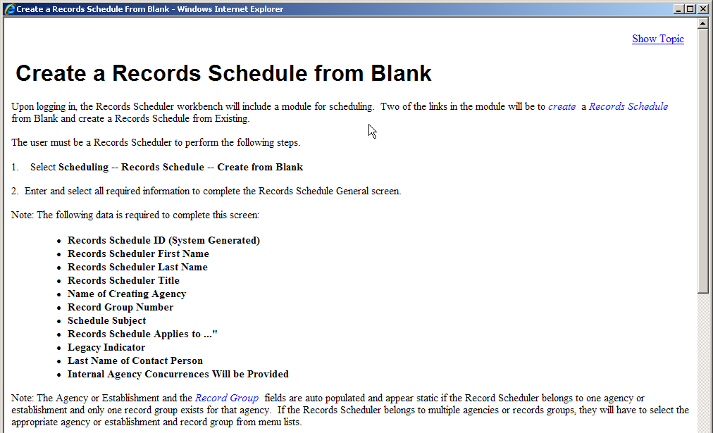
Help: Hide Topic
Notes:
I’ve clicked on “Hide Topic.” You’ll note that the Books and Topics have disappeared.
If I want to see the Books and Topics, I just need to click on “Show Topic” in the upper right-hand corner.
If I want to print out a help topic, all I need to do is right-click on my mouse while in the Help topic. This will give me a choice for “Print.”

Slide 36
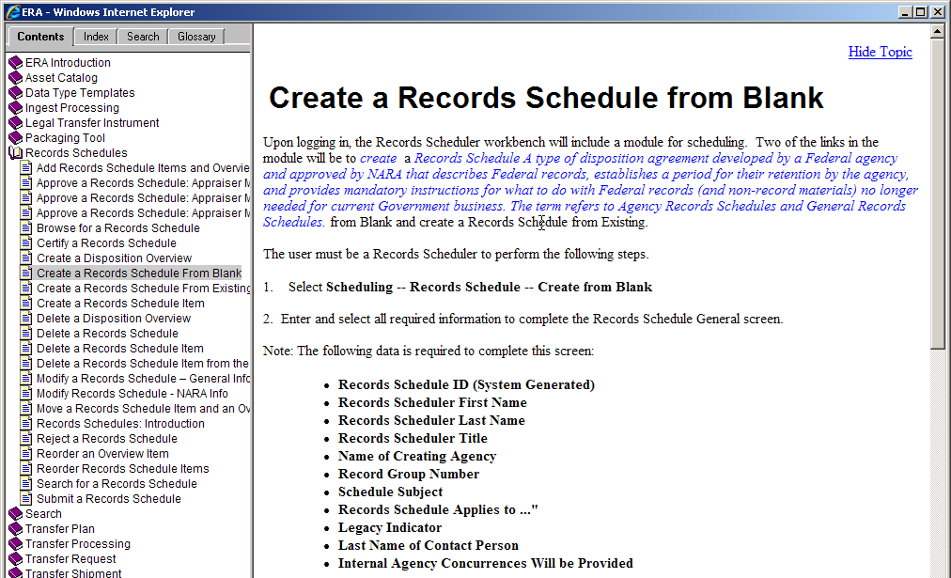
Help: Glossary Link
Notes:
Here I’ve clicked on the term “Records Schedule.” The Help portlet then displays the definition of the term found in the Glossary. If I click on “Records Schedule” a second time, the Glossary definition will disappear.

Slide 37
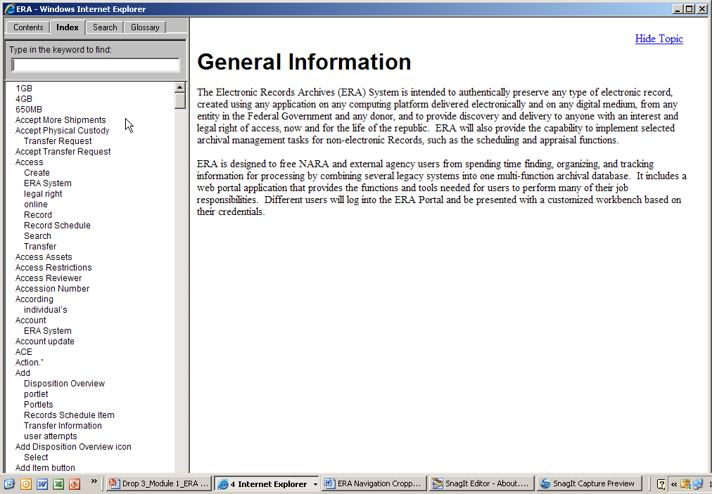
Help: Index
Notes:
Now let’s return to the tabs at the top of the left-hand pane.
Here I’ve clicked on “Index.” The system displays in alphabetical order all of the terms it has indexed. If I click on any of the words in the index, I’ll be connected to the relevant Help content.

Slide 38
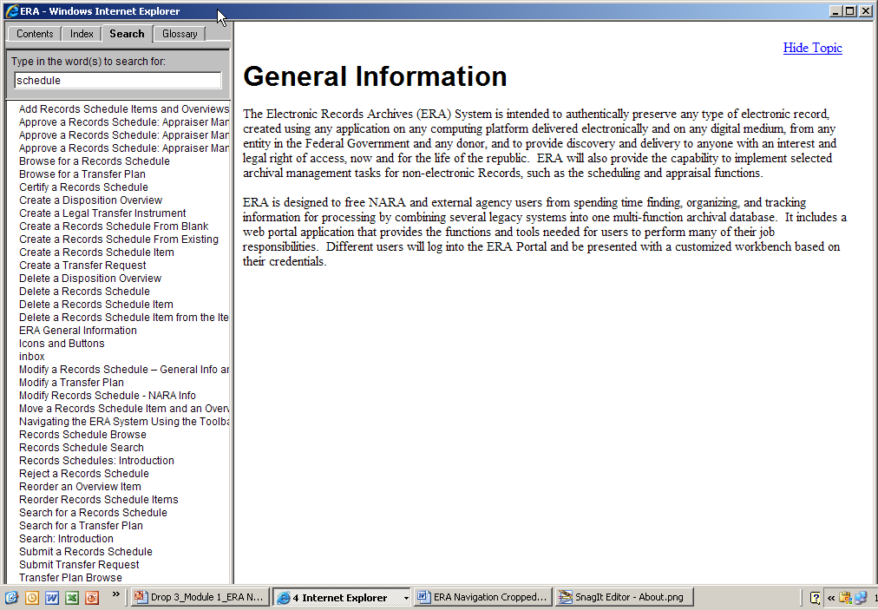
Help: Search
Notes:
Now I’ve clicked on the tab for “Search” and entered in the search term “schedule.” The system displays all of the Help topics containing the word “schedule.” As before, clicking on a word will send me to the Help contents.

Slide 39
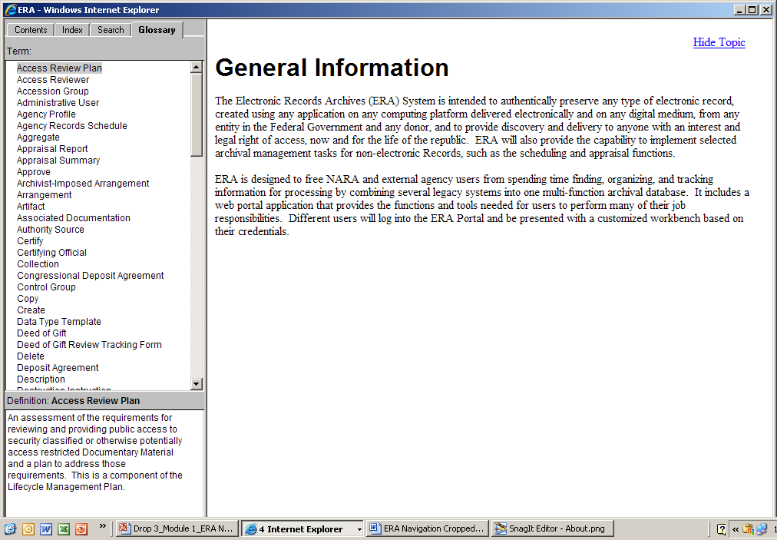
Help: Glossary
Notes:
Finally, I’ve clicked on “Glossary.” This displays all of the terms in the Glossary in alphabetical order.
In this example, the term “Access Review Plan” is highlighted and its definition is displayed below.

Slide 40
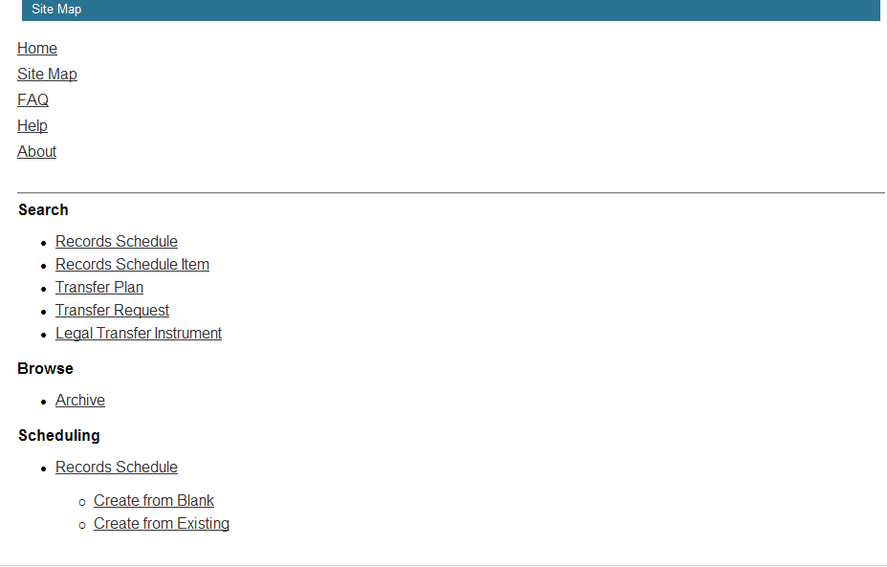
Site Map
Notes:
Now I’m leaving the Help portlet and returning to the main menu in the black bar at the upper right.
I’ve selected the link for “Site Map.” Here is part of the ERA Site Map. The underlined words are hyperlinks. Clicking on the words will activate that functionality

Slide 41
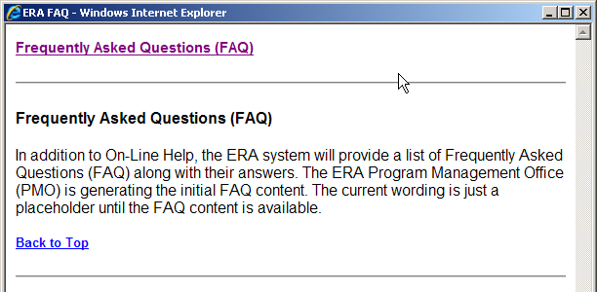
Frequently Asked Questions
Notes:
The section on Frequently Asked Questions (FAQ) will be updated as the ERA system evolves

Slide 42
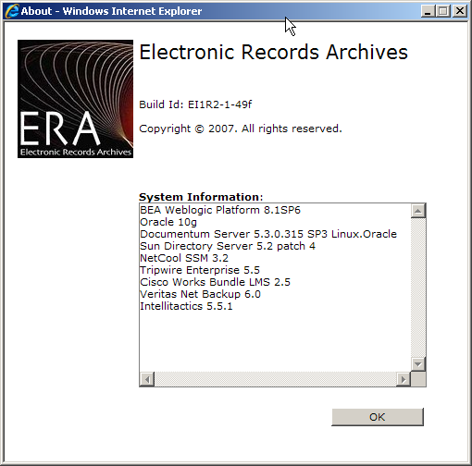
About
Notes:
The “About” screen present basic information about the version of the ERA System and some of its main components.

Slide 43
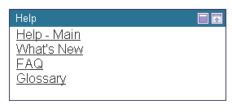
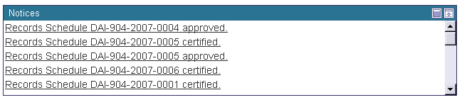
Portlets
Each individual box is a Portlet
Notes:
Each individual “box” on the Workbench is a “portlet,” which we can thin of as a “chunk” of functionality.

Slide 44
Customize My Portal
Notes:
Portal users can customize their portlets within the constraints imposed by access policies. Because each person works differently, what works for one user may not work well for another user. End-user customization allows for this flexibility.
At IOC users will be able to minimize, maximize, and restore a portlet.
In the future, users also will be able to customize their portals in other ways:
Add and/or Remove a portlet on the workbench
Arrange portlets on the workbench
Select the look and feel of the workbench. The user may prefer different theme or color to aid them in seeing more effectively

Slide 45
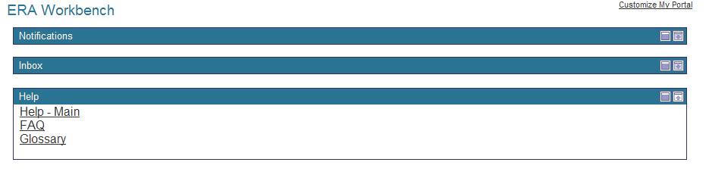
Portlets Minimized
Notes:
Using the icons in the upper right of each portlet, I can “minimize” or “maximize” each portlet.
In this case, I’ve minimized the portlets for “Notifications” and “Inbox”
The third portlet on the workbench, called “Help,” presents the same options we’ve already discussed:
Help
FAQ
Glossary

Slide 46
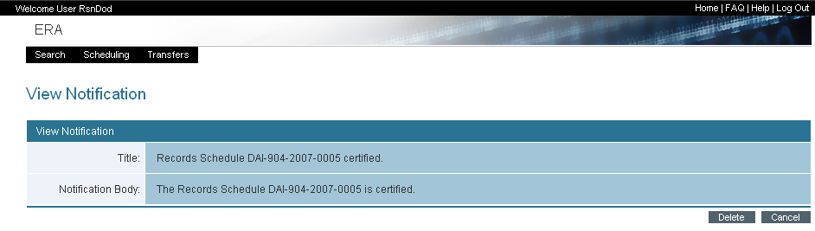
View Notification
Notes:
ERA provides users with notifications that do not require action on the user’s part. Rather, these notifications keep the user informed about business processes in which they have been involved.
Notifications are accessed by selecting items in the Notices portlet.
In the next lesson, we’ve move from navigating ERA in general to searching for assets within ERA

Slide 47
Lesson 4: Search ERA

Slide 48
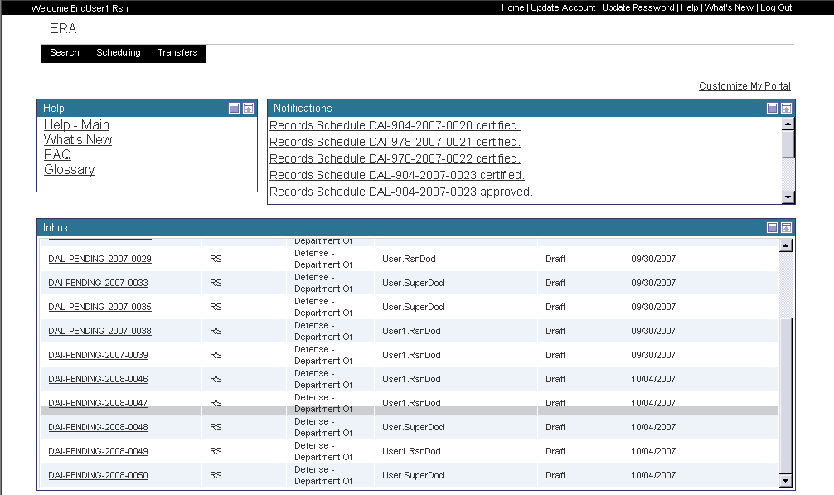
Begin A Search
Notes:
“Search” allows users to locate assets within the ERA system based upon the contents of one or more fields. It provides great flexibility to the user.

Slide 49
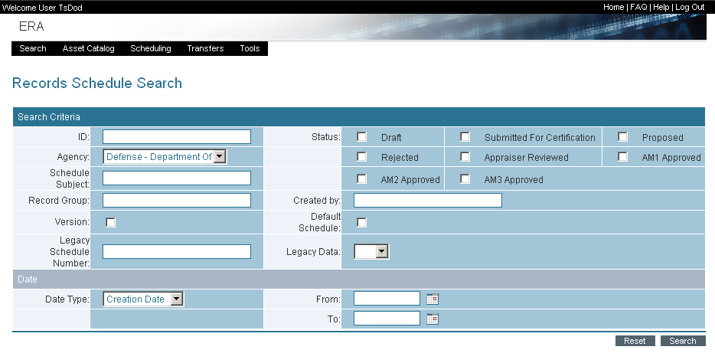
Search – Records Schedule
Notes:
This is the screen that one can use to search for a records schedule. We will discuss it is more depth as part of the module on records retention scheduling
At this point it is important to note that we can search on one or more of the fields displayed.
Clicking “search” executes the activity.
“Reset” clears the information we’ve entered into the fields

Slide 50
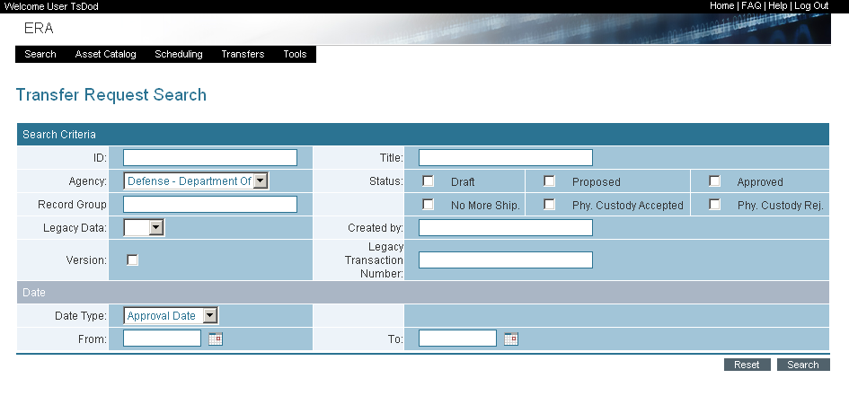
Search – Transfer Request
Notes:
This is the screen for searching Transfer Requests. We also will discuss it in detail in a subsequent module

Slide 51
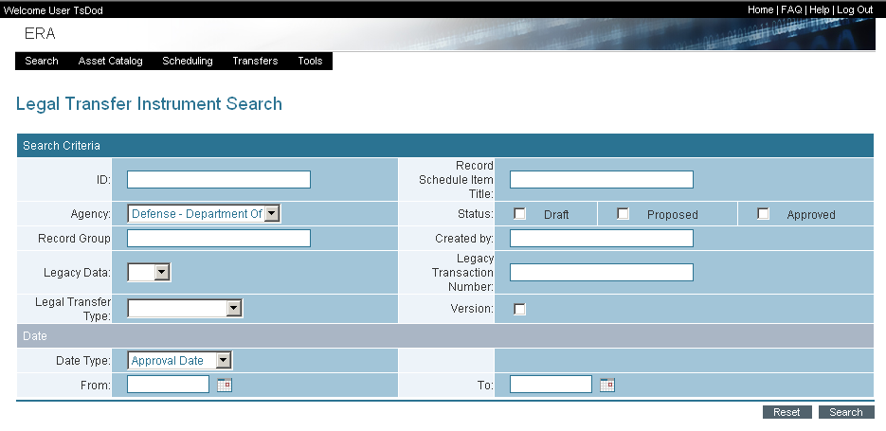
Search – Legal Transfer Instrument
Notes:
Finally, this is the screen for a search of Legal Transfer Instruments

Slide 52
Lesson 5: ERA Accounts & Help Desk

Slide 53

ERA User Accounts
After Training…
  Receive ERA Training “Certificate of Completion”
  2. Read and sign “ERA Account Rules of Behavior” form
  Review instructions and complete “ERA New User Account Request” form
    See back of Student Guide for Account Management forms
    - Consult Supervisor or DAR for ERA system role

Slide 54
ERA User Accounts
  4. Submit the following to your DAR:
    Signed User Account Request Form
    Signed Rules of Behavior
    Proof of completed training (certificate)
    Proof of Identification (agency badge)
    See back of Student Guide for list of DARs
  In 3-5 days ERA Help Desk will contact you with ERA Log-On information
  6. Log Onto ERA:
  - Main ERA URL: https://www.era.nara.gov
  - Transferring Entities, the URL for Ingest: https://ingest.era.nara.gov
  For more information about the ERA Account Management Process or for a copy of the “ERA Account Management Document” please contact your Designated Account Representative (DAR).

Slide 55

ERA Help Desk
For Technical or Archival Questions or Comments about ERA….
Help Desk Phone Number:
  1-877-ERA-9594 or (1-877-372-9594)
Email address: ERAHelp@nara.gov
Hours of Operation:
  6 am to 8 pm, Monday thru Friday (EST)

Slide 56
Conclusion
At the conclusion of this session, you understand how to:
  Log onto ERA
  Navigate ERA
  Manage workbenches
  Search ERA
  Create an ERA Account
  Contact the Help Desk
Notes:
With this general information about navigating ERA, we now are ready to turn to training modules dealing with specific NARA business processes

