Slide 1
Federal Enterprise Architecture Program Management Office
Draft Performance Reference Model:
Overview for
Federal Agencies
April 2003

Slide 2
The President has clearly challenged OMB and agencies to improve performance for citizens.
“This Administration’s goal is to champion citizen-centered electronic government that will result in a major improvement in the federal government’s value to the citizen.” ~ The President’s Management Agenda
“Our success depends on agencies working as a team across traditional boundaries to serve the American people, focusing on citizens rather than individual agency needs.” ~ President George W. Bush
Meeting this challenge will require OMB and agencies to improve performance while reducing costs

Slide 3
The Federal Enterprise Architecture is helping OMB and agencies transform to meet the President’s challenge.
“The FEA is a powerful tool for identifying both key gaps and redundant efforts and can be used to determine the most effective investment in IT.” ~ Budget of the United States Government, FY 2004
Without the FEA | With the FEA
“Stove-piped” agency operations and budget allocation decisions (e.g. 50 agencies with federal drug control operations) | Collaboration where possible visibility into agency operations for ALL agencies and budget examiners
Disparate, less than ideal performance information to make decisions (e.g. half of PART programs evaluated could not demonstrate results) | Standardized performance data to facilitate more objective, fact-based management
Potentially redundant IT spending (e.g. $250 million on financial management systems) | Agencies and budget examiners can leverage existing IT capabilities before spending new money

Slide 4

AGENDA
Session Objectives
Performance Reference Model (PRM) Overview
  Why is a PRM Necessary?
  What are the FEA and PRM?
  How Will the PRM be Used and by Whom?
  How Does the PRM Help Other Management Efforts?
What Happens Next with the PRM?

Slide 5
The FEA-PMO has three objectives for today’s PRM overview session for agencies.
Describe the draft PRM
Answer key questions about the draft PRM
Begin the agency comment period on the draft PRM

Slide 6
AGENDA
Session Objectives
Performance Reference Model (PRM) Overview
  Why is a PRM Necessary?
  What are the FEA and PRM?
  How Will the PRM be Used and by Whom?
  How Does the PRM Help Other Management Efforts?
What Happens Next with the PRM?

Slide 7
The Federal Enterprise Architecture (FEA) Performance Reference Model (PRM)
“At-A-Glance.”
WHAT IS THE PRM? | A standardized performance measurement framework designed to: Enhance available performance information, Better align inputs with outcomes, and Identify improvement opportunities across organizational boundaries.
 | Agencies can use the PRM to select standard performance indicators—which may be new or coincide with those already in use—which can be tailored or “operationalized” to the specific environment.
 | The PRM is a flexible resource for agencies to use as they build from their existing performance measurements.
HOW WILL THE PRM BE USED? | The PRM can be integrated into the existing federal budget process, including the Exhibit 300 as required by OMB Circular A-11.
 | The PRM can mutually reinforce and work together with GPRA and current PMA Budget and Performance Integration initiatives such as the PART and Common Measures.
WHAT IS THE PRM’s STATUS? | A PRM Working Draft is being released for agency comment. The FEA-PMO will address agency’s comments and change the draft PRM as needed. A PRM Version 1.0 will be released to use in FY 2005 budget formulation.

Slide 8
The PRM is a resource that can help agencies meet many of the existing legislative and policy requirements for performance.
Existing Requirement |  | PRM
E-Government Act of 2002 | Collaborative performance measures | 
Clinger-Cohen Act of 1996 | Make IT investments based on contribution to program performance | 
Government Performance and Results Act of 1993 | Plan and report progress towards outputs and outcomes | 
Chief Financial Officers Act of 1990 and other related Acts | Provide timely, reliable, useful, and consistent financial information for decision-making | 
President’s Management Agenda | Integrate planning and managing for performance into budget justification and execution. Improve performance through technology. | 

Slide 9
The PRM is consistent with and can help agencies make progress on many of the key performance initiatives that need improvements.
Initiative | How PRM Can Help
Government Performance and Results Act implementation | The PRM framework can help improve and further relate outcome and output measures in Strategic and Annual Plans and Reports. Performance by function will facilitate producing the required government-wide Performance Plan.
PMA / Budget and Performance Integration | The PRM framework can help to refine the relationship between outcomes, outputs and the processes or strategies used to produce them, and the inputs or resources used. This creates more robust information to use in budget decisions.
Program Assessment Rating Tool (PART) | Progress towards PRM indicators can provide enhanced information to include in PART evaluations. PART evaluations can guide the improvement targets set using the PRM—particularly in lower-scoring PART programs.
Common Measures | If common measures have already been identified through other initiatives like the Common Measures they can be used directly by the PRM.
IT Business Cases (Exhibit 300) | The PRM can be used to identify performance indicators that show specifically how a technology investment contributes to business outputs and, ultimately, outcomes.

Slide 10
AGENDA
Session Objectives
Performance Reference Model (PRM) Overview
  Why is a PRM Necessary?
  What are the FEA and PRM?
  How Will the PRM be Used and by Whom?
  How Does the PRM Help Other Management Efforts?
What Happens Next with the PRM?

Slide 11
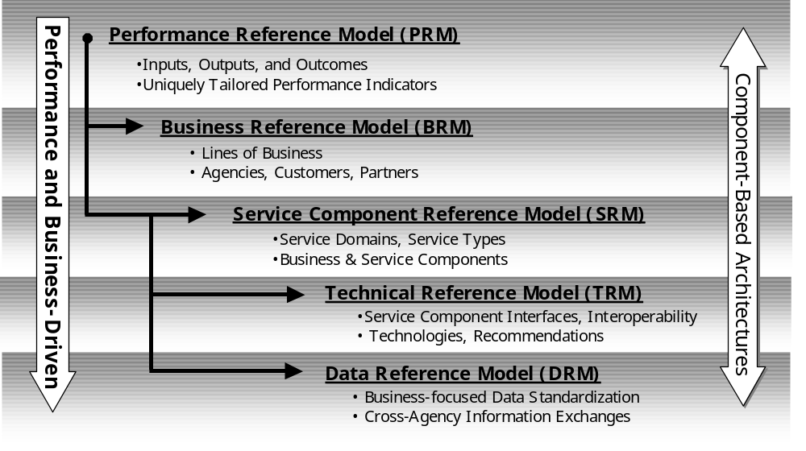
The PRM is one of five FEA “reference models” designed to improve performance, increase collaboration, and reduce costs.
Federal Enterprise Architecture (FEA)
Notes:
READ THROUGH THIS SLIDE AND USE WHITE BOARD TO DISCUSS THE THREE LEVEL FRA
WE HAVE PROPOSED SOME CHANGES TO THE ORIGINAL BUSINESS ARCHITECTURE . . . (next slide)

Slide 12
The PRM is a standardized framework to characterize the performance of IT initiatives in a common manner where appropriate.
The PRM can help produce enhanced performance information to improve strategic and daily decision-making
The PRM can help improve the alignment and contribution of inputs (people, technology, other fixed assets) through outputs (processes and activities) to outcomes (business and customer results)
The PRM can help identify collaboration and performance improvement opportunities across traditional agency boundaries
Notes:
READ THROUGH THIS SLIDE AND USE WHITE BOARD TO DISCUSS THE THREE LEVEL FRA
WE HAVE PROPOSED SOME CHANGES TO THE ORIGINAL BUSINESS ARCHITECTURE . . . (next slide)

Slide 13
The FEA-PMO is seeking the best from existing performance frameworks to create the draft PRM.
The FEA-PMO examined numerous existing frameworks and other sources, including:
  Balanced Scorecard
  Baldrige Quality Criteria
  Program Logic Models
  The Value Chain
  Theory of Constraints
  Value Measurement Methodology
  Six Sigma
The FEA-PMO also examined what types of measures agencies are currently using
  GPRA Strategic and Annual Plans
  PART Assessments
  Exhibit 300s
Notes:
READ THROUGH THIS SLIDE AND USE WHITE BOARD TO DISCUSS THE THREE LEVEL FRA
WE HAVE PROPOSED SOME CHANGES TO THE ORIGINAL BUSINESS ARCHITECTURE . . . (next slide)

Slide 14
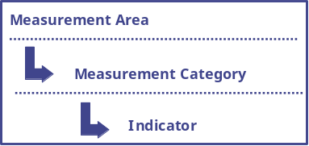
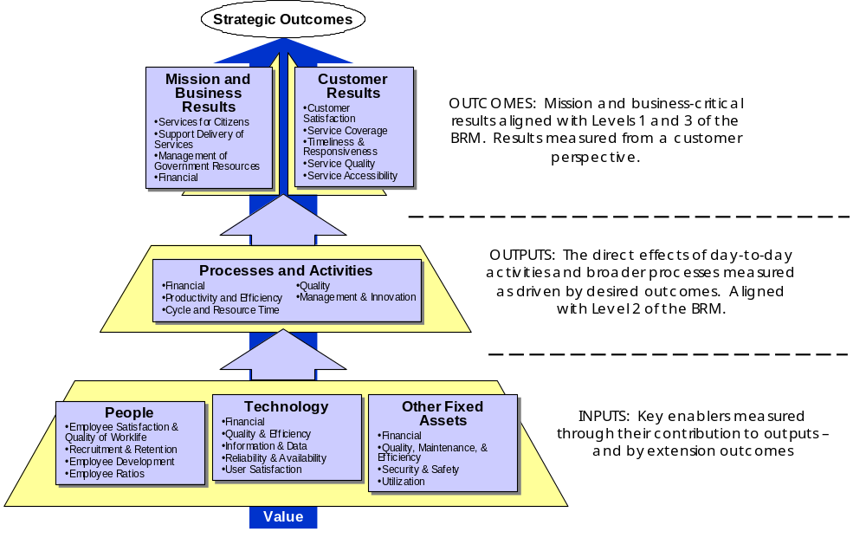
The PRM’s six Measurement Areas are designed to capture the relationship between inputs, outputs, and outcomes. Each Measurement Area contains Measurement Categories.
Notes:
READ THROUGH THIS SLIDE AND USE WHITE BOARD TO DISCUSS THE THREE LEVEL FRA
WE HAVE PROPOSED SOME CHANGES TO THE ORIGINAL BUSINESS ARCHITECTURE . . . (next slide)

Slide 15
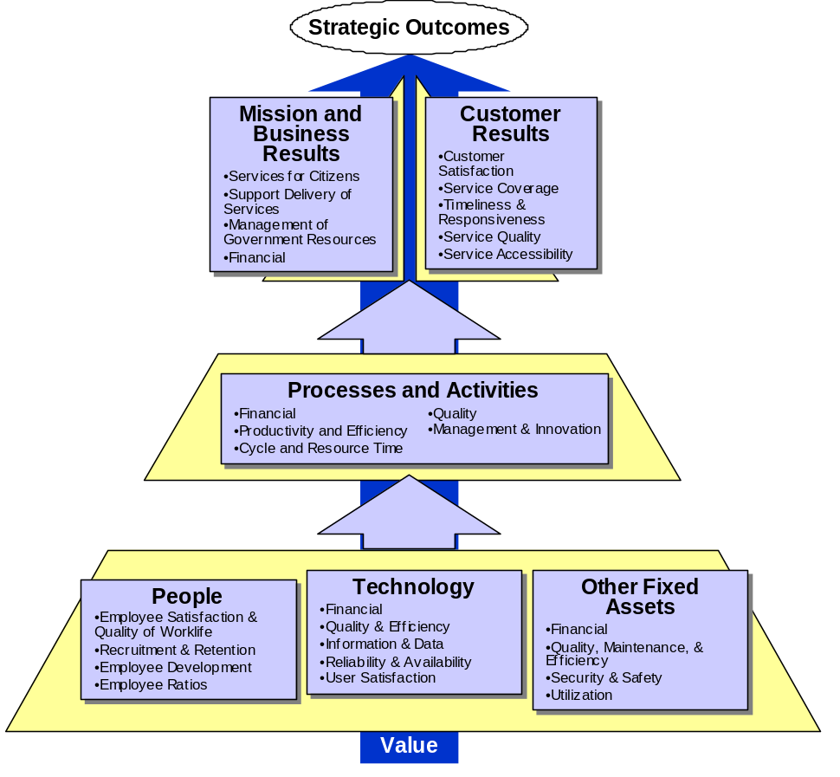
Each PRM Measurement Category contains specific Indicators that can be selected as appropriate for BRM Sub-functions, programs, and/or IT initiatives.
Productivity & Efficiency
Total # of products produced, activities performed, or services provided per relevant unit of time
# of products produced, activities performed, or services provided per FTE
% of resources used versus resources available for use
# and/or % of products or services that are electronic
Notes:
READ THROUGH THIS SLIDE AND USE WHITE BOARD TO DISCUSS THE THREE LEVEL FRA
WE HAVE PROPOSED SOME CHANGES TO THE ORIGINAL BUSINESS ARCHITECTURE . . . (next slide)

Slide 16
Decision-makers then uniquely tailor or “operationalize” these Indicators to reflect the specific environment, such as the Border Security Sub-function in the BRM.
Productivity & Efficiency
BRM Sub-function: Border Security
Total # of products produced, activities performed, or services provided per relevant unit of time
# of products produced, activities performed, or services provided per FTE
% of resources used versus resources available for use
# and/or % of products or services that are electronic
Total # of vehicle searches per month
Notes:
READ THROUGH THIS SLIDE AND USE WHITE BOARD TO DISCUSS THE THREE LEVEL FRA
WE HAVE PROPOSED SOME CHANGES TO THE ORIGINAL BUSINESS ARCHITECTURE . . . (next slide)

Slide 17
AGENDA
Session Objectives
Performance Reference Model (PRM) Overview
  Why is a PRM Necessary?
  What are the FEA and PRM?
  How Will the PRM be Used and by Whom?
  How Does the PRM Help Other Management Efforts?
What Happens Next with the PRM?

Slide 18
The process to use the PRM is as important as the PRM itself. The FEA-PMO is suggesting a process that can be integrated into the existing performance and budget processes.
Step | Description
Determine Line of Sight to Results | Agencies can use the concepts of logic models and the value chain to identify the critical cause and effect relationships between IT and process outputs, then to customer and mission or business outcomes.
Identify and Define PRM Indicators | Informed by the “line of sight,” agencies can use the PRM to identify the critical few indicators. These indicators will be tailored or “operationalized” to suit the specific IT initiative and its environment.
Conduct Baseline Analysis | Within the context of the PRM Indicators chosen, agencies can conduct a baseline analysis of current performance, constraints, and capabilities.
Set Improvement Targets | Considering the baseline and through benchmarking high-performers in the government and private sectors, agencies set improvement targets.
Explore Improvements | Possible strategies to achieve improvements targets will be identified, such as coordinating, creating or canceling processes or technology; sharing information and data; or retraining and recruiting people.
Select and Propose Improvements | The scope and strategy of the improvement will be discussed through existing budget documents, including the Exhibit 300 required by A-11.
Implement Improvements; Collect Data; and Use Performance Information in Decisions | Making improvements then tracking progress towards PRM Indicators to determine whether improvements are actually occurring. This performance information should then be a critical aspect of daily and strategic decision-making.

Slide 19
The initial steps in this process will be of critical importance for agencies as they prepare to submit their FY 2005 budgets to OMB.
For FY 2005, agencies will identify PRM Indicators for their major IT initiatives in the Exhibit 300 performance goals table
More information on this suggested process will be available in the very near future
  OMB A-11 training
  PRM Version 1.0 release document

Slide 20
Consistent with Chapter 22 of the President’s FY 2004 Budget, the PRM can be applied to any major IT initiative. The level of PRM collaboration would correspond to each category as necessary.
Category of IT Initiative | Example | Level of PRM Collaboration
One agency has the lead and the initiative can be implemented through the normal, agency-specific budget process | IRS Free File | Low
More than one-agency is involved and the initiative may require joint ownership and funding | Initiatives that align with Border Security | Medium
Initiatives are common to all agencies or rise to a level of major policy significance and require PMC action to be successful | Initiatives that align with Human Resources Training and Development | High

Slide 21
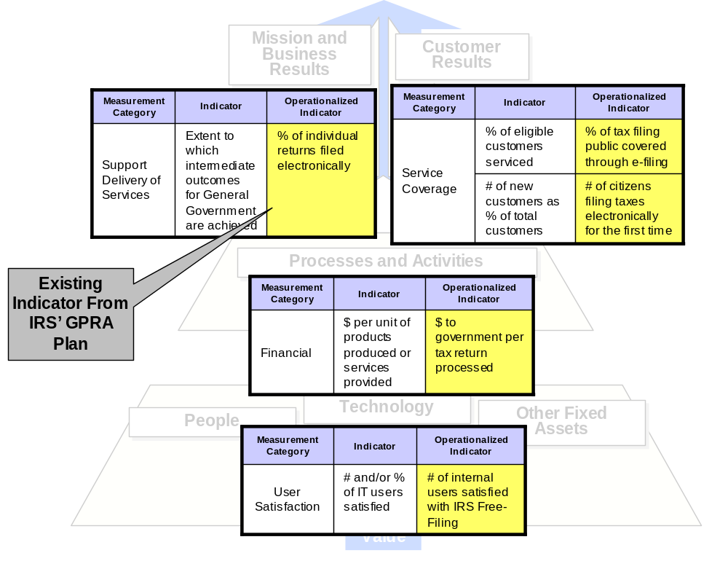
When one agency has the lead such as with the IRS Free File initiative, the PRM can be used to identify performance indicators from outcomes to inputs.

Slide 22
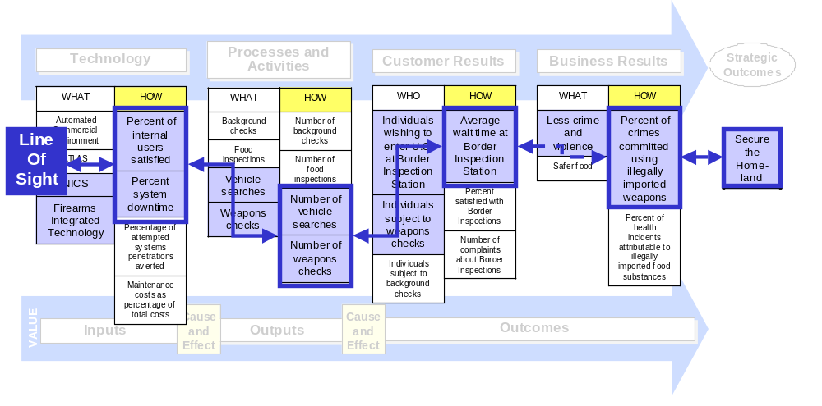
When more than one agency is involved, such as with Border Security, the PRM also can help identify indicators from outcomes to inputs.

Slide 23
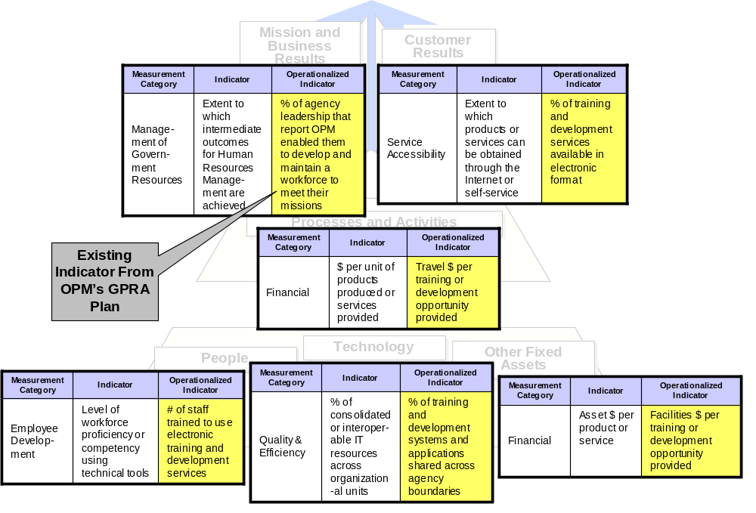
For government-wide initiatives, such as the Resource Development and Training Sub-function of Human Resources, the PRM also can help identify inputs, outputs, and outcomes.

Slide 24

Over time, progress towards PRM indicators can provide a “performance dashboard” to inform managerial and budget decisions.
Strategic Outcome(s)
SECURE THE HOMELAND
Illustrative Example
Baseline Target
Actual
Mission and Business Results
# of crimes committed using illegally imported weapons
XX XX
XX
More thorough inspections may be necessary ...
Customer Results
Average wait-time at Border Inspection station
XX XX
XX
… but not so thorough to increase wait-time and reduce customer satisfaction
Processes and Activities
# of vehicle searched performed per month
XX XX
XX
People
% of total border inspector positions unfilled
XX XX
XX
Technology
% downtime for Firearms Integrated Technology
XX XX
XX
Technology improvements could be explored and may allow more thorough inspections
Other Fixed Assets
# of Border Inspection lanes available
XX XX
XX

Slide 25
Throughout all aspects, the PRM can help OMB, CIOs, CFOs, and Program or IT Project Managers in a variety of ways.
 | Enhanced Performance Information | Alignment and Clear “Line of Sight” | Identify Improvement Opportunities Across Boundaries
OMB | Additional information to include in budget decision-making activities | More detailed information about how IT will contribute to outcomes | Standardized information for programs and IT initiatives with common or similar missions
CIOs | Additional information to use in IT Capital Planning and Investment Control activities | More clarity about what IT initiatives to select and how they will/are contributing to results | Standardized information to help identify collaboration opportunities within and outside the agency
CFOs | Additional information to use in GPRA and budget activities | Better articulation through GPRA of how budgetary resources and inputs contribute to outcomes | Standardized information to identify potential cost savings and performance improvements
Program / IT Project Managers | Additional information to manage initiatives and demonstrate contribution to outcomes | Stronger justification of proposed initiatives and articulation of how initiatives contribute to outcomes | Standardized information to identify similar programs or IT for “best practice” consultation or other collaboration

Slide 26
AGENDA
Session Objectives
Performance Reference Model (PRM) Overview
  Why is a PRM Necessary?
  What are the FEA and PRM?
  How Will the PRM be Used and by Whom?
  How Does the PRM Help Other Management Efforts?
What Happens Next with the PRM?

Slide 27
Consistent with existing processes, the PRM can help agencies better manage their IT initiatives.
Using the PRM will provide more robust performance information for agencies to use throughout their IT CPIC processes
  Pre-Select / Select - Better understanding of how IT may contribute to improved program performance
  Control – More robust information about progress towards intended outputs and outcomes to inform decision-making
  Evaluate – More structured framework to assess whether IT initiative provided its intended benefits
The PRM can also be a path forward to help agencies better align their EAs with performance
  Align business layer with key outputs and outcomes
  Align key technology initiatives with business layer, and by extension, outputs and outcomes

Slide 28
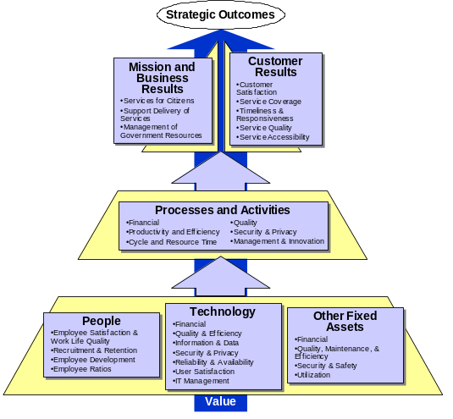
The PRM can support the President’s Budget and Performance Integration initiative, which is taking two approaches to strengthen the link between budget dollars and results.
Budget and Performance Integration Approach #1 | How the PRM Can Help
WHAT: Creating additional performance information to inform budget decisions | Creates additional performance information at the outcome, output, and input levels to use in budget decisions
HOW: Program Assessment Rating Tool (PART), which rated 50% of the programs assessed as “Results Not Demonstrated”
Budget and Performance Integration Approach #2 | How the PRM Can Help
WHAT: Linking performance and cost in the federal budget | Draws “line of sight” from inputs to outputs, then outcomes
HOW: Developing a performance budget format that shows how inputs are used to accomplish outputs and impact outcomes

Slide 29
PRM Indicators can be incorporated into GPRA plans and reports. Outcome-oriented indicators in GPRA can inform those in the PRM. Performance information by function can also support the government-wide performance plan GPRA requires.
STANDARD AND IMPROVED MEASURES
  Outcomes / Intermediate Outcomes
  Outputs
  Inputs
GPRA Requirements
Annual Performance Reports
Annual Performance Plans
Mission
Vision
Goals
Objectives
Results
Strategic Plans
Mission
Vision
Goals
Objectives
Measures
Mission
Vision
Goals
Objectives
Measures

Slide 30
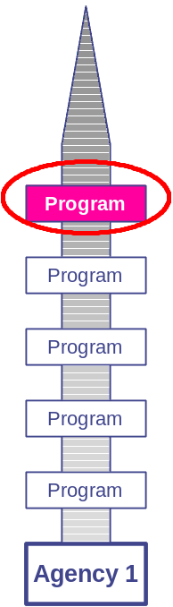
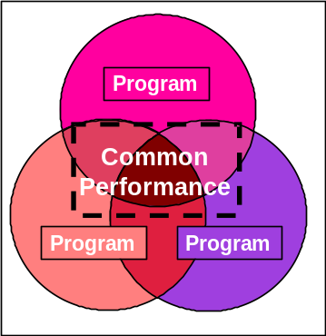
The results of PART evaluations can dictate the specific PRM indicators and targets agencies use to drive improvements.
The PRM can be applied to help improve the management capabilities and performance of lower-scoring PART programs with similar missions
Program
Assessment Rating
Tool
(PART)
Program Purpose & Design
Strategic Planning
Program Management
Program Results

Slide 31
Defining standard and improved indicators using the PRM can also provide enhanced performance information to use during PART evaluations.
PART evaluations can be complemented with more readily available, standardized, and improved performance measurement information
  50 % of FY 2004 PART assessments “Results Not Demonstrated”
Specific PART questions that can be informed include:
PART Section / Question | The PRM Will Provide Enhanced Information About …
II: Strategic Planning, Question 4: Does the program collaborate and coordinate effectively with related programs that share similar goals and objectives? | The extent to which similar programs choose common PRM indicators
IV: Program Results, Question 1: Has the program demonstrated adequate progress in achieving its long-term outcome goal(s)? | Whether the program meets the performance targets chosen in the outcome portion of the PRM
IV: Program Results, Question 4: Does the performance of this program compare favorably to other programs with similar purpose and goals? | The extent to which the program meets its performance targets compared to similar programs

Slide 32
OMB Circular A-11, specifically Section 300, provides the mechanism to integrate the PRM into the existing management and budgetary process for IT.
The FEA-PMO is currently working within OMB to update the Exhibit 300 to accommodate the PRM
Detailed information will be provided to agencies about this at OMB’s A-11 training to be held in early May

Slide 33
AGENDA
Session Objectives
Performance Reference Model (PRM) Overview
  Why is a PRM Necessary?
  What are the FEA and PRM?
  How Will the PRM be Used and by Whom?
  How Does the PRM Help Other Management Efforts?
What Happens Next with the PRM?

Slide 34
In closing, the FEA-PMO looks forward to agencies’ comments on the draft Performance Reference Model.
We would like agencies to provide comments on the PRM Working Draft
A PRM Comment Form is also being provided
The Working Draft and Comment Form will be e-mailed to CIOs
One Comment Form per agency should be e-mailed to:
  support@feapmo.gov
  No later than Monday, May 19, 2002
Please e-mail or call if there are any questions during this comment period
Contact: Bob Haycock, FEA Program Manager, at Robert_D._Haycock@omb.eop.gov

