Slide 1
Enumeration of Near-Optimal Solutions for Peptide Docking Problems
William Hart
Sandia National Laboratories
wehart@sandia.gov
Bob Carr (SNL)
Harvey Greenberg (CU Denver)
Matthew Hart (Grand Valley State)
Richard Forrester (Dickson College)
Diana Roe (SNL)

Slide 2
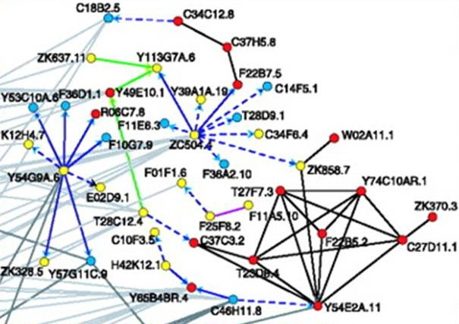
Motivation
Protein-protein interactions are essential to virtually all cellular processes
  Proteins are macro-molecules composed of a linear chain of amino acid residues
  Proteins folds into well-defined 3D structures that determine their role in cellular processes
Protein-protein interactions provide insight into protein function

Slide 3
Overview
Goal: provide computational tools to predict protein-protein interactions
Impact:
  Computational analyses can limit the number of laboratory experiments needed
  Computational analysis can focus the scope of laboratory experiments
Note: we consider computational techniques that are motivated by phage-display experimental techniques

Slide 4
Overview cont’d
Three problems with a single mathematical representation:
Predict the structure of a peptide
Predict the best structure of a peptide allowing for a set of possible amino acids for each sidechain
Predict the best amino acids for the sidechains in a peptide

Slide 5
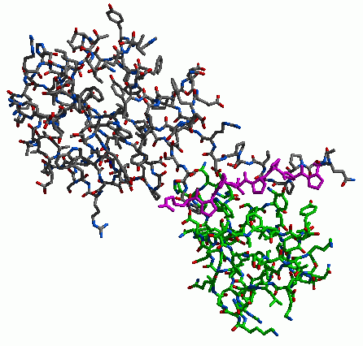
Protein-Peptide Docking
Idea: study protein-protein interactions through protein-peptide docking
Many protein-protein interactions are
mediated by modular domains
  PDZ, SH3, SH2, WW, PTB, FHA
These domains often bind to a linear
stretch of the binding partner
Impact: Peptide libraries can identify binding
sequences that can be used to search
the genome for binding partners
Complex of the SH3 domain from tyrosine protein kinase (green) complexed with P38(grey), with linear portion highlighted (magenta)

Slide 6
Phage-Display
Phage-display libraries: an experimental technique used to probe protein-protein binding interactions
  Libraries are typically of size 4-12 residues in length
  Libraries generate a consensus binding sequence
Questions that can be answered by phage-display experiments:
  What are potential binding partners?
  What are the sequence specificities of these binding interactions?

Slide 7
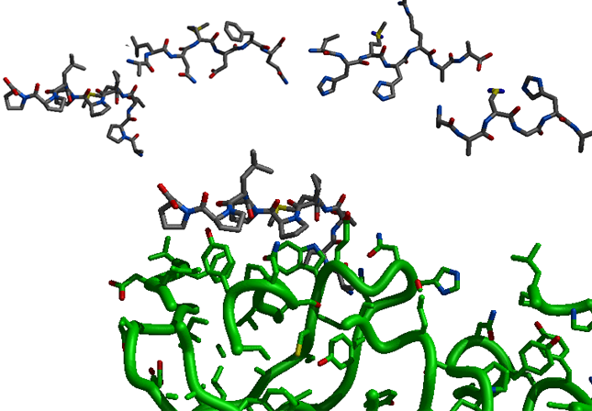
Computational Phage-Display
Idea: predict the peptide sequence that is most likely to bind
  Predict consensus sequences
Impact:
Provide the same type
of information as
experimental methods
Can be used to design a
reduced “focused”
phage-display library
(minimizes experimental costs)

Slide 8
Our Approach
Assumptions:
Side-chain structures can be well-captured by rotamer libraries
  Rotamer libraries taken from trusted data sources (e.g. PDB)
  Discretize the structure prediction
2. The peptide backbone is well-constrained
  We assume that it’s fixed
  If there is flexibility, then we could consider a (small) set of alternative backbone conformations
Objective:
  Design the peptide that is most likely to bind
  Design a peptide library containing the best peptides

Slide 9
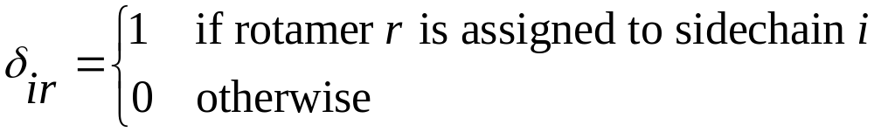
Peptide Structure Prediction
Goal: structure prediction for a given peptide
Decision variables:
Peptide-Protein Energy
  Amber scoring function
  Generalized Born continuum solvation calculation
A peptide structure is defined by a set of rotamer choices

Slide 10
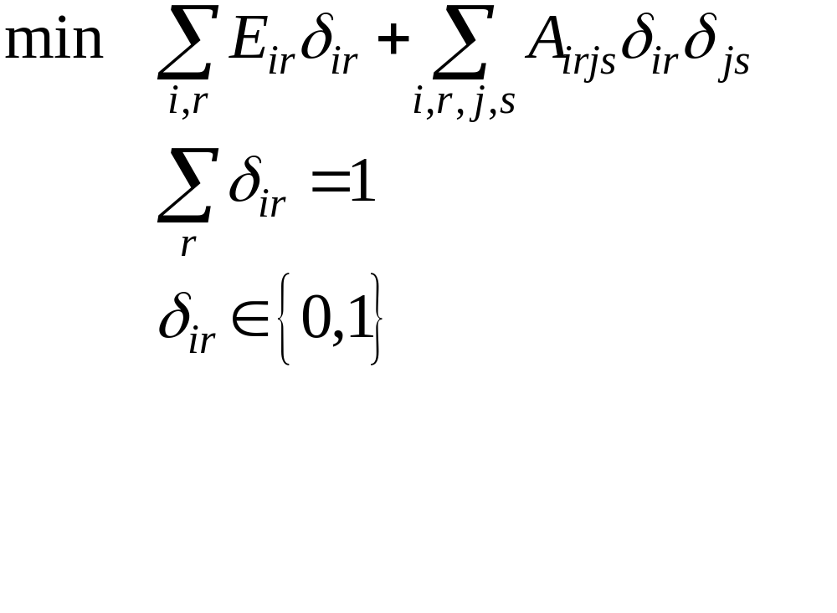
An IQP Model
Note: many of the energies are negative, so this IQP is not convex

Slide 11
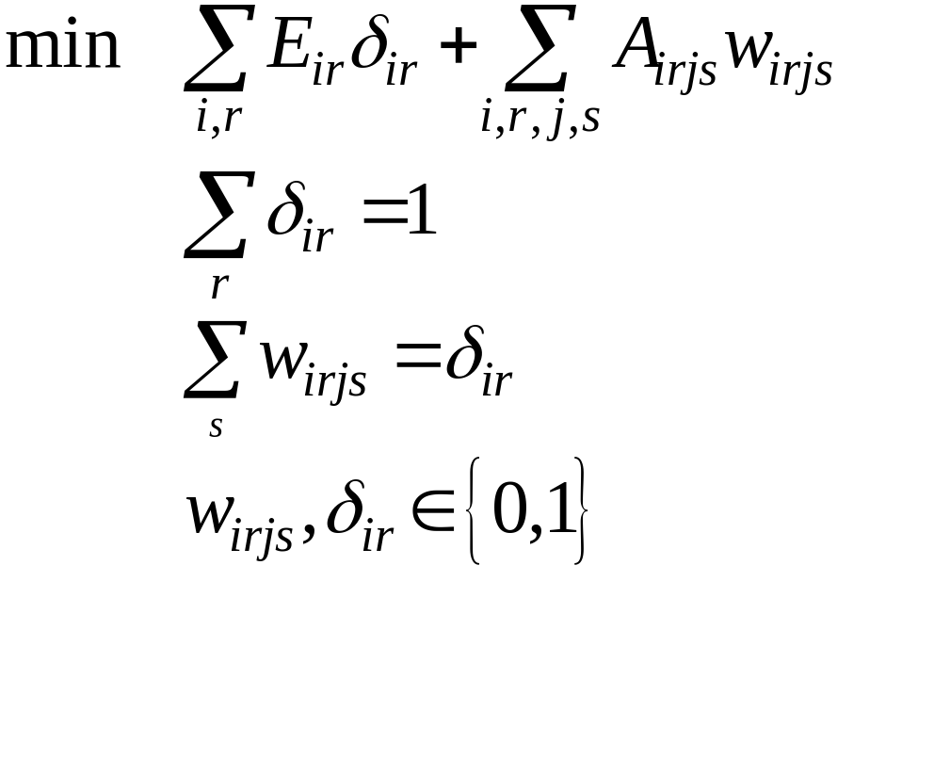
An ILP Formulation
Note: this model can be refined to exploit data sparsity
Note: similar models have been derived by several other authors…

Slide 12
Integer Programming Solvers
Solve linear IPs with branch-and-bound
  Branch to fix variables in subproblems
Solvers
  Commercial: CPLEX, OSL, XPRESS
  Research: BoB, ALPS, PICO
Performance:
  The ILP is small because peptides are typically short
  Can solve these ILPs within minutes at worst!

Slide 13
Computational Phage-Display
Method:
  Generate a bunch of (random) peptides
  Apply peptide structure prediction
  Rank peptides whose bindings were well-predicted
Note:
  This process is inherently parallelizable
  Can generate a consensus prediction of binding affinity from the top binding peptides
    Consensus amino acid sequence
    Consensus matrix of amino acid frequency at each position

Slide 14
Designing Phage-Display Experiments
Note: to make robust computational predictions we need to consider a very wide range of peptide sequences
Challenge: characterize the space of interesting peptides
Impact: limit the cost of computational and experimental phage display experiments!
We consider two approaches based on enumeration of near-optimal solutions

Slide 15
Combinatorial Formulation 1
Idea: combine rotamer libraries for different amino acids
Decision variables:
Note: this problem has the same mathematical formulation as peptide structure prediction!
  A peptide structure is defined by a set of rotamer choices
  This implicitly selects the amino acid sequence!
Goal: enumerate near-optimal solutions and compute consensus information

Slide 16
Solution Techniques
Iterated Application of Standard IP solvers
  Add constraints to eliminate previously seen solutions
  Resolve augmented IP
  Very slow… (but maybe we could speed it up?)
Combinatorial enumeration
  Maintain pool of near-optimal solutions
  Purge pool when improving incumbents are found
  Prune subproblems that are provably not within the enumeration tolerance(s)
  Combinatorial or IP-based bounds

Slide 17
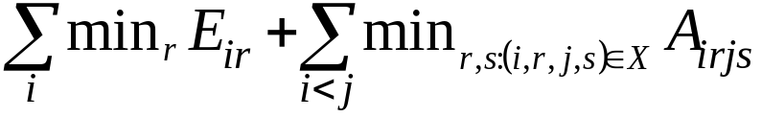
Branch-and-Bound
Idea: apply methods develop for side chain prediction (Canutescu et al. ’03)
  Branch on variable with the fewest rotamers
  Sort rotamers by energies E_{ir}
  Simple bound:
  Pseudo-cost gradients computed to bias branching decisions
Incumbent Generation:
  Sort rotamers with the “rotamer weight”
  Perform local minimization starting with the minimal weight rotamer for each amino acid

Slide 18
Empirical Results
Implementation with PEBBL:
  A modular C++ library for branch-and-bound (Rutgers/Sandia)
  Supports scalable parallelization
  Extended to enable enumeration of all near-optimal solutions
Computational Experience
  Very large problems: 4M+ variables and constraints
  Solving for the single best point is computationally difficult
  Enumerating “enough” near-optimal solutions does not appear tractable

Slide 19
Combinatorial Formulation 2
Idea: focus on peptide design alone
Method:
  Assign amino acids energies based on a Boltzman-weighted average of their corresponding rotamers
  The decision variables are now simply the choice of amino acid at each position
  The solver methodology has not changed!
Observations:
  Boltzman-weighted statistics are well-motivated because the peptide-protein interactions are dominant
  This formulation should find more “robust” peptide sequences

Slide 20
Empirical Results
Peptide Design
  The best design can be quickly found (within a second)
  Near-optimal solutions are easy to find
    Peptide-Protein interactions are the dominant energies
  The top 1000 solutions can be generated within a few seconds

Slide 21
Using Consensus Information
Limit the scope of phage-display experiments
  Only include amino acids at sites where they appear in near optimal solutions
Identify peptide docking candidates
  Use a consensus matrix to score peptide sequences with an expected frequency
  Can be use to scan the genome for binding partners
  A similar approach has been taken using Boltzman energies to predict binding affinities
  We expect that consensus information will prove more stable and predictive

Slide 22
Future Work
Compare/contrast IP-based enumeration with combinatorial enumeration
  The PEBBL library is the core B&B engine for PICO
  PEBBL supports enumeration, and PICO’s cutting mechanism has been augmented to support IP-based enumeration
  Goal: evaluate the impact of strong bounds
  Goal: evaluate IP formulations of Forrester and Greenberg for enumeration
Design of synthetic organic compounds
  Idea: use a fixed organic skeleton that includes a finite number of peptides
  Goals:
    Design rotamer library (natural and synthetic peptides)
    Predict optimal structures

Slide 23
The End
Thanks!

