Slide 1

Specialty Tracks, COP and Promotions
Overhead Handout
30 minutes
Instructor: See Notes View of this Overhead.
U.S. AIR FORCE
AUXILIARY
Notes:
AFIADL did not make these overheads. This class is to encourage students to progress through Level II and finish AFIADL-13. Section A tells how the slides are used. Most of the class is in sections B, C, D, and E and corresponds to the 4 AFIADL-13 volumes. Section F tells about other Level II requirements.
DO NOT COMPROMISE AFIADL-13 COURSE EXAM ITEMS IN YOUR BRIEFING. If you remember a question from the Course Exam, do not repeat it or paraphrase it. Teachers and students should not have access to the Course Exam any time during this class. To guard against inadvertent compromise, overhead material comes from CAP publications and AFIADL-13 equivalent courses.
Your job is to make the information clear and meaningful. We suggest:
Allow 10 hours for this course. This includes 10 minute breaks every hour and half hour for lunch. We recommend students bring their own lunch and beverages.
Use the overheads as your briefing notes. Avoid adding or deleting any material. Stick to the overheads 95 percent of the time.
Because students will use much time marking their volumes as they follow the overheads, minimize this time loss by limiting the class size to 10.
You may present alone or with a team. Have briefers arrive 30 minutes early, and stick to the time schedule.

Slide 2
Main Points
Part 1 (2 Lt to 1 Lt)
  12 months duty performance as 2 Lt
  Complete technician specialty rating
  Complete CAPF 2
Part 2 (1 Lt to Capt)
  18 months duty performance as 1 Lt
  Certificate of Proficiency
    Squadron Leadership School
    AFIADL-13 or Equivalent
    AEPSM (optional)
  Complete CAPF 2

Slide 3
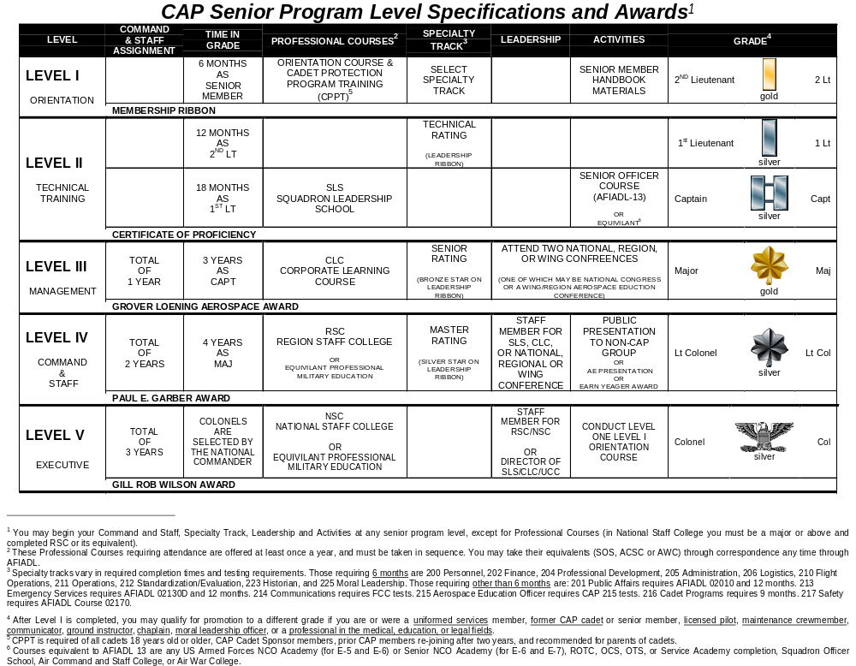

Slide 4
Specialty Tracks: Different Times
Safety AFIADL 02170
Communications FCC tests
Emergency Services AFIADL 0213D + 12 months
Cadet Program 9 months
Moral Leadership 6 months chaplain supervision
Public Relations AFIADL 02010 + 12 months
Aerospace Education CAPP 215 test
all others 6 months
Inspector, Plans & Programs, Legal, Chaplain, Health Services, and Commander have other requirements

Slide 5
Part 1
Specialty Tracks: How to Enroll
Complete Level I
  Orientation to CAP Course
  CPPT
Select specialty track based on
  unit needs
  staff assignment being authorized
  your needs, talents, and time available

Slide 6
Part 1
Specialty Tracks: How to Enroll
Annotate Professional Development Report in red
  check that your commander, admin, personnel or Professional Development Officer do this and send it to NHQ CAP
  specialty track name
  NONE for month and year until tech level completed

Slide 7
Part 1
Specialty Tracks: How to Enroll
Enter specialty track and start date in CAPF 45b
Download appropriate specialty track & study guide CAPP 200 series

Slide 8
Part 1
Specialty Tracks: Duty Performance
Duty performance and Time in Grade
  Do what the specialty track tells you to do
  Relate it to any of the three CAP missions
“Other duties as assigned”
  Wearing several “hats” at once, as needed
  Main focus should be on duty assignment and specialty track
  May need to refer to other specialty tracks to find information, occasionally

Slide 9
Part 1
Specialty Tracks: Duty Performance
Relation to Emergency Services Tasks
  Specialty Tracks refer to squadron duties
  Task Lists refer to emergency service duties

Slide 10
Part 1
Specialty Tracks: Paperwork
Update CAPF 45b with completion date
Award of Leadership Ribbon on CAPF 2a
Update PDR with month/year of tech rating to replace NONE (check that your commander, admin, personnel or Professional Development Officer do this and send to NHQ CAP)

Slide 11
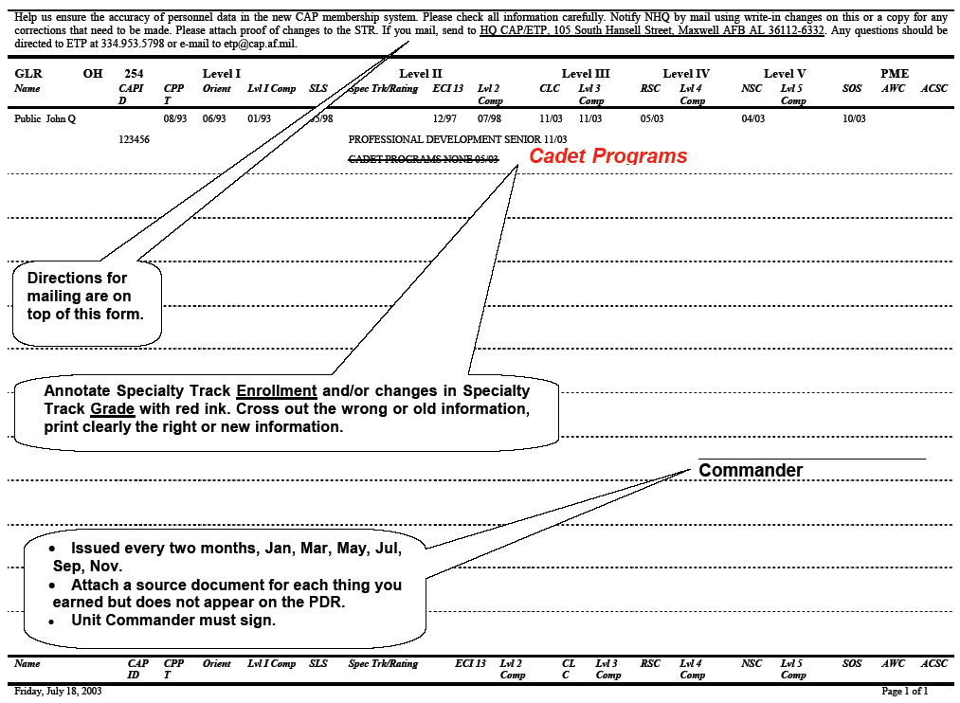
A copy of this is at the Wing web site, Professional Development, PD Report Guide
Professional Development Report

Slide 12
Part 1
Promotion to 1 Lt
Technician level in specialty track
12 months as 2 Lt with satisfactory duty performance (it is not automatic)
Complete CAPF 2
  Writing it in S/TAR format in back of CAPF 2 Section IX, Remarks, for promotion
    meaning
      S/T means Situation/Task that was done
      A means Action taken
      R means Result(s)

Slide 13
Part 1
Promotion to 1 Lt
    example
      (SITUATION/TASK) Lt John Q. Public jumped right in to improve the squadron aerospace education classes by
      (ACTION) beginning the AEPSM, studying Cadet AE books and teaching AE classes.
      (RESULTS) His efforts resulted in the cadets keeping on time with their achievements, their revitalized interest, and increased pass scores on AE Achievement testing.

Slide 14


Transition from Part 1 to Part 2
Part 1 (2 Lt to 1 Lt)
  12 months duty performance as 2 Lt
  Complete technician specialty rating
  Complete CAPF 2
Part 2 (1 Lt to Capt)
  18 months duty performance as 1 Lt
  Certificate of Proficiency
    Squadron Leadership School
    AFIADL-13 or Equivalent
    AEPSM (optional)
  Complete CAPF 2

Slide 15
Part 2
  Squadron Leadership School
may be done before or after 1 Lt
What it does
  Enhance performance at squadron level
  increase understanding of basic functions of a squadron and how to improve squadron operations
How to qualify
    CPPT and Orientation to CAP course completion
    enrollment in a specialty track
When to go
  Offered once a year; two days long, check wing website

Slide 16
Part 2
  AFIADL-13
may be done before or after 1 Lt
4-volume Air Force correspondence course
Content
  History, mission, organization of CAP
  Professional knowledge
  Communication
  Leadership skills
Must complete within 12 months of enrollment
May substitute with equivalent
  Each equivalent may be used once and completed within past 20 years of applying for equivalency.

Slide 17
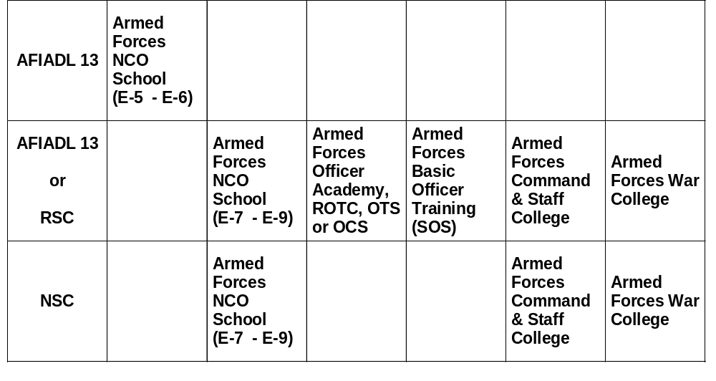

Slide 18
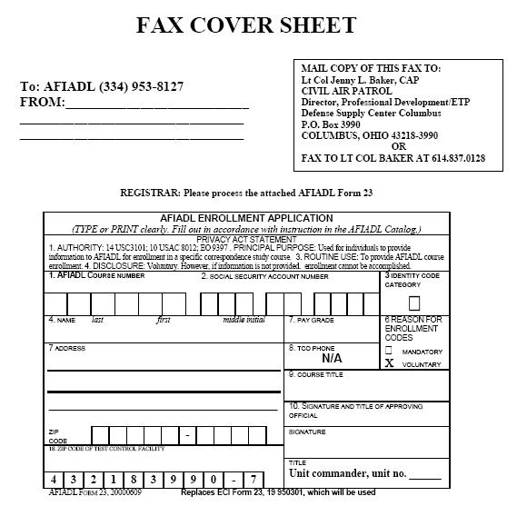
If you have an equivalent: contact the registrar NHQ CAP.
If you do not have an equivalent: enroll with AFIADL using the AFIADLF 23, to the right. Keep Wing informed.
After you pass the course AFIADL contacts the registrar NHQ CAP.

Slide 19
Part 2
  AFIADL-13
Study
Survey the material
Read for understanding
Underline or highlight important ideas
Do all Self-Tests
  answers in the volume
  highlight where the answers are
Do all Unit Review Exercises
  answers are with your packet
  highlight areas where the answers are
Write possible test questions and answers

Slide 20
Part 2
  AFIADL-13
Order your Course Exam to get Course Credit
Go to http://afiadl.custhelp.com.
Click on the “Ask a Question/Request” tab.
In the “User ID” text entry box, enter your e-mail address.
In the “Question Data” box enter your full name and LAST FOUR DIGITS of your social security number (it is not a secure website)

Slide 21
Part 2
Enter Request the Course Exam be sent to Test Control Shred Code 432183990-7 for Ohio.
In the “Categories” text entry box select “Civil Air Patrol courses” from the drop-down list.
In the “Course Name/Number” block enter “CAP Senior Officer Course 00013.”

Slide 22
Part 2
In “Branch of Service” block select “Civil Air Patrol” from the drop-down list.
When you complete the form, click “Submit Question.”
AFIADL will e-mail you to confirm your request. The test will be sent to the Wing Test Control Officer who will forward it to your unit through your Group.

Slide 23
Part 2
  AFIADL-13
Schedule your Course Exam
AFIADL sends test to Wing Test Control Officer
  who forwards it to your unit Test Control Officer
  who tells you your test is in
Schedule the test; you are responsible to set this up
  Bring your CAPID and know your social security number
  Be rested and give yourself plenty of time (although the test is not timed, 2 hours for AFIADL-13 should be sufficient)
  Arrive early, use the rest room, drink water, etc.
    Normally, breaks are not permitted during testing, particularly if others are taking the same test when you are (to avoid test compromise)

Slide 24
Part 2
  AFIADL-13
Take your Course Exam
Carefully follow directions putting identifying information on your answer sheet, before you actually start the test.
Do not rush through the test
  Many items look like the ones you have seen, until you read it carefully.
Skip items that get you stuck, return to them later
Look for key words as Not, Except, All, First, and Only.
Put your answers in the test booklet first
  Transcribe them onto the answer sheet after you finish.
  Be sure your answers correspond to the correct test item number.

Slide 25
Part 2
  AFIADL-13
Watch for Results
Test Control Officer sends your answer sheet to AFIADL for scoring
You get a post card saying what your score was
  Whether or not you passed
  What items you missed and what part of the volumes you may need to review if you decide to take the Course Exam again
  If you re-test, it will be on a different version of the Course Exam you did not pass
If you pass, AFIADL notifies CAP who updates the CAP CAPWatch computer automatically.

Slide 26
Part 2
  AFIADL-13
Enrollment Extensions
You must complete AFIADL 13 within a year of your enrollment date.
  If you do not, your current enrollment in AFIADL 13 will be cancelled.
  You will not be allowed to re-enroll for a year.
To get an extension, you must request it before your current enrollment expires.
  Extensions can be up to only 4 months.

Slide 27

Part 2
Yeager Award (optional)
may be done before or after 1 Lt
CAPR 280-2 explains Yeager Award procedure.
Self-paced study based on the CAP text, Aerospace: The Journey of Flight.

Slide 28
Part 2
Yeager Award (optional)
may be done before or after 1 Lt
Order from CAPMart for $17.50.
Order Instructors Guide for $2.50.
May use free 3.81 MB zip 61-slide PowerPoint file at the National Website at www.capnhq.gov.

Slide 29
Part 2
Yeager Award (optional)
may be done before or after 1 Lt
Take 2 to 3 hours to complete the 100-item open book or closed book test. Both options have a pass rate of 70%, correctable to 100%.
Correctable means the test administrator must take a few minutes and review the missed questions with you.

Slide 30
Part 2
Yeager Award (optional)
may be done before or after 1 Lt
Unit commanders, unit aerospace education officer [AEO]), or test control officers (TCOs) may administer the Yeager test.

Slide 31
Part 2
Yeager Award (optional)
may be done before or after 1 Lt
Squadrons send test results to wing DAE, using CAPF 126. The wing DAE will issue the Yeager Award Certificate (CAPC 20) to the squadron commanders for presentation. Wing and region headquarters units will continue to send certificates to their own personnel.

Slide 32
Part 2
Yeager Award (optional)
may be done before or after 1 Lt
You will then receive the Charles E. “Chuck” Yeager Aerospace Education Achievement Award and will be authorized to wear the Yeager Award ribbon.

Slide 33
Part 2
Certificate of Proficiency
may be done before or after 1 Lt
Level I
Technician level in specialty track
Squadron Leadership School
AFIADL-13, Senior Officer Course
Yeager Award (Optional)

Slide 34
Part 2
Promotion to Captain
18 months as 1 Lt with satisfactory duty performance (it is not automatic)
  Writing it in S/TAR format
Certificate of Proficiency
Complete CAPF 2

