Slide 1

Risk Ranking and Filtering and Its Role in Risk Management
H. Gregg Claycamp, Ph.D., CHP
Center for Veterinary Medicine
July 21, 2004
The materials presented here are opinions of the author and do not represent policy of the FDA.

Slide 2
Risk is a Concept
Risk is intuitive and familiar to everyone, yet it can be sophisticated and elusive when organizations seek definitions of risk for specific risk management programs.

Slide 3
Risk Management
Risk assessment is not a single process, but “a systematic approach to organizing and analysing scientific knowledge and information” that supports a risk decision. NRC (1994)
Risk management is a systematic process for the identification, assessment, control and communication of risks to life, property, or other valued objects.

Slide 4
Premises
As a broad concept, risk inherently has many possible meanings depending on the individual or organization.
Any effort as complex in scope as the FDA’s risk initiative necessarily defines risk at different contextual levels and can do so without departure from the mission to reduce, manage or control risk to public health.

Slide 5
Levels of Risk Management
HHM
Risk Ranking and Filtering
FME(C)A; HACCP; Root Cause Analysis; Variation Risk Management…
Probabilistic Risk Analysis; Event Tree; Decision Tree; ...

Slide 6
Multiple Levels of Risk Management
As used here,
  “high-level” refers to broadly-based, general and principle-driven approaches.
  “low-level” refers to detailed, specific and discipline-driven approaches.
There is a hierarchy in processes and systems.
Risk Ranking and Filtering is a high-level approach (or process).
Examples…

Slide 7
Sources of Risk from a Medical Product
Known Side Effects
Medication or Device Error
Product Defects
Avoidable
Unavoidable
Preventable Adverse Events
Injury or Death
Unexpected Consequences
Source: adapted from FDA (1999). Managing the Risks from Medical Product Use.

Slide 8
Sources of Risk from a Medical Product
Drug Quality
Known Side Effects
Medication or Device Error
Product Defects
Avoidable
Unavoidable
Preventable Adverse Events
Links?
Public Health
Unexpected Consequences
Injury or Death
Source: basic model adapted from FDA (1999). Managing the Risks from Medical Product Use.

Slide 9
Dual Impact of Quality Systems
Quality Systems can decrease the chances of manufacturing product defects; and, given that defects can occur, QS can also decrease the chances that a defective product will reach a patient.
Known Side Effects
Medication and Device Error
Product Defects
Avoidable
Unavoidable
Quality System
Preventable Adverse Events
Unexpected Consequences
Injury or Death
Source: modified from FDA (1999). Managing the Risks from Medical Product Use.

Slide 10
Risk Tools Supporting Quality Systems
FMEA
Known Side Effects
Medication and Device Error
Product Defects
Fault Trees
Avoidable
These tools are helpful for focusing on assessing and managing risks given a specific product or product class.
Unavoidable
HACCP
Preventable Adverse Events
PRA
Others
RCA
Unexpected Consequences
Injury or Death

Slide 11
Risk Tools for High-Level Prioritization Among Many Products
Hierarchical Holographic Modeling
Known Side Effects
Medication and Device Error
Product Defects
Risk Ranking and Filtering
Avoidable
Unavoidable
Preventable Adverse Events
Injury or Death
Unexpected Consequences
Risk Matrices
Higher level tools are needed for higher level risk questions, e.g., prioritization of products/sites for GMP inspections.
. . .

Slide 12
Risk Questions and Tools Change With the Level of Analysis
“Low” level: Risk questions focus on identifying and characterizing risks to drug quality for specific drug products or within a specific products classes.
Quantitative and qualitative tools available.
Analysis-driven.
“High” level: Risk questions focus on how risks within different drug/product classes compare with each other.
Risk analysis tools are essentially customized for each application.
Principle-driven.

Slide 13
Low-Level Example
HHM
Risk Ranking and Filtering
FME(C)A; HACCP; Root Cause Analysis; Variation Risk Management…
Fault Trees; Probabilistic Risk Analysis; Event Tree; Decision Tree; ...

Slide 14

Low Level Modeling (Fault Tree Analysis)
Bulb Fails
Example:
No electricity
Glass Broken
Filament Broken
Vacuum Leak
Power Plant Fails
Power Line Fails
Connector Corroded
Impurities
Vibrations
Wind Breaks Line
Tree Breaks Line

Slide 15
Faults/Pathways Magnified N-fold for a Simple Manufacturing Process!

Slide 16
Why Use High-Level Systems Methods in Risk Management?
Low-level approaches are elegant and capture details, but may miss interactions and relevance across systems.
Complex quantitative models may convey a level of precision and understanding about the system that is unjustified.
Different levels of understanding and quantification may exist for each sub-component of the system. High-level methods seek optimal use of diverse kinds of information to inform risk decisions.

Slide 17
High-Level Models for Risk Management
Systems approaches/thinking
Risk management of complex systems is
  Multi-objective
  Multi-decision maker
  Hierarchical (overlapped)
  Sometimes conflicted/confounded
Complex systems exceed human capacity to capture everything in a simple model.

Slide 18
High-Level Risk Management Begins With Brainstorming (HHM)
Which risk endpoints are potentially of interest for risk management?
Risk
…
SAMPLE CHART
Health
Compliance
Resource
Socio-Political
Death
VAI
Human
Public
Chronic Illness
OAI
Inspection $
Industry
Acute Illness
…
Public Leaders
…
Mental Health

Slide 19
A High-Level Approach
HHM
Risk Ranking and Filtering
FME(C)A; HACCP; Root Cause Analysis; Variation Risk Management…
Fault Trees; Probabilistic Risk Analysis; Event Tree; Decision Tree; ...

Slide 20
Drilling Down to Sources of Risk for Model Building
Risk
…
Product
Process
SAMPLE CHART ONLY
Sterility
Final Comp.
Example process endpoints
Example product risk endpoints
Formulation
Rel. Humidity
Potency
Sterility
Thera. Ratio

Slide 21
Systematically Developing the Low-Level Details
Low-level risk analysis can be quantitative, relying on FMEA, Fault Trees, or other risk analytical approaches. Alternatively, data gaps may be filled with estimates from expert elicitation
Process
Sterility
Vial Capping
Example processes for which defects might affect product sterility.
Filtering
Conveyor/Drier
etc. …
…
SAMPLE CHART ONLY

Slide 22
Sometimes, Only Qualitative Information is Available for a Specific Product or Process
Risk Estimate Based on Probability and Severity Scoring:
Health Severity Scale | Probability of Occurrence
 | Very Low | Low | Medium | High | Very High
Death | Medium | Medium | High | High | High
Chronic Illness | Low | Medium | Medium | High | High
Acute Illness | Low | Medium | Medium | High | High
Worry | Low | Low | Low | Medium | Medium

Slide 23
High-Level Combinations of Severity and Probability
High Risk
Increasing Probability of Occurrence
Medium Risk
Low Risk
Increasing Severity of Harm/Consequence

Slide 24
Risk Ranking & Filtering (e.g., Haimes, 1998)
Process
(Risk Ranking and Filtering)
Scored and Prioritized Under Multiple Criteria
Product
Fault M
Fault T
Fault C
Fault D
Fault X
Fault A
“Other”
SAMPLE CHART

Slide 25
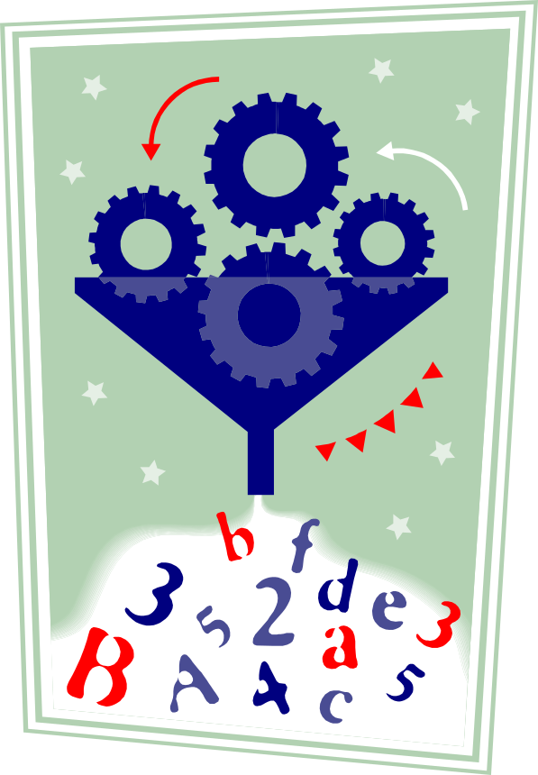
Filtering: Policy Meets Risk Management

Slide 26
The “Filtering” in RRF
Once risks/hazards are ranked a “filter” may be used to reflect resources limitations and/or programmatic goals.
Filters are policy-derived. For example,
  Selecting worst N (or X%) of risks across all organizational units; versus
  Selecting worst M (or Y%) of risks for the entire organization.
Filters may have a risk, resource, or other bases, each possibly imparting differential effects on the final ranking of risks for mitigation.
Example: Next slide

Slide 27
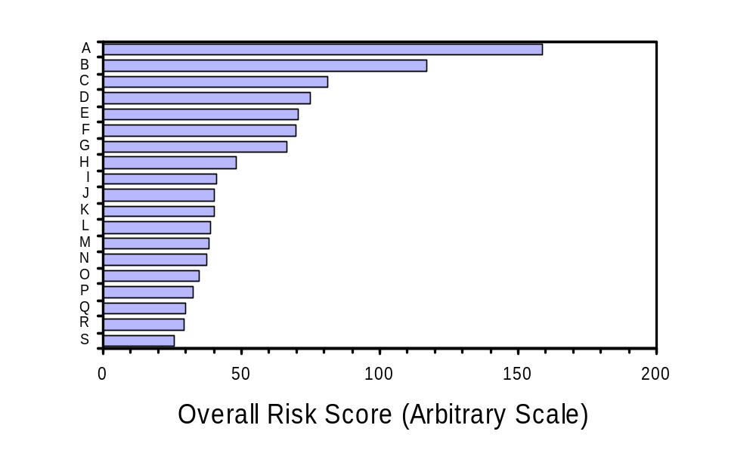
Using RRF Results: Filtering
Example of a “resource-based” filter
Example of a “risk-based” filter

Slide 28
RRF in the Risk Analysis Cycle
Start
cGMP/Compliance Inspections
Risk Assessment
Risk Management
Assessments (Data Bases)
Work Planning
Other Factors
Multi-Factorial Risk Model
Risk Ranking and Filtering
Data sources include Quality Systems & Mfrg Science

Slide 29

“Risk management and decision-making are all about [confronting probabilities] and where the balance between measurement and gut becomes the focal point of the whole story.”
(P.L. Bernstein, 1996, Against the Gods:
The Remarkable Story of Risk p. 56)

