Slide 1
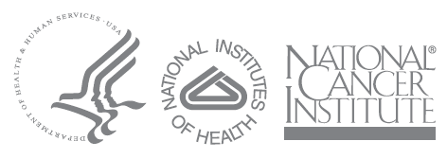
The Biospecimen Research Network
and
RAND Survey of Biospecimen Literature
Helen Moore, PhD
http://biospecimens.cancer.gov
November 30, 2006

Slide 2
Lifecycle of a Biospecimen: Biospecimen Research
The specimen is viable
Patient
Medical/
Surgical
Procedures
Handling/
Processing
Scientific
Analysis
Restocking
Unused
Sample
Acquisition
Storage
Distribution
Pre-acquisition
Post-acquisition
Time 0

Slide 3
Lifecycle of a Biospecimen: Biospecimen Research
Pre-acquisition variables:
Antibiotics
Other drugs
Type of anesthesia
Duration of anesthesia
Arterial clamp time
Blood pressure variations
Intra-op blood loss
Intra-op blood administration
Intra-op fluid administration
Pre-existing medical conditions
Patient gender
Post-acquisition variables:
Time at room temperature
Temperature of room
Type of preservative
Time in preservative
Rate of freezing
Size of aliquots
Type of collection container
Biomolecule extraction method
Storage temperature
Storage duration
Storage in vacuum

Slide 4
Effects of Biospecimen variables
  Effects on clinical outcomes:
    Morphological analysis/diagnosis
    Skewed clinical chemistry results
    Potential for incorrect therapy when diagnostic is paired with therapeutic (e.g., HER2)
  Effects on research outcomes:
    Variations in gene expression
    Variations in post-translational modification (e.g., phosphorylation status)
    Potential for misinterpretation of artefacts as biomarkers

Slide 5
Biospecimen Research Network (BRN)
  Produce scientific evidence for guiding development of data-driven SOPs for collection, processing, storage and analysis of specimens.
  Provide leadership to stimulate investment in biospecimen science development.
  What needs to be done? Informed by:
    Summer 2005 NCI workshops on Biospecimen issues
    March 2006 OBBR Biospecimen Research Symposium
      Built on several months of individual meetings with more than 100 investigators from the National Institutes of Health (NIH) intramural program and other Government, academic, and commercial research organizations
      Clinicians and scientists from the intramural and extramural community with the collective expertise to carry out complex BRN research projects

Slide 6
Biospecimen Research Network:
An Integral Part of the OBBR Guidelines Program
Develop and foster state-of-the-science methods to assess, improve, and assure the quality of biorepositories funded by the NCI.
  First Generation Guidelines for NCI-Supported Biorepositories
  RAND literature review of biospecimen science publications
  BRN: generation of new data in biospecimen science
  Collaboration with authoritative professional organizations on data-driven protocol development (e.g., College of American Pathologists)
  Step-wise development of evidence-based Second Generation Guidelines
  Development of objective biorepository evaluation criteria

Slide 7
Primary customers of BRN results
  TCGA (biospecimen factors influencing DNA/chromatin/RNA quality and utility for downstream analysis techniques; to include blood and blood products, and tissues)
  CPTAC (biospecimen factors influencing proteomics analysis of blood and blood products, and tissues)
  FDA/Clinical trials community (biospecimen factors influencing clinical diagnostic tests for personalized cancer therapies)
  Cancer research community (biospecimen factors influencing the results and conclusions of targeted studies on cancer tissues, blood, and body fluids)
  Biorepository community (biospecimen factors influencing collection, processing and storage of cancer tissues, blood, and body fluids for multiple uses)
  Epidemiological research community (biospecimen factors influencing collection, processing and storage of cancer tissues, blood, and body fluids for long-term studies)

Slide 8
BRN: “Wet” Research
Program Features:
  Interdisciplinary Research with focus on emerging technologies for cancer
  Controlled tissue acquisition
  Controlled molecular isolation and analysis
Vision of BRN:
  A network of partners (intramural, extramural, military, professional, and industrial)
  Plan and execute prospective studies
  Determine how the results of DNA, RNA and protein analysis are affected by defined pre-acquisition and post-acquisition specimen variables
  Advisory assistance of scientific experts in tissue acquisition and biomolecule analysis

Slide 9
BRN Pilot Projects
  Indivumed- Colon cancer ischemia tissue gene expression
  Urologic Oncology- Renal cell carcinoma DNA and ischemia gene expression
  Kevin Camphausen- Urine VEGF
  WRAMC- Breast ER, PR, HER-2/neu
  Milestone Medical- Recovery of RNA and proteins from FineFix-fixed tissue
  LCM and cDNA core facilities- Comparison of recovery of RNA and proteins from tissue using different laser microdissection platforms

Slide 10
Central themes of BRN research
  “Bridging the gap” between existing clinical practice for biospecimens and emerging technologies for personalized diagnostics and therapies
    Tissue preservation variables and their impact on downstream applications (e.g., HER2)
    Robotic surgery vs. manual surgery for prostate – are tissues harvested from robotic surgery suitable for advanced biomarker detection?
  Defining the most significant variables for prospective collection of tissues, blood, and body fluids
    Effects of pre-acquisition variables and biomolecule extraction methods on biomolecule analysis results in blood
  Developing evidence-based biospecimen quality indicators for specific analytical platforms
    In conjunction with above study, with accepted proper and improper conditions for collection and biomolecule analysis in blood

Slide 11
“Dry” Research: RAND survey
Comprehensive assessment of the existing published and unpublished information on biospecimen research studies
Basis of gap analysis: What important biospecimen research remains to be done?
Potential as a central resource for the biobanking community
  Type of resource? Book?
  Develop a searchable website of biospecimen research data

Slide 12
Software development for RAND survey
Literature curation tool and database to populate a publicly available, searchable biospecimen science website
Future home of prospective BRN research and Protocols
Developed in collaboration with NCICB (Ian Fore)
Two user groups:
  Literature curators (RAND)
  Future web site users

Slide 13
Software development for RAND survey
Two use cases:
  Curator reads paper and records relevant information to database
  User visits the BRN website and searches for relevant studies to advise development of their research protocols
What’s “relevant”?
How to structure the data?
What’s the right terminology?

Slide 14
Software development for RAND survey
Concepts:
  Different “Studies” can underlie a paper
  Different types of information:
    General information about the Biospecimen
    Biomolecules isolated from a Biospecimen
    Technology platforms used to analyze the Biomolecules
    Experimental factors that were the subject of the research study
Terminology “compromises”:
  Example: “Diagnosis” data field
    Different user groups (Pathologist vs. Proteomics researcher)
    Surveyed literature may be broader than cancer
    What’s logical? (and simple?)

Slide 15
Software development for RAND survey
Staged development approach:
  Development of data model in Excel
  Design of oracle database and web interface
  Pilot project in MS Access prototype
  Web development advised by pilot results

Slide 16
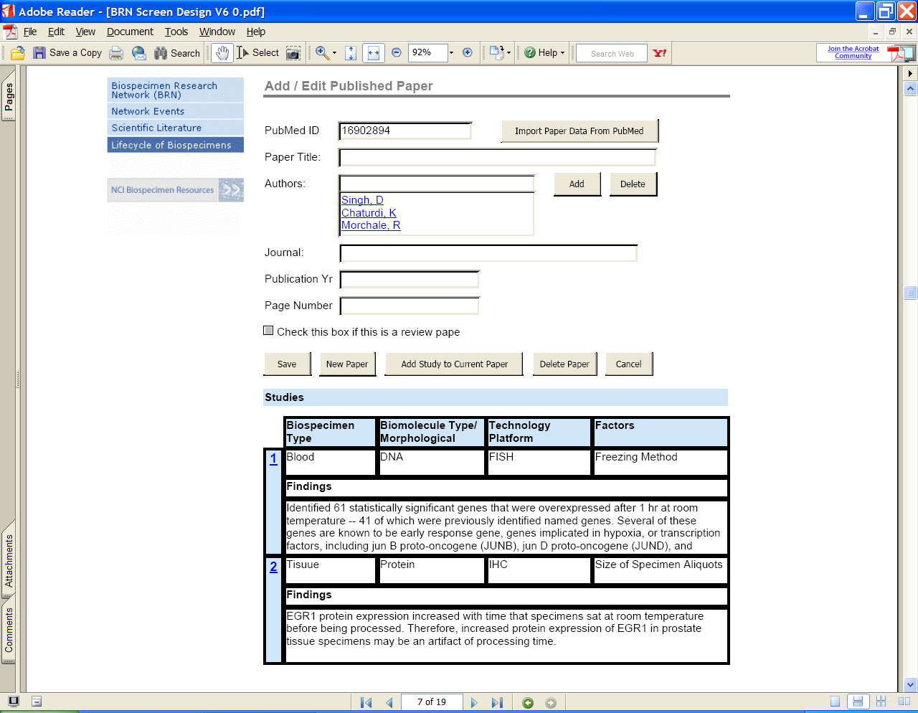
Sample screenshots

Slide 17
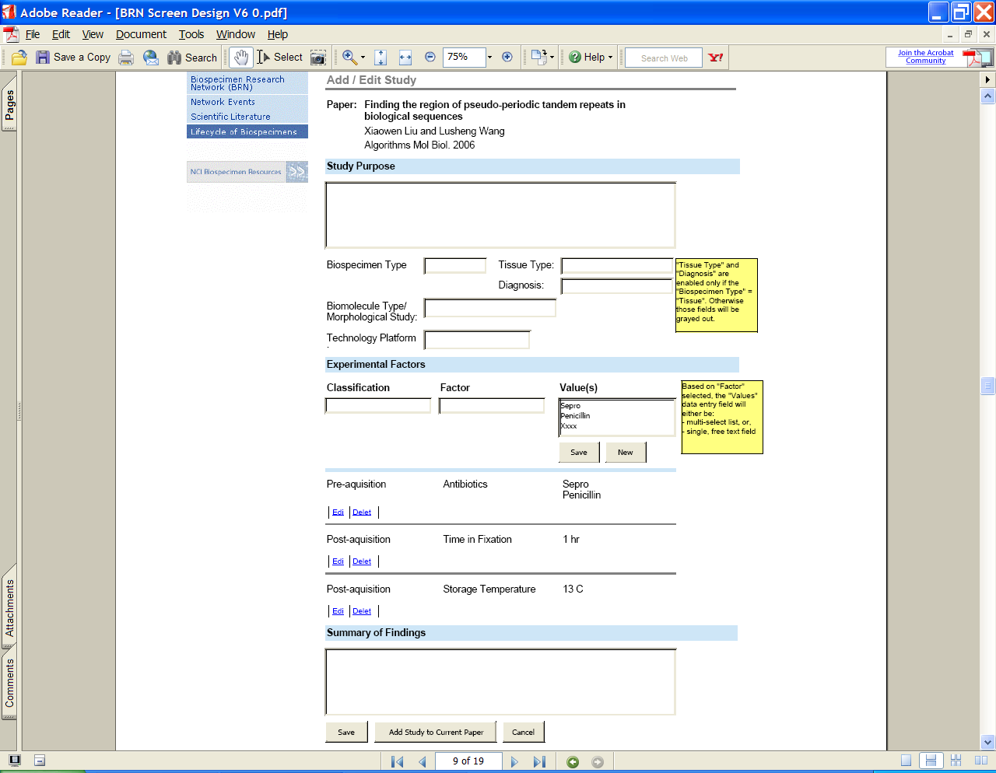
Sample screenshots

Slide 18
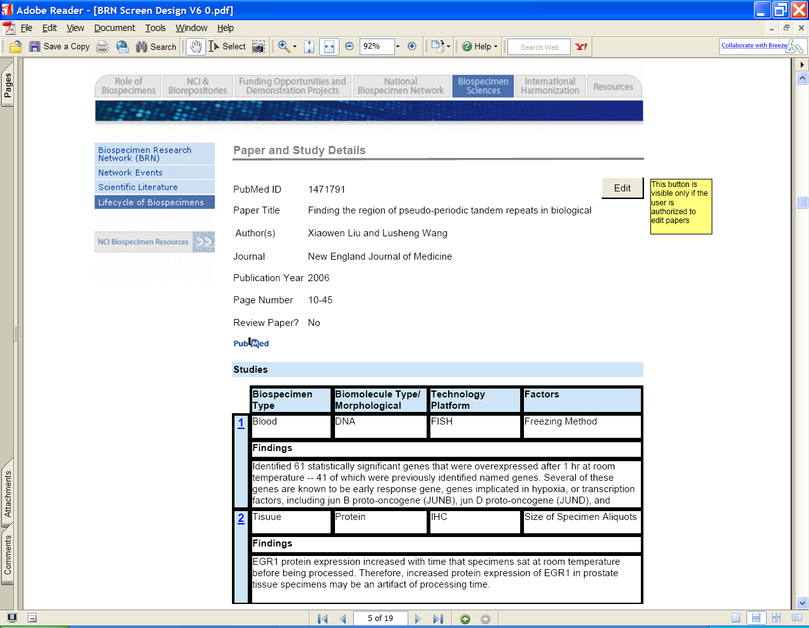
Sample screenshots

Slide 19
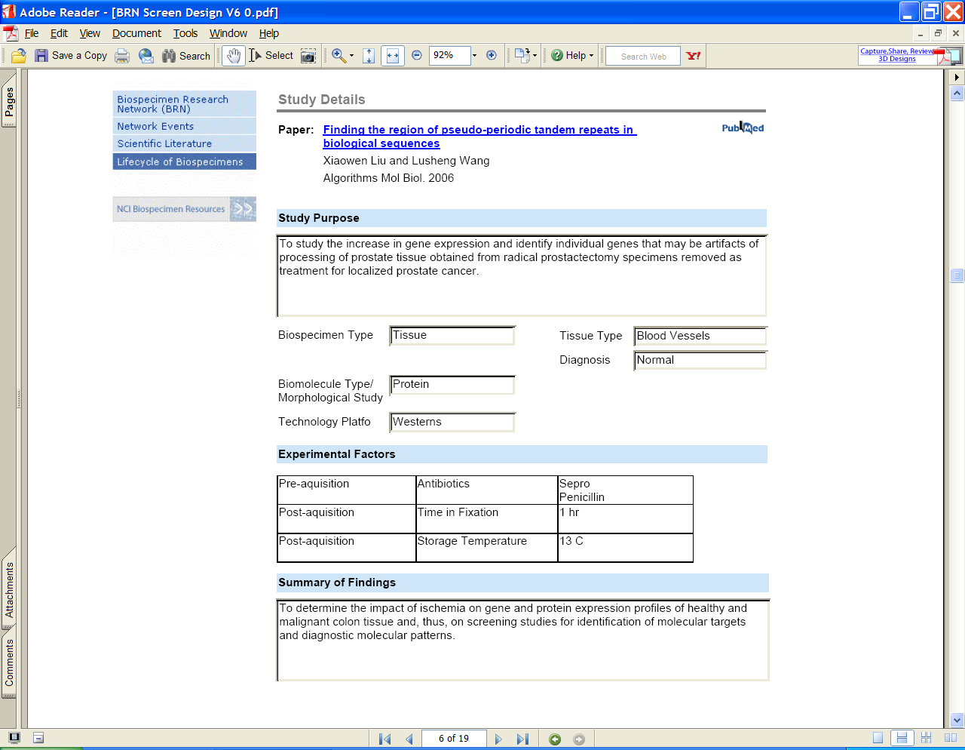
Sample screenshots

Slide 20
Development of Searchable Website for Guidelines, BRN, RAND
Milestones:
  July 2006-July 2007 – RAND study, phase 1
  July 2006
    Begin meetings with RAND introducing idea of web-based curation
    Kickoff of web development project with developer staff procured through caBIG organization
  August 2006
    Development of appropriate forms for data entry by RAND curators
    Web site prototype development
  November 2006
    Pilot project with MS Access prototype
  March 2007
    Production web site available, populated with RAND pilot data and BRN pilot project results

