Slide 1

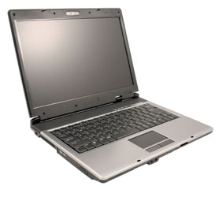
ENERGY STAR®
SALES ASSOCIATE TRAINING
Computers

Slide 2
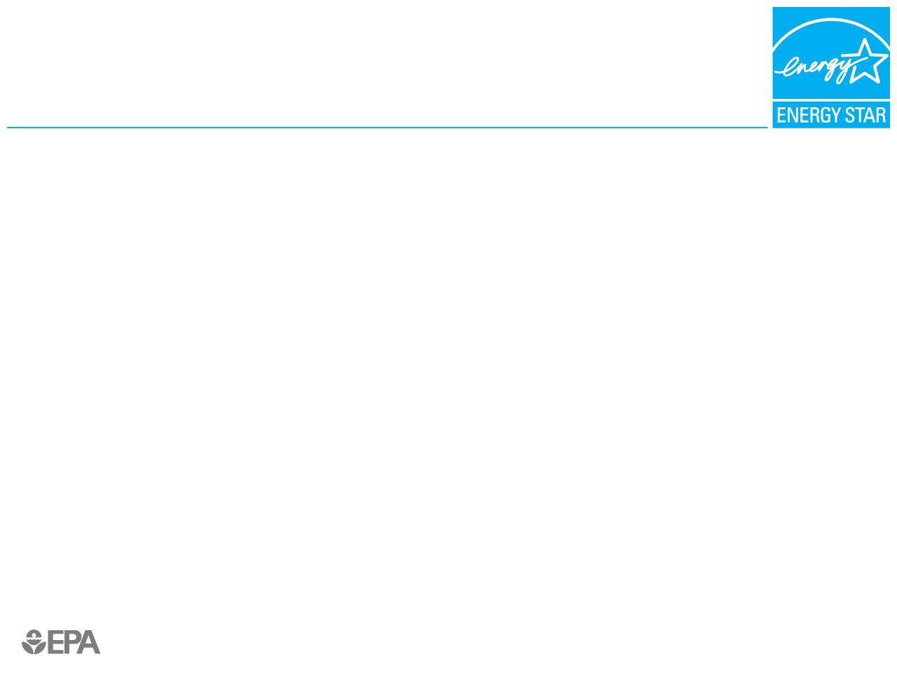

What is ENERGY STAR?
ENERGY STAR is a
government-backed program
that helps consumers identify energy-efficient products.
ENERGY STAR qualified products:
  Save energy
  Save money
  Save the environment

Slide 3
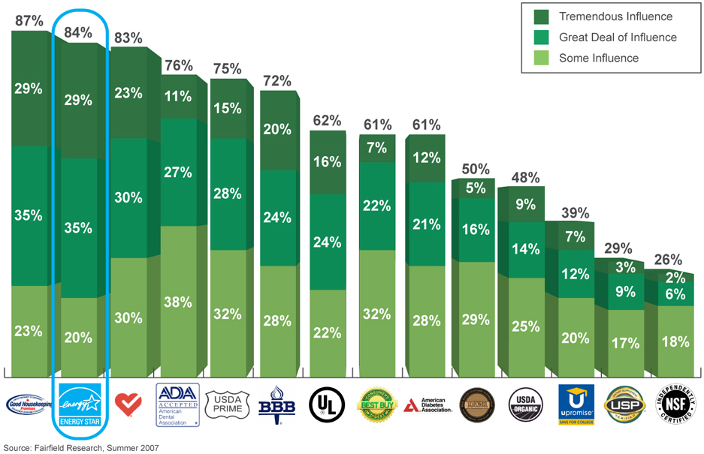
About ENERGY STAR
The ENERGY STAR mark ranks among the highest level of influence on product purchase among all consumer emblems, similar in ranking to the Good Housekeeping Seal.

Slide 4
ENERGY STAR Sales Value
Consumer awareness and desire for efficiency savings is high.
In 2007, more than 70% of households nationwide recognized the ENERGY STAR label.
Of households that purchased ENERGY STAR products in the past year:
  More than 70% of them reported the label as influential to their purchasing decision.
  80% reported they are likely to recommend ENERGY STAR products to friends.
In 2007 alone, Americans—with the help of ENERGY STAR—saved $16 billion on their utility bills and prevented greenhouse gas emissions equivalent to the annual emissions of 27 million vehicles.
SOURCES: EPA Office of Air and Radiation, Climate Protection Partnerships Division. National Awareness of ENERGY STAR® for 2007: Analysis of 2007 CEE Household Survey. U.S. EPA, 2008.“ENERGY STAR Overview of 2007 Achievements.” April 2008.

Slide 5
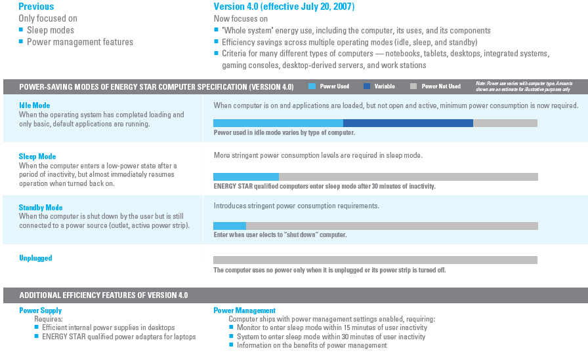
ENERGY STAR
Computer Specification Chart

Slide 6
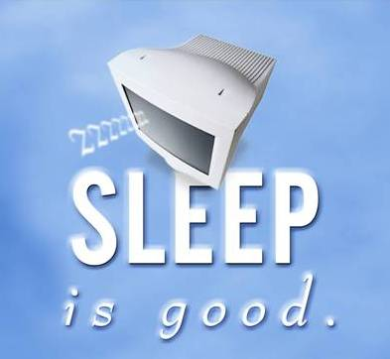
ENERGY STAR
Power Management
ENERGY STAR power management features:
  Come standard in Windows and Macintosh operating systems.
  Place computers and monitors into a low-power modes after periods of inactivity.
To maximize savings EPA recommends:
  Setting computers to standby mode after 30-60 minutes of inactivity
  Setting monitors to sleep after 5-20 minutes of inactivity
Activate power management features quickly and easily to save energy, save money, and help protect the environment.
Learn how to activate these settings at: www.energystar.gov/powermanagement

Slide 7
Power Management Myths
Myth: Screensavers are needed to eliminate “burn-in” problems.
False: Modern displays have eliminated this need. So turn on the
power management and turn off the digital aquarium.
Myth: More energy is used to turn on your computer, than to leave it on
when not in use.
False: The small surge of power when a computer is turned on is
significantly less than the energy used by running the computer when
not needed.
Myth: Shutting down computers daily does more harm than good, and
shortens the life of the computer.
False: Modern computers are designed to withstand frequent shut-downs.

Slide 8

Saving Energy = Saving Money
An ENERGY STAR qualified computer will use up to 50% less energy than a comparable product, depending on how it is used.
Enabling your computer and monitor’s ENERGY STAR power management features can save your office up to $90 per monitor per year.
If each desktop and monitor in U.S. homes was to sleep when not in use, we would save $1 billion in annual energy costs while preventing greenhouse gases equivalent to the emissions of 1 million cars.
ENERGY STAR qualified products use less energy and cost less to operate resulting in:

Slide 9
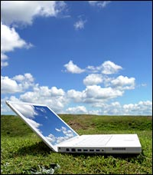
Saving Energy Helps
Protect the Environment
By choosing ENERGY STAR qualified computers, consumers can help reduce the risks of global warming by preventing greenhouse gas emissions caused by burning fossil fuels at power plants.
If all computers sold in the U.S. meet the ENERGY STAR requirements, we would prevent greenhouse gas emissions equivalent to the emissions of more than 2 million vehicles and would save about $2 billion each year in energy costs.

Slide 10
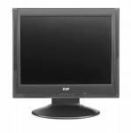
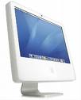
Which Brands Are
ENERGY STAR Qualified?
Trusted brands like these . . .
Apple
Dell
Hewlett-Packard
Sharp
Toshiba
[Customize as appropriate]

Slide 11
ENERGY STAR
As Your Sales Partner
Create Business Value
  Differentiation
    Arm your staff with knowledge
    Provide your customers products of choice
  Grow your customer base
    Attract and retain customers—help your customers save money and watch them keep coming back
  Partner with ENERGY STAR and increase sales and customer loyalty by providing energy savings and environmental benefits
Create Social Value
  Reducing energy use helps decelerate climate change by preventing greenhouse gas emissions
  Lower energy bills for consumers and businesses
  Boost your brand’s environmental image

Slide 12
ENERGY STAR
Qualified Computers Overview
ENERGY STAR:
The government-backed program dedicated to helping consumers
protect the environment through superior energy efficiency.
ENERGY STAR qualified computers save energy, money, and
the environment.
Why sell ENERGY STAR qualified computers?
Enabling a qualified computer and monitor’s ENERGY STAR power management features can save up to $90 per monitor per year.
A computer meeting the new ENERGY STAR specification will use up to 50% less energy than a comparable product, depending on how it is used.
Partner with ENERGY STAR and increase sales and customer loyalty by providing energy savings and environmental benefits.

Slide 13

A user-friendly and easily navigable micro-site containing training tools for partners.
Users can navigate throughout three main categories to find training resources relevant
to them: products, campaigns, utilities/energy efficiency program sponsors.
Benefits:
EASY: Access to all ENERGY STAR training materials and resources on your own.
ACCURATE: The most current training materials to share with your sales associates for increasing the sale of ENERGY STAR qualified products and services.
RELEVANT: A location for collaboration and idea exchange with other partners.
To LEARN MORE, visit the ENERGY STAR Training Center page at:
www.energystar.gov/training

