Slide 1

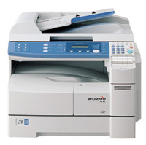
ENERGY STAR®
SALES ASSOCIATE TRAINING
Imaging Equipment

Slide 2
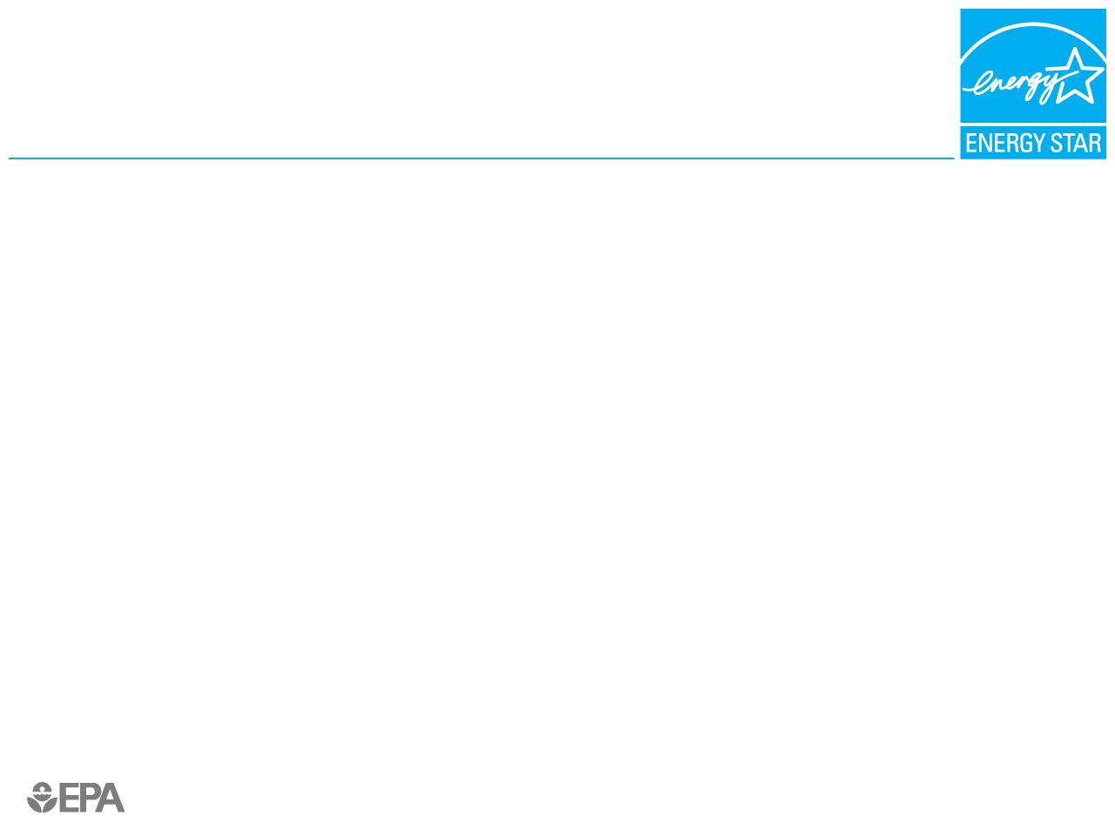

What is ENERGY STAR?
ENERGY STAR is a
government-backed program
that helps consumers identify energy-efficient products.
ENERGY STAR qualified products:
  Save energy
  Save money
  Save the environment

Slide 3
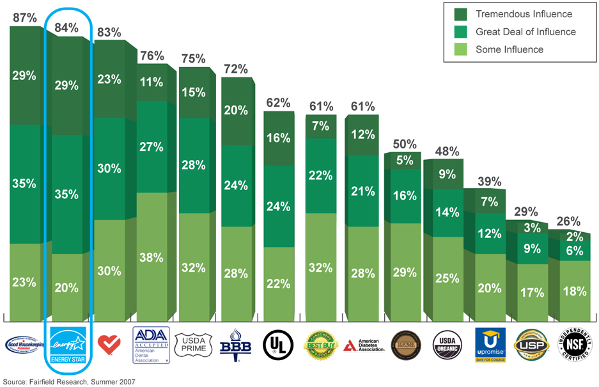
About ENERGY STAR
The ENERGY STAR mark ranks among the highest level of influence on product purchase among all consumer emblems, similar in ranking to the Good Housekeeping Seal.

Slide 4
ENERGY STAR Sales Value
Consumer awareness and desire for efficiency savings is high.
In 2007, more than 70% of households nationwide recognized the ENERGY STAR label.
Of households that purchased ENERGY STAR products in the past year:
  More than 70% of them reported the label as influential to their purchasing decision.
  More than 80% of them reported they are likely to recommend ENERGY STAR products to friends.
In 2007 alone, Americans—with the help of ENERGY STAR—saved $16 billion on their energy bills and prevented greenhouse gas emissions equivalent to the annual emissions of 27 million vehicles.
SOURCES: EPA Office of Air and Radiation, Climate Protection Partnerships Division. National Awareness of ENERGY STAR® for 2007: Analysis of 2007 CEE Household Survey. U.S. EPA, 2008.“ENERGY STAR Overview of 2007 Achievements.” April 2008.

Slide 5
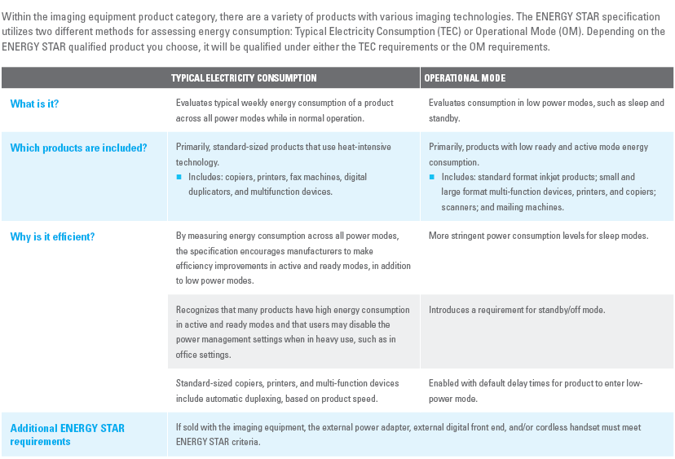
ENERGY STAR
Qualified Imaging Equipment

Slide 6

Saving Energy = Saving Money
ENERGY STAR qualified products use less energy and cost less to operate resulting in:
The typical household spends more than $2,000 a year on energy bills. With ENERGY STAR, you can save over 30%, or about $700.
A typical home office equipped with a desktop computer, LCD monitor, multi-function device, and printer that meet the ENERGY STAR requirement is projected to save more than $80 over the life of the products, and even more if you enable power management.

Slide 7
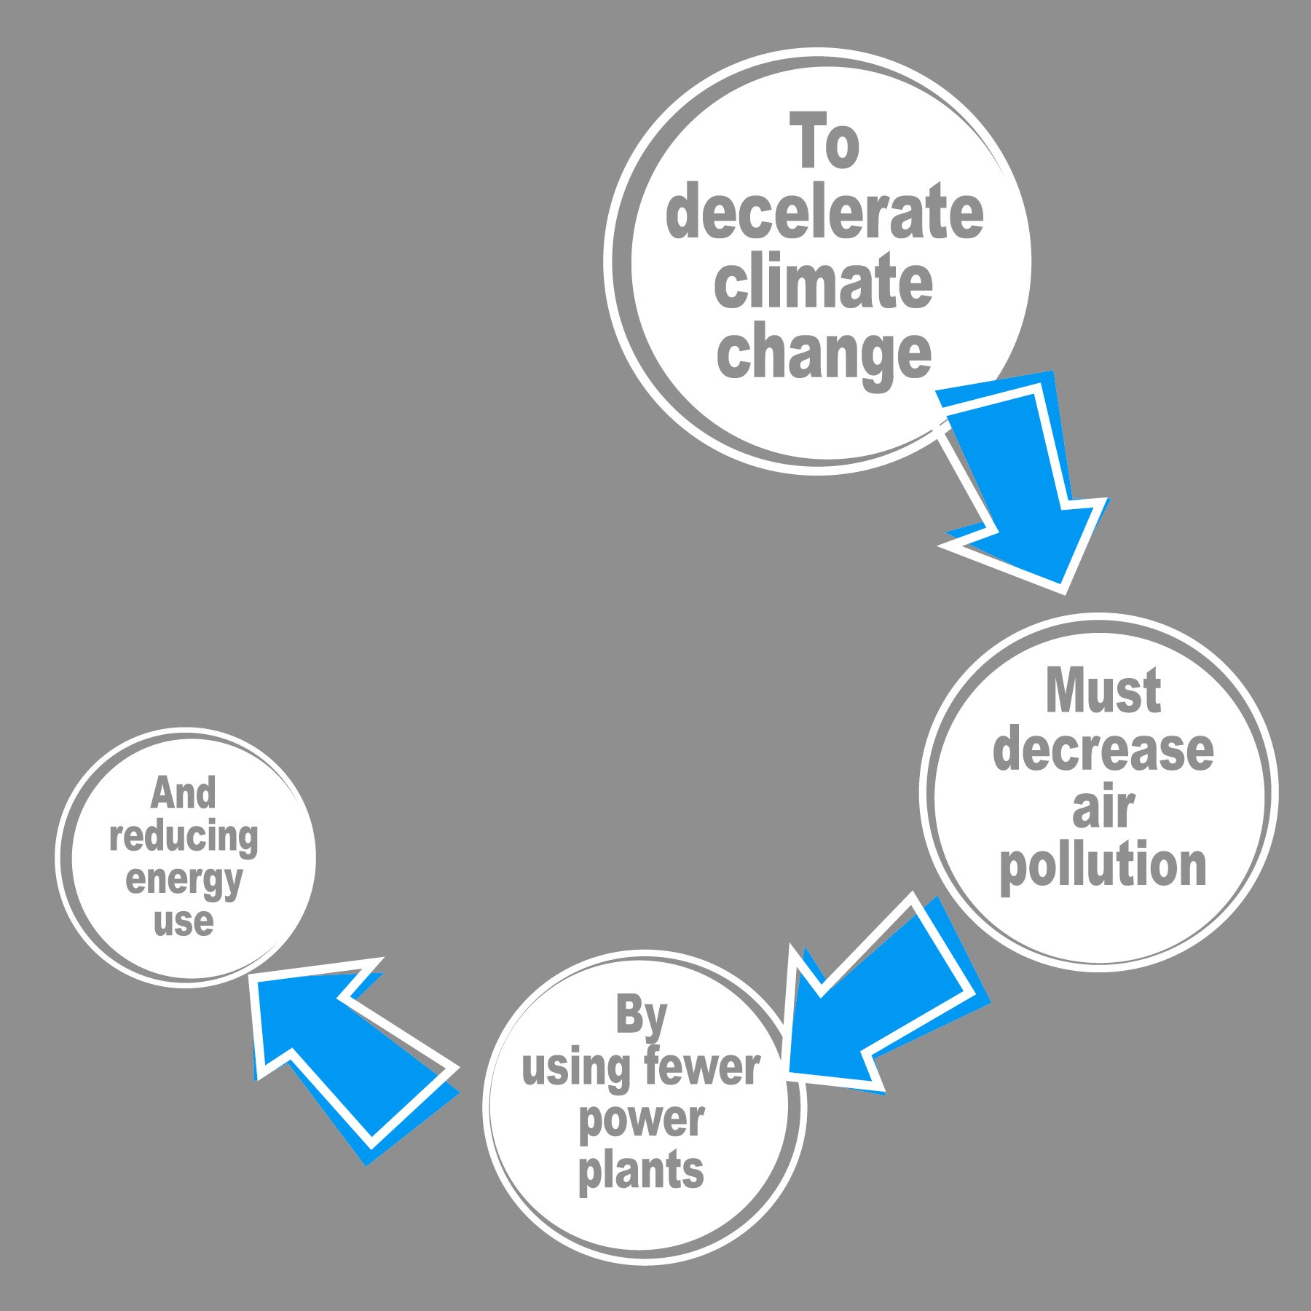
Saving Energy Helps
Protect the Environment
If all imaging equipment sold in the U.S. met ENERGY STAR requirements, we would prevent greenhouse gases equivalent to the
emissions of about 4 million vehicles.
Did You Know?
The energy used in the average house can cause twice the greenhouse gas emissions as the average car.

Slide 8
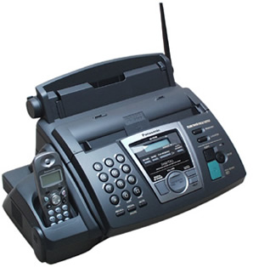
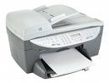
Which Brands Are
ENERGY STAR Qualified?
Trusted brands like these . . .
Canon
Epson
Hewlett-Packard
Konica Minolta
Lexmark
Sharp
Xerox
[Customize as appropriate]

Slide 9
ENERGY STAR
As Your Sales Partner
Create Business Value
  Differentiation
    Arm your staff with knowledge
    Provide your customers products of choice
  Grow your customer base
    Attract and retain customers—help your customers save money and watch them keep coming back
  Partner with ENERGY STAR and increase sales and customer loyalty by providing energy savings and environmental benefits
Create Social Value
  Reducing energy use helps decelerate climate change by preventing greenhouse gas emissions
  Lower energy bills for consumers and businesses
  Boost your brand’s environmental image

Slide 10
ENERGY STAR
Imaging Equipment Overview
ENERGY STAR:
The government-backed program dedicated to helping consumers
protect the environment through superior energy efficiency. ENERGY STAR
qualified imaging equipment save energy, money, and the environment.
Why sell ENERGY STAR qualified imaging equipment?
A typical home office equipped with a desktop computer, LCD monitor, multi-function device, and printer that meet the ENERGY STAR requirement is projected to save more than $80.
Consumers are looking for ways to reduce their energy bills and help the environment. Partnering with ENERGY STAR can increase sales and customer loyalty.
ENERGY STAR is an easy, convenient solution to energy concerns.

Slide 11

A user-friendly and easily navigable micro-site containing training tools for partners.
Users can navigate throughout three main categories to find training resources relevant
to them: products, campaigns, utilities/energy efficiency program sponsors.
Benefits:
EASY: Access to all ENERGY STAR training materials and resources on your own.
ACCURATE: The most current training materials to share with your sales associates for increasing the sale of ENERGY STAR qualified products and services.
RELEVANT: A location for collaboration and idea exchange with other partners.
To LEARN MORE, visit the ENERGY STAR Training Center page at:
www.energystar.gov/training

