Slide 1
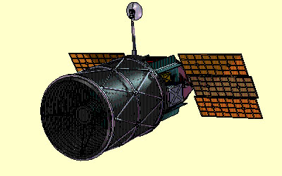
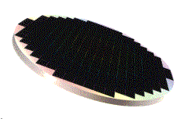
Instrumentation, Technologies, R&D
Cost & Schedule
  SuperNova /Acceleration Probe
  Talk Outline:
    Requirements (throughout)
    CCD Technology
    GigaCAM
    Spectroscopy
    Optics
    Trade-Study/Orbit
    R&D Plan
    Cost
    Schedule
  GigaCAM, a billion pixel CCD array
  Presented by: Michael Levi
  December 1, 1999

Slide 2
Instrumentation Requirements
  Need consistent uniform data set where selection criteria can be applied and systematic sources can be analyzed and factored.
  Minimum data set criteria:
    1) discovery within 2 days of explosion (peak + 3.8 magnitude),
    2) 10 high S/N photometry points on lightcurve,
    3) lightcurve out to plateau (2.5 magnitude from peak),
    4) high quality spectrophotometry,
    5) minimize color corrections,
    6) multiple spectra on lightcurve,
    7) IR spectra.
  How to obtain both data quantity AND data quality?
    Batch processing techniques -- large multiplex advantage,
    Mostly preprogrammed observations, fixed fields / spin filter wheel
    Wide field imager sensitive to 30th magnitude
    Well calibrated photometry and spectroscopy

Slide 3
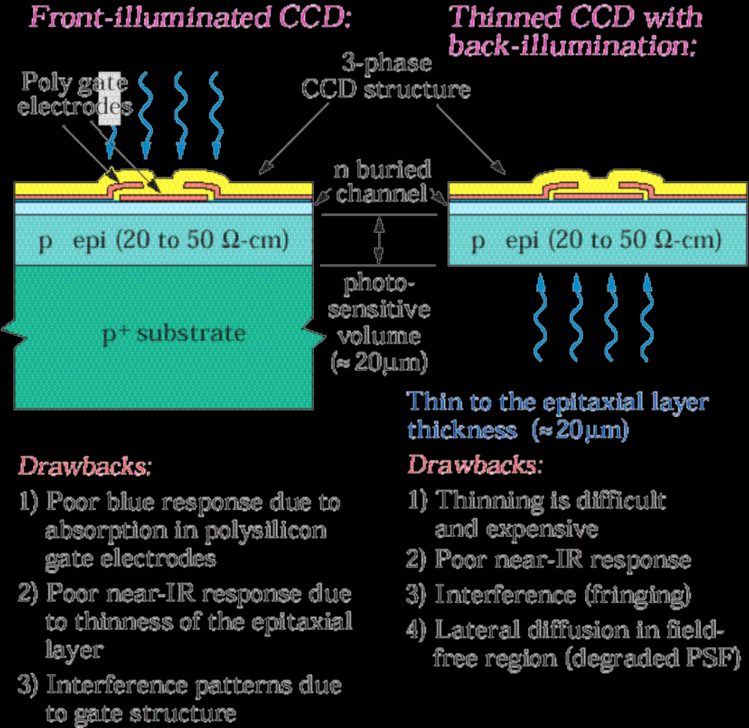
Typical CCD’s

Slide 4
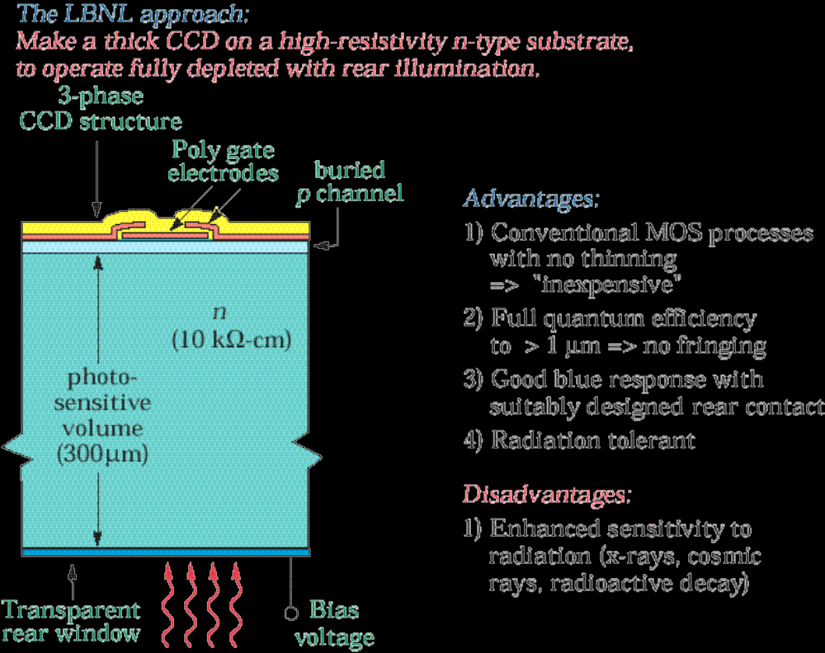
Fully-Depleted CCD’s

Slide 5
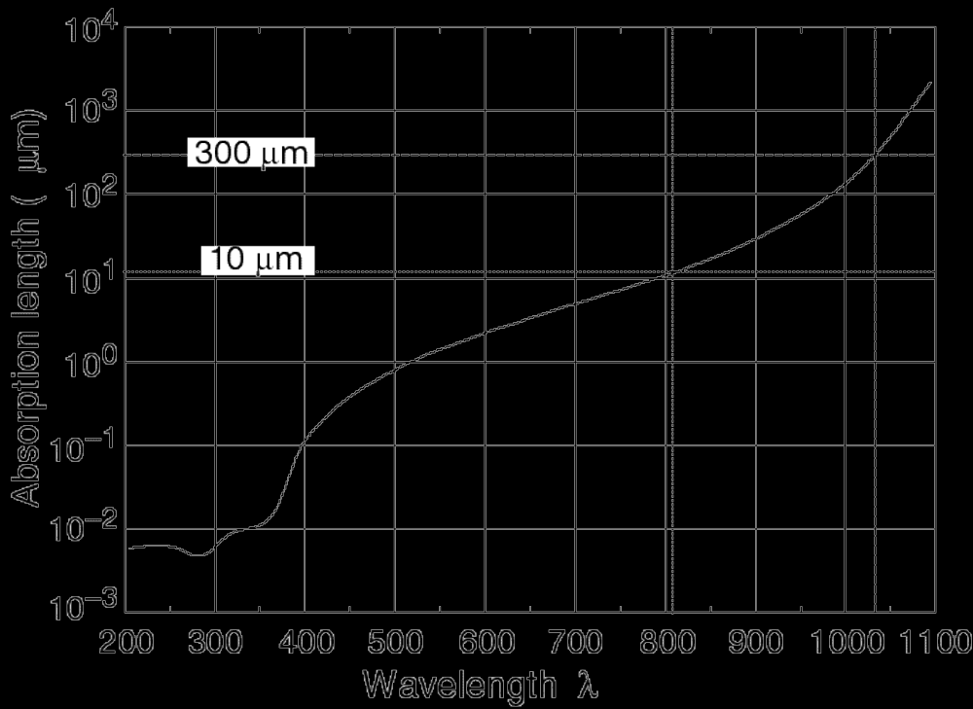
CCD Technology
  Photoactive region of standard CCD’s are 10-20 microns thick
  Photoactive region of LBNL CCD’s are 300 microns thick

Slide 6
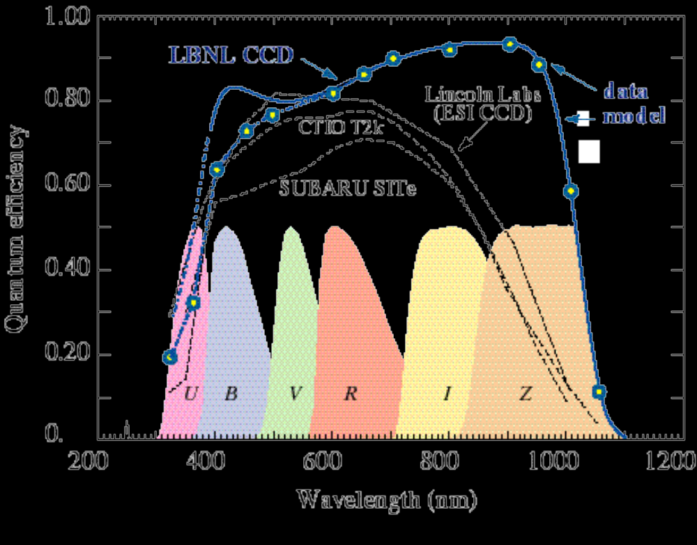
Quantum Efficiency
  Better overall response than more costly “thinned” devices in use
  High-purity silicon has better radiation tolerance for space applications
  Measured Quantum Efficiency at Lick Observatory (R. Stover):

Slide 7
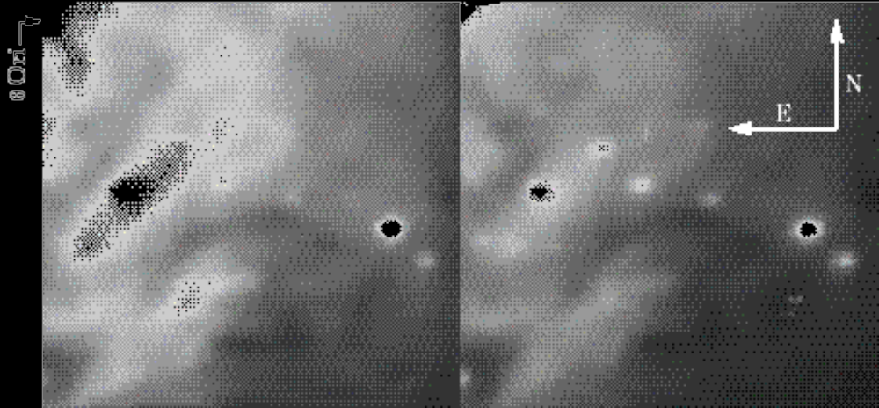
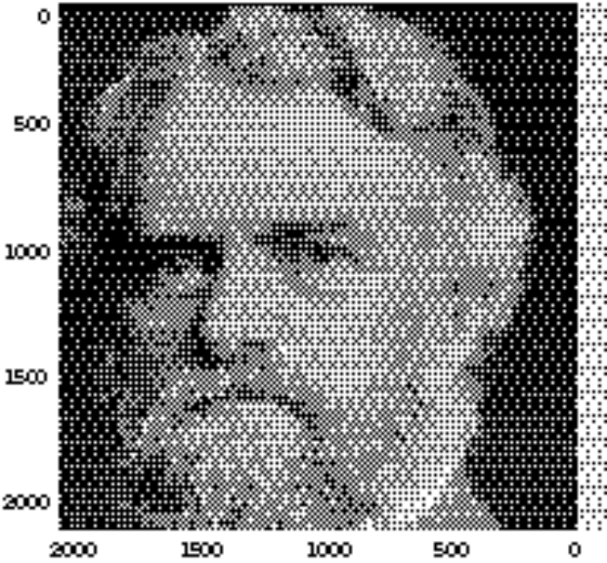
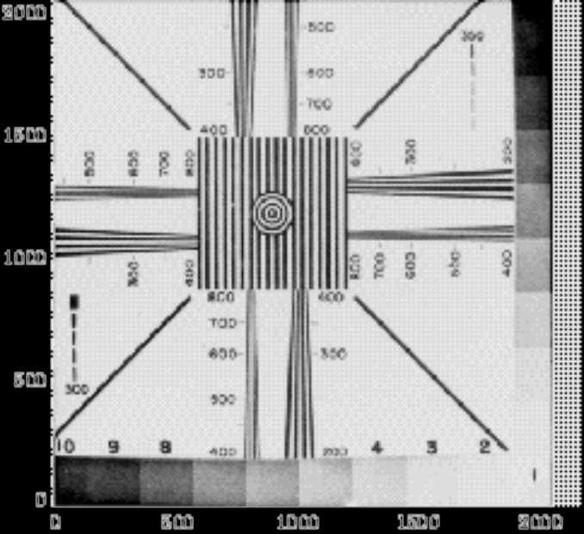
Portrait Gallery from Lick Observatory
LBNL CCD’s
  200x200
  Lick Obs.
  Orion
  Left: R band
  Rgt: Z band
  2k x 2k
  2k x 2k

Slide 8
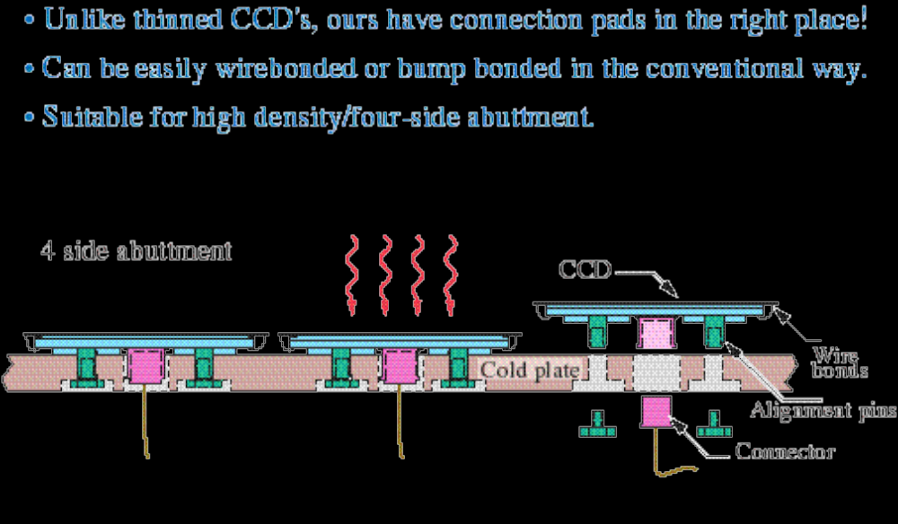
Mosaic Packaging

Slide 9
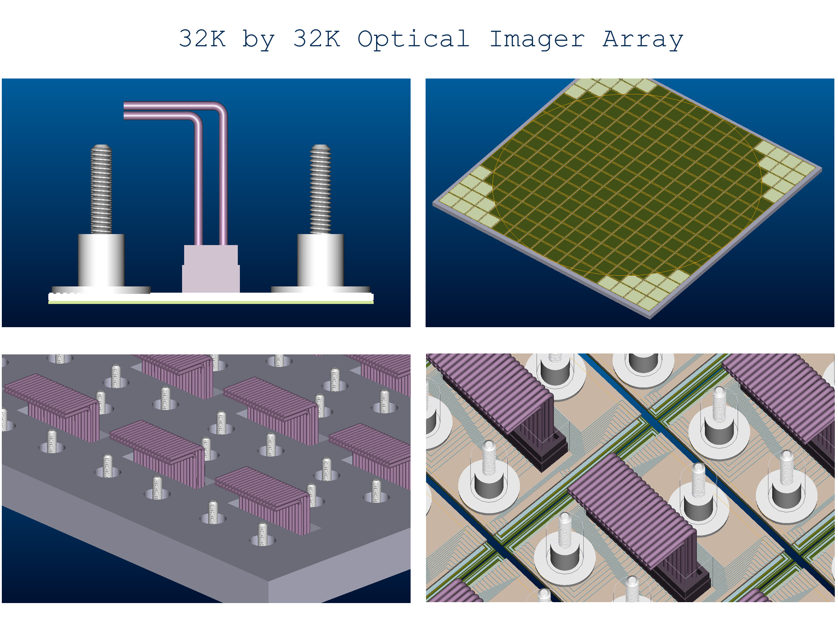
Imager Technology

Slide 10
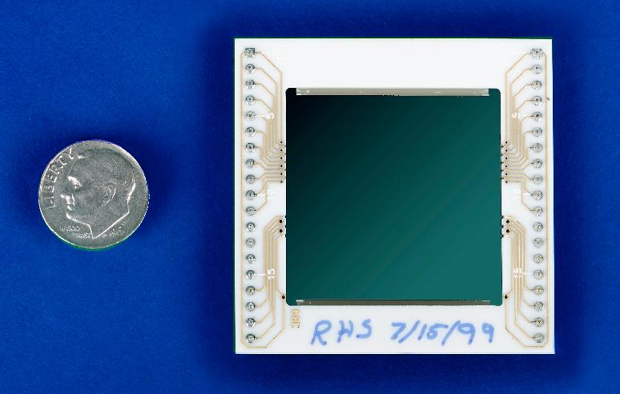
CCD Status
  2k x 2k (15 μm pixels) design successful, meets SNAP performance requirements
  Commercialization at Mitel Corp, Bromont Canada
    Fabricating 2k x 2k (15 μm pixels)
    Two separate processing runs (1) Mitel “standard”; (2) LBNL modified process recipe
    Current run of 25 wafers; will be followed by another run when this finishes (January)
  LBNL current fabrication
    2k x 4k (15 μm pixels) for Eschellette Spectrograph and Imager (Keck)
    2k x 4k (12 μm pixels)
    2k x 4k (10.5 μm pixels) for SNAP
  NSF grant to develop technology for astronomy
  Requires further radiation testing (already tested at LBNL 88” cyclotron to 20% of SNAP lifetime exposure w/o degradation)
  Complete commercialization

Slide 11
GigaCAM
GigaCAM, a one billion pixel array
  Depending on pixel scale approximately 1 billion pixels (28k x 28k imager)
  ~200 Large format CCD detectors required
  150K operation
  Issues: detectors, electronics, metrology
  Looks like the SLD vertex detector in Si area (0.1 m²)
  Larger than SDSS camera, smaller than BaBar Vertex Detector (1 m²)

Slide 12
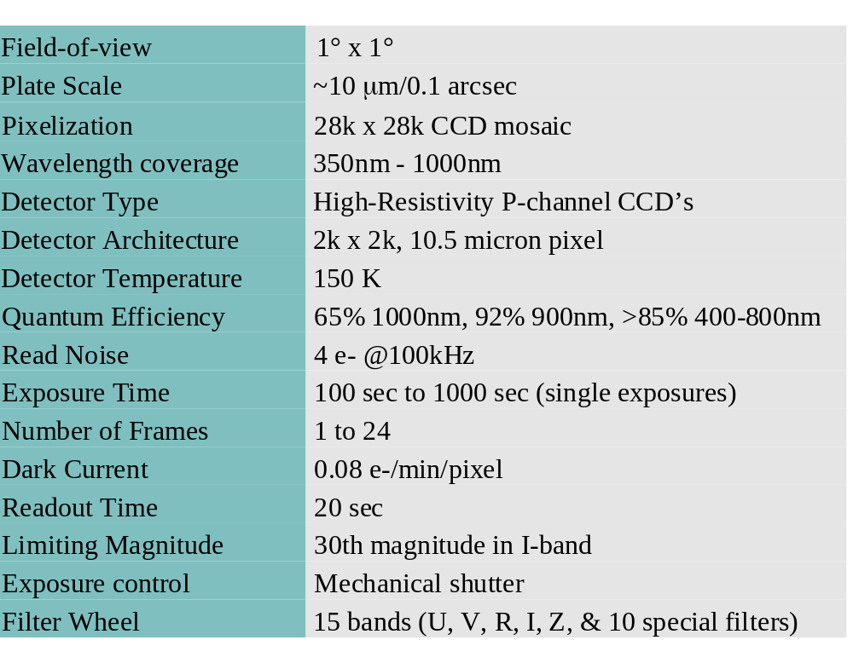
Optical Photometry Requirements

Slide 13
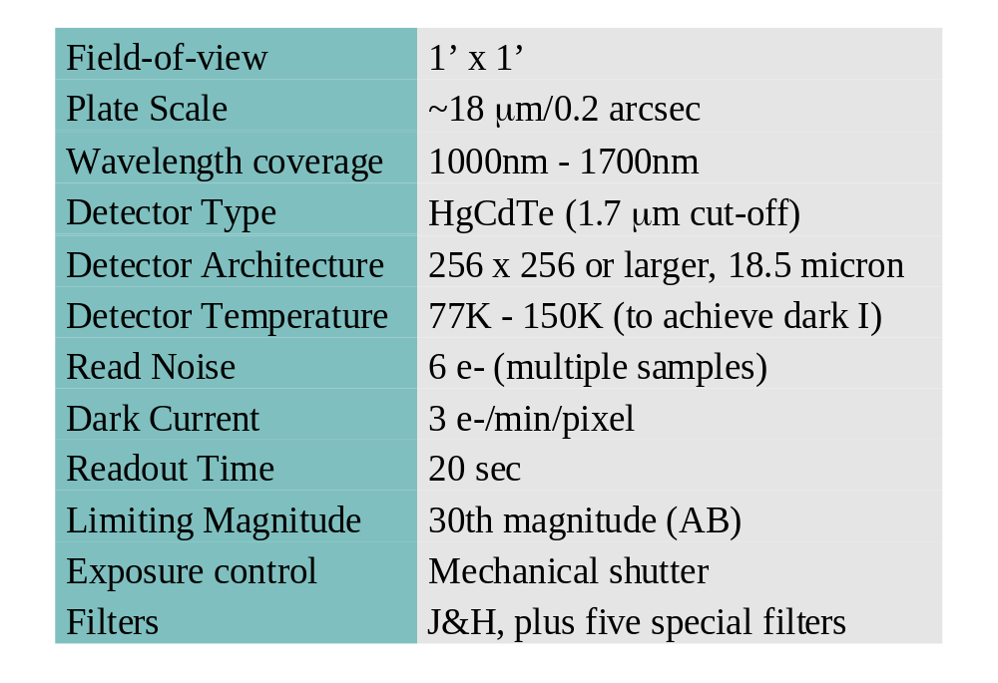
IR Photometry Requirements

Slide 14
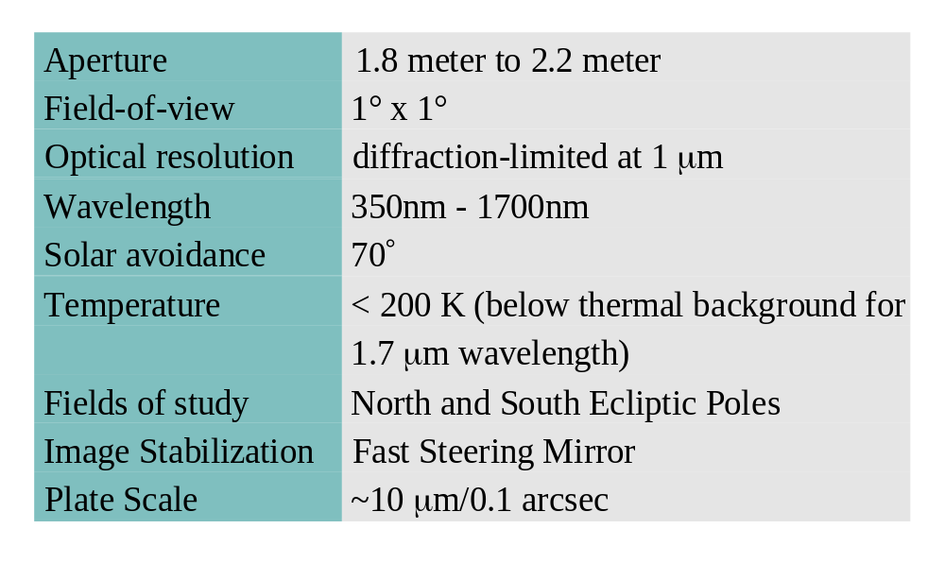
Observatory Requirements

Slide 15
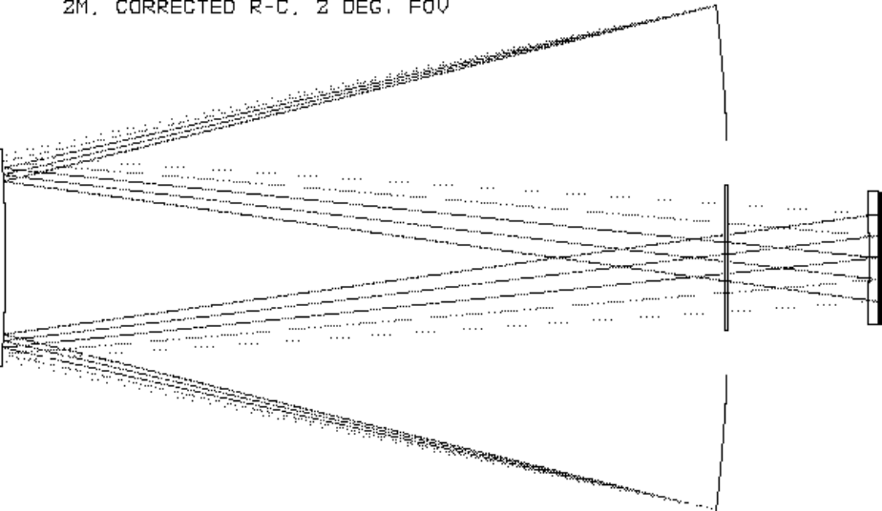
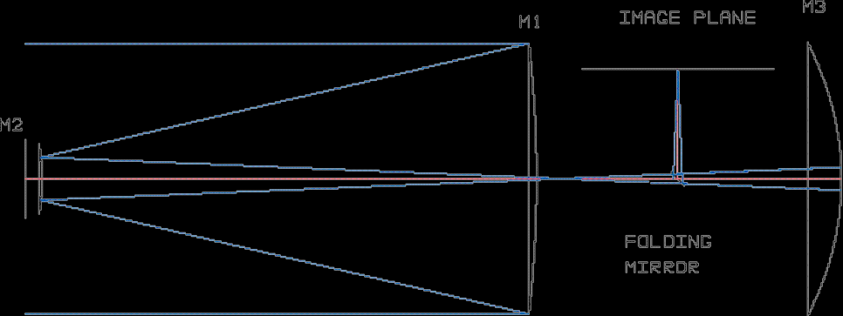
Telescope
Fully corrected image over one square-degree field.
Examined two-mirror Ritchey-Chretien & three mirror designs
Sloane
Paul-Baker
Korsch
Dark Matter Telescope
New Planetary Telescope (off-axis design)
Looking for design with intermediate
waist to facilitate filters & fast steering
mirror.
Designs that achieve a diffraction-limited 1⁰ FOV in a 2-m aperture:
S Sloan
S Korsch

Slide 16
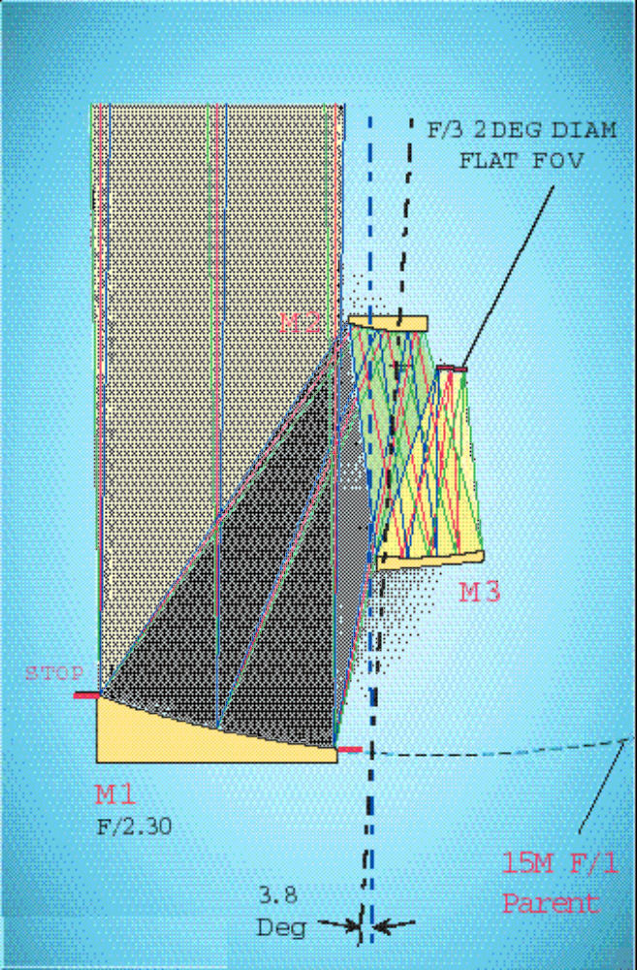
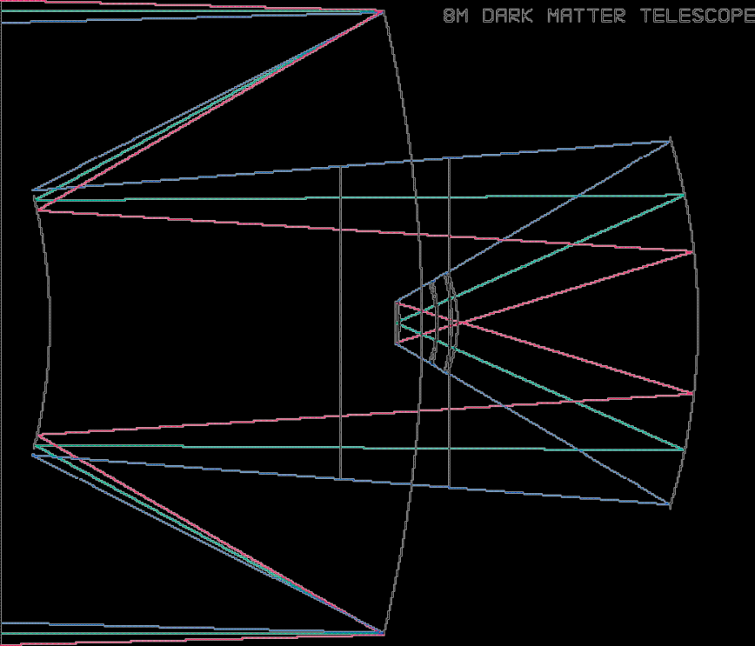
Designs that achieve a diffraction-limited 1⁰ FOV in a 2-m aperture:
S New Planetary Telescope
S Dark Matter Telescope
S

Slide 17
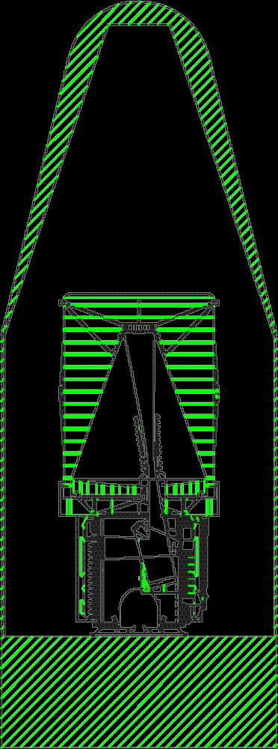
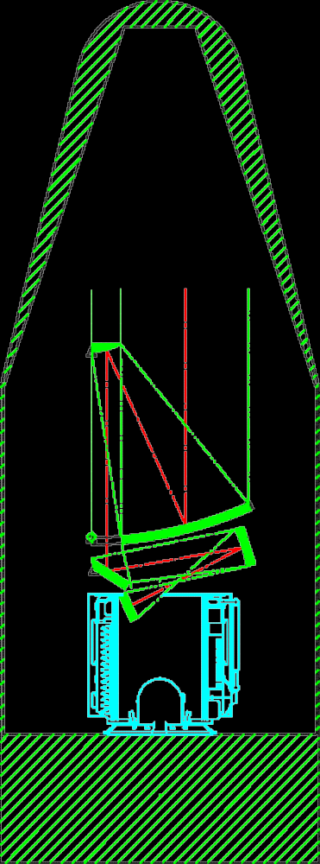
Telescope in Fairing
Ball concept study
Off-axis design

Slide 18
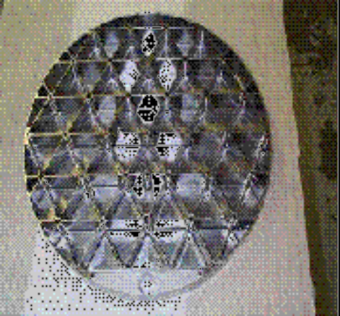
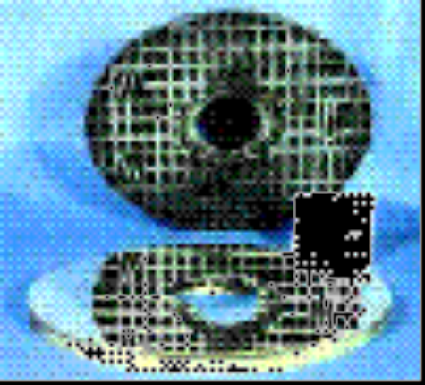
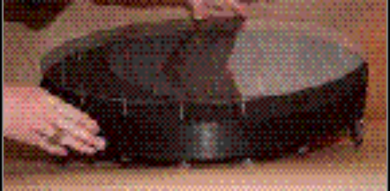
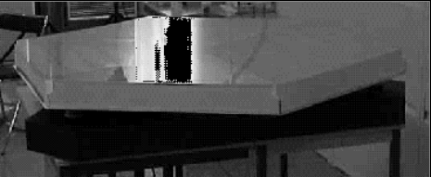
Optics
HST (2.4m) light-weighted glass 770 kg, for SNAP expect 450 kg light-weighted glass; Delta III lift to orbit > 2800 kg.
We also have the luxury of considering NGST technology:
Rigid mirrors (15 kg/m²)
  Beryllium
  Composite w/ glass face sheet
  C:SiC
Flexible mirrors (15 kg/m²)
  Glass

Slide 19
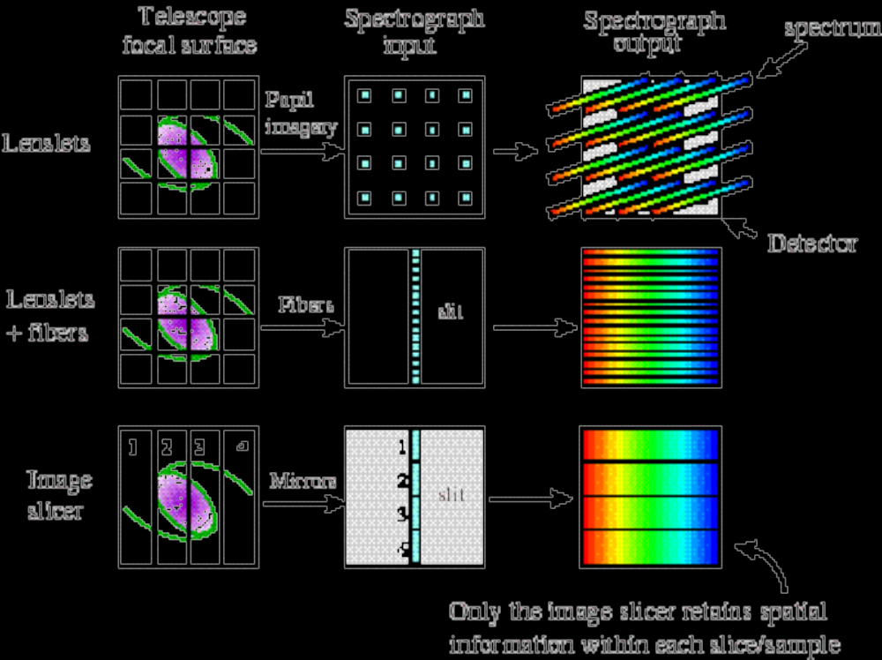
Spectroscopy Technology
MicroLens Array
Reflective Image Slicer (e.g. Palomar 200”, NGST IFMOS)

Slide 20
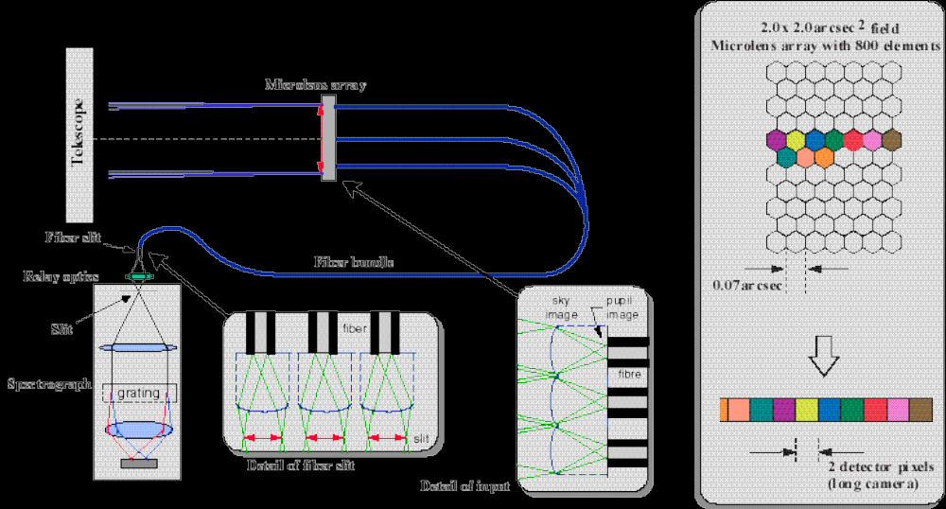
Spectroscopy w/ fibers
  MicroLens Array:
  From Haynes, astro-ph/9909017

Slide 21
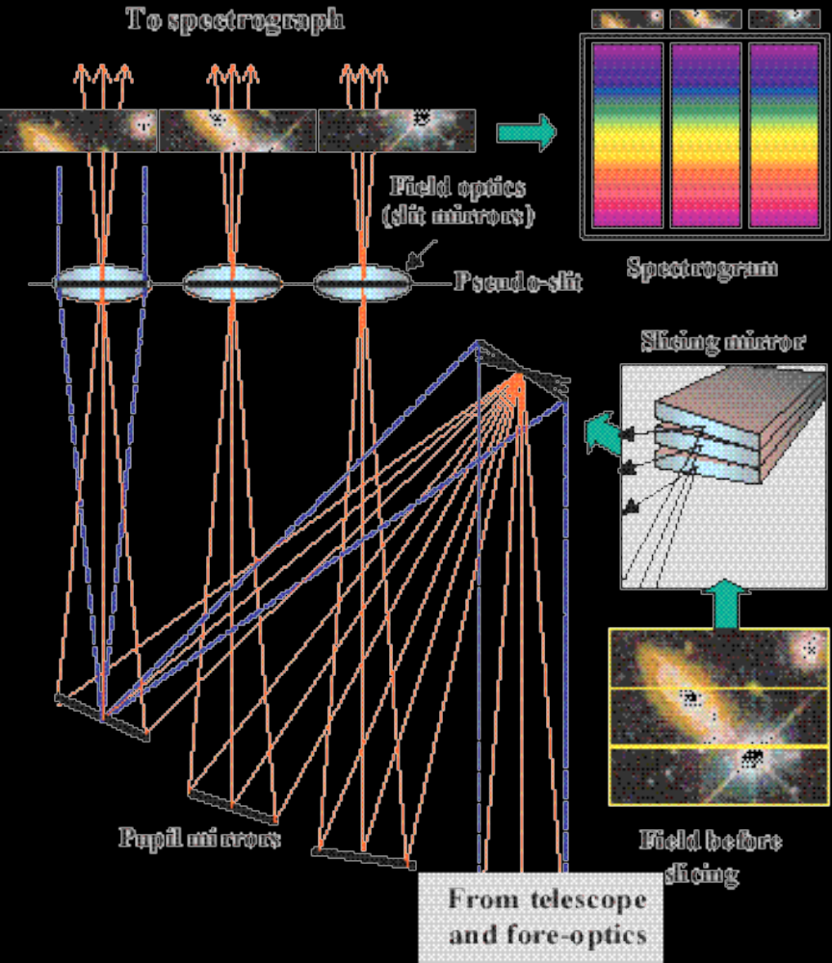
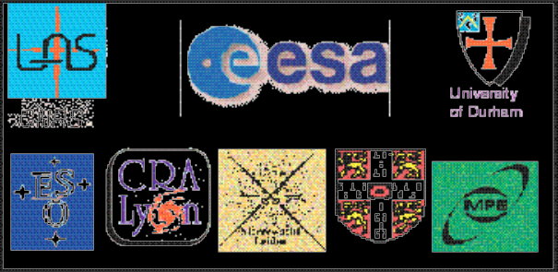
Integral Field Spectrograph for NGST
  From LAS-NGST-IFMOS-004
  O. Le Fevre, et.al - Laboratoire d’Astronomie Spatiale in Marseilles

Slide 22
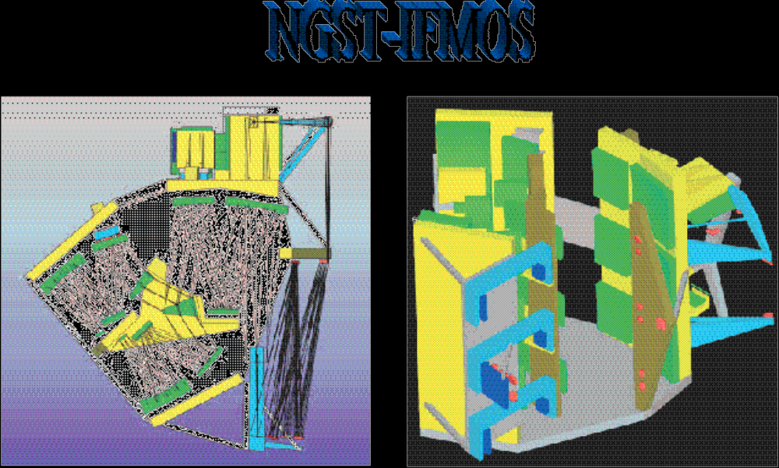
Integral Field/Multi-Object
Spectrograph for NGST
  From LAS-NGST-IFMOS-004
  O. Le Fevre, et.al - Laboratoire d’Astronomie Spatiale in Marseilles

Slide 23
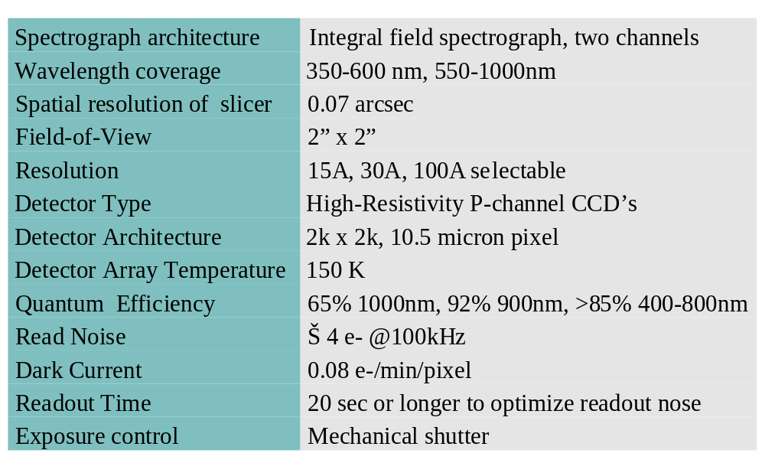
Optical Spectrograph Requirements

Slide 24
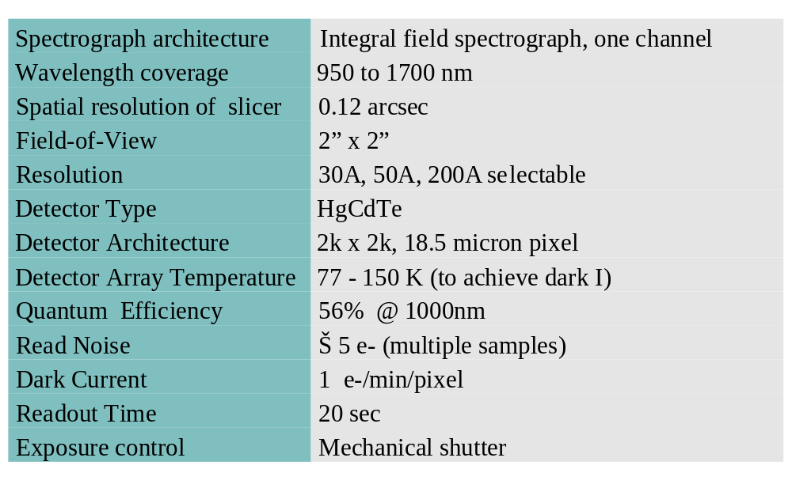
IR Spectrograph Requirements

Slide 25
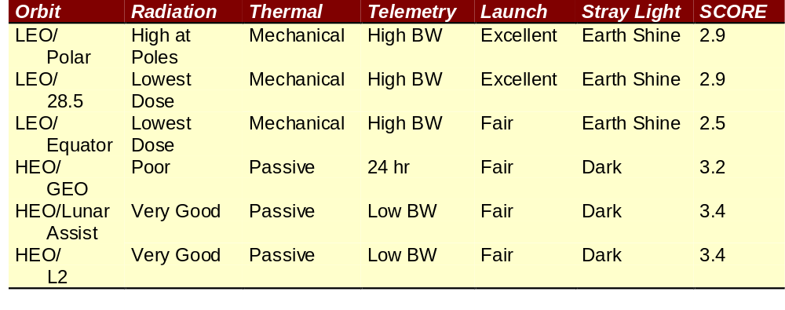
Trade-Study
Ball Aerospace Trade-Study
Selected Lunar Assist “Prometheus” Orbit
14 day orbit: 19Re Perigee/57Re Apogee
7 day orbit: 8Re Perigee/40Re Apogee

Slide 26
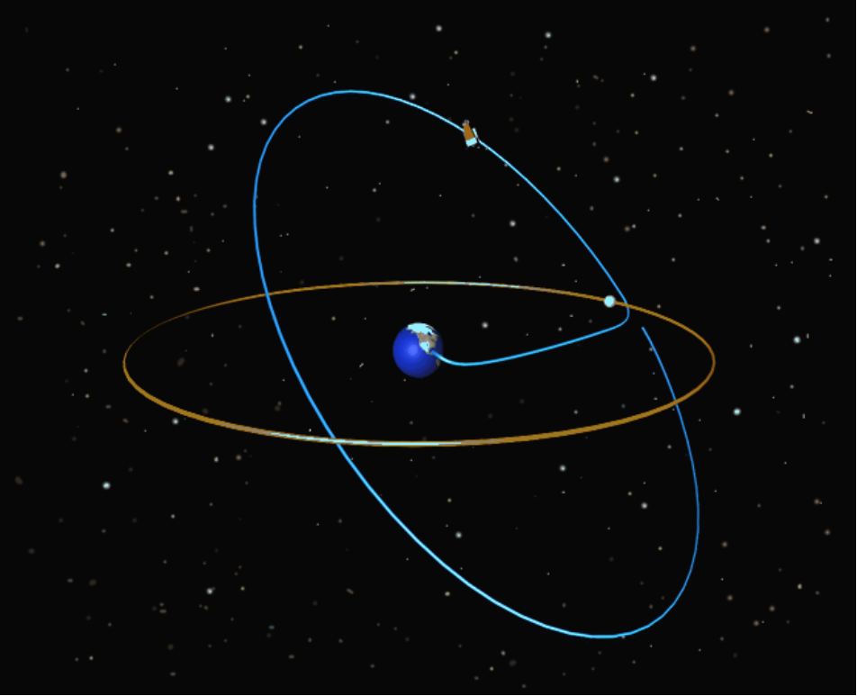
Orbit
  Lunar Assist “ Prometheus” Orbit
    Direct lunar insertion (two stage Delta III), two mid-course corrections
    Lunar swingby to increase perigee above radiation belts
    At perigee small rocket burn to lower apogee
  Orbit Parameters
    High inclination (up to 70 degrees), high angle of perigee
    7 day (8/40 Re) or 14 day (19/57 Re) period to avoid lunar perturbations

Slide 27
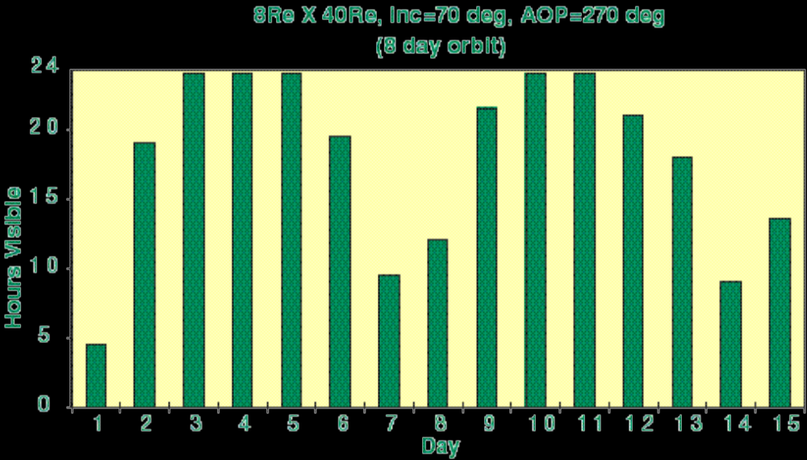
Telemetry
High northern hemisphere orbit has excellent telemetry: ~50 Mbit/s for 19/57 orbit, >50 Mbit/s for 8/40 orbit
8 Gbit image every 200s  40 Mbit/s (no image stacking required)

Slide 28
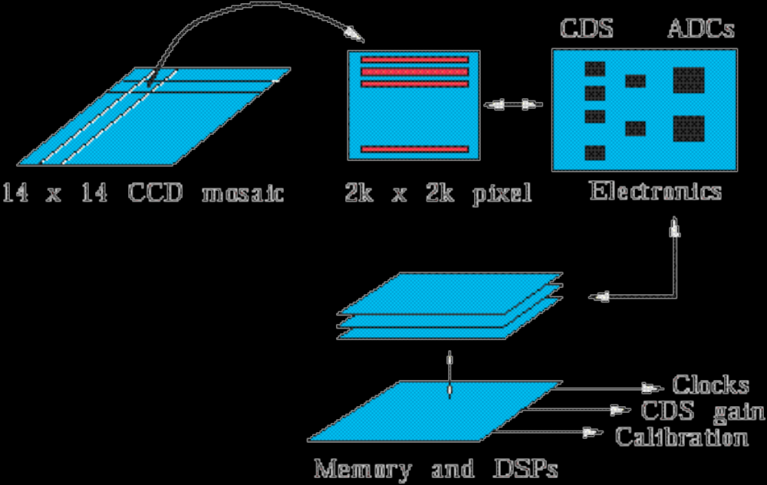
Electronics
GigaCAM Readout looks like high density vertex detector readout with 400 readout channels (two per CCD)
Design from J.F. Genat (Univ. Paris):

Slide 29
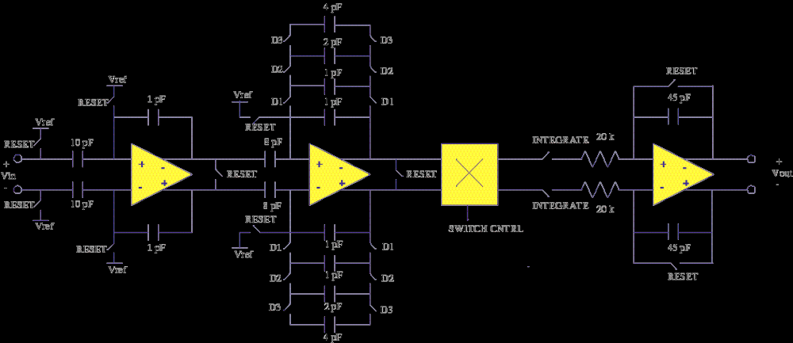
Electronics
Custom Readout - Correlated Double Sampler
Already in development (LBNL/Univ. Paris)

Slide 30
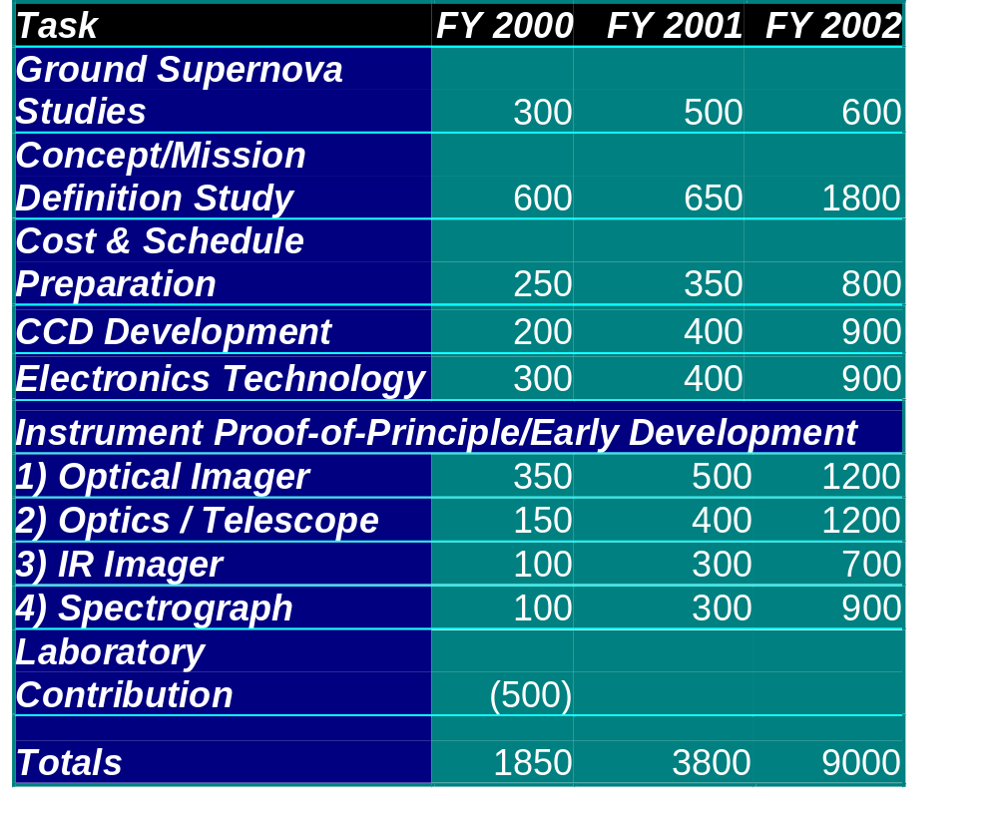
R&D Cost Plan Estimate

Slide 31
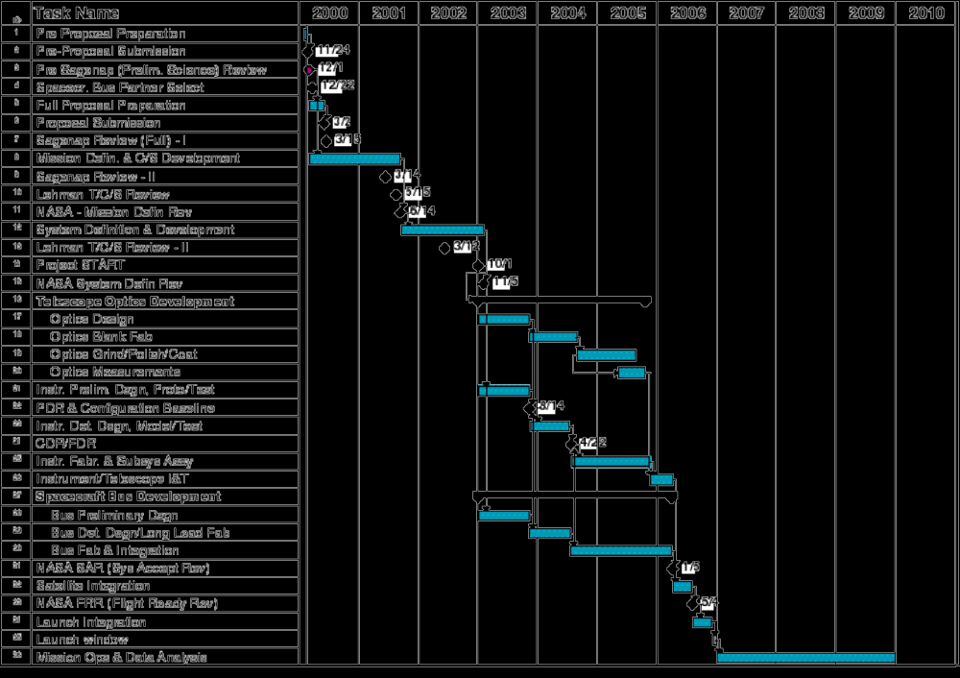
Preliminary Schedule

Slide 32
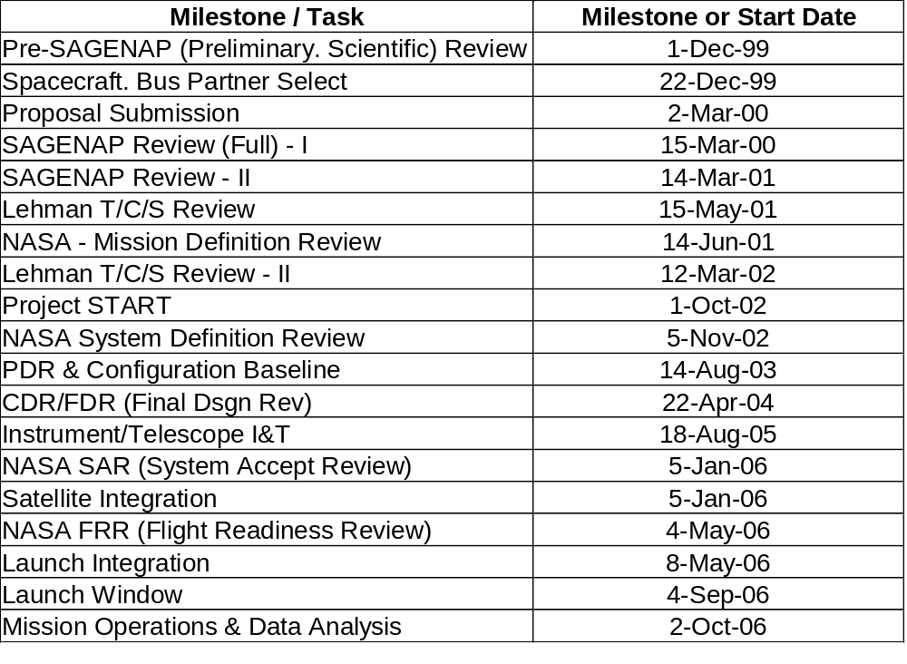
Preliminary Schedule

Slide 33
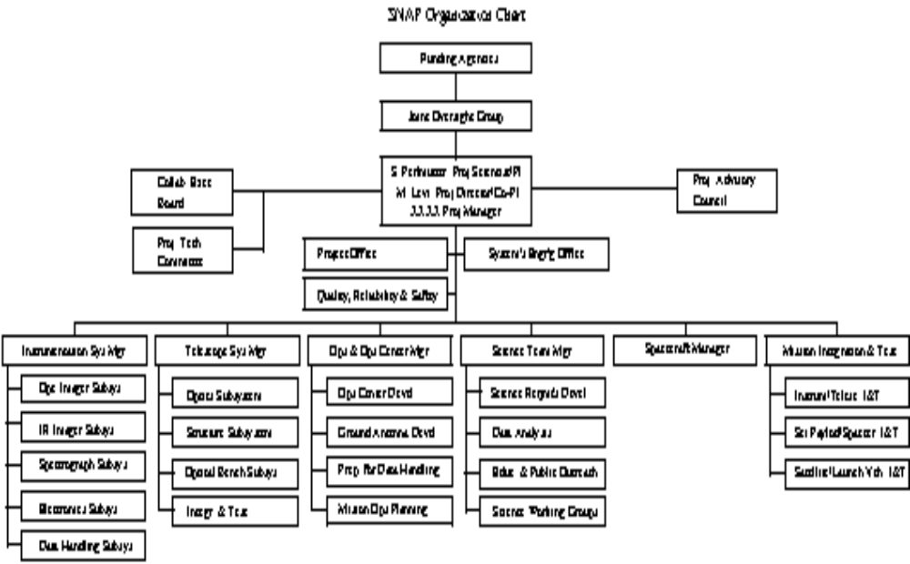
Organization

Slide 34
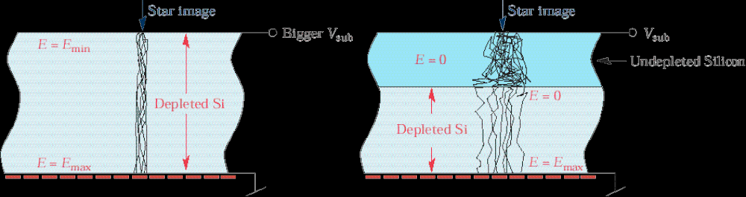
Depleted Silicon

