Slide 1

Reengineering the SIPP:
The New Dynamics of Economic Well-being System
David Johnson
CNSTAT Panel Meeting
January 26, 2007

Slide 2

Reengineering the SIPP

Slide 3
Dynamics of Economic Well-being System Mission
To provide a nationally representative sample for evaluating:
  annual and sub-annual dynamics of income
  movements into and out of government transfer programs
  family and social context of individuals and households
  interactions between these items

Slide 4
Purpose of SIPP
“The two primary goals of SIPP should be to provide improved information on the distribution of income and other economic resources for people and families and on eligibility for and participation in government assistance programs.”
  The Future of the Survey of Income and Program Participation, NAS, 1993
“... [The SIPP] provides an unprecedented opportunity to ascertain the nature of income flows and program participation, both for relatively short periods of time and over extended periods of time, for individuals and families as they experience changes in household composition, income, and labor force participation.”
  Improving National Statistics on Children, Youth and Families, 1984

Slide 5
SIPP and Administrative Data
“The planners of SIPP are to be congratulated for their intention to combine administrative data with field survey measurements. It is…clear that combining such disparate sources of information provides much richer insights into the status and behavior of individuals.”
- James Smith, Journal of Economic
and Social Measurement, 1985

Slide 6

Survey of Income and Program Participation
Uses Of SIPP
Government Agencies
  SIPP is used by many government agencies to measure the effectiveness of government programs, to anticipate effects of program changes, and to aid in program budget projections. Some specific examples are:

Slide 7
Current Uses of SIPP
Department of Agriculture
  Model food stamp eligibility and measure food stamp participation
Department of Health and Human Services
  Measure the economic effect of disabling conditions on children and adults, and determine "triggers" that cause people to go on or to go off programs.
Social Security Administration
  Model SSI benefits, and the restructuring of Social Security such as age threshold changes.
Congressional Budget Office and Congressional Research Service
  Use micro-simulation to measure participation in major government programs

Slide 8
Dynamics of Economic Well-being Goals
Use of annual data collection
Focused content selection
Lower attrition rates
Integrated administrative data
Improved documentation
Improved processing system
Work closely with disclosure review board
Ongoing content determination process; use of “hooks”
Use of ACS
Cost reduction
Improved accuracy
Improved timeliness
and accessibility
Improved relevance

Slide 9
Dynamics of Economic Well-being Progress
Development of Event History Calendar and suggested survey content
Meetings with stakeholders, and completion of matrices
Use of ACS for sample
Administrative record prototypes
CNSTAT Panel

Slide 10
2004 2005 2006 2007 2008 2009 2010
SIPP ’04 Panel
Data Collection
2/04 – 5/07
SIPP ’04 Panel
Data Files Released
9/05 – 2/08
DEWS Planning
2006 – 2009
DEWS Data
Collection
2009 and on
Time period covered by SIPP ’04 Panel data files
2/04 – 5/07
Time period covered by DEWS data collection
2008

Slide 11
Dynamics of Economic Well-being Progress
Development of Event History Calendar and suggested survey content
Meetings with stakeholders, communications and content discussion
Use of ACS for sample
Administrative record prototypes
CNSTAT Panel

Slide 12
Event history calendars
“…the use of event history calendars has considerable potential in assisting respondents to reconstruct their personal pasts more completely and accurately, maximizing the quality of retrospective reports.”
  Robert Belli

Slide 13
A few other surveys with Event History Calendars
Panel Study of Income Dynamics – Univ. of Michigan
National Survey of Family Growth – CDC/NCHS
National Survey of Adolescent Health (AddHealth) - Univ. of North Carolina
Los Angeles Family and Neighborhood Survey – UCLA
English Longitudinal Study of Ageing – NatCen UK, University College London and the Institute for Fiscal Studies.
Health and Retirement Study – Univ. Michigan (Nat. Inst. Ageing)
1998 National Retrospective Demographic Survey (EDER) – Mexico (INEGI)

Slide 14
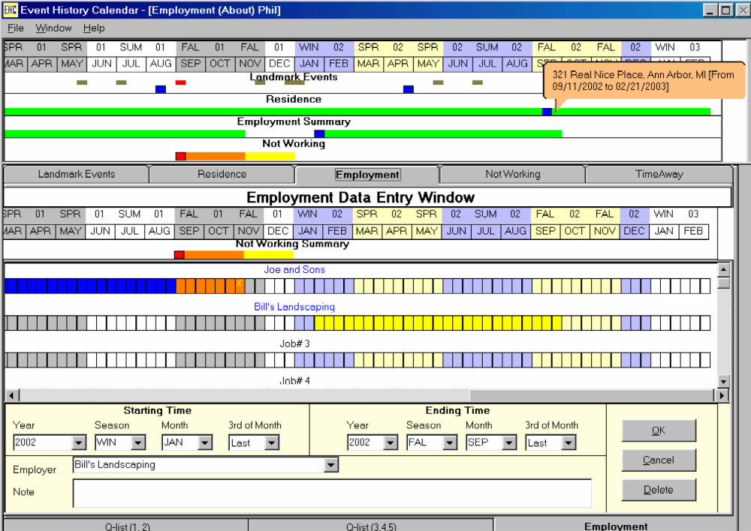
PSID 2003 EHC instrument

Slide 15
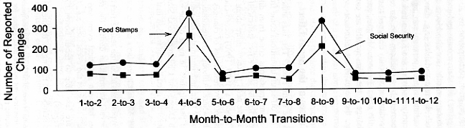
Transitions and “seam bias” in SIPP
(Burkhead and Coder, 1985)
(via Rips, et al., 2003)

Slide 16
PSID Labor transition rates, waves 1995 to 2005
Inflow UE+NE
Outflow EU+EN
40
30
20
10
0
T94_03_04
SEAM94_95
SEAM95_96
SEAM96_97
T97_98WWS
SEAM98_99
T99_00WWS
SEAM00_01
T01_02WWS
SEAM02_03
T03_04WWS
T04_11_12

Slide 17
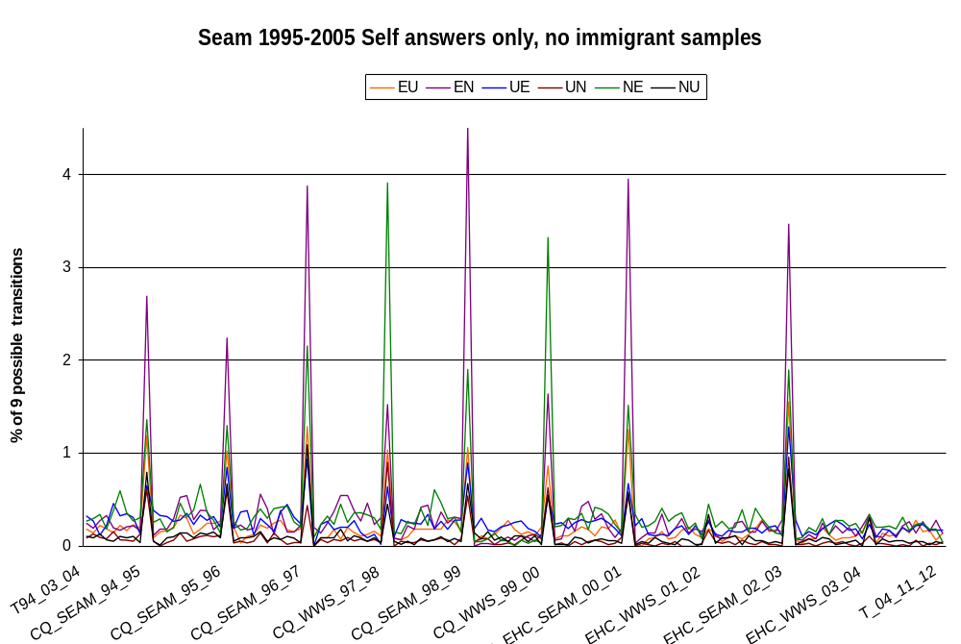

Slide 18
DEWS Instrument
Consists of both BLAISE/EHC components
EHC being developed in collaboration with
  University of Nebraska and University of Michigan
4 EHC Prototypes currently under development by Census authoring staff
First-pass at a ‘working’ integrated instrument slated for fall 2007

Slide 19
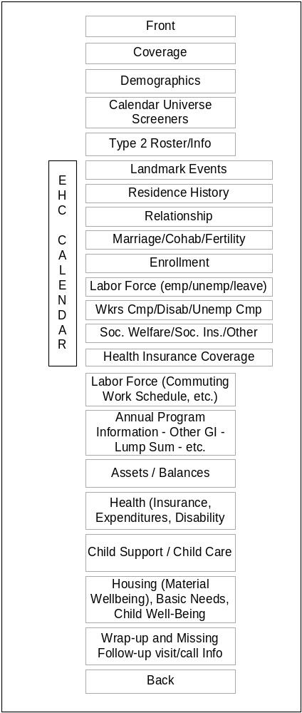
DEWS Survey
Survey Instrument –
  Annual administration
  Follow movers
  Limited feedback
Calendar –
  Improvement on other designs by integrating more closely with Blaise, utilizing the Blaise database.
Simultaneous development of processing and instrument

Slide 20
Dynamics of Economic Well-being Progress
Development of Event History Calendar and suggested survey content
Meetings with stakeholders, communications and content discussion
Use of ACS for sample
Administrative record prototypes
CNSTAT Panel

Slide 21
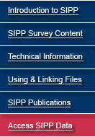







Assessing Users’ Needs
URL: http://www.sipp.census.gov/sipp/dews
Source: U.S. Census Bureau, Demographics Survey Division,
Survey of Income and Program Participation branch
Census Bureau Links: Home · Search · Subjects A-Z · FAQs · Data Tools · Catalog · Census 2000 · Quality · Privacy Policy · Contact Us

Slide 22
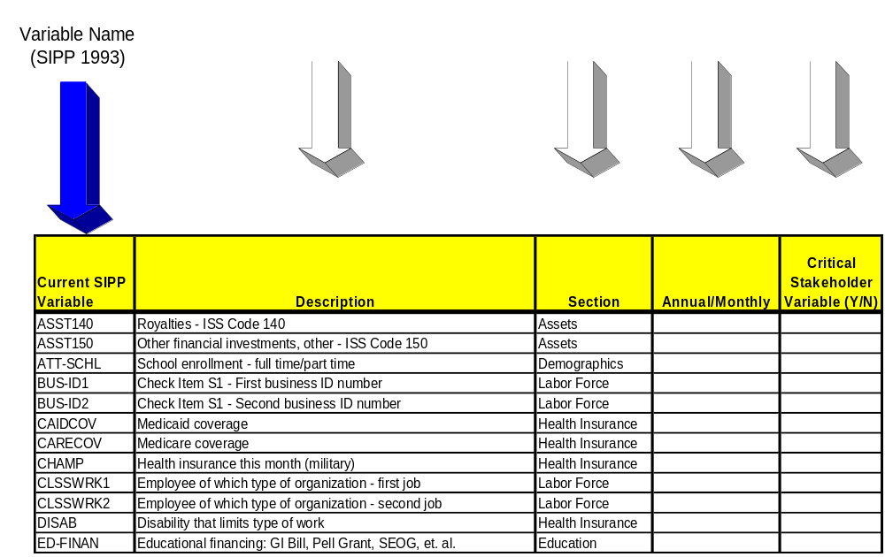
STAKEHOLDER MATRIX

Slide 23
DEWS Content
Census analyst teams review baseline needs using the SIPP 1993 longitudinal data along with evaluating other content needs
Input from stakeholders via meetings and matrices
  DEWS link added to current SIPP webpage
  Key stakeholders asked to complete matrices based on 1993 SIPP content
    Asked to rank variables based on periodicity (monthly/quarterly) and critical need

Slide 24
DEWS Content (cont.)
Similar to the content of SIPP core
  Limited topics from the topical modules included
Use of “hook” questions for future supplementary data collections
Questions only asked one-time per year
Reference period is the previous calendar year

Slide 25

New Survey: Basic versus supplemental products
Basic Topics
Demographics General Income
Labor Force Health Insurance
Assets Education
Program Participation
Child Support
Wealth
Well-being
Disability

Slide 26
Summary of DEWS Content
Based on Stakeholder Matrices
Demographics
• Family/Subfamily type and relationships within
Marital status (Spouse Identifier)
Race/Sex/Ethnicity
School enrolment & highest level completed
Age - Birth month/year
Parent/Guardian identifier

Slide 27
Programs and Participation
• TANF – Recipiency and Coverage
Food Stamps – Recipiency and Coverage
WIC – Coverage
Other welfare – Payments and Coverage
Receipt of free and/or reduced price school meals
Public housing – Residence/Unit and Amount
General Income
• Social Security – Coverage
Retirement from job/business

Slide 28
General Income (cont.)
Transfer, Property, Poverty, or Other Income and/or Earnings Totals for Persons/Families/Households
Labor Force
Employment/Armed Forces status
Hours worked per job/business
Earnings/Pay Rate per job/business
Number of Weeks – Employed, looking for work, or without pay per job/business
Industry/Occupation Code
Assets
Rental Property – Ownership and/or Income

Slide 29
Assets (cont.)
Ownership, Interest, and/or Income from – Savings, CD’s Money Market Accounts/Funds, Bonds, Mortgages, etc.
Ownership and/or Dividends received from – Stocks, Mutual Funds, and other financial investments
Income received from – Royalties
Health Insurance
Medicare/Medicaid coverage, Military health insurance coverage and/or ownership, Employer provided health insurance coverage
Disability
Work limitation/prevention

Slide 30
Stakeholder Summary
Responding users indicated a broad need for most of SIPP core content.
Select areas were added based on lost topical module content.

Slide 31
DEWS Content Determination
What we need from stakeholders
Comments on survey content presented in December
Complete content matrices online
  (http://www.sipp.census.gov/sipp/dews.html)
Participate in winter/spring sessions on topic area details
  Health
  General income/Government programs
  Assets and wealth
  Labor force
  Demographics and other items
All DEWS stakeholder matrix recommendations will be finalized by Spring.

Slide 32
Dynamics of Economic Well-being Progress
Development of Event History Calendar and suggested survey content
Meetings with stakeholders, communications and content discussion
Use of ACS for sample
Administrative record prototypes
CNSTAT Panel

Slide 33
DEWS Survey Design
Sampling Frame
  American Community Survey (ACS) interviewed cases
  Existing SIPP Primary Sampling Units (PSUs)
  Goal is to use 2-years worth of ACS sample
    One year in all PSUs
    Earlier year to supplement sample in smaller PSUs
Oversample based on similar criteria as SIPP
Sample size similar to SIPP (budget permitting)

Slide 34
Dynamics of Economic Well-being Progress
Development of Event History Calendar and suggested survey content
Meetings with stakeholders, communications and content discussion
Use of ACS for sample
Administrative record prototypes
CNSTAT Panel

Slide 35
Administrative Records Prototypes
National-level prototype
  CPS and SIPP linked with administrative records data at the person level
State-level prototype
  Many social programs administered at the state-level
  2004/2005 SIPP data linked to social program data from the states of Maryland and Illinois

Slide 36
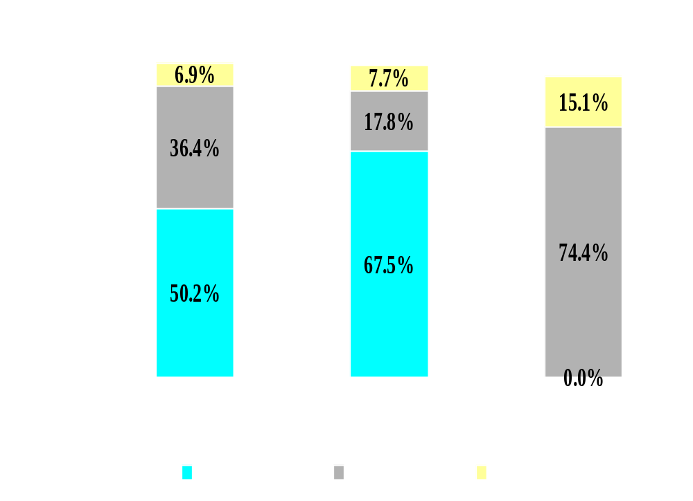
Percent found by SSN verification, ADDRESS, and NAME search (CPS, SIPP and ACS)
94%

Slide 37
Matching Valid SSA Master Benefit records With 2004 SIPP Panel -Retirement Benefits
 | No Retired Benefit-Valid SSN (SSA) | Retired Benefit- Valid SSN (SSA)
No Retired Benefit-SIPP | 84.8% | 1.3%
Retired Benefit-SIPP | 2.9% | 10.9%

Slide 38
Matching Valid SSA Master Benefit records With 2004 SIPP Panel -Retirement Benefits
 | No Retired Benefit-Valid SSN (SSA) | Retired Benefit- Valid SSN (SSA)
No Retired Benefit-SIPP | 84.8% | 1.3%
Retired Benefit-SIPP | 2.9% | 10.9%

Slide 39
Matching Valid SSA Master Benefit records With 2004 SIPP Panel -Retirement Benefits
 | No Retired Benefit-Valid SSN (SSA) | Retired Benefit- Valid SSN (SSA)
No Retired Benefit-SIPP | 84.8% | 1.3%
Retired Benefit-SIPP | 2.9% | 10.9%

Slide 40
Matching Valid SSA Master Benefit records With 2004 SIPP Panel -Retirement Benefits
 | No Retired Benefit-Valid SSN | Retired Benefit- Valid SSN | Imputed NO Benefit- NO Valid SSN | Imputed Benefit- NO Valid SSN
No Retired Benefit-SIPP | 43.4% | 0.7% | 38.4% | 3.8%
Retired Benefit-SIPP | 1.5% | 5.6% | 4.1% | 2.5%

Slide 41
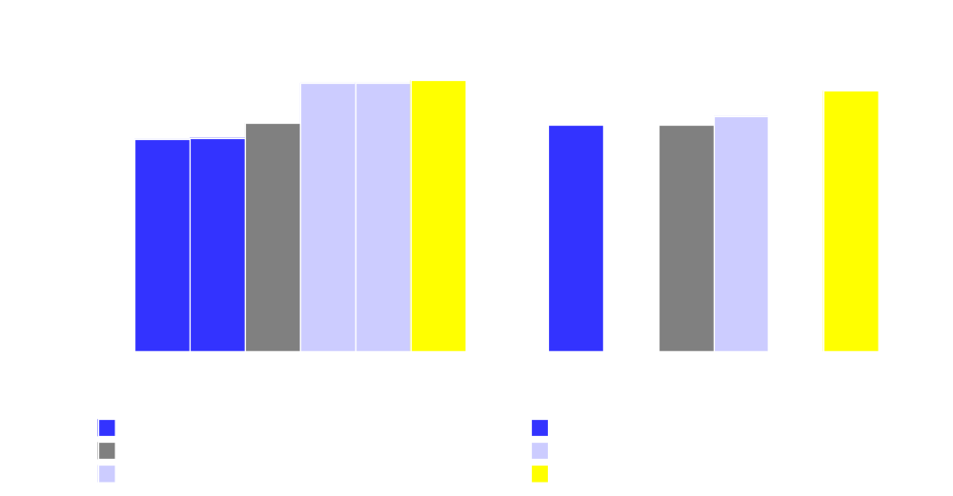
Synthetic Data:
Means for various retirement income sources using actual admin data are similar to synthetic data for many demographic groups
(SIPP 2004 Panel and Monthly Benefit Amount)

Slide 42
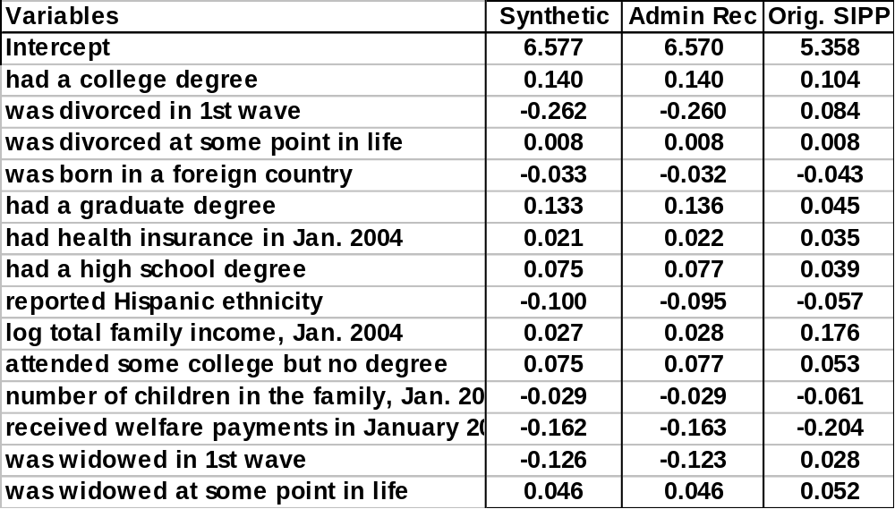
Coefficients using various measures of Retirement income (in logs) as dependent variable

Slide 43
Possible Data Products
Complete
Public
Data
DEWS
Internal files
and RDC
Synthetic
Data

Slide 44
Dynamics of Economic Well-being Progress
Development of Event History Calendar and suggested survey content
Meetings with stakeholders, communications and content discussion
Use of ACS for sample
Administrative record prototypes
CNSTAT Panel

Slide 45
Goals of CNSTAT Panel on DEWS
• To evaluate:
– the costs/benefits of various strategies for data linkage,
– accessibility of relevant administrative records,
– operational feasibility of linking administrative records
and survey data,
– quality and usefulness of linked data, and
– strategies for providing public access to the linked data
while protecting the confidentiality of individual
respondents

