Slide 1
Hepatotoxicity: Leflunomide
Lawrence Goldkind
Deputy Division Director
Division of Anti-Inflammatory, Analgesic and Ophthalmic Drug Products
CDER / FDA

Slide 2
At approval 1998 hepatic enzyme elevation (ALT) was noted
Approved label 1998

Slide 3
        “Warnings”
        Hepatotoxicity
In clinical trials, ARAVA treatment was associated with elevations of liver enzymes, primarily ALT and AST, in a significant number of patients; these effects were generally reversible. Most transaminase elevations were mild
(<2-fold ULN) and usually resolved while continuing treatment. Marked elevations (>3-fold ULN) occurred infrequently and reversed with dose reduction or discontinuation of treatment. The following table shows liver enzyme elevations seen with monthly monitoring in clinical trials US301 and MN301.

Slide 4
“Warnings” (continued)
At minimum, ALT (SGPT) should be performed at baseline and monitored initially at monthly intervals then, if stable, at intervals determined by the individual clinical situation.
Guidelines for dose adjustment or discontinuation based on the severity and persistence of ALT elevation are recommended as follows: For confirmed ALT elevations >2-fold ULN, dose reduction to 10 mg/day may allow continued administration of ARAVA. If elevations >2 but <3-fold ULN persist despite dose reduction, liver biopsy is recommended if continued treatment is desired. If elevations >3-fold ULN persist despite dose reduction, ARAVA should be discontinued and cholestyramine should be administered (see PRECAUTIONS -- General -- Need for Drug Elimination ) with close monitoring, including retreatment with cholestyramine as indicated.

Slide 5
“Warnings” (continued)
        Pre-existing Hepatic Disease
Given the possible risk of increased hepatotoxicity, and the role of the liver in drug activation, elimination and recycling, the use of ARAVA is not recommended in patients with significant hepatic impairment or evidence of infection with hepatitis B or C viruses.

Slide 6
“Precautions”
        Laboratory tests
At minimum, ALT (SGPT) should be performed at baseline
and monitored initially at monthly intervals then, if stable, at
intervals determined by the individual clinical situation.

Slide 7
“Precautions” (continued)
Drug interactions
        Hepatotoxic Drugs
“Increased side effects may occur when leflunomide is given concomitantly with hepatotoxic substances. This is also to be considered when leflunomide treatment is followed by such drugs without a drug elimination procedure.”

Slide 8
Post-approval

Slide 9
Post-marketing reports of hepatitis and acute liver failure (ALF) have been received through the Adverse Event Reporting System/Medwatch (AERS)
-ODS review in 2001 identified highly confounded report: hepatotoxicity was referenced in the label
Citizen’s Petition for removal from the market based primarily on reports of ALF: 2002
Exhaustive re-assessment of hepatotoxicity
-Assessment of individual AERS reports
-Controlled clinical trials
-Other databases, sponsor studies and medical literature
-Data mining

Slide 10
Role of Various Sources of Safety Information
Controlled clinical trials
Cohort studies
AERS database

Slide 11
Controlled Clinical Trials
Strengths
  Comparative to placebo and alternative therapies
  Least bias (imbalance in confounding factors)
  Most detailed data, access to medical records
  Denominator and hence, rate calculation
Weakness
  Not powered for rare to very rare events (<1/100-1/1000)
  Exclusions/limited enrollment vulnerable populations that will be exposed

Slide 12
Cohort Studies
Strengths
  Larger size (power to detect less common events)
  “Naturalistic” (includes “all comers”)
  Identify vulnerable groups, drug interactions
  Can provide rates for events and comparative data
Weakness
  Bias based on channeling, lack of randomization
  Ascertainment less robust (missed cases)
  Lack of access to full medical records (causality)

Slide 13
Adverse Event Reporting System (AERS)
Strengths
  Power: can identify rare events not seen in clinical trials or cohort studies
  Can identify toxicity in special populations
Limits
  Under reporting
  Cannot provide rates for rare events
  Cannot provide comparative data, content
  Limited information may limit causality assessment

Slide 14
Adverse Event Reporting System (AERS)
Limits (continued)
  Causality
    inadequate information to assess
    co-morbidities
    other causes of event (hepatic injury)
      infection, vascular, drugs, treated disease, etc.
    clinical judgement required/variability

Slide 15
Analysis of AERS Database
Survey by ODS identified 16 cases of “temporally associated acute liver failure” (ALF) in the US and 13 cases outside the US
Limited data, inherent subjective “clinical” nature of causality assessment warranted consensus approach to analysis of these reports
Analysis of reports by:
  ODS
  OND: FDA gastroenterologist
  2 external expert hepatology consultants

Slide 16
Analysis of Post-marketing
Reports of ALF
CONCLUSIONS
Rare cases of probable leflunomide induced ALF
Additional “possible” or “unlikely” cases reported
Confounding present in all but several cases
No consistent pattern of clinical and/or biochemical presentation (unlike other serious hepatotoxins, such as troglitazone or bromfenac)
ALF rate cannot be calculated with such small number of events: unknown true numerator or denominator

Slide 17
Questions
“Tip of the unreported iceberg” or exceedingly rare event?
  Can we quantitate the risk?
Is the overall risk:benefit ratio for patients changed by these case reports?
Are other therapies of similar efficacy “safer”?

Slide 18
Goal of Presentation
Assess all available databases for estimates of rates of serious hepatotoxicity

Slide 19
Outline of Presentation: Serious Hepatotoxicity in Leflunomide Databases
I. Clinical Trials Database: Pooled Analysis (PA)
II. Post-marketing Studies of Combination Therapy
III. Aetna/US Healthcare Cohort Analysis
IV. Protocare/Pharmetrics Bi-cohort Analysis
V. National Databank for Rheumatic Diseases
VI. US Acute Liver Failure Study Group (USALFSG)
VII. Data Mining Analysis of AERS

Slide 20
Definitions of Serious Hepatotoxicity
Hepatocellular necrosis: 8-10 x ULN
Hepatocellular necrosis associated with clinical jaundice (Hy’s Rule): 10% mortality
Hospitalization for hepatocellular necrosis
ALF
Death
(will vary based on database availability)

Slide 21
Outline of Presentation: Serious Hepatotoxicity in Leflunomide Databases
I. Clinical Trials Database: Pooled Analysis (PA)

Slide 22
I. Clinical Trials Database: Pooled Analysis (PA)
17 controlled clinical trials
August 1989 - February 2002
Kaplan-Meier analysis
Rates per 100 patient years
Rates of ALT elevations include all causes
(no causality assessments in these analyses)

Slide 23
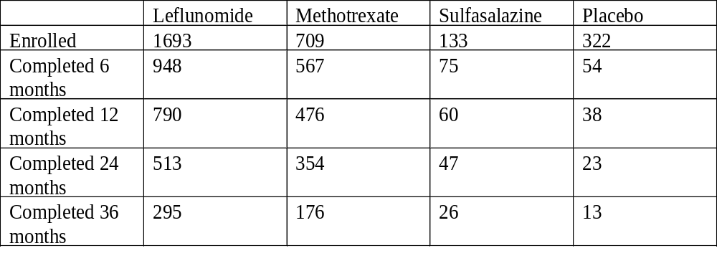
Exposure

Slide 24
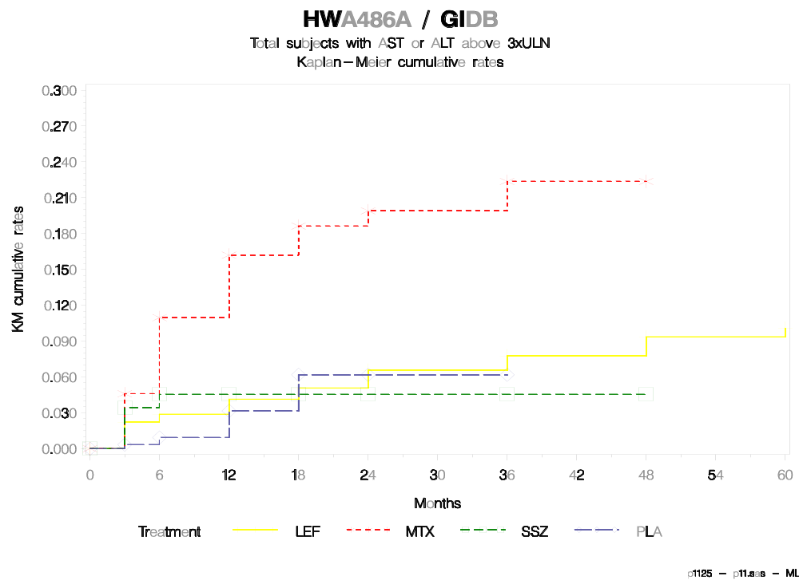

Slide 25
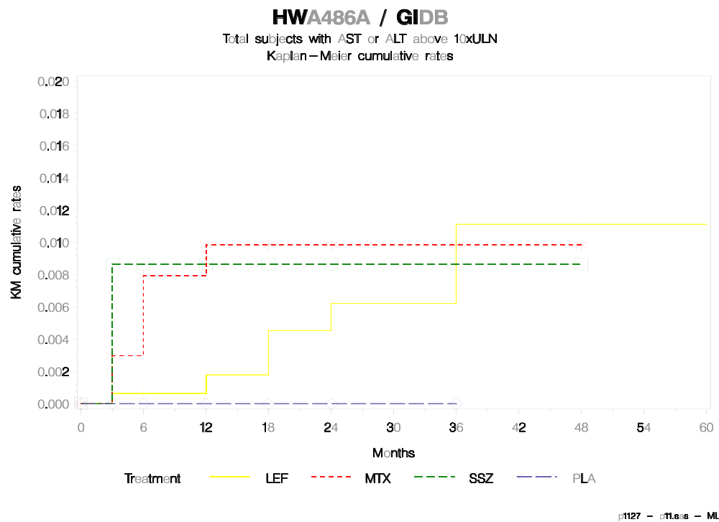

Slide 26
ALT >3 ULN Across Clinical Trials crude rates
Leflunomide Methotrexate Placebo
US 301: (12mo) 4.4% 2.7% 2.5%
MN 301: (6mo) 1.5% ---- 1.1%
MN302*:(12mo) 2.6% 16.7% ----
4001: (6mo) 3.8%
4002: (6mo) 3%
* only 10% folate use
Note:
1. Limitations of using rates of “nonspecific” biochemical changes
2. Presence of a background rate for such events

Slide 27
Assessment of Clinical Trials Database for Serious Drug-Induced Hepatocellular Injury
“Hy’s Rule” - jaundice associated with hepatocellular
injury (>10% mortality)
Review of all cases of ALT elevations and bilirubin over 1.5 x ULN in monotherapy clinical trials of 1700 subjects
- one case of treatment related hepatocellular injury (ALT
peak of 2710) but not jaundice (bilirubin peak 1.3 x ULN)
(patient was hospitalized)
- no cases of hepatocellular jaundice

Slide 28
Outline of Presentation: Serious Hepatotoxicity in Leflunomide Databases
I. Clinical Trials Database: Pooled Analysis (PA)
II. Post-marketing Studies of Combination Therapy

Slide 29
II. Post-marketing Studies of
Combination Therapy
Study 4001: 260 patients on methotrexate and leflunomide
Study 4002: 968 patients on leflunomide alone for 6 months followed by 6 months on combination SSZ
and leflunomide in unresponsive group
Out of 1200 subjects enrolled in combination studies (6-12 month studies), there were no cases of hepatocellular jaundice

Slide 30
Conclusion of Review of All Clinical Trials
ALT elevations >3 x ULN 2-4% range
ALT elevations >10 x ULN under 1%
1/2900 subjects (0.03%) treated with leflunomide experienced treatment related hepatocellular injury and slight elevation of bilirubin
0/2900 subjects experienced ALF

Slide 31
Retrospective Cohort Studies
Aetna/US Healthcare
Pharmetrics/Protocare
National Databank For Rheumatic Diseases

Slide 32
Outline of Presentation: Serious Hepatotoxicity in Leflunomide Databases
I. Clinical Trials Database: Pooled Analysis (PA)
II. Post-marketing Studies of Combination Therapy
III. Aetna/US Healthcare Cohort Analysis

Slide 33
III. Aetna/US Healthcare Cohort Analysis
Retrospective cohort study
Claims database with linkage to medical, pharmacy and laboratory data: claims validation for severe hepatic events
40,000 RA patients: 9/98-12/00
Exposed Pt yr Mean exposure (days)
Leflunomide 2633 4214 585
Methotrexate 9514 10682 410
DMARD* 14861 31158 765
* gold, ssz, penicillamine, TNF, cya, minocycline, steroids, chlorambucil, hydroxychloroquine

Slide 34
Aetna/US Healthcare
Strength:
1. Case validation for severe events (all severe hepatic cases were evaluated with 100% agreement/validation: 20% of all hepatic events were assessed with 83% validation)
2. Large size (although an even larger size would be needed to observe rare events under 1/1000)
Weakness:
1. No causality assessment
2. Channeling bias/Lack of randomization ? Sicker or refractory to MTX channeled into lef
? Prior MTX use deplete intolerant patients from current cohort

Slide 35
Results
Hepatic necrosis: rate/10,000 pt yr (n)
Leflunomide 2.4 (1)
Methotrexate 1.9 (2)
1/2633 (0.04%) experienced “hepatic necrosis”
No cases of hepatocellular jaundice
No data on hospitalization available

Slide 36
Outline of Presentation: Serious Hepatotoxicity in Leflunomide Databases
I. Clinical Trials Database: Pooled Analysis (PA)
II. Post-marketing Studies of Combination Therapy
III. Aetna/US Healthcare Cohort Analysis
IV. Protocare/Pharmetrics Bi-cohort Analysis

Slide 37
IV. Pharmetrics/Protocare
Bi-cohort Study Analysis
Nested retrospective case control study
Pharmetrics: standardized claims data for managed care organizations
Protocare: Health benefits claims including Medicaid, Medicare, PPO and HMO
First prescription: 1/98-12/01
130,000 RA patients
Rate ratios compared to methotrexate

Slide 38
Pharmetrics/Protocare Bi-cohort Study
42000 RA patients on a DMARD
-2800 on started on leflunomide monotherapy
-15000 on methotrexate
51000 pt yr exposure
Mean follow-up: 400-500 days
Weakness:
1. Channeling bias, no causality assessment
2. No clinical information for validation
- limitation of code based analysis
- imprecision obscures differences

Slide 39
Definition of Hepatic Events
Hepatic events requiring hospitalization
-Acute or subacute necrosis: ICD-9: 570
-Cirrhosis of liver without mention: 571.5
-Hepatitis-noninfectious toxic: 573.3
-Hepatic coma: 572.2
“Expanded events” definition: above codes but
without hospitalization

Slide 40
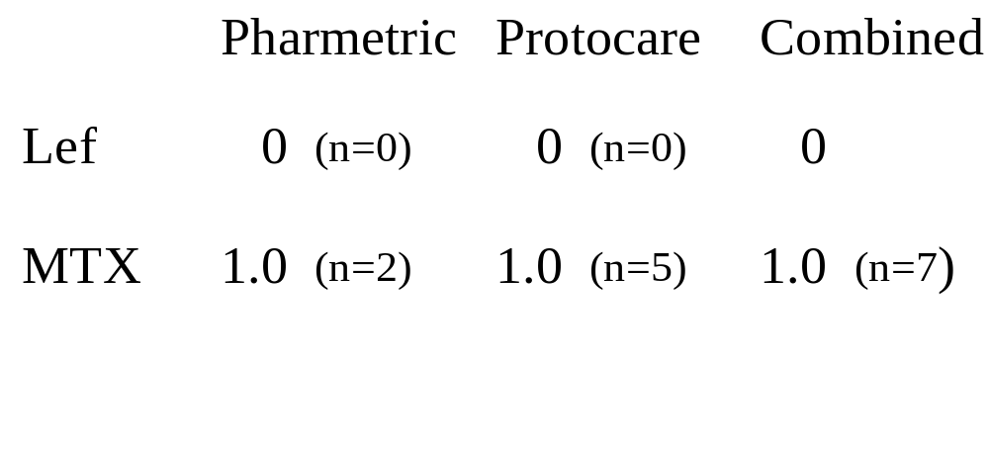
Results: Hospitalization for any hepatic events (Crude relative rate)

Slide 41
Results: Expanded Definition
Hepatic events not requiring hospitalizations
(Crude relative risk)
Pharmetric Protocare Combined
Lef 0.9 1.1 0.9
(n=45) (n=11) (n=56)
MTX 1.0 1.0 1.0
(n=93) (n=45) (n=138)

Slide 42
Conclusions from Bicohort Study
No cases of leflunomide related serious hepatitis defined by hospitalization for hepatic event (including hepatocellular necrosis)
Similar risk to methotrexate for overall hepatic events
  Caveat: limitations of lack of causality and bias/absence of randomization may obscure differences

Slide 43
Outline of Presentation: Serious Hepatotoxicity in Leflunomide Databases
I. Clinical Trials Database: Pooled Analysis (PA)
II. Post-marketing Studies of Combination Therapy
III. Aetna/US Healthcare Cohort Analysis
IV. Protocare/Pharmetrics Bi-cohort Analysis
V. National Databank for Rheumatic Diseases

Slide 44
V. National Databank for Rheumatic
Diseases
Longitudinal patient reported surveillance program
recruited from rheumatology practices and Aventis registry
Adverse events collected from patients by mail survey
- participant: at least one semi-annual questionnaire received
- 5437 on leflunomide (12786 responses)
- 10527 on methotrexate (31313 responses)
Hospitalization and deaths corroborated by physician records and death certificates

Slide 45
National Databank for Rheumatic Diseases
Strengths:
1. Large database
2. Validation of serious events (hospitalization and
death)
Weakness:
1. Not randomized (confounded by co-therapy and non
drug events)
2. Potentially incomplete reporting
3. Non-serious events are not assessed for causality
(comparative rates not accurate representation of drug
specific toxicity)

Slide 46
Results
Hospitalization rate for ICD-9 related liver codes/100 pt year
  Acute/chronic conditions
  Broad coding definition of all hepatic codes
  Unrelated events add “noise” and may obscure differences
    leflunomide: 0.20
    methotrexate: 0.27
Hospitalization for probable drug induced hepatocellular necrosis of the liver:
  One on leflunomide (neutropenia, fever and ALT 524)
  Possible septic hepatopathy
  No ALF

Slide 47
National Databank for Rheumatic Diseases: Conclusions
One hospitalization for drug related hepatocellular injury (without jaundice) in a database of over 5000 patients on leflunomide (7500 patient years)
No cases of ALF

Slide 48
Outline of Presentation: Serious Hepatotoxicity in Leflunomide Databases
I. Clinical Trials Database: Pooled Analysis (PA)
II. Post-marketing Studies of Combination Therapy
III. Aetna/US Healthcare Cohort Analysis
IV. Protocare/Pharmetrics Bi-cohort Analysis
V. National Databank for Rheumatic Diseases
VI. US Acute Liver Failure Study Group (USALFSG)

Slide 49
VI. US Acute Liver Failure Study
Group: Survey of Drug Induced
Liver Failure
“Results of a prospective study of acute liver failure at 17 tertiary care centers in the United States” Ann Intern Med 2002
January 1998-May 2001 (covers first 30 months of leflunomide marketing)
Approximately 25-40% of transplant capability (not all ALF or serious hepatotoxicity is referred to transplant centers)
308 consecutive patients admitted with ALF
39% acetaminophen
13% (40 cases): bromfenac (4), troglitazone (4), INH (5)

Slide 50
US Acute Liver Failure Study Group: Survey of Drug Induced Liver Failure
One case of ALF associated with leflunomide
This case was captured independently by the FDA AERS database
  The one case of probable leflunomide induced ALF not associated with overdose in the AERS review
Conclusion: The extent of underreporting of ALF associated with leflunomide may well be much lower than generally quoted (90-99%) given the findings from this study.

Slide 51
Conclusions
Hepatotoxicity in available databases
In studies of 6-12 months duration, ALT elevations (>3 x ULN)
are consistently associated with the use of leflunomide (2-4%), methotrexate (2-16%) and placebo (1-2%)
Clinically significant liver injury (hospitalization) in 4 databases consistently low
Across studies: for hospitalization for hepatocellular necrosis or hepatocellular jaundice
  1/2900 Clinical Trials
  0/2800 Bicohort Study
  1/5400 National Databank for Rheumatic Diseases

Slide 52
Conclusions (continued)
0.02% hospitalization for hepatocellular necrosis
  NNH: 1:5500 (lower 95% CI ~ 1:2000)
No cases of hepatocellular jaundice: 0/13700
  NNH: lower 95% CI, therefore under 1:5000
Using Hy’s Rule - 10% mortality
  NNH for hepatic necrosis causing under ~ 1:50,000 (lower 95% CI under 1:15,000)
  Caveat: event ascertainment by self reporting and diagnosis coding in health claims and hospitalization susceptible to inaccuracy and under reporting

Slide 53
Dilemma
Rare (under 1/5000) hospitalization for hepatic necrosis in controlled studies
Few probable cases of drug induced ALF in post-marketing reports
? Comparative risk to other therapies
- Redirect therapy from one potential toxicity to another
- TNF-alpha inhibitors: malignancy, infection . . .
- Methotrexate: malignancy, pneumonitis, infection,
cirrhosis …

Slide 54
Dilemma
For the patient who experiences ALF, no risk benefit analysis can favor therapy but for prospective prescribers and patients…
How to interpret magnitude of risk for very rare events in uncontrolled databases and characterize for prescribing physicians and patients
Back to post-marketing reports . . .

Slide 55
Outline of Presentation: Serious Hepatotoxicity in Leflunomide Databases
I. Clinical Trials Database: Pooled Analysis (PA)
II. Post-marketing Studies of Combination Therapy
III. Aetna/US Healthcare Cohort Analysis
IV. Protocare/Pharmetrics Bi-cohort Analysis
V. National Databank for Rheumatic Diseases
VI. US Acute Liver Failure Study Group (USALFSG)
VII. Data Mining Analysis of AERS

Slide 56
What is Data Mining?
A system to allow computer analysis of the AERS database of millions of reports to identify and quantitate “signals” for drug associated adverse events
Currently being evaluated in the Office of Biostatistics as a screening tool to identify drugs and events that require further examination and study
“ Use of Screening Algorithms and Computer Systems to Efficiently Signal Higher than Expected Combinations of Drugs and Events in the US FDA’s Spontaneous Reports Database”
Szarfman, Machado and O’Neill: Drug Safety 2002, 25(6):381-392

Slide 57
Adverse Event Reporting System
(AERS)
Strengths
  Power: can identify rare events not seen in clinical trials or cohort studies
  Can identify toxicity in special populations
Limits
  Cannot provide rates for rare events
  Cannot provide comparative data for context
  Limited information may limit causality assessment

Slide 58
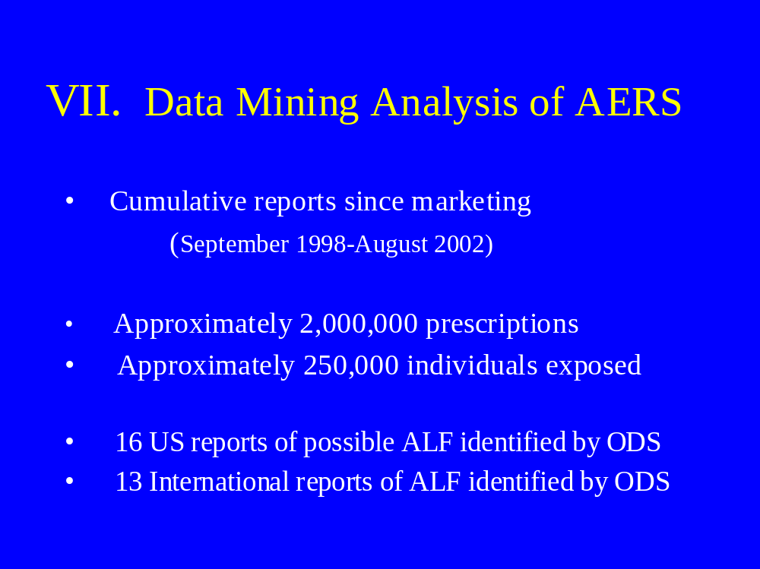

Slide 59
Why Data Mining?
Coherently organize and interpret a large database!
Medwatch Database
- over 2 million reports
- over 8000 products
- 7000 MedDRA preferred “event terms” - 56 million possible drug event combinations
(cells in a two way table)
- 300,000 new reports per year

Slide 60
Example
Data mine across the AERS database for the event code “hepatic failure”
- Limit to those drugs with at least 3 reports - Identify those drugs which have such signals out
of proportion to “background” or “expected”
reporting rate for the the overall database of drugs
Background rate: gray
Signals for higher than expected: blue-purple

Slide 61
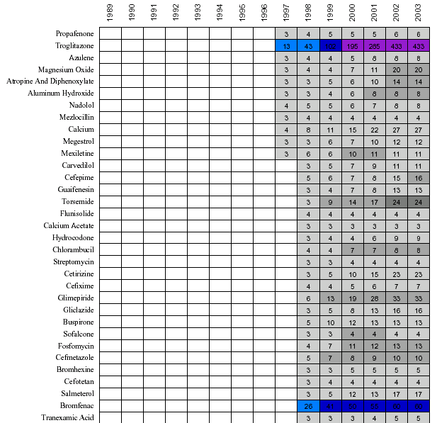

Slide 62
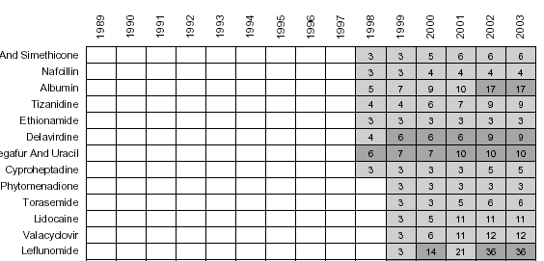

Slide 63
Drugs with a Signal for Hepatic Failure
Include
  troglitazone
  bromfenac
  trovafloxacin
  ketoconazole
  fluconazole
  flutamide
  isoniazid
  nitrofurantoin
  halothane
  isoflurane
  didanosine

Slide 64
Data Mining for Drugs Used to Treat Rheumatoid Arthritis
Highlights graphically the complexity of assessing
post-marketing serious and life threatening events
May provide insight into the AERS reports of serious hepatic events for leflunomide

Slide 65
Data Mining Study of Spectrum of Drugs and Associated Serious Adverse Events Used to Treat RA (plus Control Drugs)
RA
- leflunomide
- gold
- etanercept
- prednisone
- infliximab
- anakinra
- methotrexate
- hydroxychloroquine
- sulfasalazine
Controls
- bromfenac
- acetaminophen
- valproate
- isoniazid
- ketoconazole
- troglitazone
- chlorzoxazone (parafon)

Slide 66
Data Mining
Specific Outcome Events of Interest
Fatal events only
  Liver related events
  Opportunistic infections
  Lymphoma
  Note: only drugs with a signal appear on graph

Slide 67
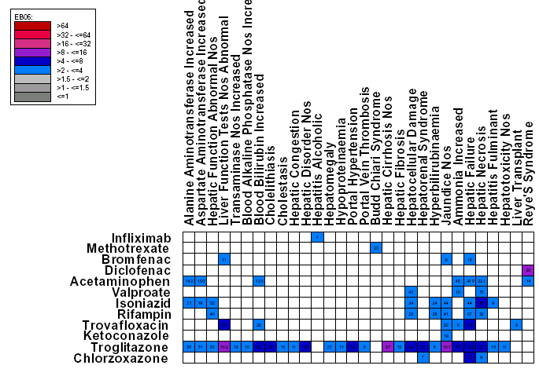

Slide 68
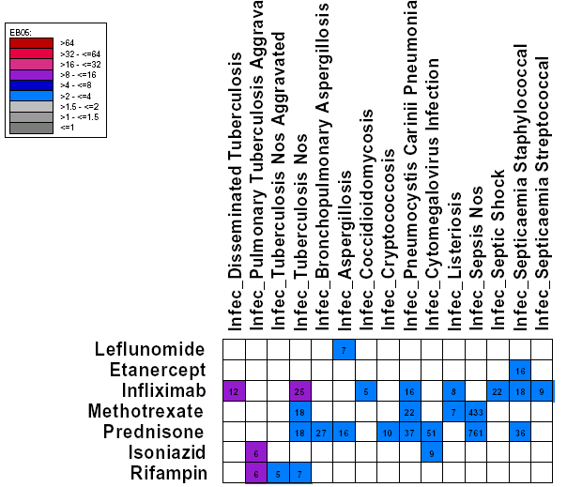

Slide 69
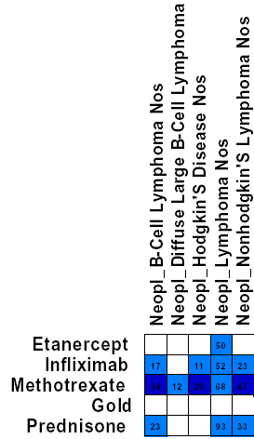
Leflunomide is not seen in this chart because there is no signal for it

Slide 70
Conclusions from Data Mining
Currently under evaluation as a signaling tool in post-marketing safety assessment
Signals require interpretation and validation based on review of reports
  false positives: based on disease being treated and reporting intensity variability
  false negative: absence of signal?

Slide 71
Conclusions from Data Mining (continued)
Highlights graphically the complexity of assessing post-marketing serious and life threatening events
Highlights graphically the “unique fingerprint” for reported rare events for each drug

Slide 72
Conclusions from Data Mining (continued)
Signal for leflunomide not above “threshold” of this data mining system for life threatening acute liver injury
This does not mean that it does not occur - ALF events have occurred
This analysis does suggest that the pattern of reported hepatic failure events for leflunomide is different than that seen for hepatotoxic drugs such as troglitazone, trovafloxacin, valproate, flutamide, isoniazid or bromfenac

Slide 73
Overall Conclusions Regarding Hepatotoxicity of Leflunomide
Minor hepatotoxicity defined by ALT elevation is not “uncommon” in clinical trials (2-4%)
Serious drug induced hepatotoxicity defined by hospitalization for hepatotoxicity in controlled databases is rare (0.02%)
ALF and death have been reported in post-marketing experience

Slide 74
Overall Conclusions Regarding Hepatotoxicity of Leflunomide
A rate for hepatocellular jaundice (Hy’s Rule) cannot be accurately defined but . . .
Based on absence of cases in a combined database of 13,700
  lower bound 95% CI very likely under 1:5000
  exposures
Based on Hy’s Rule (10% mortality)
  Estimate for deaths due to ALF 1:50,000

Slide 75
Overall Conclusions Regarding Hepatotoxicity of Leflunomide
(continued)
When looking across drugs used to treat rheumatoid arthritis, life threatening events are associated with all available therapies
  NSAIDS
  DMARDS (drugs)
  DMARDS (biologic)
It is important to characterize and communicate these rare but life threatening events as coherently as possible for optimal use

Slide 76
Finis

Slide 77
Conclusions from AERS Reports Analysis
Cases of serious hepatotoxicity including ALF due to leflunomide have occurred
Cannot calculate a rate based on post-marketing reporting
  Confounding and lack of consistent clinical or biochemical pattern
  Both numerator and denominator difficult to define

