Slide 1

Analysis of Diffusion Path and Interdiffusion Microstructure
Y. Wang and J. E. Morral
Department of Materials Science and Engineering
The Ohio State University
Work Supported by NSF
NIST Diffusion Workshop
April 19-20, 2005, Gaithersburg, MD

Slide 2
Outline
Discontinuities in interdiffusion microstructure and “horns” in the diffusion path
Motion of Type-0 boundaries and its effect on the shape of diffusion path
Variation in microstructure and diffusion path caused by deviation from local-equilibrium conditions and by precipitate coarsening
Special points on the phase diagram that act as “strange attractors” of the diffusion paths
Development of various morphological instabilities including concentration-gradient induced rafting
These phenomena are associated with intimate thermodynamic and kinetic coupling in multi-component diffusion and interactions between interdiffusion and microstructural evolution in multi-phase regions

Slide 3
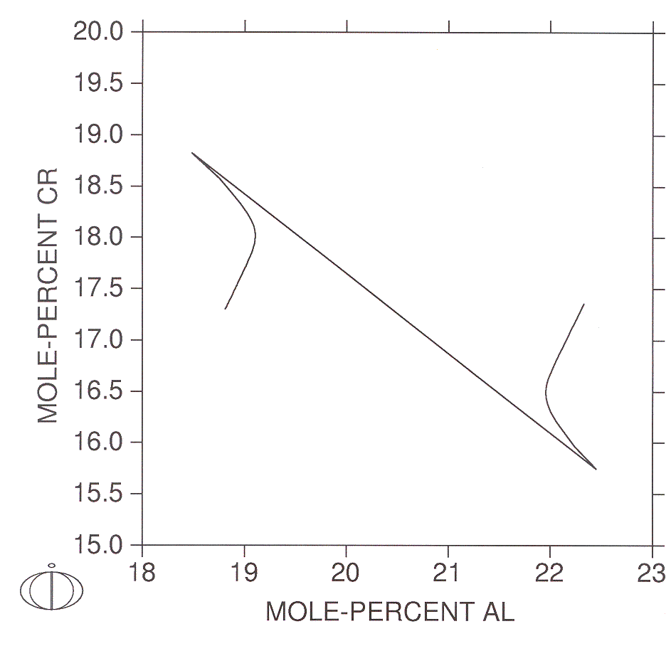
Horns predicted by DICTRA and Phase Field simulations
Understanding the “Horns” in Diffusion Path
Schwind, Helendar and Argren, Scripta mater. 2001
Wu, Morral and Wang, Acta mater. 2001

Slide 4
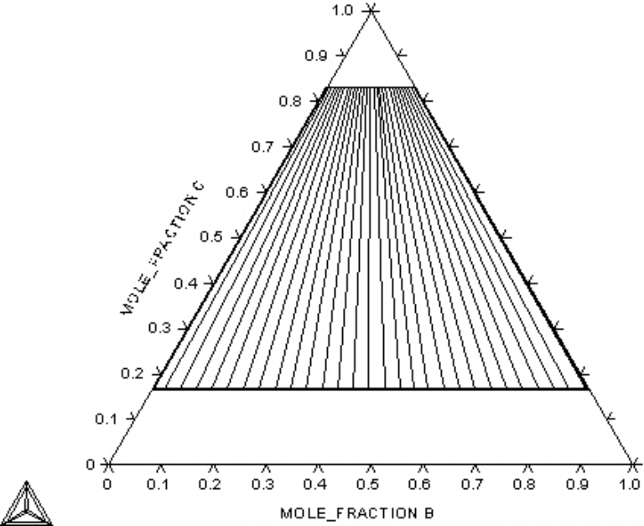
A-B-C Model System
Free energy model
C
α’
Elements A and B form ideal solution while elements A and C or B and C form regular solutions
α
A
B

Slide 5
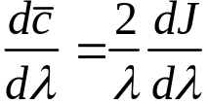
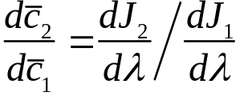

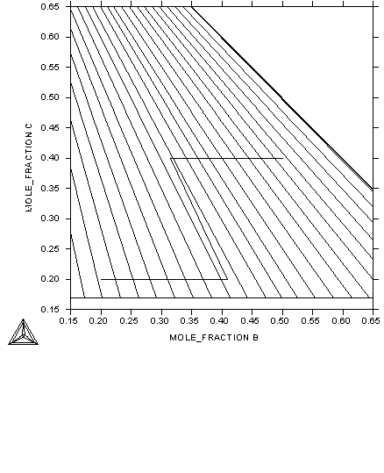



Linear Diffusion Path
β_{B}=5.0 β_{C}=1.0 β_{A}=5.0

Slide 6


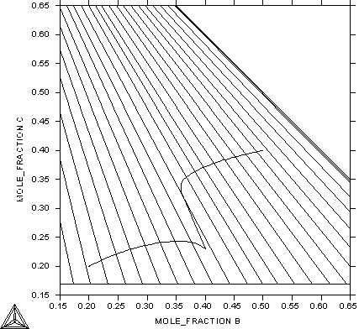
Single-Horn Diffusion Path
(2)
β_{B}=1.0 β_{C}=5.0 β_{A}=10.0
(1)

Slide 7
Single-Horn Diffusion Path
3
4
1
1
2
3
2
4

Slide 8
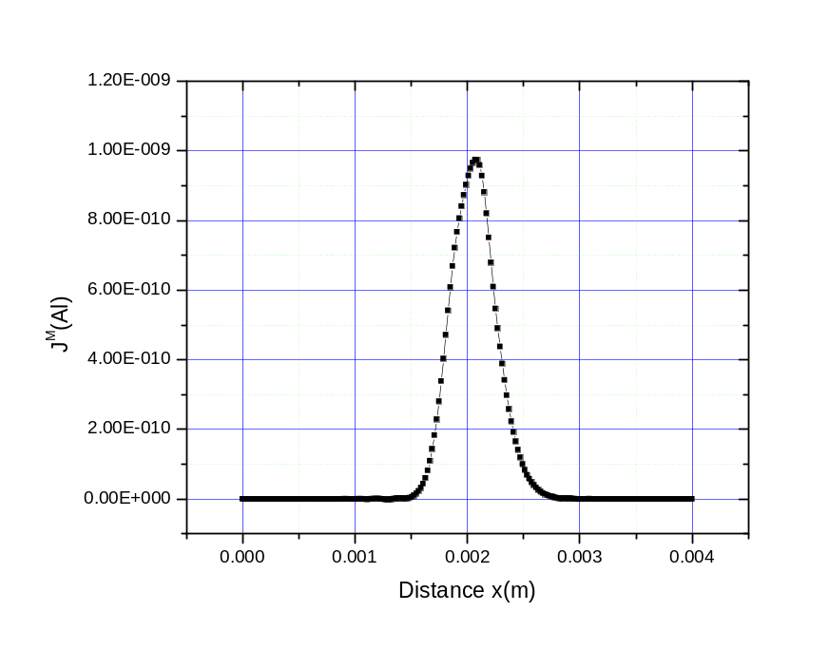
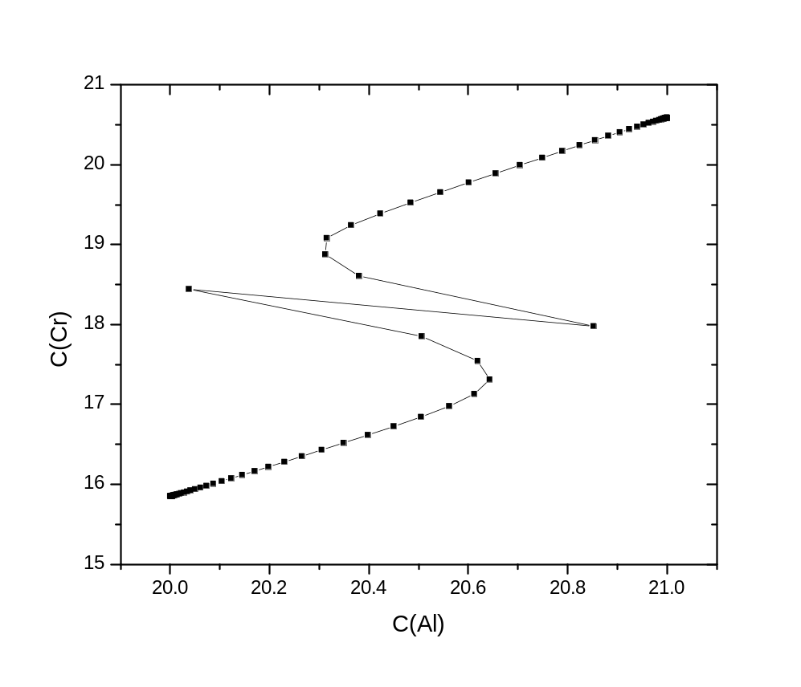
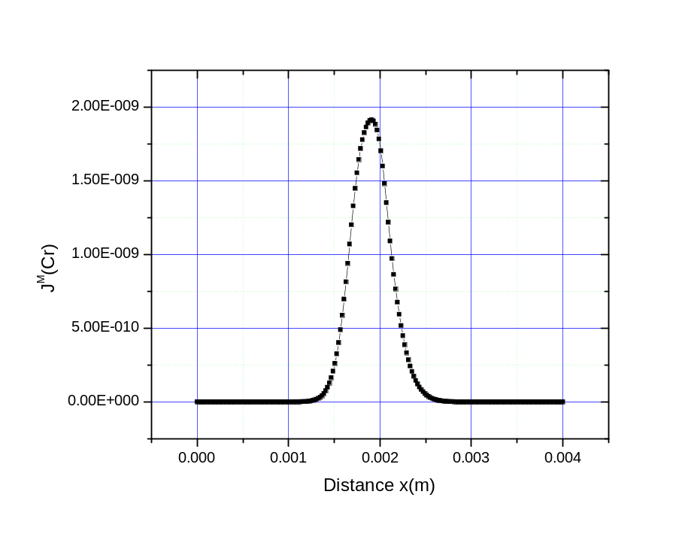
Double-Horn Diffusion Path

Slide 9
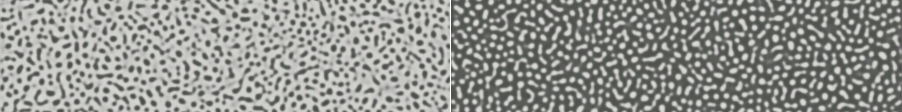

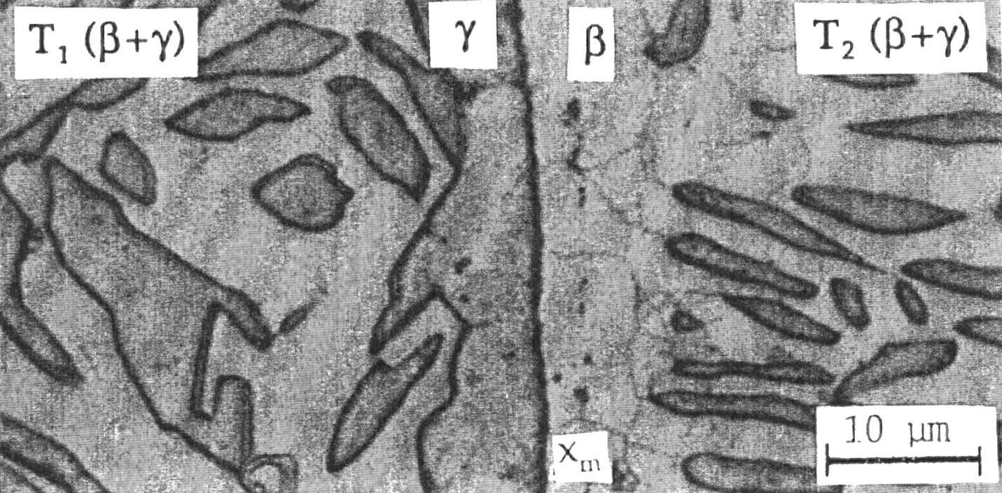
Interpretation of Simulation Results
Wu, Morral and Wang, Acta mater. 49, 3401 – 3408 (2001)
β_{B}=10.0 β_{C}=5.0 β_{A}=1.0
J_{A}
τ=0.0
J_{B}
net flux of (A+B)
τ=2000.0
γ+γ'<γ<γ'<γ′+γ
(2)
c₁ = 25 at%, c₂ = 40 at%
c₁ = 32 at%, c₂ = 60 at%
(1)
Yong-Ho Sohn and M. Dayananda
Simulations have stimulated the development of theoretical understanding and new theoretical principles have guided the interpretation of simulation results

Slide 10

γ′+γ/γ+γ′ Couple
β_{B}=1.0 β_{C}=5.0 β_{A}=10.0
τ=0.0
(2)
τ=2000.0
γ′+γ>γ+γ′
c₁ = 25 at%, c₂ = 40 at%
c₁ = 32 at%, c₂ = 60 at%
J_{A}
J_{B}
net flux of (A+B)
(1)
Wu, Morral and Wang, Acta mater. 49, 3401 – 3408 (2001)

Slide 11



Moving Type 0 Boundary
K. Wu, J. E. Marrol and Y. Wang, Acta mater. 52:1917-1925 (2004)
Ppt and Type 0 boundary migrate as a results of Kirkendall effect
Type 0 boundary becomes diffuse
Kirkendall markers move along curved path and marker plane bends around precipitates
τ = 0
τ = 100
τ = 2000
β₁=1.0 β₂=5.0 β₃=10.0
4608x64 size simulation, 1024x256 size output

Slide 12
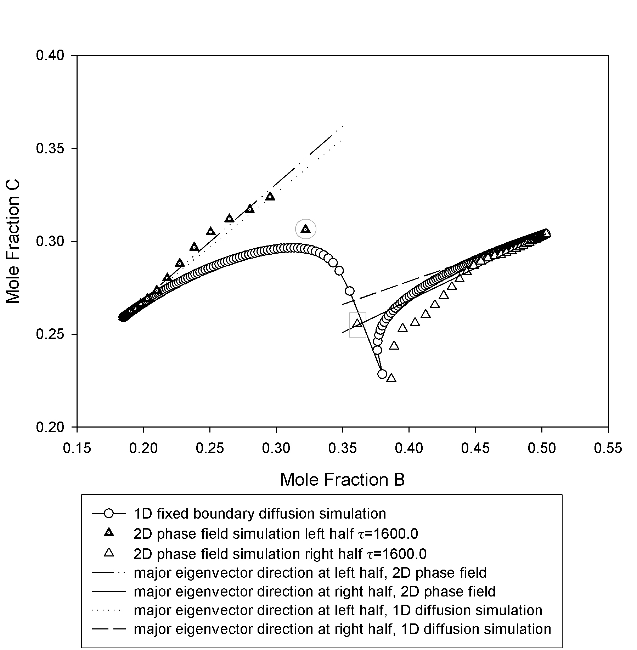
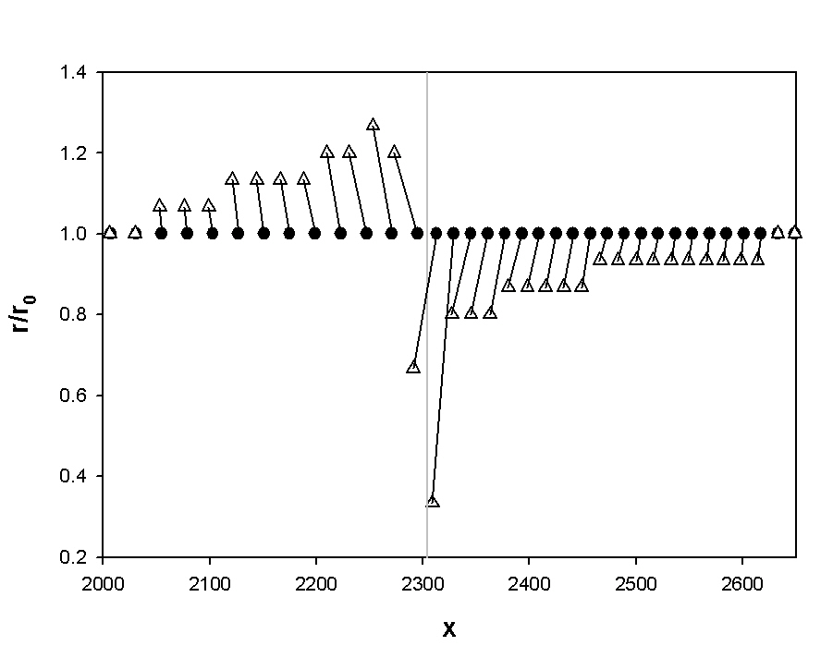
Diffusion path: comparison with 1D simulation
Size and position changes during interdiffusion

Slide 13



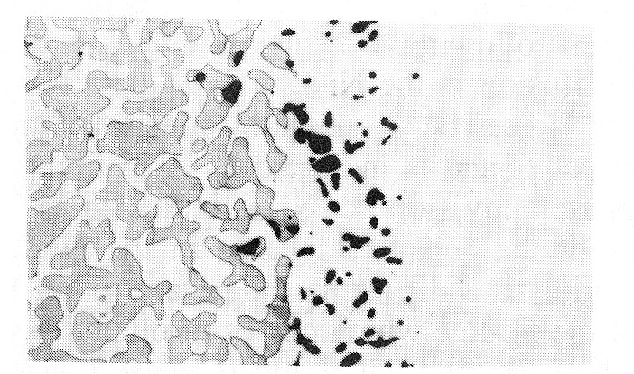
Interdiffusion Microstructure in NI-Al-Cr Diffusion Couple
0 hr
Ni-Al-Cr at 1200ºC
X_{Cr} =0.25, X_{Al}=0.001
Free energy data from Huang and Chang
Mobilities in γ from A.EngstrÖm and J.Ågren
Diffusivities in β from Hopfe, Son, Morral and Roming
320μm
4 hr
25 hr
100 hr
at 1200ºC
Exp. Observation by Nesbitt and Heckel
200μm

Slide 14

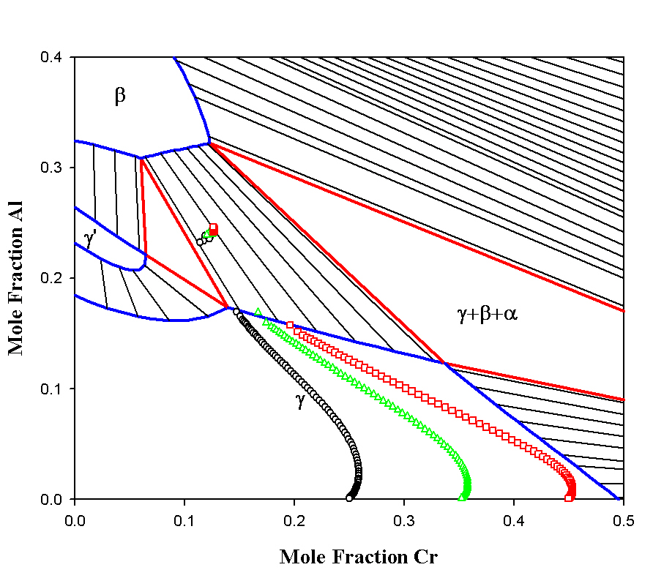

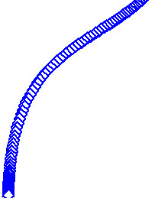

(a)
Effect of Cr content on interface migration
320μm
Annealing time: 25 hours
(b)
Ni-Al-Cr at 1200ºC
(c)
(d)
a
b
c
d

Slide 15
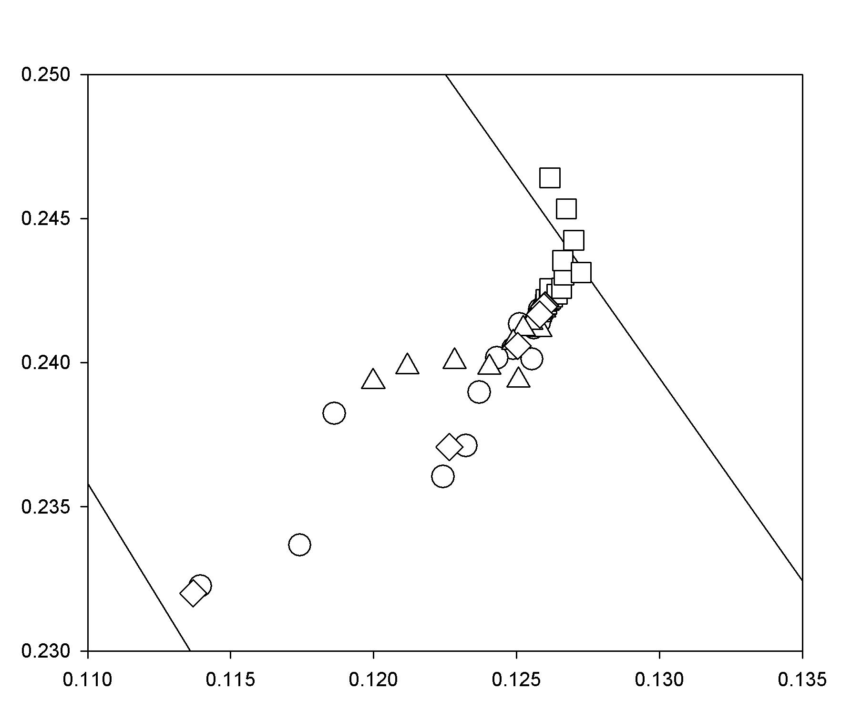
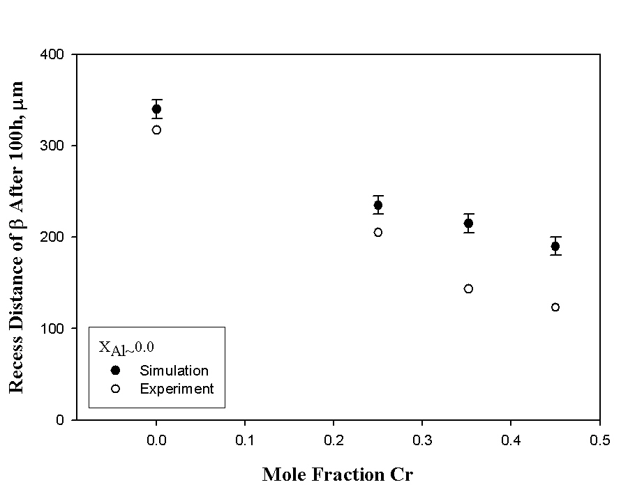
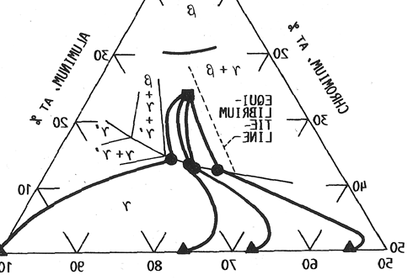
Diffusion path and recess rate - comparison with experiment
Exp. measurement by Nesbitt and Heckel

Slide 16


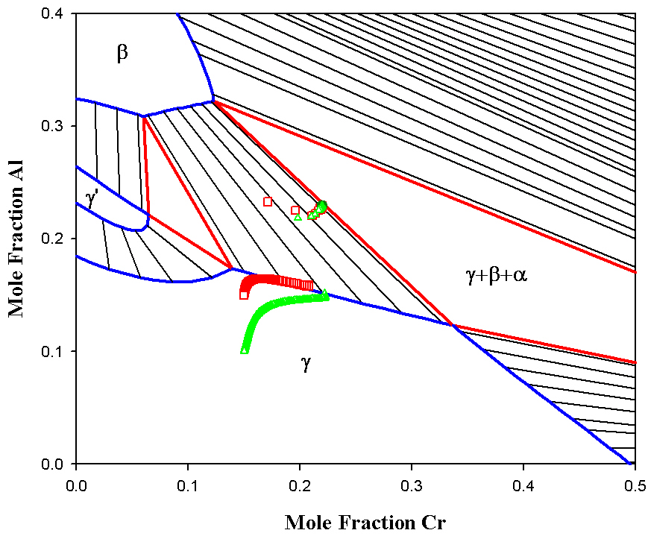
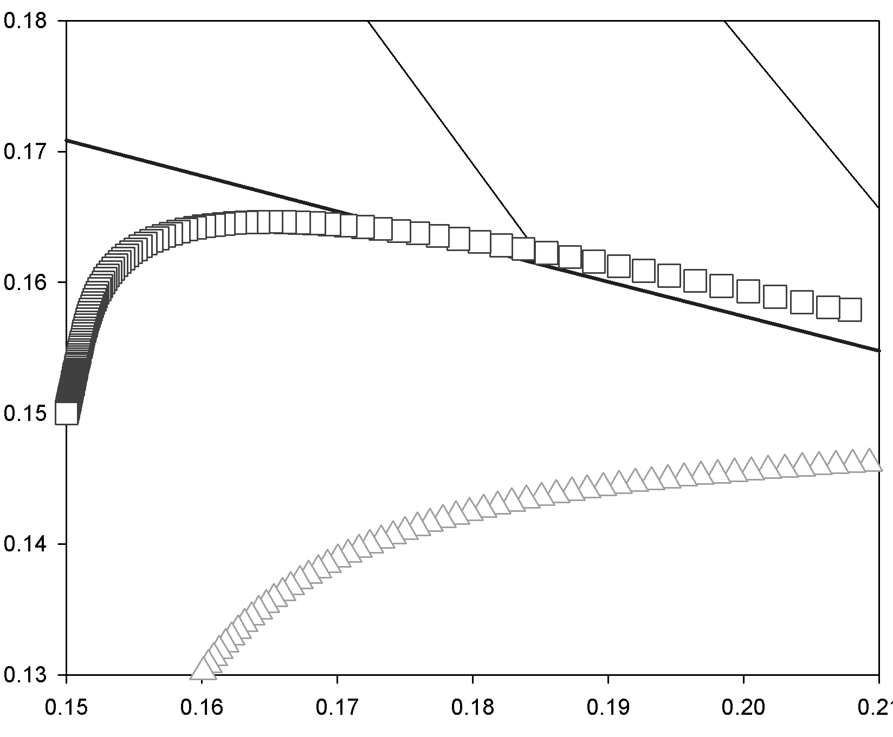
(a)
Effect of Al content on interface migration
320μm
Annealing time: 25 hours
(b)
b
a

Slide 17
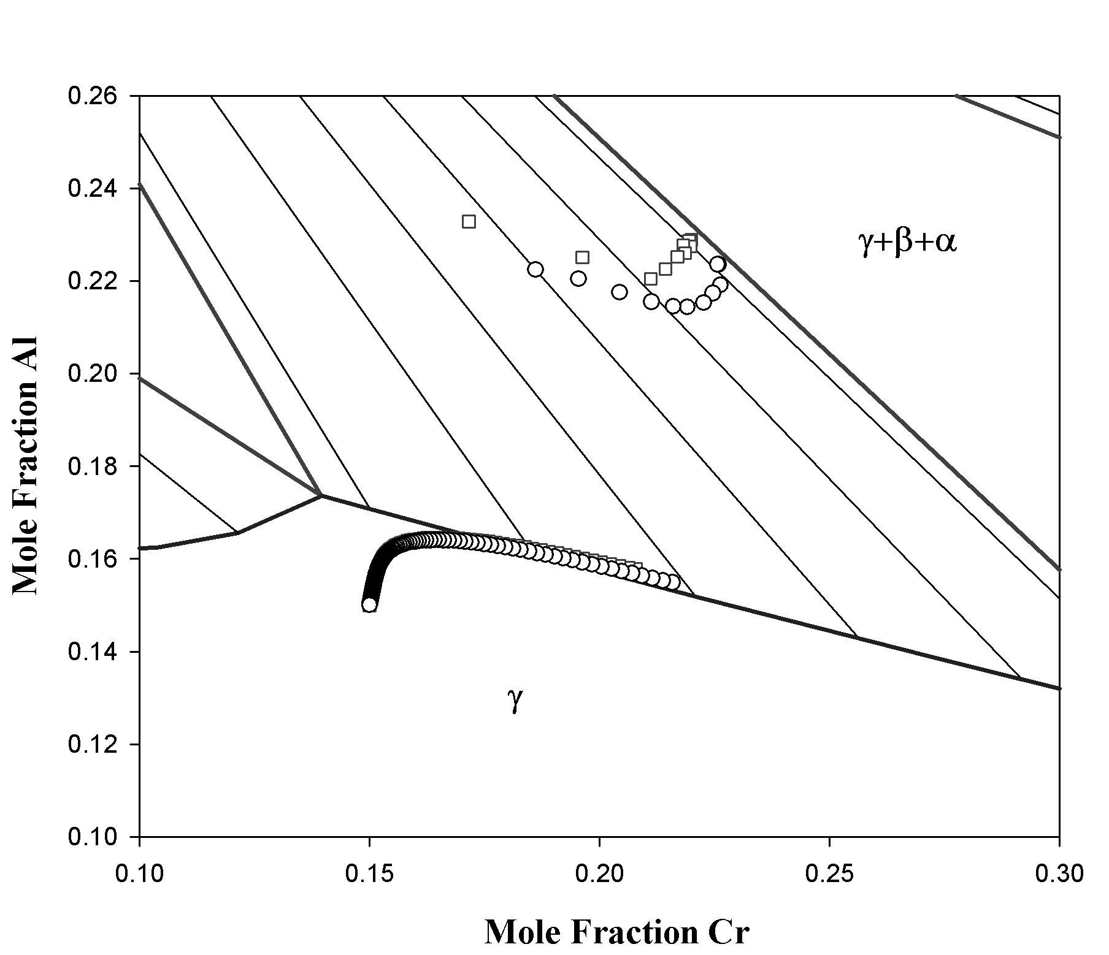

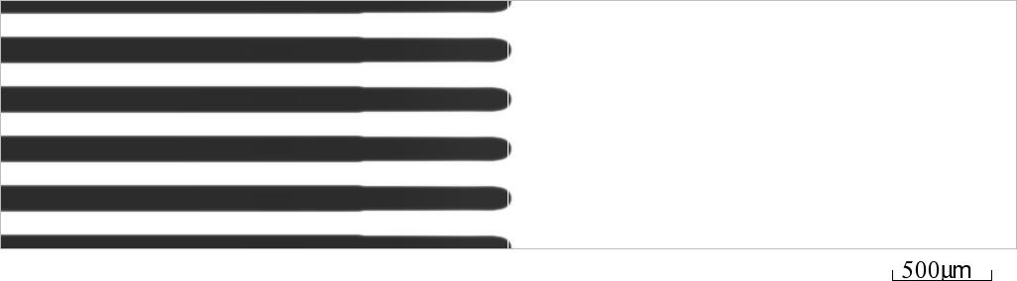
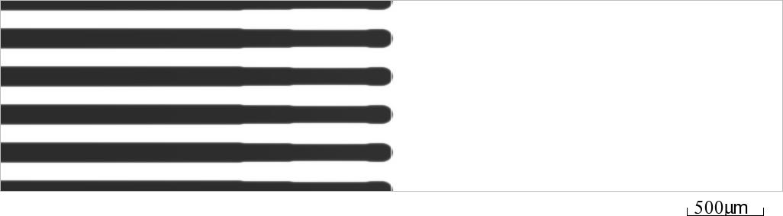
Interpretation of Phase Field Simulation - Effect of Coarsening
t = 0
t = 25h
t = 100h

Slide 18
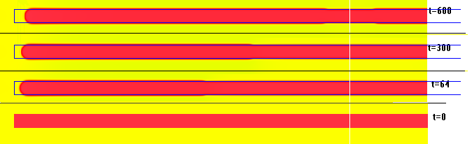
Effect of Pure Coarsening

Slide 19
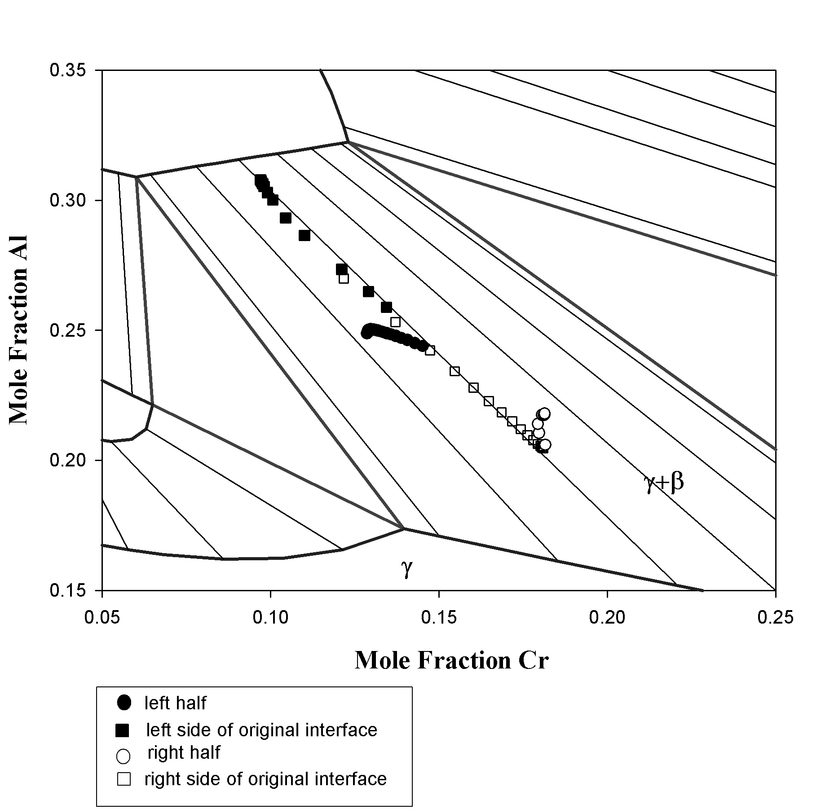


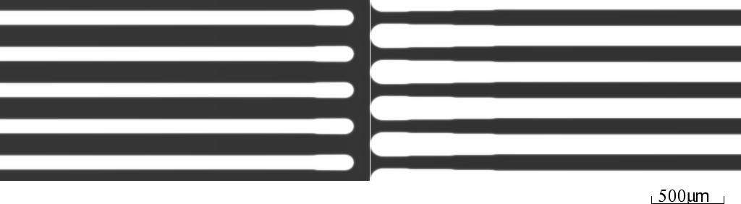
Interpretation of Phase Field Simulation - Effect of Coarsening
t = 0
t = 100h
t = 200h

Slide 20
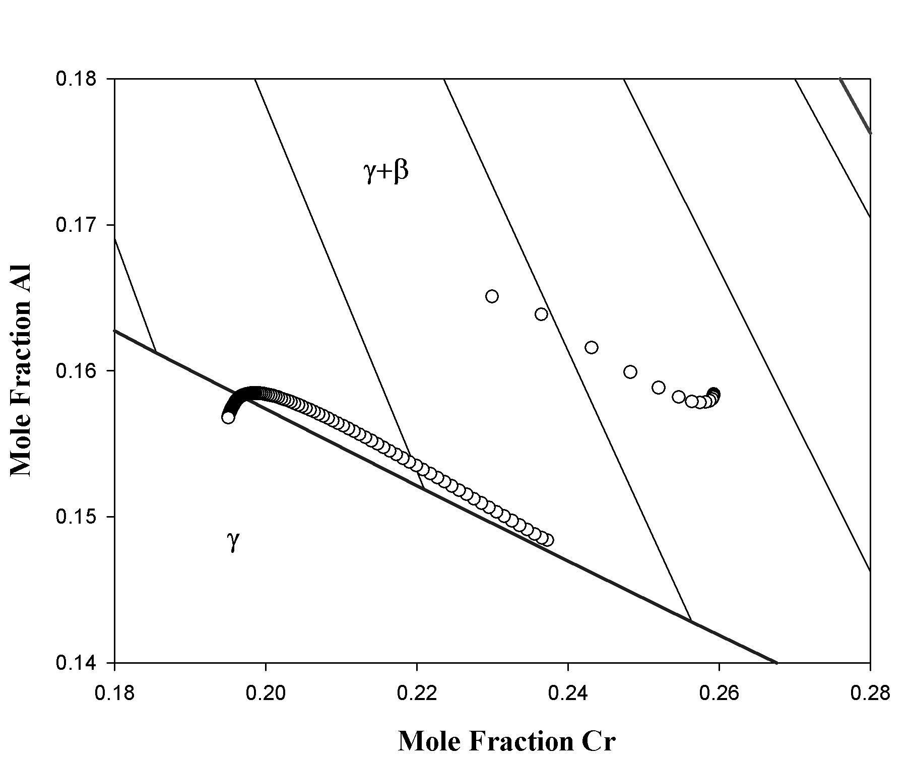
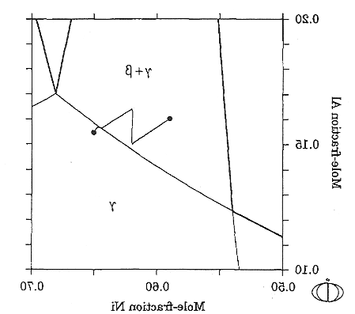
Interpretation of Phase Field Simulation - Deviation from Local Equilibrium Condition
0.20
γ+β
0.15
γ
0.10
A.EngstrÖm, J. E. Morral and J.Ågren
Acta mater. 1997
e0025.mov
e0045.mov

Slide 21
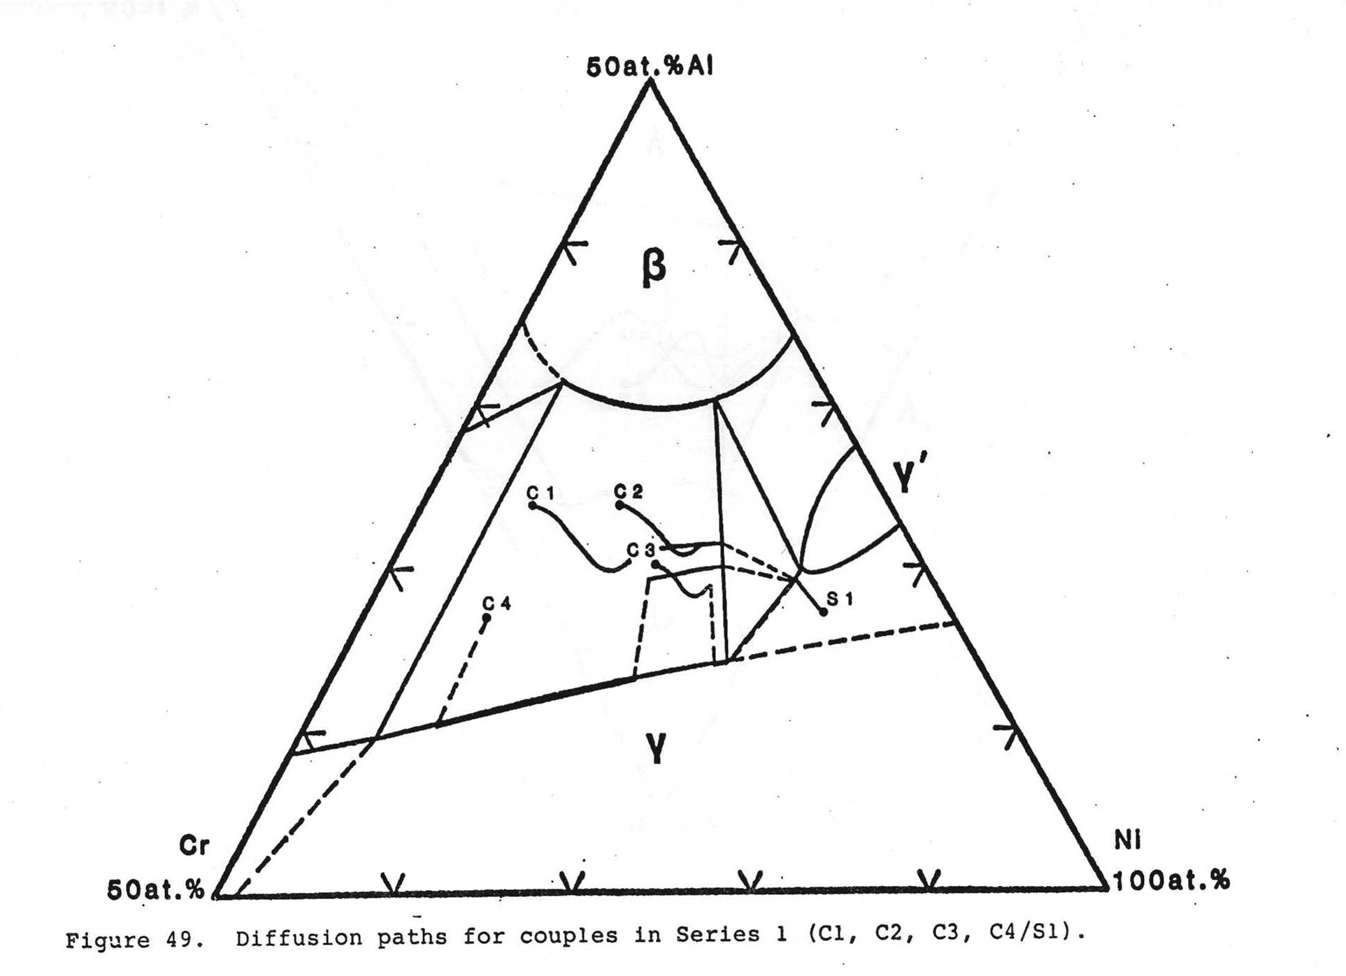
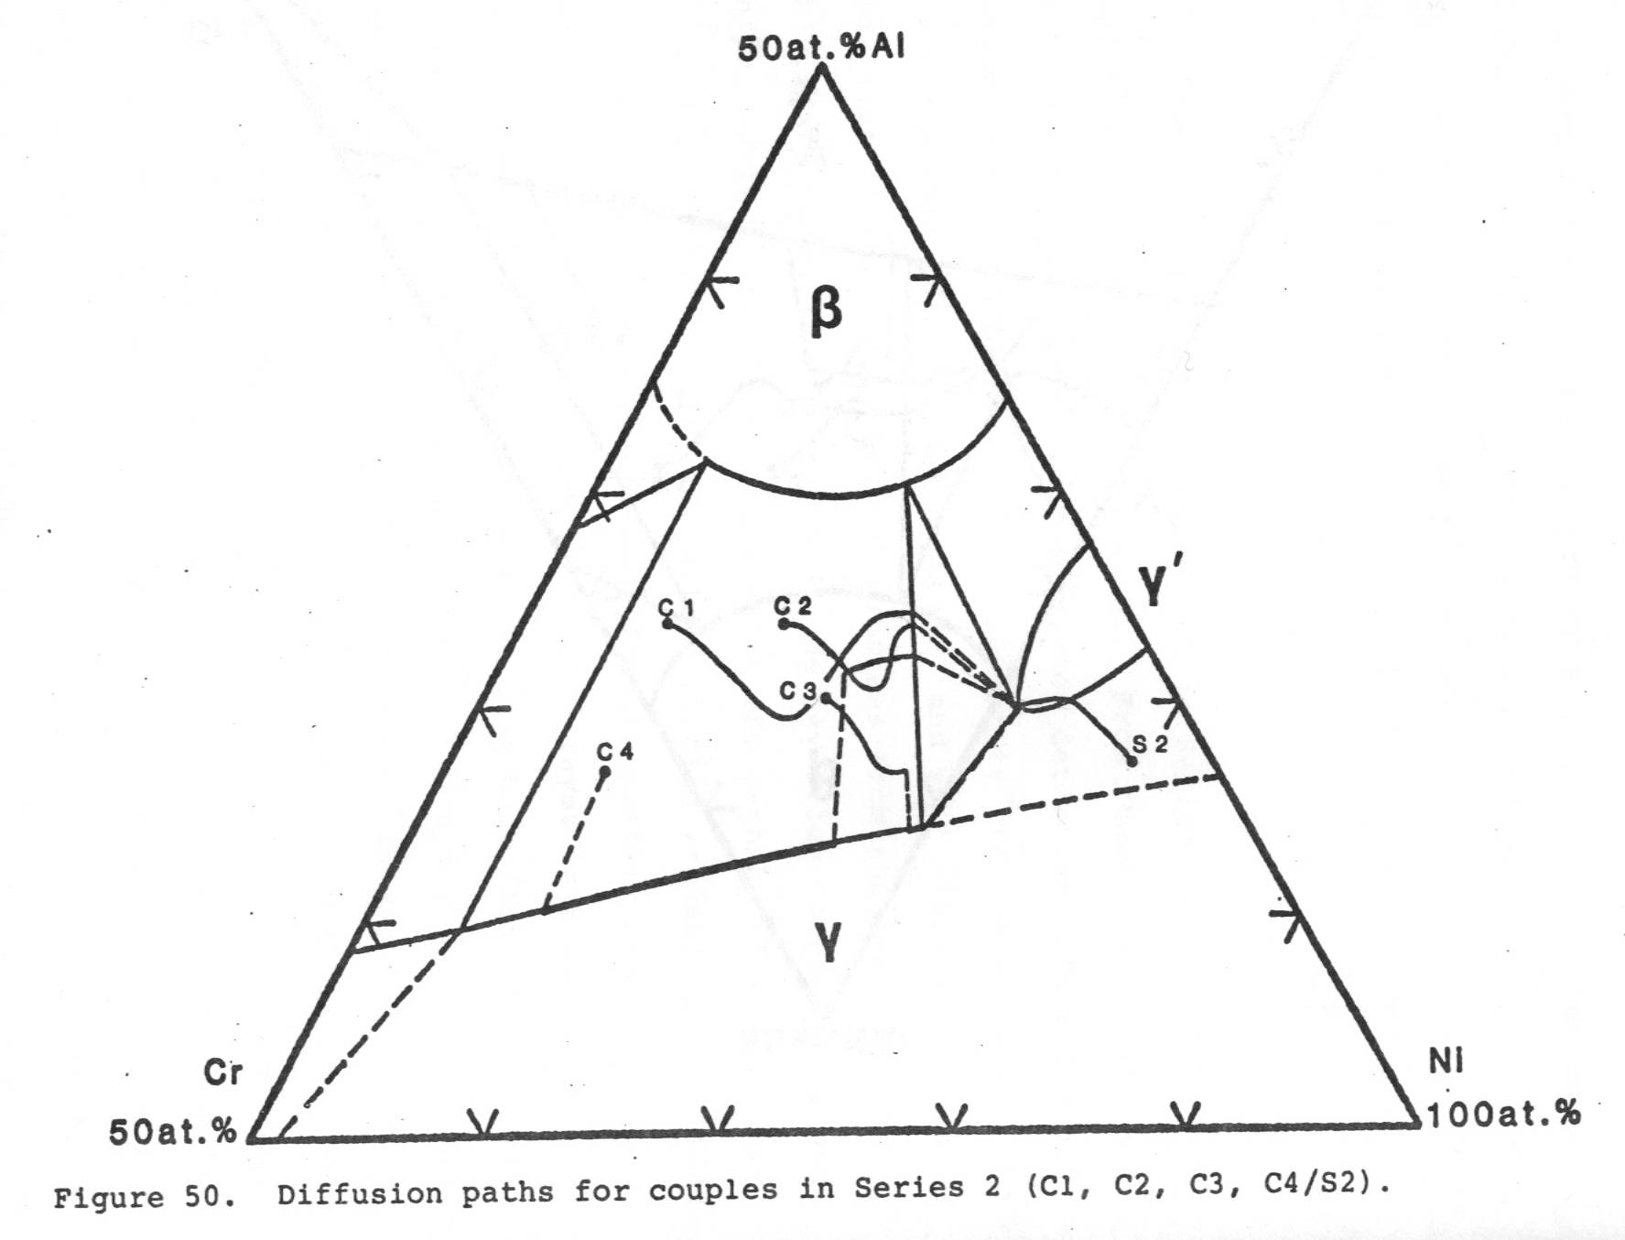
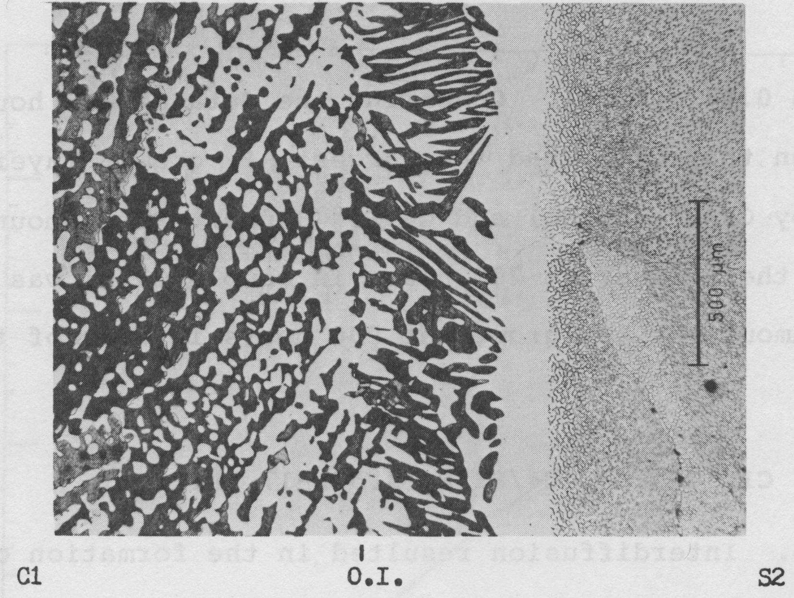
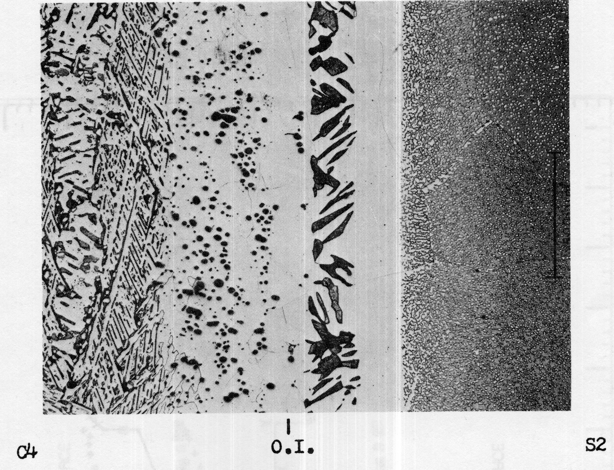
“strange attractors” of the diffusion paths
Lawrence A. Carol, Michigan Tech. 1985

Slide 22
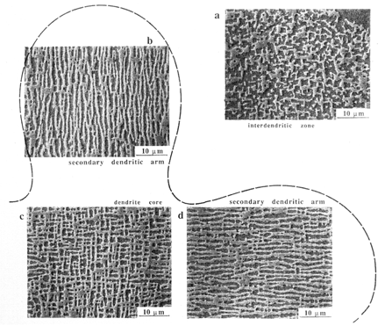
Concentration-Gradient Induced Rafting
Interdendritic zone
Aging of initially as cast alloy (1100ºC for 1500 hr.)
Secondary dendritic arm
Dendritic core
Secondary dendritic arm
Hazotte and Lacaze, Scripta metall.
Notes:
People also observed that whenever large concentration gradient exist, it will induce rafting of gamma prime particles along the direction which is perpendicular to the concentration gradient - concentration gradient induced rafting.

Slide 23
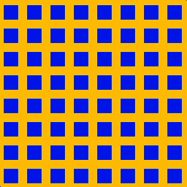
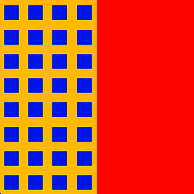
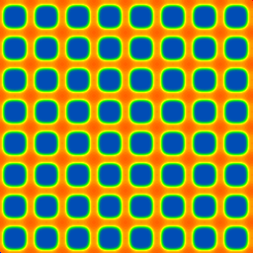
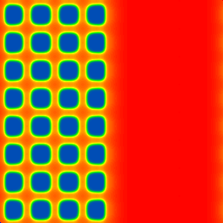
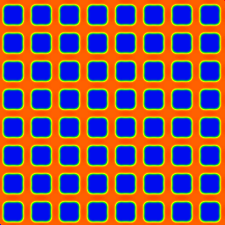
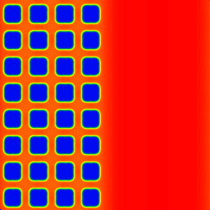
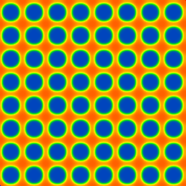
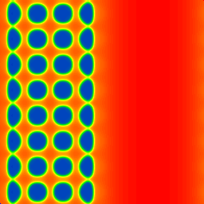
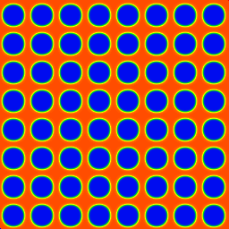
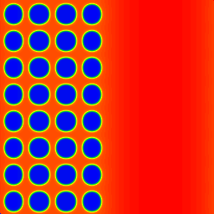
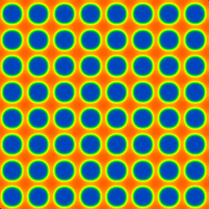
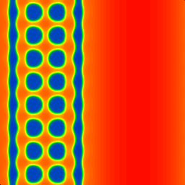
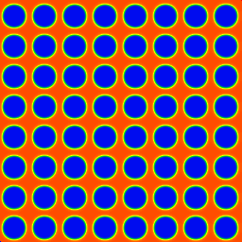
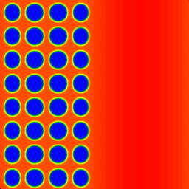
Interdiffusion Induced Rafting
β_{B}=5.0 β_{C}=1.0 β_{A}=5.0
Initial Configuration
τ = 0
left: X_{B}=0.125, X_{C}=0.489
right: X_{B}=0.6 X_{C}=0.1
Misfitting particle
Stress-free particles
τ = 40
τ = 220
τ = 400
No interdiffusion With interdiffusion
No interdiffusion With interdiffusion
Notes:
How large of the lattice mismatch:

Slide 24
Summary – Predicting of Interdiffusion Microstructure
DICTRA and Phase Field share the same thermodynamic and diffusivity databases
DICTRA directly outputs diffusion path on phase diagram and runs on PC, but is an1D program, assumes local-equilibrium, treats precipitates as point sources or sinks, and is accurate when most diffusion occurs in a single, matrix phase, no metastable states, and for limited boundary conditions
Phase Field directly outputs microstructure, does not require local-equilibrium, can treat diffusion couples of different matrix phase, is able to consider a wide variety of boundary conditions, and allows for studies of effects of precipitates morphology on interdiffusion and interdiffusion on microstructural evolution. But many critical issues remain
Computation efficiency
How to determine accurately the average compositions in the two-phase regions
How to analyze the diffusion path using statistically meaningful microstructures and computationally tractable system sizes without artificial Gibbs-Thompson effect
Incorporation of nucleation – work in progress

Slide 25
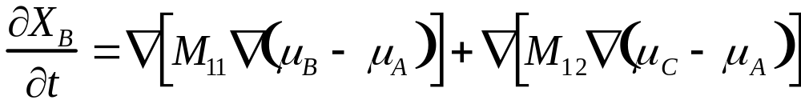
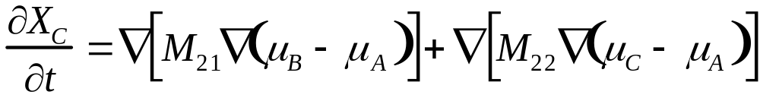

Phase Field Equations
Diffusion equations
Thermodynamic parameters
Kinetics parameters
M_{ij} - chemical mobilities
κ_{ij} - gradient coefficients
β_{I} - atomic mobilities
ρ - molar density

Slide 26


Effect of Gradient Term
J

